Slide 1
Lexicalization of PCFGs
Introduction
Christopher Manning
Notes:
Should add a slide on parsing speech lattices!
Explain queries chart must support for efficiency:
Is edge X:[i,j] already in the chart?
What edges with label Y end at position i?
What edges with label Z start at position j?

Slide 2
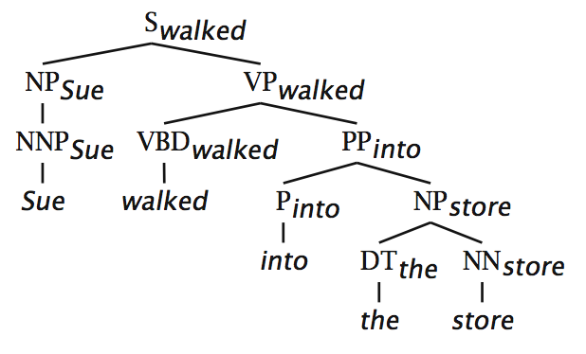
(Head) Lexicalization of PCFGs [Magerman 1995, Collins 1997; Charniak 1997]
The head word of a phrase gives a good representation of the phrase’s structure and meaning
Puts the properties of words back into a PCFG

Slide 3
(Head) Lexicalization of PCFGs [Magerman 1995, Collins 1997; Charniak 1997]
The head word of a phrase gives a good representation of the phrase’s structure and meaning
Puts the properties of words back into a PCFG
Notes:
Say how week a PCFG rule is.
Circle bilexical dependencies
Explain monolexical part: don’t even get that VP → VBD PP is likely because verb is “walked”

Slide 4
(Head) Lexicalization of PCFGs [Magerman 1995, Collins 1997; Charniak 1997]
The head word of a phrase gives a good representation of the phrase’s structure and meaning
Puts the properties of words back into a PCFG
Notes:
Circle bilexical dependencies

Slide 5
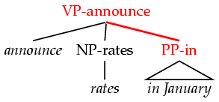
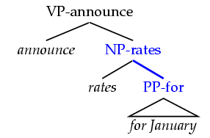
(Head) Lexicalization of PCFGs [Magerman 1995, Collins 1997; Charniak 1997]
Word-to-word affinities are useful for certain ambiguities
PP attachment is now (partly) captured in a local PCFG rule.
Think about: What useful information isn’t captured?
Also useful for: coordination scope, verb complement patterns
VP
VP
NP
PP
NP
PP
announce RATES FOR January
ANNOUNCE rates IN January

Slide 6
Lexicalized parsing was seen as the parsing breakthrough of the late 1990s
Eugene Charniak, 2000 JHU workshop: “To do better, it is necessary to condition probabilities on the actual words of the sentence. This makes the probabilities much tighter:
p(VP → V NP NP) = 0.00151
p(VP → V NP NP | said) = 0.00001
p(VP → V NP NP | gave) = 0.01980 ”
Michael Collins, 2003 COLT tutorial: “Lexicalized Probabilistic Context-Free Grammars … perform vastly better than PCFGs (88% vs. 73% accuracy)”

Slide 7
Lexicalization of PCFGs
Introduction
Christopher Manning
Notes:
Should add a slide on parsing speech lattices!
Explain queries chart must support for efficiency:
Is edge X:[i,j] already in the chart?
What edges with label Y end at position i?
What edges with label Z start at position j?

Slide 8
Lexicalization of PCFGs
The model of Charniak (1997)
Notes:
Should add a slide on parsing speech lattices!
Explain queries chart must support for efficiency:
Is edge X:[i,j] already in the chart?
What edges with label Y end at position i?
What edges with label Z start at position j?

Slide 9
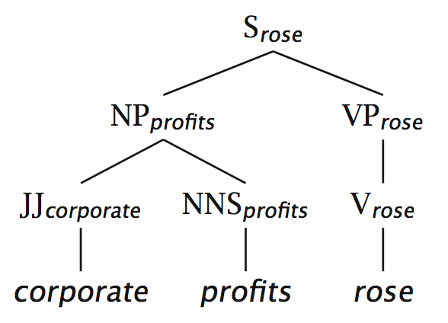
Charniak (1997)
A very straightforward model of a lexicalized PCFG
Probabilistic conditioning is “top-down” like a regular PCFG
But actual parsing is bottom-up, somewhat like the CKY algorithm we saw

Slide 10
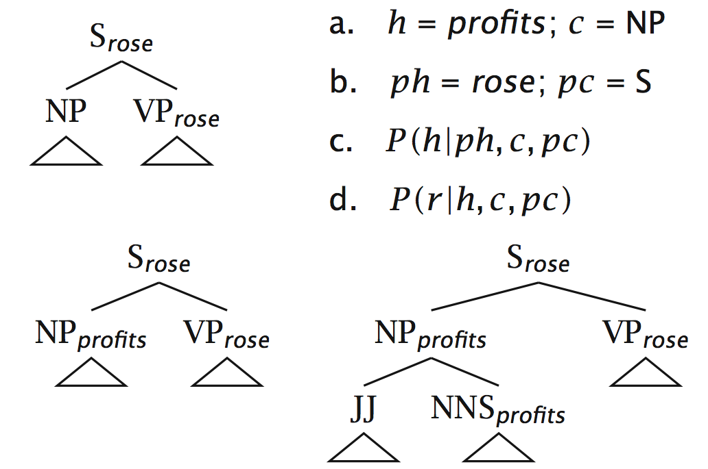
Charniak (1997) example

Slide 11
Lexicalization models argument selection by sharpening rule expansion probabilities
The probability of different verbal complement frames (i.e., “subcategorizations”) depends on the verb:
Local Tree | come | take | think | want
VP → V | 9.5% | 2.6% | 4.6% | 5.7%
VP → V NP | 1.1% | 32.1% | 0.2% | 13.9%
VP → V PP | 34.5% | 3.1% | 7.1% | 0.3%
VP → V SBAR | 6.6% | 0.3% | 73.0% | 0.2%
VP → V S | 2.2% | 1.3% | 4.8% | 70.8%
VP → V NP S | 0.1% | 5.7% | 0.0% | 0.3%
VP → V PRT NP | 0.3% | 5.8% | 0.0% | 0.0%
VP → V PRT PP | 6.1% | 1.5% | 0.2% | 0.0%
“monolexical” probabilities

Slide 12
Lexicalization sharpens probabilities: Predicting heads
“Bilexical probabilities”
P(prices | n-plural) = .013
P(prices | n-plural, NP) = .013
P(prices | n-plural, NP, S) = .025
P(prices | n-plural, NP, S, v-past) = .052
P(prices | n-plural, NP, S, v-past, fell) = .146
Notes:
Say that you clearly need to smooth!

Slide 13
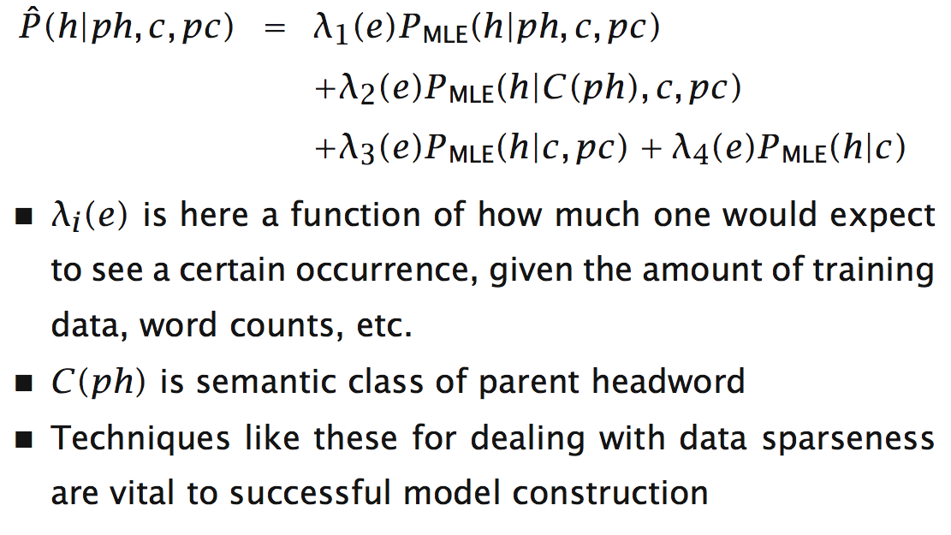
Charniak (1997) linear interpolation/shrinkage

Slide 14
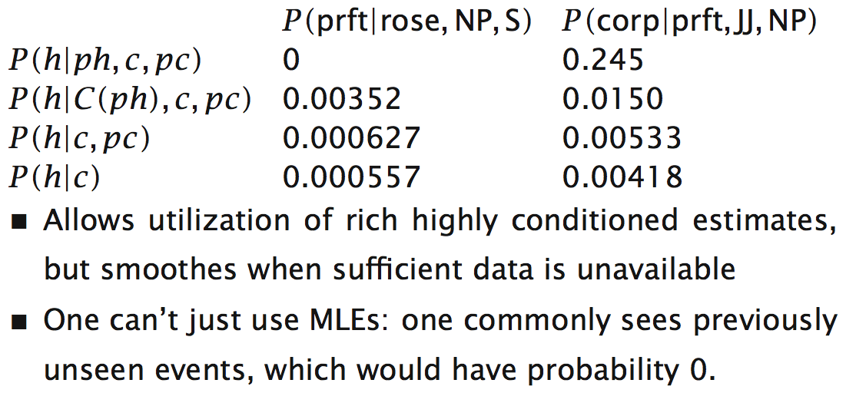
Charniak (1997) shrinkage example

Slide 15
Lexicalization of PCFGs
The model of Charniak (1997)
Notes:
Should add a slide on parsing speech lattices!
Explain queries chart must support for efficiency:
Is edge X:[i,j] already in the chart?
What edges with label Y end at position i?
What edges with label Z start at position j?

Slide 16
Sparseness & the Penn Treebank
The Penn Treebank – 1 million words of parsed English WSJ – has been a key resource (because of the widespread reliance on supervised learning)
But 1 million words is like nothing:
965,000 constituents, but only 66 WHADJP, of which only 6 aren’t how much or how many, but there is an infinite space of these
How clever/original/incompetent (at risk assessment and evaluation) …
Most of the probabilities that you would like to compute, you can’t compute

Slide 17
Quiz question!
Classify each of the italic red phrases as a:
WHNP WHADJP WHADVP WHPP
That explains why she is succeeding.
Which student scored highest on the assignment?
Nobody knows how deep the recession will be.
During which class did the slide projection not work?
Whose iPhone was stolen?

Slide 18
Sparseness & the Penn Treebank (2)
Many parse preferences depend on bilexical statistics: likelihoods of relationships between pairs of words (compound nouns, PP attachments, …)
Extremely sparse, even on topics central to the WSJ:
stocks plummeted 2 occurrences
stocks stabilized 1 occurrence
stocks skyrocketed 0 occurrences
#stocks discussed 0 occurrences
There has been only modest success in augmenting the Penn Treebank with extra unannotated materials or using semantic classes – given a reasonable amount of annotated training data.
Cf. Charniak 1997, Charniak 2000
But McClosky et al. 2006 doing self-training and Koo and Collins2008 semantic classes are rather more successful!

Slide 19
PCFG Independence Assumptions

Slide 20
PCFGs and Independence
The symbols in a PCFG define independence assumptions:
At any node, the material inside that node is independent of the material outside that node, given the label of that node
Any information that statistically connects behavior inside and outside a node must flow through that node’s label
S
S → NP VP
NP → DT NN
NP
NP
VP

Slide 21
Non-Independence I
The independence assumptions of a PCFG are often too strong
Example: the expansion of an NP is highly dependent on the parent of the NP (i.e., subjects vs. objects)
All NPs
NPs under S
NPs under VP
Notes:
This is a more general fact. Not a fact about particular headwords.

Slide 22
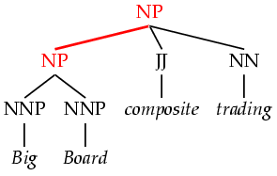
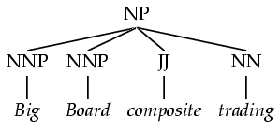
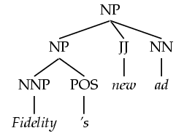
Non-Independence II
Symptoms of overly strong assumptions:
Rewrites get used where they don’t belong
In the PTB, this construction is for possessives

Slide 23
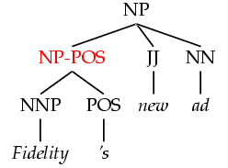
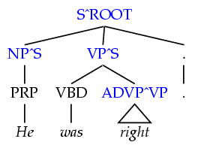
Refining the Grammar Symbols
We can relax independence assumptions by encoding dependencies into the PCFG symbols, by state splitting:
Too much state-splitting ➔ sparseness (no smoothing used!)
What are the most useful features to encode?
Parent annotation
[Johnson 98]
Marking possessive NPs
Notes:
- Annotations split the grammar categories into sub-categories.
- Conditioning on history vs. annotating
P(NP^S → PRP) is a lot like P(NP → PRP | S)
P(NP-POS → NNP POS) isn’t history conditioning.
- Feature grammars (unification-based grammars) vs. annotation
Can think of a symbol like NP^NP-POS as NP [parent:NP, +POS]
- After parsing with an annotated grammar, the annotations are then stripped for evaluation.

Slide 24
PCFG Independence Assumptions

Slide 25
Annotations
Annotations split the grammar categories into sub-categories.
Conditioning on history vs. annotating
P(NP^S → PRP) is a lot like P(NP → PRP | S)
P(NP-POS → NNP POS) isn’t history conditioning.
Feature grammars vs. annotation
Can think of a symbol like NP^NP-POS as
NP [parent:NP, +POS]
After parsing with an annotated grammar, the annotations are then stripped for evaluation.

Slide 26
The Return of Unlexicalized PCFGs

Slide 27
Accurate Unlexicalized Parsing [Klein and Manning 1993]
What do we mean by an “unlexicalized” PCFG?
Grammar rules are not systematically specified down to the level of lexical items
NP-stocks is not allowed
NP^S-CC is fine
Closed vs. open class words
Long tradition in linguistics of using function words as features or markers for selection (VB-have, SBAR-if/whether)
Different to the bilexical idea of semantic heads
Open-class selection is really a proxy for semantics
Thesis
Most of what you need for accurate parsing, and much of what lexicalized PCFGs actually capture isn’t lexical selection between content words but just basic grammatical features, like verb form, finiteness, presence of a verbal auxiliary, etc.

Slide 28
Experimental Approach
Corpus: Penn Treebank, WSJ; iterate on small dev set
Size – number of symbols in grammar.
Passive / complete symbols: NP, NP^S
Active / incomplete symbols: @NP_NP_CC [from binarization]
We state-split as sparingly as possible
Highest accuracy with fewest symbols
Error-driven, manual hill-climb, one annotation at a time
Training: | sections | 02-21
Development: | section | 22 (first 20 files) ⬅
Test: | section | 23

Slide 29
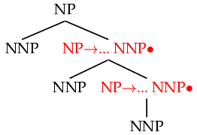
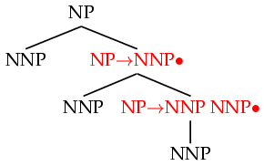

Horizontal Markovization
Horizontal Markovization: Merges States
Merged
Notes:
Say that a lot of what the lexicalized parsers were doing was other stuff that was nothing to do with lexicalization.
Collins (1997) did this.

Slide 30
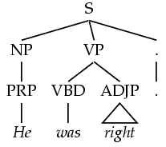
Vertical Markovization
Vertical Markov order: rewrites depend on past k ancestor nodes.
(i.e., parent annotation)
Order 1
Order 2
Model | F1 | Size
v=h=2v | 77.8 | 7.5K
Notes:
We saw that Charniak (1997) did this.

Slide 31
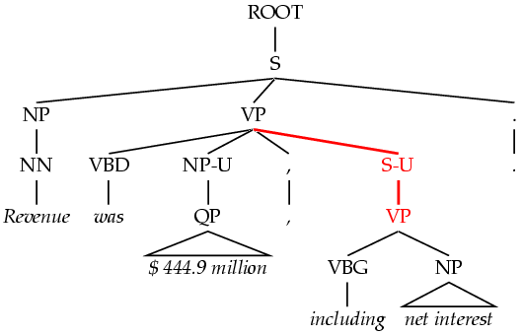

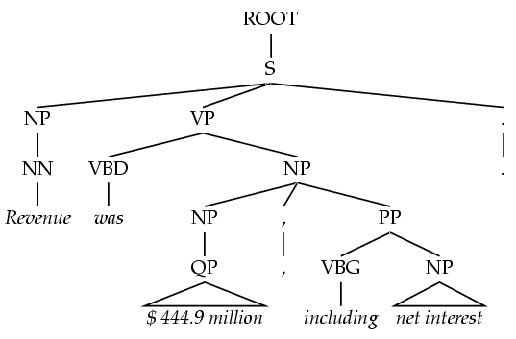
Unary Splits
Problem: unary rewrites are used to transmute categories so a high-probability rule can be used.
Solution: Mark unary rewrite sites with -U
Annotation | F1 | Size
Base | 77.8 | 7.5K
UNARY | 78.3 | 8.0K

Slide 32
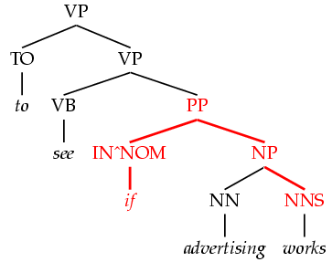
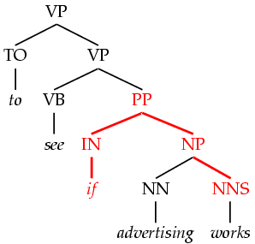
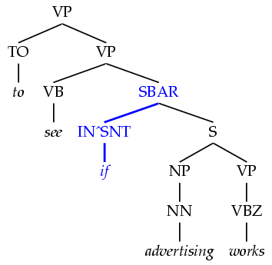
Tag Splits
Problem: Treebank tags are too coarse.
Example: SBAR sentential complementizers (that, whether, if), subordinating conjunctions (while, after), and true prepositions (in, of, to) are all tagged IN.
Partial Solution:
Subdivide the IN tag.
Annotation | F1 | Size
Previous | 78.3 | 8.0K
SPLIT-IN | 80.3 | 8.1K

Slide 33
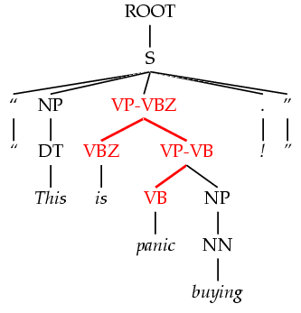
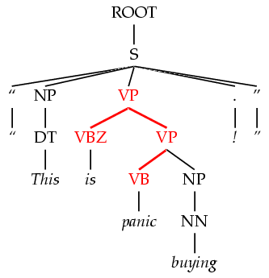
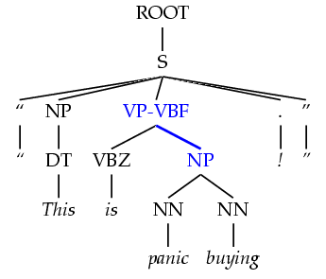
Yield Splits
Problem: sometimes the behavior of a category depends on something inside its future yield.
Examples:
Possessive NPs
Finite vs. infinite VPs
Lexical heads!
Solution: annotate future elements into nodes.
Annotation | F1 | Size
tag splits | 82.3 | 9.7K
POSS-NP | 83.1 | 9.8K
SPLIT-VP | 85.7 | 10.5K

Slide 34
Distance / Recursion Splits
Problem: vanilla PCFGs cannot distinguish attachment heights.
Solution: mark a property of higher or lower sites:
Contains a verb.
Is (non)-recursive.
Base NPs [cf. Collins 99]
Right-recursive NPs
NP
-v
VP
NP
PP
v
Annotation | F1 | Size
Previous | 85.7 | 10.5K
BASE-NP | 86.0 | 11.7K
DOMINATES-V | 86.9 | 14.1K
RIGHT-REC-NP | 87.0 | 15.2K

Slide 35
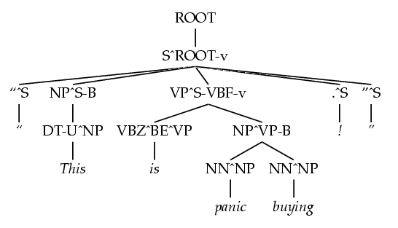
A Fully Annotated Tree

Slide 36
Final Test Set Results
Parser | LP | LR | F1
Magerman 95 | 84.9 | 84.6 | 84.7
Collins 96 | 86.3 | 85.8 | 86.0
Klein & Manning 03 | 86.9 | 85.7 | 86.3
Charniak 97 | 87.4 | 87.5 | 87.4
Collins 99 | 88.7 | 88.6 | 88.6
Beats “first generation” lexicalized parsers

Slide 37
The Return of Unlexicalized PCFGs

Slide 38
Latent Variable PCFGs
Extending the idea to induced syntactico-semantic classes

Slide 39
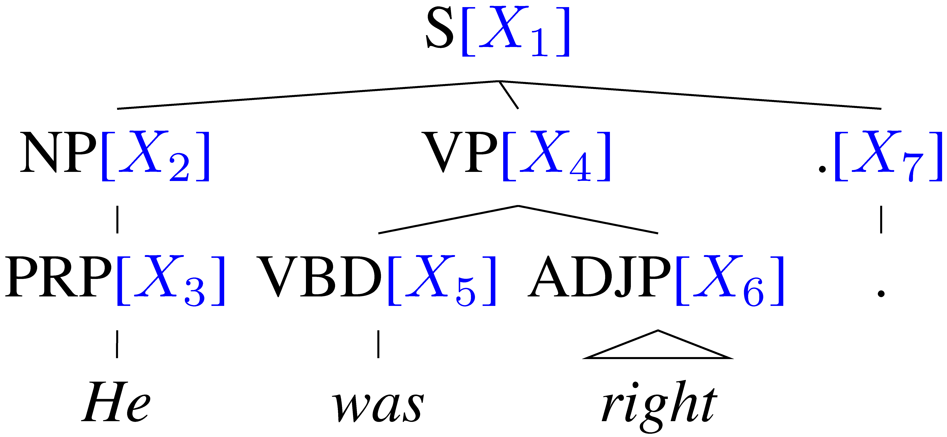
Learning Latent Annotations [Petrov and Klein 2006, 2007]
Outside
Can you automatically find good symbols?
Brackets are known
Base categories are known
Induce subcategories
Clever split/merge category refinement
X₁
X₂
X₄
X₇
X₃
X₅
X₆
.
He
was
right
EM algorithm, like Forward-Backward for HMMs, but constrained by tree
Inside
Notes:
How are we going to this? We will use an EM algorithm as Matsuzaki et al. did. The details are in their paper and also in ours and I will just give a quick high level overview. Since the brackets and categories for our training trees are already known, we only need to induce the subcategories. This means that we do not need to run the general inside outside algorithm. We can turn our parse trees into tree shaped graphical models and then use an algorithm just like the forward backward algorithm for HMMs. To emphasize, we don’t need to run the inside outside algorithm and the algorithm is not cubic but linear, therefore training can be done efficiently.

Slide 40
POS tag splits’ commonest words: effectively a semantic class-based model
Proper Nouns (NNP):
Personal pronouns (PRP):
NNP-14 | Oct. | Nov. | Sept.
NNP-12 | John | Robert | James
NNP-2 | J. | E. | L.
NNP-1 | Bush | Noriega | Peters
NNP-15 | New | San | Wall
NNP-3 | York | Francisco | Street
PRP-0 | It | He | I
PRP-1 | it | he | they
PRP-2 | it | them | him
Notes:
Before I finish, let me give you some interesting examples of what our grammars learn. These are intended to highlight some interesting observations, the full list of subcategories and more details are in the paper.
The subcategories sometimes capture syntactic and sometimes semantic difference. But very often they represent syntactico – semantic relations, which are similar to those found in distributional clustering results.
For example for the proper nouns the system learns a subcategory for months, first names, last names and initials. It also learns which words typically come first and second in multi-word units.
For personal pronouns there is a subcategory for accusative case and one for sentence initial and sentence medial nominative case.

Slide 41
Number of phrasal subcategories
Notes:
Here are the number of subcategories for each of the 25 phrasal categories. In general phrasal categories are split less heavily than lexical categories, a trend that one could have expected.

Slide 42
The Latest Parsing Results… (English PTB3 WSJ train 2-21, test 23)
 | F1 ≤ 40 words | F1 all words
Parser
Klein & Manning unlexicalized 2003 | 86.3 | 85.7
Matsuzaki et al. simple EM latent states 2005 | 86.7 | 86.1
Charniak generative, lexicalized (“maxent inspired”) 2000 | 90.1 | 89.5
Petrov and Klein NAACL 2007 | 90.6 | 90.1
Charniak & Johnson discriminative reranker 2005 | 92.0 | 91.4
Fossum & Knight 2009 combining constituent parsers |  | 92.4
Notes:
Not only that, we even outperform the fully lexicalized systems of Collins ’99 and the generative component of Charniak and Johnson ’05.

Slide 43
Latent Variable PCFGs
Extending the idea to induced syntactico-semantic classes

