Slide 1
Maxent Models and Discriminative Estimation
The maximum entropy model presentation
Notes:
Chris: 1-24; Dan 25-49; Dan 50-75; Chris 77-96

Slide 2
Maximum Entropy Models
An equivalent approach:
Lots of distributions out there, most of them very spiked, specific, overfit.
We want a distribution which is uniform except in specific ways we require.
Uniformity means high entropy – we can search for distributions which have properties we desire, but also have high entropy.
Ignorance is preferable to error and he is less remote from the truth who believes nothing than he who believes what is wrong – Thomas Jefferson (1781)

Slide 3
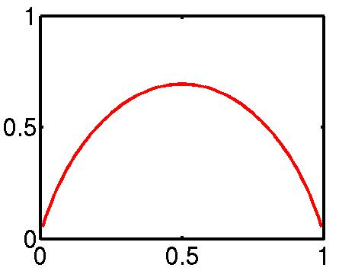
(Maximum) Entropy
Entropy: the uncertainty of a distribution.
Quantifying uncertainty (“surprise”):
Event x
Probability p_{x}
“Surprise” log(1/p_{x})
Entropy: expected surprise (over p):
H
p_{HEADS}
A coin-flip is most uncertain for a fair coin.
Notes:
Picture is mussed up. Maximum should be 1 for the coin flip!

Slide 4
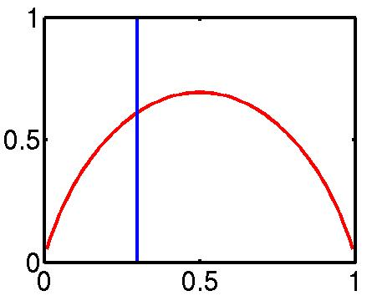
Maxent Examples I
What do we want from a distribution?
Minimize commitment = maximize entropy.
Resemble some reference distribution (data).
Solution: maximize entropy H, subject to feature-based constraints:
Adding constraints (features):
Lowers maximum entropy
Raises maximum likelihood of data
Brings the distribution further from uniform
Brings the distribution closer to data
Unconstrained, max at 0.5
Constraint that p_{HEADS} = 0.3

Slide 5
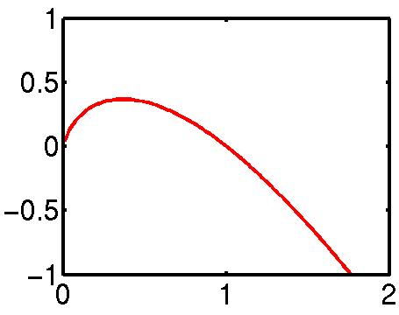
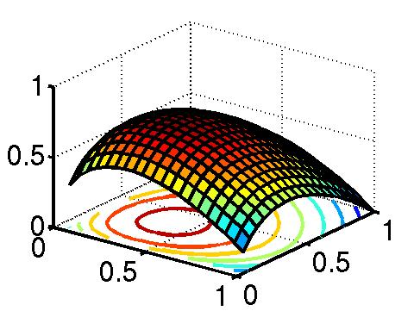
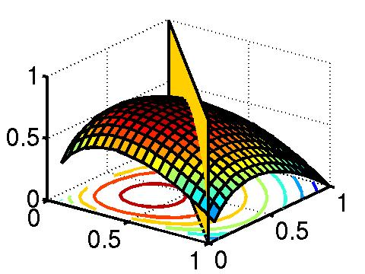
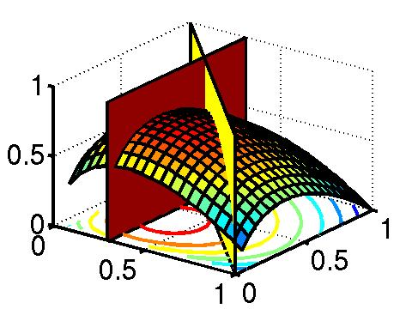
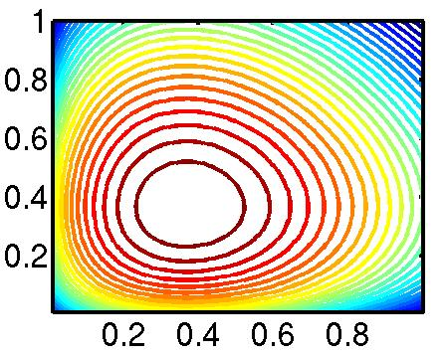
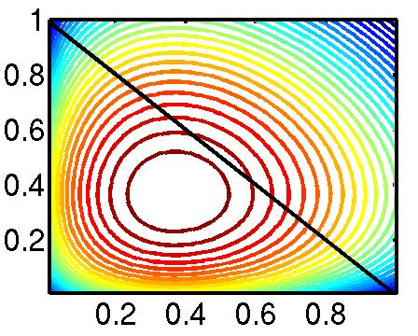
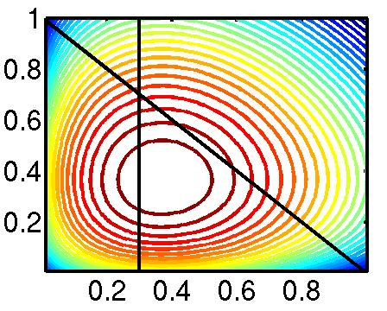
Maxent Examples II
1/e
- x log x
H(p_{H} p_{T},)
p_{H} + p_{T} = 1
p_{H} = 0.3

Slide 6
Maxent Examples III
Let’s say we have the following event space:
… and the following empirical data:
Maximize H:
… want probabilities: E[NN,NNS,NNP,NNPS,VBZ,VBD] = 1
NN | NNS | NNP | NNPS | VBZ | VBD
3 | 5 | 11 | 13 | 3 | 1
1/e | 1/e | 1/e | 1/e | 1/e | 1/e
1/6 | 1/6 | 1/6 | 1/6 | 1/6 | 1/6

Slide 7
Maxent Examples IV
Too uniform!
N* are more common than V*, so we add the feature f_{N} = {NN, NNS, NNP, NNPS}, with E[f_{N}] =32/36
… and proper nouns are more frequent than common nouns, so we add f_{P} = {NNP, NNPS}, with E[f_{P}] =24/36
… we could keep refining the models, e.g., by adding a feature to distinguish singular vs. plural nouns, or verb types.
NN | NNS | NNP | NNPS | VBZ | VBD
8/36 | 8/36 | 8/36 | 8/36 | 2/36 | 2/36
4/36 | 4/36 | 12/36 | 12/36 | 2/36 | 2/36

Slide 8
Convexity
Convex
Non-Convex
Convexity guarantees a single, global maximum because any higher points are greedily reachable.

Slide 9
Convexity II
Constrained H(p) = – ∑ x log x is convex:
– x log x is convex
– ∑ x log x is convex (sum of convex functions is convex).
The feasible region of constrained H is a linear subspace (which is convex)
The constrained entropy surface is therefore convex.
The maximum likelihood exponential model (dual) formulation is also convex.

Slide 10
Maxent Models and Discriminative Estimation
The maximum entropy model presentation
Notes:
Chris: 1-24; Dan 25-49; Dan 50-75; Chris 77-96

Slide 11
Feature Overlap/Feature Interaction
How overlapping features work in maxent models
Notes:
Chris: 1-24; Dan 25-49; Dan 50-75; Chris 77-96

Slide 12
Feature Overlap
Maxent models handle overlapping features well.
Unlike a NB model, there is no double counting!
 | A | a
B
b
 | A | a
B
b
 | A | a
B
b
Empirical
 | A | a
B | 2 | 1
b | 2 | 1
All = 1
A = 2/3
A = 2/3
 | A | a
B | 1/4 | 1/4
b | 1/4 | 1/4
 | A | a
B | 1/3 | 1/6
b | 1/3 | 1/6
 | A | a
B | 1/3 | 1/6
b | 1/3 | 1/6
 | A | a
B
b
 | A | a
B | λ_{A}
b | λ_{A}
 | A | a
B | λ’_{A}+λ’’_{A}
b | λ’_{A}+λ’’_{A}

Slide 13
Example: Named Entity Feature Overlap
Feature Weights
Grace is correlated with PERSON, but does not add much evidence on top of already knowing prefix features.
Feature Type | Feature | PERS | LOC
Previous word | at | -0.73 | 0.94
Current word | Grace | 0.03 | 0.00
Beginning bigram | <G | 0.45 | -0.04
Current POS tag | NNP | 0.47 | 0.45
Prev and cur tags | IN NNP | -0.10 | 0.14
Previous state | Other | -0.70 | -0.92
Current signature | Xx | 0.80 | 0.46
Prev state, cur sig | O-Xx | 0.68 | 0.37
Prev-cur-next sig | x-Xx-Xx | -0.69 | 0.37
P. state - p-cur sig | O-x-Xx | -0.20 | 0.82
…
Total: |  | -0.58 | 2.68
Local Context
 | Prev | Cur | Next
State | Other | ??? | ???
Word | at | Grace | Road
Tag | IN | NNP | NNP
Sig | x | Xx | Xx

Slide 14
Feature Interaction
Maxent models handle overlapping features well, but do not automatically model feature interactions.
 | A | a
B
b
 | A | a
B
b
 | A | a
B
b
Empirical
 | A | a
B | 1 | 1
b | 1 | 0
All = 1
A = 2/3
B = 2/3
 | A | a
B | 1/4 | 1/4
b | 1/4 | 1/4
 | A | a
B | 1/3 | 1/6
b | 1/3 | 1/6
 | A | a
B | 4/9 | 2/9
b | 2/9 | 1/9
 | A | a
B | 0 | 0
b | 0 | 0
 | A | a
B | λ_{A}
b | λ_{A}
 | A | a
B | λ_{A}+λ_{B} | λ_{B}
b | λ_{A}

Slide 15
Feature Interaction
If you want interaction terms, you have to add them:
A disjunctive feature would also have done it (alone):
 | A | a
B
b
 | A | a
B
b
 | A | a
B
b
Empirical
 | A | a
B | 1 | 1
b | 1 | 0
A = 2/3
B = 2/3
AB = 1/3
 | A | a
B | 1/3 | 1/6
b | 1/3 | 1/6
 | A | a
B | 4/9 | 2/9
b | 2/9 | 1/9
 | A | a
B | 1/3 | 1/3
b | 1/3 | 0
 | A | a
B
b
 | A | a
B | 1/3 | 1/3
b | 1/3 | 0

Slide 16
Quiz Question
Suppose we have a 1 feature maxent model built over observed data as shown.
What is the constructed model’s probability distribution over the four possible outcomes?
Features
Expectations
Probabilities
Empirical
 | A | a
B
b
 | A | a
B
b
 | A | a
B | 2 | 1
b | 2 | 1

Slide 17
Feature Interaction
For loglinear/logistic regression models in statistics, it is standard to do a greedy stepwise search over the space of all possible interaction terms.
This combinatorial space is exponential in size, but that’s okay as most statistics models only have 4–8 features.
In NLP, our models commonly use hundreds of thousands of features, so that’s not okay.
Commonly, interaction terms are added by hand based on linguistic intuitions.

Slide 18
Example: NER Interaction
Previous-state and current-signature have interactions, e.g. P=PERS-C=Xx indicates C=PERS much more strongly than C=Xx and P=PERS independently.
This feature type allows the model to capture this interaction.
Feature Weights
Feature Type | Feature | PERS | LOC
Previous word | at | -0.73 | 0.94
Current word | Grace | 0.03 | 0.00
Beginning bigram | <G | 0.45 | -0.04
Current POS tag | NNP | 0.47 | 0.45
Prev and cur tags | IN NNP | -0.10 | 0.14
Previous state | Other | -0.70 | -0.92
Current signature | Xx | 0.80 | 0.46
Prev state, cur sig | O-Xx | 0.68 | 0.37
Prev-cur-next sig | x-Xx-Xx | -0.69 | 0.37
P. state - p-cur sig | O-x-Xx | -0.20 | 0.82
…
Total: |  | -0.58 | 2.68
Local Context
 | Prev | Cur | Next
State | Other | ??? | ???
Word | at | Grace | Road
Tag | IN | NNP | NNP
Sig | x | Xx | Xx
Notes:
Fix slide spacing.

Slide 19
Feature Overlap/Feature Interaction
How overlapping features work in maxent models
Notes:
Chris: 1-24; Dan 25-49; Dan 50-75; Chris 77-96

Slide 20
Conditional Maxent Models for Classification
The relationship between conditional and joint maxent/exponential models
Notes:
Chris: 1-24; Dan 25-49; Dan 50-75; Chris 77-96

Slide 21
Classification
What do these joint models of P(X) have to do with conditional models P(C|D)?
Think of the space C×D as a complex X.
C is generally small (e.g., 2-100 topic classes)
D is generally huge (e.g., space of documents)
We can, in principle, build models over P(C,D).
This will involve calculating expectations of features (over C×D):
Generally impractical: can’t enumerate X efficiently.
X
C
C×D
D

Slide 22
Classification II
D may be huge or infinite, but only a few d occur in our data.
What if we add one feature for each d and constrain its expectation to match our empirical data?
Now, most entries of P(c,d) will be zero.
We can therefore use the much easier sum:
C
D

Slide 23
Classification III
But if we’ve constrained the D marginals
then the only thing that can vary is the conditional distributions:

Slide 24
Classification IV
This is the connection between joint and conditional maxent / exponential models:
Conditional models can be thought of as joint models with marginal constraints.
Maximizing joint likelihood and conditional likelihood of the data in this model are equivalent!

Slide 25
Conditional Maxent Models for Classification
The relationship between conditional and joint maxent/exponential models
Notes:
Chris: 1-24; Dan 25-49; Dan 50-75; Chris 77-96

Slide 26
Smoothing/Priors/ Regularization for Maxent Models

Slide 27
Smoothing: Issues of Scale
Lots of features:
NLP maxent models can have well over a million features.
Even storing a single array of parameter values can have a substantial memory cost.
Lots of sparsity:
Overfitting very easy – we need smoothing!
Many features seen in training will never occur again at test time.
Optimization problems:
Feature weights can be infinite, and iterative solvers can take a long time to get to those infinities.

Slide 28
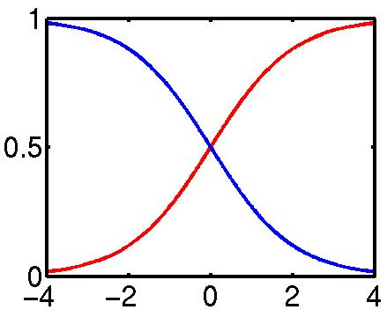
Smoothing: Issues
Assume the following empirical distribution:
Features: {Heads}, {Tails}
We’ll have the following model distribution:
Really, only one degree of freedom (λ = λ_{H}−λ_{T})
Heads | Tails
h | t
λ

Slide 29
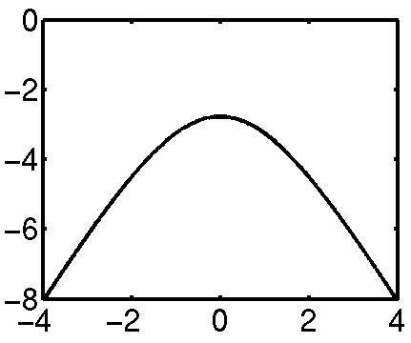
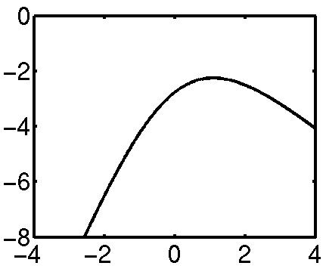
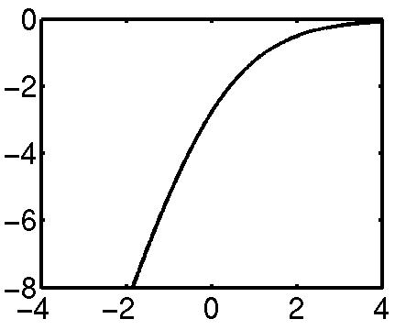
Smoothing: Issues
The data likelihood in this model is:
log P
log P
log P
λ
λ
λ
Heads | Tails
2 | 2
Heads | Tails
3 | 1
Heads | Tails
4 | 0

Slide 30
Smoothing: Early Stopping
In the 4/0 case, there were two problems:
The optimal value of λ was ∞, which is a long trip for an optimization procedure.
The learned distribution is just as spiked as the empirical one – no smoothing.
One way to solve both issues is to just stop the optimization early, after a few iterations.
The value of λ will be finite (but presumably big).
The optimization won’t take forever (clearly).
Commonly used in early maxent work.
λ
Heads | Tails
4 | 0
Input
Heads | Tails
1 | 0
Output

Slide 31
Smoothing: Priors (MAP)
What if we had a prior expectation that parameter values wouldn’t be very large?
We could then balance evidence suggesting large parameters (or infinite) against our prior.
The evidence would never totally defeat the prior, and parameters would be smoothed (and kept finite!).
We can do this explicitly by changing the optimization objective to maximum posterior likelihood:
Posterior
Prior
Evidence

Slide 32
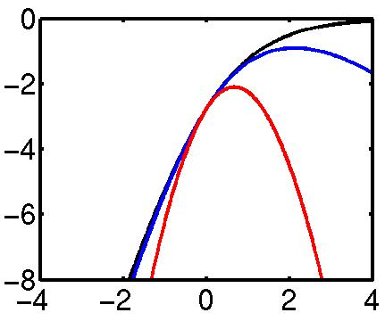
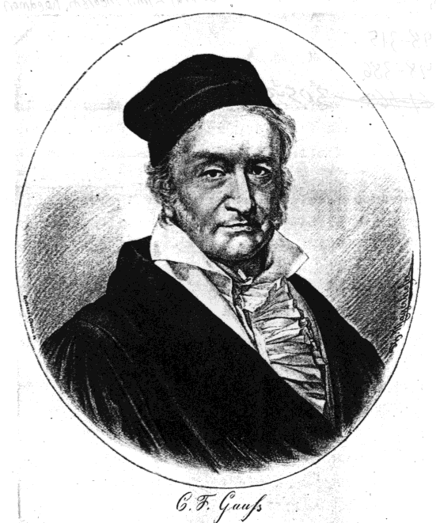
Smoothing: Priors
2σ² = ∞
Gaussian, or quadratic, or L₂ priors:
Intuition: parameters shouldn’t be large.
Formalization: prior expectation that each parameter will be distributed according to a gaussian with mean μ and variance σ².
Penalizes parameters for drifting to far from their mean prior value (usually μ=0).
2σ²=1 works surprisingly well.
2σ² = 10
2σ²=1
They don’t even capitalize my name anymore!

Slide 33
Smoothing: Priors
If we use gaussian priors:
Trade off some expectation-matching for smaller parameters.
When multiple features can be recruited to explain a data point, the more common ones generally receive more weight.
Accuracy generally goes up!
Change the objective:
Change the derivative:
2σ² = ∞
2σ² = 10
2σ²=1
Notes:
Just make mu = 0 in this model.

Slide 34
Smoothing: Priors
If we use gaussian priors:
Trade off some expectation-matching for smaller parameters.
When multiple features can be recruited to explain a data point, the more common ones generally receive more weight.
Accuracy generally goes up!
Change the objective:
Change the derivative:
2σ² = ∞
2σ² = 10
2σ²=1
Taking prior mean as 0
Notes:
Just make mu = 0 in this model.

Slide 35
Example: NER Smoothing
Feature Weights
Because of smoothing, the more common prefix and single-tag features have larger weights even though entire-word and tag-pair features are more specific.
Feature Type | Feature | PERS | LOC
Previous word | at | -0.73 | 0.94
Current word | Grace | 0.03 | 0.00
Beginning bigram | <G | 0.45 | -0.04
Current POS tag | NNP | 0.47 | 0.45
Prev and cur tags | IN NNP | -0.10 | 0.14
Previous state | Other | -0.70 | -0.92
Current signature | Xx | 0.80 | 0.46
Prev state, cur sig | O-Xx | 0.68 | 0.37
Prev-cur-next sig | x-Xx-Xx | -0.69 | 0.37
P. state - p-cur sig | O-x-Xx | -0.20 | 0.82
…
Total: |  | -0.58 | 2.68
Local Context
 | Prev | Cur | Next
State | Other | ??? | ???
Word | at | Grace | Road
Tag | IN | NNP | NNP
Sig | x | Xx | Xx

Slide 36
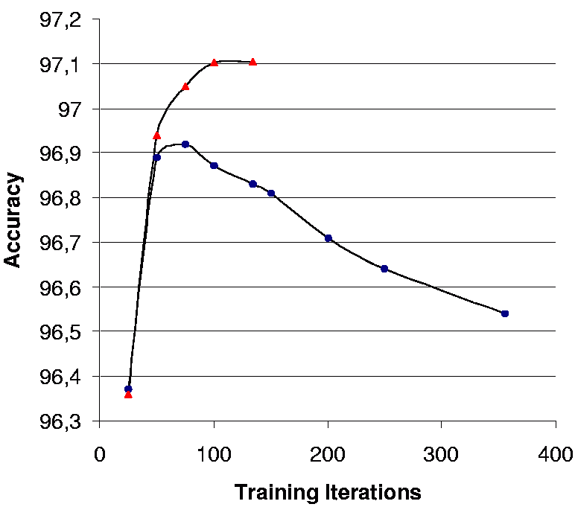

Example: POS Tagging
From (Toutanova et al., 2003):
Smoothing helps:
Softens distributions.
Pushes weight onto more explanatory features.
Allows many features to be dumped safely into the mix.
Speeds up convergence (if both are allowed to converge)!
 | Overall Accuracy | Unknown Word Acc
Without Smoothing | 96.54 | 85.20
With Smoothing | 97.10 | 88.20

Slide 37
Smoothing: Regularization
Talking of “priors” and “MAP estimation” is Bayesian language
In frequentist statistics, people will instead talk about using “regularization”, and in particular, a gaussian prior is “L₂ regularization”
The choice of names makes no difference to the math

Slide 38
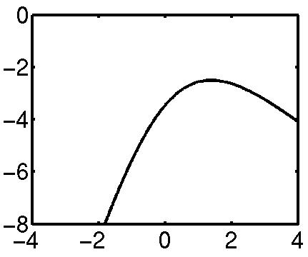
Smoothing: Virtual Data
Another option: smooth the data, not the parameters.
Example:
Equivalent to adding two extra data points.
Similar to add-one smoothing for generative models.
Hard to know what artificial data to create!
Heads | Tails
4 | 0
Heads | Tails
5 | 1

Slide 39
Smoothing: Count Cutoffs
In NLP, features with low empirical counts are often dropped.
Very weak and indirect smoothing method.
Equivalent to locking their weight to be zero.
Equivalent to assigning them gaussian priors with mean zero and variance zero.
Dropping low counts does remove the features which were most in need of smoothing…
… and speeds up the estimation by reducing model size …
… but count cutoffs generally hurt accuracy in the presence of proper smoothing.
We recommend: don’t use count cutoffs unless absolutely necessary for memory usage reasons.

Slide 40
Smoothing/Priors/ Regularization for Maxent Models

