Slide 1
CFGs and PCFGs
(Probabilistic) Context-Free Grammars

Slide 2
A phrase structure grammar
S → NP VP
VP → V NP
VP → V NP PP
NP → NP NP
NP → NP PP
NP → N
NP → e
PP → P NP
people fish tanks
people fish with rods
N → people
N → fish
N → tanks
N → rods
V → people
V → fish
V → tanks
P → with

Slide 3
Phrase structure grammars = context-free grammars (CFGs)
G = (T, N, S, R)
T is a set of terminal symbols
N is a set of nonterminal symbols
S is the start symbol (S ∈ N)
R is a set of rules/productions of the form X → γ
X ∈ N and γ ∈ (N ∪ T)*
A grammar G generates a language L.
Notes:
γ is a sequence of terminals and/or nonterminals (possibly an empty sequence)

Slide 4
Phrase structure grammars in NLP
G = (T, C, N, S, L, R)
T is a set of terminal symbols
C is a set of preterminal symbols
N is a set of nonterminal symbols
S is the start symbol (S ∈ N)
L is the lexicon, a set of items of the form X → x
X ∈ P and x ∈ T
R is the grammar, a set of items of the form X → γ
X ∈ N and γ ∈ (N ∪ C)*
By usual convention, S is the start symbol, but in statistical NLP, we usually have an extra node at the top (ROOT, TOP)
We usually write e for an empty sequence, rather than nothing
Notes:
γ is a sequence of terminals and/or nonterminals (possibly an empty sequence)

Slide 5
A phrase structure grammar
S → NP VP
VP → V NP
VP → V NP PP
NP → NP NP
NP → NP PP
NP → N
NP → e
PP → P NP
people fish tanks
people fish with rods
N → people
N → fish
N → tanks
N → rods
V → people
V → fish
V → tanks
P → with

Slide 6
Probabilistic – or stochastic – context-free grammars (PCFGs)
G = (T, N, S, R, P)
T is a set of terminal symbols
N is a set of nonterminal symbols
S is the start symbol (S ∈ N)
R is a set of rules/productions of the form X → γ
P is a probability function
P: R → [0,1]
A grammar G generates a language model L.
Notes:
P gives the probability of each rule.

Slide 7

A PCFG
S → NP VP 1.0
VP → V NP 0.6
VP → V NP PP 0.4
NP → NP NP 0.1
NP → NP PP 0.2
NP → N 0.7
PP → P NP 1.0
N → people 0.5
N → fish 0.2
N → tanks 0.2
N → rods 0.1
V → people 0.1
V → fish 0.6
V → tanks 0.3
P → with 1.0
[With empty NP removed so less ambiguous]
Notes:
Clipart: http://www.wpclipart.com/animals/aquatic/fish/_happy_fish.png.html
Public domain.

Slide 8
The probability of trees and strings
P(t) – The probability of a tree t is the product of the probabilities of the rules used to generate it.
P(s) – The probability of the string s is the sum of the probabilities of the trees which have that string as their yield
P(s) = Σ_{j} P(s, t) where t is a parse of s
= Σ_{j} P(t)

Slide 9
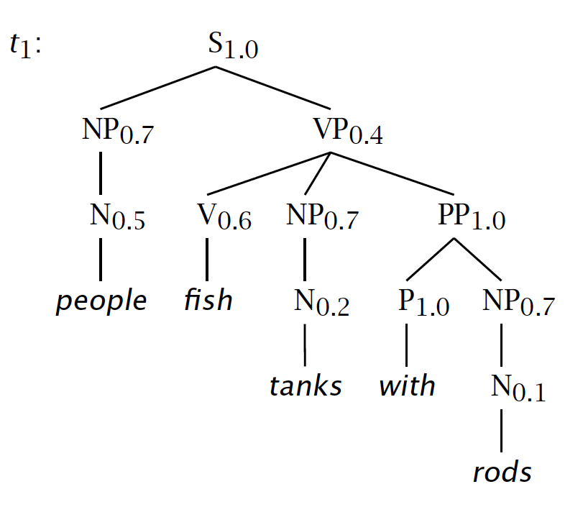

Slide 10
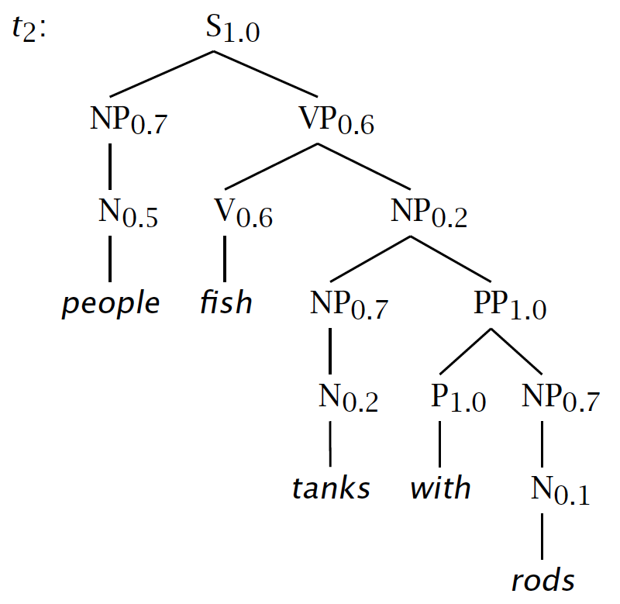

Slide 11
Tree and String Probabilities
s = people fish tanks with rods
P(t₁) = 1.0 × 0.7 × 0.4 × 0.5 × 0.6 × 0.7
× 1.0 × 0.2 × 1.0 × 0.7 × 0.1
= 0.0008232
P(t₂) = 1.0 × 0.7 × 0.6 × 0.5 × 0.6 × 0.2
× 0.7 × 1.0 × 0.2 × 1.0 × 0.7 × 0.1
= 0.00024696
P(s) = P(t₁) + P(t₂)
= 0.0008232 + 0.00024696
= 0.00107016
Verb attach
Noun attach

Slide 12
Notes:
Say that VP is 3 1/3 more times more likely because it’s 0.4 vs. 0.6 x 0.2
Say how you might think how this makes PCFGs very sensitive to how flat or deep trees are. We’ll return to that.

Slide 14
CFGs and PCFGs
(Probabilistic) Context-Free Grammars

Slide 15
Grammar Transforms
Restricting the grammar form for efficient parsing

Slide 16
Chomsky Normal Form
All rules are of the form X → Y Z or X → w
X, Y, Z ∈ N and w ∈ T
A transformation to this form doesn’t change the weak generative capacity of a CFG
That is, it recognizes the same language
But maybe with different trees
Empties and unaries are removed recursively
n-ary rules are divided by introducing new nonterminals (n > 2)

Slide 17
A phrase structure grammar
S → NP VP
VP → V NP
VP → V NP PP
NP → NP NP
NP → NP PP
NP → N
NP → e
PP → P NP
N → people
N → fish
N → tanks
N → rods
V → people
V → fish
V → tanks
P → with
Notes:
Start discussing epsilon removal

Slide 18
Chomsky Normal Form steps
S → NP VP
S → VP
VP → V NP
VP → V
VP → V NP PP
VP → V PP
NP → NP NP
NP → NP
NP → NP PP
NP → PP
NP → N
PP → P NP
PP → P
N → people
N → fish
N → tanks
N → rods
V → people
V → fish
V → tanks
P → with
Notes:
Start discussing unary removal downwards: remove S → VP

Slide 19
Chomsky Normal Form steps
S → NP VP
VP → V NP
S → V NP
VP → V
S → V
VP → V NP PP
S → V NP PP
VP → V PP
S → V PP
NP → NP NP
NP → NP
NP → NP PP
NP → PP
NP → N
PP → P NP
PP → P
N → people
N → fish
N → tanks
N → rods
V → people
V → fish
V → tanks
P → with
Notes:
Remove more unaries, next S → V

Slide 20
Chomsky Normal Form steps
S → NP VP
VP → V NP
S → V NP
VP → V
VP → V NP PP
S → V NP PP
VP → V PP
S → V PP
NP → NP NP
NP → NP
NP → NP PP
NP → PP
NP → N
PP → P NP
PP → P
N → people
N → fish
N → tanks
N → rods
V → people
S → people
V → fish
S → fish
V → tanks
S → tanks
P → with
Notes:
After remove S → V get this, and then do VP → V

Slide 21
Chomsky Normal Form steps
S → NP VP
VP → V NP
S → V NP
VP → V NP PP
S → V NP PP
VP → V PP
S → V PP
NP → NP NP
NP → NP
NP → NP PP
NP → PP
NP → N
PP → P NP
PP → P
N → people
N → fish
N → tanks
N → rods
V → people
S → people
VP → people
V → fish
S → fish
VP → fish
V → tanks
S → tanks
VP → tanks
P → with
Notes:
Remove more unaries, next NP → NP (easy, cross-it-off) and then NP → N.
Since this is the only place N appears on the RHS of a grammar rule, we can delete it from our set of nonterminals altogether.
Then NP → PP and PP → P

Slide 22
Chomsky Normal Form steps
S → NP VP
VP → V NP
S → V NP
VP → V NP PP
S → V NP PP
VP → V PP
S → V PP
NP → NP NP
NP → NP PP
NP → P NP
PP → P NP
NP → people
NP → fish
NP → tanks
NP → rods
V → people
S → people
VP → people
V → fish
S → fish
VP → fish
V → tanks
S → tanks
VP → tanks
P → with
PP → with
Notes:
And then binarize

Slide 23
Chomsky Normal Form steps
S → NP VP
VP → V NP
S → V NP
VP → V @VP_V
@VP_V → NP PP
S → V @S_V
@S_V → NP PP
VP → V PP
S → V PP
NP → NP NP
NP → NP PP
NP → P NP
PP → P NP
NP → people
NP → fish
NP → tanks
NP → rods
V → people
S → people
VP → people
V → fish
S → fish
VP → fish
V → tanks
S → tanks
VP → tanks
P → with
PP → with
Notes:
Chomsky Normal form!

Slide 24
A phrase structure grammar
S → NP VP
VP → V NP
VP → V NP PP
NP → NP NP
NP → NP PP
NP → N
NP → e
PP → P NP
N → people
N → fish
N → tanks
N → rods
V → people
V → fish
V → tanks
P → with
Notes:
Now, if a linguist hands you this

Slide 25
Chomsky Normal Form steps
S → NP VP
VP → V NP
S → V NP
VP → V @VP_V
@VP_V → NP PP
S → V @S_V
@S_V → NP PP
VP → V PP
S → V PP
NP → NP NP
NP → NP PP
NP → P NP
PP → P NP
NP → people
NP → fish
NP → tanks
NP → rods
V → people
S → people
VP → people
V → fish
S → fish
VP → fish
V → tanks
S → tanks
VP → tanks
P → with
PP → with
Notes:
and you hand them back this, then they tend not to be very happy.

Slide 26
Chomsky Normal Form
You should think of this as a transformation for efficient parsing
With some extra book-keeping in symbol names, you can even reconstruct the same trees with a detransform
In practice full Chomsky Normal Form is a pain
Reconstructing n-aries is easy
Reconstructing unaries/empties is trickier
Binarization is crucial for cubic time CFG parsing
The rest isn’t necessary; it just makes the algorithms cleaner and a bit quicker

Slide 27
An example: before binarization…
ROOT
S
NP
VP
V
NP
PP
N
P
NP
N
N
people
fish
tanks
with
rods

Slide 28
After binarization…
ROOT
S
NP
VP
@VP_V
N
V
NP
PP
N
P
NP
N
people
fish
tanks
with
rods

Slide 29
Treebank: empties and unaries
ROOT
ROOT
ROOT
ROOT
ROOT
S-HLN
S
S
S
NP-SUBJ
VP
NP
VP
VP
-NONE-
VB
-NONE-
VB
VB
VB
e
Atone
e
Atone
Atone
Atone
Atone
PTB Tree
NoFuncTags
NoEmpties
High
Low
NoUnaries

Slide 30
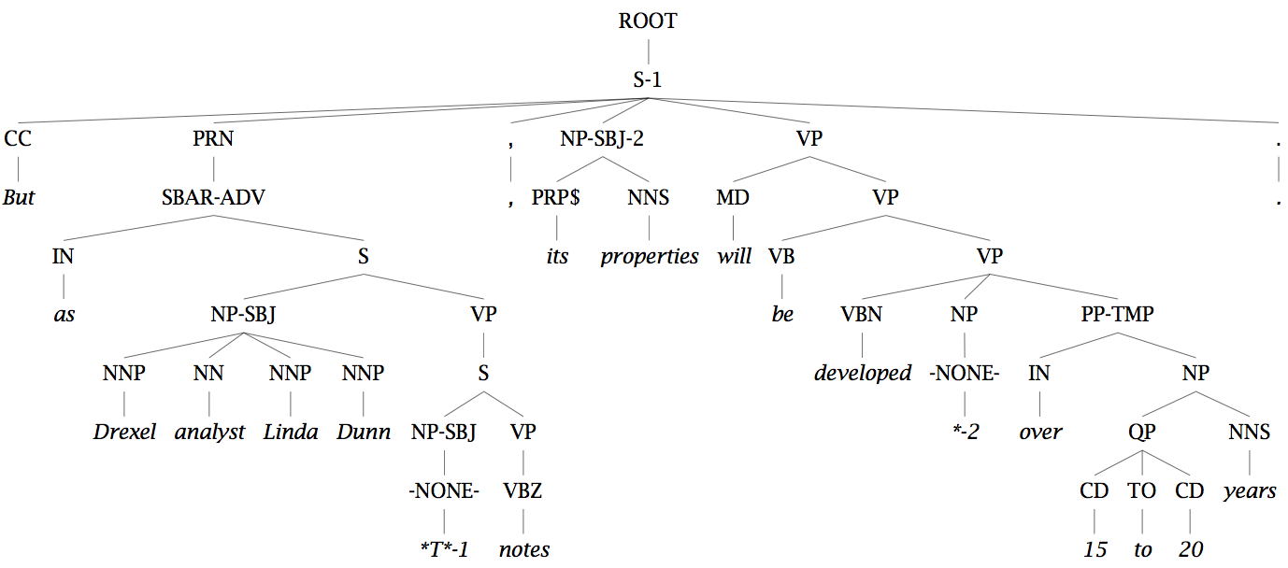
Unary rules: alchemy in the land of treebanks

Slide 31
Same-Span Reachability
TOP
NoEmpties
NX
SQ
X
RRC
LST
ADJP ADVP
FRAG INTJ NP
PP PRN QP S
SBAR UCP VP
WHNP
CONJP
NAC
SINV
PRT
SBARQ
WHADJP
WHPP
WHADVP
Notes:
SCC: Strongly connected component.

Slide 32
Grammar Transforms
Restricting the grammar form for efficient parsing

Slide 33
CKY Parsing
Exact polynomial time parsing of
(P)CFGs

Slide 34
Constituency Parsing
PCFG
fish people fish tanks
Rule Prob θ_{i}
S → NP VP θ₀
NP → NP NP θ₁
…
N → fish θ₄₂
N → people θ₄₃
V → fish θ₄₄
…
S
VP
NP
NP
N
N
V
N
Notes:
Want to work out all possible structures licensed by grammar.
In PCFG want to find the highest probability one.
Without doing any repeated work.
Probs for all rules with the same parent sum to 1.
Prob of a parse is product of probs of all the rules
Probs estimated by reading counts off of the treebank - it’s a generative model

Slide 35
Cocke-Kasami-Younger (CKY) Constituency Parsing
fish people fish tanks

Slide 36
Viterbi (Max) Scores
NP→NN NNS 0.13
i_{NP} = (0.13)(0.0023)(0.0014)
= 1.87 × 10⁻⁷
NP→NNP NNS 0.056
i_{NP} = (0.056)(0.001)(0.0014)
= 7.84 × 10⁻⁸
S 1.87 × 10⁻⁷
VP
VP 0.06
NP 0.14
V 0.6
N 0.2
NP 0.35
V 0.1
N 0.5
people fish

Slide 37
Viterbi (Max) Scores
S → NP VP 0.9
S → VP 0.1
VP → V NP 0.5
VP → V 0.1
VP → V @VP_V 0.3
VP → V PP 0.1
@VP_V → NP PP 1.0
NP → NP NP 0.1
NP → NP PP 0.2
NP → N 0.7
PP → P NP 1.0
VP 0.06
NP 0.14
V 0.6
N 0.2
NP 0.35
V 0.1
N 0.5
people fish
Notes:
NP -> NP NP = 0.35 * 0.14 * 0.1 = 0.0049
VP -> V NP = 0.1 * 0.14 * 0.5 = 0.007
S -> VP = 0.007 * 0.1 = 0.0007
S -> NP VP = 0.35 * 0.06 * 0.9 = 0.0189

Slide 38
Extended CKY parsing
Unaries can be incorporated into the algorithm
Messy, but doesn’t increase algorithmic complexity
Empties can be incorporated
Use fenceposts
Doesn’t increase complexity; essentially like unaries
Binarization is vital
Without binarization, you don’t get parsing cubic in the length of the sentence and in the number of nonterminals in the grammar
Binarization may be an explicit transformation or implicit in how the parser works (Early-style dotted rules), but it’s always there.

Slide 39
The CKY algorithm (1960/1965) … extended to unaries
function CKY(words, grammar) returns [most_probable_parse,prob]
score = new double[#(words)+1][#(words)+1][#(nonterms)]
back = new Pair[#(words)+1][#(words)+1][#nonterms]]
for i=0; i<#(words); i++
for A in nonterms
if A -> words[i] in grammar
score[i][i+1][A] = P(A -> words[i])
//handle unaries
boolean added = true
while added
added = false
for A, B in nonterms
if score[i][i+1][B] > 0 && A->B in grammar
prob = P(A->B)*score[i][i+1][B]
if prob > score[i][i+1][A]
score[i][i+1][A] = prob
back[i][i+1][A] = B
added = true

Slide 40
The CKY algorithm (1960/1965) … extended to unaries
for span = 2 to #(words)
for begin = 0 to #(words)- span
end = begin + span
for split = begin+1 to end-1
for A,B,C in nonterms
prob=score[begin][split][B]*score[split][end][C]*P(A->BC)
if prob > score[begin][end][A]
score[begin]end][A] = prob
back[begin][end][A] = new Triple(split,B,C)
//handle unaries
boolean added = true
while added
added = false
for A, B in nonterms
prob = P(A->B)*score[begin][end][B];
if prob > score[begin][end][A]
score[begin][end][A] = prob
back[begin][end][A] = B
added = true
return buildTree(score, back)

Slide 41
Quiz Question!
PP → IN 0.002
NP → NNS NNS 0.01
NP → NNS NP 0.005
NP → NNS PP 0.01
VP → VB PP 0.045
VP → VB NP 0.015
?? ??
?? ??
PP 0.2
IN 0.0014
NNS 0.0001
NNS 0.0023
VB 0.001
What constituents (with what probability can you make?
runs down

Slide 42
CKY Parsing
Exact polynomial time parsing of
(P)CFGs

Slide 43
CKY Parsing
A worked example

Slide 44
The grammar: Binary, no epsilons,
S → NP VP 0.9
S → VP 0.1
VP → V NP 0.5
VP → V 0.1
VP → V @VP_V 0.3
VP → V PP 0.1
@VP_V → NP PP 1.0
NP → NP NP 0.1
NP → NP PP 0.2
NP → N 0.7
PP → P NP 1.0
N → people 0.5
N → fish 0.2
N → tanks 0.2
N → rods 0.1
V → people 0.1
V → fish 0.6
V → tanks 0.3
P → with 1.0
Notes:
Start discussing unary removal downwards: remove S → VP

Slide 45
fish
1
people
2
fish
3
tanks
4
0
score[0][1]
score[0][2]
score[0][3]
score[0][4]
1
score[1][2]
score[1][3]
score[1][4]
2
score[2][3]
score[2][4]
3
score[3][4]
4

Slide 46
fish
1
people
2
fish
3
tanks
4
S → NP VP 0.9
S → VP 0.1
VP → V NP 0.5
VP → V 0.1
VP → V @VP_V 0.3
VP → V PP 0.1
@VP_V → NP PP 1.0
NP → NP NP 0.1
NP → NP PP 0.2
NP → N 0.7
PP → P NP 1.0
N → people 0.5
N → fish 0.2
N → tanks 0.2
N → rods 0.1
V → people 0.1
V → fish 0.6
V → tanks 0.3
P → with 1.0
0
1
2
3
for i=0; i<#(words); i++
for A in nonterms
if A -> words[i] in grammar
score[i][i+1][A] = P(A -> words[i]);
4

Slide 47
fish
1
people
2
fish
3
tanks
4
S → NP VP 0.9
S → VP 0.1
VP → V NP 0.5
VP → V 0.1
VP → V @VP_V 0.3
VP → V PP 0.1
@VP_V → NP PP 1.0
NP → NP NP 0.1
NP → NP PP 0.2
NP → N 0.7
PP → P NP 1.0
N → people 0.5
N → fish 0.2
N → tanks 0.2
N → rods 0.1
V → people 0.1
V → fish 0.6
V → tanks 0.3
P → with 1.0
0
N → fish 0.2
V → fish 0.6
1
N → people 0.5
V → people 0.1
2
N → fish 0.2
V → fish 0.6
// handle unaries
boolean added = true
while added
added = false
for A, B in nonterms
if score[i][i+1][B] > 0 && A->B in grammar
prob = P(A->B)*score[i][i+1][B]
if(prob > score[i][i+1][A])
score[i][i+1][A] = prob
back[i][i+1][A] = B
added = true
3
N → tanks 0.2
V → tanks 0.1
4

Slide 48
fish
1
people
2
fish
3
tanks
4
S → NP VP 0.9
S → VP 0.1
VP → V NP 0.5
VP → V 0.1
VP → V @VP_V 0.3
VP → V PP 0.1
@VP_V → NP PP 1.0
NP → NP NP 0.1
NP → NP PP 0.2
NP → N 0.7
PP → P NP 1.0
N → people 0.5
N → fish 0.2
N → tanks 0.2
N → rods 0.1
V → people 0.1
V → fish 0.6
V → tanks 0.3
P → with 1.0
0
N → fish 0.2
V → fish 0.6
NP → N 0.14
VP → V 0.06
S → VP 0.006
1
N → people 0.5
V → people 0.1
NP → N 0.35
VP → V 0.01
S → VP 0.001
2
N → fish 0.2
V → fish 0.6
NP → N 0.14
VP → V 0.06
S → VP 0.006
3
N → tanks 0.2
V → tanks 0.1
NP → N 0.14
VP → V 0.03
S → VP 0.003
prob=score[begin][split][B]*score[split][end][C]*P(A->BC)
if (prob > score[begin][end][A])
score[begin]end][A] = prob
back[begin][end][A] = new Triple(split,B,C)
4
Notes:
And then start the binaries.

Slide 49
fish
1
people
2
fish
3
tanks
4
S → NP VP 0.9
S → VP 0.1
VP → V NP 0.5
VP → V 0.1
VP → V @VP_V 0.3
VP → V PP 0.1
@VP_V → NP PP 1.0
NP → NP NP 0.1
NP → NP PP 0.2
NP → N 0.7
PP → P NP 1.0
N → people 0.5
N → fish 0.2
N → tanks 0.2
N → rods 0.1
V → people 0.1
V → fish 0.6
V → tanks 0.3
P → with 1.0
0
N → fish 0.2
V → fish 0.6
NP → N 0.14
VP → V 0.06
S → VP 0.006
NP → NP NP
0.0049
VP → V NP
0.105
S → NP VP
0.00126
1
N → people 0.5
V → people 0.1
NP → N 0.35
VP → V 0.01
S → VP 0.001
NP → NP NP
0.0049
VP → V NP
0.007
S → NP VP
0.0189
2
N → fish 0.2
V → fish 0.6
NP → N 0.14
VP → V 0.06
S → VP 0.006
NP → NP NP
0.00196
VP → V NP
0.042
S → NP VP
0.00378
//handle unaries
boolean added = true
while added
added = false
for A, B in nonterms
prob = P(A->B)*score[begin][end][B];
if prob > score[begin][end][A]
score[begin][end][A] = prob
back[begin][end][A] = B
added = true
3
N → tanks 0.2
V → tanks 0.1
NP → N 0.14
VP → V 0.03
S → VP 0.003
4
Notes:
Unaries change 0,2 and 2,4 S scores

Slide 50
fish
1
people
2
fish
3
tanks
4
S → NP VP 0.9
S → VP 0.1
VP → V NP 0.5
VP → V 0.1
VP → V @VP_V 0.3
VP → V PP 0.1
@VP_V → NP PP 1.0
NP → NP NP 0.1
NP → NP PP 0.2
NP → N 0.7
PP → P NP 1.0
N → people 0.5
N → fish 0.2
N → tanks 0.2
N → rods 0.1
V → people 0.1
V → fish 0.6
V → tanks 0.3
P → with 1.0
0
N → fish 0.2
V → fish 0.6
NP → N 0.14
VP → V 0.06
S → VP 0.006
NP → NP NP
0.0049
VP → V NP
0.105
S → VP
0.0105
1
N → people 0.5
V → people 0.1
NP → N 0.35
VP → V 0.01
S → VP 0.001
NP → NP NP
0.0049
VP → V NP
0.007
S → NP VP
0.0189
2
N → fish 0.2
V → fish 0.6
NP → N 0.14
VP → V 0.06
S → VP 0.006
NP → NP NP
0.00196
VP → V NP
0.042
S → VP
0.0042
3
N → tanks 0.2
V → tanks 0.1
NP → N 0.14
VP → V 0.03
S → VP 0.003
for split = begin+1 to end-1
for A,B,C in nonterms
prob=score[begin][split][B]*score[split][end][C]*P(A->BC)
if prob > score[begin][end][A]
score[begin]end][A] = prob
back[begin][end][A] = new Triple(split,B,C)
4

Slide 51
fish
1
people
2
fish
3
tanks
4
S → NP VP 0.9
S → VP 0.1
VP → V NP 0.5
VP → V 0.1
VP → V @VP_V 0.3
VP → V PP 0.1
@VP_V → NP PP 1.0
NP → NP NP 0.1
NP → NP PP 0.2
NP → N 0.7
PP → P NP 1.0
N → people 0.5
N → fish 0.2
N → tanks 0.2
N → rods 0.1
V → people 0.1
V → fish 0.6
V → tanks 0.3
P → with 1.0
0
N → fish 0.2
V → fish 0.6
NP → N 0.14
VP → V 0.06
S → VP 0.006
NP → NP NP
0.0049
VP → V NP
0.105
S → VP
0.0105
NP → NP NP
0.0000686
VP → V NP
0.00147
S → NP VP
0.000882
1
N → people 0.5
V → people 0.1
NP → N 0.35
VP → V 0.01
S → VP 0.001
NP → NP NP
0.0049
VP → V NP
0.007
S → NP VP
0.0189
2
N → fish 0.2
V → fish 0.6
NP → N 0.14
VP → V 0.06
S → VP 0.006
NP → NP NP
0.00196
VP → V NP
0.042
S → VP
0.0042
3
N → tanks 0.2
V → tanks 0.1
NP → N 0.14
VP → V 0.03
S → VP 0.003
for split = begin+1 to end-1
for A,B,C in nonterms
prob=score[begin][split][B]*score[split][end][C]*P(A->BC)
if prob > score[begin][end][A]
score[begin]end][A] = prob
back[begin][end][A] = new Triple(split,B,C)
4
Notes:
Results for 0,1 and 1,3
But everything done the other way is lower.
NP -> NP NP for 0,2 and 2,3 is same; A TIE !!; VP is impossible;
S is 0.0049 * 0.06 * 0.9 = 0.0002646
Then doing unaries does nothing (0.000147 S)
Then do (1,4) cell.

Slide 52
fish
1
people
2
fish
3
tanks
4
S → NP VP 0.9
S → VP 0.1
VP → V NP 0.5
VP → V 0.1
VP → V @VP_V 0.3
VP → V PP 0.1
@VP_V → NP PP 1.0
NP → NP NP 0.1
NP → NP PP 0.2
NP → N 0.7
PP → P NP 1.0
N → people 0.5
N → fish 0.2
N → tanks 0.2
N → rods 0.1
V → people 0.1
V → fish 0.6
V → tanks 0.3
P → with 1.0
0
N → fish 0.2
V → fish 0.6
NP → N 0.14
VP → V 0.06
S → VP 0.006
NP → NP NP
0.0049
VP → V NP
0.105
S → VP
0.0105
NP → NP NP
0.0000686
VP → V NP
0.00147
S → NP VP
0.000882
1
N → people 0.5
V → people 0.1
NP → N 0.35
VP → V 0.01
S → VP 0.001
NP → NP NP
0.0049
VP → V NP
0.007
S → NP VP
0.0189
NP → NP NP
0.0000686
VP → V NP
0.000098
S → NP VP
0.01323
2
N → fish 0.2
V → fish 0.6
NP → N 0.14
VP → V 0.06
S → VP 0.006
NP → NP NP
0.00196
VP → V NP
0.042
S → VP
0.0042
3
N → tanks 0.2
V → tanks 0.1
NP → N 0.14
VP → V 0.03
S → VP 0.003
for split = begin+1 to end-1
for A,B,C in nonterms
prob=score[begin][split][B]*score[split][end][C]*P(A->BC)
if prob > score[begin][end][A]
score[begin]end][A] = prob
back[begin][end][A] = new Triple(split,B,C)
4
Notes:
(1,4) S ->

Slide 53
fish
1
people
2
fish
3
tanks
4
S → NP VP 0.9
S → VP 0.1
VP → V NP 0.5
VP → V 0.1
VP → V @VP_V 0.3
VP → V PP 0.1
@VP_V → NP PP 1.0
NP → NP NP 0.1
NP → NP PP 0.2
NP → N 0.7
PP → P NP 1.0
N → people 0.5
N → fish 0.2
N → tanks 0.2
N → rods 0.1
V → people 0.1
V → fish 0.6
V → tanks 0.3
P → with 1.0
0
N → fish 0.2
V → fish 0.6
NP → N 0.14
VP → V 0.06
S → VP 0.006
NP → NP NP
0.0049
VP → V NP
0.105
S → VP
0.0105
NP → NP NP
0.0000686
VP → V NP
0.00147
S → NP VP
0.000882
NP → NP NP
0.0000009604
VP → V NP
0.00002058
S → NP VP
0.00018522
1
N → people 0.5
V → people 0.1
NP → N 0.35
VP → V 0.01
S → VP 0.001
NP → NP NP
0.0049
VP → V NP
0.007
S → NP VP
0.0189
NP → NP NP
0.0000686
VP → V NP
0.000098
S → NP VP
0.01323
2
N → fish 0.2
V → fish 0.6
NP → N 0.14
VP → V 0.06
S → VP 0.006
NP → NP NP
0.00196
VP → V NP
0.042
S → VP
0.0042
3
N → tanks 0.2
V → tanks 0.1
NP → N 0.14
VP → V 0.03
S → VP 0.003
4
Call buildTree(score, back) to get the best parse
Notes:
(0,4) S from NP(0,2) + VP(2,4) = 0.0049 * 0.042 * 0.9 =

Slide 54
CKY Parsing
A worked example

Slide 55
Constituency Parser Evaluation

Slide 56
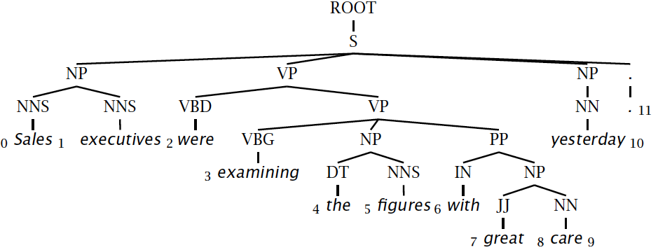
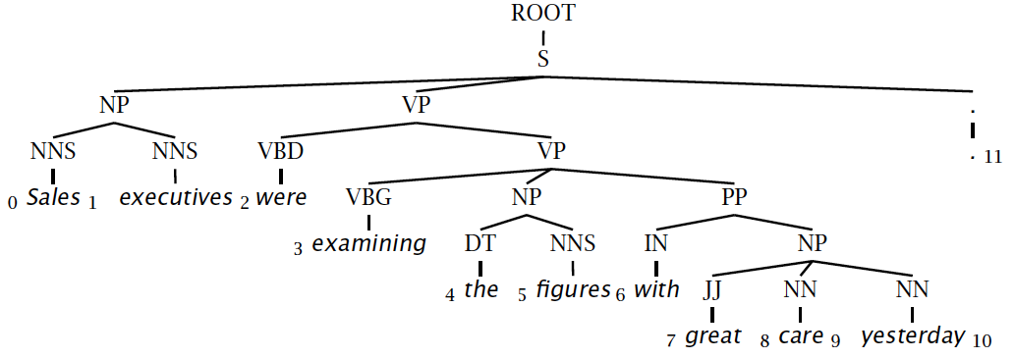
Evaluating constituency parsing
Notes:
Most sentences are not given a completely correct parse by any currently existing parser.
A constituent is a triple, which must be exact in the true parse for the constituent to be marked correct.

Slide 57
Evaluating constituency parsing
Gold standard brackets:
S-(0:11), NP-(0:2), VP-(2:9), VP-(3:9), NP-(4:6), PP-(6-9), NP-(7,9), NP-(9:10)
Candidate brackets:
S-(0:11), NP-(0:2), VP-(2:10), VP-(3:10), NP-(4:6), PP-(6-10), NP-(7,10)
Labeled Precision 3/7 = 42.9%
Labeled Recall 3/8 = 37.5%
LP/LR F1 40.0%
Tagging Accuracy 11/11 = 100.0%
Notes:
This isn’t necessarily a great measure … me and many other people think dependency accuracy would be better.

Slide 58
How good are PCFGs?
Penn WSJ parsing accuracy: about 73% LP/LR F1
Robust
Usually admit everything, but with low probability
Partial solution for grammar ambiguity
A PCFG gives some idea of the plausibility of a parse
But not so good because the independence assumptions are too strong
Give a probabilistic language model
But in the simple case it performs worse than a trigram model
The problem seems to be that PCFGs lack the lexicalization of a trigram model

Slide 59
Constituency Parser Evaluation

