Slide 1
Question Answering
What is Question Answering?

Slide 2
Question Answering
One of the oldest NLP tasks (punched card systems in 1961)
Simmons, Klein, McConlogue. 1964. Indexing and Dependency Logic for Answering English Questions. American Documentation 15:30, 196-204

Slide 3
Question Answering: IBM’s Watson
Won Jeopardy on February 16, 2011!
WILLIAM WILKINSON’S
“AN ACCOUNT OF THE PRINCIPALITIES OF WALLACHIA AND MOLDOVIA”
INSPIRED THIS AUTHOR’S
MOST FAMOUS NOVEL
Bram Stoker

Slide 4
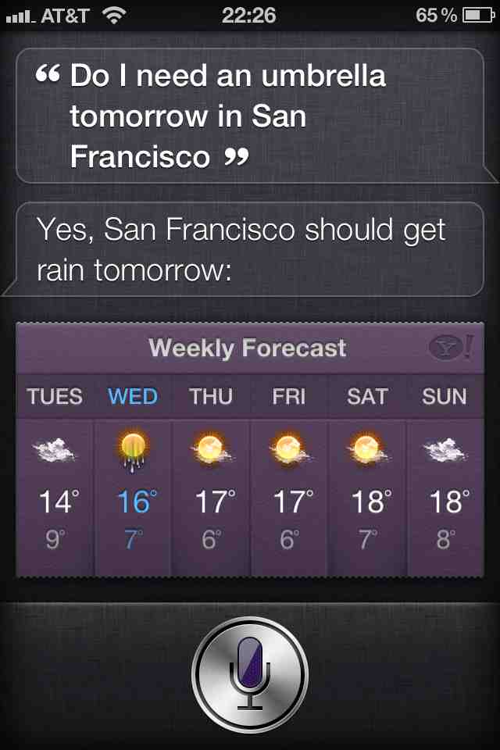
Apple’s Siri

Slide 5
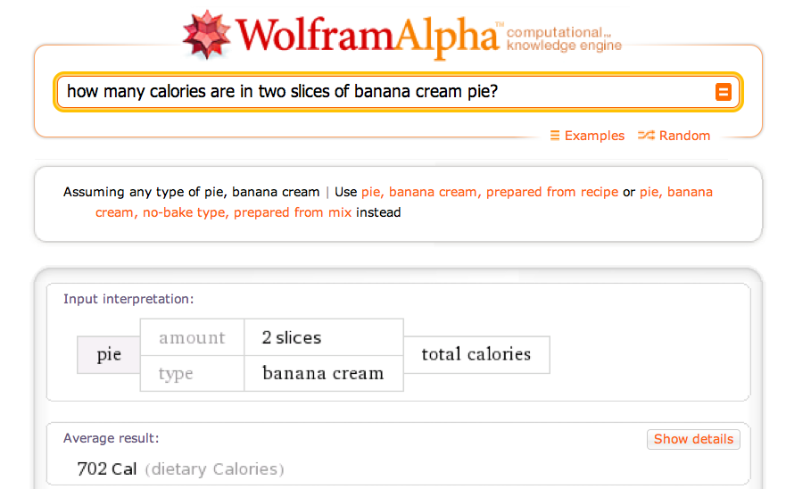
Wolfram Alpha

Slide 6
Types of Questions in Modern Systems
Factoid questions
Who wrote “The Universal Declaration of Human Rights”?
How many calories are there in two slices of apple pie?
What is the average age of the onset of autism?
Where is Apple Computer based?
Complex (narrative) questions:
In children with an acute febrile illness, what is the efficacy of acetaminophen in reducing fever?
What do scholars think about Jefferson’s position on dealing with pirates?

Slide 7
Commercial systems: mainly factoid questions
Where is the Louvre Museum located? | In Paris, France
What’s the abbreviation for limited partnership? | L.P.
What are the names of Odin’s ravens? | Huginn and Muninn
What currency is used in China? | The yuan
What kind of nuts are used in marzipan? | almonds
What instrument does Max Roach play? | drums
What is the telephone number for Stanford University? | 650-723-2300

Slide 8
Paradigms for QA
IR-based approaches
TREC; IBM Watson; Google
Knowledge-based and Hybrid approaches
IBM Watson; Apple Siri; Wolfram Alpha; True Knowledge Evi

Slide 9
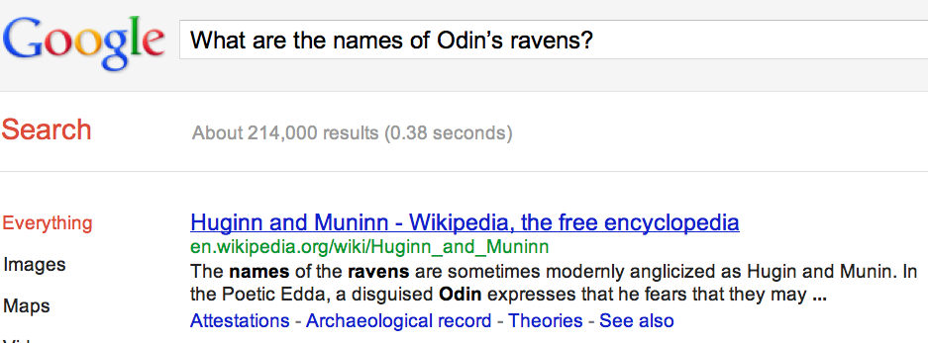
Many questions can already be answered by web search
a

Slide 10
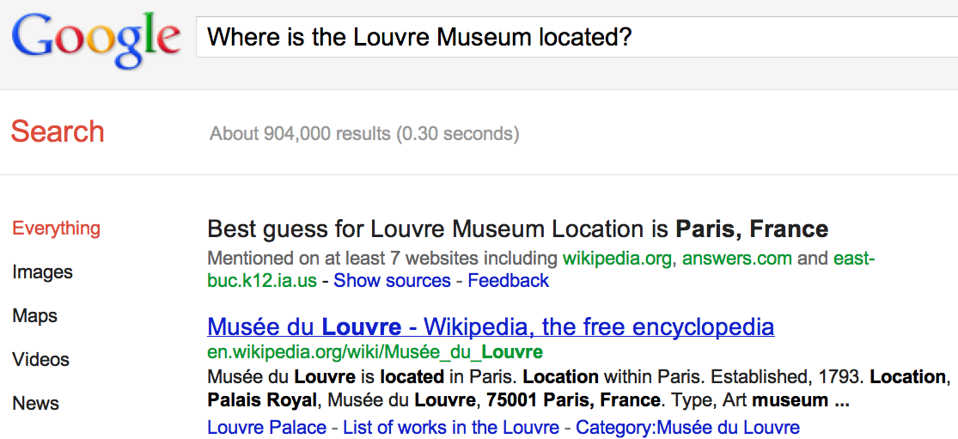
IR-based Question Answering
a

Slide 11
IR-based Factoid QA

Slide 12
IR-based Factoid QA
QUESTION PROCESSING
Detect question type, answer type, focus, relations
Formulate queries to send to a search engine
PASSAGE RETRIEVAL
Retrieve ranked documents
Break into suitable passages and rerank
ANSWER PROCESSING
Extract candidate answers
Rank candidates
using evidence from the text and external sources

Slide 13
Knowledge-based approaches (Siri)
Build a semantic representation of the query
Times, dates, locations, entities, numeric quantities
Map from this semantics to query structured data or resources
Geospatial databases
Ontologies (Wikipedia infoboxes, dbPedia, WordNet, Yago)
Restaurant review sources and reservation services
Scientific databases

Slide 14
Hybrid approaches (IBM Watson)
Build a shallow semantic representation of the query
Generate answer candidates using IR methods
Augmented with ontologies and semi-structured data
Score each candidate using richer knowledge sources
Geospatial databases
Temporal reasoning
Taxonomical classification

Slide 15
Question Answering
What is Question Answering?

Slide 16
Question Answering
Answer Types and Query Formulation

Slide 17
Factoid Q/A

Slide 18
Question Processing Things to extract from the question
Answer Type Detection
Decide the named entity type (person, place) of the answer
Query Formulation
Choose query keywords for the IR system
Question Type classification
Is this a definition question, a math question, a list question?
Focus Detection
Find the question words that are replaced by the answer
Relation Extraction
Find relations between entities in the question

Slide 19
Question Processing They’re the two states you could be reentering if you’re crossing Florida’s northern border
Answer Type: US state
Query: two states, border, Florida, north
Focus: the two states
Relations: borders(Florida, ?x, north)

Slide 20
Answer Type Detection: Named Entities
Who founded Virgin Airlines?
PERSON
What Canadian city has the largest population?
CITY.

Slide 21
Answer Type Taxonomy
Xin Li, Dan Roth. 2002. Learning Question Classifiers. COLING'02
6 coarse classes
ABBEVIATION, ENTITY, DESCRIPTION, HUMAN, LOCATION, NUMERIC
50 finer classes
LOCATION: city, country, mountain…
HUMAN: group, individual, title, description
ENTITY: animal, body, color, currency…

Slide 22
Part of Li & Roth’s Answer Type Taxonomy

Slide 23
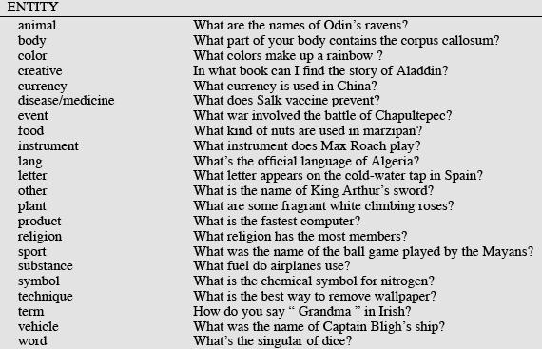
Answer Types

Slide 24
More Answer Types

Slide 25
Answer types in Jeopardy
Ferrucci et al. 2010. Building Watson: An Overview of the DeepQA Project. AI Magazine. Fall 2010. 59-79.
2500 answer types in 20,000 Jeopardy question sample
The most frequent 200 answer types cover < 50% of data
The 40 most frequent Jeopardy answer types
he, country, city, man, film, state, she, author, group, here, company, president, capital, star, novel, character, woman, river, island, king, song, part, series, sport, singer, actor, play, team, show, actress, animal, presidential, composer, musical, nation, book, title, leader, game

Slide 26
Answer Type Detection
Hand-written rules
Machine Learning
Hybrids

Slide 27
Answer Type Detection
Regular expression-based rules can get some cases:
Who {is|was|are|were} PERSON
PERSON (YEAR – YEAR)
Other rules use the question headword:
(the headword of the first noun phrase after the wh-word)
Which city in China has the largest number of foreign financial companies?
What is the state flower of California?

Slide 28
Answer Type Detection
Most often, we treat the problem as machine learning classification
Define a taxonomy of question types
Annotate training data for each question type
Train classifiers for each question class using a rich set of features.
features include those hand-written rules!

Slide 29
Features for Answer Type Detection
Question words and phrases
Part-of-speech tags
Parse features (headwords)
Named Entities
Semantically related words

Slide 30
Factoid Q/A

Slide 31
Keyword Selection Algorithm
Dan Moldovan, Sanda Harabagiu, Marius Paca, Rada Mihalcea, Richard Goodrum, Roxana Girju and Vasile Rus. 1999. Proceedings of TREC-8.
1. Select all non-stop words in quotations
2. Select all NNP words in recognized named entities
3. Select all complex nominals with their adjectival modifiers
4. Select all other complex nominals
5. Select all nouns with their adjectival modifiers
6. Select all other nouns
7. Select all verbs
8. Select all adverbs
9. Select the QFW word (skipped in all previous steps)
10. Select all other words

Slide 32
Choosing keywords from the query
Slide from Mihai Surdeanu
Who coined the term “cyberspace” in his novel “Neuromancer”?
1
1
4
4
7
cyberspace/1 Neuromancer/1 term/4 novel/4 coined/7

Slide 33
Question Answering
Answer Types and Query Formulation

Slide 34
Question Answering
Passage Retrieval and Answer Extraction

Slide 35
Factoid Q/A

Slide 36
Passage Retrieval
Step 1: IR engine retrieves documents using query terms
Step 2: Segment the documents into shorter units
something like paragraphs
Step 3: Passage ranking
Use answer type to help rerank passages

Slide 37
Features for Passage Ranking
Either in rule-based classifiers or with supervised machine learning
Number of Named Entities of the right type in passage
Number of query words in passage
Number of question N-grams also in passage
Proximity of query keywords to each other in passage
Longest sequence of question words
Rank of the document containing passage

Slide 38
Factoid Q/A

Slide 39
Answer Extraction
Run an answer-type named-entity tagger on the passages
Each answer type requires a named-entity tagger that detects it
If answer type is CITY, tagger has to tag CITY
Can be full NER, simple regular expressions, or hybrid
Return the string with the right type:
Who is the prime minister of India (PERSON)
Manmohan Singh, Prime Minister of India, had told left leaders that the deal would not be renegotiated.
How tall is Mt. Everest? (LENGTH)
The official height of Mount Everest is 29035 feet

Slide 40
Ranking Candidate Answers
But what if there are multiple candidate answers!
Q: Who was Queen Victoria’s second son?
Answer Type: Person
Passage:
The Marie biscuit is named after Marie Alexandrovna, the daughter of Czar Alexander II of Russia and wife of Alfred, the second son of Queen Victoria and Prince Albert

Slide 41
Ranking Candidate Answers
But what if there are multiple candidate answers!
Q: Who was Queen Victoria’s second son?
Answer Type: Person
Passage:
The Marie biscuit is named after Marie Alexandrovna, the daughter of Czar Alexander II of Russia and wife of Alfred, the second son of Queen Victoria and Prince Albert

Slide 42
Use machine learning: Features for ranking candidate answers
Answer type match: Candidate contains a phrase with the correct answer type.
Pattern match: Regular expression pattern matches the candidate.
Question keywords: # of question keywords in the candidate.
Keyword distance: Distance in words between the candidate and query keywords
Novelty factor: A word in the candidate is not in the query.
Apposition features: The candidate is an appositive to question terms
Punctuation location: The candidate is immediately followed by a comma, period, quotation marks, semicolon, or exclamation mark.
Sequences of question terms: The length of the longest sequence of question terms that occurs in the candidate answer.

Slide 43
Candidate Answer scoring in IBM Watson
Each candidate answer gets scores from >50 components
(from unstructured text, semi-structured text, triple stores)
logical form (parse) match between question and candidate
passage source reliability
geospatial location
California is ”southwest of Montana”
temporal relationships
taxonomic classification

Slide 44
Common Evaluation Metrics
Accuracy (does answer match gold-labeled answer?)
Mean Reciprocal Rank
For each query return a ranked list of M candidate answers.
Query score is 1/Rank of the first correct answer
If first answer is correct: 1
else if second answer is correct: ½
else if third answer is correct: ⅓, etc.
Score is 0 if none of the M answers are correct
Take the mean over all N queries

Slide 45
Question Answering
Passage Retrieval and Answer Extraction

Slide 46
Question Answering
Using Knowledge in QA

Slide 47
Relation Extraction
Answers: Databases of Relations
born-in(“Emma Goldman”, “June 27 1869”)
author-of(“Cao Xue Qin”, “Dream of the Red Chamber”)
Draw from Wikipedia infoboxes, DBpedia, FreeBase, etc.
Questions: Extracting Relations in Questions
Whose granddaughter starred in E.T.?
(acted-in ?x “E.T.”)
(granddaughter-of ?x ?y)

Slide 48
Temporal Reasoning
Relation databases
(and obituaries, biographical dictionaries, etc.)
IBM Watson
”In 1594 he took a job as a tax collector in Andalusia”
Candidates:
Thoreau is a bad answer (born in 1817)
Cervantes is possible (was alive in 1594)

Slide 49
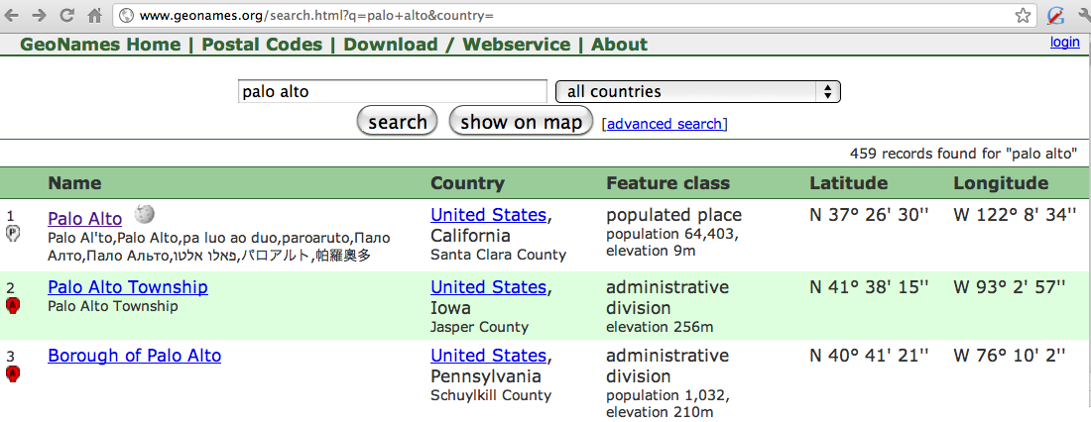
Geospatial knowledge (containment, directionality, borders)
Beijing is a good answer for ”Asian city”
California is ”southwest of Montana”
geonames.org:

Slide 50
Context and Conversation in Virtual Assistants like Siri
Coreference helps resolve ambiguities
U: “Book a table at Il Fornaio at 7:00 with my mom”
U: “Also send her an email reminder”
Clarification questions:
U: “Chicago pizza”
S: “Did you mean pizza restaurants in Chicago or Chicago-style pizza?”

Slide 51
Question Answering
Using Knowledge in QA

