Slide 1
7.1 Matrices, Vectors:
Addition and Scalar Multiplication
Notes:
In the previous lectures, we introduced the concept of a vector and showed how vector calculus can be applied to engineering. Vectors are useful in engineering because, unlike scalars, they can capture both the magnitude and the direction in two or three dimensional space. Hence, they can be used to represent curves, surfaces or a region in space.
Physical phenomena such as force and temperature in space can be described using the scalar or vector functions. Physical properties can be described or computed using the differential or integral calculus, such as the gradient, divergence, curl, line integral, surface integral or triple integral. There are also integral theorems that allow us to compute the integrals, or convert one integral into another to simplify the computation.
In this section, we will generalize concept of vectors even further to a structure called the matrix. Similar to the vectors, we can define some operations such as addition and multiplication. Such operations are called linear algebra. Linear algebra is widely used in engineering because it is capable of modeling many practical problems. It also provide simple and computable solutions to these problems. The google search engine, for instance, use linear algebra to compute the page rank of the web pages.

Slide 2
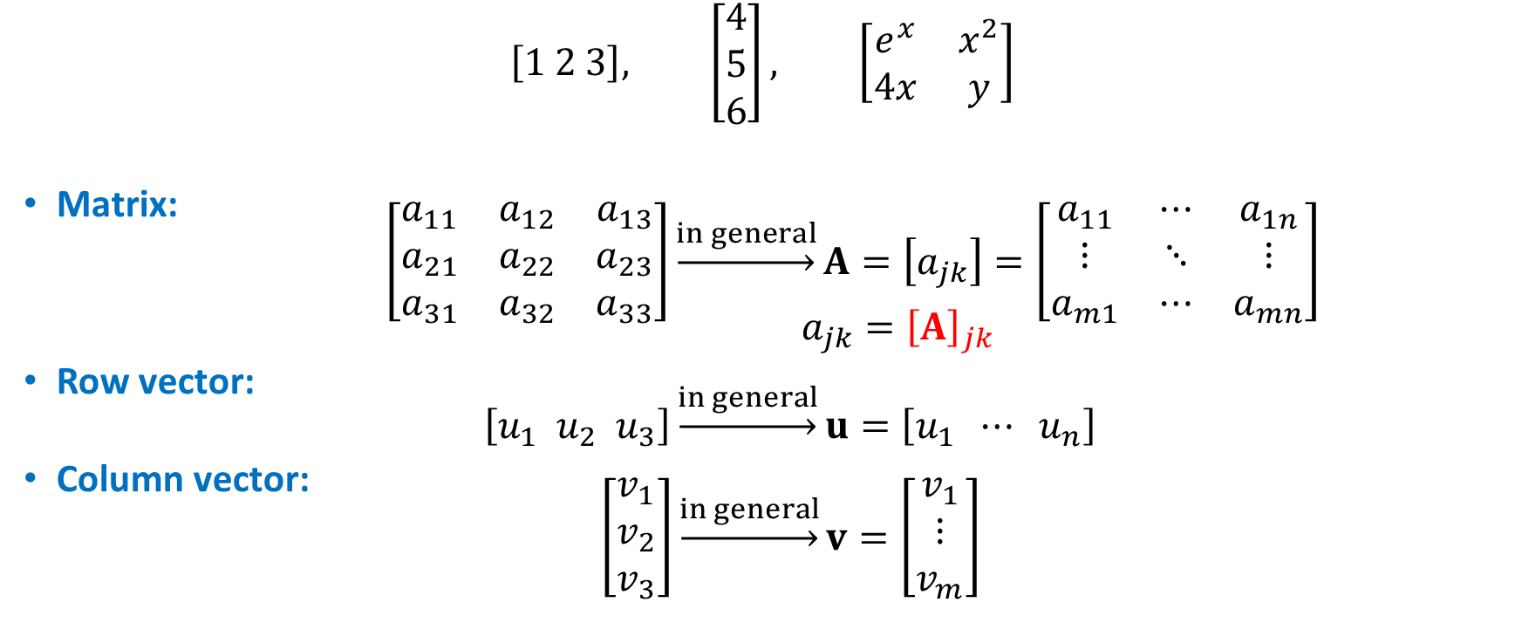
Examples and General notations
$$\left[1 2 3\right], \left[\begin{matrix}4 \\ 5 \\ 6\end{matrix}\right], \left[\begin{matrix}ⅇ^{x} & x^{2} \\ 4x & y\end{matrix}\right]$$
Matrix: $\left[\begin{matrix}a_{11} & a_{12} & a_{13} \\ a_{21} & a_{22} & a_{23} \\ a_{31} & a_{32} & a_{33}\end{matrix}\right]\underset{→}{in general}A=\left[a_{jk}\right]=\left[\begin{matrix}a_{11} & ⋯ & a_{1n} \\ ⋮ & ⋱ & ⋮ \\ a_{m1} & ⋯ & a_{mn}\end{matrix}\right]$ $a_{jk}={\left[A\right]}_{jk}$
Row vector: $\left[u_{1} u_{2} u_{3}\right]\underset{→}{in general}u=\left[u_{1} ⋯ u_{n}\right]$
Column vector: $\left[\begin{matrix}v_{1} \\ v_{2} \\ v_{3}\end{matrix}\right]\underset{→}{in general}v=\left[\begin{matrix}v_{1} \\ ⋮ \\ v_{m}\end{matrix}\right]$
Notes:
Some examples of matrices are shown at the top. They are simply a set of numbers or mathematical expressions organized into roles and columns inside a pair of square brackets. Each number or expression inside the matrix is called an entry.
It is customary to index the entry by its role index first followed by its column index. For instance, ei one two corresponds to the entry at the first role and second column. In general, we use a boldface capital letter to denote a matrix, and the lower case letter to denote its entries. We may also denote the entry of a matrix by the notation shown in red.
In the special case when there is only one role, we call the matrix a role vector. It is usually denoted as a boldface lower case letter.
In the other special case when the number of columns is equal to one, the matrix is called a column vector, also denoted by a boldface lower case letter. Note that, although we did not distinguish between role or column vector in vector calculus, it will be important to do so for linear algebra.

Slide 3
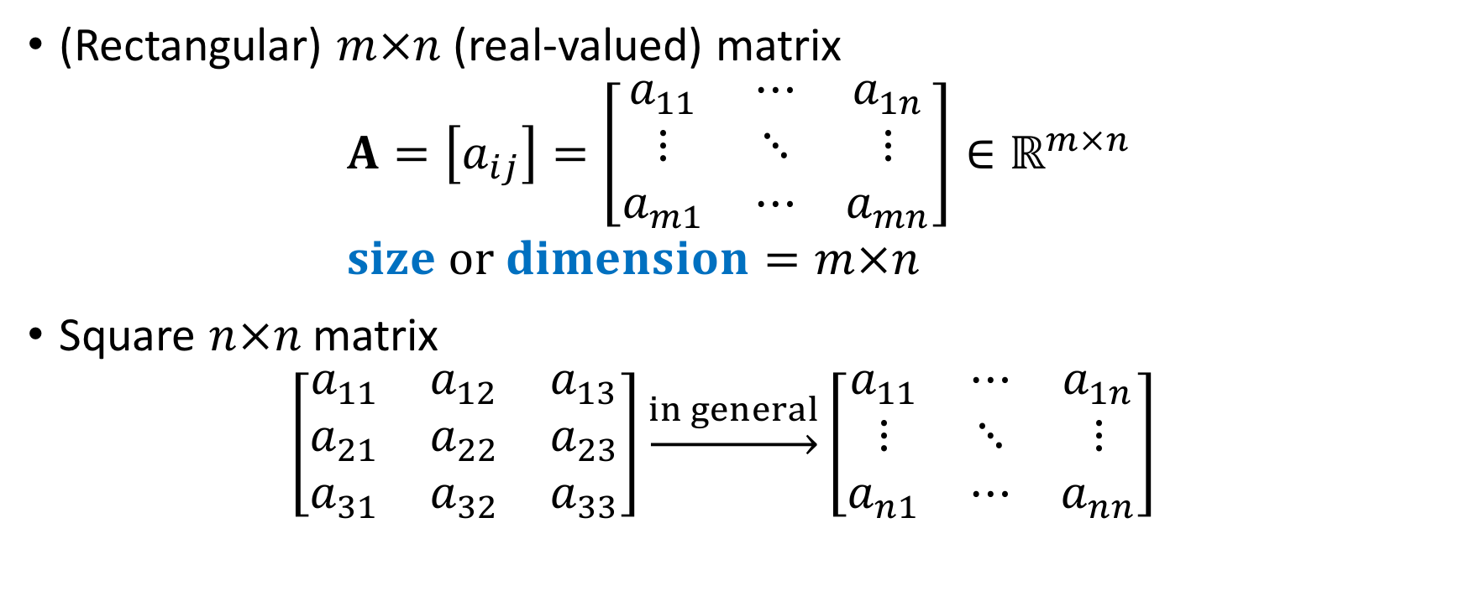
Matrix dimensions
(Rectangular) $m×n$(real-valued) matrix $A=\left[a_{ij}\right]=\left[\begin{matrix}a_{11} & ⋯ & a_{1n} \\ ⋮ & ⋱ & ⋮ \\ a_{m1} & ⋯ & a_{mn}\end{matrix}\right]∈ℝ^{m×n}$ $size or dimension=m×n$
Square $n×n$matrix $\left[\begin{matrix}a_{11} & a_{12} & a_{13} \\ a_{21} & a_{22} & a_{23} \\ a_{31} & a_{32} & a_{33}\end{matrix}\right]\underset{→}{in general}\left[\begin{matrix}a_{11} & ⋯ & a_{1n} \\ ⋮ & ⋱ & ⋮ \\ a_{n1} & ⋯ & a_{nn}\end{matrix}\right]$
minor diagonal elements
$$main diagonal elements:a_{ii},i=1…n$$
Notes:
A matrix with m roles and n columns is called an m by n matrix. We also say that the size or dimension of the matrix is m by n,.
If the number of role is equal to the number of columns, the matrix is said to be a square matrix.
The elements circled in red is called the main diagonal element. If the roles and columns are indexed from one to n, then the main diagonal elements are entries with the same role index as the column index.
All other entries are called the off-diagonal elements. Sometimes, we also refer to the entries circled in blue as the minor diagonal elements. The main diagonal elements may also be defined in the same way for rectangular matrices when the number of roles may not be equal to the number of columns.

Slide 4
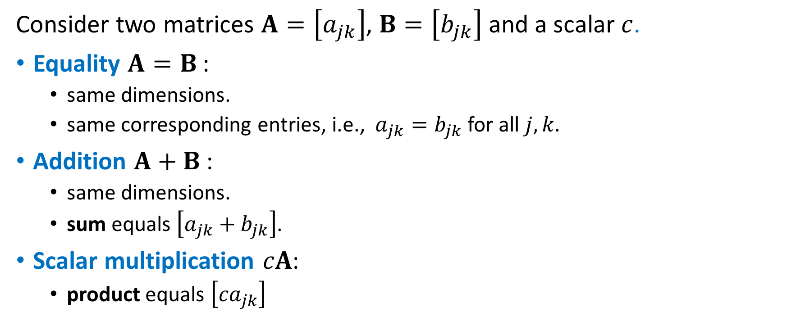

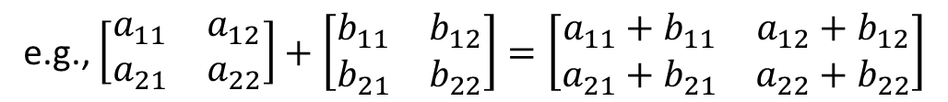
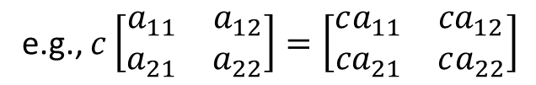
Definitions
Consider two matrices $A=\left[a_{jk}\right]$, $B=\left[b_{jk}\right]$ and a scalar $c$.
Equality $A=B$:
same dimensions.
same corresponding entries, i.e., $a_{jk}=b_{jk}$ for all $j,k$.
Addition $A+B$:
same dimensions.
sum equals $\left[a_{jk}+b_{jk}\right]$.
Scalar multiplication $cA$:
product equals $\left[{ca}_{jk}\right]$
e.g., $\left[v_{1} v_{2} v_{3}\right]≠\left[\begin{matrix}v_{1} \\ v_{2} \\ v_{3}\end{matrix}\right]$
e.g., $\left[\begin{matrix}a_{11} & a_{12} \\ a_{21} & a_{22}\end{matrix}\right]+\left[\begin{matrix}b_{11} & b_{12} \\ b_{21} & b_{22}\end{matrix}\right]=\left[\begin{matrix}a_{11}+b_{11} & a_{12}+b_{12} \\ a_{21}+b_{21} & a_{22}+b_{22}\end{matrix}\right]$
e.g., $c\left[\begin{matrix}a_{11} & a_{12} \\ a_{21} & a_{22}\end{matrix}\right]=\left[\begin{matrix}ca_{11} & {ca}_{12} \\ {ca}_{21} & ca_{22}\end{matrix}\right]$
Notes:
We will first introduce two basic operations for the matrices in this section. Consider two matrices Ei and Bee, with entries ei jay kay and bee jay kay respectively.
We say that the two matrices are equal if and only if the matrices have the same dimensions and corresponding entries. For example, a role vector of more than one entries cannot be equal to a column vector because they do not have the same size. That is to say, we distinguish between role and column vectors.
The addition of two matrices, denoted as Ei plus Bee, is equal to a matrix whose entry is the sum of the corresponding entries of Ei and Bee. For the addition to be well-defined, the matrices we add together must have the same dimension. An example of adding two square matrices together is shown on the right.
Finally, for any scalar c, the scalar mulplication of c to the matrix Ei is equal to the matrix whose entry is the corresponding entries of Ei but multiplied by the scalar c,. An example is also given on the right.

Slide 5
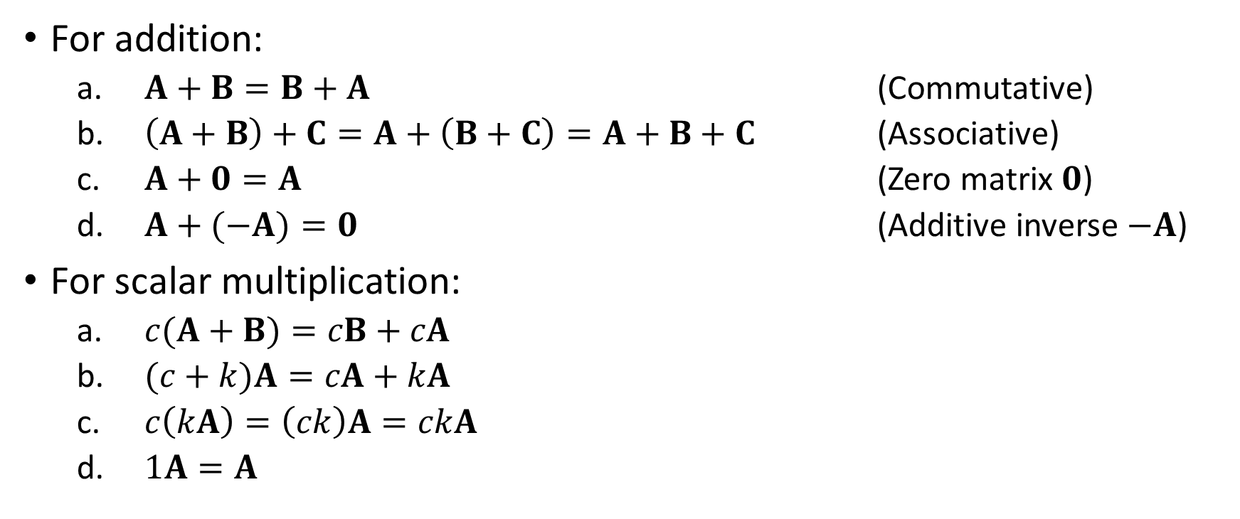
Properties
For addition:
$A+B=B+A$ (Commutative)
$\left(A+B\right)+C=A+\left(B+C\right)=A+B+C$ (Associative)
$A+0=A$ (Zero matrix $0$)
$A+(−A)=0$ (Additive inverse $−A$)
For scalar multiplication:
$c(A+B)=cB+cA$
$(c+k)A=cA+kA$
$c\left(kA\right)=\left(ck\right)A=ckA$
$1A=A$
(3)
(4)
Notes:
Similar to vector addition, matrix addition satisfies some properties such as commutativity and associativity.
The addition is commutative in the sense that Ei plus Bee is equal to Bee plus Ei.
If we add Bee to Ei first, and then add C to the sum, it is the same as adding B and C first, and add the sum to Ei. Therefore, we do not need to use parentheses to indicate the order of the additions.
Similar to the zero vector, we also use the boldface zero to denote a zero matrix. The zero matrix is also called the additive identity, because adding it to any matrix Ei gives the same matrix Ei.
If multiply negative to the matrix Ei, that is, multiply negative one to every entry of Ei, the result matrix is called the additive inverse of Ei. This is because Adding negative Ei to Ei gives the zero matrix, the additive identity.
For scalar multiplication, we also have a set of properties similar to those of the vectors.

