Slide 1

Hà Ngọc Hùng

Slide 2
Contents
Game ideas
Game genres
Game engine and tools
Game scenes
Difficulties
Potential additional features

Slide 3
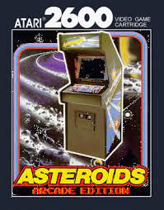

Game ideas

Slide 4
Game genre
Arcade
Space shooter

Slide 5
Game engine and tools
Gameloft Framework
Visual studio
Gimp
Sfxr
SoLoud
Game assets: Kenny.nl, screamingbrainstudios, itch.io

Slide 6
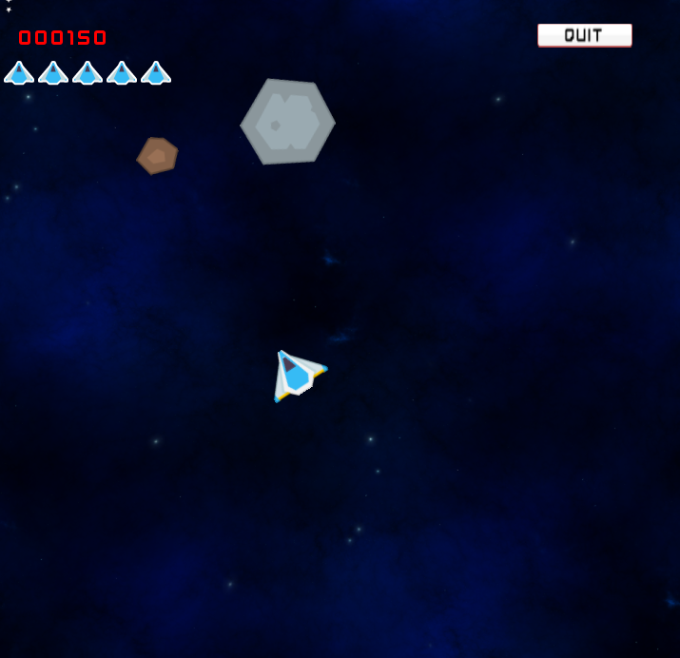
Game scenes
Play demo!

Slide 7
Game scenes
Intro
Menu
Select Ship
Game over
Play

Slide 8
Difficulties
Controlling the ship
Game objects managing
Explosion effect
Using framework and tools

Slide 9
Potential additional features
Power up: Shield, lives…
Credit

Slide 10
Special thanks to
Mr. Nguyễn Hữu Hoàng
Mr. Hoàng Mạnh Hưng
All other leapers
Company’s staffs

