Slide 1
EEE416 Embedded Systems
Project proposal

Slide 2
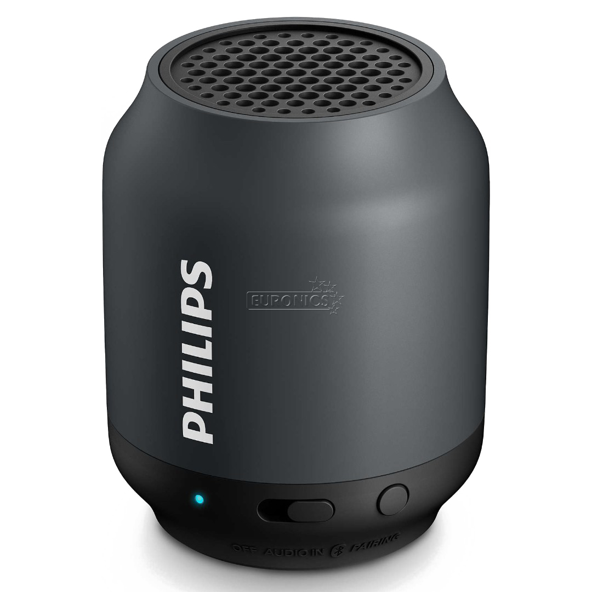

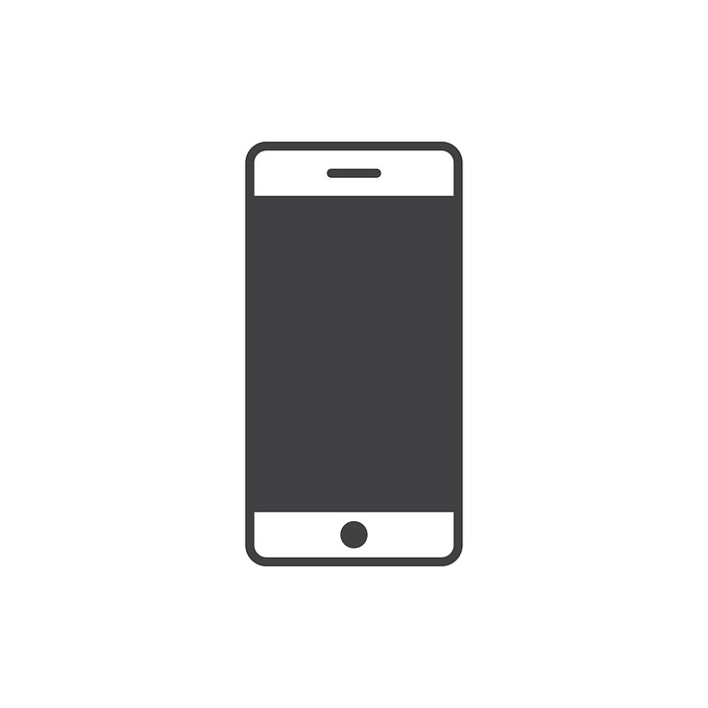
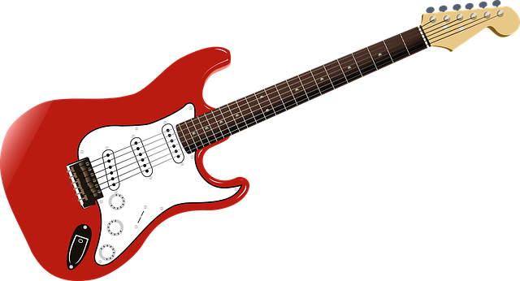
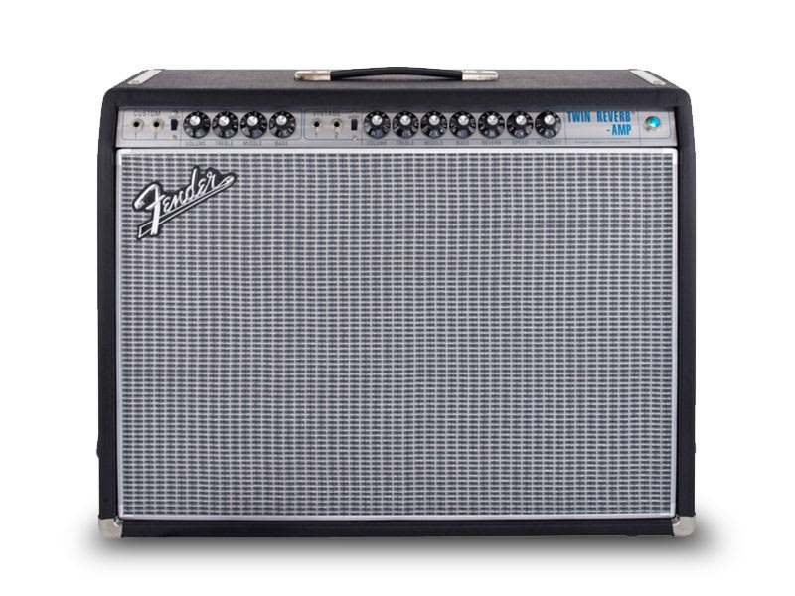
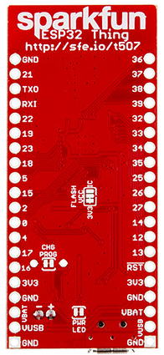

Concept
C)
B)
A)
ESP32
ESP32 & WM8960 (DAC)
This Photo by Unknown Author is licensed under CC BY

Slide 3
Overview
Process ‘A’ – Audio source
Takes audio signal from guitar and sends it over Bluetooth to a phone/PC and to a receiving Bluetooth audio device.
Process ‘B’ – Receiver
Receives the audio signal from the Bluetooth audio source and sends it to an audio jack output.
Process ‘C’ – Phone/PC user interface
Advanced audio functions and user feedback.

Slide 4
Audio source
Guitar pickups generate small voltage signal which is sent along the 3.5 mm audio cable connected to circuit.
Circuit cleans (band pass filter) and amplifies signal to 0-5V range which is output to Arduino Analog input.
Arduino Nano ESP32 reads as 12 bit at 32 kHZ
Arduino Nano ESP32 writes data to A2DP sink – paired with other ESP32 (Audio output).
https://en.wikipedia.org/wiki/List_of_Bluetooth_profiles#Advanced_Audio_Distribution_Profile_(A2DP)
It should be possible to also pair with a mobile phone or PC at the same time and send the data there.

Slide 5
Audio output
Connect to Bluetooth Audio source and use the ESP32 as a Bluetooth audio sink.
Using WM8960 audio codec module set as an I²S peripheral, the ESP32 will receive audio and play it back via I²S.
Once the WM8960 receives the I²S audio, it will be sent to the DAC and then to the output to the amplifier.

Slide 6
Phone/PC user interface
.NET MAUI cross platform app receives audio data.
Stetch objectives
Note detection (Stretch objective)
Using Fast Fourier Transform (FFT) split the time domain signal into frequency bins.
By analysing the most common frequencies we can determine which note has been played and display this on the screen.
Guitar tuning function.
By sampling the audio signal and sending a stream to Shazam API ‘songs/v2/detect’ we can know which song is being played.
Apply ‘Effects’ on sound – e.g. echo.

Slide 7
Other boards
https://www.adafruit.com/product/3006
https://www.sparkfun.com/products/15663
https://thepihut.com/products/arduino-nano-esp32-with-headers

