Slide 1
Computer Corrected Color Blindness
Jimmy Hickey

Slide 2
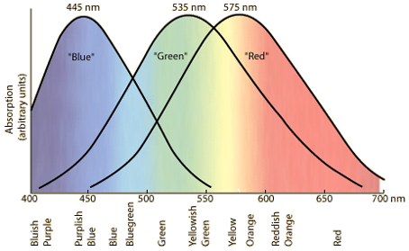
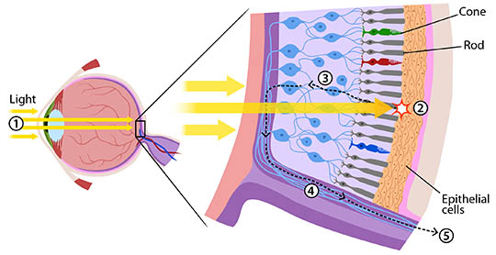
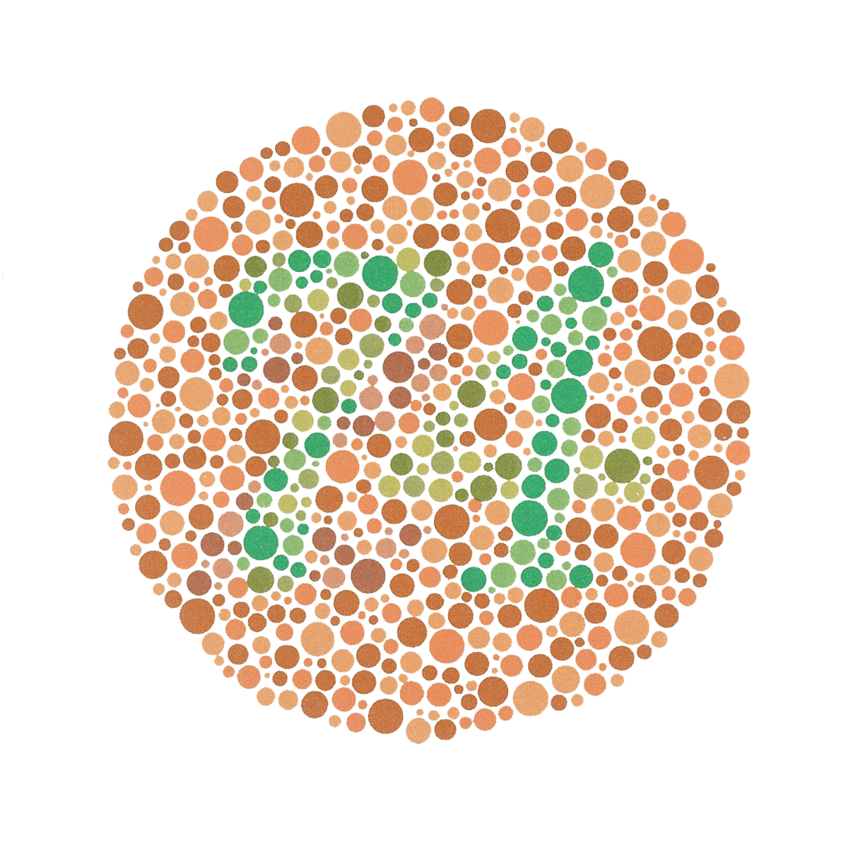
Color Blindness
We can still see colors!
https://askabiologist.asu.edu/rods-and-cones
http://hyperphysics.phy-astr.gsu.edu/hbase/vision/colcon.html
https://en.wikipedia.org/wiki/Ishihara_test

Slide 3
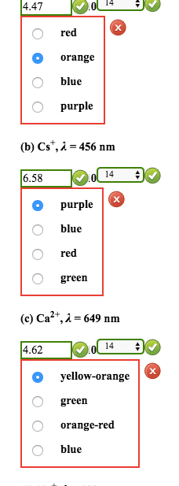
Goals
Identify colorblind problem areas
Correct these issues without ruining the image
Apply the system to any image

Slide 4




Data Creation
Data created rather than using Ishihara test
Drawn using Adobe Photoshop
Images with many color combinations

Slide 5
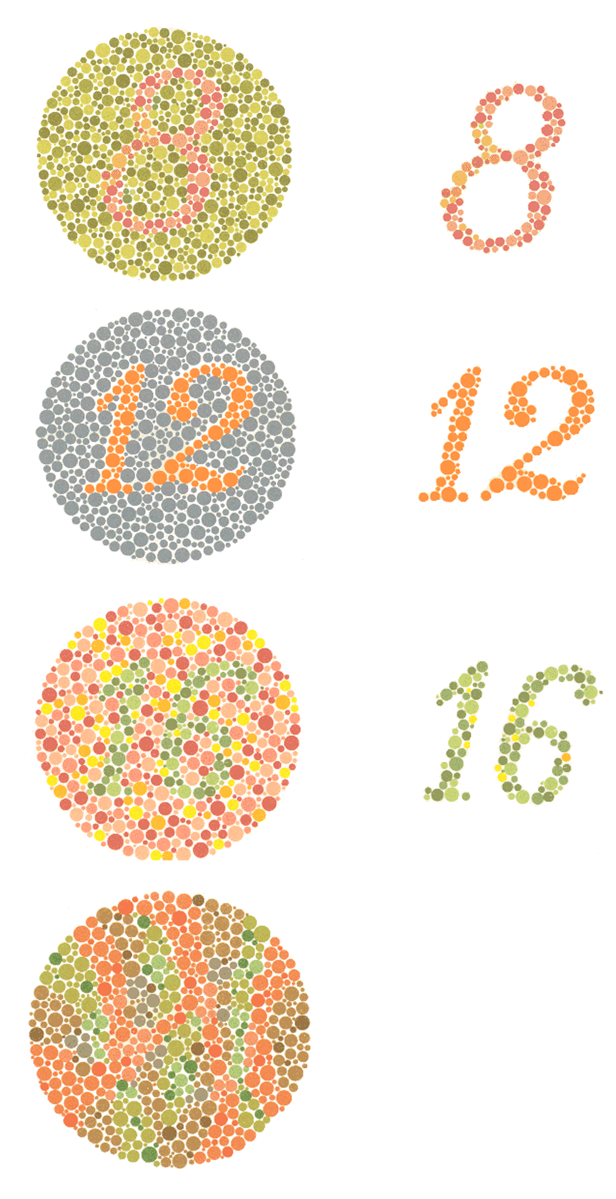
Color Detection
Unsupervised learning pattern recognition
Examine RGB value of each pixel in an image
Learn which combination of values are problematic
https://chrismarkland.wordpress.com/2012/02/28/map-specific/

Slide 6
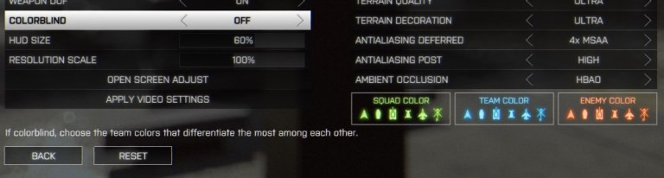
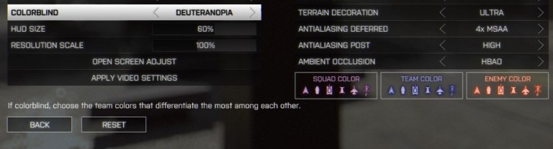
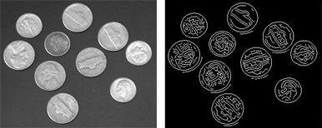
Color Correction
Edge detection
Color reassignment
http://www.gamersexperience.com/colorblind-accessibility-in-video-games-is-the-industry-heading-in-the-right-direction/
https://www.mathworks.com/discovery/edge-detection.html

Slide 7
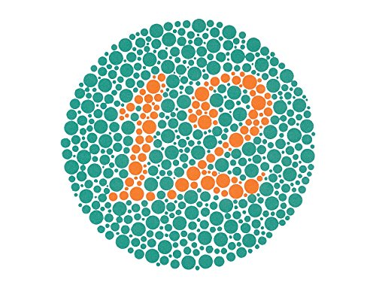
Flaws and Improvements
Non-representative data
No expert opinions
No user feedback
https://www.amazon.com/KANEHARA-Ishihara-Chart-Deficiency-Plates/dp/B00MAVIR3Y

Slide 8
Typeface
https://opendyslexic.org/

