Slide 1
DIJKSTRA’S ALGORITHM
and it’s use in Google Maps

Slide 2
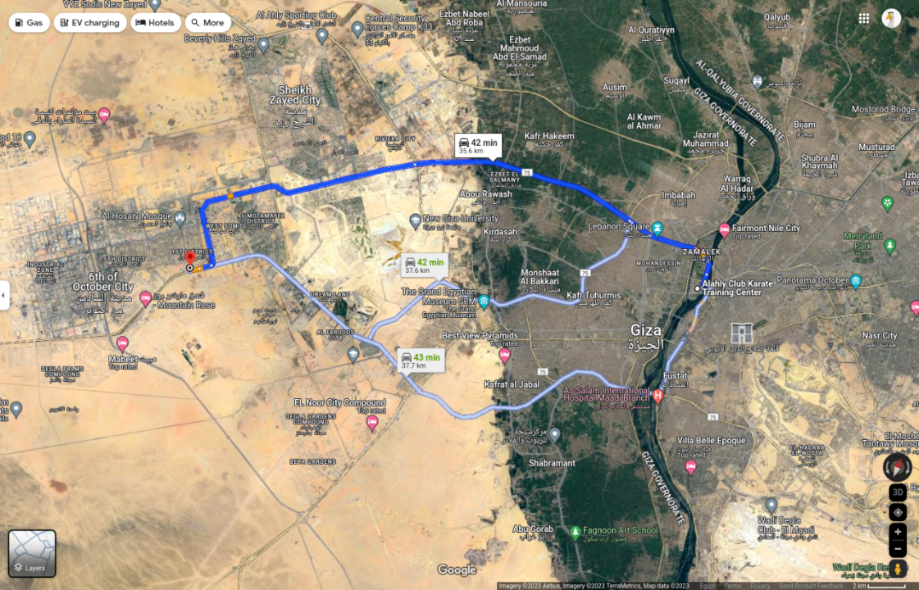
DIJKSTRA’S ALGORITHM
and it’s use in Google Maps
35.6KM
37.6KM
37.7KM

Slide 3
DIJKSTRA’S ALGORITHM
and it’s use in Google Maps
B
J
A
E
S
G
C
I
F
H
D

Slide 4
DIJKSTRA’S ALGORITHM
and it’s use in Google Maps
Path
City
From: String
Name: String
B
J
A
To: String
Smallest Cost: int
E
S
G
C
I
Cost
Neighbours: [Path]
F
H
D

Slide 5
DIJKSTRA’S ALGORITHM
and it’s use in Google Maps
Path
City
From: String
Name: String
B
J
A
To: String
Smallest Cost: int
E
S
G
C
I
Cost
Neighbours: [Path]
F
H
D

