Slide 1
DIJKSTRA’S ALGORITHM
and The Last Mile Problem

Slide 2
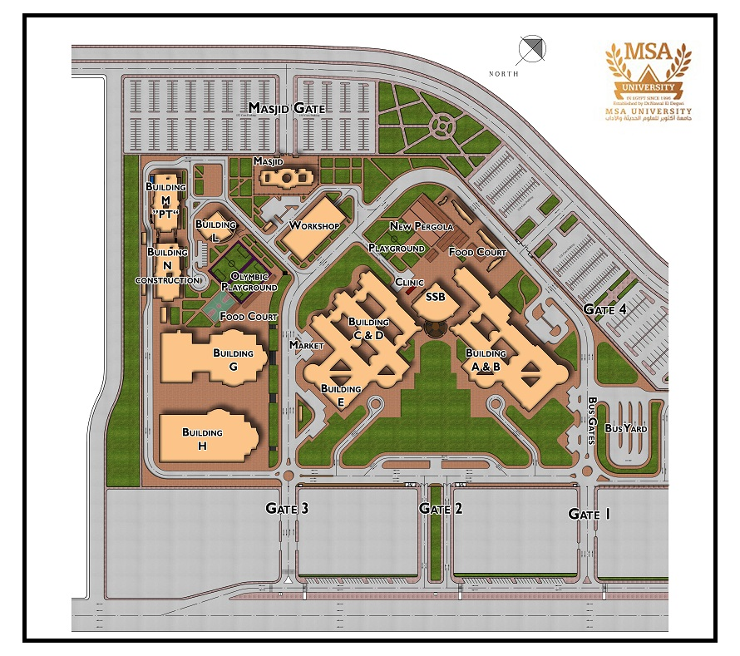
DIJKSTRA’S ALGORITHM
and The Last Mile Problem

Slide 3
DIJKSTRA’S ALGORITHM
and The Last Mile Problem
M
w
w
w
W
L
w
L
L
L
L
F
F
F
N
N
N
N
N
D
D
D
D
G
G
G
G
G
A
A
H
H
S
S

Slide 4
DIJKSTRA’S ALGORITHM
and The Last Mile Problem
M
w
w
w
W
L
w
L
L
L
L
F
F
F
N
N
N
N
N
D
D
D
D
G
G
G
G
G
A
A
H
H
S
S

Slide 5
DIJKSTRA’S ALGORITHM
and The Last Mile Problem
Path
Building
M
From: String
Name: String
w
w
w
W
L
w
L
L
L
L
F
F
F
To: String
Smallest Cost: int
N
N
N
N
N
D
Cost
Neighbours: [Path]
D
D
D
G
G
G
G
G
A
A
H
H
S
S

Slide 6
DIJKSTRA’S ALGORITHM
and The Last Mile Problem
Algorithm Steps:
Update the costs of neighbours
Move to the Building with smallest cost

Slide 7
DIJKSTRA’S ALGORITHM
and The Last Mile Problem
∞
∞
Algorithm Steps:
∞
M
∞
L
W
Update the costs of neighbours
Move to the building with smallest cost
F
∞
N
∞
D
∞
G
A
A
∞
H
H
∞
S
S
0

Slide 8
DIJKSTRA’S ALGORITHM
and The Last Mile Problem
∞
∞
Algorithm Steps:
∞
M
∞
L
W
Update the costs of neighbours
Move to the building with smallest cost
F
∞
N
4
D
G
A
3
A
∞
H
H
4
S
S
0
D
-
3
H
-
4
A
-
4

Slide 9
DIJKSTRA’S ALGORITHM
and The Last Mile Problem
∞
∞
Algorithm Steps:
∞
M
∞
L
W
Update the costs of neighbours
Move to the building with smallest cost
F
∞
N
4
D
G
A
3
A
∞
H
H
4
S
S
0
H
-
4
A
-
4

Slide 10
DIJKSTRA’S ALGORITHM
and The Last Mile Problem
∞
7
Algorithm Steps:
∞
M
∞
L
W
Update the costs of neighbours
Move to the building with smallest cost
F
∞
N
4
D
G
A
3
A
6
H
H
4
S
S
0
H
-
4
A
-
4
G
-
6
W
-
7

Slide 11
DIJKSTRA’S ALGORITHM
and The Last Mile Problem
∞
7
Algorithm Steps:
∞
M
∞
L
W
Update the costs of neighbours
Move to the building with smallest cost
F
∞
N
4
D
G
A
3
A
6
H
H
4
S
S
0
A
-
4
G
-
6
W
-
7

Slide 12
DIJKSTRA’S ALGORITHM
and The Last Mile Problem
∞
7
Algorithm Steps:
∞
M
∞
L
W
Update the costs of neighbours
Move to the building with smallest cost
F
∞
N
4
D
G
A
3
A
5
H
H
4
S
S
0
A
-
4
G
-
5
W
-
7

Slide 13
DIJKSTRA’S ALGORITHM
and The Last Mile Problem
∞
7
Algorithm Steps:
∞
M
∞
L
W
Update the costs of neighbours
Move to the building with smallest cost
F
∞
N
4
D
G
A
3
A
5
H
H
4
S
S
0
G
-
5
W
-
7

Slide 14
DIJKSTRA’S ALGORITHM
and The Last Mile Problem
∞
7
Algorithm Steps:
∞
M
6
L
W
Update the costs of neighbours
Move to the building with smallest cost
F
∞
N
4
D
G
A
3
A
5
H
H
4
S
S
0
G
-
5
F
-
6
W
-
7

Slide 15
DIJKSTRA’S ALGORITHM
and The Last Mile Problem
∞
7
Algorithm Steps:
∞
M
6
L
W
Update the costs of neighbours
Move to the building with smallest cost
F
∞
N
4
D
G
A
3
A
5
H
H
4
S
S
0
F
-
6
W
-
7

Slide 16
DIJKSTRA’S ALGORITHM
and The Last Mile Problem
10
7
Algorithm Steps:
∞
M
6
L
W
Update the costs of neighbours
Move to the building with smallest cost
F
9
N
4
D
G
A
3
A
5
H
H
4
S
S
0
F
-
6
W
-
7
N
-
9
L
-
10

Slide 17
DIJKSTRA’S ALGORITHM
and The Last Mile Problem
10
7
Algorithm Steps:
∞
M
6
L
W
Update the costs of neighbours
Move to the building with smallest cost
F
9
N
4
D
G
A
3
A
5
H
H
4
S
S
0
W
-
7
N
-
9
L
-
10

Slide 18
DIJKSTRA’S ALGORITHM
and it’s use in Google Maps
10
7
Algorithm Steps:
∞
M
6
L
W
Update the costs of neighbours
Move to the building with smallest cost
F
9
N
4
D
G
A
3
A
5
H
H
4
S
S
0
N
-
9
L
-
10

Slide 19
DIJKSTRA’S ALGORITHM
and The Last Mile Problem
8
7
Algorithm Steps:
∞
M
6
L
W
Update the costs of neighbours
Move to the building with smallest cost
F
9
N
4
D
G
A
3
A
5
H
H
4
S
S
0
L
-
8
N
-
9

Slide 20
DIJKSTRA’S ALGORITHM
and The Last Mile Problem
8
7
Algorithm Steps:
∞
M
6
L
W
Update the costs of neighbours
Move to the building with smallest cost
F
9
N
4
D
G
A
3
A
5
H
H
4
S
S
0
N
-
9

Slide 21
DIJKSTRA’S ALGORITHM
and The Last Mile Problem
8
7
Algorithm Steps:
9
M
6
L
W
Update the costs of neighbours
Move to the building with smallest cost
F
9
N
4
D
G
A
3
A
5
H
H
4
S
S
0
N
-
9
M
-
9

Slide 22
DIJKSTRA’S ALGORITHM
and The Last Mile Problem
8
7
Algorithm Steps:
9
M
6
L
W
Update the costs of neighbours
Move to the building with smallest cost
F
9
N
4
D
G
A
3
A
5
H
H
4
S
S
0

Slide 23
DIJKSTRA’S ALGORITHM
and The Last Mile Problem
Path
Building
Path
City
9
8
M
6
Name: String
From: String
Name: String
L
W
From: String
F
To: String
4
To: String
Smallest Cost: int
9
N
Smallest Cost: int
D
G
A
3
A
Cost
Neighbours: [Path]
5
Cost
Neighbours: [Path]
H
H
4
S
S
0

Slide 24
DIJKSTRA’S ALGORITHM
and The Last Mile Problem
Path
Building
9
8
M
6
L
W
From: String
Name: String
F
9
N
4
To: String
Smallest Cost: int
D
G
A
3
A
5
Cost
Neighbours: [Path]
H
H
4
Previous Building: Building
S
S
0

Slide 25
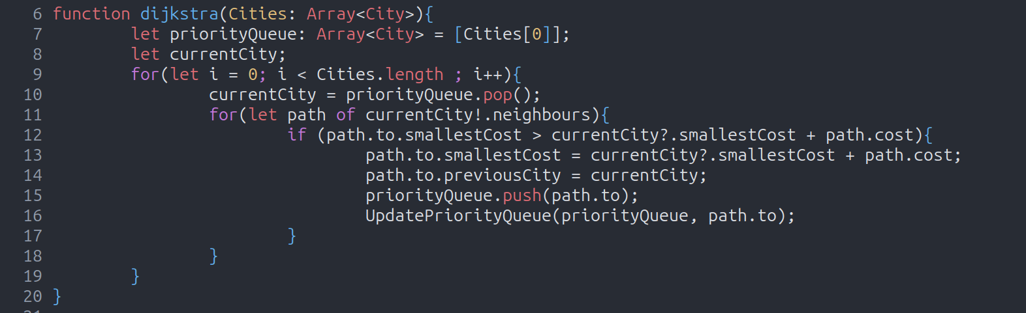
DIJKSTRA’S ALGORITHM
and The Last Mile Problem

Slide 26
DIJKSTRA’S ALGORITHM
and The Last Mile Problem
V
E

Slide 27

DIJKSTRA’S ALGORITHM
and The Last Mile Problem
$$\sum_{i=1}^{V}{\sum_{j = 1}^{E}{log(V)}}$$

Slide 28
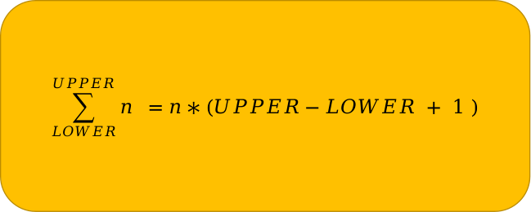

DIJKSTRA’S ALGORITHM
and The Last Mile Problem
$$\sum_{LOWER}^{UPPER}{n} =n∗(UPPER−LOWER + 1 )$$
$$\sum_{i=1}^{V}{\sum_{j = 1}^{E}{log(V)}}$$
$$\sum_{i=1}^{V}{(E)Log(V)}$$

Slide 29
DIJKSTRA’S ALGORITHM
and The Last Mile Problem
$$\sum_{LOWER}^{UPPER}{n} =n∗(UPPER−LOWER + 1 )$$
$$\sum_{i=1}^{V}{\sum_{j = 1}^{E}{log(V)}}$$
$$\sum_{i=1}^{V}{(E)Log(V)}$$
$$V(E)Log(V)$$
$$∈θ(VELog(V)$$

