Slide 1
DIJKSTRA’S ALGORITHM
and it’s use in Google Maps

Slide 2
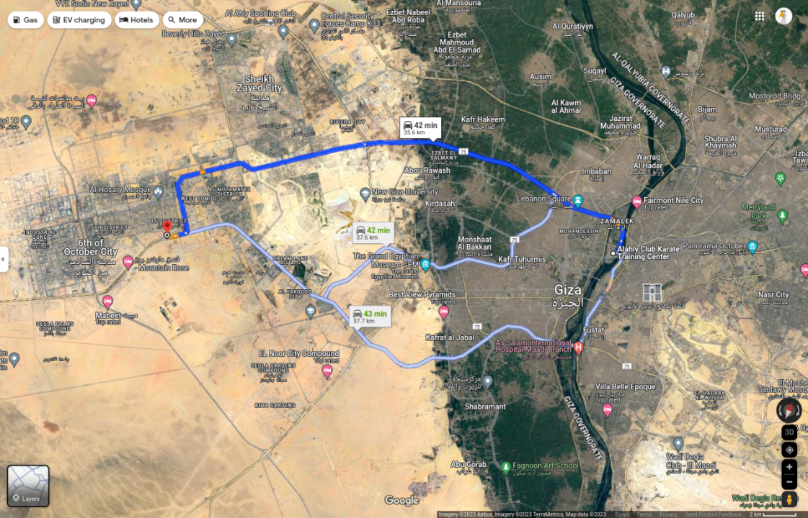
DIJKSTRA’S ALGORITHM
and it’s use in Google Maps
35.6KM
37.6KM
37.7KM

Slide 3
DIJKSTRA’S ALGORITHM
and it’s use in Google Maps
B
J
A
E
S
G
C
I
F
H
D

Slide 4
DIJKSTRA’S ALGORITHM
and it’s use in Google Maps
Path
City
From: String
Name: String
B
J
A
To: String
Smallest Cost: int
E
S
G
C
I
Cost
Neighbours: [Path]
F
H
D

Slide 5
DIJKSTRA’S ALGORITHM
and it’s use in Google Maps
Path
City
From: String
Name: String
B
J
A
To: String
Smallest Cost: int
E
S
G
C
I
Cost
Neighbours: [Path]
F
H
D

Slide 6
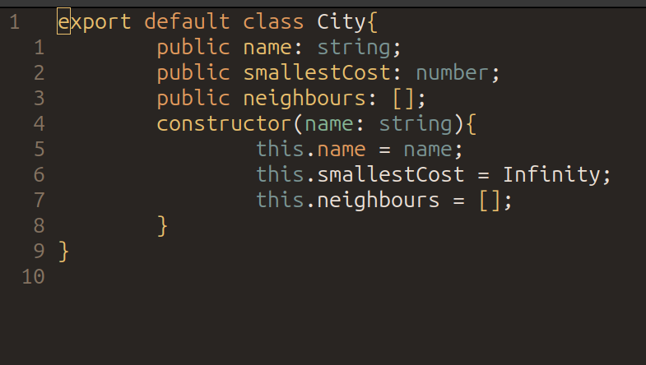
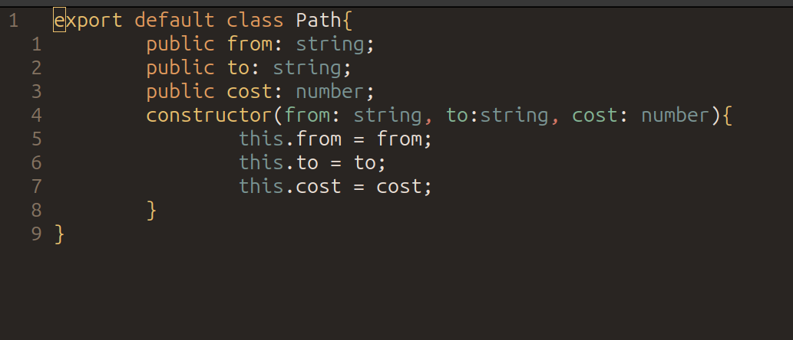
DIJKSTRA’S ALGORITHM
and it’s use in Google Maps
B
J
A
E
S
G
C
I
F
H
D

Slide 7
DIJKSTRA’S ALGORITHM
and it’s use in Google Maps
Algorithm Steps:
Update the costs of neighbours
9Move to the city with smallest cost

Slide 8
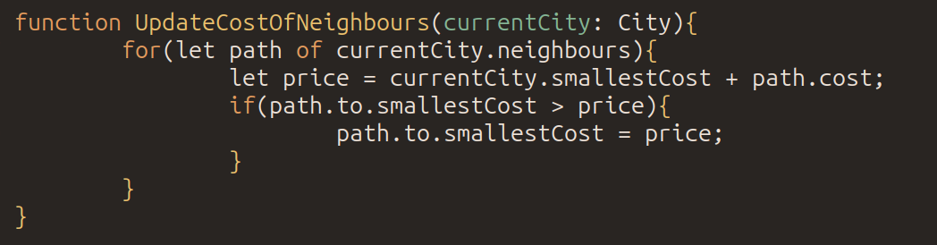
DIJKSTRA’S ALGORITHM
and it’s use in Google Maps
Algorithm Steps:
B
1
Update the costs of neighbours
Move to the city with smallest cost
J
0
A
E
S
G
C
I
3
F
H
D

Slide 9
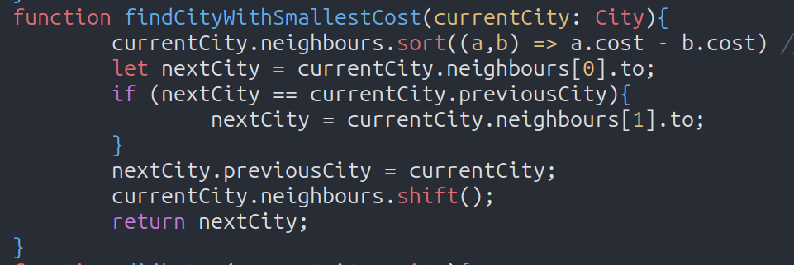
DIJKSTRA’S ALGORITHM
and it’s use in Google Maps
Algorithm Steps:
B
1
Update the costs of neighbours
Move to the city with smallest cost
J
0
A
E
S
G
C
I
3
F
H
D

Slide 10
DIJKSTRA’S ALGORITHM
and it’s use in Google Maps
Algorithm Steps:
2
B
1
Update the costs of neighbours
Move to the city with smallest cost
J
0
A
3
S
E
G
C
I
3
F
H
D

Slide 11
DIJKSTRA’S ALGORITHM
and it’s use in Google Maps
Algorithm Steps:
2
B
1
Update the costs of neighbours
Move to the city with smallest cost
J
0
A
3
S
E
G
C
I
3
F
H
D

Slide 12
DIJKSTRA’S ALGORITHM
and it’s use in Google Maps
Algorithm Steps:
2
5
B
1
Update the costs of neighbours
Move to the city with smallest cost
J
0
A
3
S
E
G
C
I
3
F
H
D

Slide 13
DIJKSTRA’S ALGORITHM
and it’s use in Google Maps
Algorithm Steps:
2
5
B
1
Update the costs of neighbours
Move to the city with smallest cost
J
0
A
3
S
E
G
C
I
3
F
H
D

Slide 14
DIJKSTRA’S ALGORITHM
and it’s use in Google Maps
Algorithm Steps:
2
5
B
1
Update the costs of neighbours
Move to the city with smallest cost
J
0
7
A
3
S
E
G
C
I
3
F
H
D

Slide 15
DIJKSTRA’S ALGORITHM
and it’s use in Google Maps
Algorithm Steps:
2
5
B
1
Update the costs of neighbours
Move to the city with smallest cost
J
0
7
A
3
S
E
G
C
I
3
F
H
D

Slide 16
DIJKSTRA’S ALGORITHM
and it’s use in Google Maps
Path
City
From: String
Name: String
B
J
A
To: String
Smallest Cost: int
E
S
G
C
I
Cost
Neighbours: [Path]
F
H
D

Slide 17
DIJKSTRA’S ALGORITHM
and it’s use in Google Maps
Path
City
From: String
Name: String
B
J
A
To: String
Smallest Cost: int
E
S
G
C
I
Cost
Neighbours: [Path]
F
H
D
Previous City: City

