Slide 1
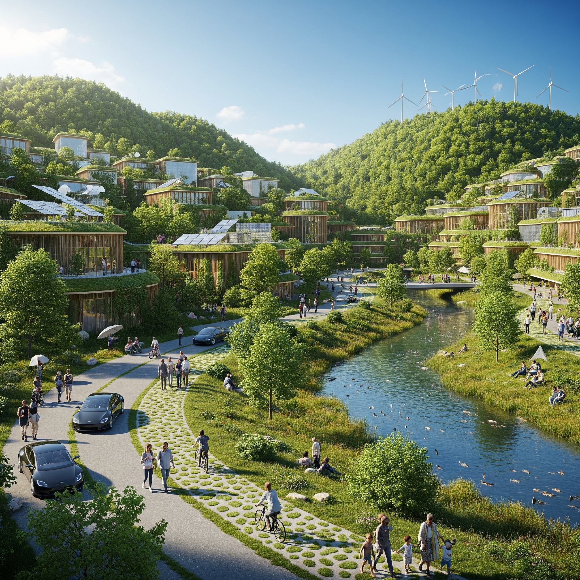
Parking Garage Management System
Course: CS 401-02 Fall 2025
Group 4:
Tuan Do
Matthew Gomez Smith
Christopher Ovando Morales
Kegang Peng
Diego Ruiz Paredes

Slide 2

Project Introduction
How it works:
Hi everyone. Our project is a Parking Garage Management System. We built it so it works like a real garage, it read’s license plate and open the gate for drivers to enter the garage. when they ready to leave, the exit will have a gui for them to pay tickets. once the ticket is paid. it will store in the server txt file.
To make that possible, we run one server that can do multithreading that allows multiple clients to connect the server system.That lets drivers, operators, and the owner all use their own GUIs at the same time without blocking each other.
Each of us will walk through our part of the system and show how it all fits together.

Slide 3
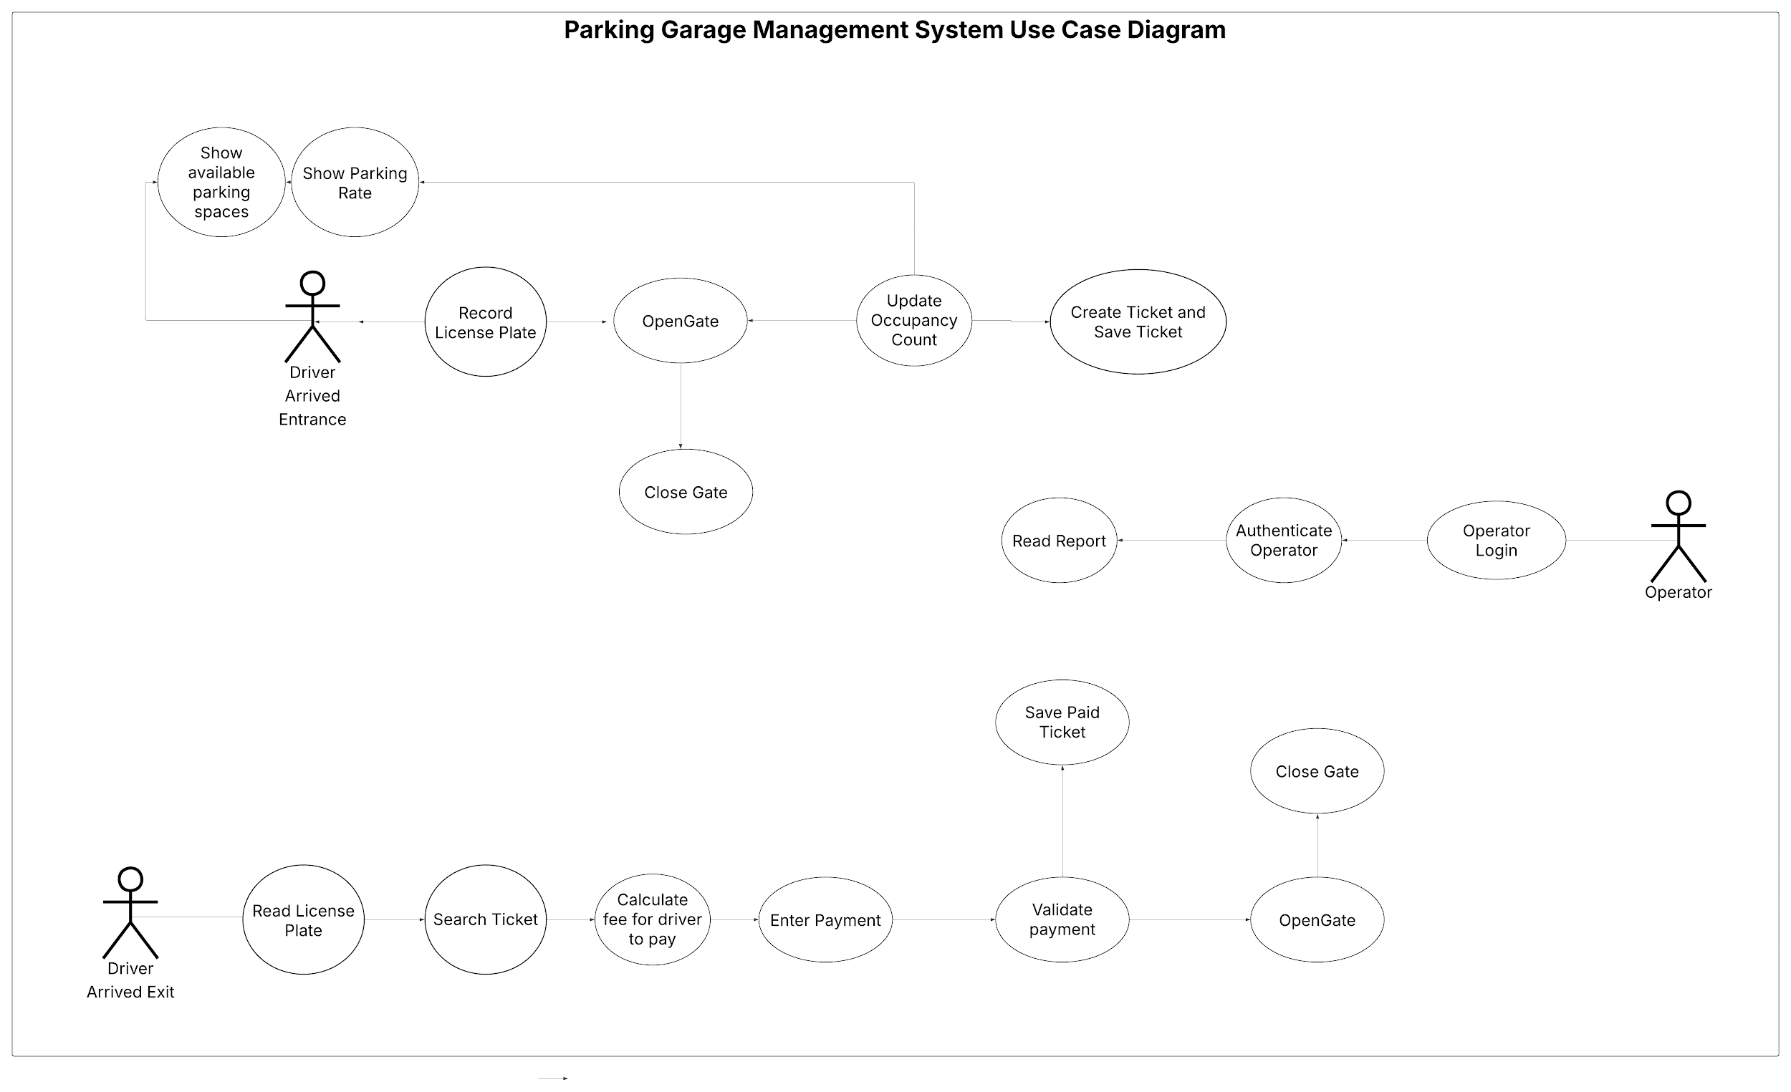

Slide 4
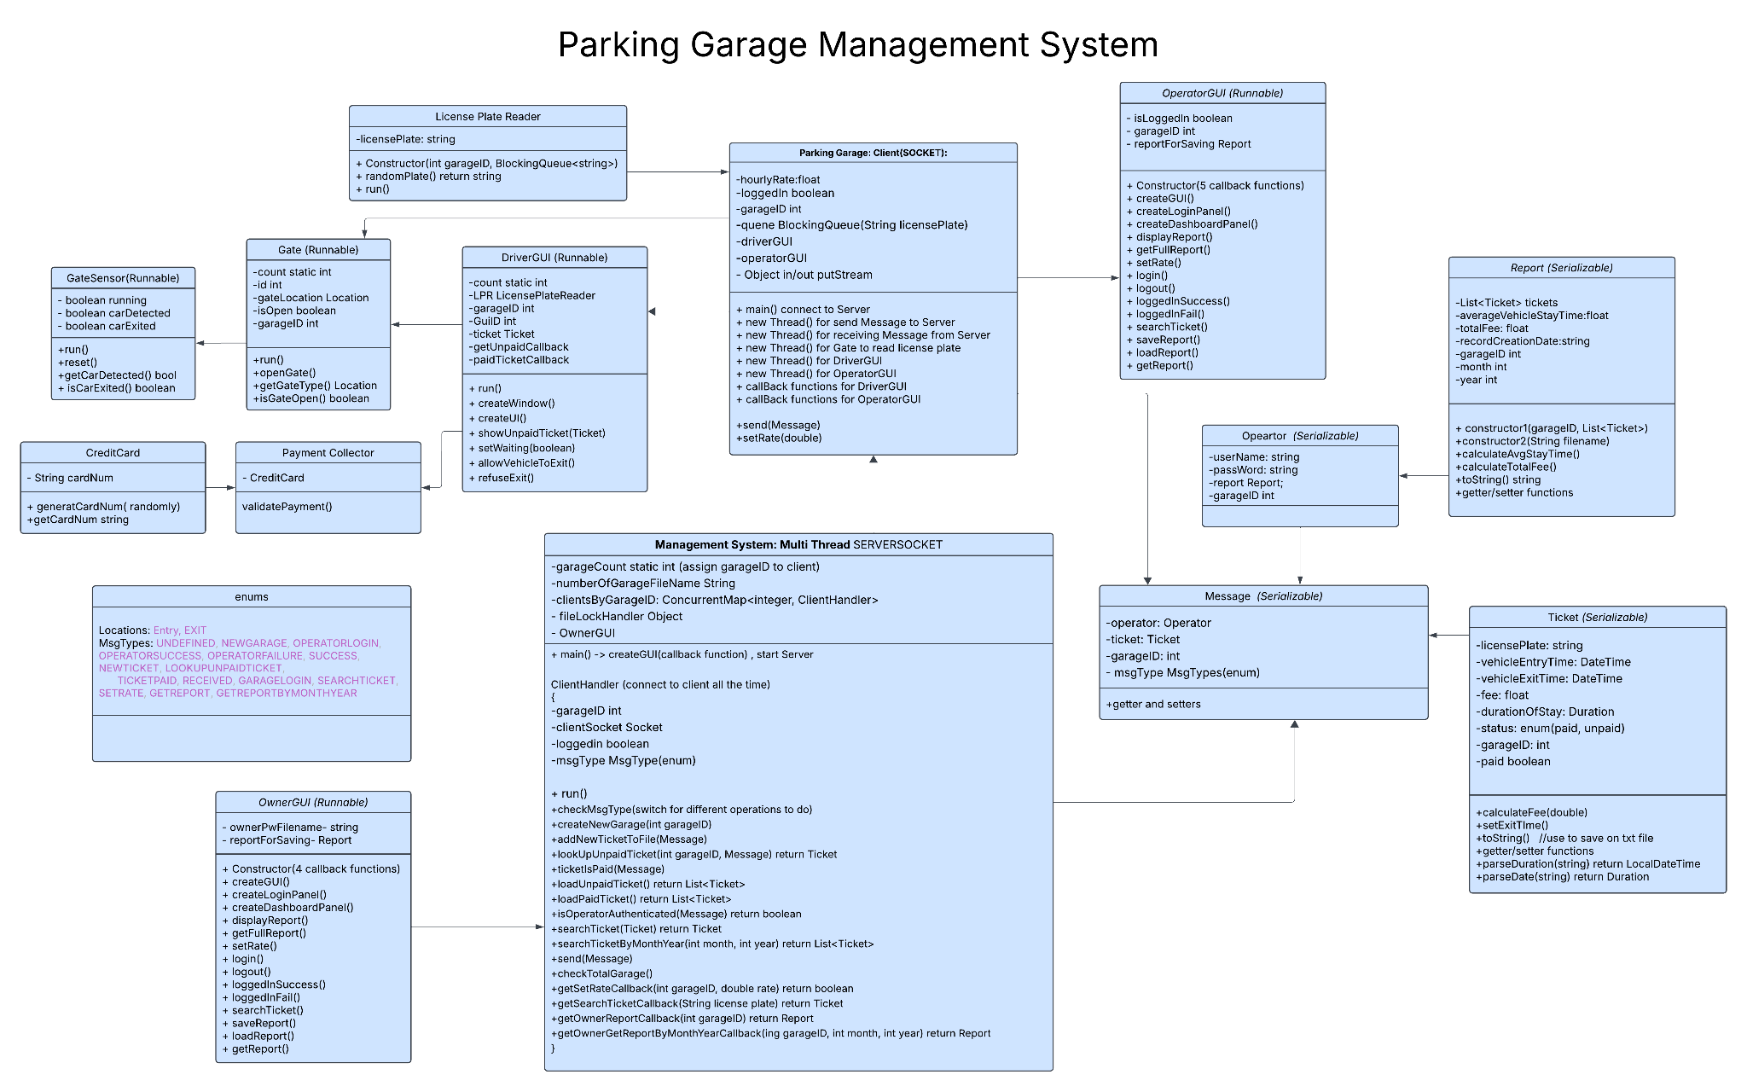
Notes:
This is the overview of the UML class diagram

Slide 5
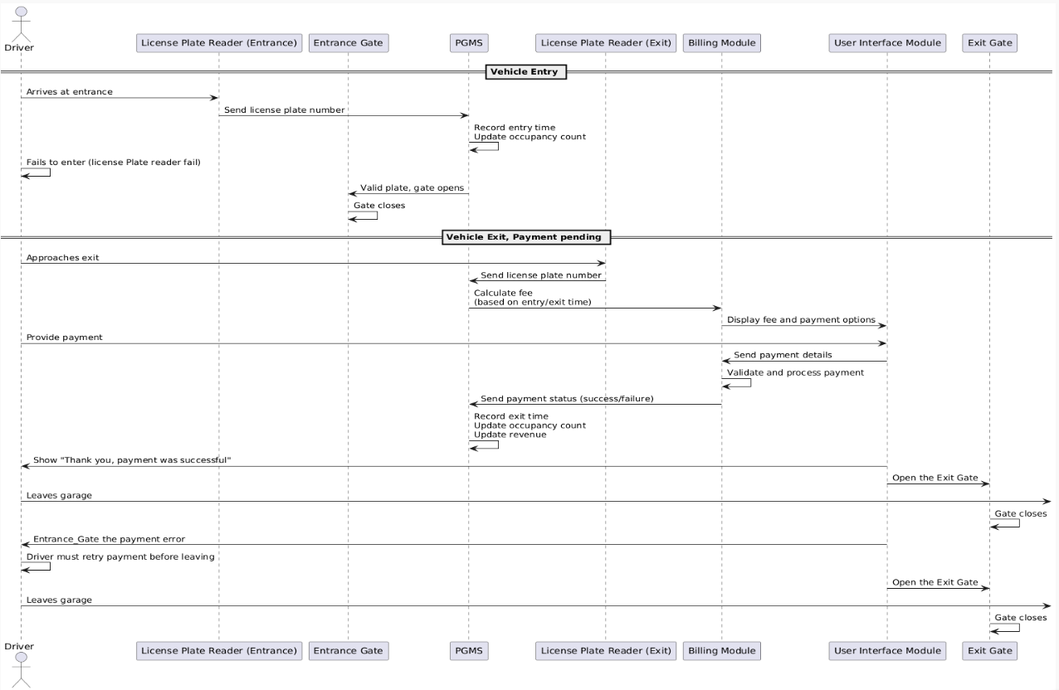

Slide 6

In conclusion
So to wrap everything up, our Parking Garage Management System ties all parts of the garage operation into one coordinated system. We have real-time ticket creation, automated fee calculation based on duration, and a full reporting system for the owner.
Building this project taught us how to work with multi-threaded client-server communication, shared files, GUI design, and teamwork across multiple components.
Overall, the system runs smoothly and covers everything you’d expect from a real parking garage workflow. Thank you for time.

