Slide 1
How to Customize This Template
Choose an appropriate title slide and delete the others
Edit presentation title, author names, and affiliation(s)
Choose „Insert / Header and Footer...“ and edit the footer to display your name
Delete this slide and start working on your presentation

Slide 2
Light Background Slides
The standard color scheme is light background with dark text – it should be used by default

Slide 3
Dark Background Slides
An alternate color scheme for dark background slides is provided – use it only if it’s unavoidable
Option 1: Select “Design…” and “Colors”
By right-clicking on “Dark background” you can apply it to the current slide, then right-click the rightmost “Background Style”
Option 2: just select the rightmost Background Style (some colors might not adapt correctly)

Slide 4
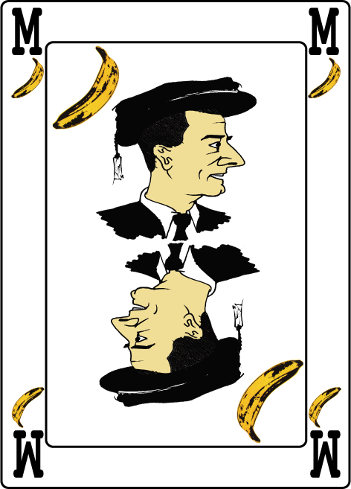
Motivation
The quick brown fox jumps over the lazy master
The quick brown fox jumps over the lazy dog
The quick brown master jumps over the lazy dog

Slide 5
Outline
The quick brown fox jumps over the lazy dog
The quick brown fox jumps over the lazy master
The quick brown fox jumps over the lazy dog
The quick brown fox jumps over the lazy dog
The quick brown fox jumps over the lazy master
The quick brown fox jumps over the lazy dog

Slide 6
Conclusions
The quick brown fox jumps over the lazy dog
The quick brown master jumps over the lazy dog
The quick brown fox jumps over the lazy dog
The quick brown master jumps over the lazy dog
The quick brown fox jumps over the lazy dog

Slide 7
Procedural modelling of complex systems
Bernhard Rainer¹ and Silvester Farda¹
¹TU Wien, Austria

