Slide 1
Analyzing the Purchasing Power of Currency
Jimmy Liang December 2, 2015
General Assembly Data Science

Slide 2
Background
Currency Analysis:
US Dollars, Euro, British Pound, Canadian Dollar, Swiss Franc
The goal is to track the purchasing power of different currencies to determine whether a given currency is gaining or losing value.
Currency data is obtained from 5 years and 6 months worth of value based on gold (XAU)
Notes:
I decided to go with 6 months worth of data due to XAU as an element based to correlate with currencies.
Obtain data from Oanda.com
Idea: Possible leverage the purchase power of the currency to our advantage which would be good for our travel plan or such.

Slide 3
4 Ways to Forecast Currency Changes
Purchasing Power Parity (PPP)
Relative Economic Strength Approach
Econometric Models
USD/EUR(1-year) = z + a(INT) + b(GDP) + c(IGR)
z, a, b, c: coefficient on how much a certain factor affects the exchange rate and direction of the effect (positive or negative)
INT: interest rate differential between US and EUR
GDP: GDP growth rates
IGR: Income growth rate
Time Series Model
Notes:
PPP: a theory in which countries determine the exchange rates between currencies to ensure equivalences so that the purchasing power amounts to the same value in each country
Relative Economic Strength Approach: explore the strength of economic growth in different countries in order to forecast the direction of exchange rates
Econometric Models: Equation created by economic experts
The Time Series Model is selected to evaluate complex and significant data over time.

Slide 4
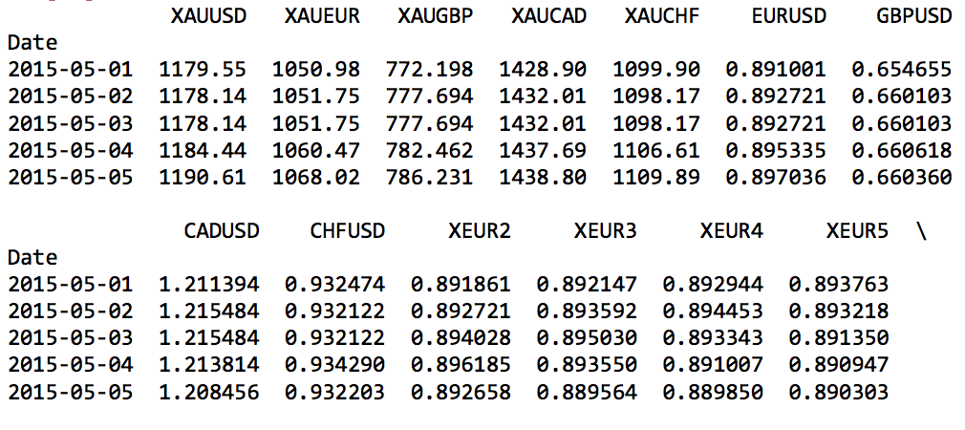
XAU_Data.head( )
Notes:
Show high-level overview of data, currency rate, moving average calculations
Remark: Fill in nulls for XEUR data when shifting the data to line up with EURUSD
EUR/USD is selected as the main focus and will be explained in later slides.
XEUR2 and XEUR3 provided the most close correlations for a few of the models worked on.

Slide 5
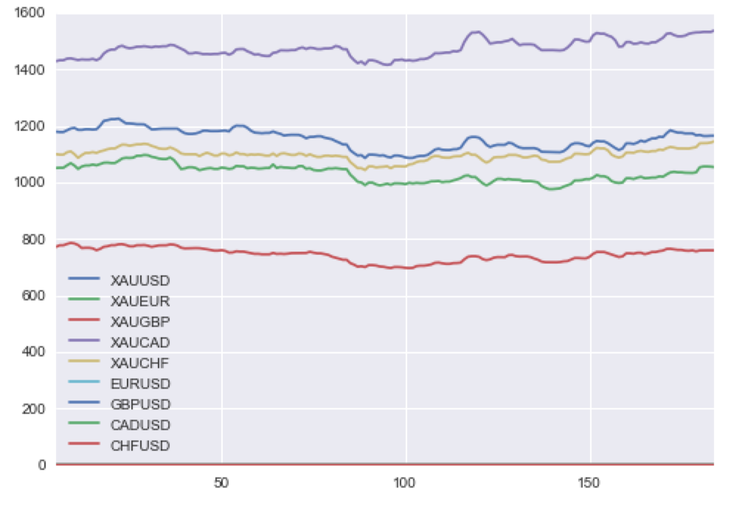
XAU Plot
Notes:
Y-Axis: Price/Currency Rate
X-Axis: Date

Slide 6
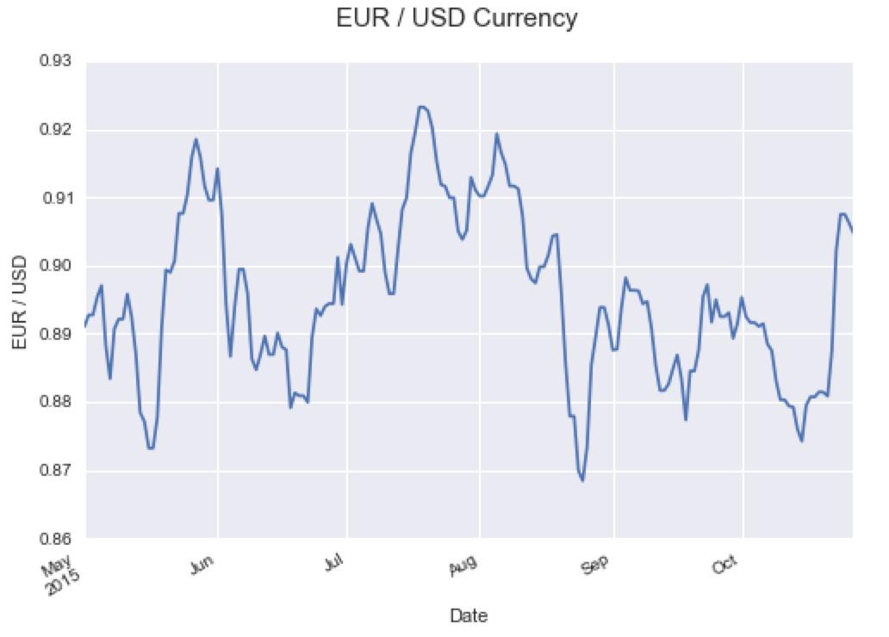
Notes:
Possible Key Events which may result in currency fluctuations:
Federal Open Market Committee , Shocker Events, Interest Rate announcement
Two events were derived from May and August to show significant upward gains and downward losses in purchasing power.

Slide 7
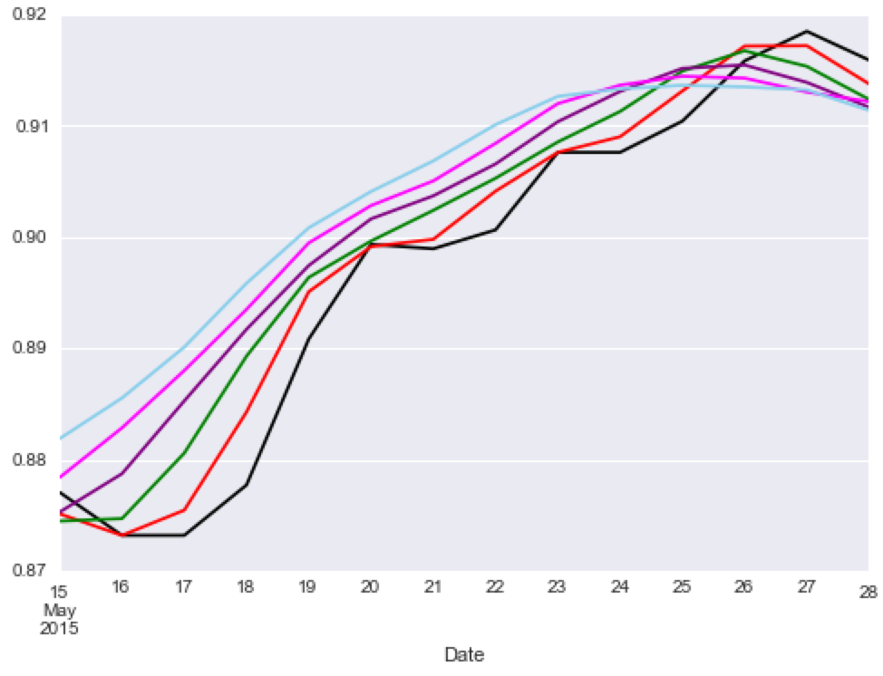
EUR/USD May 2015
Notes:
Month of May 2015: Mixed US Economic Data and Greek Debt Crisis, US GDP for 1st Quarter fell -0.7%
Black line represents original data set while colored lines represent the moving averages for 2 – 6 days range.

Slide 8
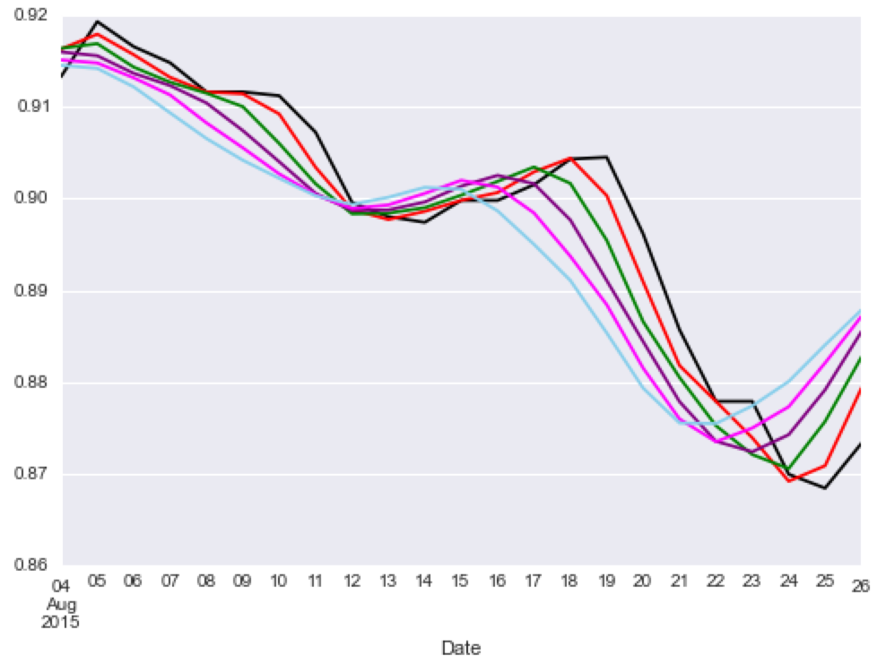
EUR/USD August 2015
Notes:
Month of August 2015: European Central Bank Chief Mario Draght’s Euro stimulus and expected Greece Debt Crisis: 3rd Bailout repayment by Aug 20, 2015.

Slide 9
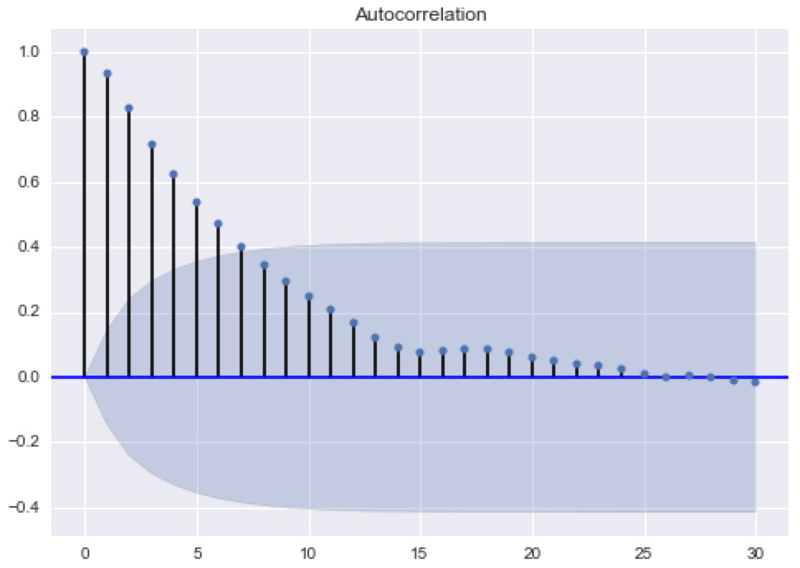
Autocorrelation
Notes:
This plot better demonstrates an understanding about the correlation between days and random signals with regard to analyzed data.
** The smaller the plot is, the weaker the correlation signal will be.
Cross Validation
Linear Regression
Random Decision Forest

Slide 10
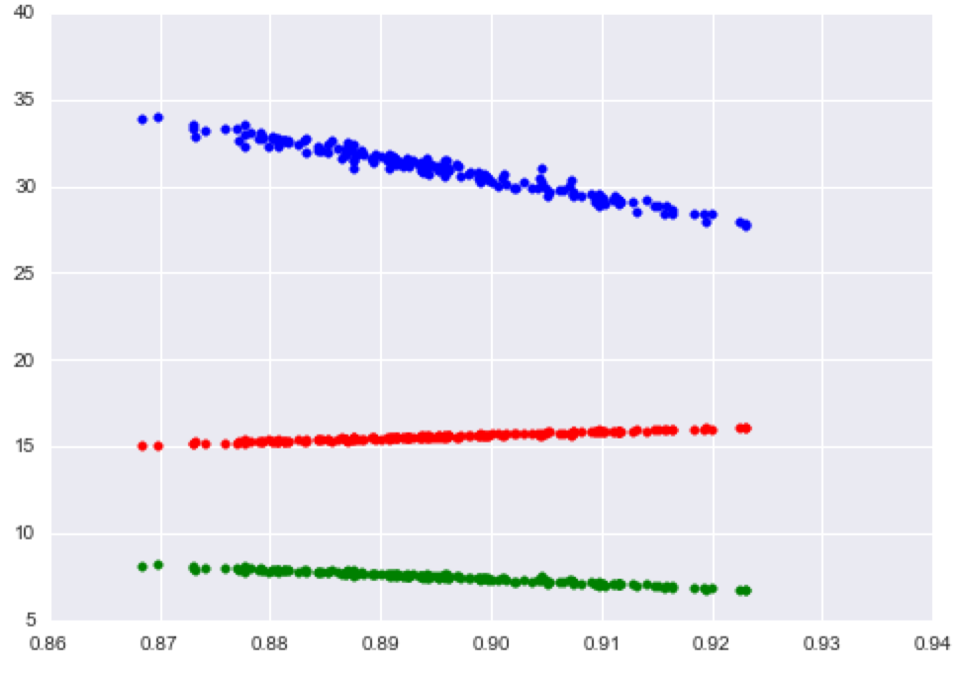
Linear Regression Comparison
Notes:
Red: Linear Regression by day
Blue: Linear Regression by week
Green: Linear Regression by month
X-Axis shows rate of EUR and USD
Y-Axis shows linear regression prediction

Slide 11
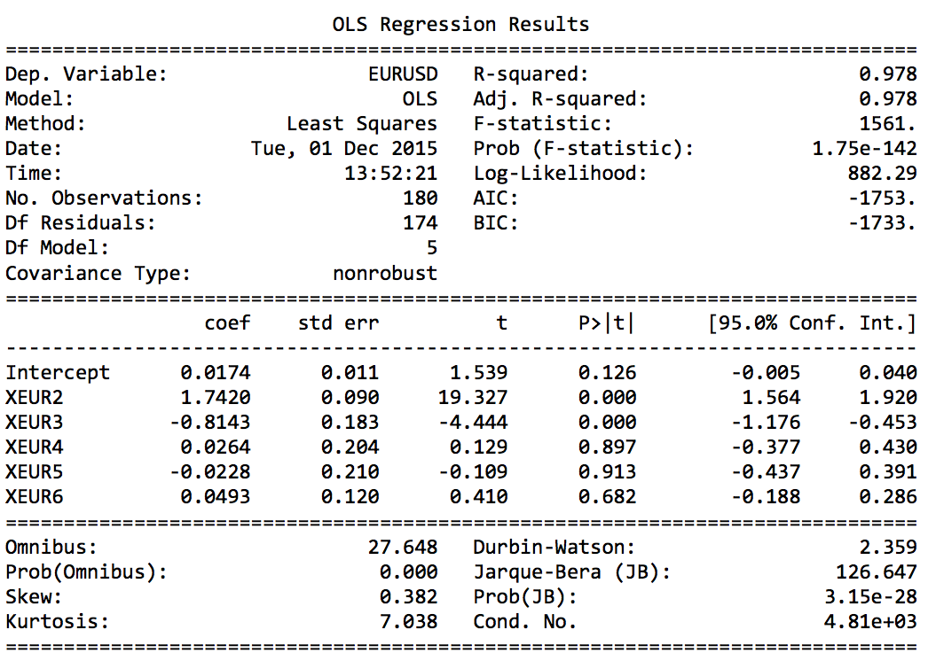
Notes:
Notice the R-Squared was high and resulted in better variability between EUR/USD and Moving Averages data.

Slide 12
Summary
Linear and Logistic Regression
Random Decision Tree: Max Depth = 6
Explorated Moving Average Approaches
Notes:
Conclusion:
Due to better Root Mean Squared Error (RMSE), the Linear Regression would give better insight with analyzing the purchasing power of currency.
Forecasting the exchange rate is a challenging task as the currencies are sensitive to unexpected external events and can become difficult to measure.

Slide 13
What’s next?
Suggestions
Seek various predictive application models
Smoothing with Exponentially Weighted Moving Average (EWMA)
Time Series and Holt-Winters Forecasting
Holt-Winters Second Order EWMA
Autoregressive Integrated Moving Average (ARIMA)
Questions
Notes:
Recent suggestions shared from the EIC include checking out the aforementioned application models as there are many possible uses for this particular project.
If you are interested to check it out, please visit this project at my GitHub!

