Slide 1
Currency Purchase Power
Jimmy Liang December 2, 2015
General Assembly Data Science

Slide 2
Background
Currency:
US Dollars, Euro, British Pound, Canadian Dollar, Swiss Franc
Track the purchase power of currencies to determine whether a given currency is gaining or losing value.
Obtained currency data of 5 years and 6 months with Gold based (XAU)
Notes:
I decided to go with 6 months worth of data due to XAU as an element based to correlate with currencies.
Idea: Possible leverage the purchase power of the currency to our advantage which would be good for our travel plan or such.

Slide 3
4 Ways to Forecast Currency Changes
Purchasing Power Parity (PPP)
Relative Economic Strength Approach
Econometric Models
USD/EUR(1-year) = z + a(INT) + b(GDP) + c(IGR)
z, a, b, c: coefficient on how much a certain factor affects the exchange rate and direction of the effect (positive or negative)
INT: interest rate differential between US and EUR
GDP: GDP growth rates
IGR: Income growth rate
Time Series Model
Notes:
Selected Time Series Model based on lectures I learn as the other need significant data and complex inputs to evaluate.

Slide 4
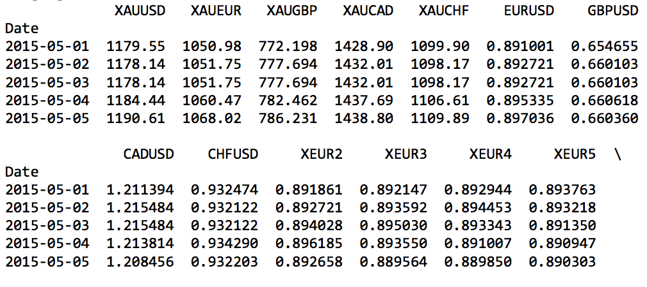
XAU_Data.head( )
Notes:
Show high-level overview of data, currency rate, moving average calculations
Remark: Fill in nulls for XEUR data when I shift the data to line up with EURUSD
I select EUR/USD to focus on as I plan to explain in later slides.
XEUR2 and XEUR3 give me the most close correlations for some models I work on.

Slide 5
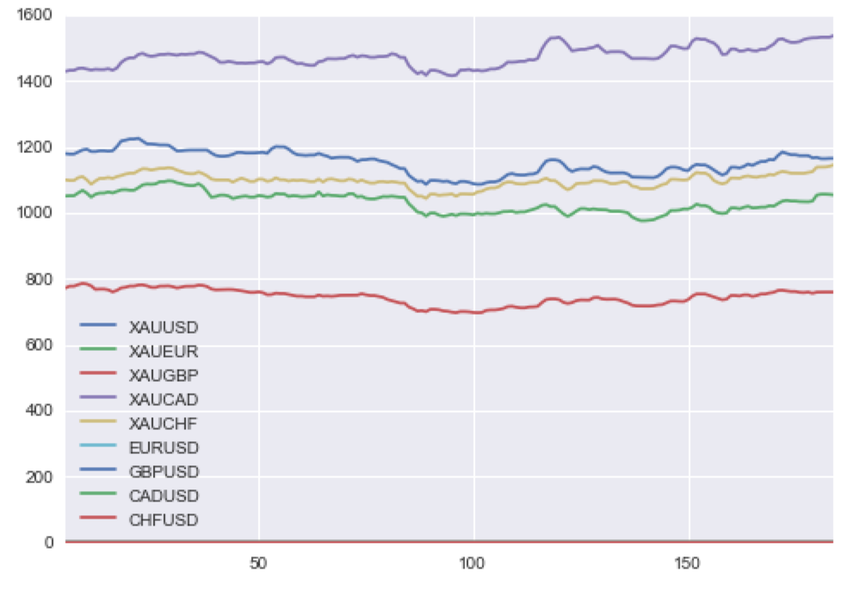
XAU Plot
Notes:
Y-Axis: Price/Currency Rate
X-Axis: Date

Slide 6
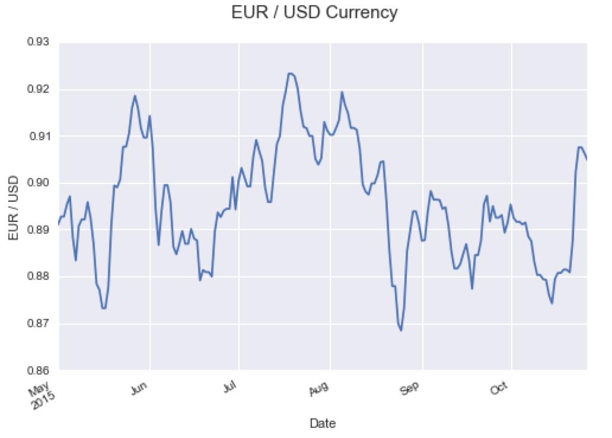
Notes:
Possible Key Events which may result currency fluctuations:
Federal Open Market Committee , Shocker Events, Interest Rate announcement
Two events I snippet from May and August that show big upward gain and downward losing currency purchase power.

Slide 7
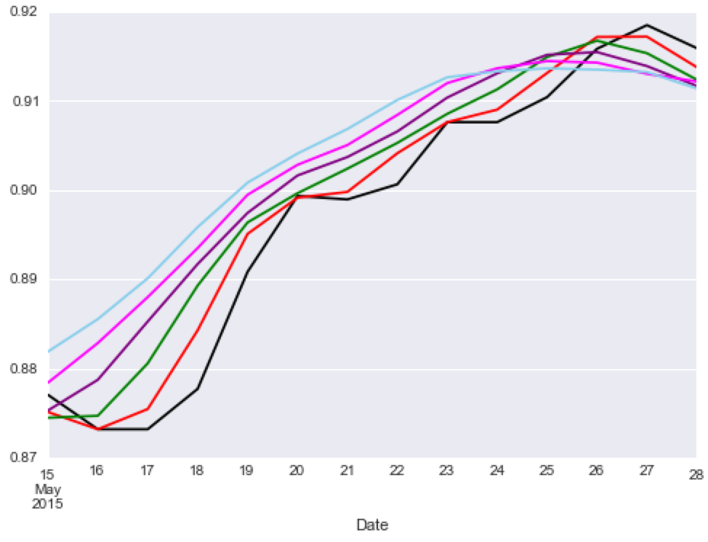
Notes:
Month of May, 2015: Mixed US Economic Data and Greek Debt Crisis, US GDP for 1st Quarter was revised downward to -0.7%
Black line represents original data set while color lines represents moving average for 2 – 6 days range.

Slide 8
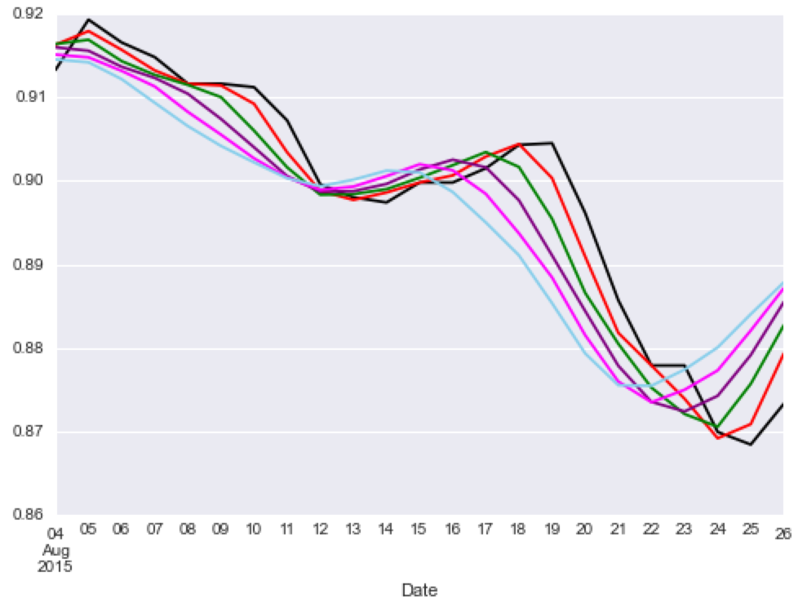
Notes:
Month of August, 2015: European Central Bank Chief Mario Draght’s Euro stimulus and expected Greece Debt Crisis: 3rd Bailout repayment by Aug 20, 2015.

Slide 9
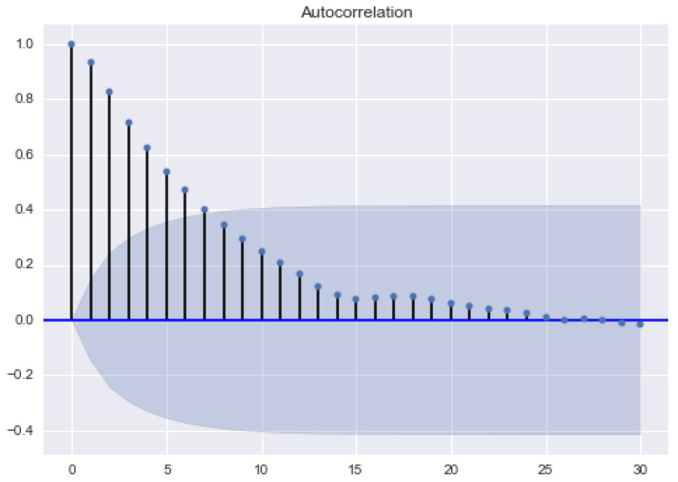
Notes:
This plot shows me better understanding about the correlation between days and random signal in regard of data.
** The further the plot heads, the less correlation signal it would be.
Cross Validation
Linear Regression
Random Decision Forest

Slide 10
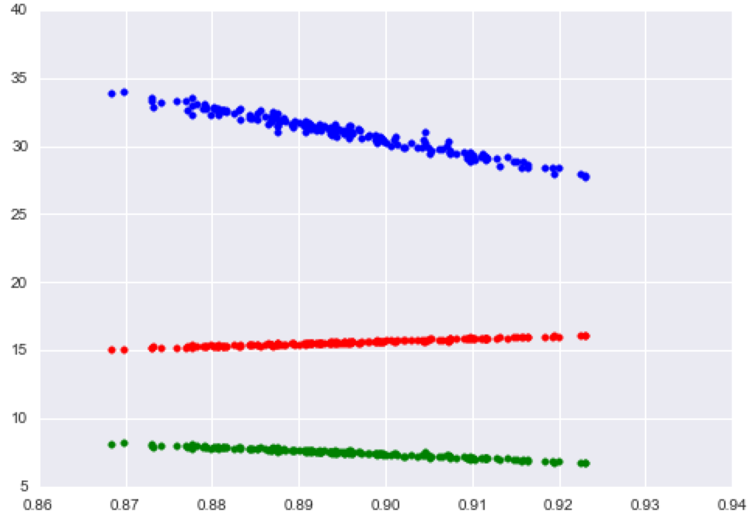
Linear Regressions
Notes:
Red: Linear Regression by day
Blue: Linear Regression by week
Green: Linear Regression by month
X-Axis shows rate of EUR and USD
Y-Axis shows linear regression prediction

Slide 11
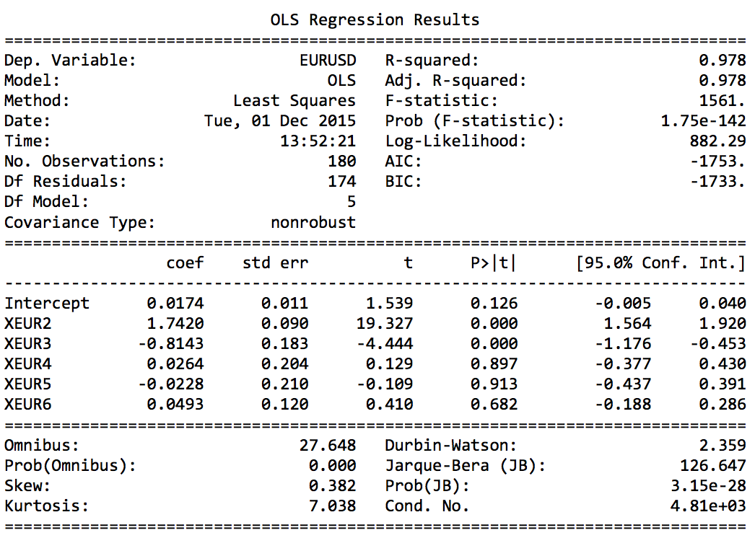
Notes:
Noticed R-Squared was high which resulted better variability between EURUSD and Moving Averages data.

Slide 12
Summary
Linear and Logistic Regression
Random Decision Tree: Max Depth = 6
Explorated Moving Average approaches
Notes:
Conclusion:
Due to better Root Mean Squared Error (RMSE), Linear Regression would give better insight with currency purchase power analysis.

Slide 13
What’s next?
Suggestion
Seek various predictive application models
Smoothing with Exponentially Weighted Moving Average (EWMA)
Time Series and Holt-Winters Forecasting
Holt-Winters Second Order EWMA
Autoregressive Integrated Moving Average (ARIMA)
Questions
Notes:
There are recent suggestions shared from EIC’s and myself that would be worthy checking out though there is so much possibilities to use for this particular project.

