Slide 1
Final Project- Refactoring
Student: 劉晉瑋

Slide 2
Outline
Add the base class- LoadBalanceMethod
Add the base class- Matrix

Slide 3
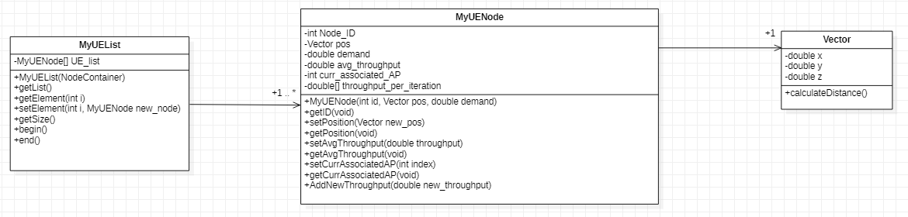
Add a new class- My_UE_List
We can provide some methods which contain multiple actions.
Though it can also make it with functional programming, programmers cannot easily find where it is if
the files are large.

Slide 4
Add the base class- LoadBalanceMethod
Before
(functional programming)
ProposedDynamicLB(…)
Precalculate(…)
Is first state?
N
ProposedDynamicLBStateN(…)
Y
ProposedDynamicLBState0(…)
sorting

Slide 5
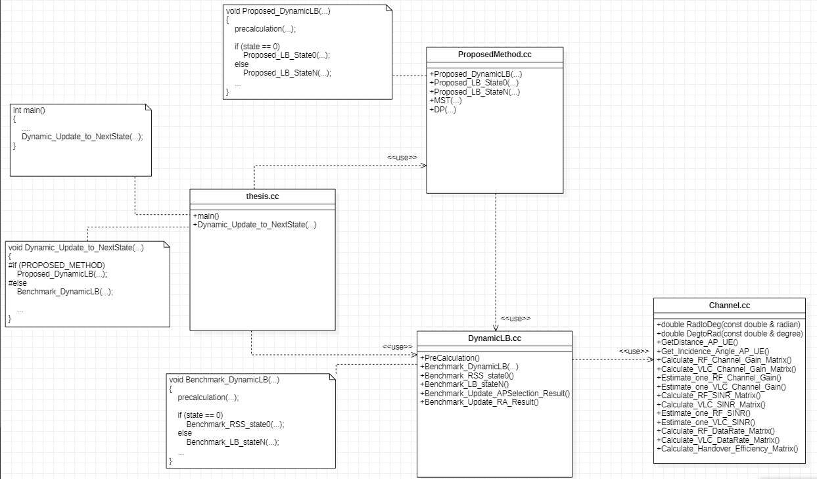
Add the base class- LoadBalanceMethod

Slide 6
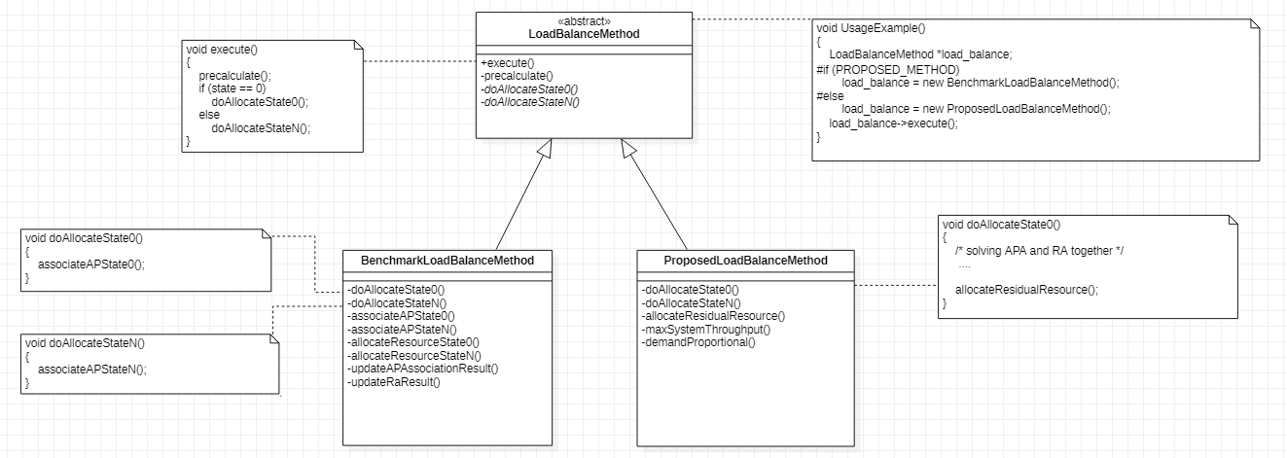
Add the base class- LoadBalanceMethod
After
(OO programming)
Abstract methods
Next section to be refactored
more clear

Slide 7
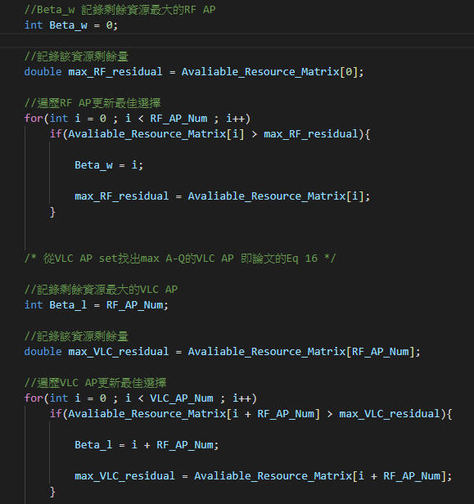
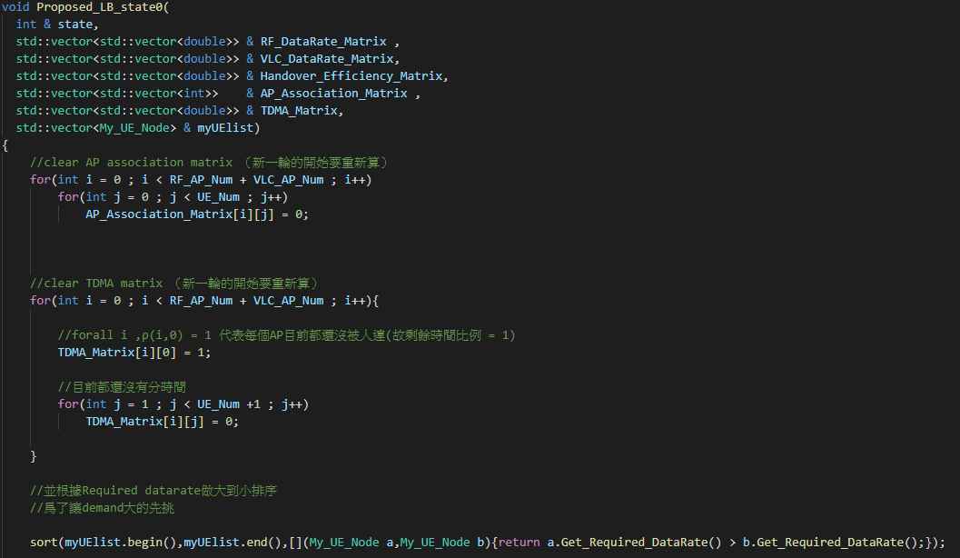
Add the base class- Matrix
Before (code snippet)

Slide 8
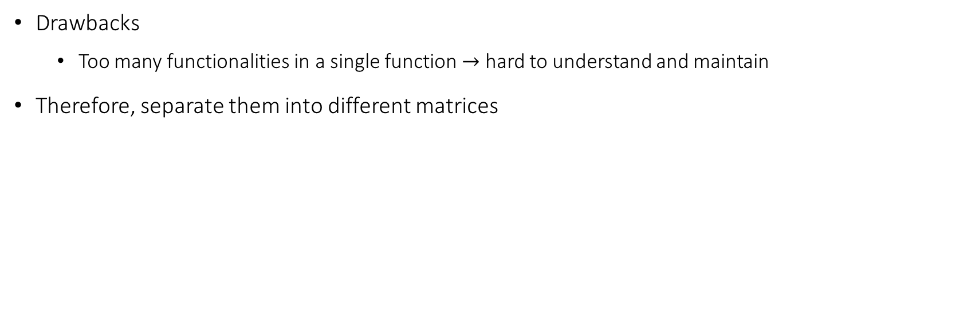
Add the base class- Matrix
Drawbacks
Too many functionalities in a single function $→$ hard to understand and maintain
Therefore, separate them into different matrices

Slide 9
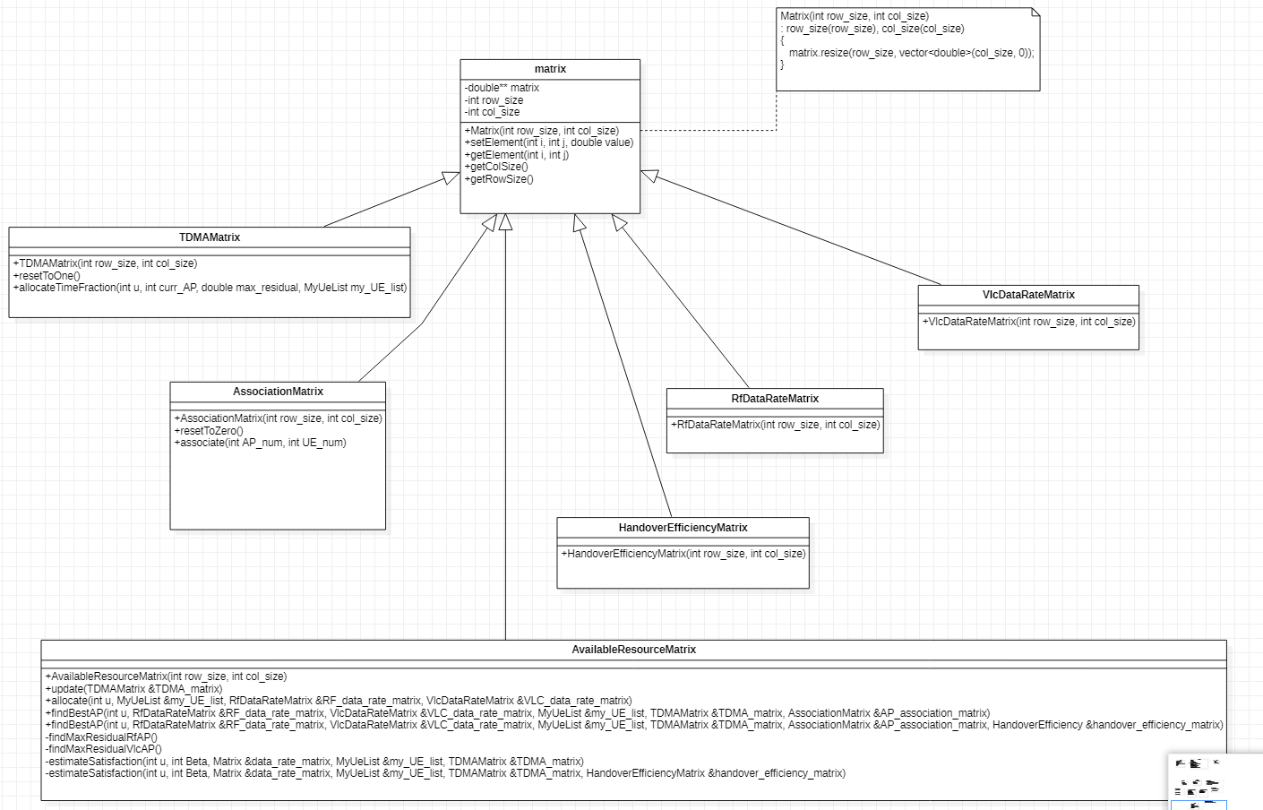
Vector<vector<double>> matrix

Slide 10
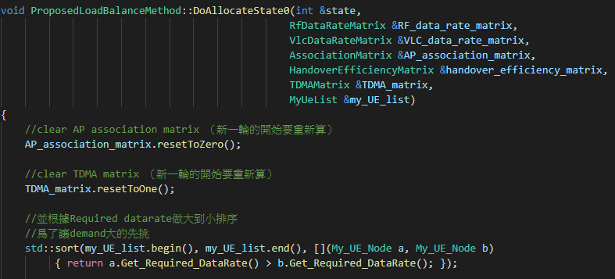
Add the base class- Matrix
After (code snippet)

Slide 11
Add the base class- Matrix

