Slide 1
TypeScript Fundamentals
Jimmy Mathew

Slide 2
Objective
Why TypeScript?
What is TypeScript?
Environment Setup
Basic concepts
Advanced concepts
Q&A

Slide 3
Why TypeScript?
As JS grows it tends to get messier making it difficult to maintain the code.
JS is weakly typed or untyped
Features like Object Orientation, strong type checking and compile-time error checks prevents JavaScript from succeeding at the enterprise level.
Lack of modularity.
TypeScript was presented to bridge this gap.

Slide 4
What is TypeScript
TypeScript is a superset of JavaScript
TypeScript is just JavaScript (With added features).
TypeScript is a strongly typed, object oriented, compiled language.
Designed by Anders Hejlsberg (designer of C#) at Microsoft.
TypeScript supports other JS libraries.
Any valid .js file can be renamed to .ts and compiled with other TypeScript files.
Compiled TypeScript can be consumed from any JavaScript code
TypeScript is portable.

Slide 5
Features
Compilation
Strong Static Typing
Compile time error checking
Supports Object Oriented Programming
Supports other JS libraries
Aligned with the ECMAScript6 specification.

Slide 6
Environment Setup
Download and install node.js
Open CMD
Check if node.js has installed correctly - node -v
To install TypeScript compiler use npm - npm install -g typescript
Download and install VS Code

Slide 7
Basic Concepts
Transpiling TS code to JS code
Data types
Variables and type assertion
Operators
Decision making
Looping
Built in Number and string functions
Functions

Slide 8
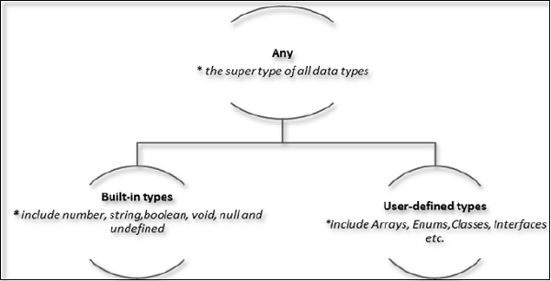
Data Types

Slide 9
Advanced Concepts
Arrow functions using Lambda expression
Arrays & Tuples
Union
Class and object
Interfaces
Constructors
Namespaces
Modules

Slide 10
Thank you

