Slide 1
M626 structure
3nm InAs cap
200nm In₄₈Al₅₂As
4 monolayers GaAs QD
200nm In₄₈Al₅₂As
50nm In₄₇Ga₅₃As
InP(111)A

Slide 2
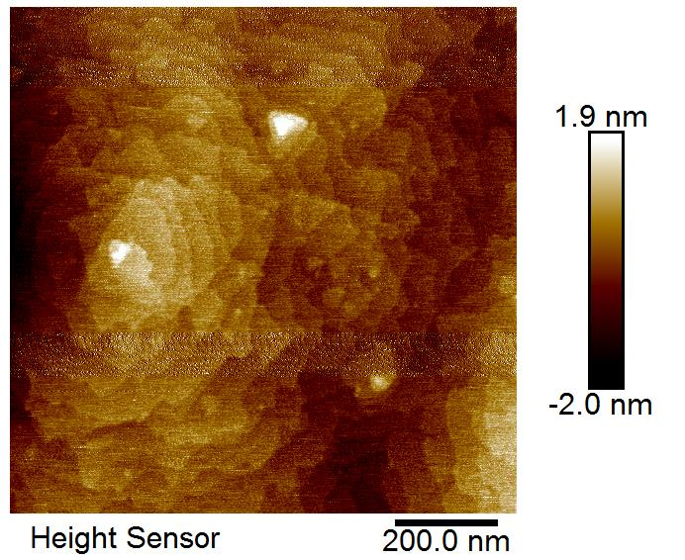
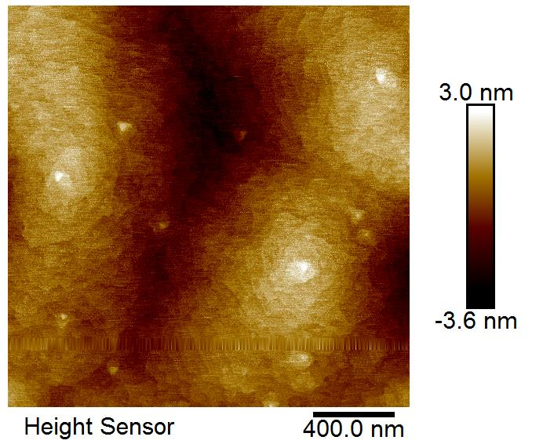
1x1 microns
2x2 microns

Slide 3
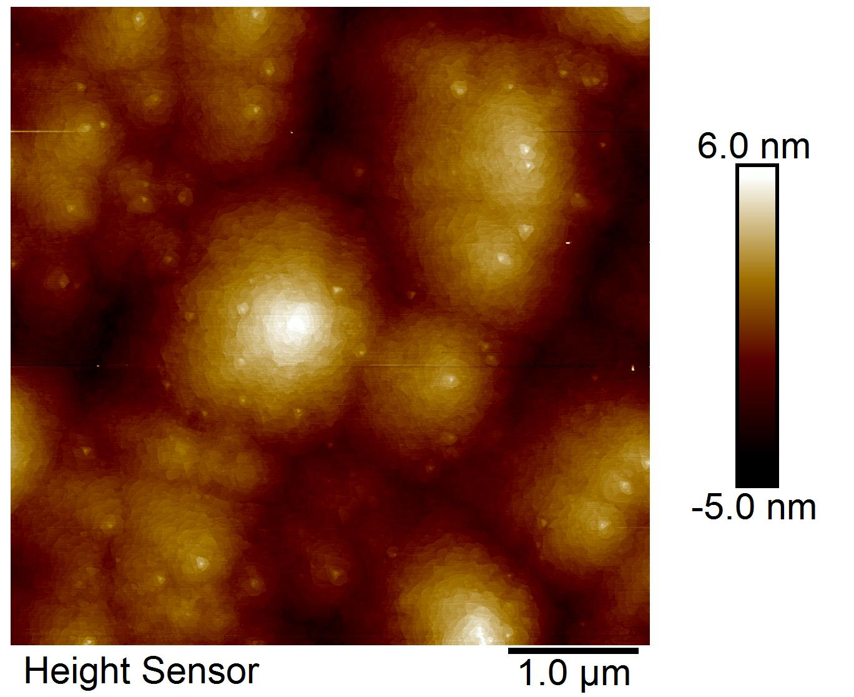
5x5 microns

