Slide 1
Savering me

Slide 2
Problem
The reality that being out alone isn't always safe.
Sometimes you get separated from friends when going out in a group setting
People find themselves in uncomfortable situations

Slide 3
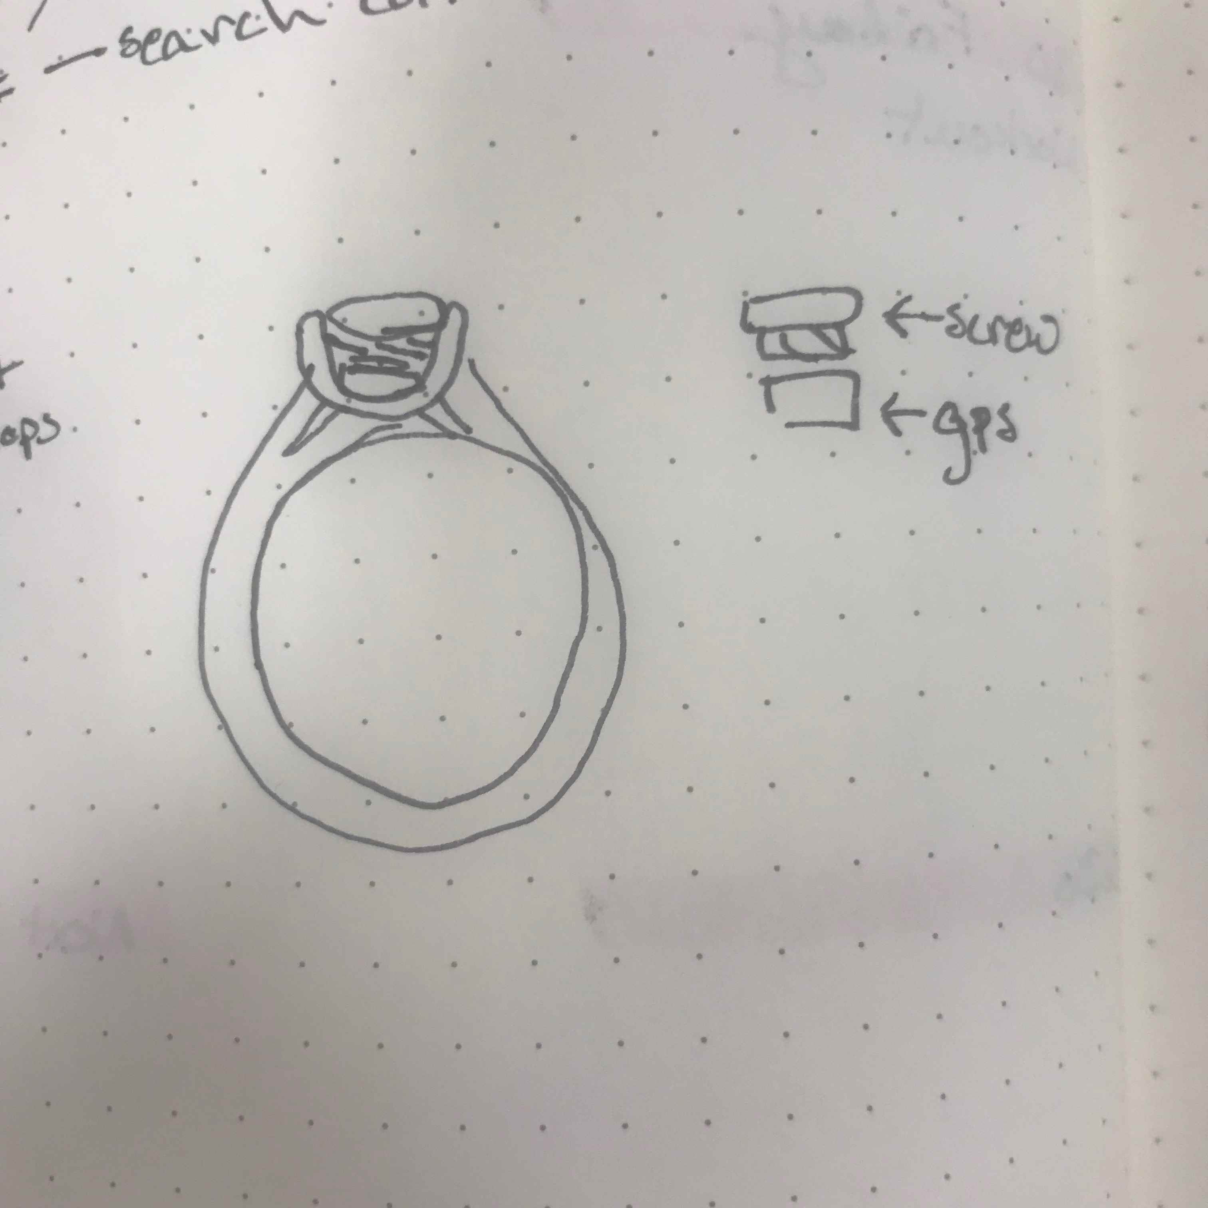
Solution
A Discrete GPS Ring
Twist Gemstone
Twist button to notify friend that your in need of Savering
GPS tracker
Notifies your friends when you're are far from them

Slide 4
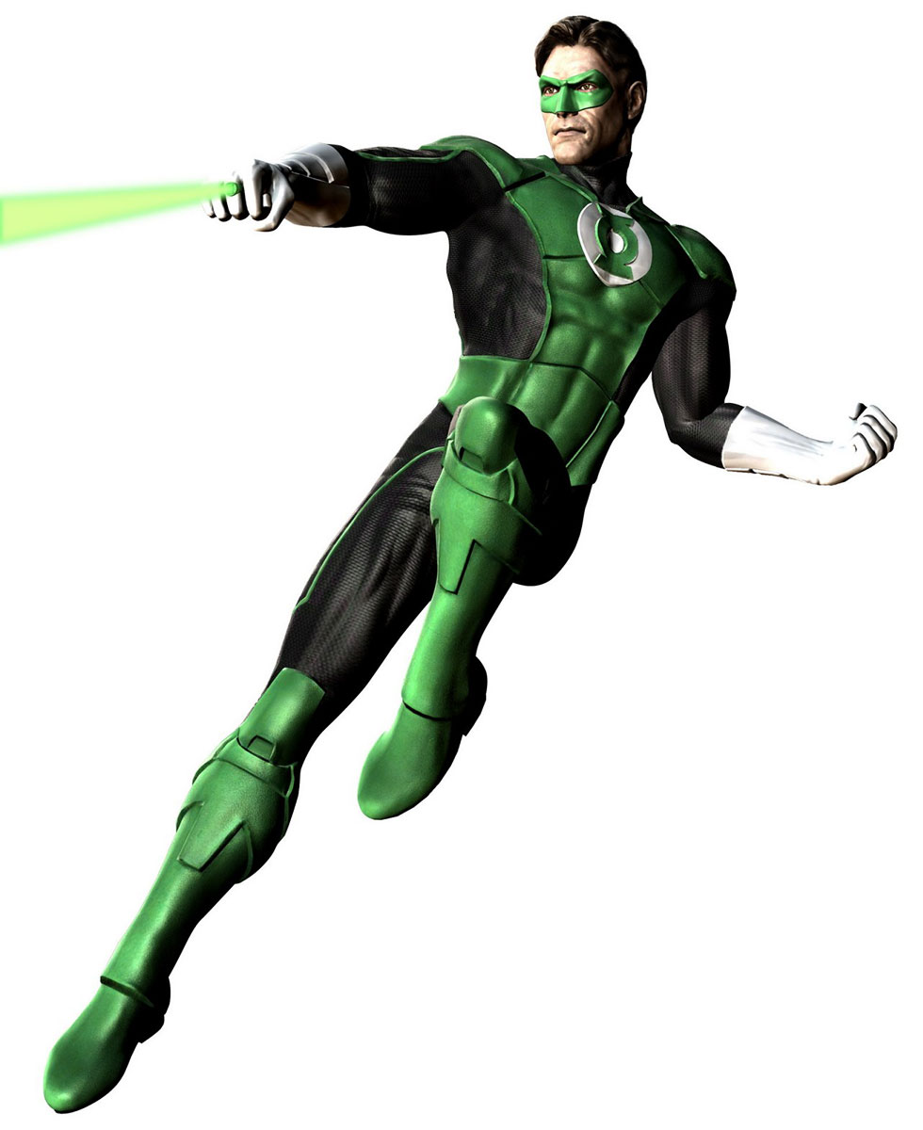
How it Works
Sign In/Sign Up Page
Each account is linked to a phone number
Using Bluetooth the ring is linked each individual’s mobile device

Slide 5
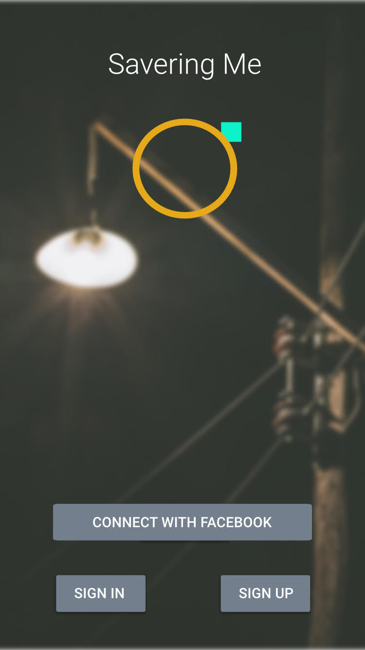
Create Account

Slide 6
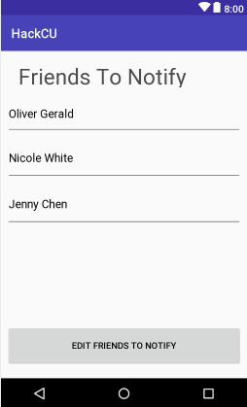
Choose Which Friends to Notify

Slide 7
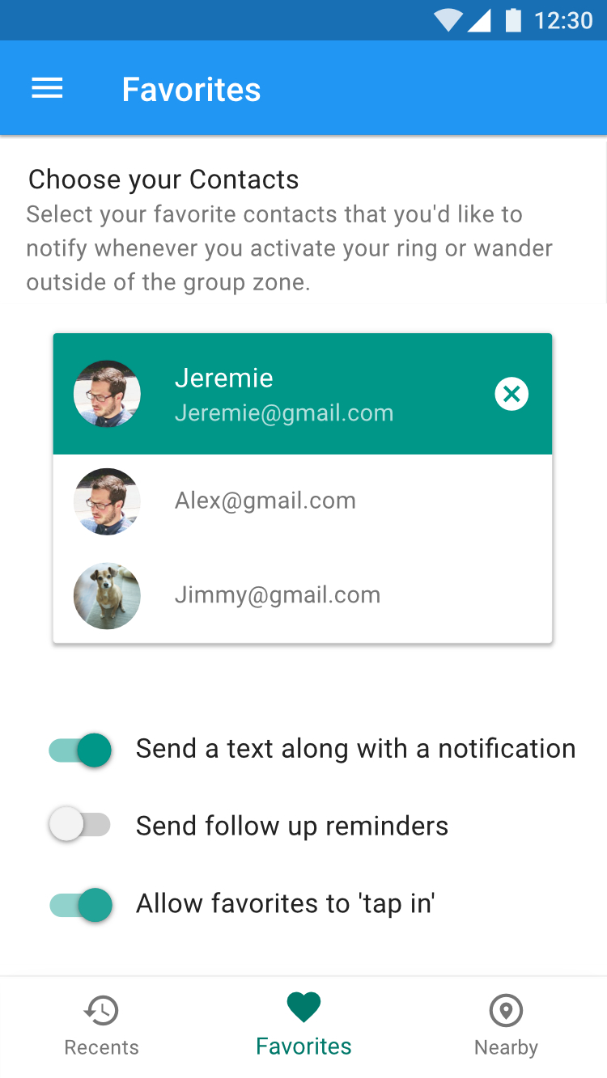
If you have the ring, you can choose which friends to notify

Slide 8
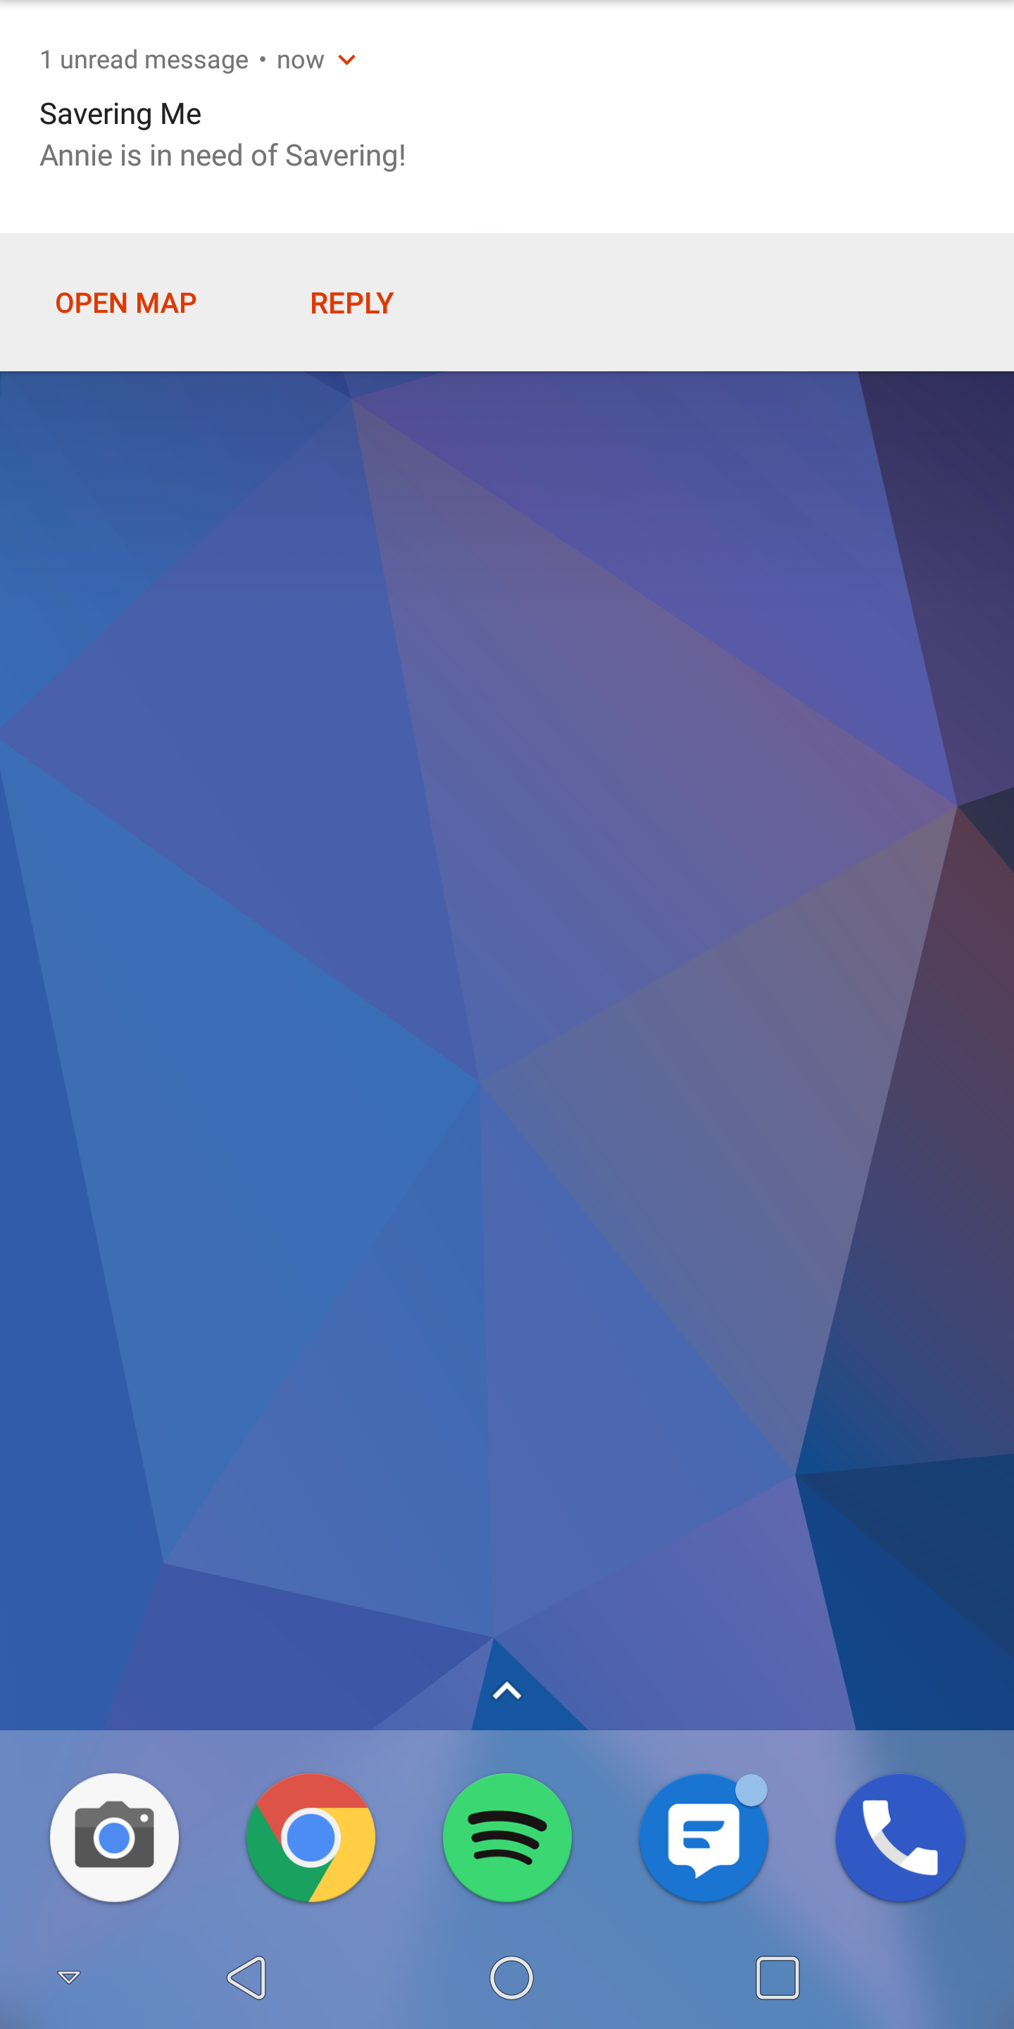

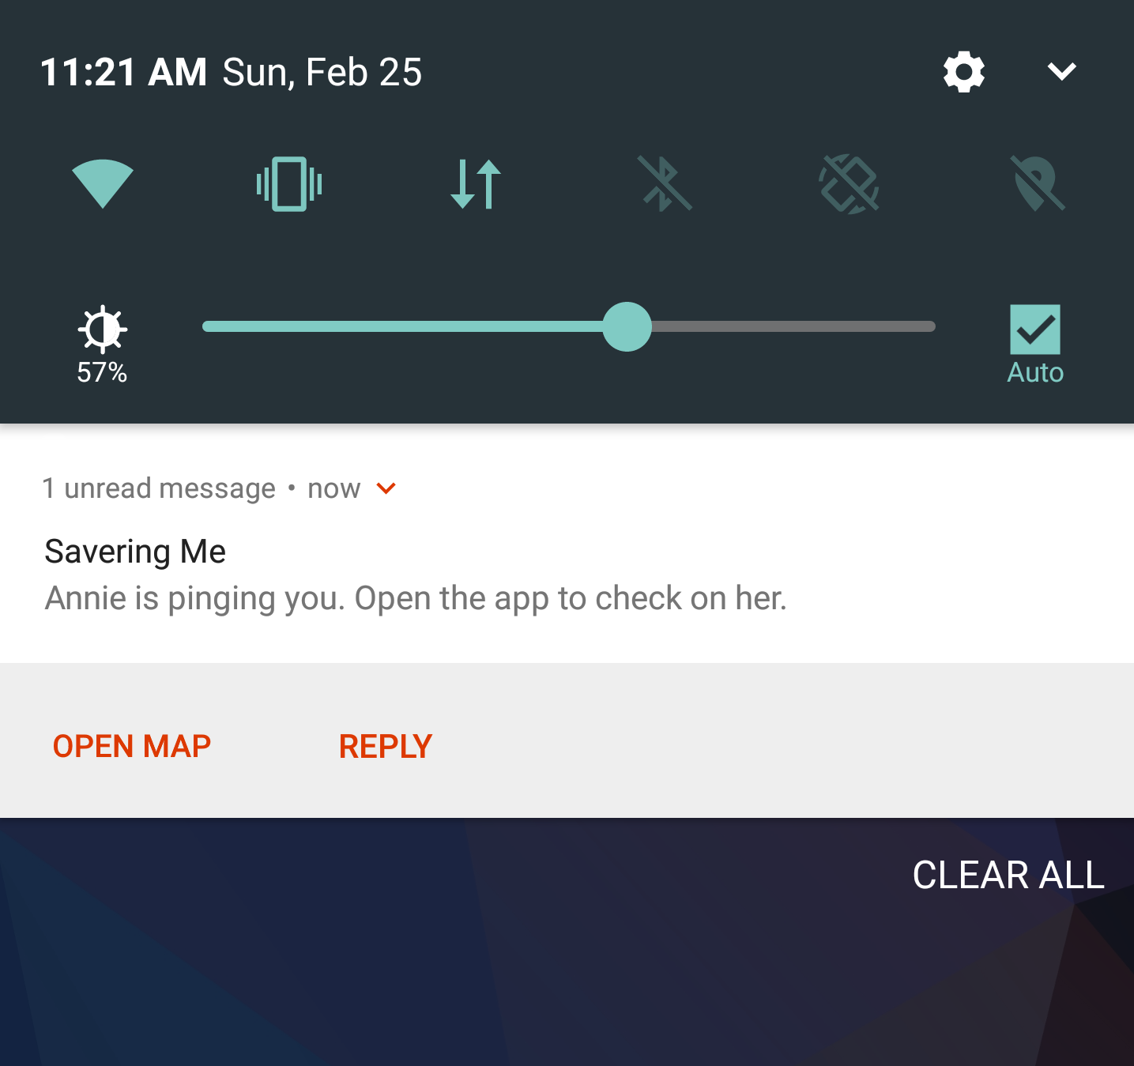

Slide 9
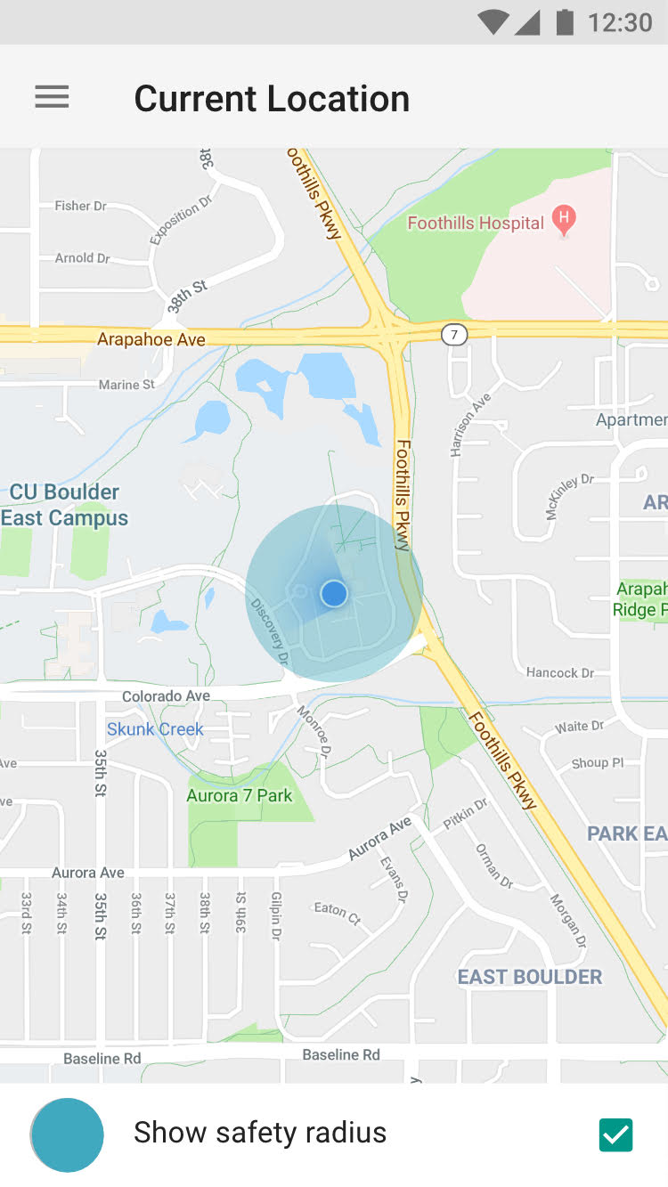
View Location of friends with Permission

Slide 10
Attempt at creating the app
React is hard
Why we used it?
Compatible with iphone and android
Widely used
Android Studio
Not as hard but a lot of debugging
Ex: GitIgnore, working with the emulator

