Slide 1
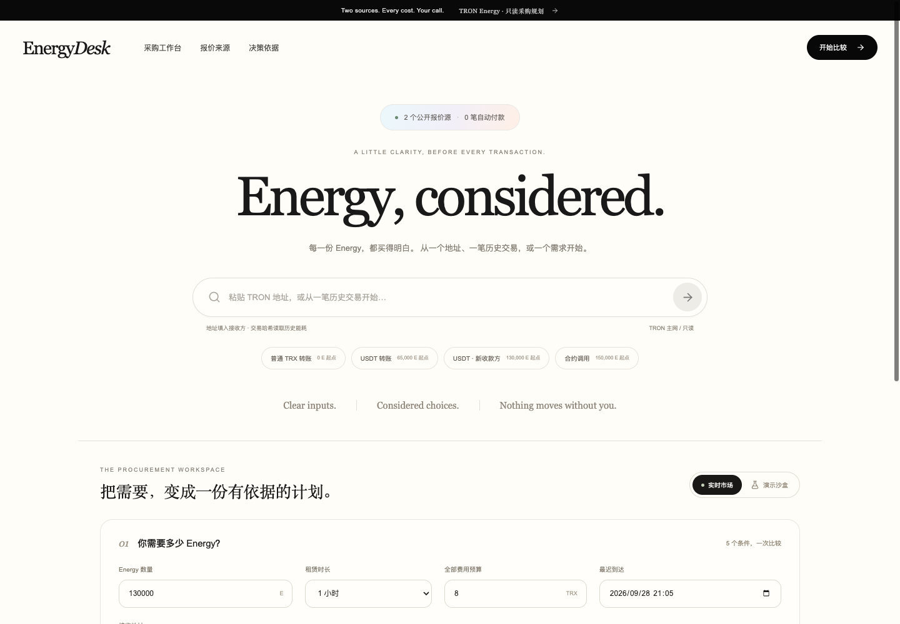
TRON CHALLENGE A · ENERGY RENTAL MARKET
Buy the Energy
you actually need.
Quote comparison and procurement evidence for TRON operations.
SOLO BUILDER / TEAM 37
GWDC 2026 KOREA
PRODUCT CAPTURE
Notes:
Slide 1 — Team and product cover.
Repository sources: projects/tron-a/README.md; projects/tron-a/docs/verification.md; projects/tron-a/docs/bai-verification.md.
Nile plan receipt: https://nile.tronscan.org/#/transaction/956b8f7ea035c816210e6f03a9c97b827069d777a8d26e92b0d6fce6a1a47bd9
ReceiptRegistry address: https://nile.tronscan.org/#/contract/TSqoRAmu4qviTuscsakTWdYRZQjpiTjP2u/code
Screenshot: projects/tron-a/docs/bai-desktop.png
GWDC 2026 official challenge brief: https://drive.google.com/file/d/1HXLhu1_vCoMD5aN3APEYEjDrh9oVCj7g/view

Slide 2
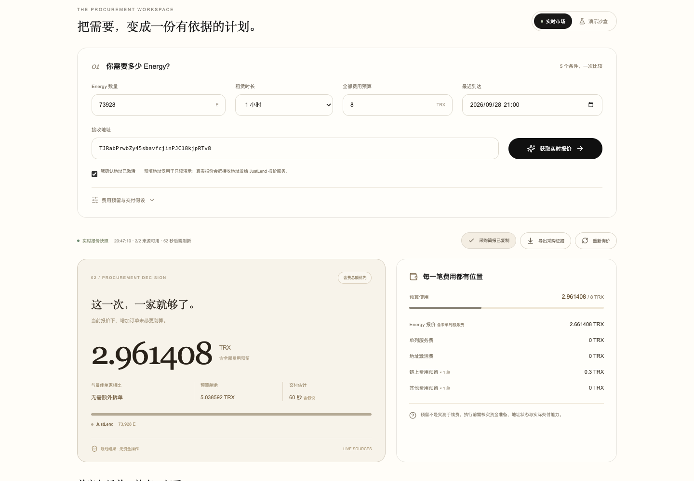
ENERGYDESK
OVERVIEW
Live quotes become an auditable procurement decision.
EnergyDesk normalizes provider quotes, includes all visible costs, tests one-provider and split plans, and records the chosen plan for later review.
WORKING PRODUCT
2
public quote sources
5
decision constraints
1
Nile plan receipt
BOUNDARY
The Nile receipt commits a procurement plan. It is not an Energy rental or provider order.
ENERGYDESK · SOLO BUILDER / TEAM 37
02 / 07
Notes:
Slide 2 — Product overview and current evidence boundary.
Repository sources: projects/tron-a/README.md; projects/tron-a/docs/verification.md; projects/tron-a/docs/bai-verification.md.
Nile plan receipt: https://nile.tronscan.org/#/transaction/956b8f7ea035c816210e6f03a9c97b827069d777a8d26e92b0d6fce6a1a47bd9
ReceiptRegistry address: https://nile.tronscan.org/#/contract/TSqoRAmu4qviTuscsakTWdYRZQjpiTjP2u/code
Screenshot: projects/tron-a/docs/bai-live-result.png
Boundary: The Nile receipt commits a procurement plan. It is not an Energy rental or provider order.
GWDC 2026 official challenge brief: https://drive.google.com/file/d/1HXLhu1_vCoMD5aN3APEYEjDrh9oVCj7g/view

Slide 3
ENERGYDESK
PROBLEM + SOLUTION
THE PROBLEM
THE SOLUTION
Energy is cheap only when the quote, timing and address all agree.
Normalize the whole purchase before committing.
1
Read live market inputs from two public sources.
01
Provider quotes expose different fee components.
2
Compare single-provider and split allocations under one budget.
02
A low headline price can miss delivery or address costs.
03
Manual comparisons leave no durable decision trail.
3
Commit the selected plan and assumptions to a Nile receipt.
ENERGYDESK · SOLO BUILDER / TEAM 37
03 / 07
Notes:
Slide 3 — Problem and solution.
Repository sources: projects/tron-a/README.md; projects/tron-a/docs/verification.md; projects/tron-a/docs/bai-verification.md.
Nile plan receipt: https://nile.tronscan.org/#/transaction/956b8f7ea035c816210e6f03a9c97b827069d777a8d26e92b0d6fce6a1a47bd9
ReceiptRegistry address: https://nile.tronscan.org/#/contract/TSqoRAmu4qviTuscsakTWdYRZQjpiTjP2u/code
Claims are product-scope statements derived from the repository README and verification record; no market-size estimate is asserted.
GWDC 2026 official challenge brief: https://drive.google.com/file/d/1HXLhu1_vCoMD5aN3APEYEjDrh9oVCj7g/view

Slide 4
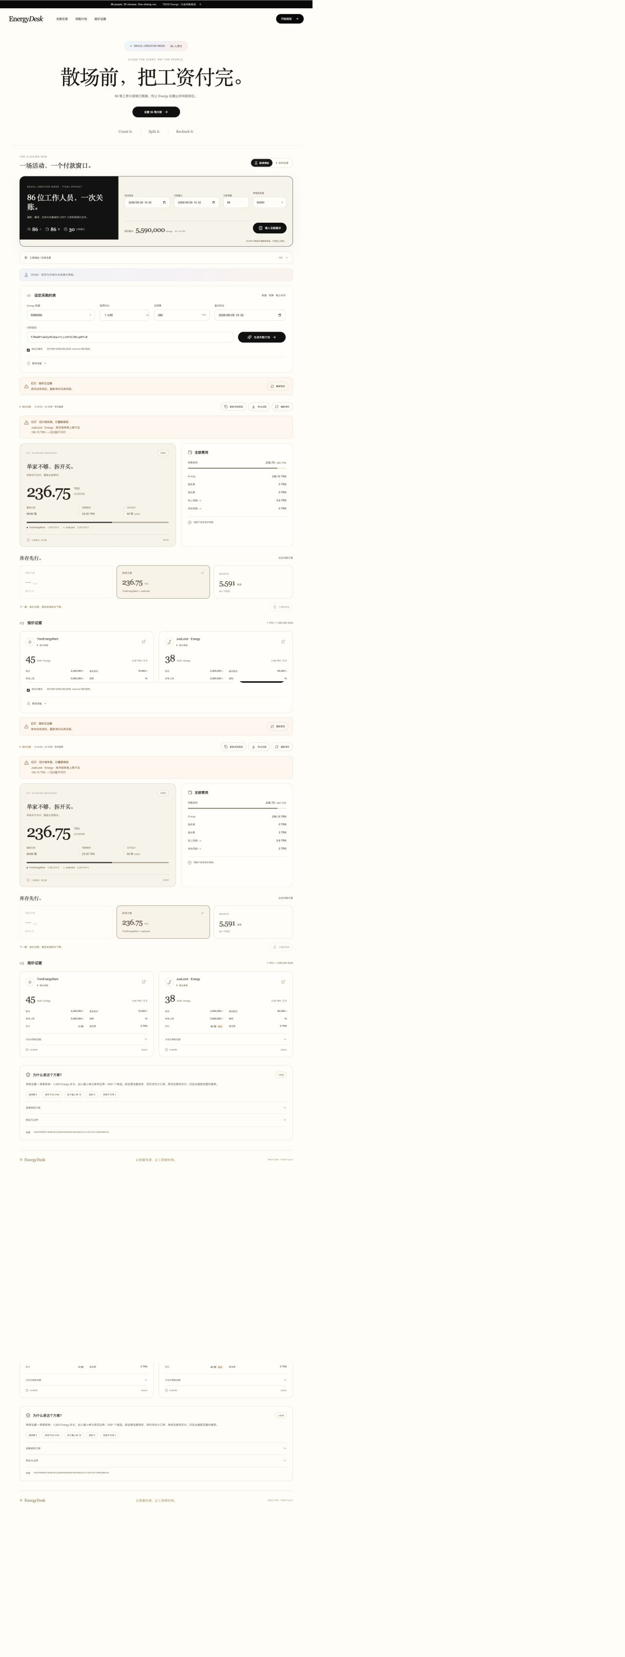
ENERGYDESK
PRODUCT WORKFLOW
A four-step procurement loop.
Each handoff preserves the data needed for review, replay and recovery.
01
Demand
COSTED RECOMMENDATION WITH ASSUMPTIONS
Energy amount, rental window, budget, deadline and receiver.
02
Quote
Fetch and timestamp public provider data.
03
Compare
Normalize total cost and test feasible allocations.
04
Commit
Copy the plan and store its digest on Nile.
ENERGYDESK · SOLO BUILDER / TEAM 37
04 / 07
Notes:
Slide 4 — Product workflow.
Repository sources: projects/tron-a/README.md; projects/tron-a/docs/verification.md; projects/tron-a/docs/bai-verification.md.
Nile plan receipt: https://nile.tronscan.org/#/transaction/956b8f7ea035c816210e6f03a9c97b827069d777a8d26e92b0d6fce6a1a47bd9
ReceiptRegistry address: https://nile.tronscan.org/#/contract/TSqoRAmu4qviTuscsakTWdYRZQjpiTjP2u/code
Screenshot: projects/tron-a/docs/final-desktop.jpg
GWDC 2026 official challenge brief: https://drive.google.com/file/d/1HXLhu1_vCoMD5aN3APEYEjDrh9oVCj7g/view

Slide 5
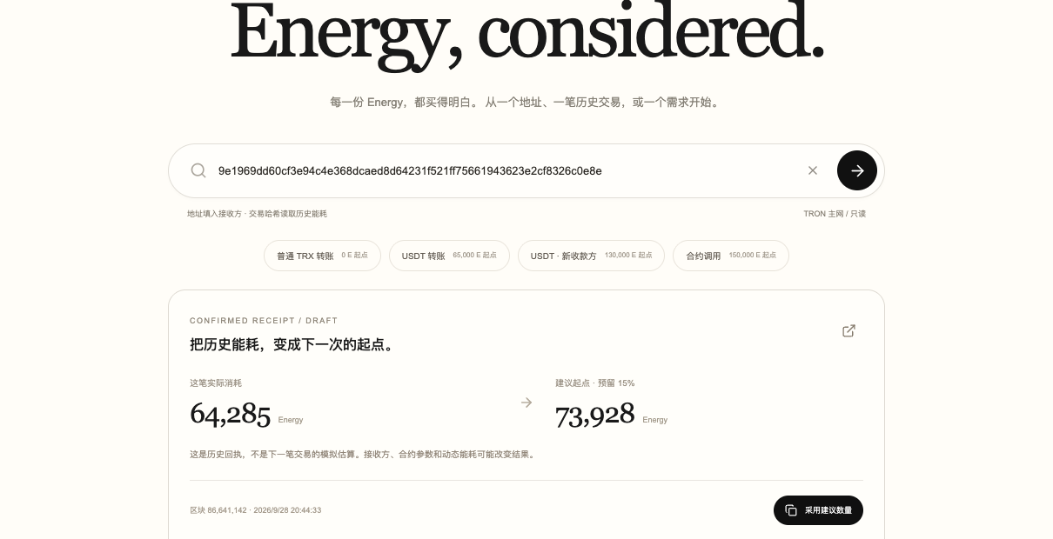
ENERGYDESK
TECHNICAL HIGHLIGHTS
Procurement math stays inspectable.
A compact architecture makes every trust boundary visible.
Public quote sources
→
Cost normalizer
→
Constraint planner
→
ReceiptRegistry on Nile
WHY IT HOLDS
CONFIRMED · NILE
01
Integer-safe Energy and TRX calculations with explicit budget reserve.
Plan receipt only · no rental transaction
02
Quote timestamps and source labels remain attached to the decision.
03
Independent Nile reads verify the committed receipt and runtime contract.
ENERGYDESK · SOLO BUILDER / TEAM 37
05 / 07
Notes:
Slide 5 — Technical architecture and evidence.
Repository sources: projects/tron-a/README.md; projects/tron-a/docs/verification.md; projects/tron-a/docs/bai-verification.md.
Nile plan receipt: https://nile.tronscan.org/#/transaction/956b8f7ea035c816210e6f03a9c97b827069d777a8d26e92b0d6fce6a1a47bd9
ReceiptRegistry address: https://nile.tronscan.org/#/contract/TSqoRAmu4qviTuscsakTWdYRZQjpiTjP2u/code
Screenshot: projects/tron-a/docs/bai-history-desktop.png
Evidence status: CONFIRMED · NILE — Plan receipt only · no rental transaction
GWDC 2026 official challenge brief: https://drive.google.com/file/d/1HXLhu1_vCoMD5aN3APEYEjDrh9oVCj7g/view

Slide 6
ENERGYDESK
MARKET + COMPETITION
A narrow wedge in an existing workflow.
A buyer-side decision layer across existing Energy suppliers.
CURRENT OPTION
WHAT IT DOES
WHERE WE ENTER
PRIMARY USER
Single quote
Fast supplier view
No cross-source normalization
TRON treasury and operations teams
BUYING TRIGGER
Manual broker chat
Human assistance
Weak reproducibility
Each burst of contract calls, transfers or campaign traffic
Spreadsheet
Flexible calculations
Stale inputs and no receipt
ENTRY WEDGE
EnergyDesk
Comparable total cost
Plan evidence without lock-in
A buyer-side decision layer across existing Energy suppliers.
ENERGYDESK · SOLO BUILDER / TEAM 37
06 / 07
Notes:
Slide 6 — Market and competitive positioning.
Repository sources: projects/tron-a/README.md; projects/tron-a/docs/verification.md; projects/tron-a/docs/bai-verification.md.
Nile plan receipt: https://nile.tronscan.org/#/transaction/956b8f7ea035c816210e6f03a9c97b827069d777a8d26e92b0d6fce6a1a47bd9
ReceiptRegistry address: https://nile.tronscan.org/#/contract/TSqoRAmu4qviTuscsakTWdYRZQjpiTjP2u/code
Comparison is qualitative and based on workflow scope. No market-size or revenue estimate is claimed.
GWDC 2026 official challenge brief: https://drive.google.com/file/d/1HXLhu1_vCoMD5aN3APEYEjDrh9oVCj7g/view

Slide 7
ENERGYDESK
ROADMAP
Ship the missing proof, then scale.
The next milestone closes the current evidence gap before expanding product scope.
NOW
NEXT
LATER
WORKING PROTOTYPE
EVIDENCE MILESTONE
PRODUCT EXPANSION
01
Two live quote sources
01
Provider order adapters
01
Treasury policy API
02
Constraint-based comparison
02
Quote-expiry enforcement
02
Historical price benchmarks
03
Nile plan receipt
03
Post-order delivery checks
03
Automated renewal rules
TRUTHFUL BOUNDARY
Today: real market inputs + real Nile commitment. Energy fulfillment is not executed.
ENERGYDESK · SOLO BUILDER / TEAM 37
07 / 07
Notes:
Slide 7 — Roadmap and current product boundary.
Repository sources: projects/tron-a/README.md; projects/tron-a/docs/verification.md; projects/tron-a/docs/bai-verification.md.
Nile plan receipt: https://nile.tronscan.org/#/transaction/956b8f7ea035c816210e6f03a9c97b827069d777a8d26e92b0d6fce6a1a47bd9
ReceiptRegistry address: https://nile.tronscan.org/#/contract/TSqoRAmu4qviTuscsakTWdYRZQjpiTjP2u/code
Boundary: Today: real market inputs + real Nile commitment. Energy fulfillment is not executed.
GWDC 2026 official challenge brief: https://drive.google.com/file/d/1HXLhu1_vCoMD5aN3APEYEjDrh9oVCj7g/view

