Slide 1
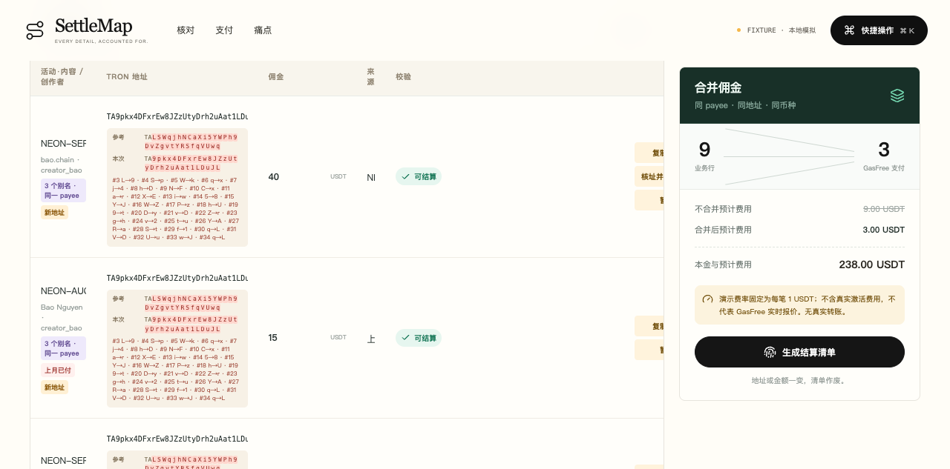
TRON CHALLENGE C · GASFEE-FREE PAYMENTS
Every payout row.
One recoverable trail.
From campaign spreadsheet to grouped TRON settlement evidence.
SOLO BUILDER / TEAM 37
GWDC 2026 KOREA
PRODUCT CAPTURE
Notes:
Slide 1 — Team and product cover.
Repository sources: projects/tron-c/docs/gasfree-one-shot.md; projects/tron-c/server/integration/README.md; sanitized canary evidence at submissions/gwdc-2026-settlemap/.data/gasfree-one-shot/gwdc-final-20260930-001.evidence.json.
Verified Nile canary transaction: https://nile.tronscan.org/#/transaction/1f3a3de905eeef90570bf297bb592d4ac16383a5a10c1187c4e09b41b5fdd586
Canary result: provider SUCCEED; chain SOLIDITY; block 71389721; exact TRC-20 Transfer at log index 2.
Transfer: 1.000001 USDT from derived GasFree account TH3V9cnUct542ss5ZgAzNHWnFH9ycB1Tw1 to dedicated EOA TQcxtc1CmGRL8NwuDs3LewTBFycgXb28AR. Actual fee: 1.3 USDT.
Verification source: GasFree provider status + Nile Solidity RPC.
GasFree API source: https://docs.gasfree.io/
TRON Solidity confirmation source: https://developers.tron.network/docs/confirmation-semantics
Nile Solidity receipt endpoint: https://nile.trongrid.io/walletsolidity/gettransactioninfobyid (POST)
Scope boundary: this proves one recipient canary only, not the complete multi-recipient batch.
Screenshot: projects/tron-c/docs/creator-story-anomalies.png
GWDC 2026 official challenge brief: https://drive.google.com/file/d/1HXLhu1_vCoMD5aN3APEYEjDrh9oVCj7g/view

Slide 2
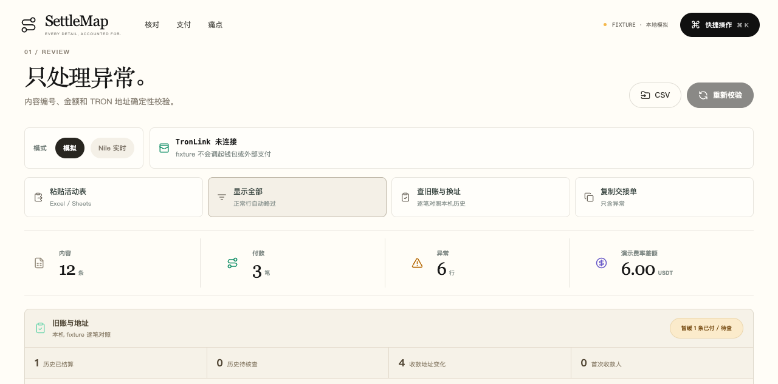
SETTLEMAP
OVERVIEW
Business rows survive payment grouping and recovery.
SettleMap validates a payout sheet, preserves each source row, groups valid payments, binds a manifest digest, and reconciles every result back to the original business record.
WORKING PRODUCT
12
raw business rows
9
valid payable rows
3
grouped payments
VERIFIED SCOPE
Verified Nile canary: 1.000001 USDT from derived GasFree account to dedicated EOA. Actual fee: 1.3 USDT.
SETTLEMAP · SOLO BUILDER / TEAM 37
02 / 07
Notes:
Slide 2 — Product overview and verified canary scope.
Repository sources: projects/tron-c/docs/gasfree-one-shot.md; projects/tron-c/server/integration/README.md; sanitized canary evidence at submissions/gwdc-2026-settlemap/.data/gasfree-one-shot/gwdc-final-20260930-001.evidence.json.
Verified Nile canary transaction: https://nile.tronscan.org/#/transaction/1f3a3de905eeef90570bf297bb592d4ac16383a5a10c1187c4e09b41b5fdd586
Canary result: provider SUCCEED; chain SOLIDITY; block 71389721; exact TRC-20 Transfer at log index 2.
Transfer: 1.000001 USDT from derived GasFree account TH3V9cnUct542ss5ZgAzNHWnFH9ycB1Tw1 to dedicated EOA TQcxtc1CmGRL8NwuDs3LewTBFycgXb28AR. Actual fee: 1.3 USDT.
Verification source: GasFree provider status + Nile Solidity RPC.
GasFree API source: https://docs.gasfree.io/
TRON Solidity confirmation source: https://developers.tron.network/docs/confirmation-semantics
Nile Solidity receipt endpoint: https://nile.trongrid.io/walletsolidity/gettransactioninfobyid (POST)
Scope boundary: this proves one recipient canary only, not the complete multi-recipient batch.
Screenshot: projects/tron-c/docs/creator-story-review.png
GWDC 2026 official challenge brief: https://drive.google.com/file/d/1HXLhu1_vCoMD5aN3APEYEjDrh9oVCj7g/view

Slide 3
SETTLEMAP
PROBLEM + SOLUTION
THE PROBLEM
THE SOLUTION
Batching saves fees—until rows, retries and unknown outcomes lose their identity.
Preserve identity across the whole settlement lifecycle.
1
Validate and review each source row before grouping.
01
A grouped payment can hide which invoices it settles.
2
Bind grouped payments to one deterministic manifest.
02
A browser timeout can trigger a dangerous duplicate attempt.
03
Business exports and chain traces often diverge.
3
Recover the original trace when state is unknown; never pay again blindly.
SETTLEMAP · SOLO BUILDER / TEAM 37
03 / 07
Notes:
Slide 3 — Problem and solution.
Repository sources: projects/tron-c/docs/gasfree-one-shot.md; projects/tron-c/server/integration/README.md; sanitized canary evidence at submissions/gwdc-2026-settlemap/.data/gasfree-one-shot/gwdc-final-20260930-001.evidence.json.
Verified Nile canary transaction: https://nile.tronscan.org/#/transaction/1f3a3de905eeef90570bf297bb592d4ac16383a5a10c1187c4e09b41b5fdd586
Canary result: provider SUCCEED; chain SOLIDITY; block 71389721; exact TRC-20 Transfer at log index 2.
Transfer: 1.000001 USDT from derived GasFree account TH3V9cnUct542ss5ZgAzNHWnFH9ycB1Tw1 to dedicated EOA TQcxtc1CmGRL8NwuDs3LewTBFycgXb28AR. Actual fee: 1.3 USDT.
Verification source: GasFree provider status + Nile Solidity RPC.
GasFree API source: https://docs.gasfree.io/
TRON Solidity confirmation source: https://developers.tron.network/docs/confirmation-semantics
Nile Solidity receipt endpoint: https://nile.trongrid.io/walletsolidity/gettransactioninfobyid (POST)
Scope boundary: this proves one recipient canary only, not the complete multi-recipient batch.
Claims describe product scope; no market-size estimate is asserted.
GWDC 2026 official challenge brief: https://drive.google.com/file/d/1HXLhu1_vCoMD5aN3APEYEjDrh9oVCj7g/view

Slide 4
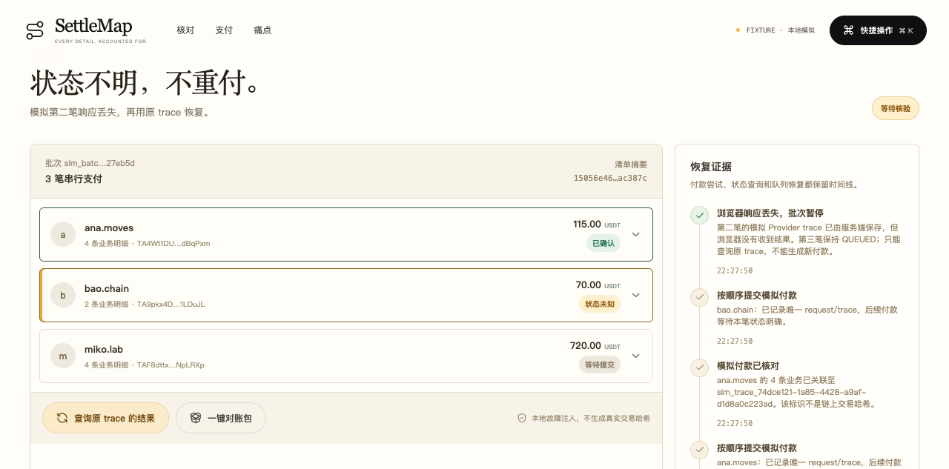
SETTLEMAP
PRODUCT WORKFLOW
Review first. Group once. Recover safely.
Each handoff preserves the data needed for review, replay and recovery.
01
Review
UNKNOWN PRESERVES THE ORIGINAL ATTEMPT AND TRACE
Validate address, amount, invoice history and anomalies.
02
Group
Merge by payee, address and token while retaining row links.
03
Authorize
Prepare one TIP-712 payment at a time for TronLink.
04
Recover
Query the existing trace, then export row + payment evidence.
SETTLEMAP · SOLO BUILDER / TEAM 37
04 / 07
Notes:
Slide 4 — Product workflow.
Repository sources: projects/tron-c/docs/gasfree-one-shot.md; projects/tron-c/server/integration/README.md; sanitized canary evidence at submissions/gwdc-2026-settlemap/.data/gasfree-one-shot/gwdc-final-20260930-001.evidence.json.
Verified Nile canary transaction: https://nile.tronscan.org/#/transaction/1f3a3de905eeef90570bf297bb592d4ac16383a5a10c1187c4e09b41b5fdd586
Canary result: provider SUCCEED; chain SOLIDITY; block 71389721; exact TRC-20 Transfer at log index 2.
Transfer: 1.000001 USDT from derived GasFree account TH3V9cnUct542ss5ZgAzNHWnFH9ycB1Tw1 to dedicated EOA TQcxtc1CmGRL8NwuDs3LewTBFycgXb28AR. Actual fee: 1.3 USDT.
Verification source: GasFree provider status + Nile Solidity RPC.
GasFree API source: https://docs.gasfree.io/
TRON Solidity confirmation source: https://developers.tron.network/docs/confirmation-semantics
Nile Solidity receipt endpoint: https://nile.trongrid.io/walletsolidity/gettransactioninfobyid (POST)
Scope boundary: this proves one recipient canary only, not the complete multi-recipient batch.
Screenshot: projects/tron-c/docs/creator-story-unknown.png
GWDC 2026 official challenge brief: https://drive.google.com/file/d/1HXLhu1_vCoMD5aN3APEYEjDrh9oVCj7g/view

Slide 5
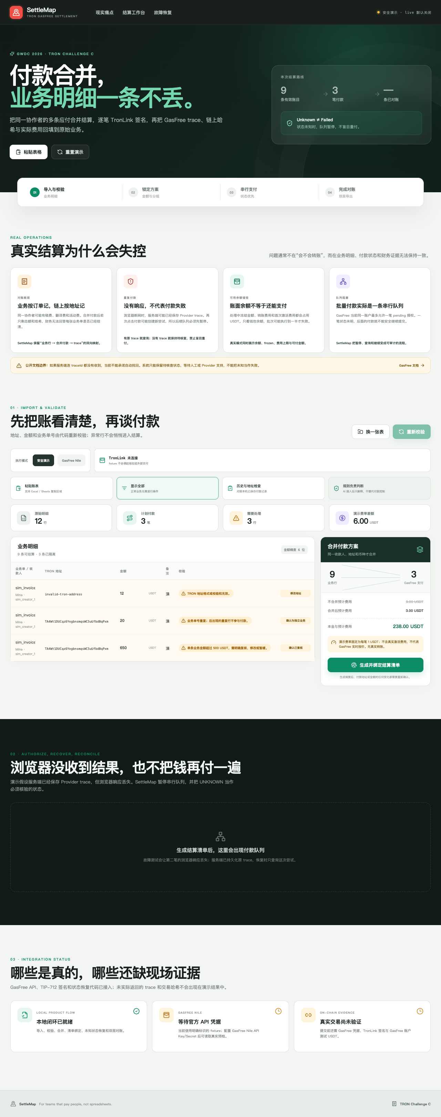
SETTLEMAP
TECHNICAL HIGHLIGHTS
The live path now has a verified Nile canary.
GasFree provider status and Nile Solidity RPC agree on the exact TRC-20 Transfer.
GasFree preflight
→
TIP-712 via TronLink
→
HMAC submit + trace
→
Independent Nile verification
WHY IT HOLDS
ONE-RECIPIENT CANARY VERIFIED
01
Sequential queue respects Provider pending limits.
SUCCEED · SOLIDITY · block 71389721 · log 2
02
UNKNOWN queries the original trace instead of creating a new payment.
03
Exact token, sender, receiver and 1.000001 USDT matched at log index 2.
SETTLEMAP · SOLO BUILDER / TEAM 37
05 / 07
Notes:
Slide 5 — Technical architecture and verified canary evidence.
Repository sources: projects/tron-c/docs/gasfree-one-shot.md; projects/tron-c/server/integration/README.md; sanitized canary evidence at submissions/gwdc-2026-settlemap/.data/gasfree-one-shot/gwdc-final-20260930-001.evidence.json.
Verified Nile canary transaction: https://nile.tronscan.org/#/transaction/1f3a3de905eeef90570bf297bb592d4ac16383a5a10c1187c4e09b41b5fdd586
Canary result: provider SUCCEED; chain SOLIDITY; block 71389721; exact TRC-20 Transfer at log index 2.
Transfer: 1.000001 USDT from derived GasFree account TH3V9cnUct542ss5ZgAzNHWnFH9ycB1Tw1 to dedicated EOA TQcxtc1CmGRL8NwuDs3LewTBFycgXb28AR. Actual fee: 1.3 USDT.
Verification source: GasFree provider status + Nile Solidity RPC.
GasFree API source: https://docs.gasfree.io/
TRON Solidity confirmation source: https://developers.tron.network/docs/confirmation-semantics
Nile Solidity receipt endpoint: https://nile.trongrid.io/walletsolidity/gettransactioninfobyid (POST)
Scope boundary: this proves one recipient canary only, not the complete multi-recipient batch.
Screenshot: projects/tron-c/docs/verification-live-ui.png
GWDC 2026 official challenge brief: https://drive.google.com/file/d/1HXLhu1_vCoMD5aN3APEYEjDrh9oVCj7g/view

Slide 6
SETTLEMAP
MARKET + COMPETITION
A narrow wedge in an existing workflow.
A reconciliation layer for teams adopting GasFree batch payouts.
CURRENT OPTION
WHAT IT DOES
WHERE WE ENTER
PRIMARY USER
Wallet-by-wallet
Direct control
Slow and error-prone
Creator, campaign and operations teams
BUYING TRIGGER
Batch script
Efficient submission
Weak recovery semantics
A payout spreadsheet with repeated recipients and uncertain retries
Custodial payout API
Managed execution
Business-row opacity
ENTRY WEDGE
SettleMap
Row-preserving grouping
Recoverable evidence trail
A reconciliation layer for teams adopting GasFree batch payouts.
SETTLEMAP · SOLO BUILDER / TEAM 37
06 / 07
Notes:
Slide 6 — Market and competitive positioning.
Repository sources: projects/tron-c/docs/gasfree-one-shot.md; projects/tron-c/server/integration/README.md; sanitized canary evidence at submissions/gwdc-2026-settlemap/.data/gasfree-one-shot/gwdc-final-20260930-001.evidence.json.
Verified Nile canary transaction: https://nile.tronscan.org/#/transaction/1f3a3de905eeef90570bf297bb592d4ac16383a5a10c1187c4e09b41b5fdd586
Canary result: provider SUCCEED; chain SOLIDITY; block 71389721; exact TRC-20 Transfer at log index 2.
Transfer: 1.000001 USDT from derived GasFree account TH3V9cnUct542ss5ZgAzNHWnFH9ycB1Tw1 to dedicated EOA TQcxtc1CmGRL8NwuDs3LewTBFycgXb28AR. Actual fee: 1.3 USDT.
Verification source: GasFree provider status + Nile Solidity RPC.
GasFree API source: https://docs.gasfree.io/
TRON Solidity confirmation source: https://developers.tron.network/docs/confirmation-semantics
Nile Solidity receipt endpoint: https://nile.trongrid.io/walletsolidity/gettransactioninfobyid (POST)
Scope boundary: this proves one recipient canary only, not the complete multi-recipient batch.
Comparison is qualitative and based on workflow scope. No market-size or revenue estimate is claimed.
GWDC 2026 official challenge brief: https://drive.google.com/file/d/1HXLhu1_vCoMD5aN3APEYEjDrh9oVCj7g/view

Slide 7
SETTLEMAP
ROADMAP
One verified canary. Full batch proof comes next.
The Nile write path now has real evidence. Multi-recipient execution remains unproven.
NOW
NEXT
LATER
VERIFIED EVIDENCE
CONTROLLED EXPANSION
PRODUCT EXPANSION
01
12→9→3 fixture proof
01
Multi-recipient Nile batch
01
Sheets / ERP connectors
02
One-recipient Nile canary
02
Live UI receipt capture
02
Policy approvals
03
Exact Transfer at log 2
03
Recovery drill on real trace
03
Operational monitoring
TRUTHFUL BOUNDARY
Verified: 1 recipient, 1.000001 USDT, 1.3 USDT fee. Full batch remains unproven.
SETTLEMAP · SOLO BUILDER / TEAM 37
07 / 07
Notes:
Slide 7 — Roadmap and current product boundary.
Repository sources: projects/tron-c/docs/gasfree-one-shot.md; projects/tron-c/server/integration/README.md; sanitized canary evidence at submissions/gwdc-2026-settlemap/.data/gasfree-one-shot/gwdc-final-20260930-001.evidence.json.
Verified Nile canary transaction: https://nile.tronscan.org/#/transaction/1f3a3de905eeef90570bf297bb592d4ac16383a5a10c1187c4e09b41b5fdd586
Canary result: provider SUCCEED; chain SOLIDITY; block 71389721; exact TRC-20 Transfer at log index 2.
Transfer: 1.000001 USDT from derived GasFree account TH3V9cnUct542ss5ZgAzNHWnFH9ycB1Tw1 to dedicated EOA TQcxtc1CmGRL8NwuDs3LewTBFycgXb28AR. Actual fee: 1.3 USDT.
Verification source: GasFree provider status + Nile Solidity RPC.
GasFree API source: https://docs.gasfree.io/
TRON Solidity confirmation source: https://developers.tron.network/docs/confirmation-semantics
Nile Solidity receipt endpoint: https://nile.trongrid.io/walletsolidity/gettransactioninfobyid (POST)
Scope boundary: this proves one recipient canary only, not the complete multi-recipient batch.
Next evidence milestone: a controlled multi-recipient Nile batch with live UI receipt capture.
GWDC 2026 official challenge brief: https://drive.google.com/file/d/1HXLhu1_vCoMD5aN3APEYEjDrh9oVCj7g/view

