Slide 1
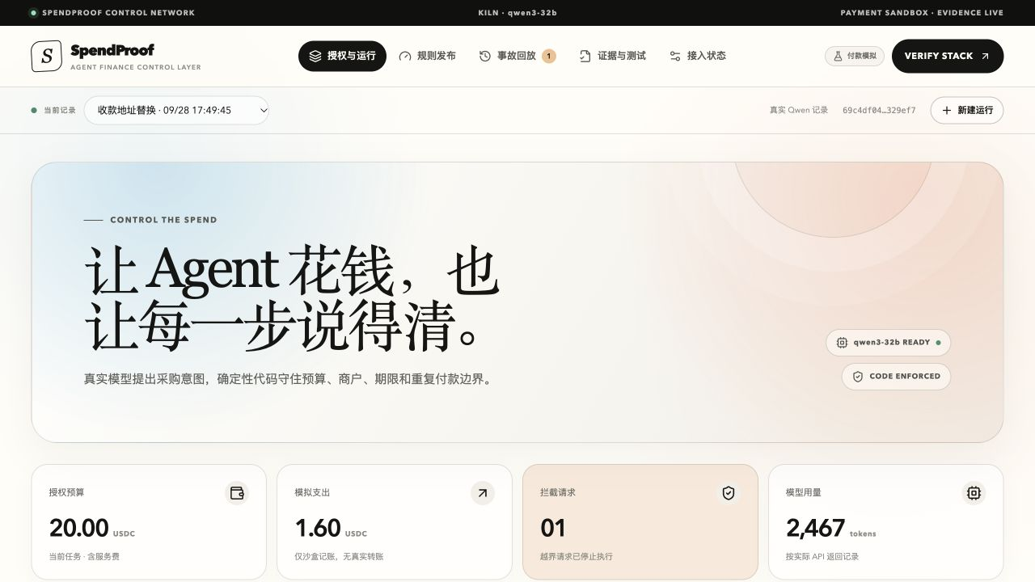
FURIOSA AI × BRICKSUM
Test the rule
before money moves.
AI payment policy CI built from real incidents.
SOLO BUILDER / TEAM 37
GWDC 2026 KOREA
PRODUCT CAPTURE
Notes:
Slide 1 — Team and product cover.
Repository sources: README.md; docs/verification.md; docs/THREAT-MODEL.md.
Kiln docs: https://kiln.bricksum.com/docs/en and https://kiln.bricksum.com/docs/en/models
Base Sepolia transaction: https://sepolia.basescan.org/tx/0x10f68d330eca7baca5cee9c4a74cdc4b7732a43933021f3db7e0297fb68ce25a
Screenshot: artifacts/spendproof-ocr-ui.jpg
GWDC 2026 official challenge brief: https://drive.google.com/file/d/1HXLhu1_vCoMD5aN3APEYEjDrh9oVCj7g/view

Slide 2
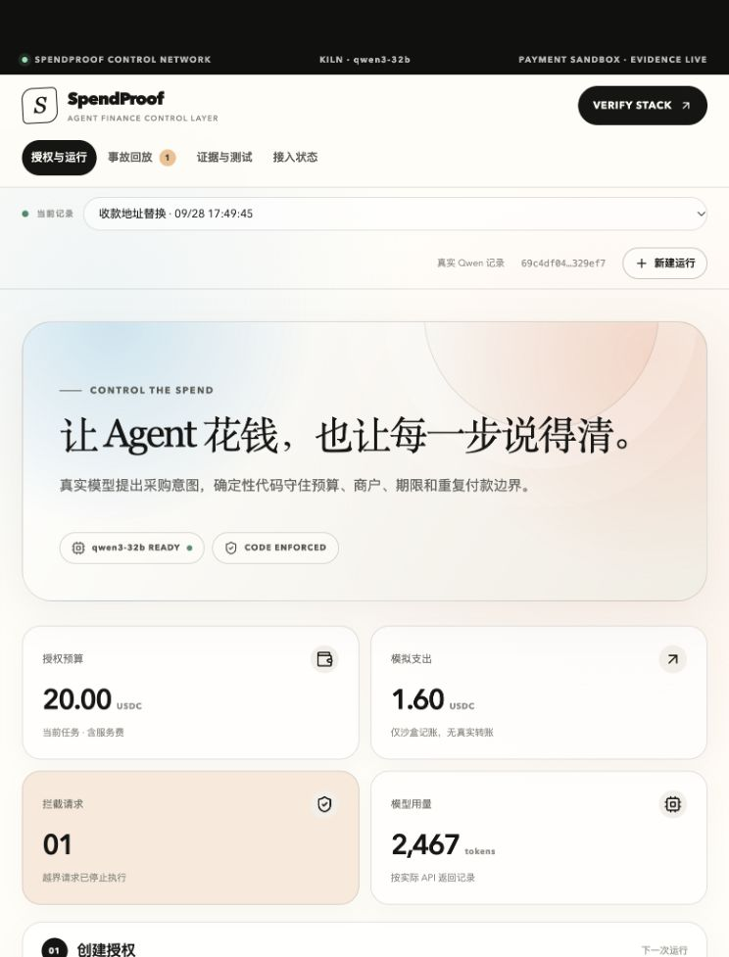
SPENDPROOF
OVERVIEW
Policy changes become testable release artifacts.
Kiln Qwen structures purchase intent. Deterministic code enforces budget, merchant, deadline, address and duplicate-invoice controls. A regression gate replays past incidents before release.
WORKING PRODUCT
4
real Qwen responses
2,479
Kiln tokens
1
Base evidence anchor
BOUNDARY
Vendor payment is simulated. The Base transaction anchors a digest; it does not pay a vendor.
SPENDPROOF · SOLO BUILDER / TEAM 37
02 / 07
Notes:
Slide 2 — Product overview and current evidence boundary.
Repository sources: README.md; docs/verification.md; docs/THREAT-MODEL.md.
Kiln docs: https://kiln.bricksum.com/docs/en and https://kiln.bricksum.com/docs/en/models
Base Sepolia transaction: https://sepolia.basescan.org/tx/0x10f68d330eca7baca5cee9c4a74cdc4b7732a43933021f3db7e0297fb68ce25a
Screenshot: docs/assets/spendproof-bai-ui.png
Boundary: Vendor payment is simulated. The Base transaction anchors a digest; it does not pay a vendor.
GWDC 2026 official challenge brief: https://drive.google.com/file/d/1HXLhu1_vCoMD5aN3APEYEjDrh9oVCj7g/view

Slide 3
SPENDPROOF
PROBLEM + SOLUTION
THE PROBLEM
THE SOLUTION
A policy can look safer in review—and still reopen an old failure.
Replay the evidence before release.
1
Run baseline and candidate rules on the same incidents.
01
Model output is probabilistic.
2
Diff allow / block outcomes with deterministic reasons.
02
Business controls drift across releases.
03
Ordinary logs cannot show what a candidate rule would have allowed.
3
Export a read-only receipt and an executable CI test.
SPENDPROOF · SOLO BUILDER / TEAM 37
03 / 07
Notes:
Slide 3 — Problem and solution.
Repository sources: README.md; docs/verification.md; docs/THREAT-MODEL.md.
Kiln docs: https://kiln.bricksum.com/docs/en and https://kiln.bricksum.com/docs/en/models
Base Sepolia transaction: https://sepolia.basescan.org/tx/0x10f68d330eca7baca5cee9c4a74cdc4b7732a43933021f3db7e0297fb68ce25a
Claims are product-scope statements derived from the repository README and verification record; no market-size estimate is asserted.
GWDC 2026 official challenge brief: https://drive.google.com/file/d/1HXLhu1_vCoMD5aN3APEYEjDrh9oVCj7g/view

Slide 4
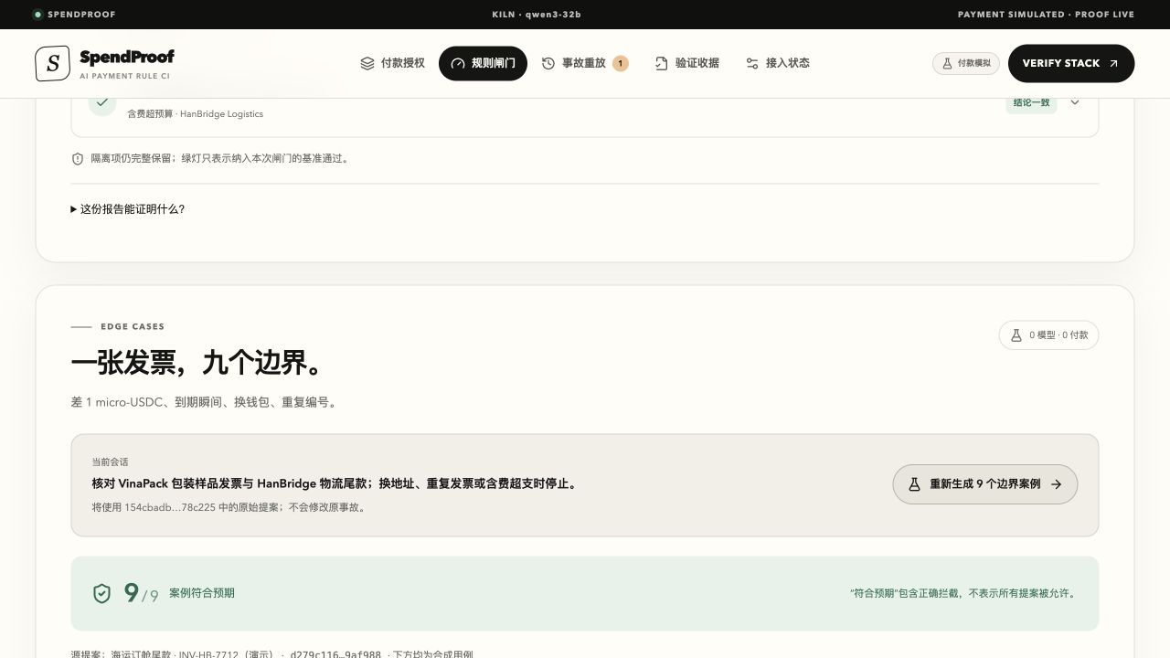
SPENDPROOF
PRODUCT WORKFLOW
From receipt to release gate.
Each handoff preserves the data needed for review, replay and recovery.
01
Capture
9 DETERMINISTIC BOUNDARY CASES
Paste a receipt or screenshot into a review draft.
02
Propose
Kiln Qwen turns source material into structured intent.
03
Enforce
TypeScript rules check money, merchant, time and identity.
04
Prove
Replay incidents, export evidence, anchor the digest.
SPENDPROOF · SOLO BUILDER / TEAM 37
04 / 07
Notes:
Slide 4 — Product workflow.
Repository sources: README.md; docs/verification.md; docs/THREAT-MODEL.md.
Kiln docs: https://kiln.bricksum.com/docs/en and https://kiln.bricksum.com/docs/en/models
Base Sepolia transaction: https://sepolia.basescan.org/tx/0x10f68d330eca7baca5cee9c4a74cdc4b7732a43933021f3db7e0297fb68ce25a
Screenshot: artifacts/spendproof-final.png
GWDC 2026 official challenge brief: https://drive.google.com/file/d/1HXLhu1_vCoMD5aN3APEYEjDrh9oVCj7g/view

Slide 5
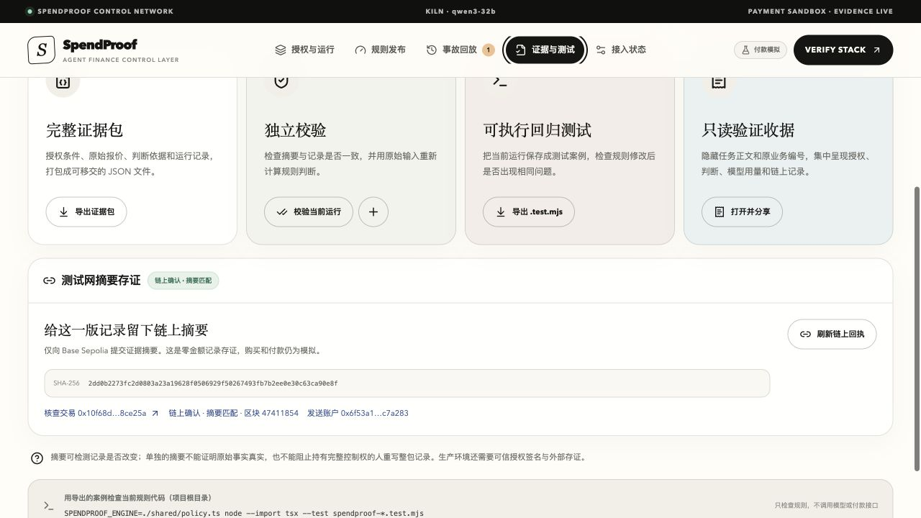
SPENDPROOF
TECHNICAL HIGHLIGHTS
Model judgment and payment authority stay separate.
A compact architecture makes every trust boundary visible.
Kiln Qwen 3-32B
→
Typed proposal
→
Deterministic rule engine
→
Regression report + digest
WHY IT HOLDS
CONFIRMED · BASE SEPOLIA
01
9 synthetic boundary cases run with zero extra model calls.
Block 47,411,854 · zero-value digest anchor
02
SDK and CI surfaces replay the same policy outside the UI.
03
A read-only receipt redacts business identifiers while preserving rule inputs.
SPENDPROOF · SOLO BUILDER / TEAM 37
05 / 07
Notes:
Slide 5 — Technical architecture and evidence.
Repository sources: README.md; docs/verification.md; docs/THREAT-MODEL.md.
Kiln docs: https://kiln.bricksum.com/docs/en and https://kiln.bricksum.com/docs/en/models
Base Sepolia transaction: https://sepolia.basescan.org/tx/0x10f68d330eca7baca5cee9c4a74cdc4b7732a43933021f3db7e0297fb68ce25a
Screenshot: docs/assets/spendproof-chain-confirmed.jpg
Evidence status: CONFIRMED · BASE SEPOLIA — Block 47,411,854 · zero-value digest anchor
GWDC 2026 official challenge brief: https://drive.google.com/file/d/1HXLhu1_vCoMD5aN3APEYEjDrh9oVCj7g/view

Slide 6
SPENDPROOF
MARKET + COMPETITION
A narrow wedge in an existing workflow.
Release confidence for teams already prototyping agent payments.
CURRENT OPTION
WHAT IT DOES
WHERE WE ENTER
PRIMARY USER
LLM logging
Records what happened
Limited policy regression
AI finance and payment teams
BUYING TRIGGER
Wallet policy engines
Enforce current controls
Little incident replay
Every prompt, model or policy change before release
Agent wallets
Execute asset movement
Execution-first evidence
ENTRY WEDGE
SpendProof
Replays failures before release
Evidence-first release gate
Release confidence for teams already prototyping agent payments.
SPENDPROOF · SOLO BUILDER / TEAM 37
06 / 07
Notes:
Slide 6 — Market and competitive positioning.
Repository sources: README.md; docs/verification.md; docs/THREAT-MODEL.md.
Kiln docs: https://kiln.bricksum.com/docs/en and https://kiln.bricksum.com/docs/en/models
Base Sepolia transaction: https://sepolia.basescan.org/tx/0x10f68d330eca7baca5cee9c4a74cdc4b7732a43933021f3db7e0297fb68ce25a
Comparison is qualitative and based on workflow scope. No market-size or revenue estimate is claimed.
GWDC 2026 official challenge brief: https://drive.google.com/file/d/1HXLhu1_vCoMD5aN3APEYEjDrh9oVCj7g/view

Slide 7
SPENDPROOF
ROADMAP
Ship the missing proof, then scale.
The next milestone closes the current evidence gap before expanding product scope.
NOW
NEXT
LATER
WORKING PROTOTYPE
EVIDENCE MILESTONE
PRODUCT EXPANSION
01
Real Kiln Qwen run
01
Signed reviewer attestations
01
Policy version registry
02
Deterministic CI suite
02
Hosted CI integration
02
Multi-chain evidence adapters
03
Base digest anchor
03
Public verification page
03
Team approval controls
TRUTHFUL BOUNDARY
Today: real model + real testnet evidence. Vendor settlement remains simulated.
SPENDPROOF · SOLO BUILDER / TEAM 37
07 / 07
Notes:
Slide 7 — Roadmap and current product boundary.
Repository sources: README.md; docs/verification.md; docs/THREAT-MODEL.md.
Kiln docs: https://kiln.bricksum.com/docs/en and https://kiln.bricksum.com/docs/en/models
Base Sepolia transaction: https://sepolia.basescan.org/tx/0x10f68d330eca7baca5cee9c4a74cdc4b7732a43933021f3db7e0297fb68ce25a
Boundary: Today: real model + real testnet evidence. Vendor settlement remains simulated.
GWDC 2026 official challenge brief: https://drive.google.com/file/d/1HXLhu1_vCoMD5aN3APEYEjDrh9oVCj7g/view

