Slide 1
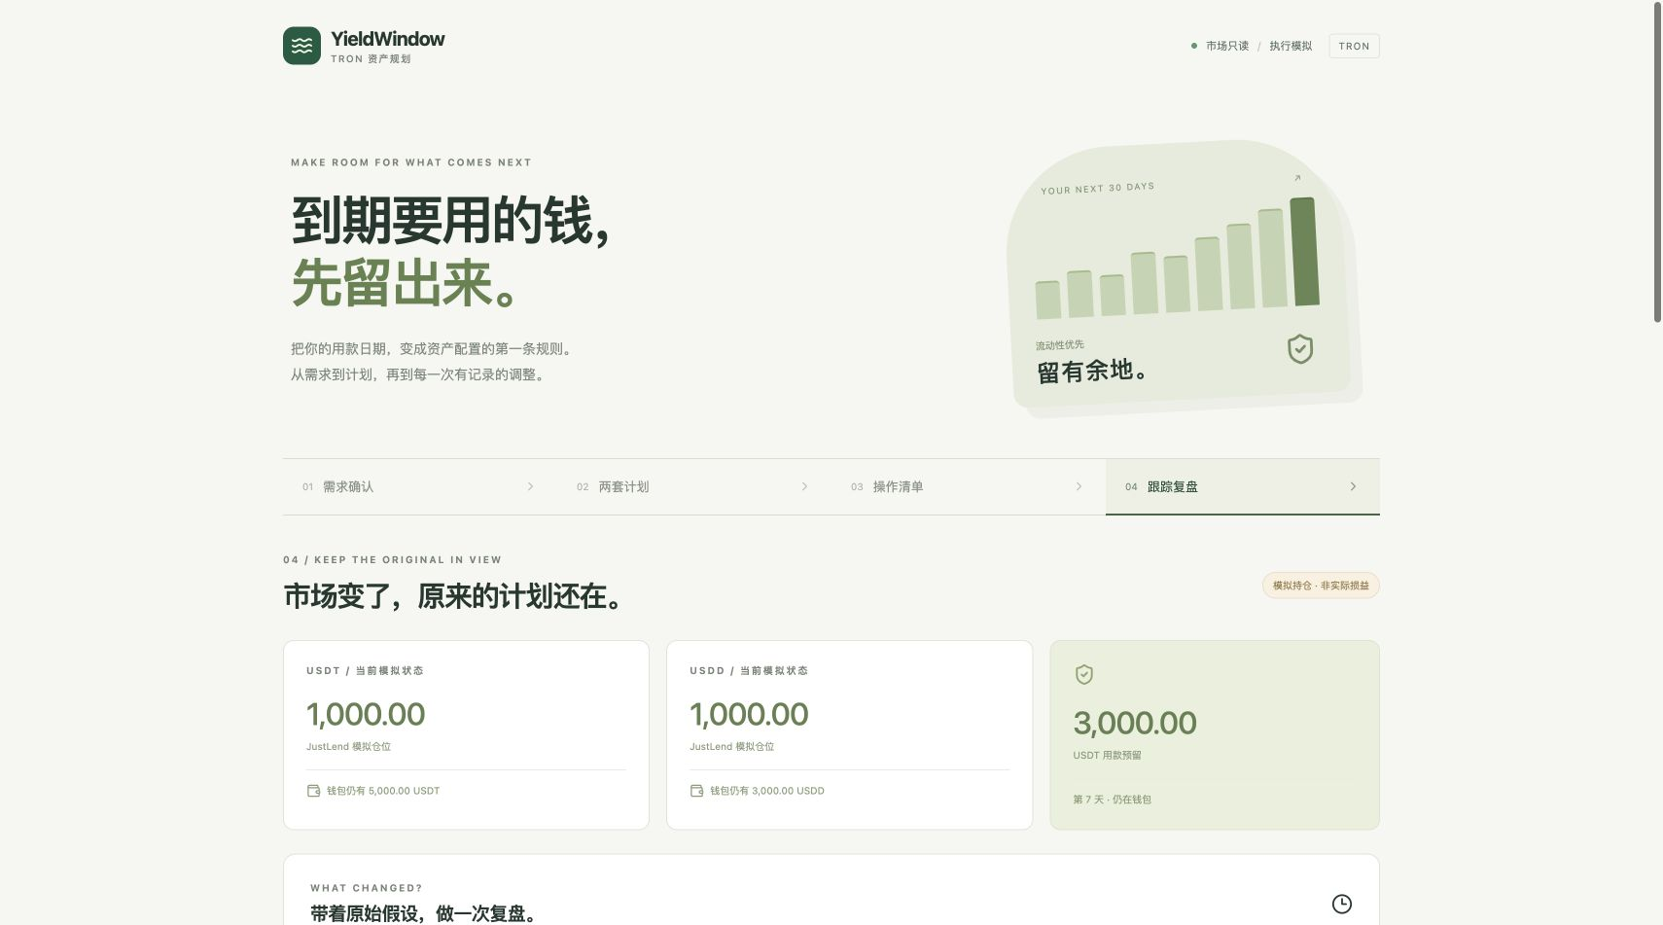
TRON CHALLENGE B · DEFI YIELD
Protect the bill
before chasing yield.
Liquidity-aware yield planning for stablecoin operators.
SOLO BUILDER / TEAM 37
GWDC 2026 KOREA
PRODUCT CAPTURE
Notes:
Slide 1 — Team and product cover.
Repository sources: projects/tron-b/README.md; projects/tron-b/docs/verification.md; projects/tron-b/docs/nile-receipt.md.
Nile plan commitment: https://nile.tronscan.org/#/transaction/4adaf2cfc03e80c36533cad6024e17de463eedc2efef66da3c1873602c1fca51
JustLend jTRX mint (block 71389024, SUCCESS): https://nile.tronscan.org/#/transaction/9b2098a8751d002bc80ca139737db0ded3cbd64770f71644ab4520aadf30b663
JustLend jTRX redeemUnderlying (block 71389044, SUCCESS): https://nile.tronscan.org/#/transaction/9546eb310aa71bd514a9709b3082e4c525a744539ae6f541069b4a27d36128ff
Canary artifact: artifacts/tron-nile/yieldwindow-justlend-canary.json. Official JustLend V1 jTRX market: https://nile.tronscan.org/#/contract/TKM7w4qFmkXQLEF2MgrQroBYpd5TY7i1pq
Boundary: the live write-path canary used 1 test TRX and returned jTRX raw balance 0 → 8,946,435,518 → 0. It did not execute the USDT/USDD treasury plan.
Screenshot: projects/tron-b/docs/preview.png
GWDC 2026 official challenge brief: https://drive.google.com/file/d/1HXLhu1_vCoMD5aN3APEYEjDrh9oVCj7g/view

Slide 2
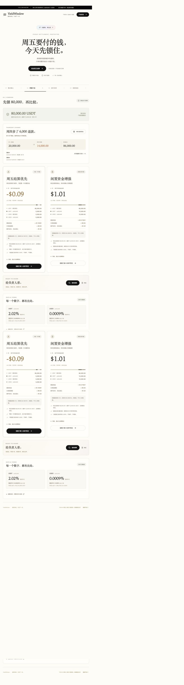
YIELDWINDOW
OVERVIEW
A due date becomes the first portfolio constraint.
YieldWindow preserves near-term operating cash, compares multiple allocation plans, and keeps the original assumptions visible as rates and balances change.
WORKING PRODUCT
2
stablecoin tracks
2+
plan alternatives
1
Nile plan receipt
BOUNDARY
A separate 1 test TRX jTRX mint → redeem canary succeeded. The USDT/USDD treasury plan remains simulated.
YIELDWINDOW · SOLO BUILDER / TEAM 37
02 / 07
Notes:
Slide 2 — Product overview and current evidence boundary.
Repository sources: projects/tron-b/README.md; projects/tron-b/docs/verification.md; projects/tron-b/docs/nile-receipt.md.
Nile plan commitment: https://nile.tronscan.org/#/transaction/4adaf2cfc03e80c36533cad6024e17de463eedc2efef66da3c1873602c1fca51
JustLend jTRX mint (block 71389024, SUCCESS): https://nile.tronscan.org/#/transaction/9b2098a8751d002bc80ca139737db0ded3cbd64770f71644ab4520aadf30b663
JustLend jTRX redeemUnderlying (block 71389044, SUCCESS): https://nile.tronscan.org/#/transaction/9546eb310aa71bd514a9709b3082e4c525a744539ae6f541069b4a27d36128ff
Canary artifact: artifacts/tron-nile/yieldwindow-justlend-canary.json. Official JustLend V1 jTRX market: https://nile.tronscan.org/#/contract/TKM7w4qFmkXQLEF2MgrQroBYpd5TY7i1pq
Boundary: the live write-path canary used 1 test TRX and returned jTRX raw balance 0 → 8,946,435,518 → 0. It did not execute the USDT/USDD treasury plan.
Screenshot: projects/tron-b/docs/final-desktop.jpg
Boundary: A separate 1 test TRX jTRX mint → redeem canary succeeded. The USDT/USDD treasury plan remains simulated.
GWDC 2026 official challenge brief: https://drive.google.com/file/d/1HXLhu1_vCoMD5aN3APEYEjDrh9oVCj7g/view

Slide 3
YIELDWINDOW
PROBLEM + SOLUTION
THE PROBLEM
THE SOLUTION
The highest APY is irrelevant if Friday’s settlement cash is locked.
Plan from the liability backward.
1
Reserve dated obligations before considering yield.
01
Yield screens start with return, not obligations.
2
Compare conservative and higher-yield alternatives side by side.
02
Liquidity assumptions disappear once a plan is executed.
03
Changing rates can silently invalidate yesterday’s allocation.
3
Track drift against the original snapshot before any rebalance.
YIELDWINDOW · SOLO BUILDER / TEAM 37
03 / 07
Notes:
Slide 3 — Problem and solution.
Repository sources: projects/tron-b/README.md; projects/tron-b/docs/verification.md; projects/tron-b/docs/nile-receipt.md.
Nile plan commitment: https://nile.tronscan.org/#/transaction/4adaf2cfc03e80c36533cad6024e17de463eedc2efef66da3c1873602c1fca51
JustLend jTRX mint (block 71389024, SUCCESS): https://nile.tronscan.org/#/transaction/9b2098a8751d002bc80ca139737db0ded3cbd64770f71644ab4520aadf30b663
JustLend jTRX redeemUnderlying (block 71389044, SUCCESS): https://nile.tronscan.org/#/transaction/9546eb310aa71bd514a9709b3082e4c525a744539ae6f541069b4a27d36128ff
Canary artifact: artifacts/tron-nile/yieldwindow-justlend-canary.json. Official JustLend V1 jTRX market: https://nile.tronscan.org/#/contract/TKM7w4qFmkXQLEF2MgrQroBYpd5TY7i1pq
Boundary: the live write-path canary used 1 test TRX and returned jTRX raw balance 0 → 8,946,435,518 → 0. It did not execute the USDT/USDD treasury plan.
Claims are product-scope statements derived from the repository README and verification record; no market-size estimate is asserted.
GWDC 2026 official challenge brief: https://drive.google.com/file/d/1HXLhu1_vCoMD5aN3APEYEjDrh9oVCj7g/view

Slide 4
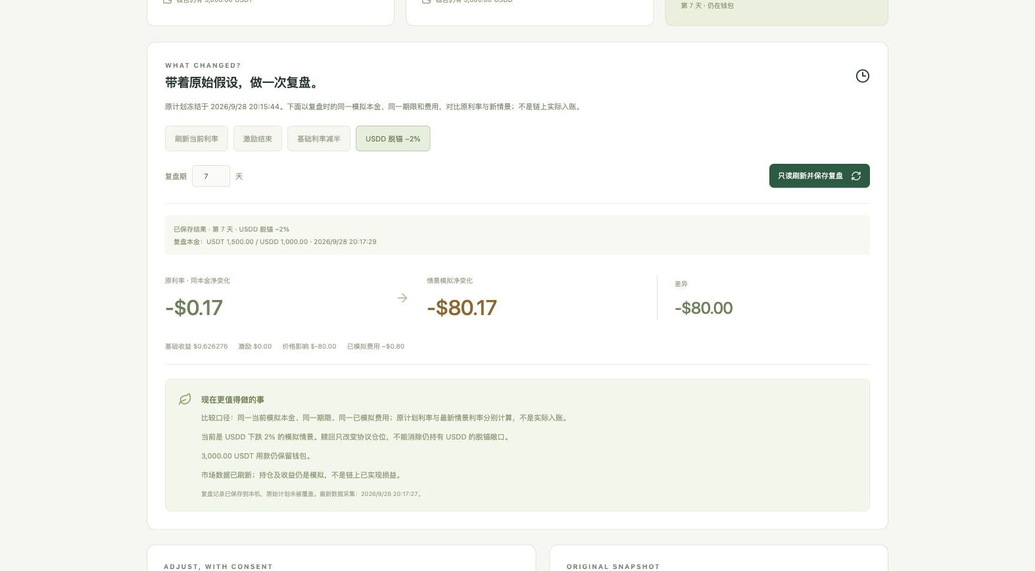
YIELDWINDOW
PRODUCT WORKFLOW
Intent, alternatives, consent, follow-through.
Each handoff preserves the data needed for review, replay and recovery.
01
Obligations
ORIGINAL ASSUMPTIONS REMAIN VISIBLE DURING REVIEW
Capture due dates, amounts, assets and liquidity rules.
02
Snapshots
Read JustLend and USDD market inputs.
03
Plans
Compare reserves, yield and downside assumptions.
04
Track
Revisit the saved plan as rates and balances move.
YIELDWINDOW · SOLO BUILDER / TEAM 37
04 / 07
Notes:
Slide 4 — Product workflow.
Repository sources: projects/tron-b/README.md; projects/tron-b/docs/verification.md; projects/tron-b/docs/nile-receipt.md.
Nile plan commitment: https://nile.tronscan.org/#/transaction/4adaf2cfc03e80c36533cad6024e17de463eedc2efef66da3c1873602c1fca51
JustLend jTRX mint (block 71389024, SUCCESS): https://nile.tronscan.org/#/transaction/9b2098a8751d002bc80ca139737db0ded3cbd64770f71644ab4520aadf30b663
JustLend jTRX redeemUnderlying (block 71389044, SUCCESS): https://nile.tronscan.org/#/transaction/9546eb310aa71bd514a9709b3082e4c525a744539ae6f541069b4a27d36128ff
Canary artifact: artifacts/tron-nile/yieldwindow-justlend-canary.json. Official JustLend V1 jTRX market: https://nile.tronscan.org/#/contract/TKM7w4qFmkXQLEF2MgrQroBYpd5TY7i1pq
Boundary: the live write-path canary used 1 test TRX and returned jTRX raw balance 0 → 8,946,435,518 → 0. It did not execute the USDT/USDD treasury plan.
Screenshot: projects/tron-b/docs/verification-desktop.png
GWDC 2026 official challenge brief: https://drive.google.com/file/d/1HXLhu1_vCoMD5aN3APEYEjDrh9oVCj7g/view

Slide 5
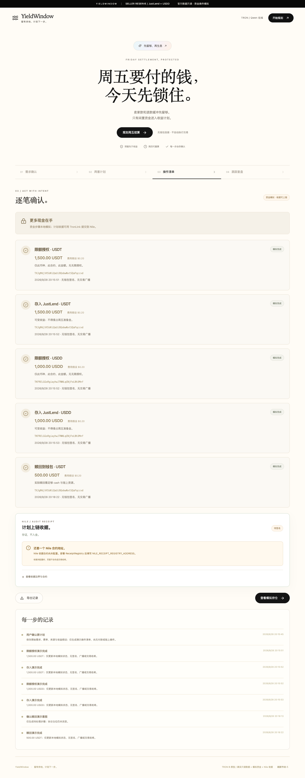
YIELDWINDOW
TECHNICAL HIGHLIGHTS
Plan execution is gated; the jTRX canary is live.
A compact architecture makes every trust boundary visible.
Qwen-assisted intake
→
Official market snapshots
→
Constraint engine
→
Receipt + jTRX canary
WHY IT HOLDS
LIVE JUSTLEND CANARY · NILE
01
Every plan shows reserves, allocation and liquidity assumptions.
1 test TRX · mint + redeem SUCCESS · balance back to 0
02
JustLend V1 mint block 71,389,024 and redeem block 71,389,044 both succeeded.
03
jTRX raw 0 → 8,946,435,518 → 0; this did not execute the USDT/USDD plan.
YIELDWINDOW · SOLO BUILDER / TEAM 37
05 / 07
Notes:
Slide 5 — Technical architecture and evidence.
Repository sources: projects/tron-b/README.md; projects/tron-b/docs/verification.md; projects/tron-b/docs/nile-receipt.md.
Nile plan commitment: https://nile.tronscan.org/#/transaction/4adaf2cfc03e80c36533cad6024e17de463eedc2efef66da3c1873602c1fca51
JustLend jTRX mint (block 71389024, SUCCESS): https://nile.tronscan.org/#/transaction/9b2098a8751d002bc80ca139737db0ded3cbd64770f71644ab4520aadf30b663
JustLend jTRX redeemUnderlying (block 71389044, SUCCESS): https://nile.tronscan.org/#/transaction/9546eb310aa71bd514a9709b3082e4c525a744539ae6f541069b4a27d36128ff
Canary artifact: artifacts/tron-nile/yieldwindow-justlend-canary.json. Official JustLend V1 jTRX market: https://nile.tronscan.org/#/contract/TKM7w4qFmkXQLEF2MgrQroBYpd5TY7i1pq
Boundary: the live write-path canary used 1 test TRX and returned jTRX raw balance 0 → 8,946,435,518 → 0. It did not execute the USDT/USDD treasury plan.
Screenshot: projects/tron-b/docs/nile-receipt-desktop.png
Evidence status: LIVE JUSTLEND CANARY · NILE — 1 test TRX · mint + redeem SUCCESS · balance back to 0
GWDC 2026 official challenge brief: https://drive.google.com/file/d/1HXLhu1_vCoMD5aN3APEYEjDrh9oVCj7g/view

Slide 6
YIELDWINDOW
MARKET + COMPETITION
A narrow wedge in an existing workflow.
A consent-first planning layer between yield discovery and execution.
CURRENT OPTION
WHAT IT DOES
WHERE WE ENTER
PRIMARY USER
Yield dashboard
Surfaces rates
Weak liability context
Stablecoin treasurers and small operating teams
BUYING TRIGGER
Auto-yield bot
Moves capital
Opaque trade-offs
A known payment date with idle cash in the same window
Spreadsheet
Models obligations
Manual market refresh
ENTRY WEDGE
YieldWindow
Preserves dated liquidity
Plans before execution
A consent-first planning layer between yield discovery and execution.
YIELDWINDOW · SOLO BUILDER / TEAM 37
06 / 07
Notes:
Slide 6 — Market and competitive positioning.
Repository sources: projects/tron-b/README.md; projects/tron-b/docs/verification.md; projects/tron-b/docs/nile-receipt.md.
Nile plan commitment: https://nile.tronscan.org/#/transaction/4adaf2cfc03e80c36533cad6024e17de463eedc2efef66da3c1873602c1fca51
JustLend jTRX mint (block 71389024, SUCCESS): https://nile.tronscan.org/#/transaction/9b2098a8751d002bc80ca139737db0ded3cbd64770f71644ab4520aadf30b663
JustLend jTRX redeemUnderlying (block 71389044, SUCCESS): https://nile.tronscan.org/#/transaction/9546eb310aa71bd514a9709b3082e4c525a744539ae6f541069b4a27d36128ff
Canary artifact: artifacts/tron-nile/yieldwindow-justlend-canary.json. Official JustLend V1 jTRX market: https://nile.tronscan.org/#/contract/TKM7w4qFmkXQLEF2MgrQroBYpd5TY7i1pq
Boundary: the live write-path canary used 1 test TRX and returned jTRX raw balance 0 → 8,946,435,518 → 0. It did not execute the USDT/USDD treasury plan.
Comparison is qualitative and based on workflow scope. No market-size or revenue estimate is claimed.
GWDC 2026 official challenge brief: https://drive.google.com/file/d/1HXLhu1_vCoMD5aN3APEYEjDrh9oVCj7g/view

Slide 7
YIELDWINDOW
ROADMAP
Ship the missing proof, then scale.
The next milestone closes the current evidence gap before expanding product scope.
NOW
NEXT
LATER
WORKING PROTOTYPE
EVIDENCE MILESTONE
PRODUCT EXPANSION
01
Official market snapshots
01
Read-only wallet balances
01
Policy-based rebalancing
02
Nile plan commitment
02
USDT/USDD position reads
02
More lending venues
03
Live jTRX mint + redeem canary
03
Plan-scoped signed testnet execution
03
Treasury audit API
TRUTHFUL BOUNDARY
Today: real market data + plan receipt + jTRX write-path canary. The USDT/USDD plan remains simulated.
YIELDWINDOW · SOLO BUILDER / TEAM 37
07 / 07
Notes:
Slide 7 — Roadmap and current product boundary.
Repository sources: projects/tron-b/README.md; projects/tron-b/docs/verification.md; projects/tron-b/docs/nile-receipt.md.
Nile plan commitment: https://nile.tronscan.org/#/transaction/4adaf2cfc03e80c36533cad6024e17de463eedc2efef66da3c1873602c1fca51
JustLend jTRX mint (block 71389024, SUCCESS): https://nile.tronscan.org/#/transaction/9b2098a8751d002bc80ca139737db0ded3cbd64770f71644ab4520aadf30b663
JustLend jTRX redeemUnderlying (block 71389044, SUCCESS): https://nile.tronscan.org/#/transaction/9546eb310aa71bd514a9709b3082e4c525a744539ae6f541069b4a27d36128ff
Canary artifact: artifacts/tron-nile/yieldwindow-justlend-canary.json. Official JustLend V1 jTRX market: https://nile.tronscan.org/#/contract/TKM7w4qFmkXQLEF2MgrQroBYpd5TY7i1pq
Boundary: the live write-path canary used 1 test TRX and returned jTRX raw balance 0 → 8,946,435,518 → 0. It did not execute the USDT/USDD treasury plan.
Boundary: Today: real market data + plan receipt + jTRX write-path canary. The USDT/USDD plan remains simulated.
GWDC 2026 official challenge brief: https://drive.google.com/file/d/1HXLhu1_vCoMD5aN3APEYEjDrh9oVCj7g/view

