Slide 1
Encryption Modes
Encryption mode or mode of operation refers to the many ways to make the input of an encryption algorithm different.
Examples include:
  Electronic Codebook (ECB)
  Cipher Block Chaining (CBC)
  Propagating CBC (PCBC)
  Cipher Feedback (CFB)
  Output Feedback (OFB)
  Counter (CTR)

Slide 2
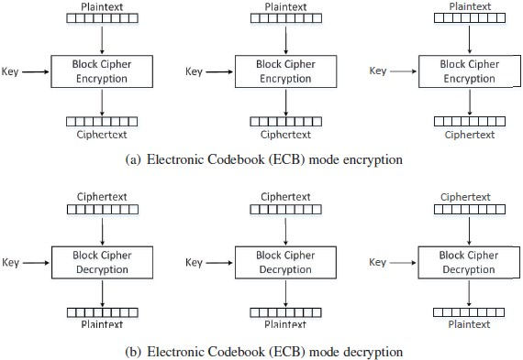
Electronic Codebook (ECB) Mode

Slide 3
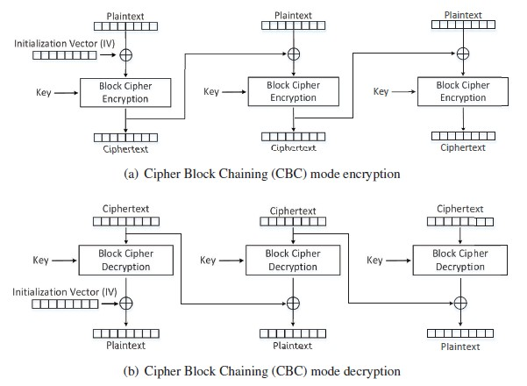
Cipher Block Chaining (CBC) Mode
The main purpose of IV is to ensure that even if two plaintexts are identical, their ciphertexts are still different, because different IVs will be used.
Decryption can be parallelized
Encryption cannot be parallelized

Slide 4
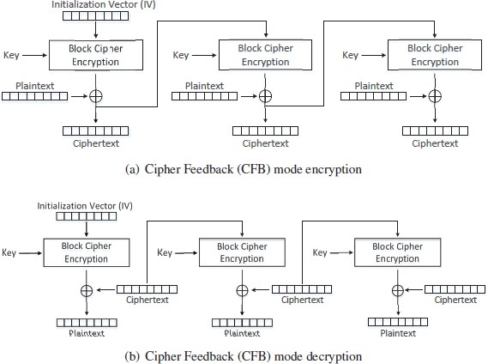
Cipher Feedback (CFB) Mode
A block cipher is turned into a stream cipher.
Ideal for encrypting real-time data.
Padding not required for the last block.
decryption using the CFB mode can be parallelized, while encryption can only be conducted sequentially

Slide 5
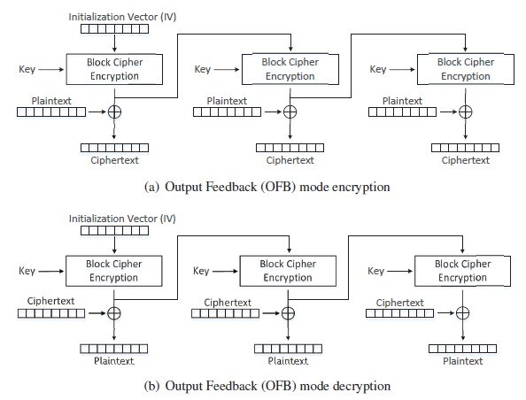
Output Feedback (OFB) Mode
Similar to CFB
  Used as stream cipher
  Does not need padding
  Decryption can parallelized
Encryption in the OFB mode can be parallelized

Slide 6
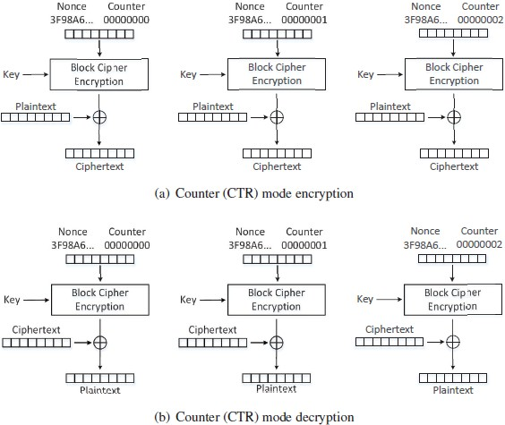
Counter (CTR) Mode
It basically uses a counter to generate the key streams
no key stream can be reused, hence the counter value for each block is prepended with a randomly generated value called nonce
This nonce serves the same role as the IV does to the other encryption modes.
both encryption and decryption can be parallelized
the key stream in the CTR mode can be calculated in parallel during the encryption

