Slide 1
Design Theory
Design Theory
Chapter 6

Slide 2
1. Normal forms & functional dependencies
Design Theory > Section 1

Slide 3
What you will learn about in this section
Design Theory > Section 1
Overview of design theory & normal forms
Data anomalies & constraints
Functional dependencies

Slide 4
Design Theory
Design Theory > Section 1 > Overview
Design theory is about how to represent your data to avoid anomalies.
It is a mostly mechanical process
  Tools can carry out routine portions

Slide 5
Normal Forms
Design Theory > Section 1 > Overview
1st Normal Form (1NF) = All tables are flat
2nd Normal Form
3rd Normal Form (3NF)
Boyce-Codd Normal Form (BCNF)
4th and 5th Normal Forms = see text books
DB designs based on functional dependencies, intended to prevent data anomalies
Our focus in this lecture + next one

Slide 6
1st Normal Form (1NF)
Design Theory > Section 1 > Overview
Student | Courses
Mary | CS145
Mary | CS229
Joe | CS145
Joe | CS106
Student | Courses
Mary | {CS145,CS229}
Joe | {CS145,CS106}
… | …
Violates 1NF.
In 1st NF
1NF Constraint: Types must be atomic!

Slide 7
Data Anomalies & Constraints
Design Theory > Section 1 > Data anomalies & constraints

Slide 8
Constraints Prevent (some)
Anomalies in the Data
Design Theory > Section 1 > Data anomalies & constraints
A poorly designed database causes anomalies:
Student | Course | Room
Mary | CS145 | B01
Joe | CS145 | B01
Sam | CS145 | B01
.. | .. | ..
If every course is in only one room, contains redundant information!

Slide 9
Constraints Prevent (some)
Anomalies in the Data
Design Theory > Section 1 > Data anomalies & constraints
A poorly designed database causes anomalies:
Student | Course | Room
Mary | CS145 | B01
Joe | CS145 | C12
Sam | CS145 | B01
.. | .. | ..
If we update the room number for one tuple, we get inconsistent data = an update anomaly

Slide 10
Constraints Prevent (some)
Anomalies in the Data
Design Theory > Section 1 > Data anomalies & constraints
A poorly designed database causes anomalies:
Student | Course | Room
.. | .. | ..
If everyone drops the class, we lose what room the class is in! = a delete anomaly

Slide 11
Constraints Prevent (some)
Anomalies in the Data
Design Theory > Section 1 > Data anomalies & constraints
A poorly designed database causes anomalies:
Student | Course | Room
Mary | CS145 | B01
Joe | CS145 | B01
Sam | CS145 | B01
.. | .. | ..
Similarly, we can’t reserve a room without students = an insert anomaly
… | CS229 | C12

Slide 12
Constraints Prevent (some)
Anomalies in the Data
Design Theory > Section 1 > Data anomalies & constraints
Is this form better?
Redundancy?
Update anomaly?
Delete anomaly?
Insert anomaly?
Student | Course
Mary | CS145
Joe | CS145
Sam | CS145
.. | ..
Course | Room
CS145 | B01
CS229 | C12
Today: develop theory to understand why this design may be better and how to find this decomposition…

Slide 13
Functional Dependencies
Design Theory > Section 1 > Functional dependencies

Slide 14
Functional Dependency
Design Theory > Section 1 > Functional dependencies
Def: Let A,B be sets of attributes
We write A 🡪 B or say A functionally determines B if, for any tuples t₁ and t₂:
t₁[A] = t₂[A] implies t₁[B] = t₂[B]
and we call A 🡪 B a functional dependency
A->B means that
“whenever two tuples agree on A then they agree on B.”

Slide 15
A Picture Of FDs
Design Theory > Section 1 > Functional dependencies
Defn (again):
Given attribute sets A={A₁,…,A_{m}} and B = {B₁,…B_{n}} in R,
 | A₁ | … | A_{m} |  | B₁ | … | B_{n}

Slide 16
A Picture Of FDs
Design Theory > Section 1 > Functional dependencies
Defn (again):
Given attribute sets A={A₁,…,A_{m}} and B = {B₁,…B_{n}} in R,
The functional dependency A🡪 B on R holds if for any t_{i},t_{j} in R:
 | A₁ | … | A_{m} |  | B₁ | … | B_{n}
t_{i}
t_{j}

Slide 17
A Picture Of FDs
Design Theory > Section 1 > Functional dependencies
Defn (again):
Given attribute sets A={A₁,…,A_{m}} and B = {B₁,…B_{n}} in R,
The functional dependency A🡪 B on R holds if for any t_{i},t_{j} in R:
t_{i}[A₁] = t_{j}[A₁] AND t_{i}[A₂]=t_{j}[A₂] AND … AND t_{i}[A_{m}] = t_{j}[A_{m}]
 | A₁ | … | A_{m} |  | B₁ | … | B_{n}
t_{i}
t_{j}
If t1,t2 agree here..

Slide 18
A Picture Of FDs
Design Theory > Section 1 > Functional dependencies
Defn (again):
Given attribute sets A={A₁,…,A_{m}} and B = {B₁,…B_{n}} in R,
The functional dependency A🡪 B on R holds if for any t_{i},t_{j} in R:
if t_{i}[A₁] = t_{j}[A₁] AND t_{i}[A₂]=t_{j}[A₂] AND … AND t_{i}[A_{m}] = t_{j}[A_{m}]
then t_{i}[B₁] = t_{j}[B₁] AND t_{i}[B₂]=t_{j}[B₂] AND … AND t_{i}[B_{n}] = t_{j}[B_{n}]
 | A₁ | … | A_{m} |  | B₁ | … | B_{n}
t_{i}
t_{j}
If t1,t2 agree here..
…they also must agree here!

Slide 19
FDs for Relational Schema Design
Design Theory > Section 1 > Functional dependencies
High-level idea: why do we care about FDs?
  Start with some relational schema
  Find out its functional dependencies (FDs)
  Use these to design a better schema
    One which minimizes the possibility of anomalies

Slide 20
Functional Dependencies as Constraints
Design Theory > Section 1
A functional dependency is a form of constraint
  Holds on some instances (but not others) – can check whether there are violations
  Part of the schema, helps define a valid instance
Student | Course | Room
Mary | CS145 | B01
Joe | CS145 | B01
Sam | CS145 | B01
.. | .. | ..
Note: The FD {Course} -> {Room} holds on this instance
Recall: an instance of a schema is a multiset of tuples conforming to that schema, i.e. a table

Slide 21
Functional Dependencies as Constraints
Design Theory > Section 1
Note that:
You can check if an FD is violated by examining a single instance;
However, you cannot prove that an FD is part of the schema by examining a single instance.
  This would require checking every valid instance
Student | Course | Room
Mary | CS145 | B01
Joe | CS145 | B01
Sam | CS145 | B01
.. | .. | ..
However, cannot prove that the FD {Course} -> {Room} is part of the schema

Slide 22
More Examples
Design Theory > Section 1 > Functional dependencies
An FD is a constraint which holds, or does not hold on an instance:
EmpID | Name | Phone | Position
E0045 | Smith | 1234 | Clerk
E3542 | Mike | 9876 | Salesrep
E1111 | Smith | 9876 | Salesrep
E9999 | Mary | 1234 | Lawyer

Slide 23
More Examples
Design Theory > Section 1 > Functional dependencies
EmpID | Name | Phone | Position
E0045 | Smith | 1234 | Clerk
E3542 | Mike | 9876 ← | Salesrep
E1111 | Smith | 9876 ← | Salesrep
E9999 | Mary | 1234 | Lawyer
{Position} 🡪 {Phone}

Slide 24
More Examples
Design Theory > Section 1 > Functional dependencies
EmpID | Name | Phone | Position
E0045 | Smith | 1234 → | Clerk
E3542 | Mike | 9876 | Salesrep
E1111 | Smith | 9876 | Salesrep
E9999 | Mary | 1234 → | Lawyer
but not {Phone} 🡪 {Position}

Slide 25
ACTIVITY
Design Theory > Section 1 > ACTIVITY
Find at least three FDs which are violated on this instance:
A | B | C | D | E
1 | 2 | 4 | 3 | 6
3 | 2 | 5 | 1 | 8
1 | 4 | 4 | 5 | 7
1 | 2 | 4 | 3 | 6
3 | 2 | 5 | 1 | 8
{ } 🡪 { }
{ } 🡪 { }
{ } 🡪 { }
Notes:
A -> D, B🡪 C, C->D

Slide 26
2. Finding functional dependencies
Design Theory > Section 2

Slide 27
“Good” vs. “Bad” FDs
Design Theory > Section 2 > Good vs. Bad FDs
We can start to develop a notion of good vs. bad FDs:
EmpID | Name | Phone | Position
E0045 | Smith | 1234 | Clerk
E3542 | Mike | 9876 | Salesrep
E1111 | Smith | 9876 | Salesrep
E9999 | Mary | 1234 | Lawyer
Intuitively:
EmpID -> Name, Phone, Position is “good FD”
Minimal redundancy, less possibility of anomalies

Slide 28
“Good” vs. “Bad” FDs
Design Theory > Section 2 > Good vs. Bad FDs
We can start to develop a notion of good vs. bad FDs:
EmpID | Name | Phone | Position
E0045 | Smith | 1234 | Clerk
E3542 | Mike | 9876 | Salesrep
E1111 | Smith | 9876 | Salesrep
E9999 | Mary | 1234 | Lawyer
Intuitively:
EmpID -> Name, Phone, Position is “good FD”
But Position -> Phone is a “bad FD”
Redundancy! Possibility of data anomalies

Slide 29
“Good” vs. “Bad” FDs
Design Theory > Section 2 > Good vs. Bad FDs
Student | Course | Room
Mary | CS145 | B01
Joe | CS145 | B01
Sam | CS145 | B01
.. | .. | ..
Returning to our original example… can you see how the “bad FD” {Course} -> {Room} could lead to an:
  Update Anomaly
  Insert Anomaly
  Delete Anomaly
  …
Given a set of FDs (from user) our goal is to:
Find all FDs, and
Eliminate the “Bad Ones".

Slide 30
FDs for Relational Schema Design
Design Theory > Section 2 > Finding FDs
High-level idea: why do we care about FDs?
  Start with some relational schema
  Find out its functional dependencies (FDs)
  Use these to design a better schema
    One which minimizes possibility of anomalies
This part can be tricky!

Slide 31
Finding Functional Dependencies
Design Theory > Section 2 > Finding FDs
There can be a very large number of FDs…
  How to find them all efficiently?
We can’t necessarily show that any FD will hold on all instances…
  How to do this?
We will start with this problem:
Given a set of FDs, F, what other FDs must hold?

Slide 32
Finding Functional Dependencies
Design Theory > Section 2 > Finding FDs
Example:
Products
Provided FDs:
Name | Color | Category | Dep | Price
Gizmo | Green | Gadget | Toys | 49
Widget | Black | Gadget | Toys | 59
Gizmo | Green | Whatsit | Garden | 99
1. {Name} 🡪 {Color}
2. {Category} 🡪 {Department}
3. {Color, Category} 🡪 {Price}
Given the provided FDs, we can see that {Name, Category} 🡪 {Price} must also hold on any instance…
Which / how many other FDs do?!?

Slide 33
Finding Functional Dependencies
Design Theory > Section 2 > Finding FDs
Equivalent to asking: Given a set of FDs, F = {f₁,…f_{n}}, does an FD g hold?
Inference problem: How do we decide?
Answer: Three simple rules called Armstrong’s Rules.
Split/Combine,
Reduction, and
Transitivity… ideas by picture

Slide 34
1. Split/Combine
Design Theory > Section 2 > Finding FDs
 | A₁ | … | A_{m} |  | B₁ | … | B_{n}
A₁, …, A_{m} 🡪 B₁,…,B_{n}

Slide 35
1. Split/Combine
Design Theory > Section 2 > Finding FDs
 | A₁ | … | A_{m} |  | B₁ | … | B_{n}
A₁, …, A_{m} 🡪 B₁,…,B_{n}
… is equivalent to the following n FDs…
A₁,…,A_{m} 🡪 B_{i} for i=1,…,n

Slide 36
1. Split/Combine
Design Theory > Section 2 > Finding FDs
 | A₁ | … | A_{m} |  | B₁ | … | B_{n}
And vice-versa, A₁,…,A_{m} 🡪 B_{i} for i=1,…,n
… is equivalent to …
A₁, …, A_{m} 🡪 B₁,…,B_{n}

Slide 37
Example
Name, Color -> price, Dept
Split:
  Name, Color -> Price
  Name, Color -> Dept

Slide 38
Reduction/Trivial
Design Theory > Section 2 > Finding FDs
 | A₁ | … | A_{m}
Reduction:
  Name, Color -> Name
  Name, Color -> Color
A₁,…,A_{m} 🡪 A_{j} for any j=1,…,m

Slide 39
3. Transitive Closure
Design Theory > Section 2 > Finding FDs
 | A₁ | … | A_{m} |  | B₁ | … | B_{n} |  | C₁ | … | C_{k}
A₁, …, A_{m} 🡪 B₁,…,B_{n} and
B₁,…,B_{n} 🡪 C₁,…,C_{k}

Slide 40
3. Transitive Closure
Design Theory > Section 2 > Finding FDs
 | A₁ | … | A_{m} |  | B₁ | … | B_{n} |  | C₁ | … | C_{k}
A₁, …, A_{m} 🡪 B₁,…,B_{n} and
B₁,…,B_{n} 🡪 C₁,…,C_{k}
implies
A₁,…,A_{m} 🡪 C₁,…,C_{k}

Slide 41
Finding Functional Dependencies
Design Theory > Section 2 > Finding FDs
Example:
Products
Provided FDs:
Name | Color | Category | Dep | Price
Gizmo | Green | Gadget | Toys | 49
Widget | Black | Gadget | Toys | 59
Gizmo | Green | Whatsit | Garden | 99
1. {Name} 🡪 {Color}
2. {Category} 🡪 {Department}
3. {Color, Category} 🡪 {Price}
Which / how many other FDs hold?

Slide 42
Finding Functional Dependencies
Design Theory > Section 2 > Finding FDs
Example:
Inferred FDs:
Provided FDs:
Inferred FD | Rule used
4. {Name, Category} -> {Name} | ?
5. {Name, Category} -> {Color} | ?
6. {Name, Category} -> {Category} | ?
7. {Name, Category} -> {Color, Category} | ?
8. {Name, Category} -> {Price} | ?
1. {Name} 🡪 {Color}
2. {Category} 🡪 {Dept.}
3. {Color, Category} 🡪 {Price}
Which / how many other FDs hold?

Slide 43
Finding Functional Dependencies
Design Theory > Section 2 > Finding FDs
Example:
Inferred FDs:
Provided FDs:
Inferred FD | Rule used
4. {Name, Category} -> {Name} | Trivial
5. {Name, Category} -> {Color} | Transitive (4 -> 1)
6. {Name, Category} -> {Category} | Trivial
7. {Name, Category} -> {Color, Category} | Split/combine (5 + 6)
8. {Name, Category} -> {Price} | Transitive (7 -> 3)
1. {Name} 🡪 {Color}
2. {Category} 🡪 {Dept.}
3. {Color, Category} 🡪 {Price}
Can we find an algorithmic way to do this?

Slide 44
Closures
Design Theory > Section 2 > Closures

Slide 45
Closure of a set of Attributes
Design Theory > Section 2 > Closures
Given a set of attributes A₁, …, A_{n} and a set of FDs F:
Then the closure, {A₁, …, A_{n}}⁺ is the set of attributes B s.t. {A₁, …, A_{n}} 🡪 B
Example: F =
{name} 🡪 {color}
{category} 🡪 {dept}
{color, category} 🡪 {price}
Example Closures:
{name}⁺ = {name, color}
{name, category}⁺ =
{name, category, color, dept, price}
{color}⁺ = {color}

Slide 46
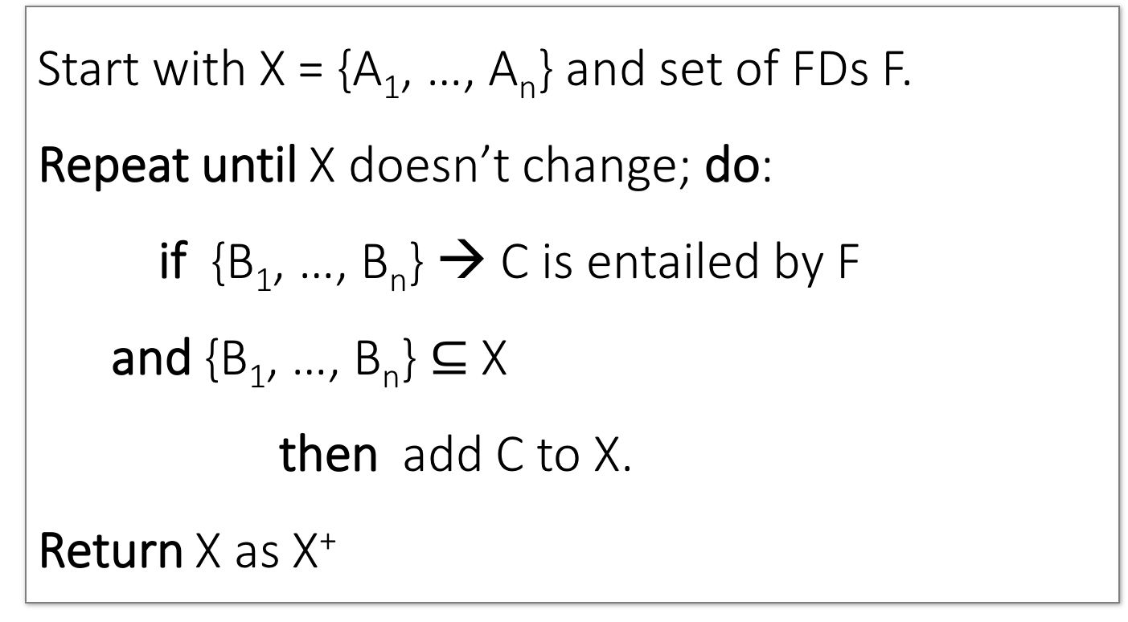
Closure Algorithm
Design Theory > Section 2 > Closures

Slide 47
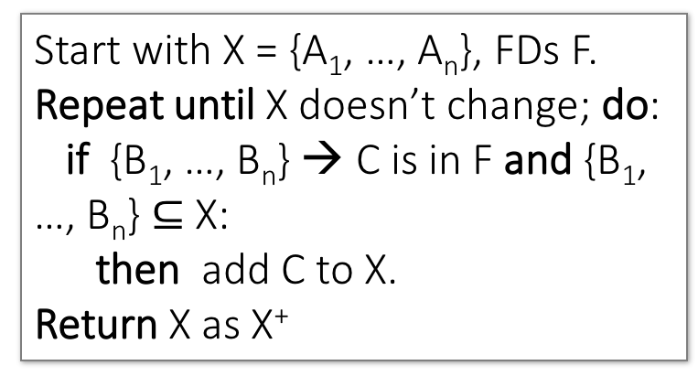
Closure Algorithm
Design Theory > Section 2 > Closures
{name, category}⁺ =
{name, category}
F =
{name} 🡪 {color}
{category} 🡪 {dept}
{color, category} 🡪 {price}

Slide 48
Closure Algorithm
Design Theory > Section 2 > Closures
{name, category}⁺ =
{name, category}
{name, category}⁺ =
{name, category, color}
F =
{name} 🡪 {color}
{category} 🡪 {dept}
{color, category} 🡪 {price}

Slide 49
Closure Algorithm
Design Theory > Section 2 > Closures
{name, category}⁺ =
{name, category}
{name, category}⁺ =
{name, category, color}
F =
{name, category}⁺ =
{name, category, color, dept}
{name} 🡪 {color}
{category} 🡪 {dept}
{color, category} 🡪 {price}

Slide 50
Closure Algorithm
Design Theory > Section 2 > Closures
{name, category}⁺ =
{name, category}
{name, category}⁺ =
{name, category, color}
F =
{name, category}⁺ =
{name, category, color, dept}
{name} 🡪 {color}
{category} 🡪 {dept}
{color, category} 🡪 {price}
{name, category}⁺ =
{name, category, color, dept, price}

Slide 51
Example
Design Theory > Section 2 > Closures
{A,B} 🡪 {C}
{A,D} 🡪 {E}
{B} 🡪 {D}
{F} 🡪 {H}
{A,F} 🡪 {B}
R(A,B,C,D,E,F, H)
Compute {A,B}⁺ = {A, B, }
Compute {A, F}⁺ = {A, F, }
Compute {A, C}⁺ = { }

Slide 52
3. Closures, Superkeys & Keys
Design Theory > Section 3

Slide 53
Why Do We Need the Closure?
Design Theory > Section 3 > Closures Pt. II
With closure we can find all FD’s easily
To check if X → A
  Compute X⁺
  Check if A ∈ X⁺
Note here that X is a set of attributes, but A is a single attribute. Why does considering FDs of this form suffice?
Recall the Split/combine rule:
X 🡪 A₁, …, X 🡪 A_{n}
implies
X 🡪 {A₁, …, A_{n}}

Slide 54
Using Closure to Infer ALL FDs
Design Theory > Section 3 > Closures Pt. II
Example:
Given F =
{A,B} 🡪 C
{A,D} 🡪 B
{B} 🡪 D
For table R(A, B, C, D)
Step 1: Compute X⁺, for every set of attributes X:
{A}⁺ = {A}
{B}⁺ = {B,D}
{C}⁺ = {C}
{D}⁺ = {D}
{A,B}⁺ = {A,B,C,D}
{A,C}⁺ = {A,C}
{A,D}⁺ = {A,B,C,D}
{B,C} ⁺ = {B,C,D}
{B,D} ⁺ = {B,D}
{C,D} ⁺ = {C,D}
{A,B,C}⁺ = {A,B,D}⁺ = {A,C,D}⁺ = {A,B,C,D}
{B,C,D}⁺ = {B,C,D}
{A,B,C,D}⁺ = {A,B,C,D}
No need to compute all of these- why?

Slide 55
Using Closure to Infer ALL FDs
Design Theory > Section 3 > Closures Pt. II
Example:
Given F =
{A,B} 🡪 C
{A,D} 🡪 B
{B} 🡪 D
Step 1: Compute X⁺, for every set of attributes X:
{A}⁺ = {A}, {B}⁺ = {B,D}, {C}⁺ = {C}, {D}⁺ = {D}, {A,B}⁺ = {A,B,C,D}, {A,C}⁺ = {A,C}, {A,D}⁺ = {A,B,C,D}, {A,B,C}⁺ = {A,B,D}⁺ = {A,C,D}⁺ = {A,B,C,D}, {B,C,D}⁺ = {B,C,D}, {A,B,C,D}⁺ = {A,B,C,D}
Step 2: Enumerate all FDs X 🡪 Y, s.t. Y ⊆ X⁺ and X ∩ Y = ∅:
{A,B} 🡪 {C,D}, {A,D} 🡪 {B,C},
{A,B,C} 🡪 {D}, {A,B,D} 🡪 {C},
{A,C,D} 🡪 {B}

Slide 56
Using Closure to Infer ALL FDs
Design Theory > Section 3 > Closures Pt. II
Example:
Given F =
{A,B} 🡪 C
{A,D} 🡪 B
{B} 🡪 D
Step 1: Compute X⁺, for every set of attributes X:
{A}⁺ = {A}, {B}⁺ = {B,D}, {C}⁺ = {C}, {D}⁺ = {D}, {A,B}⁺ = {A,B,C,D}, {A,C}⁺ = {A,C}, {A,D}⁺ = {A,B,C,D}, {A,B,C}⁺ = {A,B,D}⁺ = {A,C,D}⁺ = {A,B,C,D}, {B,C,D}⁺ = {B,C,D}, {A,B,C,D}⁺ = {A,B,C,D}
Step 2: Enumerate all FDs X 🡪 Y, s.t. Y ⊆ X⁺ and X ∩ Y = ∅:
“Y is in the closure of X”
{A,B} 🡪 {C,D}, {A,D} 🡪 {B,C},
{A,B,C} 🡪 {D}, {A,B,D} 🡪 {C},
{A,C,D} 🡪 {B}

Slide 57
Using Closure to Infer ALL FDs
Design Theory > Section 3 > Closures Pt. II
Example:
Given F =
{A,B} 🡪 C
{A,D} 🡪 B
{B} 🡪 D
Step 1: Compute X⁺, for every set of attributes X:
{A}⁺ = {A}, {B}⁺ = {B,D}, {C}⁺ = {C}, {D}⁺ = {D}, {A,B}⁺ = {A,B,C,D}, {A,C}⁺ = {A,C}, {A,D}⁺ = {A,B,C,D}, {A,B,C}⁺ = {A,B,D}⁺ = {A,C,D}⁺ = {A,B,C,D}, {B,C,D}⁺ = {B,C,D}, {A,B,C,D}⁺ = {A,B,C,D}
Step 2: Enumerate all FDs X 🡪 Y, s.t. Y ⊆ X⁺ and X ∩ Y = ∅:
The FD X 🡪 Y is non-trivial
{A,B} 🡪 {C,D}, {A,D} 🡪 {B,C},
{A,B,C} 🡪 {D}, {A,B,D} 🡪 {C},
{A,C,D} 🡪 {B}

Slide 58
Superkeys and Keys
Design Theory > Section 3 > Superkeys & Keys

Slide 59
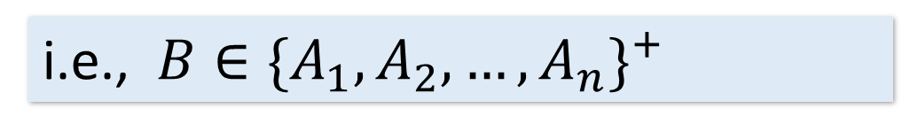
Keys and Superkeys
Design Theory > Section 3 > Superkeys & Keys
A superkey is a set of attributes A₁, …, A_{n} s.t.
for any other attribute B in R,
we have {A₁, …, A_{n}} 🡪 B
I.e. all attributes are functionally determined by a superkey
This means that no subset of a key is also a superkey (i.e., dropping any attribute from the key makes it no longer a superkey)
A key is a minimal superkey

Slide 60
Finding Keys and Superkeys
Design Theory > Section 3 > Superkeys & Keys
For each set of attributes X
  Compute X⁺
  If X⁺ = set of all attributes then X is a superkey
  If X is minimal, then it is a key

Slide 61
Example of Finding Keys
Design Theory > Section 3 > Superkeys & Keys
Product(name, price, category, color)
{name, category} 🡪 price
{category} 🡪 color
What is a key?
{name, category}+ = {name, category, color, price}
{name, category, color}+ = {name, category, color, price}

Slide 62
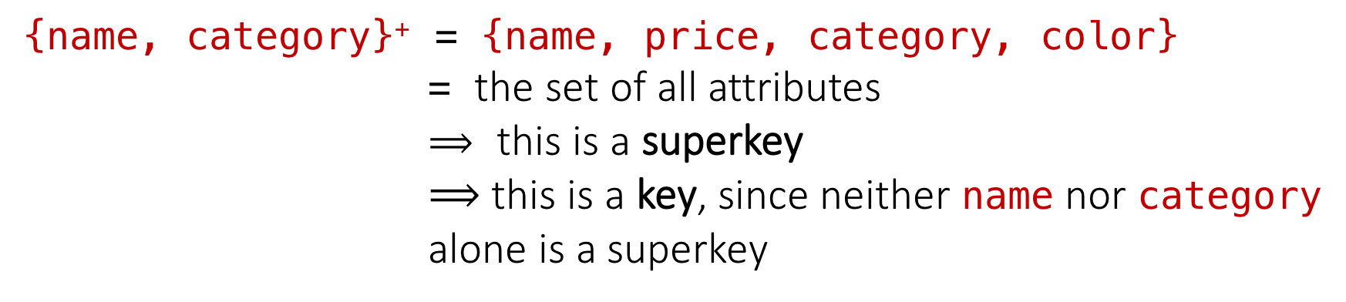
Example of Keys
Design Theory > Section 3 > Superkeys & Keys
Product(name, price, category, color)
{name, category} 🡪 price
{category} 🡪 color

Slide 63
Superkey vs Key
{name, category}+ = {name, category, color, price}
  superkey and key
{name, category, color}+ = {name, category, color, price}
Superkey but not key

Slide 64
Design Theory II
Design Theory II

Slide 65
Normal Forms
Design Theory II > Normal Forms

Slide 66
2NF
Definition
  A relation schema R is in Second Normal Form (2NF) if every non-prime attribute A in R is not partially dependent on any key of R.
Prime attribute:
  Is an attribute that is part of any key
Partially dependent 🡺 depends on subset of the key

Slide 67
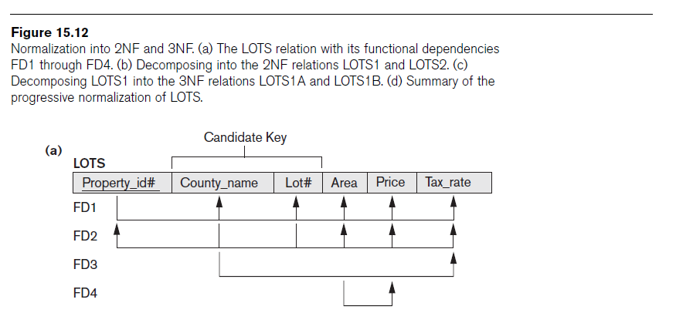
Example
Design Theory II > Normal Forms
A relation schema R is in Second Normal Form (2NF) if every non-prime attribute A in R is not partially dependent on any key of R
LOTS(p_id, county_name, lot#, Area, price, tax_rate)
FD1: p_id -> {county_name, lot#, Area, price, tax_rate}
FD2: county_name, lot#}->{p_id, area, price, tax_rate}
FD3: county_name -> Tax_rate
FD4: area -> price
(p_id)+={ p_id, county_name, lot#, area, price, tax_rate}
{county_name, lot#}+={ p_id, county_name, lot#, area, price, tax_rate}
{county_name}+ ={county_name, tax_rate}
{area}+={price, area}
Prime attributes:
  p_id
  county_name
  lot#
non-prime attributes:
  Area, Price, Tax rate
It is not in 2NF as we have county_name -> tax_rate
Lots1( p_id, county_name, lot#, Area, price)
Lots2(county_name, tax_rate)

Slide 68
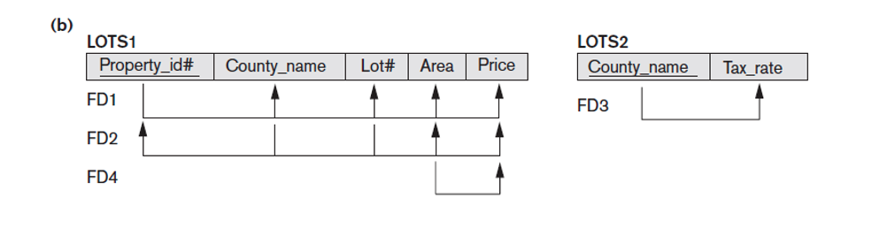

2NF
Design Theory II > Normal Forms
2NF

Slide 69
3NF
Definition:
A relation schema R is in Third Normal Form (3NF) if, whenever a nontrivial functional dependency X → A holds in R, either:
(a) X is a superkey of R, or
(b) A is a prime attribute of R.

Slide 70
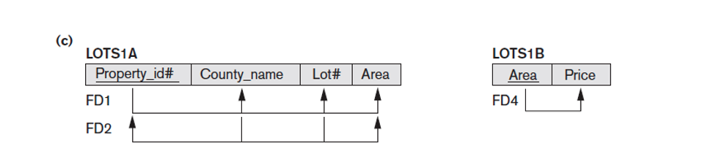
2NF -> 3NF
Design Theory II > Normal Forms
2NF
FD: X->A
(a) X is a superkey
or (b) A is a prime attribute
Lots1(p_id, county_name, lot#, Area, price)
FD1:p_id -> {county_name, lot#, Area, price}
FD2:{county_name, lot#}->{p_id, area, price}
FD4:area -> price
3NF
Lots1A(p_id, county_name, lot#, Area)
Lots1B(area, price)
+ LOTS2

Slide 71
BCNF:
A relation schema R is in BCNF if, whenever a nontrivial functional dependency X → A holds in R, then X is a superkey of R
3NF:
A relation schema R is in Third Normal Form (3NF) if, whenever a nontrivial functional dependency X → A holds in R, either:
(a) X is a superkey of R, or
(b) A is a prime attribute of R.

Slide 72
BCNF
Definition:
A relation schema R is in BCNF if, whenever a nontrivial functional dependency X → A holds in R, then X is a superkey of R

Slide 73
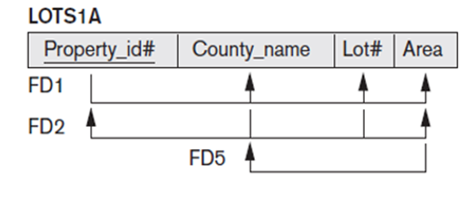
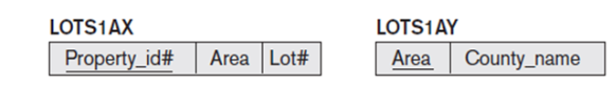
3NF to BCNF
Design Theory II > Normal Forms
3NF
BCNF:
X->A
X has to be a superkey
FD5:
Area- > county_name
Lots1A(p_id, county_name, lot#, Area)
is in 3NF but not in BCNF (county is prime attribute)
Lots1AX(p_id, lot#, Area)
Lots1AY(Area,county_name )
BCNF

Slide 74
Boyce-Codd Normal Form (BCNF)
Design Theory II > BCNF
Main idea is that we define “good” and “bad” FDs as follows:
  X 🡪 A is a “good FD” if X is a (super)key
    In other words, if A is the set of all attributes
  X 🡪 A is a “bad FD” otherwise
We will try to eliminate the “bad” FDs!

Slide 75
Boyce-Codd Normal Form (BCNF)
Design Theory II > BCNF
Why does this definition of “good” and “bad” FDs make sense?
If X is not a (super)key, it functionally determines some of the attributes; therefore, those other attributes can be duplicated
  Recall: this means there is redundancy
  And redundancy like this can lead to data anomalies!
EmpID | Name | Phone | Position
E0045 | Smith | 1234 | Clerk
E3542 | Mike | 9876 | Salesrep
E1111 | Smith | 9876 | Salesrep
E9999 | Mary | 1234 | Lawyer

Slide 76
Boyce-Codd Normal Form
Design Theory II > BCNF
BCNF is a simple condition for removing anomalies from relations:
A relation R is in BCNF if:
if {A₁, ..., A_{n}} 🡪 B is a non-trivial FD in R
then {A₁, ..., A_{n}} is a superkey for R
In other words: there are no “bad” FDs

Slide 77
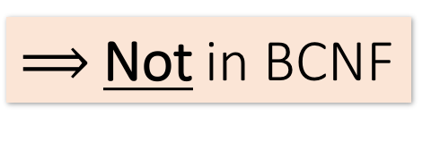
Example
Design Theory II > Section 2 > BCNF
Name | SSN | PhoneNumber | City
Fred | 123-45-6789 | 206-555-1234 | Seattle
Fred | 123-45-6789 | 206-555-6543 | Seattle
Joe | 987-65-4321 | 908-555-2121 | Westfield
Joe | 987-65-4321 | 908-555-1234 | Westfield
{SSN} 🡪 {Name,City}
This FD is bad because it is not a superkey
What is the key?
{SSN, PhoneNumber}

Slide 78
Example
Design Theory II > BCNF
Name | SSN | City
Fred | 123-45-6789 | Seattle
Joe | 987-65-4321 | Madison
{SSN} 🡪 {Name,City}
This FD is now good because it is the key
SSN | PhoneNumber
123-45-6789 | 206-555-1234
123-45-6789 | 206-555-6543
987-65-4321 | 908-555-2121
987-65-4321 | 908-555-1234
Let’s check anomalies:
  Redundancy ?
  Update ?
  Delete ?
Now in BCNF!

Slide 79
BCNF Decomposition Algorithm
Design Theory II > BCNF
BCNFDecomp(R):
Find X s.t.: X⁺ ≠ X and X⁺ ≠ [all attributes]
if (not found) then Return R
let Y = X⁺ - X, Z = (X⁺)^{C}
decompose R into R1(X ∪ Y) and R2(X ∪ Z)
Return BCNFDecomp(R1), BCNFDecomp(R2)

Slide 80
BCNF Decomposition Algorithm
Design Theory II > BCNF
BCNFDecomp(R):
Find a set of attributes X s.t.: X⁺ ≠ X and X⁺ ≠ [all attributes]
if (not found) then Return R
let Y = X⁺ - X, Z = (X⁺)^{C}
decompose R into R1(X ∪ Y) and R2(X ∪ Z)
Return BCNFDecomp(R1), BCNFDecomp(R2)
Find a set of attributes X which has non-trivial “bad” FDs, i.e. is not a superkey, using closures

Slide 81
BCNF Decomposition Algorithm
Design Theory II > BCNF
BCNFDecomp(R):
Find a set of attributes X s.t.: X⁺ ≠ X and X⁺ ≠ [all attributes]
if (not found) then Return R
let Y = X⁺ - X, Z = (X⁺)^{C}
decompose R into R1(X ∪ Y) and R2(X ∪ Z)
Return BCNFDecomp(R1), BCNFDecomp(R2)
If no “bad” FDs found, in BCNF!

Slide 82
BCNF Decomposition Algorithm
Design Theory II > BCNF
BCNFDecomp(R):
Find a set of attributes X s.t.: X⁺ ≠ X and X⁺ ≠ [all attributes]
if (not found) then Return R
let Y = X⁺ - X, Z = (X⁺)^{C}
decompose R into R1(X ∪ Y) and R2(X ∪ Z)
Return BCNFDecomp(R1), BCNFDecomp(R2)
Let Y be the attributes that X functionally determines (+ that are not in X)
And let Z be the complement, the other attributes that it doesn’t

Slide 83
BCNF Decomposition Algorithm
Design Theory II > BCNF
BCNFDecomp(R):
Find a set of attributes X s.t.: X⁺ ≠ X and X⁺ ≠ [all attributes]
if (not found) then Return R
let Y = X⁺ - X, Z = (X⁺)^{C}
decompose R into R₁(X ∪ Y) and R₂(X ∪ Z)
Return BCNFDecomp(R1), BCNFDecomp(R2)
Split into one relation (table) with X plus the attributes that X determines (Y)…
Y
X
Z
R₁
R₂

Slide 84
BCNF Decomposition Algorithm
Design Theory II > BCNF
BCNFDecomp(R):
Find a set of attributes X s.t.: X⁺ ≠ X and X⁺ ≠ [all attributes]
if (not found) then Return R
let Y = X⁺ - X, Z = (X⁺)^{C}
decompose R into R₁(X ∪ Y) and R₂(X ∪ Z)
Return BCNFDecomp(R1), BCNFDecomp(R2)
And one relation with X plus the attributes it does not determine (Z)
Y
X
Z
R₁
R₂

Slide 85
BCNF Decomposition Algorithm
Design Theory II > BCNF
BCNFDecomp(R):
Find a set of attributes X s.t.: X⁺ ≠ X and X⁺ ≠ [all attributes]
if (not found) then Return R
let Y = X⁺ - X, Z = (X⁺)^{C}
decompose R into R₁(X ∪ Y) and R₂(X ∪ Z)
Return BCNFDecomp(R₁), BCNFDecomp(R₂)
Proceed recursively until no more “bad” FDs!

Slide 86
Design Theory II > BCNF
Example
BCNFDecomp(R):
Find a set of attributes X s.t.: X⁺ ≠ X and X⁺ ≠ [all attributes]
if (not found) then Return R
let Y = X⁺ - X, Z = (X⁺)^{C}
decompose R into R₁(X ∪ Y) and R₂(X ∪ Z)
Return BCNFDecomp(R₁), BCNFDecomp(R₂)
R(A,B,C,D,E)
{A} 🡪 {B,C}
{C} 🡪 {D}

Slide 87
Example
Design Theory II > BCNF
R(A,B,C,D,E)
{A} 🡪 {B,C}
{C} 🡪 {D}
R(A,B,C,D,E)
{A}⁺ = {A,B,C,D} ≠ {A,B,C,D,E}
R₁(A,B,C,D)
{C}⁺ = {C,D} ≠ {A,B,C,D}
R₁₁(C,D)
R₁₂(A,B,C)
R₂(A,E)

Slide 88
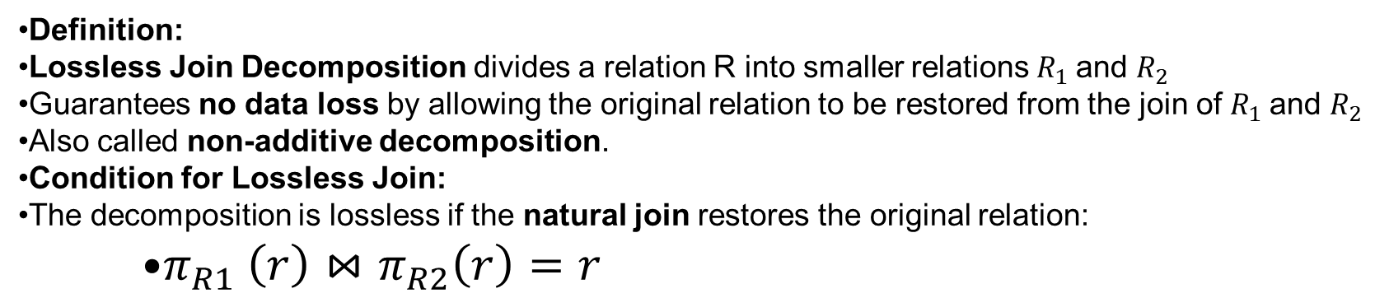
Lossless join decomposition

Slide 89
Lossless join decomposition
Criteria for Lossless Join:
A decomposition R=R1∪R2 ​ is lossless with respect to functional dependencies F if one of the following holds:
  (R1​∩R2​)→(R1​∖R2​)∈F+
  (R1​∩R2​)→(R2​∖R1​)∈F+

Slide 90
Summary
SUMMARY
Constraints allow one to reason about redundancy in the data
Normal forms describe how to remove this redundancy by decomposing relations
  Elegant—by representing data appropriately certain errors are essentially impossible
  For FDs, BCNF is the normal form.
A tradeoff for insert performance: 3NF

Slide 91
Exercise
Find all candidate keys.
Identify the normal forms that R satisfy (1NF, 2NF, 3NF,BCNF).
If the relation is not in BNCF, decompose it until it becomes BCNF.
At each step, identify a new relation, decompose and re-compute the keys and the normal forms they satisfy.
Question 1
Consider relation: R = (A, B , C, D, E) with the set of functional dependencies: {CE → D, D → B, C → A}
Question 2
Consider relation: R = (A, B, C, D, E, F, G, H, I, J)
with the set of functional dependencies: {AB → C, A → DE, B → F, F → GH, D → IJ}
Question 3
Consider relation: R = {A, B, C, D, E, F, G, H, I, J}
and the set of functional dependencies: {AB → C, BD → EF, AD → GH, A → I, H → J}

