Slide 1
The E/R Model

Slide 2
1. E/R Basics: Entities & Relations

Slide 3
Database Design
Database design: Why do we need it?
  Agree on structure of the database before deciding on a particular implementation
Consider issues such as:
  What entities to model
  How entities are related
  What constraints exist in the domain
  How to achieve good designs
Several formalisms exist
  We discuss one flavor of E/R diagrams

Slide 4
Database Design Process
1. Requirements Analysis
2. Conceptual Design
3. Logical, Physical, Security, etc.
Requirements analysis
  What is going to be stored?
  How is it going to be used?
  What are we going to do with the data?
  Who should access the data?
Technical and non-technical people are involved

Slide 5
Database Design Process
1. Requirements Analysis
2. Conceptual Design
3. Logical, Physical, Security, etc.
2. Conceptual Design
  A high-level description of the database
  Sufficiently precise that technical people can understand it
  But, not so precise that non-technical people can’t participate
This is where E/R fits in.

Slide 6
Database Design Process
1. Requirements Analysis
2. Conceptual Design
3. Logical, Physical, Security, etc.
3. More:
  Logical Database Design
  Physical Database Design
  Security Design

Slide 7
Database Design Process
1. Requirements Analysis
2. Conceptual Design
3. Logical, Physical, Security, etc.
This process is iterated many times
E/R Model & Diagrams used
name
name
category
price
Product
Makes
Company
E/R is a visual syntax for DB design which is precise enough for technical points, but abstracted enough for non-technical people

Slide 8

Interlude: Impact of the ER model
The E/R model is one of the most cited articles in Computer Science
  “The Entity-Relationship model – toward a unified view of data” Peter Chen, 1976
Used by companies big and small
  You’ll know it soon enough

Slide 9
Entities and Entity Sets
Entities & entity sets are the primitive unit of the E/R model
  Entities are the individual objects, which are members of entity sets
    Ex: A specific person or product
  Entity sets are the classes or types of objects in our model
    Ex: Person, Product
    These are what is shown in E/R diagrams - as rectangles
    Entity sets represent the sets of all possible entities
Product
Person
These represent entity sets

Slide 10
Entities and Entity Sets
An entity set has attributes
  Represented by ovals attached to an entity set
Shapes are important. Colors are not.
name
category
price
Product

Slide 11

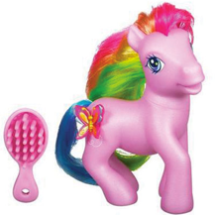
Entities vs. Entity Sets
Entities are not explicitly represented in E/R diagrams!
Example:
Entity
name
category
price
Name: Xbox
Category: Total Multimedia System
Price: $250
Entity Attribute
Name: My Little Pony Doll
Category: Toy
Price: $25
Product
Product
Entity Set

Slide 12
Keys
A key is a minimal set of attributes that uniquely identifies an entity.
Denote elements of the primary key by underlining.
Here, {name, category} is not a key (it is not minimal).
If it were, what would it mean?
name
category
price
Product
The E/R model forces us to designate a single primary key, though there may be multiple candidate keys

Slide 13
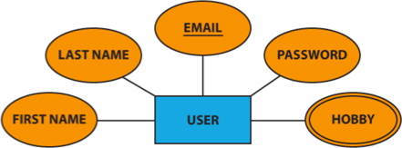
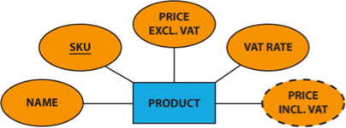






Multivalued and Derived Attributes
Multivalued Attribute
Derived Attribute

Slide 14
The R in E/R: Relationships
A relationship is between two entities
name
name
category
price
Product
Makes
Company

Slide 15
What is a Relationship?
A mathematical definition:
  Let A, B be sets
    A={1,2,3}, B={a,b,c,d}
B=
A=
1
a
2
b
c
3
d

Slide 16
What is a Relationship?
A mathematical definition:
  Let A, B be sets
    A={1,2,3}, B={a,b,c,d}
  A x B (the cross-product) is the set of all pairs (a,b)
    A × B = {(1,a), (1,b), (1,c), (1,d), (2,a), (2,b), (2,c), (2,d), (3,a), (3,b), (3,c), (3,d)}
B=
A=
1
a
2
b
c
3
d

Slide 17
What is a Relationship?
A mathematical definition:
  Let A, B be sets
    A={1,2,3}, B={a,b,c,d},
  A x B (the cross-product) is the set of all pairs (a,b)
    A × B = {(1,a), (1,b), (1,c), (1,d), (2,a), (2,b), (2,c), (2,d), (3,a), (3,b), (3,c), (3,d)}
  We define a relationship to be a subset of A x B
    R = {(1,a), (2,c), (2,d), (3,b)}
B=
A=
1
a
2
b
c
3
d

Slide 18
What is a Relationship?
A mathematical definition:
  Let A, B be sets
  A x B (the cross-product) is the set of all pairs
  A relationship is a subset of A x B
Makes is relationship- it is a subset of Product × Company:
B=
A=
1
a
2
b
c
3
d
makes
Company
Product

Slide 19
What is a Relationship?
name
name
category
price
Product
Makes
Company
A relationship between entity sets P and C is a subset of all possible pairs of entities in P and C, with tuples uniquely identified by P and C’s keys

Slide 20
What is a Relationship?
Company
Product
name
GizmoWorks
GadgetCorp
name | category | price
Gizmo | Electronics | $9.99
GizmoLite | Electronics | $7.50
Gadget | Toys | $5.50
name
category
name
price
Product
Makes
Company
A relationship between entity sets P and C is a subset of all possible pairs of entities in P and C, with tuples uniquely identified by P and C’s keys

Slide 21

What is a Relationship?
Company
Product
name
GizmoWorks
GadgetCorp
name | category | price
Gizmo | Electronics | $9.99
GizmoLite | Electronics | $7.50
Gadget | Toys | $5.50
C.name | P.name | P.category | P.price
GizmoWorks | Gizmo | Electronics | $9.99
GizmoWorks | GizmoLite | Electronics | $7.50
GizmoWorks | Gadget | Toys | $5.50
GadgetCorp | Gizmo | Electronics | $9.99
GadgetCorp | GizmoLite | Electronics | $7.50
GadgetCorp | Gadget | Toys | $5.50
name
category
name
price
Product
Makes
Company
A relationship between entity sets P and C is a subset of all possible pairs of entities in P and C, with tuples uniquely identified by P and C’s keys

Slide 22

What is a Relationship?
Company
Product
name
GizmoWorks
GadgetCorp
name | category | price
Gizmo | Electronics | $9.99
GizmoLite | Electronics | $7.50
Gadget | Toys | $5.50
C.name | P.name | P.category | P.price
GizmoWorks | Gizmo | Electronics | $9.99
GizmoWorks | GizmoLite | Electronics | $7.50
GizmoWorks | Gadget | Toys | $5.50
GadgetCorp | Gizmo | Electronics | $9.99
GadgetCorp | GizmoLite | Electronics | $7.50
GadgetCorp | Gadget | Toys | $5.50
name
category
name
price
Product
Makes
Company
Makes
C.name | P.name
GizmoWorks | Gizmo
GizmoWorks | GizmoLite
GadgetCorp | Gadget
A relationship between entity sets P and C is a subset of all possible pairs of entities in P and C, with tuples uniquely identified by P and C’s keys

Slide 23

What is a Relationship?
There can only be one relationship for every unique combination of entities
This also means that the relationship is uniquely determined by the keys of its entities
Example: the “key” for Makes (to right) is
{Product.name, Company.name}
This follows from our mathematical definition of a relationship- it’s a SET!
since
name
name
category
price
Product
Makes
Company
Why does this make sense?

Slide 24
Relationships and Attributes
Relationships may have attributes as well.
since
name
name
category
price
Product
Makes
Company
For example: “since” records when company started making a product
Note: “since” is implicitly unique per pair here! Why?
Note #2: Why not “how long”?

Slide 25
Relationships
A relationship connects two or more entity sets.
It is represented by a diamond, with lines to each of the entity sets involved.
The degree of the relationship defines the number of entity classes that participate in the relationship
  Degree 1 is a unary relationship
  Degree 2 is a binary relationship
  Degree 3 is a ternary relationship

Slide 26
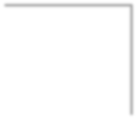
Conceptual Unary Relationship
Person
Marries

Slide 27
Conceptual Binary Relationship
Person
Owns
Car

Slide 28
Multiplicity of E/R Relationships
One-to-one:
1
2
3
a
b
c
d
Indicated using arrows
1
2
3
a
b
c
d
Many-to-one:
X -> Y means there exists a function mapping from X to Y (recall the definition of a function)
1
2
3
a
b
c
d
One-to-many:
1
2
3
a
b
c
d
Many-to-many:

Slide 29
Minimum Cardinality
Minimum cardinality is the minimum number of entity instances that must participate in a relationship instance
These values typically assume a value of zero (optional) or one (mandatory)

Slide 30
Maximum Cardinality
Relationships are named and classified by their cardinalities, which is a word that means count (as in the number of items in a set)
Each of the three types of binary relationship shown previously has a different maximum cardinality
Maximum cardinality is the maximum number of entity instances that can participate in a relationship instance
– One, many, or some other positive fixed number

Slide 31
Conceptual Ternary Relationship
Doctor
Patient
Prescription
Drug

Slide 32
name
category
name
price
makes
Company
Product
stockprice
buys
employs
Person
address
name
ssn

Slide 33
name
category
name
price
makes
Company
Product
stockprice
What does this say?
buys
employs
Person
address
name
ssn
Notes:
a person may be employed by at most one company
a product may be made by at most one company

Slide 34
Decision: Relationship vs. Entity?
What about this way?
Now we can have multiple purchases per product, person pair!
date
PID#
quantity
name
name
category
Purchase
price
ProductOf
BuyerOf
Product
Person
We can always use a new entity instead of a relationship. For example, to permit multiple instances of each entity combination!

Slide 35
Multi-way Relationships
How do we model a purchase relationship between buyers,
products and stores?
Product
Purchase
Store
Person
Notes:
need to identify purchases by all three keys

Slide 36
Arrows in Multiway Relationships
Q: What does the arrow mean ?
Product
Purchase
Store
Person
given a person, can determine what they bought and the store where they bought it
Notes:
given a person, can determine what they bought and the store where they bought it

Slide 37
Arrows in Multiway Relationships
Q: What does the arrow mean ?
Product
Purchase
Store
Person
given a store, can determine who shopped there and the product they bought
each store sells one product and to one person, ever
Notes:
given a store, can determine who shopped there and the product they bought
each store sells one product and to one person, ever

Slide 38
Arrows in Multiway Relationships
Q: How do we say that every person shops in at most one store ?
Product
Purchase
Store
Person
A: Cannot. This is the best approximation.
(Why only approximation ?)
Notes:
our representation is not complete! trade-off between complexity and abstraction

Slide 39
Converting Multi-way Relationships to Binary
date
ProductOf
From what we had on previous slide to this - what did we do?
Product
Purchase
StoreOf
Store
BuyerOf
Person

Slide 40
Decision: Relationship vs. Entity?
Q: What does this say?
A: A person can only buy a specific product once (on one date)
date
name
category
name
price
Product
Purchased
Person
Modeling something as a relationship makes it unique; what if not appropriate?

Slide 41
Decision: Multi-way or New Entity + Binary?
Multiple purchases per (product, store, person) combo possible here!
(A) Multi-way Relationship
(B) Entity + Binary
Product
ProductOf
Purchase
Product
Store
date
StoreOf
Purchase
Store
Person
BuyerOf
Person
Covered earlier: (B) is useful if we want to have multiple instances of the “relationship” per entity combination
(A) is useful when a relationship really is between multiple entities
  - Ex: A three-party legal contract
(B) is also useful when we want to add details (constraints or attributes) to the relationship
  “A person who shops in only one store”
  “How long a person has been shopping at a store”

Slide 42
3. Design Principles
What’s wrong with these examples?
Purchase
Product
Person
President
Country
Person
Notes:
product buys only one product, then out
multiple presidents, also may want to require country to have president

Slide 43
Design Principles:
What’s Wrong?
date
Product
Purchase
Store
personAddr
personName
Notes:
maybe people should be entitites!

Slide 44
Design Principles:
What’s Wrong?
Dates
date
Product
Purchase
Store
Person
Notes:
dates don’t need to be an entity by themselves

Slide 45
Examples: Entity vs. Attribute
Should address (A) be an attribute?
Or (B) be an entity?
Addr 1
Addr 2
Street Addr
ZIP
Address
Employee
AddrOf
Employee
Notes:
every employee has _exactly_ two addresses!

Slide 46
Examples: Entity vs. Attribute
Should address (A) be an attribute?
How do we handle employees with multiple addresses here?
How do we handle addresses where internal structure of the address (e.g. zip code, state) is useful?
Addr 1
Addr 2
Employee

Slide 47
Examples: Entity vs. Attribute
Or (B) be an entity?
Should address (A) be an attribute?
Street Addr
ZIP
Addr 1
Addr 2
Address
AddrOf
Employee
Employee
In general, when we want to record several values, we choose new entity

Slide 48
ACTIVITY: E/R Diagrams

Slide 49


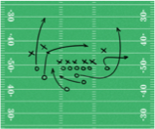


DRAW AN E/R DIAGRAM FOR FOOTBALL
Use the following simplified model of a football season
(concepts to include are underlined):
Teams play each other in Games.
Each pair of teams can play each other multiple times
Players belong to Teams
A Game is made up of Plays that result in a yardage gain/loss, and potentially a touchdown
A Play will contain either a Pass from one player to another, or a Run by one player

Slide 50
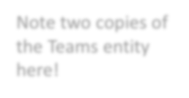


Note two copies of the Teams entity here!
Team ID
date
location
Teams
PlayingAway
Games
PlayingHome
Teams play each other in Games. Each pair of teams can play each other multiple times

Slide 51

Team ID
date
location
name
Player ID
Teams
MemberOf
PlayingAway
Players
Games
PlayingHome
Players belong to Teams (assume no trades / changes)

Slide 52
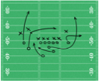
Team ID
date
location
name
Player ID
Teams
MemberOf
PlayingAway
Players
Games
PlayingHome
Plays
OccurIn
Play ID
Yardage Diff
Touchdown
A Game is made up of Plays that result in a yardage gain/loss, and potentially a touchdown

Slide 53
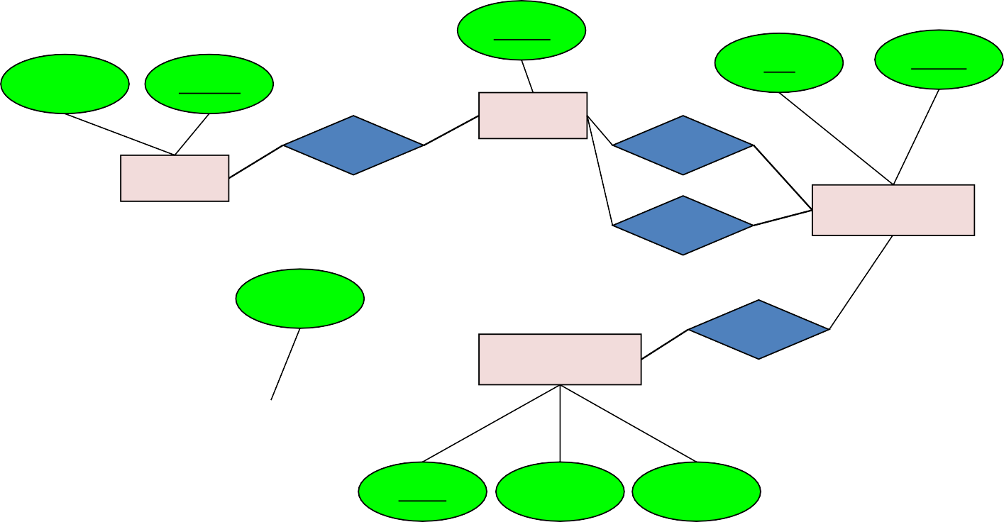

Team ID
date
location
name
Player ID
Teams
MemberOf
PlayingAway
Players
PlayingHome
Games
Participation Type
OccurIn
Plays
ParticipateIn
Play ID
Yardage Diff
Touchdown
A Play will contain either a Pass from one player to another, or a Run by one player

Slide 54


ENHANCE YOUR E/R DIAGRAM!
Also make sure to add (new concepts underlined):
A player can only belong to one team, a play can only be in one game, a pass/run..?
Players can achieve a Personal Record linked to a specific Game and Play

Slide 55
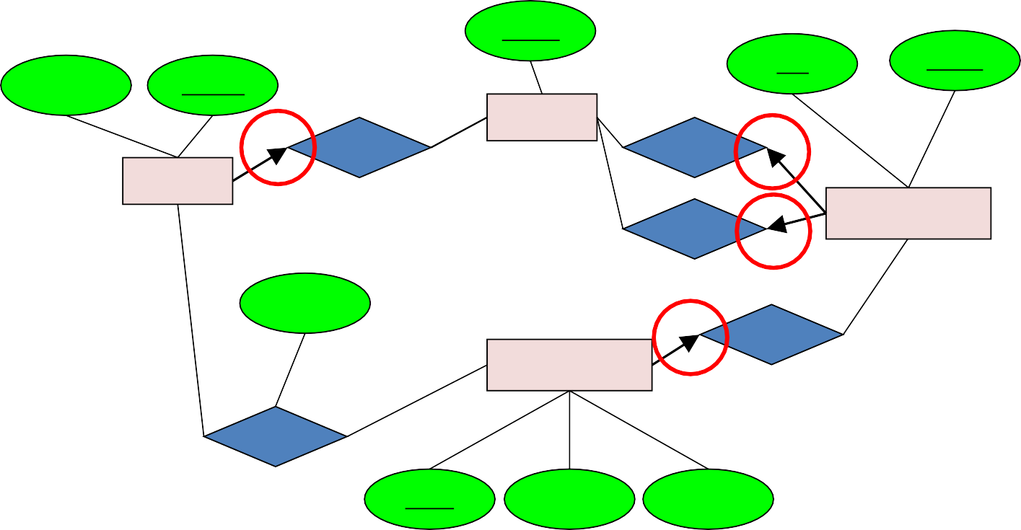

Team ID
date
location
name
Player ID
Teams
MemberOf
PlayingAway
Players
PlayingHome
Games
Participation Type
OccurIn
Plays
ParticipateIn
A player can only belong to one team, a play can only be in one game, a pass/run..?
Play ID
Yardage Diff
Touchdown

Slide 56
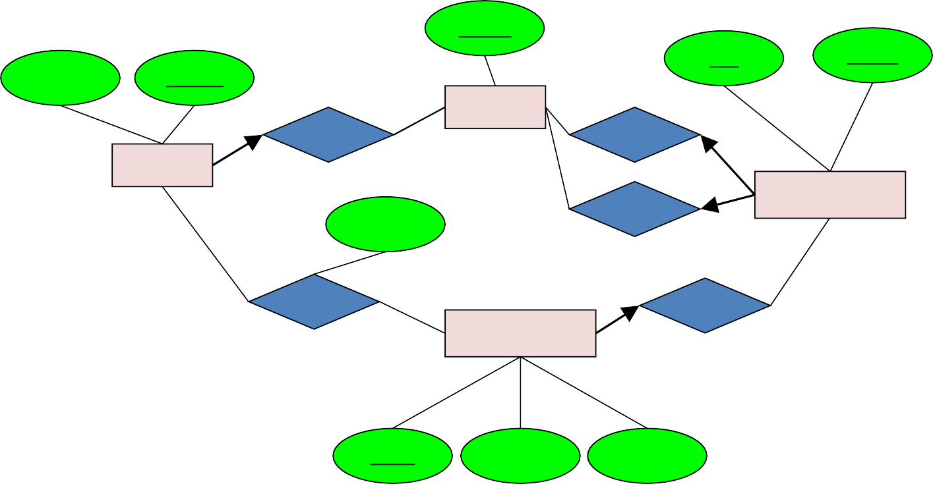

Team ID
date
location
name
Player ID
Teams
MemberOf
PlayingAway
Players
PlayingHome
Games
Participation Type
ParticipateIn
OccurIn
Plays
PRIn
Play ID
Yardage Diff
Touchdown
Players can achieve a Personal Record linked to a specific Game and Play

Slide 57
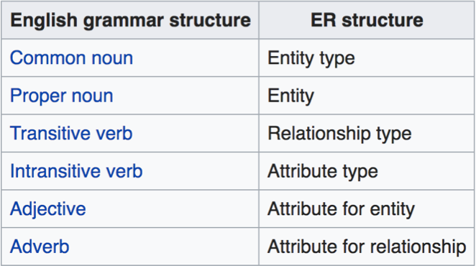
Mapping natural language
Chen proposed the following "rules of thumb" for mapping natural language descriptions into ER diagrams: "English, Chinese and ER diagrams" by Peter Chen.
•
Source: https://en.wikipedia.org/wiki/Entity%E2%80%93relationship_model#Mapping_natural_language

Slide 58
E/R Summary
Summary
E/R diagrams are a visual syntax that allows technical and non-technical people to talk
  For conceptual design
Basic constructs: entity, relationship, and attributes
A good design is faithful to the constraints of the application, but not overzealous

Slide 59
From E/R Diagrams to Relational Schema
Key concept:
  Both Entity sets and Relationships become relations (tables in RDBMS)

Slide 60
From E/R Diagrams to Relational Schema
price
category
An entity set becomes table
  Each tuple is one entity
  Each tuple is composed of the entity’s attributes, and has the same primary key
name
Product
Product
name | price | category
Gizmo1 | 99.99 | Camera
Gizmo2 | 19.99 | Edible

Slide 61
From E/R Diagrams to Relational Schema
price
category
name
Product
CREATE TABLE Product(
name CHAR(50) PRIMARY KEY,
price DOUBLE,
category VARCHAR(30)
)
Product
name | price | category
Gizmo1 | 99.99 | Camera
Gizmo2 | 19.99 | Edible

Slide 62
From E/R Diagrams to Relational Schema
date
firstname
lastname
A relation between entity sets A₁, …, A_{N} also becomes a multiset of tuples / a table
  Each row/tuple is one relation, i.e. one unique combination of entities (a₁,…,a_{N})
  Each row/tuple is
    composed of the union of the entity sets’ keys
    has the entities’ primary keys as foreign keys
    has the union of the entity sets’ keys as primary key
name
category
price
Product
Purchased
Person
Purchased
name | firstname | lastname | date
Gizmo1 | Bob | Joe | 01/01/15
Gizmo2 | Joe | Bob | 01/03/15
Gizmo1 | JoeBob | Smith | 01/05/15

Slide 63
From E/R Diagrams to Relational Schema
date
firstname
lastname
CREATE TABLE Purchased(
name CHAR(50),
firstname CHAR(50),
lastname CHAR(50),
date DATE,
PRIMARY KEY (name, firstname, lastname),
FOREIGN KEY (name)
REFERENCES Product,
FOREIGN KEY (firstname, lastname)
REFERENCES Person
)
name
category
price
Product
Purchased
Person
Purchased
name | firstname | lastname | date
Gizmo1 | Bob | Joe | 01/01/15
Gizmo2 | Joe | Bob | 01/03/15
Gizmo1 | JoeBob | Smith | 01/05/15

Slide 64
From E/R Diagram to Relational Schema
date
firstname
lastname
How do we represent this as a relational schema?
name
category
price
CREATE TABLE purchased (
  Firstname varchar(20),
  Lastname varchar(20),
  Pname varchar(20),
  Sname varchar(20),
  pdate date,
  Primary key (firstname, lastname, pname,sname),
  Foreign key (firstname, lastname) references Person,
  Foreign key pname references product(name),
  Foreign key sname references store(name)
);
Product
Purchased
Person
name
address
Store

Slide 65
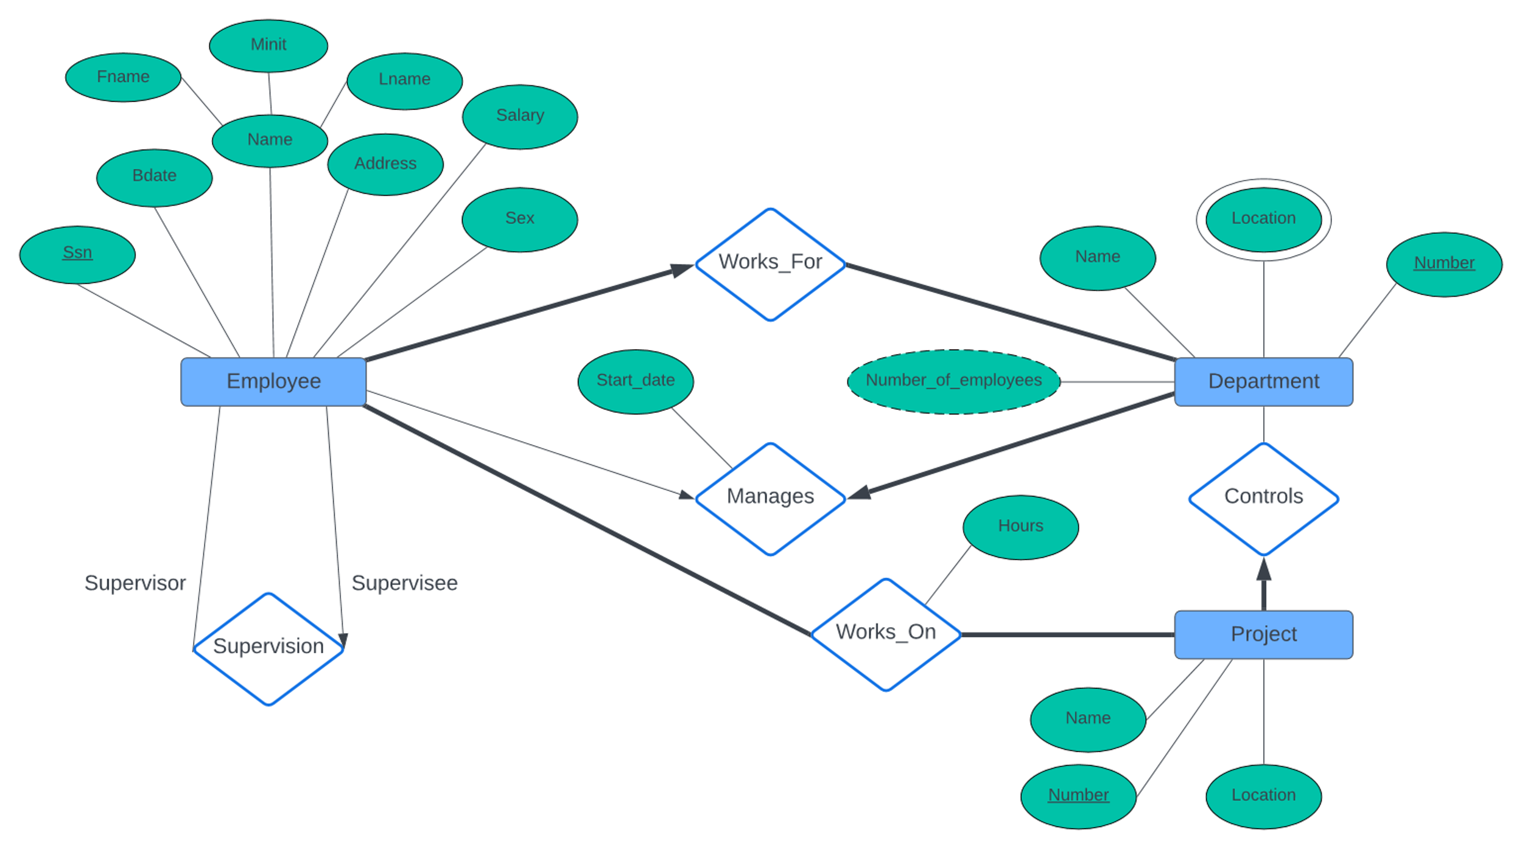
erd.sql
Notes:
https://lucid.app/lucidchart/5fe930d0-f318-48fb-bf7d-afcdb68bb8df/edit?invitationId=inv_bd1fdd51-cc4e-4f0d-a9ba-b60c4288c492&page=0_0#

Slide 66
It has SQL for the previous example
Notes:
create table Employee(
ssn primary key
bdate
fname
midint
laname
address
salary
gender
supervisor_ssn
dnumber NOT NULL
foreign key supervisor_ssn references employee(ssn)
foreign key dnumber references Department(number)
);
CREATE TABLE Dept (
Name
Number primary key
mgrssn NOT NULL
mgr_sdate
foreign key mgrss REFERENCES Employee(ssn)
unique(mgrssn )
);
CREATE TABLE Dept_location(
dnumber ,
location ,
Primary key (number, location),
foreign key dnumber references Dept(Number)
);
CREATE TABLE Project(
Name
Number primary key
Location
cdept NOT NULL
foreign key cdept references Dept(number)
);
create TABLE works_on(
Pnumber
essn
hours
primary key (pnumber, essn),
foregin key pnumber references Project(number),
foreign key essn references Employee(ssn)
);

Slide 67
ER-to-Relational Mapping Algorithm
COMPANY database example
  Assume that the mapping will create tables with simple single-valued attributes
Step 1: Mapping of Regular Entity Types
  For each regular entity type, create a relation R that includes all the simple attributes of E
  Called entity relations
    Each tuple represents an entity instance

Slide 68
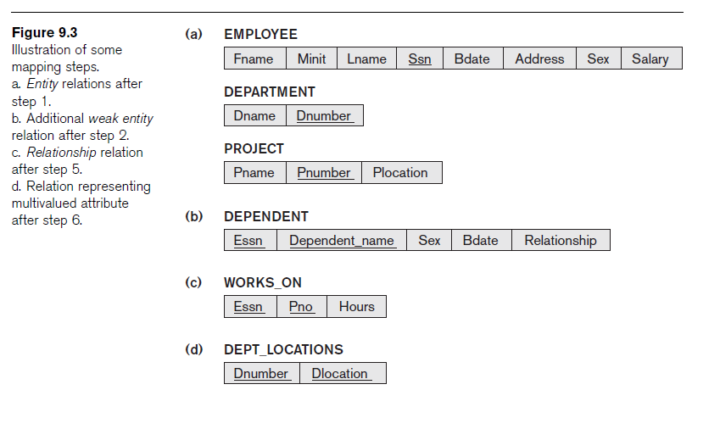
ER-to-Relational Mapping Algorithm (cont’d.)

Slide 69
ER-to-Relational Mapping Algorithm (cont’d.)
Step 3: Mapping of Binary 1:1 Relationship Types
  For each binary 1:1 relationship type
    Identify relations that correspond to entity types participating in R
  Possible approaches:
    Foreign key approach
    Merged relationship approach
    Crossreference or relationship relation approach
  Alternative approach (Avoid this)
    Use the relationship relation (cross-reference) option as in the third option for binary 1:1 relationships

Slide 70
ER-to-Relational Mapping Algorithm (cont’d.)
Step 4: Mapping of Binary 1:N Relationship Types
  For each regular binary 1:N relationship type
    Identify relation that represents participating entity type at N-side of relationship type
    Include primary key of other entity type as foreign key in S
    Include simple attributes of 1:N relationship type as attributes of S

Slide 71
ER-to-Relational Mapping Algorithm (cont’d.)
Step 5: Mapping of Binary M:N Relationship Types
  For each binary M:N relationship type
    Create a new relation S
    Include primary key of participating entity types as foreign key attributes in S
    Include any simple attributes of M:N relationship type

Slide 72
ER-to-Relational Mapping Algorithm (cont’d.)
Step 6: Mapping of Multivalued Attributes
  For each multivalued attribute
    Create a new relation
    Primary key of R is the combination of A and K
    If the multivalued attribute is composite, include its simple components

Slide 73
ER-to-Relational Mapping Algorithm (cont’d.)
Step 7: Mapping of N-ary Relationship Types
  For each n-ary relationship type R
    Create a new relation S to represent R
    Include primary keys of participating entity types as foreign keys
    Include any simple attributes as attributes

Slide 74
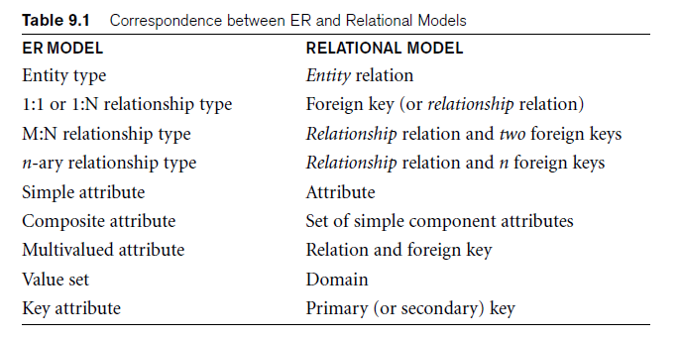
Discussion and Summary of Mapping for ER Model Constructs

Slide 75
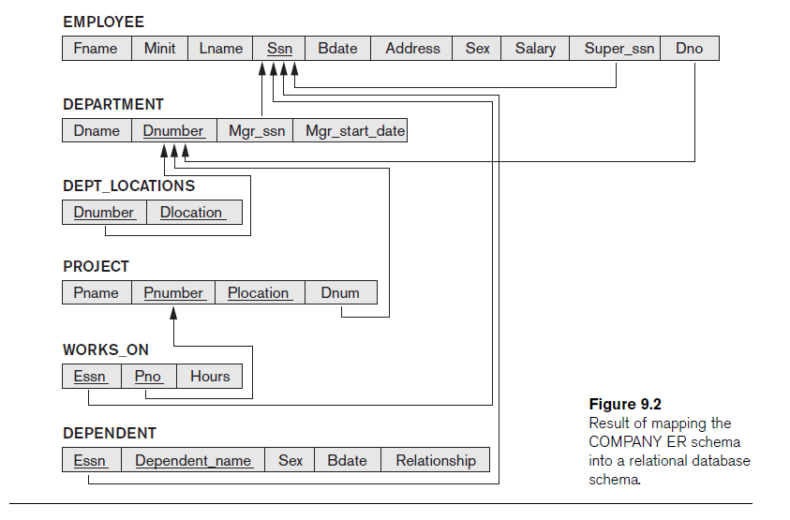

Slide 76
Mapping Summary
Entity set -> table
Single attribute 🡪 table attribute (column)
Multivalued Attribute-> table (with the primary key of the entity set and the attribute)
Derived Attributes 🡪 nothing
Many to many binary (or unary) relationship 🡪 table
1-1 or 1-many binary (or unary) relationship -> attribute to the one side
3-way or more relationship 🡪 table
Total participation 🡪 NOT NULL

Slide 77
Example in Class
manages
Dept
Empl

Slide 78
Example in Class
CREATE TABLE Dept(
  name char(10) ,
  budget decimal(10,2),
  managerSSN char(10) NOT NULL /*Total Particpation*/,
  foreign key managerSSN references Person(ssn),
  managerstartdate date
  Primary Key(name)
);

Slide 79
/* no longer needed*/ Not Recommended
CREATE TABLE Manages(
managerSSN char(10),
deptname char(10),
startdate DATE,
Primary key (managerSSN,deptname),
Foreign Key deptname references dept(name),
Foreign Key managerSSN references person(ssn)
)

Slide 80
CREATE TABLE Person(
name varchar(100) not null,
salary decimal(10,2),
SSN char(10),
unique(name),
Primary Key(ssn)
);

Slide 81
3. Advanced E/R Concepts (EERD)

Slide 82
What you will learn about in this section
Subclasses & connection to OO
Constraints
Weak entity sets

Slide 83
Modeling Subclasses
  Some objects in a class may be special, i.e. worthy of their own class
  Define a new class?
    But what if we want to maintain connection to current class?
  Better: define a subclass
    Ex:
Products
Software
products
Educational
products
We can define subclasses in E/R!

Slide 84
Modeling Subclasses
name
price
Child subclasses contain all the attributes of all of their parent classes plus the new attributes shown attached to them in the E/R diagram
Product
isA
Software Product
Educational Product
platforms
ageGroup

Slide 85
Understanding Subclasses
Think in terms of records; ex:
  Product
  SoftwareProduct
  EducationalProduct
name
Child subclasses contain all the attributes of all of their parent classes plus the new attributes shown attached to them in the E/R diagram
name
price
price
Product
name
isA
price
Software Product
Educational Product
platforms
platforms
ageGroup
name
price
ageGroup

Slide 86
Think like tables…
Product
name | price | category
Gizmo | 99 | gadget
Camera | 49 | photo
Toy | 39 | gadget
name
price
Product
Sw.Product
name | platforms
Gizmo | unix
isA
Ed.Product
Software Product
Educational Product
name | ageGroup
Gizmo | toddler
Toy | retired
platforms
ageGroup

Slide 87
IsA Review
If we declare A IsA B then every A is a B
We use IsA to
  Add descriptive attributes to a subclass
  To identify entities that participate in a relationship
No need for multiple inheritance

Slide 88
Modeling UnionTypes With Subclasses
Person
FurniturePiece
Company
Suppose each piece of furniture is owned either by a person, or by a company. How do we represent this?

Slide 89
Modeling Union Types with Subclasses
Say: each piece of furniture is owned either by a person, or by a company
Solution 1. Acceptable, but imperfect (What’s wrong ?)
Person
FurniturePiece
Company
ownedByPerson
ownedByComp

Slide 90
Modeling Union Types with Subclasses
Solution 2: better (though more laborious)
FurniturePiece
What is happening here?
ownedBy
Owner
Person
Company
isa

Slide 91
Constraints in E/R Diagrams
Finding constraints is part of the E/R modeling process. Commonly used constraints are:
  Keys: Implicit constraints on uniqueness of entities
    Ex: An SSN uniquely identifies a person
  Single-value constraints:
    Ex: a person can have only one father
  Referential integrity constraints: Referenced entities must exist
    Ex: if you work for a company, it must exist in the database
  Other constraints:
    Ex: peoples’ ages are between 0 and 150
Recall FOREIGN KEYs!

Slide 92
Participation Constraints: Partial v. Total
makes
Product
Company
Are there products made by no company? Companies that don’t make a product?
makes
Product
Company
Bold line indicates total participation (i.e. here: all products are made by a company)

Slide 93
Keys in E/R Diagrams
name
category
Underline keys:
price
Note: no formal way to specify multiple keys in E/R diagrams…
Product
Person
address
name
ssn

Slide 94
Single Value Constraints
See previous section!
makes
v. s.
makes

Slide 95
Referential Integrity Constraints
makes
Product
Company
Each product made by at most one company.
Some products made by no company?
makes
Product
Company
Each product made by exactly one company.

Slide 96
Weak Entity Sets
Entity sets are weak when their key comes from other
classes to which they are related.
affiliation
Team
University
sport
number
name
“Football team” v. “The Stanford Football team” (E.g., Berkeley has a football team too, sort of)

Slide 97
Weak Entity Sets
Entity sets are weak when their key comes from other
classes to which they are related.
affiliation
Team
University
sport
number
name
number is a partial key. (denote with dashed underline).
University is called the identifying owner.
Participation in affiliation must be total. Why?

Slide 98
Strong and Weak Entities
A weak entity is an entity whose instances cannot exist in the database without the existence of an instance of another entity
Any entity that is not weak entity is called a strong entity
– Instances of a strong entity can exist in the database independently
The weak entity’s identifier is a combination of the identifier of the owner entity and the partial key of the weak entity.

Slide 99
ACTIVITY: E/R Diagrams

Slide 100

Players have a weight which changes in on vs. off-season

Slide 101
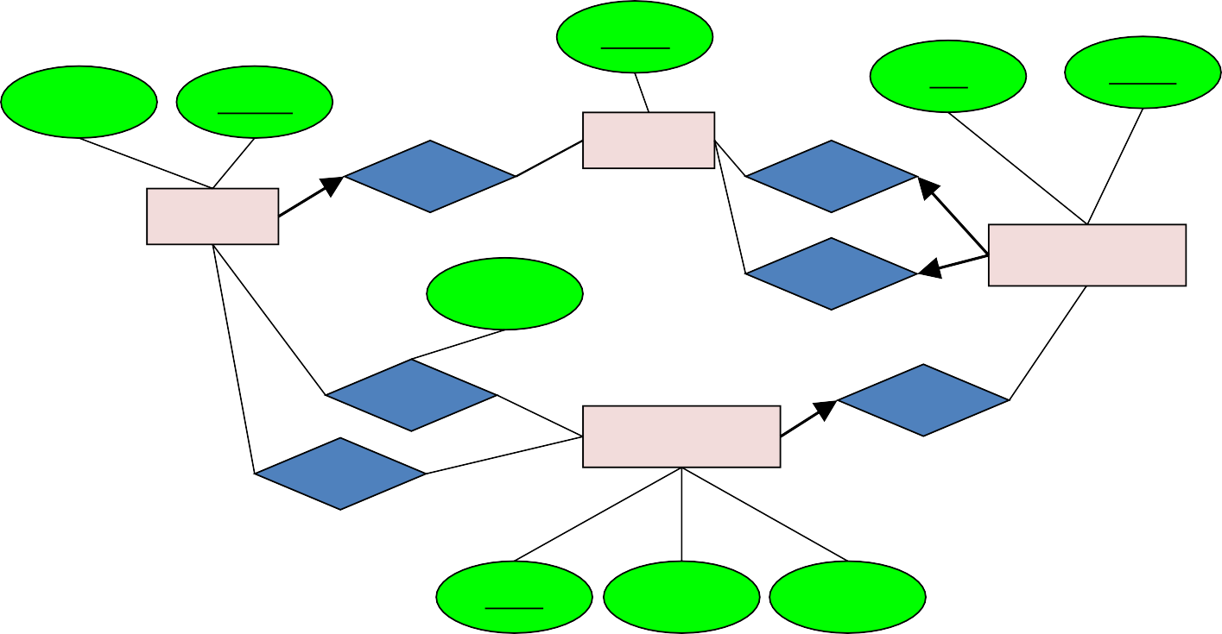
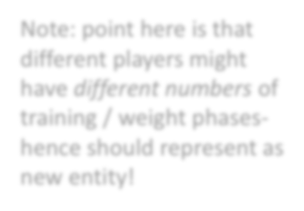

Team ID
date
location
name
Player ID
Teams
MemberOf
PlayingAway
Players
Players might have different weights at different times
WeightOf
PlayingHome
Games
Participation Type
Weight
ParticipateIn
OccurIn
Weight
Plays
Time Period
PRIn
Note: point here is that different players might have different numbers of training / weight phases- hence should represent as new entity!
Play ID
Yardage Diff
Touchdown
Notes:
Make weight weak entity

Slide 102



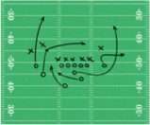
ADD IN: SUBCLASSES, CONSTRAINTS, AND WEAK ENTITY SETS
Concepts to include / model:
Teams belong to cities- model as weak entity sets
Players are either on Offense or Defense, and are of types (QB, RB, WR, TE, K)
All passes are to exactly one player; all runs include a player
Make sure you have designated keys for all our concepts!

Slide 103
Team Name
Teams
LocatedIn
Cities
Teams belong to cities- model as weak entity sets
Name

Slide 104



name
Player ID
Team Name
MemberOf
Teams
Players
LocatedIn
PlaysPosition
Type
Cities
Position
String
isa
Name
Players are either on Offense or Defense, and are of types (QB, RB, WR, TE, etc.)
OffensePosition DefensePosition
OffensivePosType
DefensivePosType

Slide 105
ER-to-Relational Mapping Algorithm (cont’d.)
Step 2: Mapping of Weak Entity Types
  For each weak entity type, create a relation R and include all simple attributes of the entity type as attributes of R
  Include primary key attribute of owner as foreign key attributes of R

Slide 106
Player ID
name
Player
Weight(Player_id, time_period, weightinlbs)
WeightOf
Weight
Weightinlbs
Time Period

Slide 107
Mapping EER Model Constructs to Relations
Extending ER-to-relational mapping algorithm

Slide 108
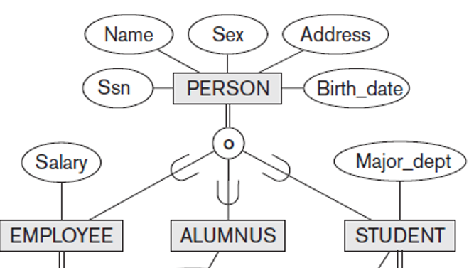
Mapping of Specialization or Generalization
SSN
Name
Person
IsA
Step 8: Options for Mapping Specialization or Generalization
  Option 8A: Multiple relations—superclass and subclasses
    For any specialization (total or partial, disjoint or overlapping)
    Person(ssn, name)
    Employee(ssn, salary)
    Student(ssn, major)
    Alumnus(ssn)
  Option 8B: Multiple relations—subclass relations only
    Subclasses are total
    Specialization has disjointedness constraint
    Employee(ssn, name,salary)
    Student(ssn, name,major)
    Alumnus(ssn,name)
Employee
Student
Alumnus
salary
major

Slide 109
Mapping of Specialization or Generalization (cont’d.)
SSN
Name
Person
IsA
  Option 8C: Single relation with one type attribute
    Type or discriminating attribute indicates subclass of tuple
    Subclasses are disjoint
      Potential for generating many NULL values if many specific attributes exist in the subclasses
      Person(ssn, name, type, salary, major)
  Option 8D: Single relation with multiple type attributes
    Subclasses are overlapping
    Will also work for a disjoint specialization
      Person(ssn, name, isEmployee, isStudent, isAlumnus, salary, major)
Employee
Student
Alumnus
salary
major

Slide 110
Mapping of Shared Subclasses (Multiple Inheritance)
Apply any of the options discussed in step 8 to a shared subclass
Notes:
Add 8-b and 8-c and 8-d

Slide 111
Mapping of Categories (Union Types)
Step 9: Mapping of Union Types (Categories)
  Defining superclasses have different keys
  Specify a new key attribute
    Surrogate key

Slide 112
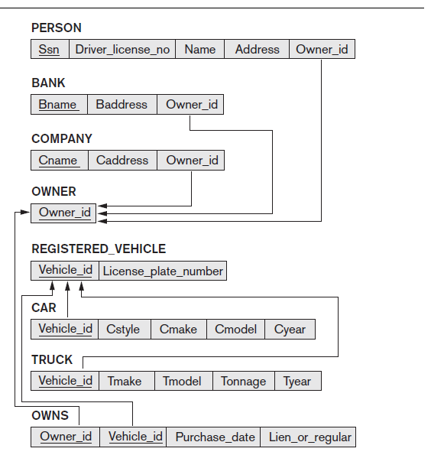
Purchase date
Owner
owns
Owner_id
Registered_vehicle
isA
Plate number
Vehicle_id
isA
Company
Bank
Person
bname
car
truck
cname
ssn
style
tonnage
Notes:
Option 1
owner(owner_id)
Company(cname,owner_id)
Bank(bname, owner_id)
Person(ssn, owner_id)
registered_vechile(vid, platenumber)
car(vid, style)
trunk(vid, tonnage)
Owns(owner_id, vid, purchase_date)
Option 2
Company(cname,owner_id)
Bank(bname, owner_id)
Person(ssn, owner_id)
registered_vechile(vid, platenumber)
car(vid, style)
trunk(vid, tonnage)
Owns(owner_id, vid, purchase_date)

Slide 113
Chen Notation
Entity Set
Attribute
Key Attribute
Weak Entity Set
Multivalued Attribute
Relationship
Derived Attribute
E1
R
E2
E1 has a most one in R
E1
R
E2
Each item in E2 must participate in R

Slide 114
Example
Employee
works
Department
1 Employee works in 1 department
1 Department have Many Employees
Every employee works for a department

Slide 115
ERD Examples

Slide 116
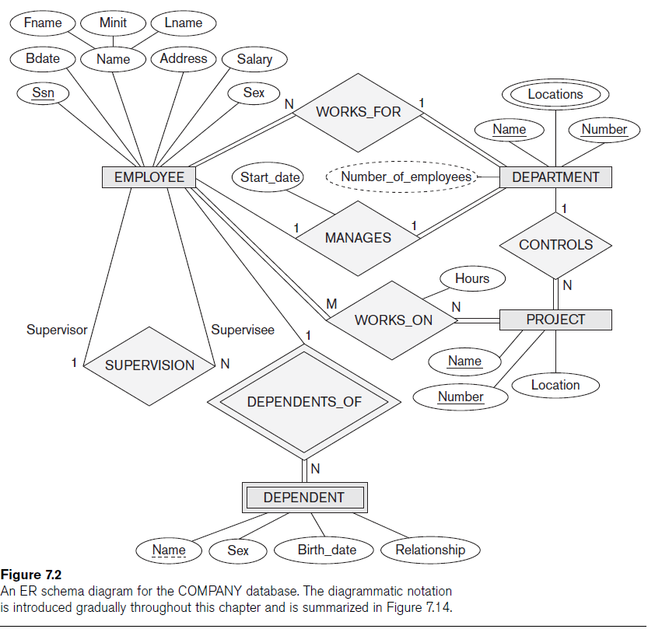

Slide 117
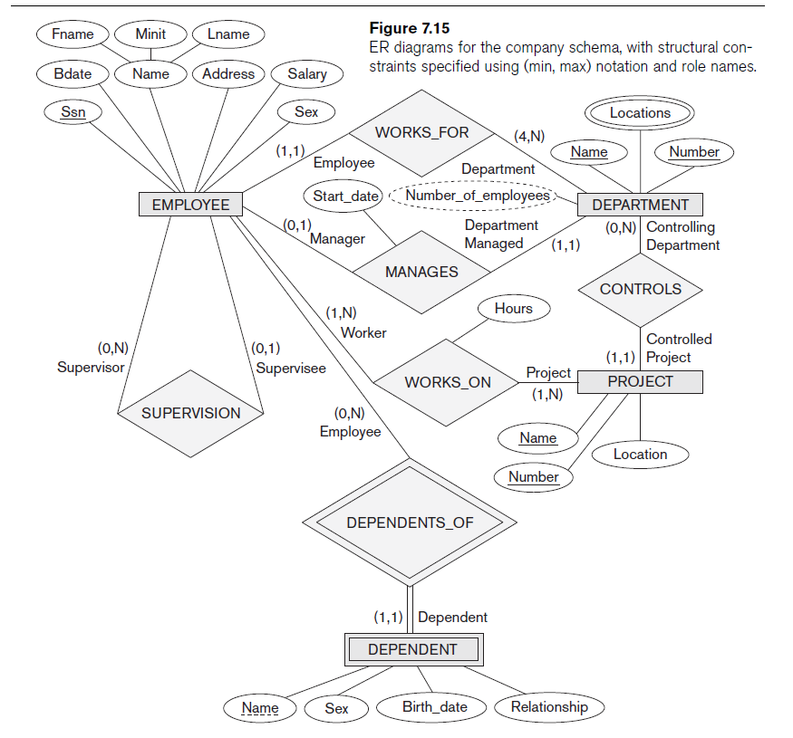

Slide 118
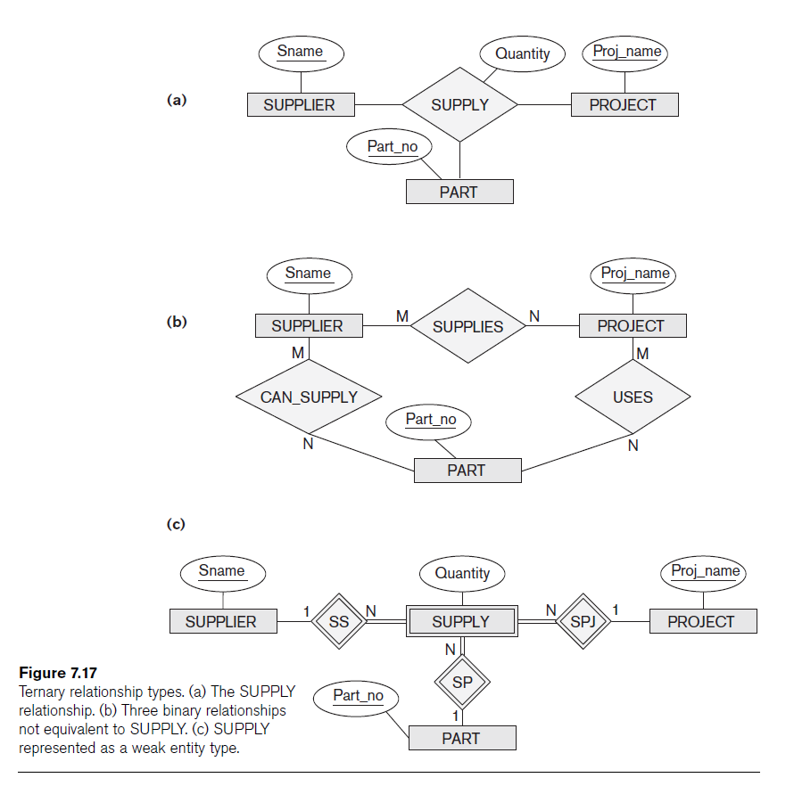

Slide 119
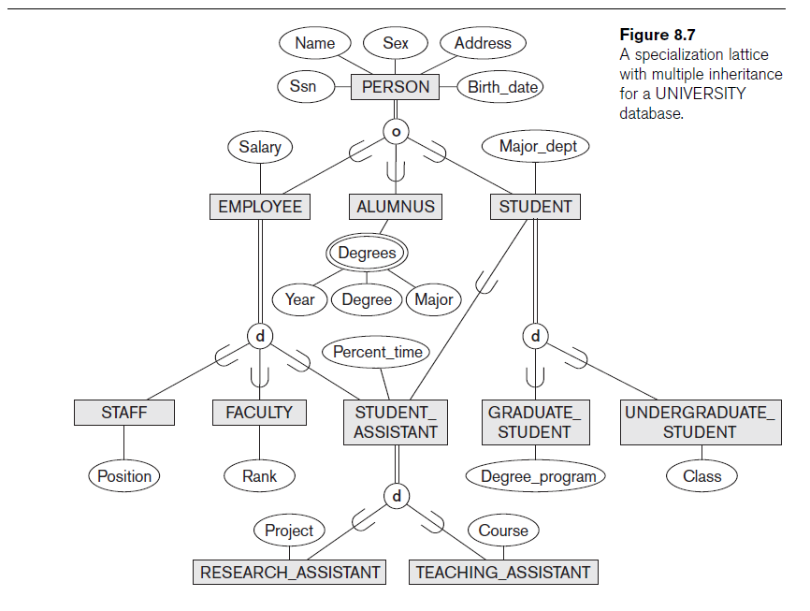

Slide 120
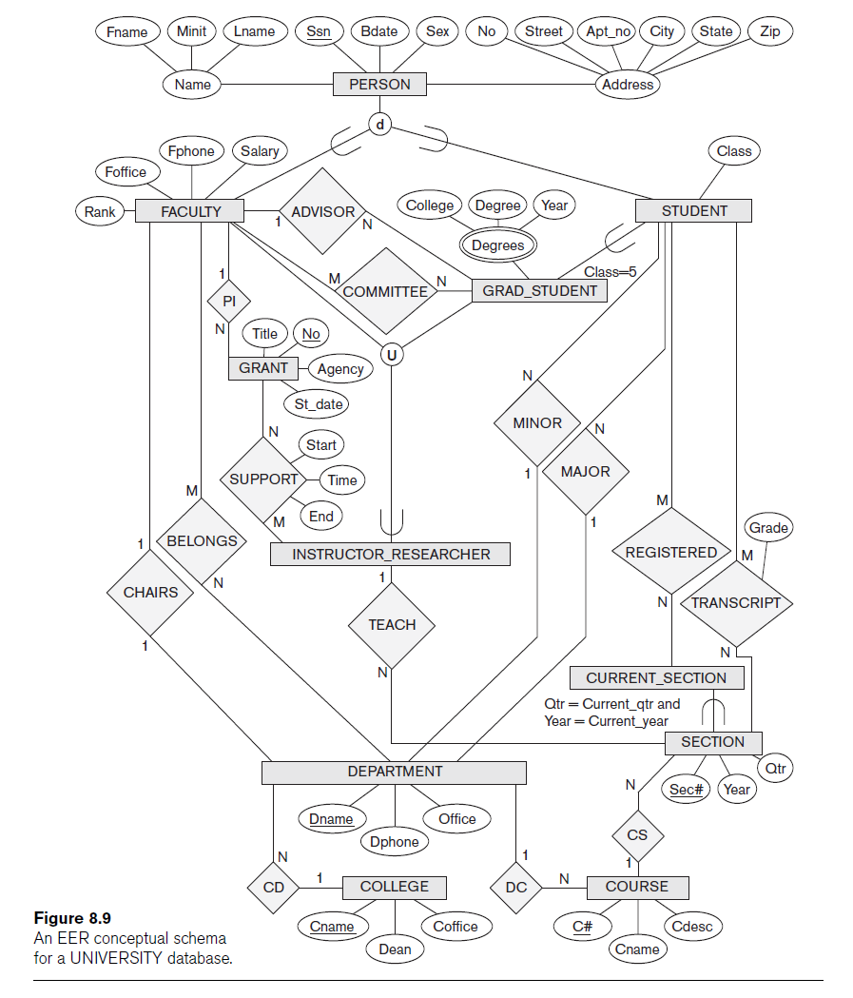

Slide 121
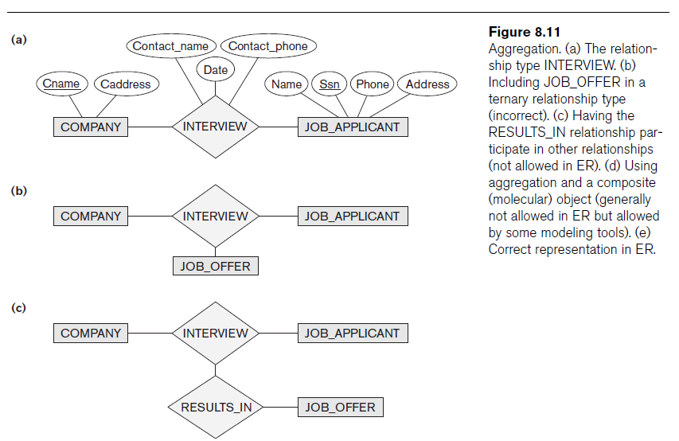
Advanced Notation

Slide 122
Weak Entity in E/R Diagrams
weight
Time Period
name
Player Weight
Player
Plays- on
Double diamond for supporting many-one relationship with Weak Entity.
Double rectangle for the weak entity set.
Notes:
Change the example

Slide 123
ERD Problems

Slide 124
Congress
Design an ER schema for keeping track of information about votes taken in the U.S. House of Representatives during the current two-year congressional session.
The database needs to keep track of each U.S. STATEs Name (e.g., Texas, New York, California) and include the Region of the state(whose domain is Northeast, Midwest, Southeast, Southwest, West).
Each CONGRESSPERSON in the House of Representatives is described by his or her Name, plus the District represented, the Start date when the congressperson was first elected, and the political Party to which he or she belongs (whose domain is Republican, Democrat, Independent, Other).
The database keeps track of each BILL (i.e., proposed law), including the Bill name, the Date of vote on the bill, whether the bill Passed or failed (whose domain is Yes, No), and the Sponsor (the congressperson(s) who sponsored that is, proposed the bill).
The database also keeps track of how each congressperson voted on each bill (domain of Vote attribute is Yes, No, Abstain, Absent).
Draw an ER schema diagram for this application. State clearly any assumptions you make

Slide 125
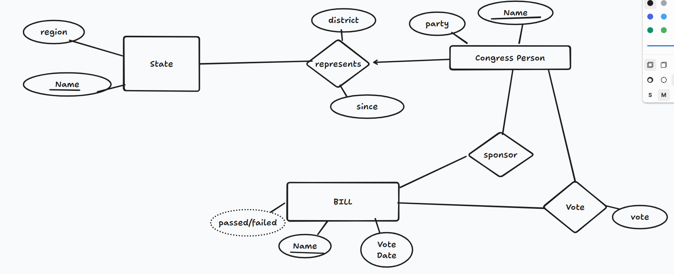
Diagram https://www.tldraw.com/r/12YKkWcscWMT87vOHgE_b?d=v0.0.1920.919.page

Slide 126
Problem 2
You have just been hired as a consultant by the local airport. Impressed by your background in databases, they want you to completely redesign their database system. Your first task is to organize the information about all the airplanes stationed and maintained at the airport. The relevant information is as follows:
Every airplane has a registration number, and each airplane is of a specific model.
The airport accommodates a number of airplane models, and each model is identified by a model number (e.g., DC-lO) and has a
capacity and a weight.
A number of technicians work at the airport. You need to store the name, SSN, address, phone number, and salary of each technician
Each technician is an expert on one or more plane model(s), and his or her expertise may overlap with that of other technicians. This information about technicians must also be recorded.
Traffic controllers must have an annual medical examination. For each traffic controller, you must store the date of the most recent exam.
All airport employees (including technicians) belong to a union. You must store the union member-ship number of each employee. You can assume that each employee is uniquely identified by a social security number
The airport has a number of tests that are used periodically to ensure that airplanes are still airworthy.Each test has a Federal Aviation Administration (FAA) test number, a name, and a maximum possible score.
The FAA requires the airport to keep track of each time a given airplane is tested by a given technician using a given test. For each testing event, the information needed is the date, the number of hours the technician spent doing the test, and the score the airplane received on the test
(20 points) Draw an ER diagram for the airport database. Be sure to indicate the various attributes of each entity and relationship set; also specify the key and participation constraints for each relationships. Specify any necessary overlap and covering constraints a.s well (in English)
(5 points) The FAA passes a regulation that tests on a plane must be conducted by a technician whois an expert on that model. How would you express this constraint in the ER diagram? If you cannot express it, explain briefly.

Slide 127
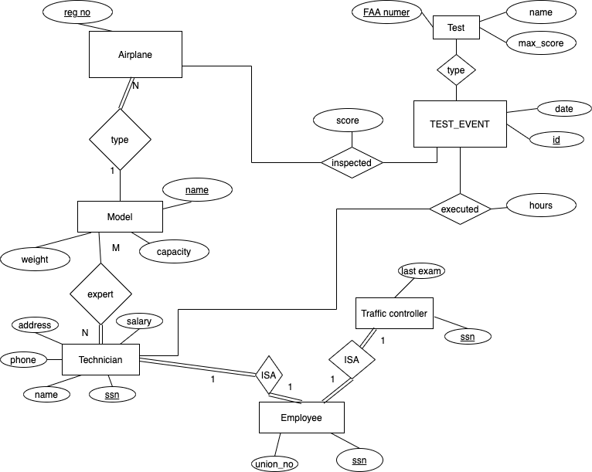

Slide 128
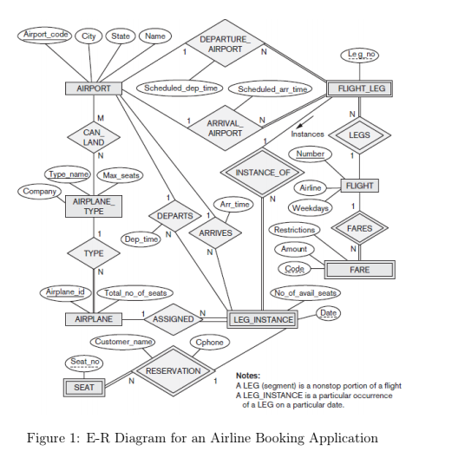
Convert to logical Schema
Airport(airport code, city , state, Name)
Airplane(airplane_id , total_no_of_seats, type_name)
Airplane_type(type_name, company, max_seat)
FLIGHT(flight_number, weekdays, airline)
CAN_LAND(airport_code, type_name)
FARE(code, flight_number, amount, restriction)
FLIGHT_LEG(leg_no, flight_number, dep_airport_code,
sch_dep_time, arr_airport_code, sch_arr_time)
LEG_INSTANCE(leg_no, flight_number, date,no_of_avail_seats,airplane_id)
SEAT(leg_no, flight_number, date,seat_no, customer_name, cphone)

Slide 129
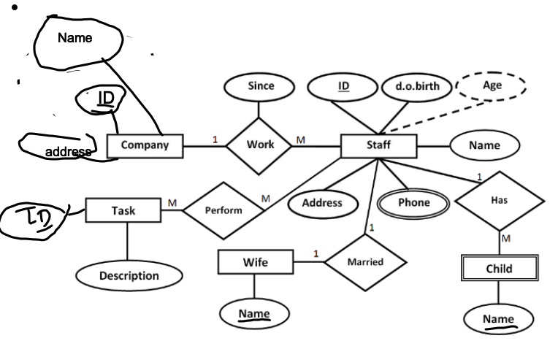
Company(ID, name , address )
Staff( StaffID , dob , address, companyID, since )
Child( ChildID , name , StaffID )
Wife ( WifeID , name, StaffID)
Phone( StaffID, phoneNumber )
Task ( TaskID , description)
Perform(StaffID , TaskID )
Primary Key is underlined. Foreign key is bold italic

Slide 130
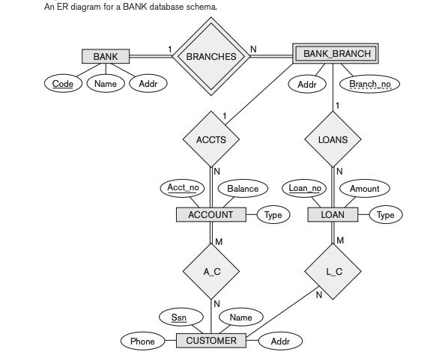
Convert to logical Schema

Slide 131
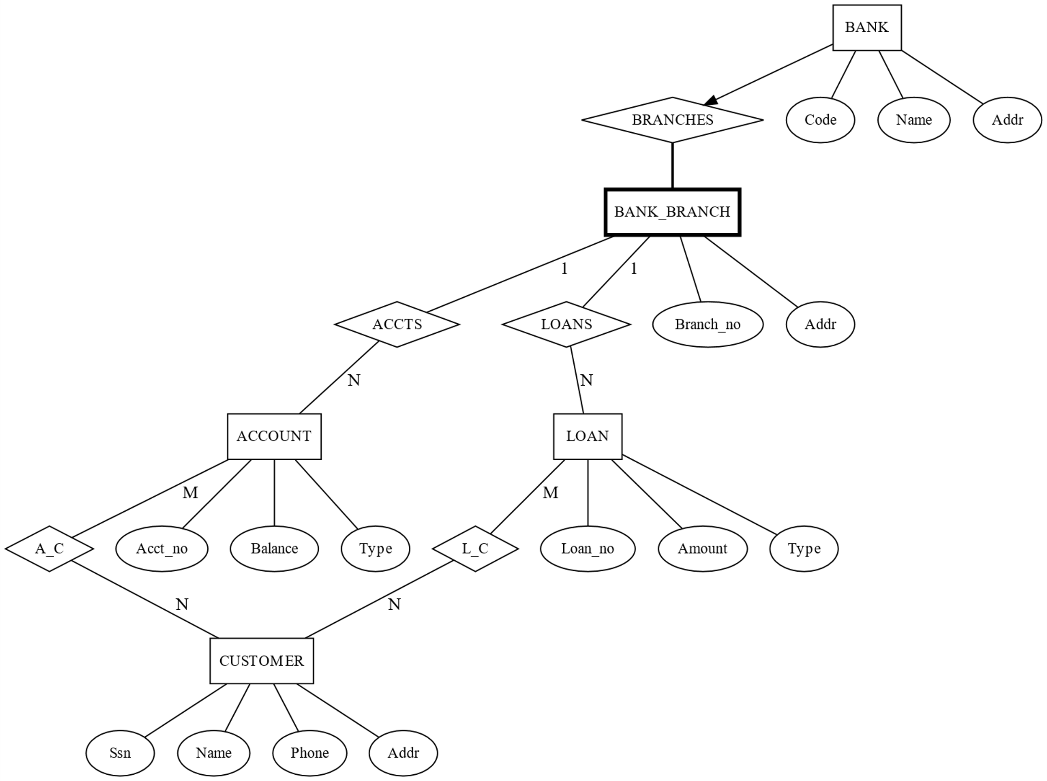
Notes:
digraph BankER {
// Entity style
node [shape=box, fontcolor=black, fontsize=12];
// Entities
BANK [label="BANK", penwidth=1];
BRANCHES [label="BRANCHES", shape=diamond];
BANK_BRANCH [label="BANK_BRANCH", penwidth=3];
ACCTS [label="ACCTS", shape=diamond];
ACCOUNT [label="ACCOUNT"];
LOANS [label="LOANS", shape=diamond];
LOAN [label="LOAN"];
CUSTOMER [label="CUSTOMER"];
A_C [label="A_C", shape=diamond];
L_C [label="L_C", shape=diamond];
// Attributes (ellipses)
BANK_CODE [label="Code", shape=ellipse];
BANK_NAME [label="Name", shape=ellipse];
BANK_ADDR [label="Addr", shape=ellipse];
BRANCH_NO [label="Branch_no", shape=ellipse];
BRANCH_ADDR [label="Addr", shape=ellipse];
ACCT_NO [label="Acct_no", shape=ellipse];
BALANCE [label="Balance", shape=ellipse];
LOAN_NO [label="Loan_no", shape=ellipse];
AMOUNT [label="Amount", shape=ellipse];
ACCT_TYPE [label="Type", shape=ellipse];
LOAN_TYPE [label="Type", shape=ellipse];
CUSTOMER_SSN [label="Ssn", shape=ellipse];
CUSTOMER_NAME [label="Name", shape=ellipse];
CUSTOMER_PHONE [label="Phone", shape=ellipse];
CUSTOMER_ADDR [label="Addr", shape=ellipse];
// Relationships
BANK -> BANK_CODE [dir="none"];
BANK -> BANK_NAME [dir="none"];
BANK -> BANK_ADDR [dir="none"];
BANK_BRANCH -> BRANCH_NO [dir="none"];
BANK_BRANCH -> BRANCH_ADDR [dir="none"];
ACCOUNT -> ACCT_NO [dir="none"];
ACCOUNT -> BALANCE [dir="none"];
ACCOUNT -> ACCT_TYPE [dir="none"];
LOAN -> LOAN_NO [dir="none"];
LOAN -> AMOUNT [dir="none"];
LOAN -> LOAN_TYPE [dir="none"];
CUSTOMER -> CUSTOMER_SSN [dir="none"];
CUSTOMER -> CUSTOMER_NAME [dir="none"];
CUSTOMER -> CUSTOMER_PHONE [dir="none"];
CUSTOMER -> CUSTOMER_ADDR [dir="none"];
// Relationships between entities
BANK -> BRANCHES [];
BRANCHES -> BANK_BRANCH [penwidth=2, dir="none"];
BANK_BRANCH -> ACCTS [label="1", dir="none"];
ACCTS -> ACCOUNT [label="N", dir="none"];
BANK_BRANCH -> LOANS [label="1", dir="none"];
LOANS -> LOAN [label="N", dir="none"];
ACCOUNT -> A_C [label="M", dir="none"];
A_C -> CUSTOMER [label="N", dir="none"];
LOAN -> L_C [label="M", dir="none"];
L_C -> CUSTOMER [label="N", dir="none"];
}

Slide 132
create table bank(code char(10), name varchar(20), addr varchar(100), primary key code)
Create table bankbranch (code char(10), bronchno int, addr varchar(100), primary key (code, brachno), foreign key code references bank on delete cascade)
create table loan(loanno int primary key amount decimal (10,2), type char(10) , code char(10) NOT NULL, branchno int NOT NULL, foreign key code reference bankbranch, foreign key branchno references bankbranch )
create table account(acctno int primary key, balance decimal (10,2), type char(10) , code char(10) , branchno, foreign key code reference bankbrach ,foreign key branchno references bankbranch)
create table customer(ssn char(10) primary key, name varchar(20),phone char(10), addr varchar(100))
create table AC (ssn char(10), actno int, primary key (ssn_actno), foreign key (ssn) references customer, foreign key (act_no) references account)
create table LC (ssn char(10), loanno int, primary key (ssn_actno), foreign key (ssn) references customer, foreign key (loanno) references loan)

Slide 133
ERD Example
A retail company keeps tracks of Customer, Order, Line Item, Part, Supplier, Nation.
For customer, we keep track of name, id, and market segment.
Customer makes orders. The systems stores order number, order total price and date of the order.
Each order can have multiple line items. For each line item, we store quantity, extended price, and return flag.
Each line item (with in an order is identified by line no) corresponds to a part, we store id for this part, its size, and its retail price. The Supplier supplies these parts. We store supplier_id, name, address and account balance for supplier.
Both suppliers and customers belongs to a nation. We store nation name, capital and region.w
Notes:
Item. (parts) can be persiable or non perishable
for pershiable item we need to store the expiration date
parts are stored in data warehouse
sku

Slide 134
Employee(
SSN, fname, lname, minit, bdate, gender, salary, address,
d_number NOT NULL,
supervisor_ssn
primary key (SSN)
)
Department(Number, Name)
Dept_loc(Number, location,
manager_ssn NOT NULL
primary key (Number, location))
Project(Number, Name, Location,
department_number NOT NULL)
Works_on(Project_number, ssn, hours
primary key (project_number, ssn))

