Slide 1
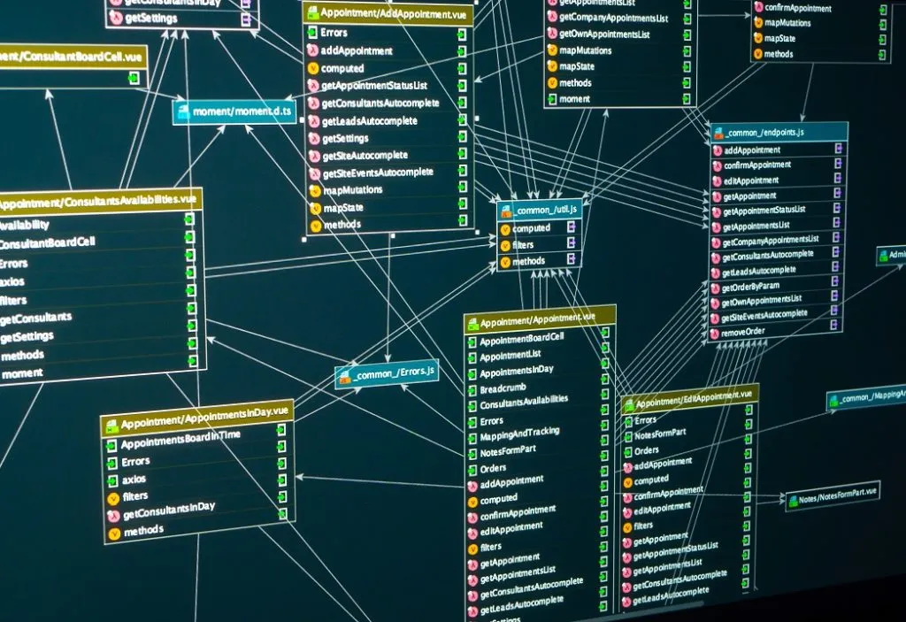
Database Management Systems
CS 4550

Slide 2
Lectures
NAB 0113
MW 4:30 PM – 6:10 PM
Lectures are in person

Slide 3
Instructor
Instructor: Mohamed E Khalefa
Office NAB 1015
Office hours W 6:10 pm to 7:10 pm or by appointment
Email: khalefam@oldwestbury.edu (add CS 4550 in the subject line)

Slide 4
Textbook
  Database Systems: Design, Implementation, and Management, 13 Edition By Coronel & Morris. ISBN:9781337627900
  Elmasri, Ramez, and Shamkant B. Navathe. Fundamentals of Database Systems, 7thEdition. Pearson Education Limited, 2015. SBN-13: 978-0133970777 (Recommended)

Slide 5
Evaluations
Class participation and one-to-one meeting 10%
Quizzes 5%
Hws 25%
Labs 20%
Projects 25%
Midterm exams 10%
Final exam 20%
A = [94, 100] A⁻ = [90, 93] | B ⁺ = [87, 89] | C ⁺ = [77, 79] | D ⁺ = [67, 69] | F = [0, 59]
 | B = [84, 86] | C = [74, 76] | D = [64, 66]
 | B ⁻ = [80, 83] | C ⁻ = [70, 73] | D ⁻ = [60, 63]

Slide 6
What is expected from you
Section 1 > Logistics
Attend lectures
Be active and think critically
  Ask questions, post comments on forums
Do programming and homework projects
  Start early and be honest
Study for tests and exams
Do not over think the assignments and programming projects
Ask for help

Slide 7
Course Objectives
After taking this course, the student should be able to:
  Design a relational database based on the given data requirements
  Write SQL queries
  Understand the basis of relational databases: relational model, relational algebra, query processing, and query optimization.
  Understand the translation from SQL queries to physical query plans
  Demonstrate the ability to properly document a database system and programming assignments.

Slide 8
week | Topic
1 | Introduction to the course
2 | SQL: Introduction
3 | SQL: Advanced
4 | Relational Data Model
5 | ER Model
6 | Relational algebra
7 | Database Design
8 | Midterm (March/14)
9 | Spring Break
10 | Transactions: A user's perspective
11 | Transactions: logging & locking
12 | Under the hood: DB internals
13 | Indexing
14 | Database Tuning
15 | NoSQL Systems
16 | Project Discussions
17 | Final Exam (May/16)

