Slide 1
Transactions
Isolation Levels

Slide 2
Transactions made a promise to the programmer about complexities they didn't have to worry about
      Peter Alvaro
      University of California, Santa Cruz

Slide 3
Transaction Properties: ACID
Atomic
  State shows either all the effects of txn, or none of them
Consistent
  Txn moves from a state where integrity holds, to another where integrity holds
Isolated
  Effect of txns is the same as txns running one after another (ie looks like batch mode)
Durable
  Once a txn has committed, its effects remain in the database
ACID continues to be a source of great debate!

Slide 4
Lock Granularity
Lock can be of different levels
  Database
  Table
  Page
  Record

Slide 5
Solution for both concurrency and failures
Transactions
A transaction is a sequence of one or more SQL
operations treated as a unit
  Transactions appear to run in isolation
  If the system fails, each transaction’s changes are
  reflected either entirely or not at all

Slide 6
(ACID Properties) Isolation
. . .
Serializability
Operations may be
interleaved, but execution
must be equivalent to some
sequential (serial) order
of all transactions
DBMS
⇒ Overhead
⇒ Reduction in concurrency
Data
Data

Slide 7
(ACID Properties) Isolation
. . .
Weaker “Isolation Levels”
Read Uncommitted
Read Committed
Repeatable Read
DBMS
↓ Overhead ↑ Concurrency
↓ Consistency Guarantees
Data
Data

Slide 8
Isolation Levels
  Per transaction
  “In the eye of the beholder”
. . .
My transaction is
Repeatable Read
My transaction is
Read Uncommitted
DBMS
Data
Data

Slide 9
Anomalies
Dirty Read
Non-repeatable read
Phantom Read

Slide 10
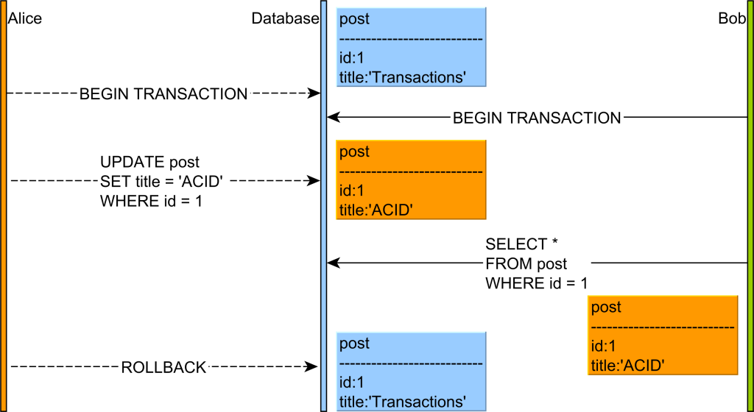
Dirty Read
Source: https://vladmihalcea.com/dirty-read/

Slide 11
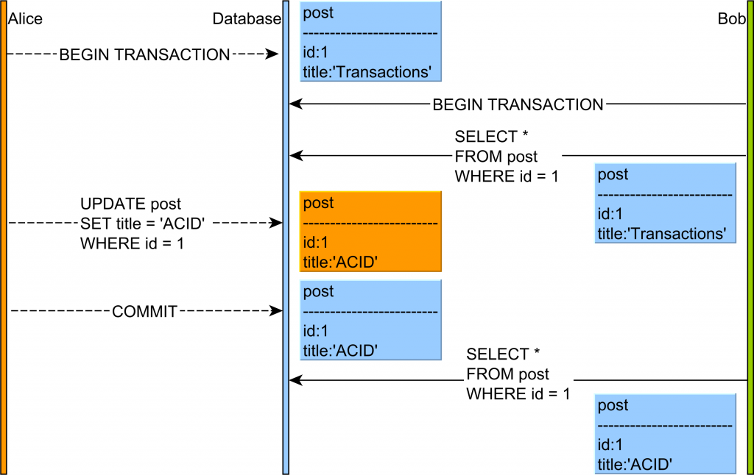
Non Repeatable Read
Source: https://vladmihalcea.com/non-repeatable-read/

Slide 12
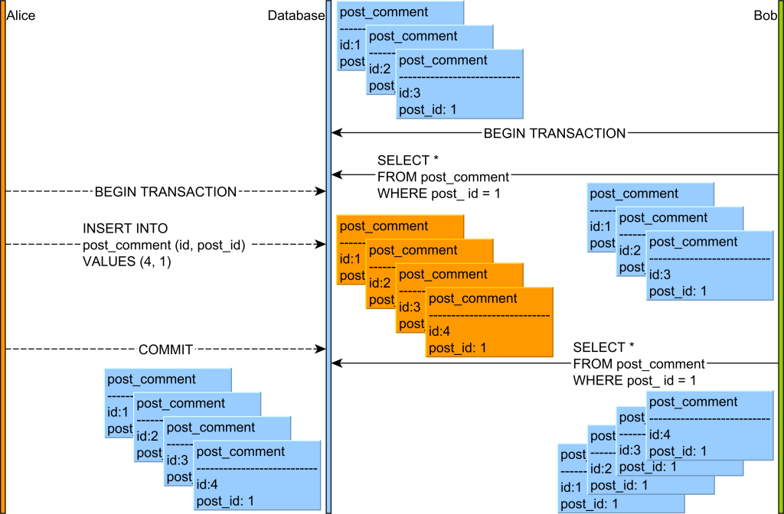
Phantom Read
Source: https://vladmihalcea.com/phantom-read/

Slide 13
Example
users
id | name | age
1 | Alice | 20
2 | Bob | 25
SQL data: https://raw.githubusercontent.com/TeachingOW/DBMS-SQL-Labs/refs/heads/main/inclass/users.sql
Notes:
create table users (id int primary key, name char(10), age int);
insert into users values (1,'Alice',20);
insert into users values (2,'Bob',25);
commit;

Slide 14
Read phenomena / Isolation Level
Transaction 1 | Transaction 2
BEGIN; SELECT age FROM users WHERE id = 1; -- retrieves 20
 | BEGIN; UPDATE users SET age = 21 WHERE id = 1; -- no commit here
SELECT age FROM users WHERE id = 1; --READ UNCOMMITTED retrieves 21 (dirty read) --READ COMMITTED retrieves 20 (dirty read has been avoided) --REPEATABLE READ retrieves 20 (dirty read has been avoided) -- SERIALIZABLE retrieves 20 (dirty read has been avoided) COMMIT;
 | ROLLBACK;

Slide 15
Read phenomena / Isolation Level
Transaction 1 | Transaction 2
BEGIN; SELECT age FROM users WHERE id = 1; -- retrieves 20
 | BEGIN; UPDATE users SET age = 21 WHERE id = 1; COMMIT;
SELECT age FROM users WHERE id = 1; --READ UNCOMMITTED retrieves 21 (non-repeatable read) -- READ COMMITTED retrieves 21 (non-repeatable read) -- REPEATABLE READ retrieves 20 (non-repeatable read has been avoided) -- SERIALIZABLE retrieves 20 (non-repeatable read has been avoided) COMMIT;

Slide 16
Read phenomena / Isolation Level
Transaction 1 | Transaction 2
BEGIN; SELECT name FROM users WHERE age > 17; -- retrieves Alice and Bob
 | BEGIN; INSERT INTO users VALUES (3, 'Carol', 26); COMMIT;
SELECT name FROM users WHERE age > 17; -- READ UNCOMMITTED retrieves Alice, Bob and Carol (phantom read) -- READ COMMITTED retrieves Alice, Bob and Carol (phantom read) -- REPEATABLE READ retrieves Alice, Bob and Carol (phantom read) -- SERIALIZABLE retrieves Alice and Bob (phantom read has been avoided) COMMIT;

Slide 17
Read Only transactions
Helps system optimize performance
Independent of isolation level
Set Session Transaction Isolation Level Serializable;
Start Transaction Read ONLY;
Select Avg(age) From Users;
Select Max(age) From Users;

Slide 18
Isolation Levels: Summary
 | dirty reads | nonrepeatable reads | phantoms
Read Uncommitted | Y | Y | Y
Read Committed | N | Y | Y
Repeatable Read | N | N | Y*
Serializable | N | N | N
MySQL includes more optimizations*

Slide 19
Example I
Transaction 1 | Transaction 2
SET SESSION TRANSACTION ISOLATION LEVEL Serializable; BEGIN;
 | SET SESSION TRANSACTION ISOLATION LEVEL Serializable; BEGIN; SELECT COUNT(*) FROM users;
SELECT * FROM users;
 | INSERT INTO `users` VALUES (4,'Dave', 26);
INSERT INTO `users` VALUES (5,'Eric', 26);
Notes:
Deadlock

Slide 20
Example II
Transaction 1 | Transaction 2
SET SESSION TRANSACTION ISOLATION LEVEL Serializable; BEGIN;
 | SET SESSION TRANSACTION ISOLATION LEVEL Serializable; BEGIN;
INSERT INTO `users` VALUES (6,'Fred', 26);
 | INSERT INTO `users` VALUES (7,'George', 27);
Commit;
 | Commit;
Notes:
No problem

Slide 21
Example III
Transaction 1 | Transaction 2
SET SESSION TRANSACTION ISOLATION LEVEL Serializable; BEGIN;
 | SET SESSION TRANSACTION ISOLATION LEVEL Serializable; BEGIN;
INSERT INTO `users` VALUES (8,’Hany’, 28);
 | INSERT INTO `users` VALUES (8,’Henry’, 28);
Commit; (Try with Rollback;)
 | Commit;
Notes:
Only one works

Slide 22
Example IV
Transaction 1 | Transaction 2
Set Session Transaction Isolation Level SERIALIZABLE;
 | Set Session Transaction Isolation Level SERIALIZABLE;
BEGIN; SELECT name FROM users WHERE id= 1;
 | BEGIN; INSERT INTO users VALUES (110, 'Eve', 26); COMMIT;
COMMIT;
Notes:
Check out the lock granularity

Slide 23
Example V
Transaction 1 | Transaction 2
Set Transaction Isolation Level Repeatable read, Read Only;
 | Set Transaction Isolation Level SERIALIZABLE;
BEGIN; SELECT count(*) FROM users;
 | BEGIN; INSERT INTO users VALUES (10, ‘Eve', 26); COMMIT;
SELECT count(*) FROM users; COMMIT;
Notes:
Example of phantom ( n ot working

Slide 24
Example V
Transaction 1 | Transaction 2
Set session Transaction Isolation Level SERIALIZABLE, Read Only;
 | Set Transaction Isolation Level SERIALIZABLE;
BEGIN; SELECT count(*) FROM users;
 | BEGIN; INSERT INTO users VALUES (10, ‘Eve', 26); COMMIT;
SELECT max(age) FROM users; COMMIT;
Notes:
Example of phantom ( n ot working

Slide 26
Isolation Levels: Summary
Standard default: Repeatable read (InnoDB) in Mysql
  Weaker isolation levels
    Increased concurrency + decreased overhead =
    increased performance
    Weaker consistency guarantees
  Isolation level per transaction and “eye of the beholder”
    Each transaction’s reads must conform to its isolation level

