Slide 1
Joins!

Slide 2
1. Nested Loop Joins

Slide 3
RECAP: Joins
Joins

Slide 4

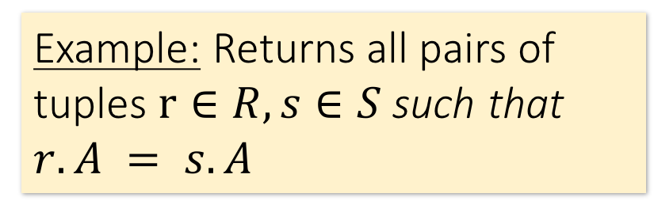
Joins: Example
Joins
SELECT R.A,B,C,D
FROM R, S
WHERE R.A = S.A
R
S
A | B | C
1 | 0 | 1
2 | 3 | 4
2 | 5 | 2
3 | 1 | 1
A | D
3 | 7
2 | 2
2 | 3
A | B | C | D
2 | 3 | 4 | 2

Slide 5
Joins: Example
Joins
SELECT R.A,B,C,D
FROM R, S
WHERE R.A = S.A
R
S
A | B | C
1 | 0 | 1
2 | 3 | 4
2 | 5 | 2
3 | 1 | 1
A | D
3 | 7
2 | 2
2 | 3
A | B | C | D
2 | 3 | 4 | 2
2 | 3 | 4 | 3

Slide 6
Joins: Example
Joins
SELECT R.A,B,C,D
FROM R, S
WHERE R.A = S.A
R
S
A | B | C
1 | 0 | 1
2 | 3 | 4
2 | 5 | 2
3 | 1 | 1
A | D
3 | 7
2 | 2
2 | 3
A | B | C | D
2 | 3 | 4 | 2
2 | 3 | 4 | 3
2 | 5 | 2 | 2

Slide 7
Joins: Example
Joins
SELECT R.A,B,C,D
FROM R, S
WHERE R.A = S.A
R
S
A | B | C
1 | 0 | 1
2 | 3 | 4
2 | 5 | 2
3 | 1 | 1
A | D
3 | 7
2 | 2
2 | 3
A | B | C | D
2 | 3 | 4 | 2
2 | 3 | 4 | 3
2 | 5 | 2 | 2
2 | 5 | 2 | 3

Slide 8
Joins: Example
Joins
SELECT R.A,B,C,D
FROM R, S
WHERE R.A = S.A
R
S
A | B | C
1 | 0 | 1
2 | 3 | 4
2 | 5 | 2
3 | 1 | 1
A | D
3 | 7
2 | 2
2 | 3
A | B | C | D
2 | 3 | 4 | 2
2 | 3 | 4 | 3
2 | 5 | 2 | 2
2 | 5 | 2 | 3
3 | 1 | 1 | 7

Slide 9

Semantically: A Subset of the Cross Product
Joins
SELECT R.A,B,C,D
FROM R, S
WHERE R.A = S.A
R
S
A | B | C | D
2 | 3 | 4 | 2
2 | 3 | 4 | 3
2 | 5 | 2 | 2
2 | 5 | 2 | 3
3 | 1 | 1 | 7
A | B | C
1 | 0 | 1
2 | 3 | 4
2 | 5 | 2
3 | 1 | 1
A | D
3 | 7
2 | 2
2 | 3
…
Can we actually implement a join in this way?
Cross Product
Filter by conditions
(r.A = s.A)

Slide 10
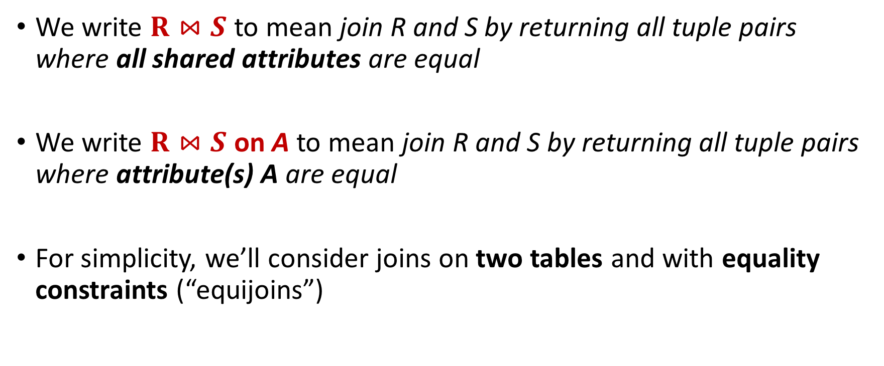
Notes
Joins
However joins can merge 2 tables, and some algorithms do support non-equality constraints!

Slide 11
Nested Loop Joins
NLJ

Slide 12
Notes
NLJ
We are again considering “IO aware” algorithms: care about disk IO
Given a relation R, let:
  T(R) = # of tuples in R
  P(R) = # of pages in R
Note also that we omit ceilings in calculations… good exercise to put back in!
Recall that we read / write entire pages with disk IO

Slide 13
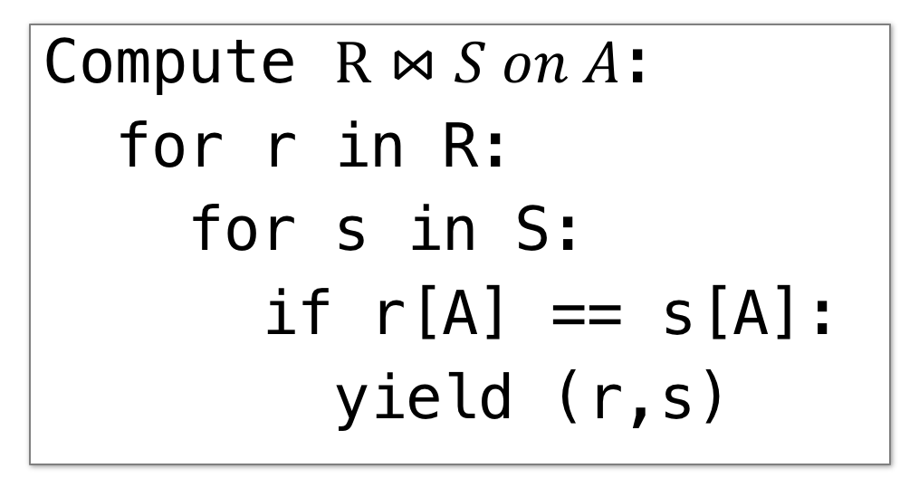
Nested Loop Join (NLJ)
NLJ

Slide 14
Nested Loop Join (NLJ)
NLJ
Cost:
P(R)
Loop over the tuples in R
Note that our IO cost is based on the number of pages loaded, not the number of tuples!

Slide 15
Nested Loop Join (NLJ)
NLJ
Cost:
P(R) + T(R)*P(S)
Loop over the tuples in R
For every tuple in R, loop over all the tuples in S
Have to read all of S from disk for every tuple in R!

Slide 16
Nested Loop Join (NLJ)
NLJ
Cost:
P(R) + T(R)*P(S)
Loop over the tuples in R
For every tuple in R, loop over all the tuples in S
Check against join conditions
Note that NLJ can handle things other than equality constraints… just check in the if statement!

Slide 17
Nested Loop Join (NLJ)
NLJ
Cost:
P(R) + T(R)*P(S) + OUT
Loop over the tuples in R
For every tuple in R, loop over all the tuples in S
Check against join conditions
Write out (to page, then when page full, to disk)
What would OUT be if our join condition is trivial (if TRUE)?
OUT could be bigger than P(R)*P(S)… but usually not that bad

Slide 18
Nested Loop Join (NLJ)
NLJ
Cost:
P(R) + T(R)*P(S) + OUT
What if R (“outer”) and S (“inner”) switched?
P(S) + T(S)*P(R) + OUT
Outer vs. inner selection makes a huge difference- DBMS needs to know which relation is smaller!

Slide 19
IO-Aware Approach
BNLJ

Slide 20
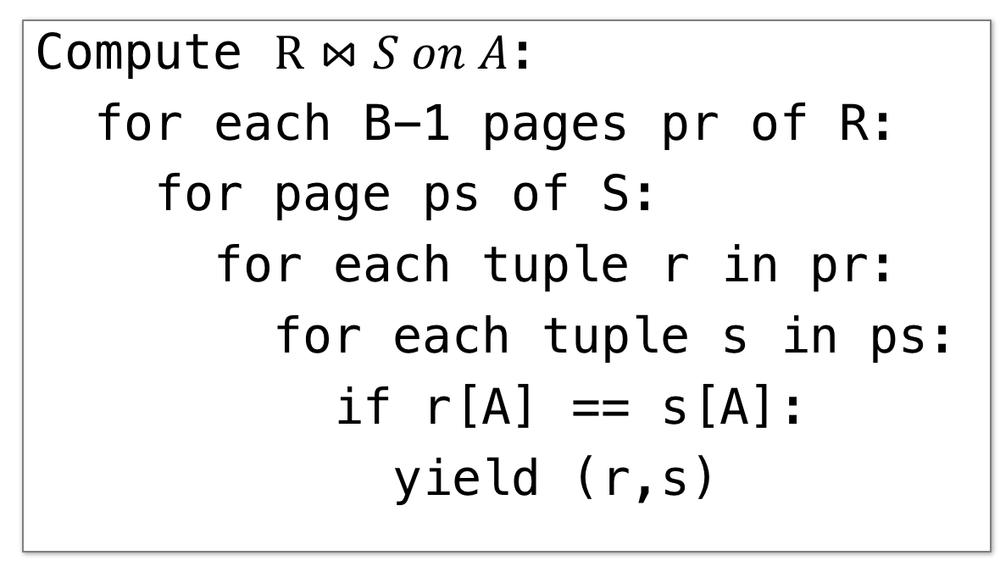
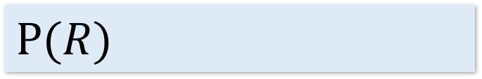
Block Nested Loop Join (BNLJ)
BNLJ
Given B+1 pages of memory
Cost:
Load in B-1 pages of R at a time (leaving 1 page each free for S & output)
Note: There could be some speedup here due to the fact that we’re reading in multiple pages sequentially however we’ll ignore this here!

Slide 21
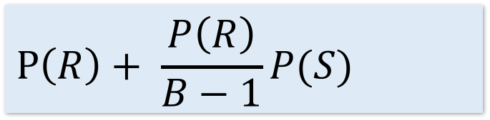
Block Nested Loop Join (BNLJ)
BNLJ
Given B+1 pages of memory
Cost:
Load in B-1 pages of R at a time (leaving 1 page each free for S & output)
For each (B-1)-page segment of R, load each page of S
Note: Faster to iterate over the smaller relation first!

Slide 22
Block Nested Loop Join (BNLJ)
BNLJ
Given B+1 pages of memory
Cost:
Load in B-1 pages of R at a time (leaving 1 page each free for S & output)
For each (B-1)-page segment of R, load each page of S
Check against the join conditions
BNLJ can also handle non-equality constraints

Slide 23
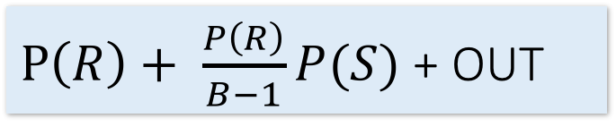
Block Nested Loop Join (BNLJ)
BNLJ
Given B+1 pages of memory
Cost:
Load in B-1 pages of R at a time (leaving 1 page each free for S & output)
For each (B-1)-page segment of R, load each page of S
Check against the join conditions
Write out
Again, OUT could be bigger than P(R)*P(S)… but usually not that bad

Slide 24
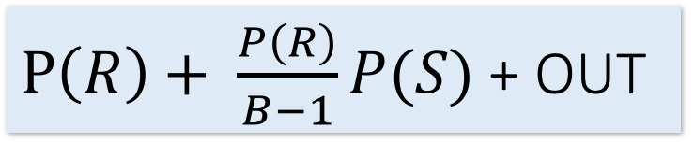
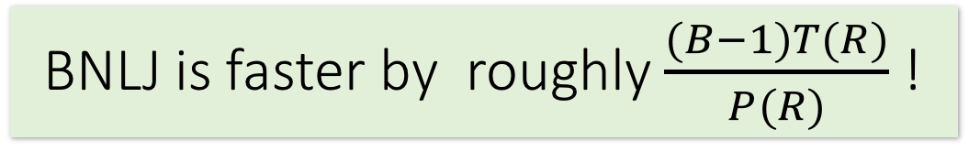
BNLJ vs. NLJ: Benefits of IO Aware
BNLJ
In BNLJ, by loading larger chunks of R, we minimize the number of full disk reads of S
  We only read all of S from disk for every (B-1)-page segment of R!
  Still the full cross-product, but more done only in memory
NLJ
BNLJ
P(R) + T(R)*P(S) + OUT

Slide 25
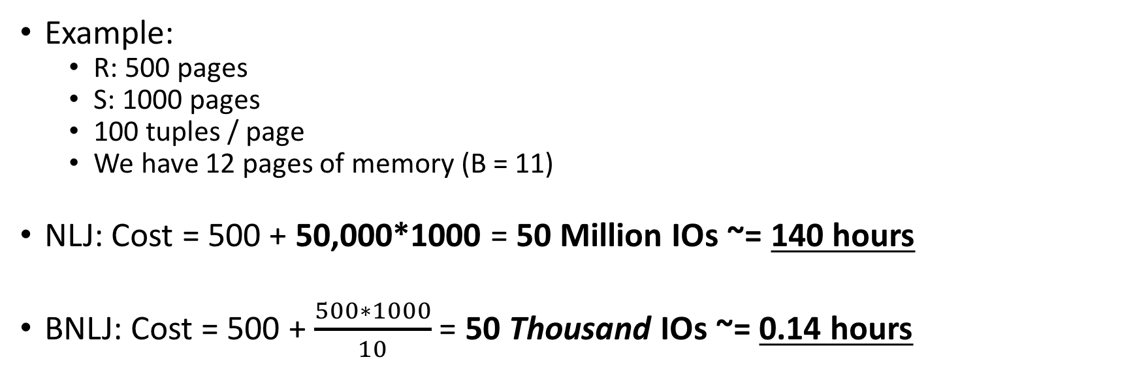
BNLJ vs. NLJ: Benefits of IO Aware
BNLJ
Ignoring OUT here…
A very real difference from a small change in the algorithm!

Slide 26
Smarter than Cross-Products
INLJ

Slide 27
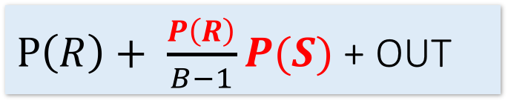
Smarter than Cross-Products: From Quadratic to Nearly Linear
INLJ
All joins that compute the full cross-product have some quadratic term
  For example we saw:
Now we’ll see some (nearly) linear joins:
  ~ O(P(R) + P(S) + OUT), where again OUT could be quadratic but is usually better
NLJ
P(R) + T(R)P(S) + OUT
BNLJ
We get this gain by taking advantage of structure- moving to equality constraints (“equijoin”) only!

Slide 28
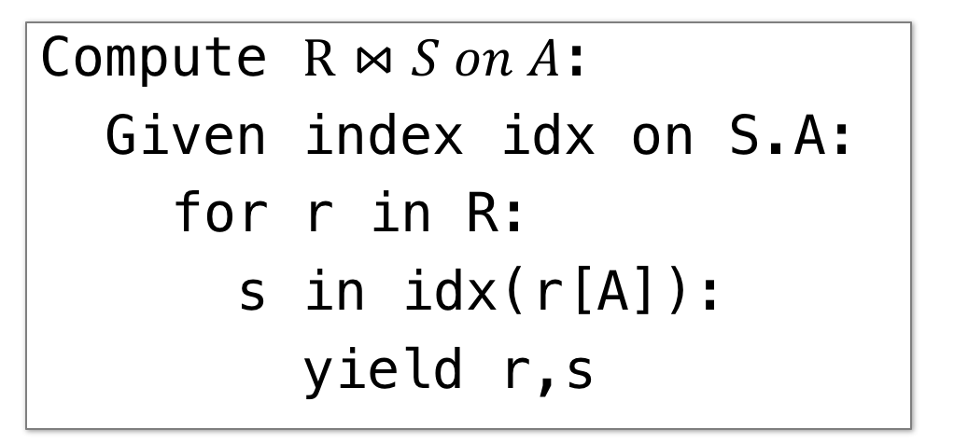
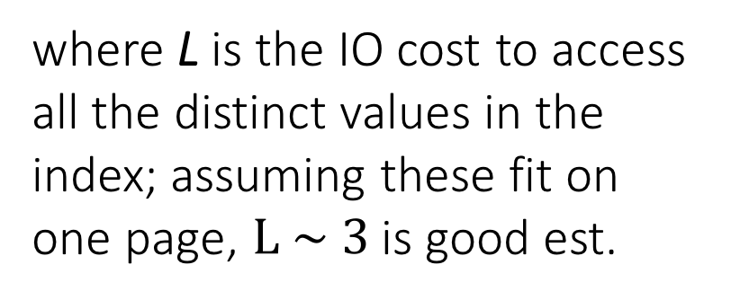
Index Nested Loop Join (INLJ)
INLJ
Cost:
P(R) + T(R)*L + OUT
🡪 We can use an index (e.g. B+ Tree) to avoid doing the full cross-product!

Slide 29
Joins: A Cage Match
Message: It’s all about the memory!

Slide 30

1. Sort-Merge Join (SMJ)

Slide 31
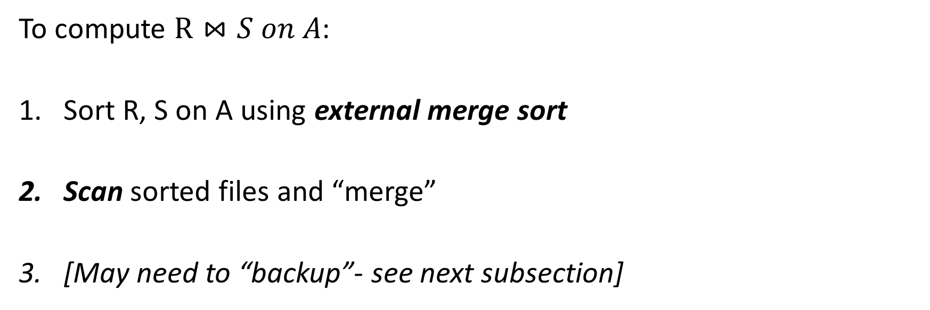
Sort Merge Join (SMJ): Basic Procedure
SMJ
Note that we are only considering equality join conditions here
Note that if R, S are already sorted on A, SMJ will be awesome!

Slide 32

SMJ
For simplicity: Let each page be one tuple, and let the first value be A
We show the file HEAD, which is the next value to be read!
Disk
Main Memory
R
(0,a)
(5,b)
(3,j)
Buffer
S
(3,g)
(7,f)
(0,j)

Slide 33
SMJ
1. Sort the relations R, S on the join key (first value)
Disk
Main Memory
(3,j)
(5,b)
(5,b)
(0,a)
(3,j)
R
(0,a)
Buffer
S
(7,f)
(3,g)
(0,j)
(0,j)
(7,f)
(3,g)

Slide 34
SMJ
2. Scan and “merge” on join key!
Disk
Main Memory
(0,a)
(3,j)
(5,b)
R
(0,a)
Buffer
S
(0,j)
(3,g)
(7,f)
(0,j)
Output

Slide 35
SMJ
2. Scan and “merge” on join key!
Disk
Main Memory
R
(0,a)
(3,j)
(5,b)
Buffer
S
(0,j)
(3,g)
(7,f)
(0,a)
(0,j)
(0,a,j)
Output

Slide 36
SMJ
2. Scan and “merge” on join key!
Disk
Main Memory
(0,a)
(3,j)
(5,b)
R
(3,j)
(5,b)
Buffer
S
(0,j)
(3,g)
(7,f)
(3,g)
(7,f)
(3,j,g)
Output
(0,a,j)

Slide 37
SMJ
2. Done!
Disk
Main Memory
(0,a)
3,j
5,b
R
(3,j)
(5,b)
Buffer
S
(0,j)
3,g
7,f
(3,g)
(7,f)
Output
(0,a,j)
(3,j,g)

Slide 38
What happens with duplicate join keys?
Backup

Slide 39
Multiple tuples with Same Join Key: “Backup”
Backup
1. Start with sorted relations, and begin scan / merge…
Disk
Main Memory
(0,a)
3,j
5,b
R
(0,a)
(0,j)
(0,b)
Buffer
S
(0,j)
(0,j)
3,g
7,f
(0,g)
(7,f)
Output

Slide 40
Multiple tuples with Same Join Key: “Backup”
Backup
1. Start with sorted relations, and begin scan / merge…
Disk
Main Memory
(0,a)
3,j
5,b
R
(0,j)
(0,b)
Buffer
S
(0,j)
3,g
7,f
(0,g)
(7,f)
(0,a)
(0,j)
(0,a,j)
Output

Slide 41
Multiple tuples with Same Join Key: “Backup”
Backup
1. Start with sorted relations, and begin scan / merge…
Disk
Main Memory
(0,a)
(0,j)
5,b
R
(0,j)
(0,b)
Buffer
S
(0,j)
(0,g)
7,f
(0,g)
(7,f)
(0,a)
(0,a,g)
Output
(0,a,j)

Slide 42
Multiple tuples with Same Join Key: “Backup”
Backup
1. Start with sorted relations, and begin scan / merge…
Disk
Main Memory
(0,a)
0,j
5,b
R
(0,j)
(0,b)
Buffer
S
(0,j)
0,g
7,f
(0,j)
(0,g)
(7,f)
(0,j)
Output
(0,a,j)
(0,a,g)
Have to “backup” in the scan of S and read tuple we’ve already read!

Slide 43
Backup
Backup
At best, no backup 🡪 scan takes P(R) + P(S) reads
  For ex: if no duplicate values in join attribute
At worst (e.g. full backup each time), scan could take P(R) * P(S) reads!
  For ex: if all duplicate values in join attribute, i.e. all tuples in R and S have the same value for the join attribute
  Roughly: For each page of R, we’ll have to back up and read each page of S…
Often not that bad however, plus we can:
  Leave more data in buffer (for larger buffers)
  Can “zig-zag” (see animation)

Slide 44
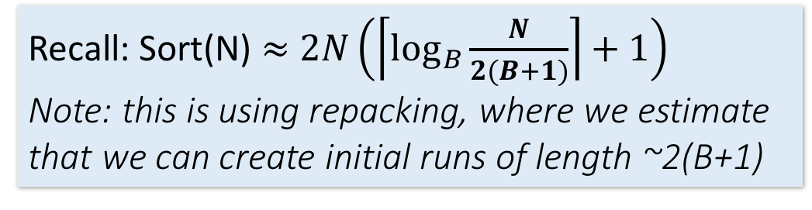
SMJ: Total cost
Backup
Cost of SMJ is cost of sorting R and S…
Plus the cost of scanning: ~P(R)+P(S)
  Because of backup: in worst case P(R)*P(S); but this would be very unlikely
Plus the cost of writing out: ~P(R)+P(S) but in worst case T(R)*T(S)
~ Sort(P(R)) + Sort(P(S)) + P(R) + P(S) + OUT

Slide 45
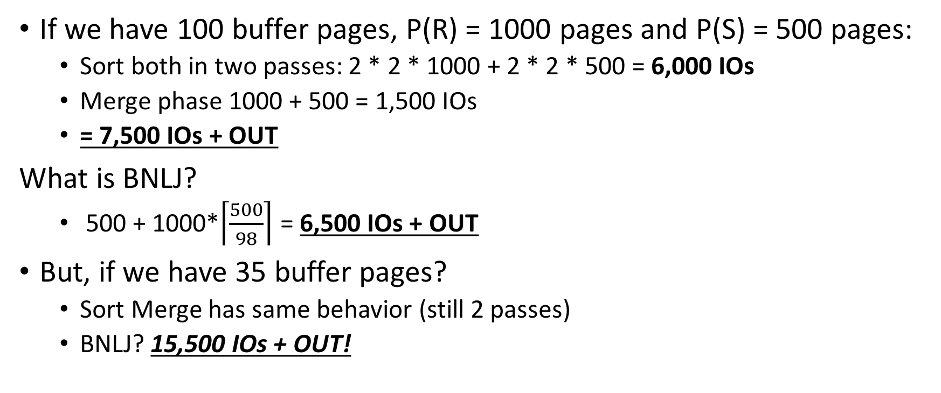
SMJ vs. BNLJ: Steel Cage Match
Backup
SMJ is ~ linear vs. BNLJ is quadratic…
But it’s all about the memory.

Slide 46
A Simple Optimization: Merges Merged!
Backup
Given B+1 buffer pages
SMJ is composed of a sort phase and a merge phase
During the sort phase, run passes of external merge sort on R and S
  Suppose at some point, R and S have <= B (sorted) runs in total
  We could do two merges (for each of R & S) at this point, complete the sort phase, and start the merge phase…
  OR, we could combine them: do one B-way merge and complete the join!

Slide 47
Un-Optimized SMJ
Backup
Given B+1 buffer pages
Unsorted input relations
Sort Phase
(Ext. Merge Sort)
R
S
Split & sort
Split & sort
Merge
Merge
Merge
Merge
Merge / Join Phase
Joined output file created!

Slide 48
Simple SMJ Optimization
Backup
Given B+1 buffer pages
Unsorted input relations
Sort Phase
(Ext. Merge Sort)
R
S
Split & sort
Split & sort
Merge
Merge
<= B total runs
B-Way Merge / Join
Merge / Join Phase
Joined output file created!

Slide 49
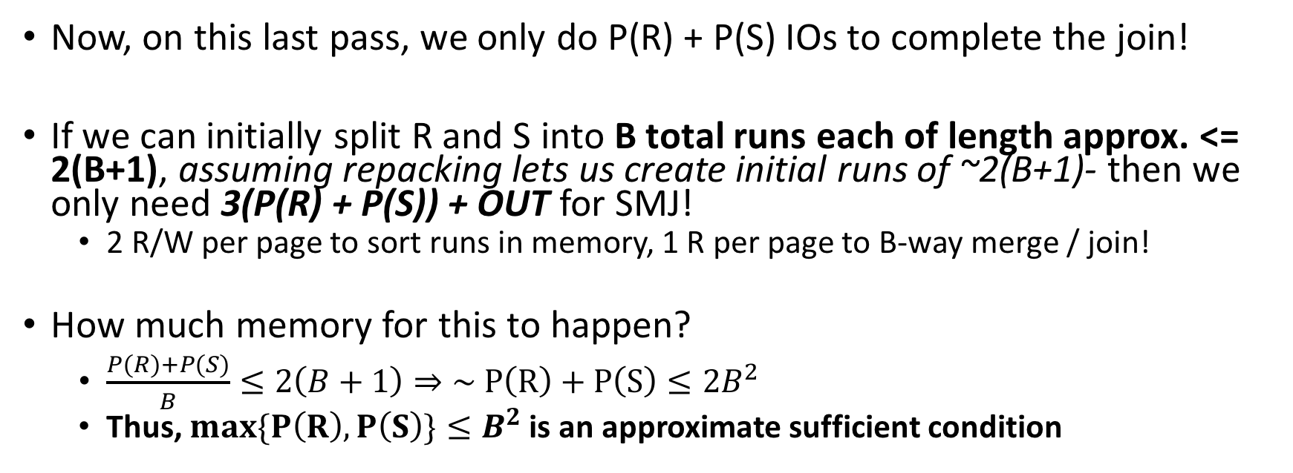
Simple SMJ Optimization
Backup
Given B+1 buffer pages
See , Slide 13-14 – to clarify this slide.
If the larger of R,S has <= B² pages, then SMJ costs 3(P(R)+P(S)) + OUT!

Slide 50
Takeaway points from SMJ
Summary
If input already sorted on join key, skip the sorts.
  SMJ is basically linear.
  Nasty but unlikely case: Many duplicate join keys.
SMJ needs to sort both relations
  If max { P(R), P(S) } < B² then cost is 3(P(R)+P(S)) + OUT

Slide 51

4. Hash Join (HJ)

Slide 52
Recall: Hashing
HJ
Magic of hashing:
  A hash function h_{B} maps into [0,B-1]
  And maps nearly uniformly
A hash collision is when x != y but h_{B}(x) = h_{B}(y)
  Note however that it will never occur that x = y but h_{B}(x) != h_{B}(y)
We hash on an attribute A, so our has function is h_{B}(t) has the form h_{B}(t.A).
  Collisions may be more frequent.

Slide 53
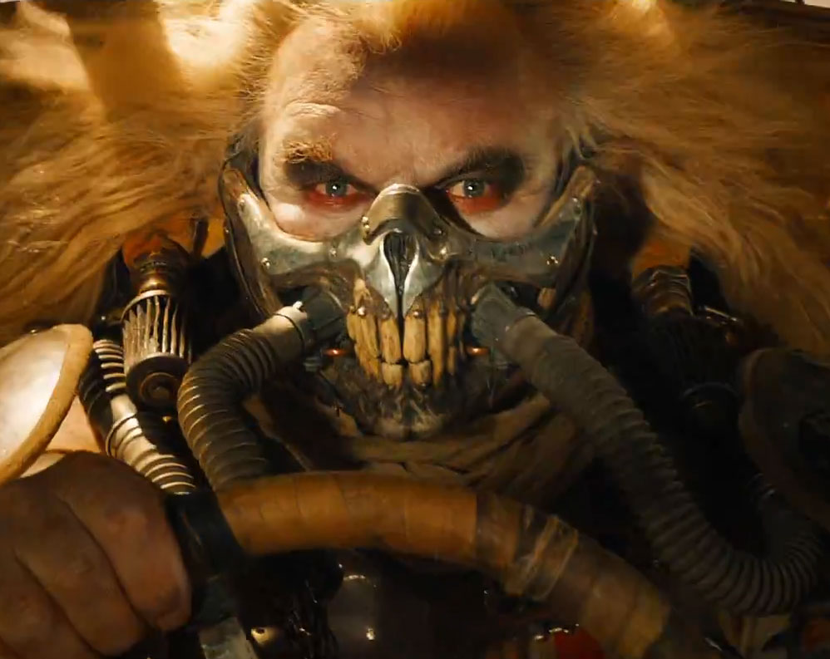

Recall: Mad Hash Collisions
HJ
Say something here to justify this slide’s existence? [TODO]

Slide 54
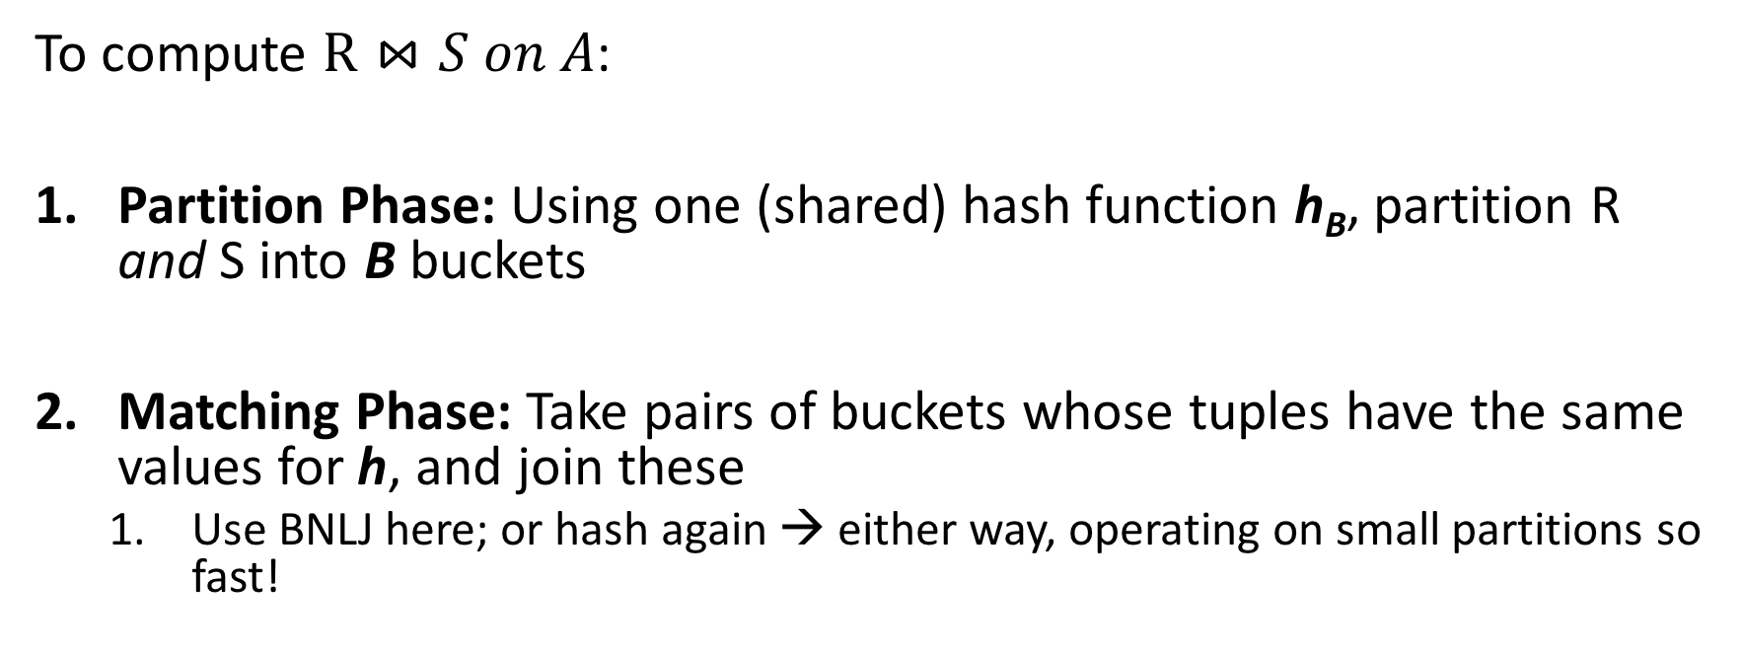
Hash Join: High-level procedure
HJ
Note again that we are only considering equality constraints here
We decompose the problem using h_{B}, then complete the join

Slide 55
Hash Join: High-level procedure
HJ
1. Partition Phase: Using one (shared) hash function h_{B}, partition R and S into B buckets
Disk
Disk
Note our new convention: pages each have two tuples (one per row)
(0,a)
(0,a)
(0,j)
R
(0,a)
(0,a)
(3,j)
(0,j)
(3,b)
R₁
h_{B}
R₂
(3,j)
(3,b)
S
(0,a)
(0,j)
(5,b)
S₁
(0,a)
(0,j)
More detail in a second…
S₂
(5,b)
(5,b)

Slide 56
Hash Join: High-level procedure
HJ
2. Matching Phase: Take pairs of buckets whose tuples have the same values for h_{B}, and join these
Disk
Disk
(0,a)
(0,a)
(0,j)
R
(0,a)
(0,a)
(3,j)
(0,j)
(3,b)
R₁
h_{B}
Join matching buckets
R₂
(3,j)
(3,b)
S
(0,a)
(0,j)
(5,b)
S₁
(0,a)
(0,j)
S₂
(5,b)
(5,b)

Slide 57
Hash Join: High-level procedure
HJ
2. Matching Phase: Take pairs of buckets whose tuples have the same values for h_{B}, and join these
Disk
Disk
(0,a)
(0,a)
(0,j)
R
(0,a)
(0,a)
(3,j)
(0,j)
(3,b)
R₁
h_{B}
(3,j)
(3,b)
Don’t have to join the others! E.g. (S₁ and R₂)!
R₂
S
(0,a)
(0,j)
(5,b)
S₁
(0,a)
(0,j)
S₂
(5,b)
(5,b)

Slide 58
Hash Join Phase 1: Partitioning
HJ
Goal: For each relation, partition relation into buckets such that if h_{B}(t.A) = h_{B}(t’.A) they are in the same bucket
Given B+1 buffer pages, we partition into B buckets:
  We use B buffer pages for output (one for each bucket), and 1 for input
    The “dual” of sorting.
    For each tuple t in input, copy to buffer page for h_{B}(t.A)
    When page fills up, flush to disk.

Slide 59
How big are the resulting buckets?
HJ
Given B+1 buffer pages
Given N input pages, we partition into B buckets:
  🡪 Ideally our buckets are each of size ~ N/B pages
What happens if there are hash collisions?
  Buckets could be N/B
  We’ll do several passes…
What happens if there are duplicate join keys?
  Nothing we can do here… could have some skew in size of the buckets

Slide 60
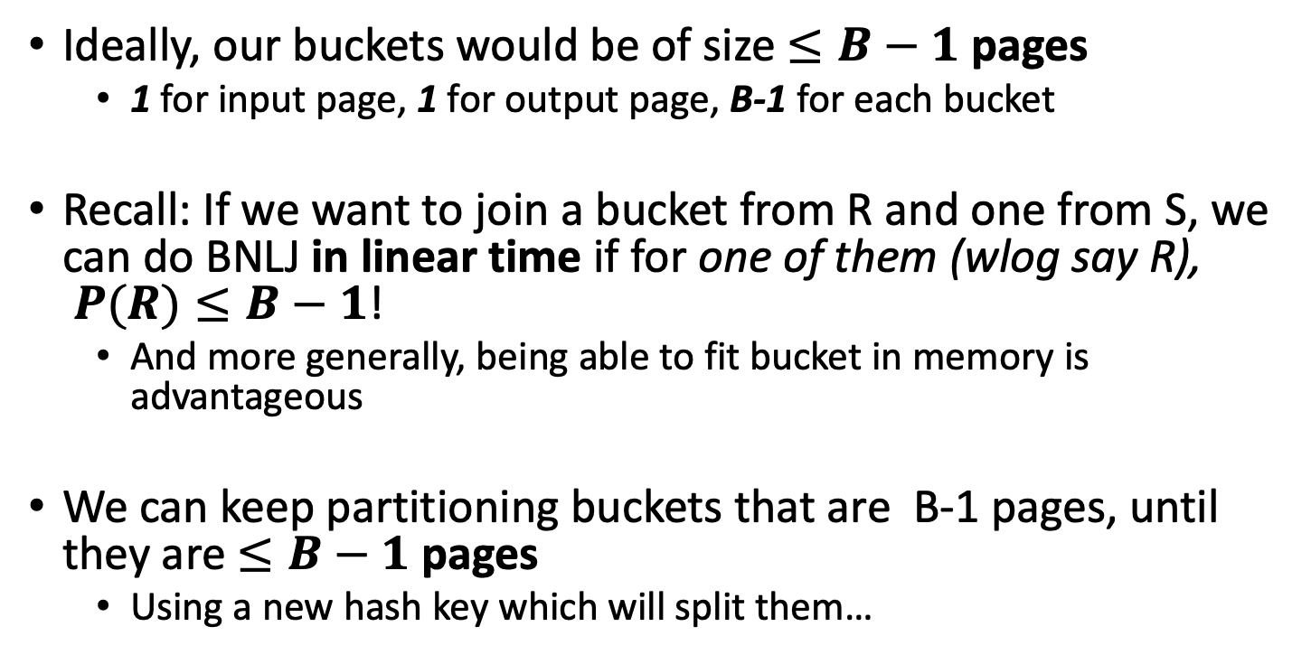
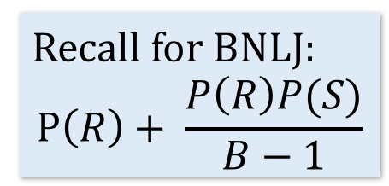
How big do we want the resulting buckets?
HJ
Given B+1 buffer pages
We’ll call each of these a “pass” again…

Slide 61
Hash Join Phase 1: Partitioning
HJ
Given B+1 = 3 buffer pages
We partition into B = 2 buckets using hash function h₂ so that we can have one buffer page for each partition (and one for input)
Disk
For simplicity, we’ll look at partitioning one of the two relations- we just do the same for the other relation!
(5,b)
(5,a)
(0,j)
(3,j)
(0,j)
R
(0,a)
(3,a)
Recall: our goal will be to get B = 2 buckets of size <= B-1 🡪 1 page each

Slide 62
Hash Join Phase 1: Partitioning
HJ
Given B+1 = 3 buffer pages
1. We read pages from R into the “input” page of the buffer…
Disk
Main Memory
(5,b)
(5,a)
(0,j)
(3,j)
(0,j)
R
Buffer
(0,a)
(3,a)
Input page
0
1
Output (bucket) pages

Slide 63
Hash Join Phase 1: Partitioning
HJ
Given B+1 = 3 buffer pages
2. Then we use hash function h₂ to sort into the buckets, which each have one page in the buffer
Disk
Main Memory
h₂(0) = 0
R
(5,b)
(5,a)
(0,j)
(3,j)
(0,j)
Buffer
(3,a)
(0,a)
(3,a)
(0,a)
Input page
0
1
Output (bucket) pages

Slide 64
Hash Join Phase 1: Partitioning
HJ
Given B+1 = 3 buffer pages
2. Then we use hash function h₂ to sort into the buckets, which each have one page in the buffer
Disk
Main Memory
h₂(3) = 1
R
(5,b)
(5,a)
(0,j)
(3,j)
(0,j)
Buffer
(3,a)
(0,a)
(3,a)
Input page
0
1
Output (bucket) pages

Slide 65
Hash Join Phase 1: Partitioning
HJ
Given B+1 = 3 buffer pages
3. We repeat until the buffer bucket pages are full…
Disk
Main Memory
R
(5,b)
(5,a)
(0,j)
(3,j)
(0,j)
Buffer
(0,a)
(3,a)
Input page
0
1
Output (bucket) pages

Slide 66
Hash Join Phase 1: Partitioning
HJ
Given B+1 = 3 buffer pages
3. We repeat until the buffer bucket pages are full…
Disk
Main Memory
h₂(3) = 1
R
(5,b)
(5,a)
(0,j)
Buffer
(3,j)
(0,j)
(3,a)
(3,j)
(0,j)
(0,a)
(3,a)
Input page
0
1
Output (bucket) pages

Slide 67
Hash Join Phase 1: Partitioning
HJ
Given B+1 = 3 buffer pages
3. We repeat until the buffer bucket pages are full…
Disk
Main Memory
h₂(0) = 0
R
(5,b)
(5,a)
(0,j)
Buffer
(0,a)
(0,j)
(3,a)
(3,j)
(0,j)
(0,a)
(3,a)
Input page
0
1
Output (bucket) pages

Slide 68
Hash Join Phase 1: Partitioning
HJ
Given B+1 = 3 buffer pages
3. We repeat until the buffer bucket pages are full… then flush to disk
Disk
Main Memory
R
(5,b)
(5,a)
(0,j)
Buffer
B0
(0,a)
(0,j)
(3,a)
(3,j)
B1
Input page
0
1
Output (bucket) pages

Slide 69
Hash Join Phase 1: Partitioning
HJ
Given B+1 = 3 buffer pages
3. We repeat until the buffer bucket pages are full… then flush to disk
Disk
Main Memory
R
(5,b)
(5,a)
(0,j)
Buffer
(0,a)
(0,j)
B0
(3,a)
(3,j)
Input page
B1
0
1
Output (bucket) pages

Slide 70
Hash Join Phase 1: Partitioning
HJ
Given B+1 = 3 buffer pages
Note that collisions can occur!
Collision!!!
Disk
Main Memory
h₂(5) = h₂(3) = 1
h₂(5) = 1
R
(5,b)
Buffer
(0,a)
(0,j)
(0,j)
(5,a)
B0
(5,a)
(0,j)
(3,a)
(3,j)
Input page
B1
0
1
Output (bucket) pages

Slide 71
Hash Join Phase 1: Partitioning
HJ
Given B+1 = 3 buffer pages
Finish this pass…
Disk
Main Memory
h₂(0) = 0
R
(5,b)
Buffer
(0,a)
(0,j)
(0,j)
(0,j)
(5,a)
B0
(3,a)
(3,j)
Input page
B1
0
1
Output (bucket) pages

Slide 72
Hash Join Phase 1: Partitioning
HJ
Given B+1 = 3 buffer pages
Finish this pass…
Disk
Main Memory
R
(5,b)
Buffer
(0,a)
(0,j)
(0,j)
(5,a)
B0
(3,a)
(3,j)
Input page
B1
0
1
Output (bucket) pages

Slide 73
Hash Join Phase 1: Partitioning
HJ
Given B+1 = 3 buffer pages
Finish this pass…
Collision!!!
Disk
Main Memory
h₂(5) = h₂(3) = 1
h₂(5) = 1
R
Buffer
(0,a)
(0,j)
(5,b)
(0,j)
(5,a)
B0
(5,a)
(5,b)
(3,a)
(3,j)
Input page
B1
0
1
Output (bucket) pages

Slide 74
Hash Join Phase 1: Partitioning
HJ
Given B+1 = 3 buffer pages
Finish this pass…
Disk
Main Memory
R
Buffer
(0,a)
(0,j)
(0,j)
(5,a)
(5,b)
B0
(3,a)
(3,j)
Input page
B1
0
1
Output (bucket) pages

Slide 75
Hash Join Phase 1: Partitioning
HJ
Given B+1 = 3 buffer pages
We wanted buckets of size B-1 = 1… however we got larger ones due to:
Disk
(0,a)
(0,j)
(0,j)
(1) Duplicate join keys
B0
(3,a)
(3,j)
(5,a)
(5,b)
(2) Hash collisions
B1

Slide 76
Hash Join Phase 1: Partitioning
HJ
Given B+1 = 3 buffer pages
To take care of larger buckets caused by (2) hash collisions, we can just do another pass!
Disk
(0,a)
(0,j)
(0,j)
What hash function should we use?
B0
(3,a)
(3,j)
(5,a)
(5,b)
B1
Do another pass with a different hash function, h’_{2,} ideally such that:
h’₂(3) != h’₂(5)

Slide 77
Hash Join Phase 1: Partitioning
HJ
Given B+1 = 3 buffer pages
To take care of larger buckets caused by (2) hash collisions, we can just do another pass!
Disk
(0,a)
(0,j)
(0,j)
What hash function should we use?
B0
(3,a)
(3,j)
B1
Do another pass with a different hash function, h’_{2,} ideally such that:
h’₂(3) != h’₂(5)
(5,a)
(5,b)
B2

Slide 78
Hash Join Phase 1: Partitioning
HJ
Given B+1 = 3 buffer pages
What about duplicate join keys? Unfortunately this is a problem… but usually not a huge one.
Disk
(0,a)
(0,j)
(0,j)
B0
We call this unevenness in the bucket size skew
(3,a)
(3,j)
B1
(5,a)
(5,b)
B2

Slide 79
Now that we have partitioned R and S…
HJ

Slide 80
Hash Join Phase 2: Matching
HJ
Now, we just join pairs of buckets from R and S that have the same hash value to complete the join!
Disk
Disk
(0,a)
(0,a)
(0,j)
R
(0,a)
(0,a)
(3,j)
(0,j)
(3,b)
R₁
h_{B}
Join matching buckets
R₂
(3,j)
(3,b)
S
(0,a)
(0,j)
(5,b)
S₁
(0,a)
(0,j)
S₂
(5,b)
(5,b)

Slide 81
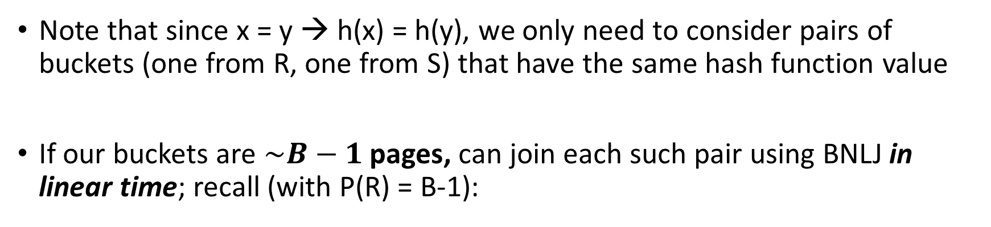
Hash Join Phase 2: Matching
HJ
Joining the pairs of buckets is linear!
(As long as smaller bucket <= B-1 pages)

Slide 82

Hash Join Phase 2: Matching
HJ
h(1)=0
h(1)=0
h(2)=0
h(3)=1
h(3)=1
h(4)=1
h(5)=2
h(6)=2
h(6)=2
 | h(1) | h(1) | h(2) | h(2) | h(3) | h(4) | h(5) | h(6) | h(6)
R.A hashed values
S.A hashed values

Slide 83
Hash Join Phase 2: Matching
HJ
A=1
h(1)=0
h(1)=0
h(2)=0
h(3)=1
h(3)=1
h(4)=1
h(5)=2
h(6)=2
h(6)=2
 | h(1) | h(1) | h(2) | h(2) | h(3) | h(4) | h(5) | h(6) | h(6)
A=2
To perform the join, we ideally just need to explore the dark blue regions
= the tuples with same values of the join key A
A=3
R.A hashed values
A=4
A=5
A=6
S.A hashed values

Slide 84
Hash Join Phase 2: Matching
HJ
h(1)=0
h(1)=0
h(2)=0
h(3)=1
h(3)=1
h(4)=1
h(5)=2
h(6)=2
h(6)=2
 | h(1) | h(1) | h(2) | h(2) | h(3) | h(4) | h(5) | h(6) | h(6)
With a join algorithm like BNLJ that doesn’t take advantage of equijoin structure, we’d have to explore this whole grid!
R.A hashed values
S.A hashed values

Slide 85
Hash Join Phase 2: Matching
HJ
h(A)=0
h(1)=0
h(1)=0
h(2)=0
h(3)=1
h(3)=1
h(4)=1
h(5)=2
h(6)=2
h(6)=2
 | h(1) | h(1) | h(2) | h(2) | h(3) | h(4) | h(5) | h(6) | h(6)
With HJ, we only explore the blue regions
= the tuples with same values of h(A)!
h(A)=1
R.A hashed values
h(A)=2
S.A hashed values
We can apply BNLJ to each of these regions

Slide 86
Hash Join Phase 2: Matching
HJ
h'(A)=0
h'(A)=1
An alternative to applying BNLJ:
We could also hash again, and keep doing passes in memory to reduce further!
h'(A)=2
R.A hashed values
h'(A)=3
h'(A)=4
h'(A)=5
S.A hashed values

Slide 87
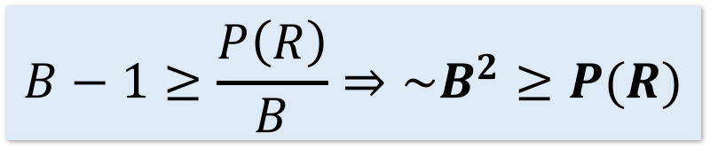
How much memory do we need for HJ?
Memory requirements
Given B+1 buffer pages
Suppose (reasonably) that we can partition into B buckets in 2 passes:
  For R, we get B buckets of size ~P(R)/B
  To join these buckets in linear time, we need these buckets to fit in B-1 pages, so we have:
+ WLOG: Assume P(R) <= P(S)
Quadratic relationship between smaller relation’s size & memory!

Slide 88
Hash Join Summary
Memory requirements
Given enough buffer pages as on previous slide…
  Partitioning requires reading + writing each page of R,S
    🡪 2(P(R)+P(S)) IOs
  Matching (with BNLJ) requires reading each page of R,S
    🡪 P(R) + P(S) IOs
  Writing out results could be as bad as P(R)*P(S)… but probably closer to P(R)+P(S)
HJ takes ~3(P(R)+P(S)) + OUT IOs!

Slide 89
3. The Cage Match
The Cage Match

Slide 90
Sort-Merge v. Hash Join
The Cage Match
Given enough memory, both SMJ and HJ have performance:
“Enough” memory =
  SMJ: B² max{P(R), P(S)}
  HJ: B² min{P(R), P(S)}
~3(P(R)+P(S)) + OUT
  Hash Join superior if relation sizes differ greatly. Why?
Notes:
16

Slide 91
Further Comparisons of Hash and Sort Joins
The Cage Match
Hash Joins are highly parallelizable.
Sort-Merge less sensitive to data skew and result is sorted

Slide 92
Summary
The Cage Match
Saw IO-aware join algorithms
  Massive difference
Memory sizes key in hash versus sort join
  Hash Join = Little dog (depends on smaller relation)
Skew is also a major factor

