Slide 1
MongoDB-1
WPI, Mohamed Eltabakh

Slide 2
High-Level Overview

Slide 3

Name comes from “Humongous” & huge data
Written in C++, developed in 2009
Creator: 10gen, former doublick

Slide 4
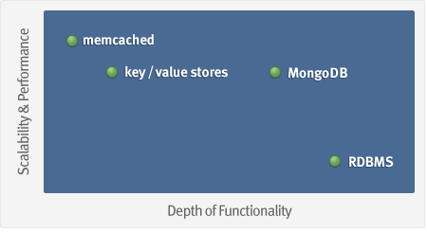
MongoDB: Goal
Goal: bridge the gap between key-value stores (which are fast and scalable) and relational databases (which have rich functionality).

Slide 5
What is MongoDB?
Defination: MongoDB is an open source, document-oriented database designed with both scalability and developer agility in mind.
Instead of storing your data in tables and rows as you would with a relational database, in MongoDB you store JSON-like documents with dynamic schemas (schema-free, schemaless).

Slide 6
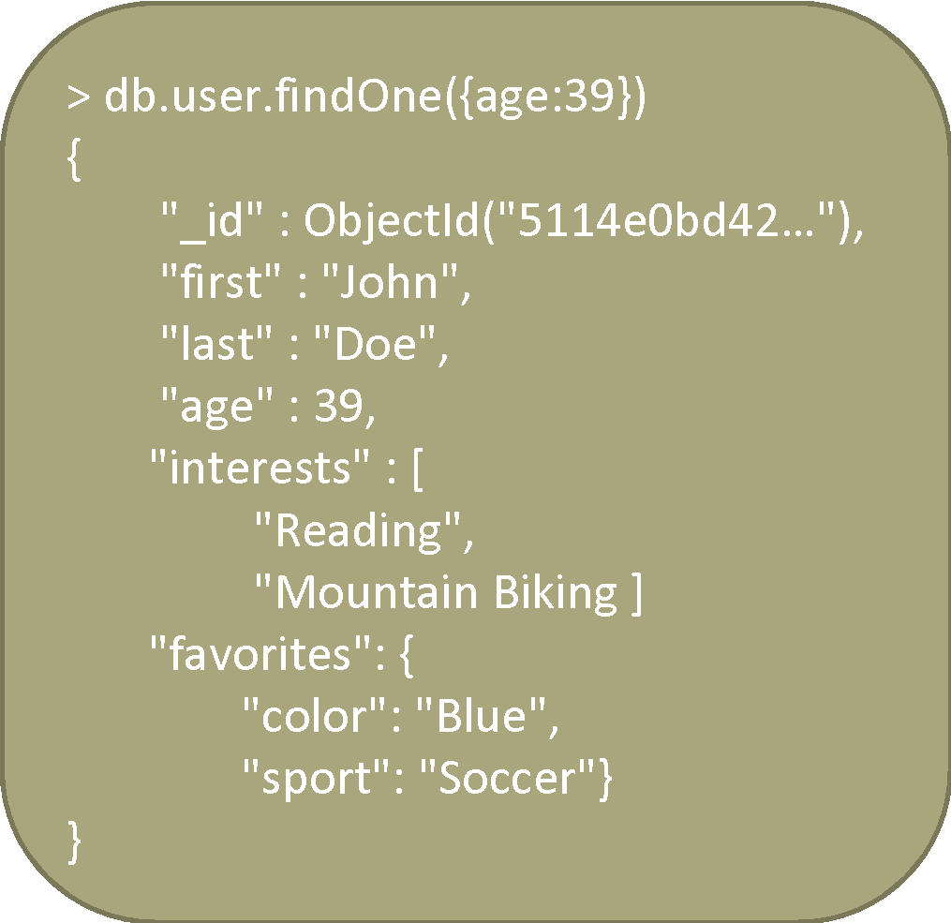
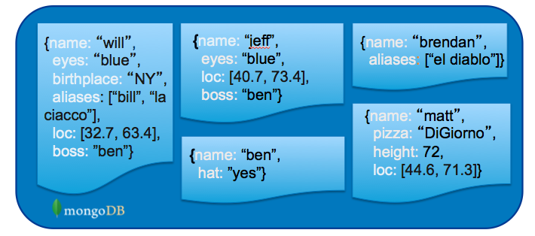
What is MongoDB? (Cont’d)
Document-Oriented DB
  Unit object is a document instead of a row (tuple) in relational DBs

Slide 7
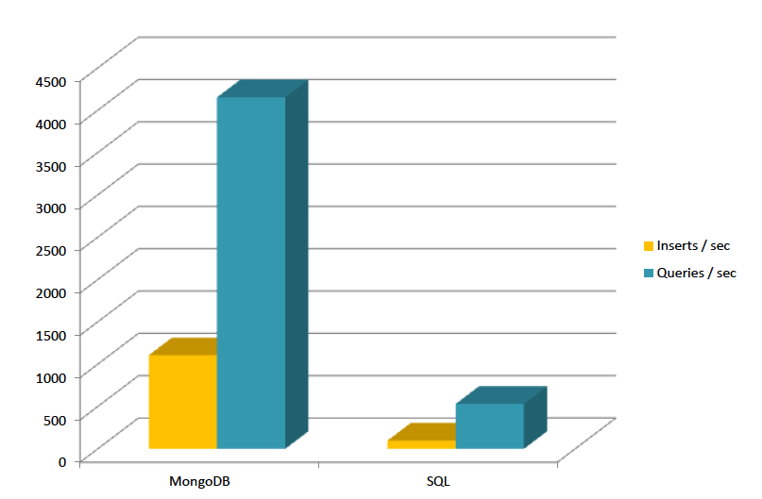
Is It Fast?
For semi-structured & complex relationships: Yes

Slide 8
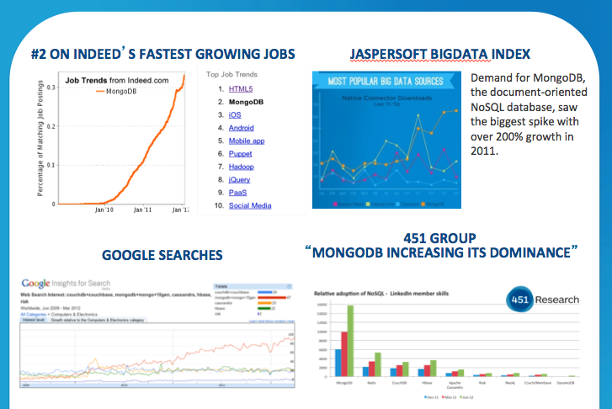
It is Growing Fast

Slide 9
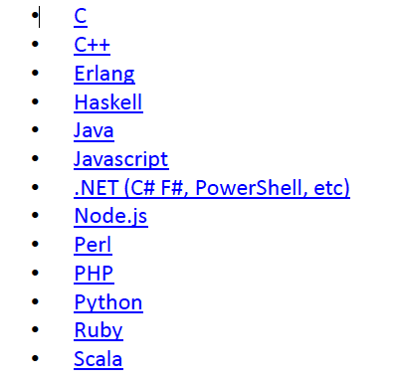
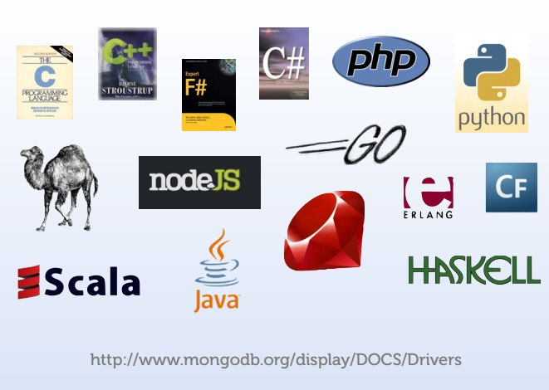
Integration with Others

Slide 10
NoSQL DBs

Slide 11
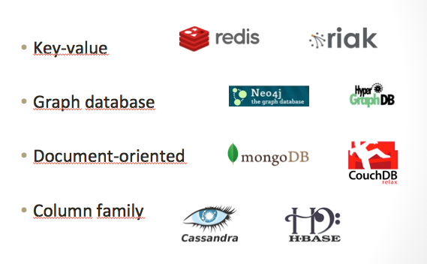
NoSQL: Categories

Slide 12
What is NoSQL
Stands for Not Only SQL??
Class of non-relational data storage systems
Usually do not require a fixed table schema nor
do they use the concept of joins
  Distributed data storage systems
All NoSQL offerings relax one or more of the ACID properties
  will talk about the CAP theorem

Slide 13
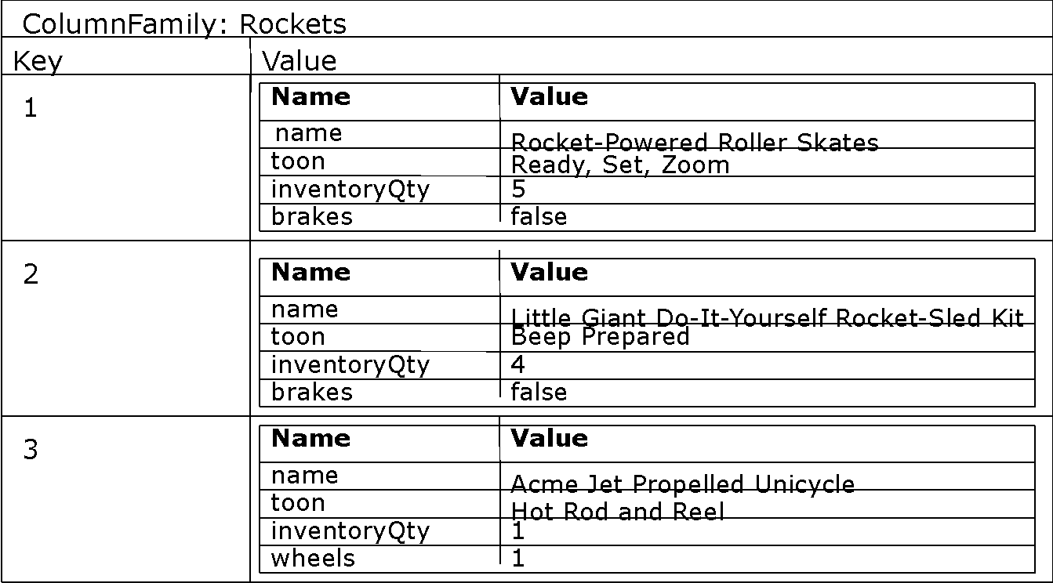

Example of Column-Family
(E.g., Hbase)
MongoDB has more flexible data model & stronger querying interface
Typical APIs: get(key), put(key, value), delete(key), …

Slide 14
CAP Theorem
Three properties of a system
  Consistency (all copies have same value)
  Availability (system can run even if parts have failed)
    All nodes can still accept reads and writes
  Partition Tolerance (Even if part is down, others can take over)
CAP “Theorem”:
  You can have at most two of these three properties for any system
  Pick two !!!

Slide 15
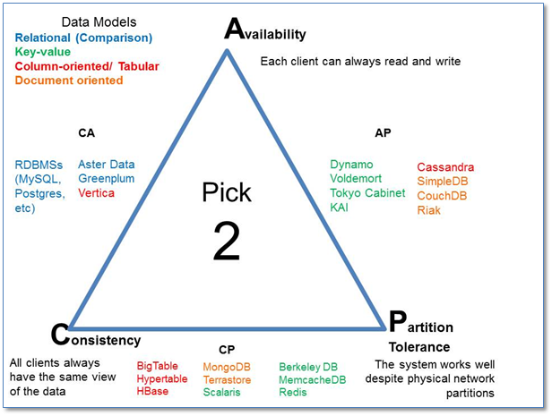
CAP Theorem

Slide 16
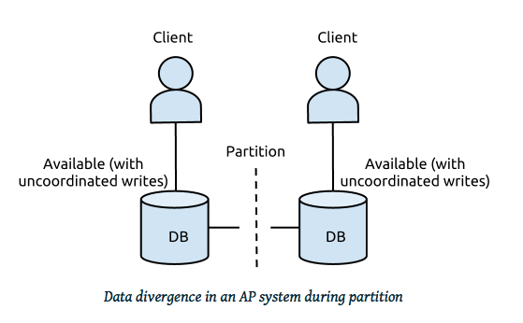
Example
In distributed systems, CA is not a choice
Either select AP or CP
Network Failure
If select Availability 🡺 Loose Consistency (AP Design)
If select Consistency 🡺 Loose Availability (CP Design)

Slide 17
Availability
Traditionally, thought of as the server/process available five 9’s (99.999 %).
  Failures are rare
In modern commodity distributed systems:
  Want a system that is resilient in the face of network disruption
  Use Replication

Slide 18
Eventual Consistency
When no updates occur for a long period of time:
  Eventually all updates will propagate through the system and all the nodes will be consistent
For a given accepted update and a given node:
  Eventually either the update reaches the node or the node is removed from service

Slide 19
Eventual Consistency
BASE Concept
  Basically Available, Soft state, Eventual consistency
  As opposed to ACID in RDBMS
  Soft state: copies of a data item may be inconsistent
  Eventually Consistent – copies becomes consistent at some later time if there are no more updates to that data item

Slide 20


What does NoSQL Not Provide
No built-in join
No ACID transactions
No SQL
ISA
Follows

Slide 21
Data Model

Slide 22
Data Model
BSON format (binary JSON)
Developers can easily map to modern object-oriented languages without a complicated ORM layer.
lightweight, traversable, efficient

Slide 23
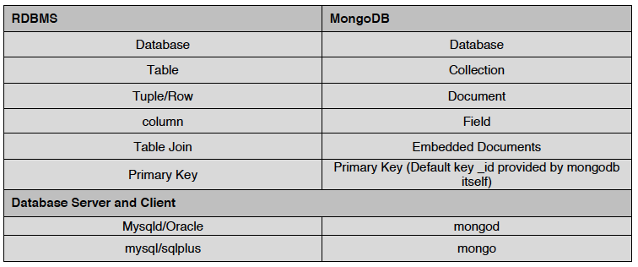
Terms Mapping (DB vs. MongoDB)

Slide 24
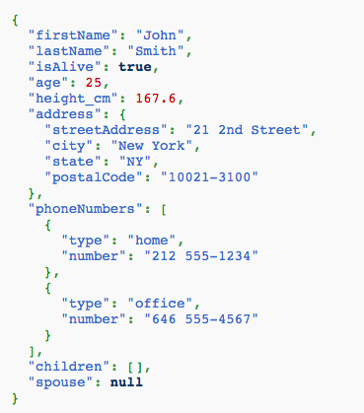
JSON
Field Name
Field Value
Field Value
  Scalar (Int, Boolean, String, Date, …)
  Document (Embedding or Nesting)
  Array of JSON objects
One document

Slide 25
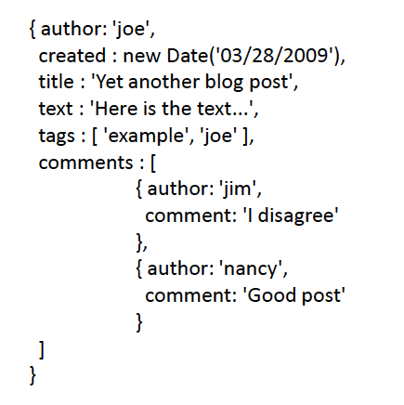
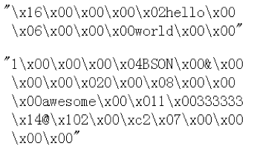
Another Example
Remember it is stored in binary formats (BSON)

Slide 26
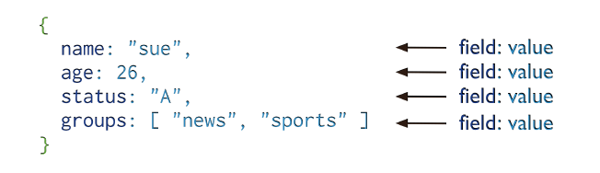
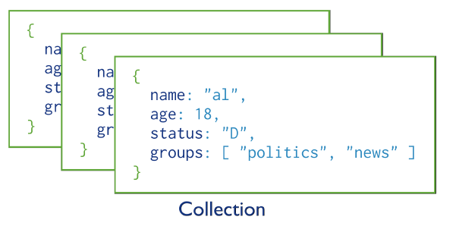
MongoDB Model
One document (e.g., one tuple in RDBMS)
Collection is a group of similar documents
Within a collection, each document must have a unique Id
One Collection (e.g., one Table in RDBMS)
Unlike RDBMS:
No Integrity Constraints in MongoDB

Slide 27
MongoDB Model
One document (e.g., one tuple in RDBMS)
The field names cannot start with the $ character
The field names cannot contain the . character
Max size of single document 16MB
One Collection (e.g., one Table in RDBMS)

Slide 28
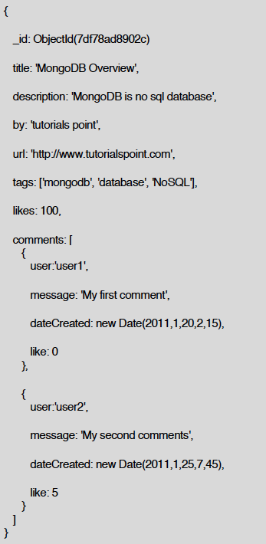
Example Document in MongoDB
_id is a special column in each document
Unique within each collection
_id 🡸🡺 Primary Key in RDBMS
_id is 12 Bytes, you can set it yourself
Or:
  1st 4 bytes 🡺 timestamp
  Next 3 bytes 🡺 machine id
  Next 2 bytes 🡺 Process id
  Last 3 bytes 🡺 incremental values

Slide 29
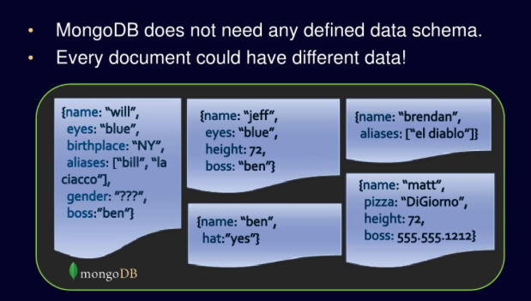
No Defined Schema
(Schema-free Or Schema-less)

Slide 30
Data Model Comparison
Relational DB vs. NoSQL

Slide 31
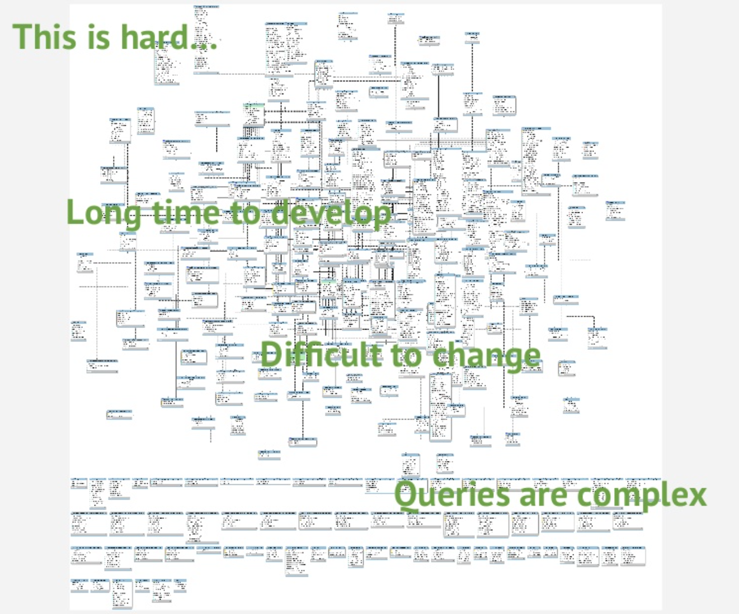
Complex relationships
Dynamic environment
RDBMS are not the best choice

Slide 32
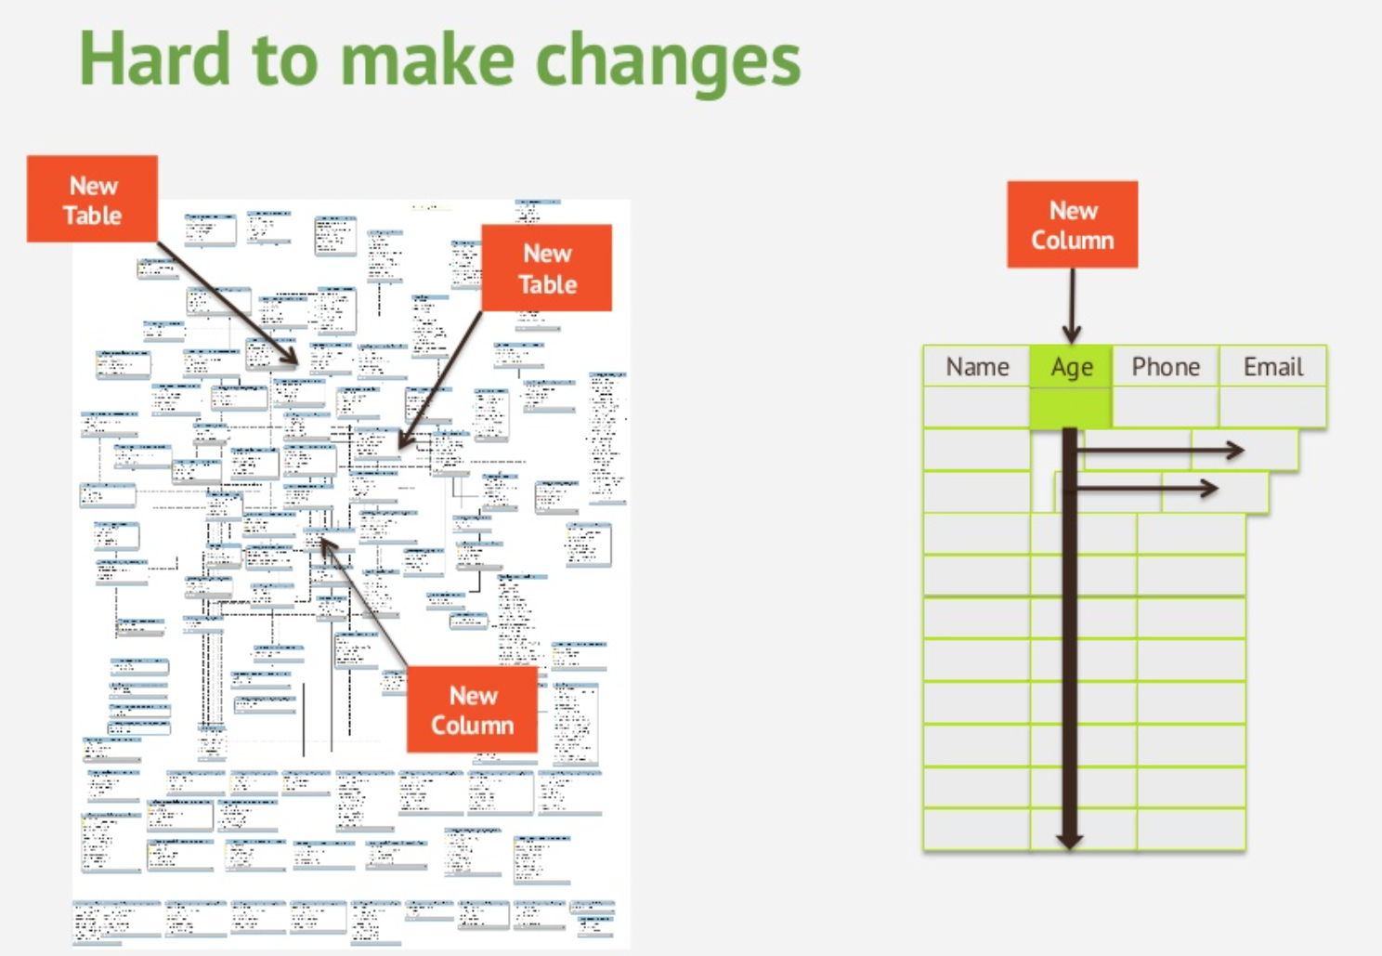

Slide 33
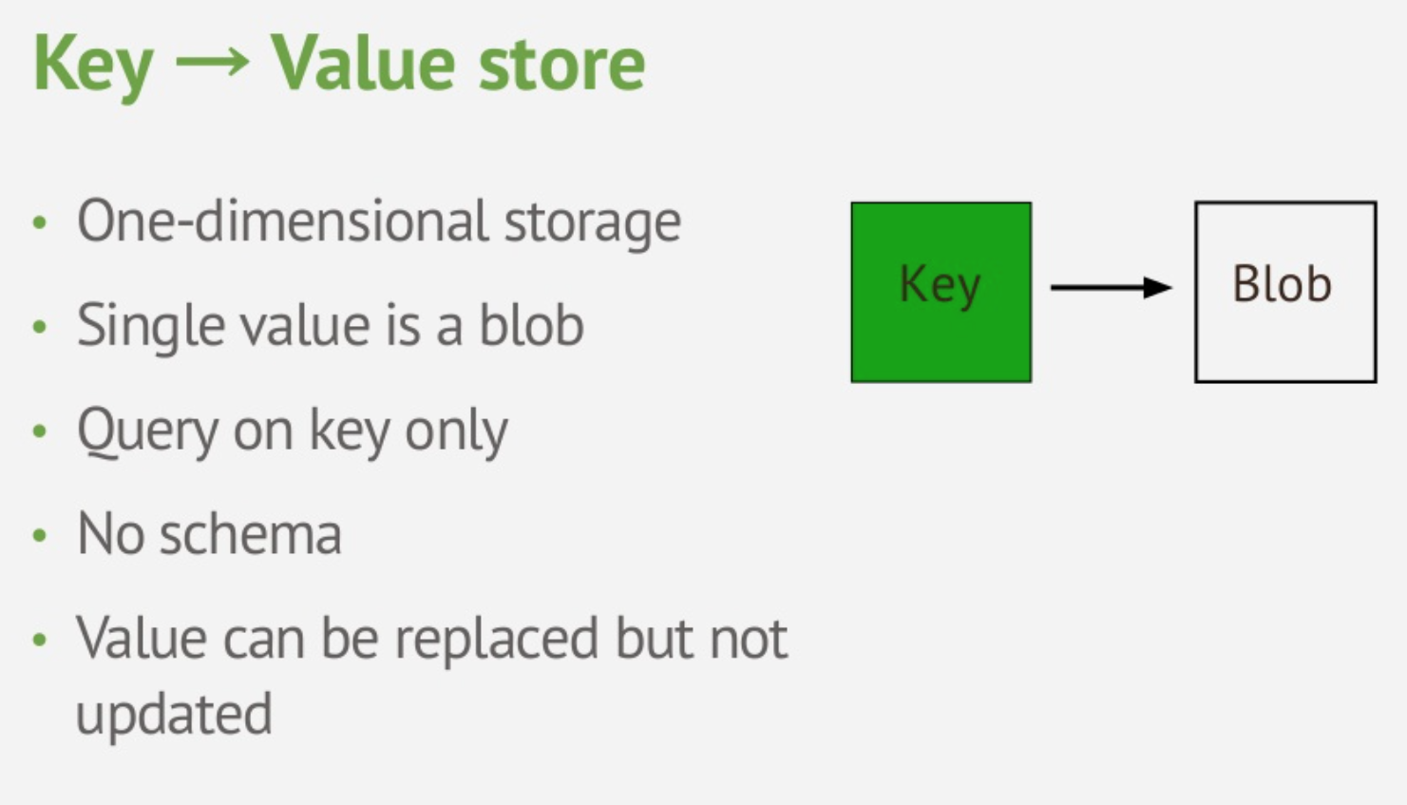
Key-Value Data Model

Slide 34
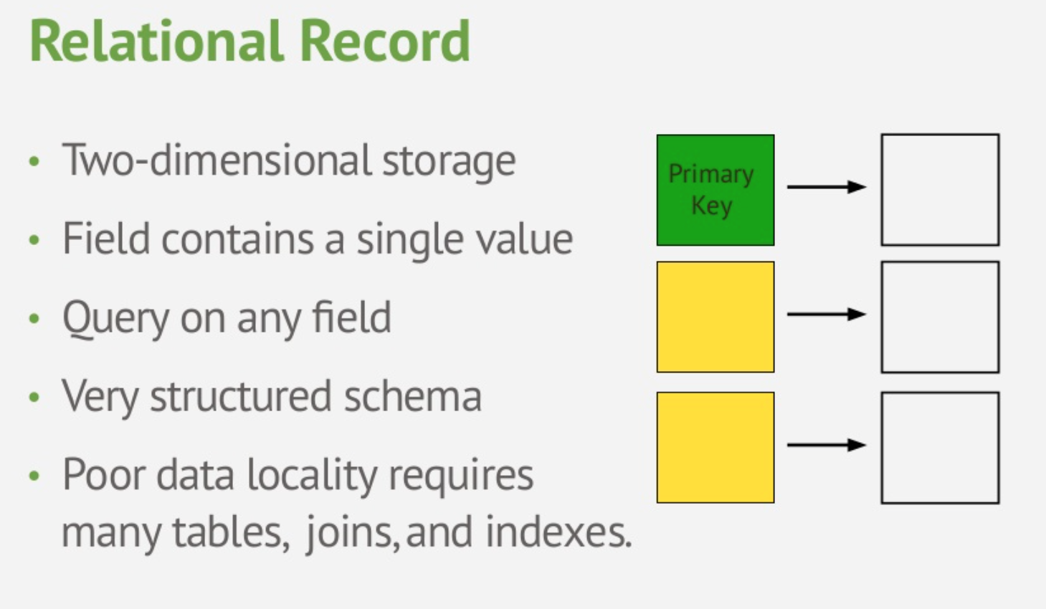
Relational Data Model

Slide 35
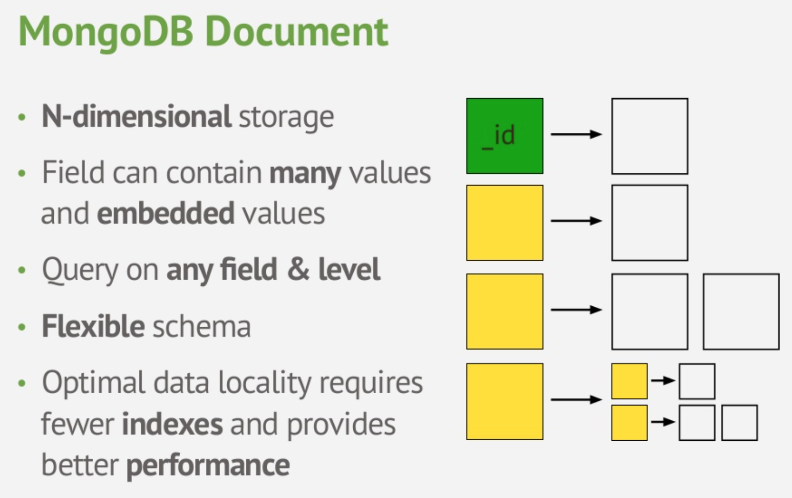
Document Data Model

Slide 36
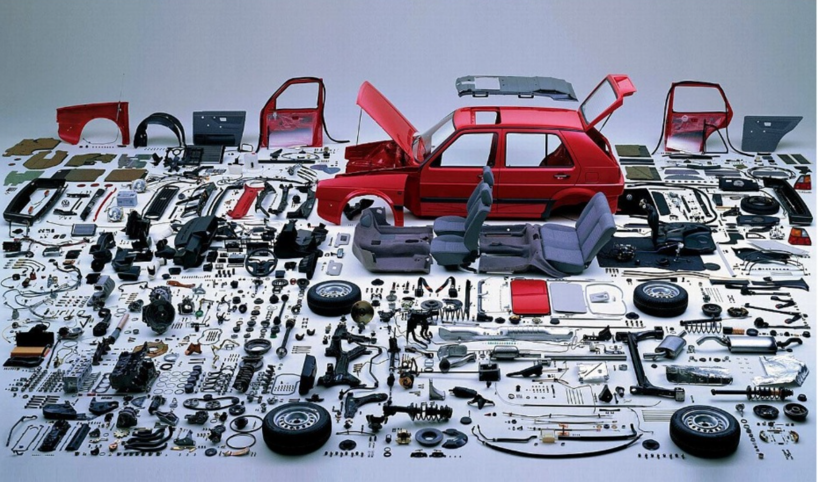
Document vs. Relational Models
Relational
  Focus on data storage
  At query time 🡺 build your business objects
Document
  Focus on data usage
  Always maintain your business object

Slide 37
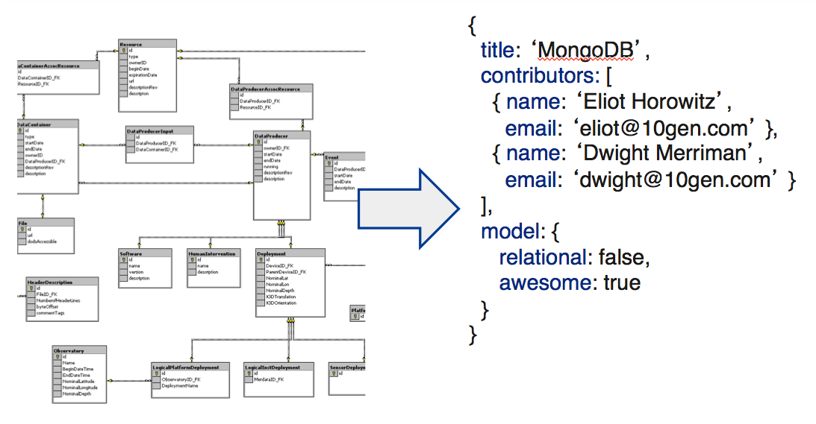
Tradeoff: Normalization vs. Easy Usage

Slide 38
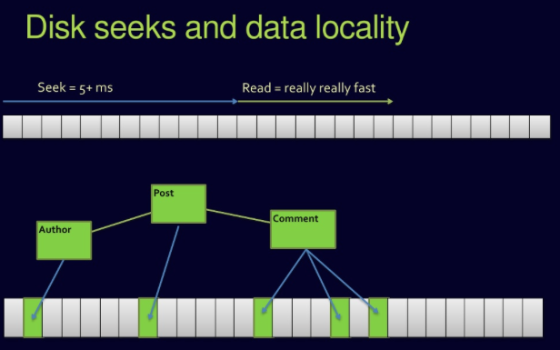
Complex Join Queries
Relational DBs

Slide 39
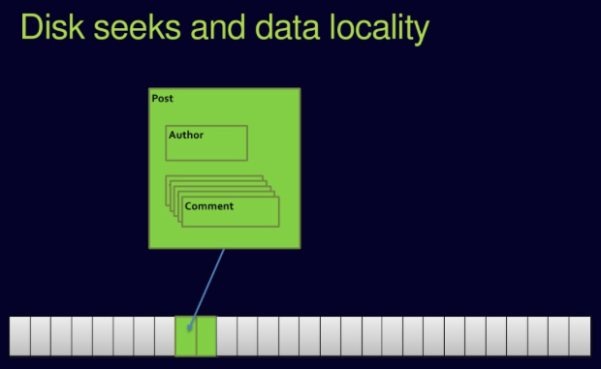
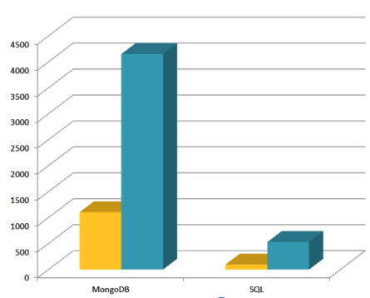
No Joins in MongoDB

Slide 40
Updates & Querying

Slide 41



Must Practice It
Install it
Practice simple stuff
Move to complex stuff
Install it from here: http://www.mongodb.org
Manual: http://docs.mongodb.org/master/MongoDB-manual.pdf
(Focus on Ch. 3, 4 for now)
Dataset: http://docs.mongodb.org/manual/reference/bios-example-collection/

Slide 42
CRUD
Create
  db.collection.insert( <document> )
  db.collection.save( <document> )
  db.collection.update( <query>, <update>, { upsert: true } )
Read
  db.collection.find( <query>, <projection> )
  db.collection.findOne( <query>, <projection> )
Update
  db.collection.update( <query>, <update>, <options> )
Delete
  db.collection.remove( <query>, <justOne> )

Slide 43
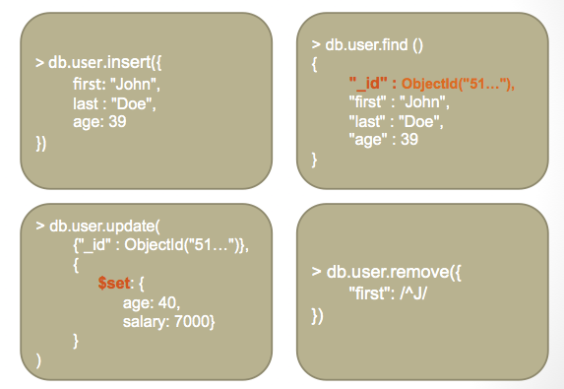
CRUD Examples

Slide 44
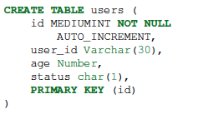


Examples
In RDBMS
In MongoDB
Either insert the 1st docuement
Or create “Users” collection explicitly

Slide 45
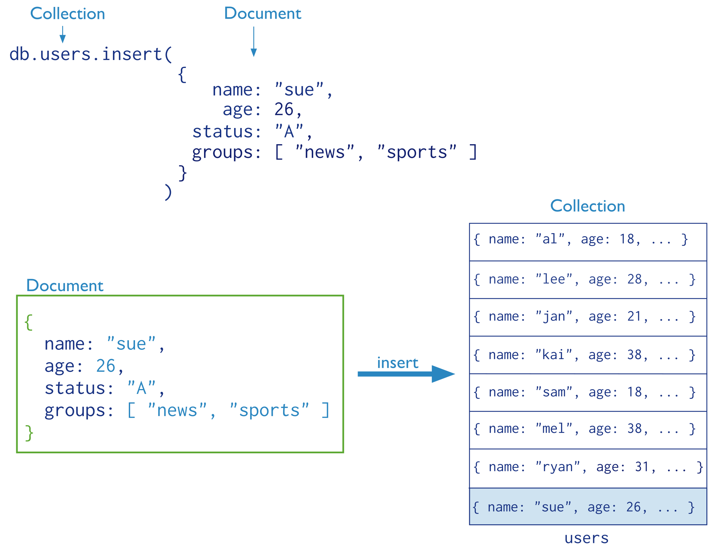
Insertion
The collection “users” is created automatically if it does not exist

Slide 46
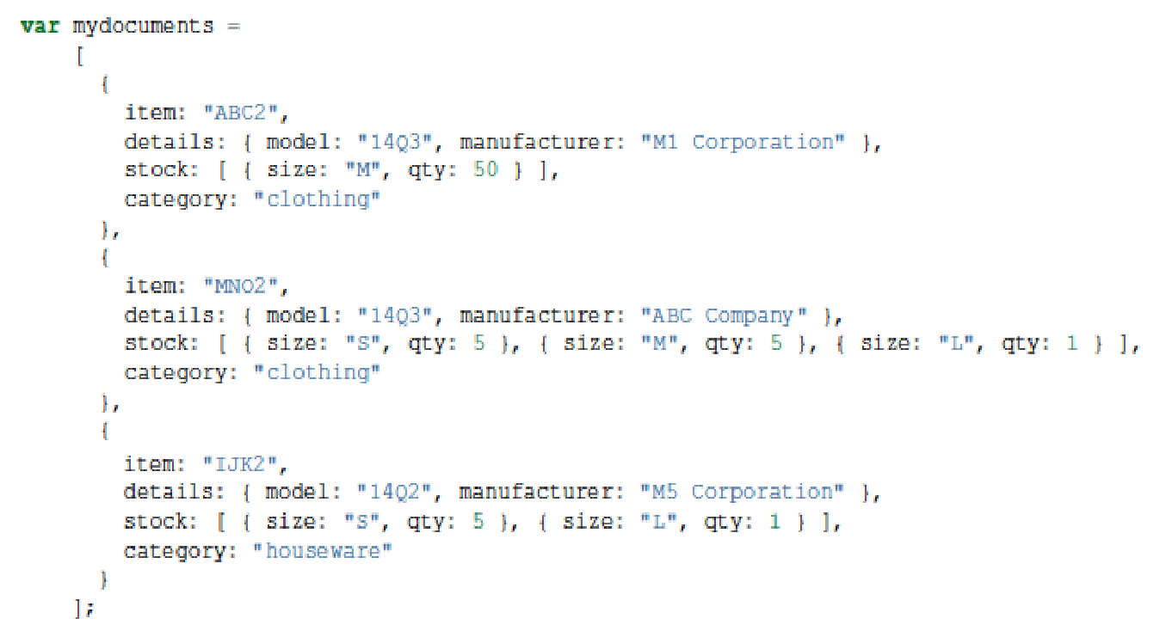
Multi-Document Insertion
(Use of Arrays)
All the documents are inserted at once

Slide 47
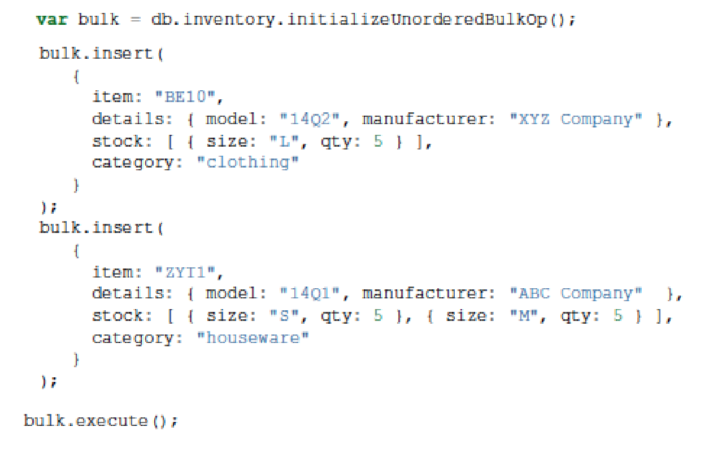
Multi-Document Insertion
(Bulk Operation)
A temporary object in memory
Holds your insertions and uploads them at once
There is also Bulk Ordered object
_id column is added automatically

Slide 48
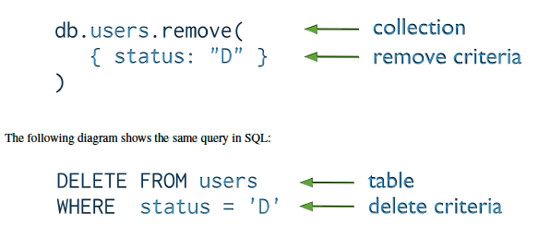
Deletion
(Remove Operation)
You can put condition on any field in the document (even _id)
db.users.remove ( )
Removes all documents from users collection

Slide 49
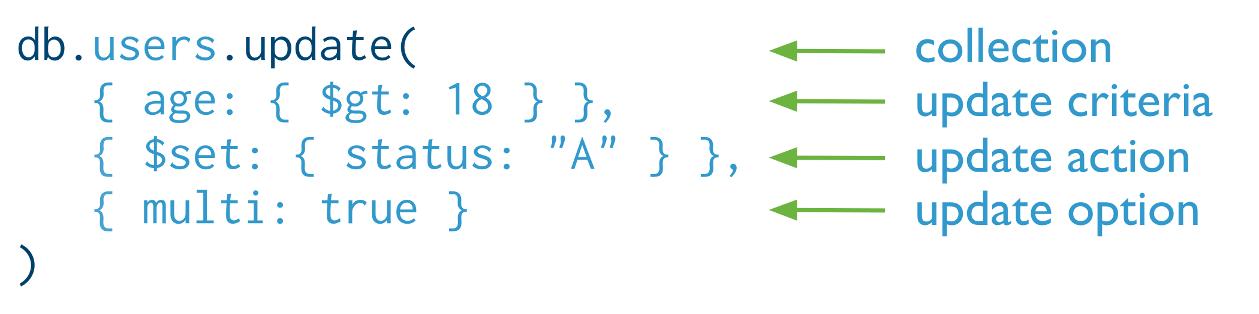

Update
Otherwise, it will update only the 1st matching document
Equivalent to in SQL:

Slide 50
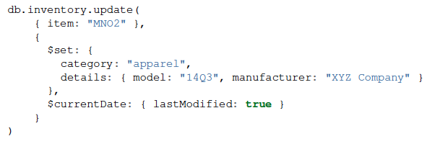
Update (Cont’d)
Two operators

Slide 51
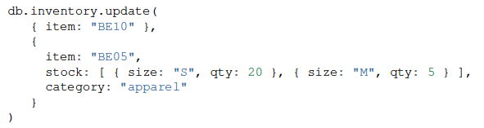
Replace a document
Query Condition
New
doc
For the document having item = “BE10”, replace it with the given document

Slide 52
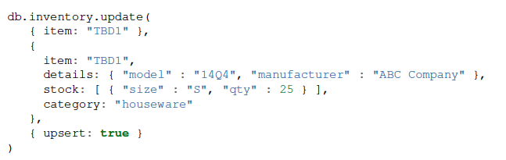
Insert or Replace
The upsert option
If the document having item = “TBD1” is in the DB, it will be replaced
Otherwise, it will be inserted.

