Slide 1
MySQL Programming
Mimi Opkins & David Brown
CECS 323

Slide 2
General Introduction
There are several different ways to protect a database from corruption:
  Datatypes for the individual columns
  Primary key and other uniqueness constraints
  Referential integrity constraints:
    Implement relationships between tables
    Ensure that enumerated values are valid
    Implementing reference data
  Database code that implements complex (non declarative) constraints
One major benefit to doing all of this in the database is that there is no way to “back door” the database.
The other benefit is that the stored procedure/function/trigger runs on the server, which saves on network traffic.

Slide 3
Other Approaches
Alternatively, you could require that all access to a given database (using that term loosely) has to be brokered by an application.
It’s not uncommon to have an application start off “owning” the data, then that data becomes of interest to other applications.
That means that outside applications coming in through an interface somehow need to use that application so that the business rules are only implemented once.
Or, the business rules need to be published and agreed to by all users of the data to prevent corruption.

Slide 4
Basic Programming Structures
Stored Procedures
  Blocks of code stored in the database that are pre-compiled.
  They can operate on the tables within the database and return scalars or results sets.
Functions
  Can be used like a built-in function to provide expanded capability to your SQL statements.
  They can take any number of arguments and return a single value.
Triggers
  Kick off in response to standard database operations on a specified table.
  Can be used to automatically perform additional database operations when the triggering event occurs.

Slide 5
Basic Programming Structures Reference
None of this is original, look at it as a digest from: http://dev.mysql.com/doc/.
More specifically, we’ll be talking about material found in: https://dev.mysql.com/doc/refman/8.0/en/sql-compound-statements.html.

Slide 6
Stored Procedures in MySQL
A stored procedure contains a sequence of SQL commands stored in the database catalog so that it can be invoked later by a program
Stored procedures are declared using the following syntax:
  Create Procedure <proc-name>
  (param_spec₁, param_spec₂, …, param_spec_{n} )
  begin
  -- execution code
  end;
  where each param_spec is of the form:
  [in | out | inout] <param_name> <param_type>
  in mode: allows you to pass values into the procedure,
  out mode: allows you to pass value back from procedure to the calling program

Slide 7
More about Stored Procedures
You can declare variables in stored procedures
Can have any number of parameters.
Each parameter has to specify whether it’s in, out, or inout.
  The typical argument list will look like
  (out ver_param varchar(25), inout incr_param int …)
  Be careful of output parameters for side effects.
Your varchar declarations for the parameters have to specify the maximum length.
The individual parameters can have any supported MySQL datatype.
They can be called using the call command, followed by the procedure name, and the arguments.
You can use flow control statements (conditional IF-THEN-ELSE or loops such as WHILE and REPEAT)

Slide 8
Conditions and Handlers
A condition is somewhat like an exception.
  You can declare your own conditions, but we’re not going to get into that for the purposes of this course.
A handler is somewhat like the catch block in a try/catch construct.
  The “canned” conditions that MySQL has will prove to be enough for our purposes.
  We should be able to get by with just a few conditions, we’ll see as we go along.

Slide 9
IF
Note that <condition> is a generic Boolean expression, not a condition in the MySQL sense of the word.
IF <condition> then
  <statements>
ELSEIF <condition> then
  <statements>
ELSE
  <statements>
END IF
Note the annoying syntax: END IF has an embedded blank, ELSEIF does not.
There can be any number of ELSIF clauses in your IF statement.

Slide 10
Case Statement
Two different syntaxes:
CASE <expression>
  WHEN <value> then
    <statements>
  WHEN <value> then
    <statements>
  …
  ELSE
    <statements>
END CASE;

Slide 11
CASE Statement (Continued)
CASE
  WHEN <condition> then
    <statements>
  WHEN <condition> then
    <statements>
  …
  ELSE
    <statements>
END CASE;

Slide 12
Looping
[begin_label:] LOOP
  <statement list>
END LOOP [end_label]
Note that the end_label has to = the begin_label
Both are optional
[begin_label:] REPEAT
  <statement list>
UNTIL <search_condition>
END REPEAT [end_label]

Slide 13
Repeat Until Example
DELIMITER //
CREATE FUNCTION CalcIncome ( starting_value INT )
RETURNS INT
BEGIN
DECLARE income INT;
SET income = 0;
label1: REPEAT
SET income = income + starting_value;
UNTIL income >= 4000
END REPEAT label1;
RETURN income;
END; //
DELIMITER ;

Slide 14
Notes on the previous example
The DELIMITER // statement sets a session variable so that the // becomes the statement terminator.
For the purposes of that session, the “;” within the stored procedure are just like any other character.
When the stored procedure is run, however, the “;” function the way that they normally do in MySQL.
You always want to make the delimiter a “;” again when you change it.

Slide 15
While
[begin_label:] WHILE <condition> DO
  <statements>
END WHILE [end_label]

Slide 16
Loop Control Flow
Iterate <label> – start the loop again
  Can only be issued within LOOP, REPEAT, or WHILE statements
  Works much like the “continue” statement in Java or C++.
Leave <label> – jumps out of the control construct that has the given label.
  Can only be issued within LOOP, REPEAT, or WHILE statements, just like the iterate statement.
  You can use this at any level of nesting, 🡪 you can jump out to the out of the outermost loop if you desire.

Slide 17
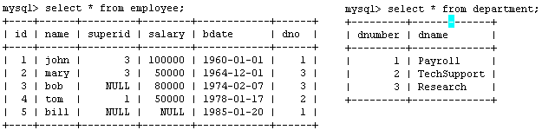
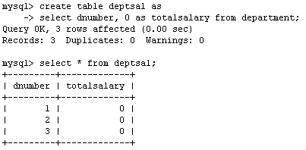
Example
Suppose we want to keep track of the total salaries of employees working for each department
We need to write a procedure to update the salaries in
the deptsal table

Slide 18
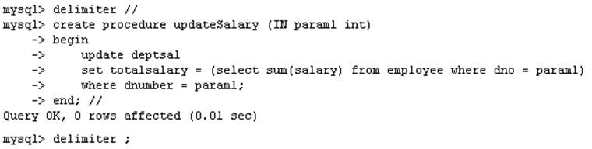
Example – Step 1
Step 1: Change the delimiter (i.e., terminating character) of SQL statement from semicolon (;) to something else (e.g., //) So that you can distinguish between the semicolon of the SQL statements in the procedure and the terminating character of the procedure definition

Slide 19
Example – Step 2
Step 2:
Define a procedure called updateSalary which takes as input a department number.
The body of the procedure is an SQL command to update the totalsalary column of the deptsal table.
Terminate the procedure definition using the delimiter you had defined in step 1 (//)

Slide 20
Example – Step 3
Step 3: Change the delimiter back to semicolon (;)

Slide 21
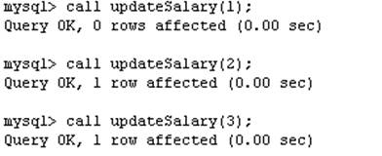
Example – Step 4
Step 4: Call the procedure to update the totalsalary for each department

Slide 22
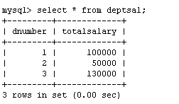
Example – Step 5
Step 5: Show the updated total salary in the deptsal table

Slide 23
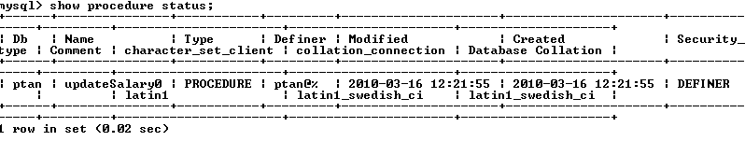

Stored Procedures in MySQL
Use show procedure status to display the list of stored procedures you have created
Use drop procedure to remove a stored procedure

Slide 24
Debugging your stored procedures
Using the select statement
  SELECT ‘Comment’; -- Put the literal Comment out to console
  SELECT concat(‘myvar is ‘, myvar); -- Put the literal prompt out, followed by the current value of a variable named myvar.
    Note, you cannot do this in a function as that is regarded as returning a result set.
Insert into a table. Putting the current time and date stamp into a column with the message would be good too.
Log messages to an output file: select … into outfile ‘<file_name>’;
  Which might be blocked by the secure-file-priv option in MySQL.

Slide 25
Stored Procedures in MySQL
MySQL also supports cursors in stored procedures.
  A cursor is used to iterate through a set of rows returned by a query so that we can process each individual row.
To learn more about stored procedures, go to:
  http://www.mysqltutorial.org/mysql-stored-procedure-tutorial.aspx

Slide 26
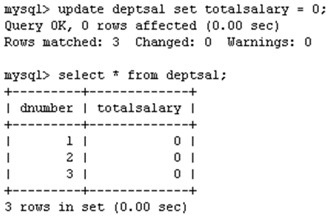
Example using Cursors
The previous procedure updates one row in deptsal table based on input parameter
Suppose we want to update all the rows in deptsal simultaneously
  First, let’s reset the totalsalary in deptsal to zero

Slide 27
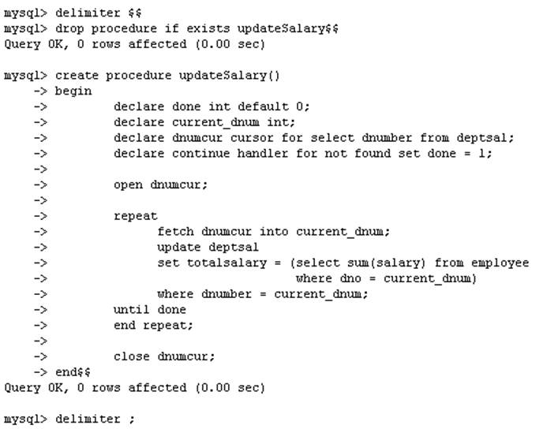
Example using Cursors – Part 2
Drop the old procedure
Use cursor to iterate the rows

Slide 28
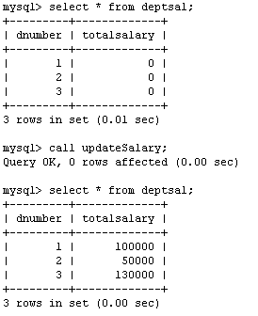
Example using Cursors – Part 3
Call procedure

Slide 29
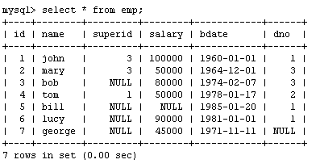
Another Example
Create a procedure to give a raise to all employees

Slide 30
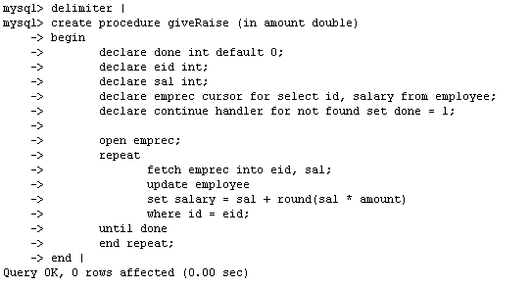
Another Example – Part 2

Slide 31
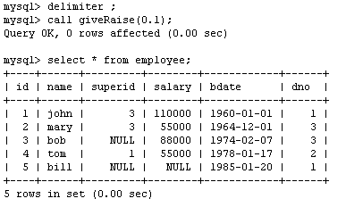
Another Example – Part 3

Slide 32
Functions
Your user-defined functions can act just like a function defined in the database.
They take arguments and return a single output.
The general syntax is: create function <name> (<arg1> <type1>, [<arg2> <type2> [,…]) returns <return type> [deterministic]
  Deterministic means that the output from the function is strictly a consequence of the arguments.
  Same values input 🡪 same values output.
  Like a static method in Java.
  Note that the arguments cannot be changed and the new values passed back to the caller.
Follow that with begin … end and you have a function.

Slide 33
Functions
  You need ADMIN privilege to create functions on mysql-user server
Functions are declared using the following syntax:
  function <function-name> (param_spec₁, …, param_spec_{k})
  returns <return_type>
  [not] deterministic allow optimization if same output
  for the same input (use RAND not deterministic )
  Begin
  -- execution code
  end;
  where param_spec is:
  [in | out | in out] <param_name> <param_type>

Slide 34
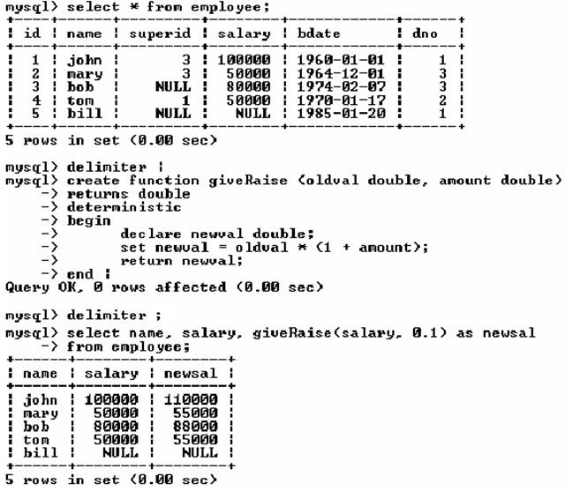
Example of Functions

Slide 35
Another Example of Functions

Slide 36
SQL Triggers
To monitor a database and take a corrective action when a condition occurs
  Examples:
    Charge $10 overdraft fee if the balance of an account after a withdrawal transaction is less than $500
    Limit the salary increase of an employee to no more than 5% raise
CREATE TRIGGER trigger-name
trigger-time trigger-event
ON table-name
FOR EACH ROW
trigger-action;
  trigger-time ∈ {BEFORE, AFTER}
  trigger-event ∈ {INSERT,DELETE,UPDATE}

Slide 37
Triggers
Please see: https://dev.mysql.com/doc/refman/8.0/en/create-trigger.html
for the complete specification for triggers.
CREATE
[DEFINER = { user | CURRENT_USER }]
TRIGGER trigger_name
trigger_time trigger_event
ON tbl_name FOR EACH ROW
[trigger_order]
trigger_body
trigger_time: { BEFORE | AFTER }
trigger_event: { INSERT | UPDATE | DELETE }
trigger_order: { FOLLOWS | PRECEDES } other_trigger_name

Slide 38
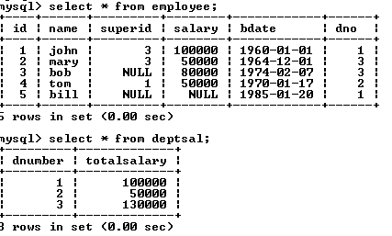
SQL Triggers: An Example
We want to create a trigger to update the total salary of a department when a new employee is hired

Slide 39
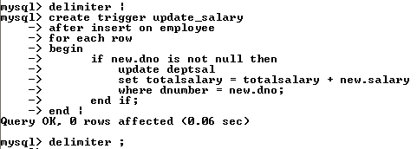
SQL Triggers: Another Example
Create a trigger to update the total salary of a department when a new employee is hired:
The keyword “new” refers to the new row inserted

Slide 40
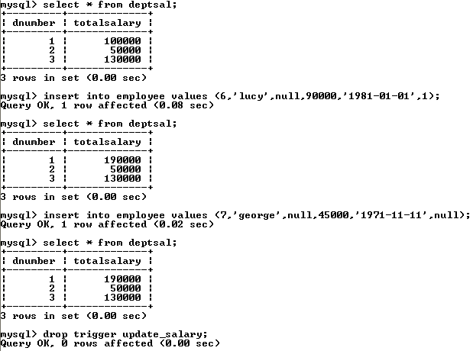
SQL Triggers: Another Example – Part 2
totalsalary increases by 90K
totalsalary did not change

Slide 41
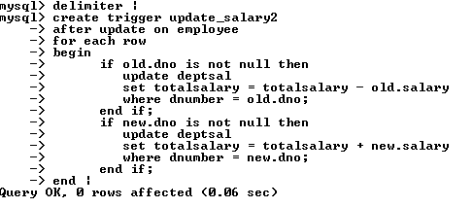
SQL Triggers: Another Example – Part 3
A trigger to update the total salary of a department when an employee tuple is modified:

Slide 42
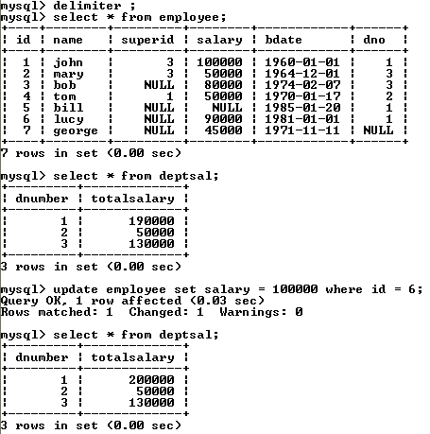
SQL Triggers: An Example – Part 4

Slide 43
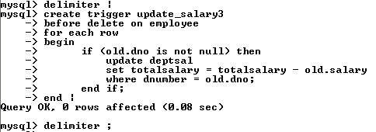
SQL Triggers: Another Example – Part 5
A trigger to update the total salary of a department when an employee tuple is deleted:

Slide 44
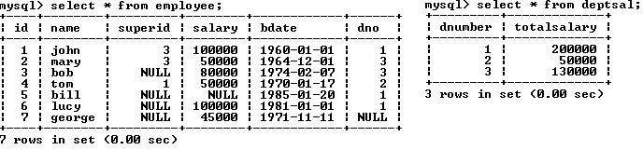
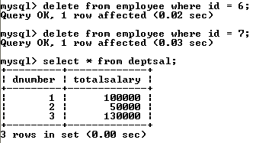
SQL Triggers: Another Example – Part 6

Slide 45
A Few Things to Note
A given trigger can only have one event.
If you have the same or similar processing that has to go on during insert and delete, then it’s best to have that in a procedure or function and then call it from the trigger.
A good naming standard for a trigger is <table_name>_event if you have the room for that in the name.
Just like a function or a procedure, the trigger body will need a begin … end unless it is a single statement trigger.

Slide 46
The Special Powers of a Trigger
While in the body of a trigger, there are potentially two sets of column values available to you, with special syntax for denoting them.
  old.<column name> will give you the value of the column before the DML statement executed.
  new.<column name> will give you the value of that column after the DML statement executed.
Insert triggers have no old values available, and delete triggers have no new values available for obvious reasons. Only update triggers have both the old and the new values available.
Only triggers can access these values this way.

Slide 47
Changing columns in a trigger
In the body of a trigger, it is possible to change the values for the columns in the current row.
Just use the “set” verb to change them.
You can only do this for an update or insert trigger.
You can only change the values of new.<column name> since there is no point to changing the old values.

Slide 48
More Examples
Simplified example of a parent table: hospital_room as the parent and hospital_bed as the child.
The room has a column: max_beds that dictates the maximum number of beds for that room.
The hospital_bed table has a before insert trigger that checks to make sure that the hospital room does not already have its allotted number of beds.

Slide 49
The Trigger
CREATE DEFINER=`root`@`localhost`
TRIGGER `programming`.`hospital_bed_BEFORE_INSERT`
BEFORE INSERT ON `hospital_bed` FOR EACH ROW
BEGIN
declare max_beds_per_room int;
declare current_count int;
select max_beds into max_beds_per_room
from hospital_room
where hospital_room_no = new.room_id;
select count(*) into current_count
from hospital_bed
where room_id = new.room_id;
if current_count >= max_beds_per_room then
signal sqlstate '45000' set message_text='Too many beds in that room already!';
end if;
END;

Slide 50
Firing the trigger
insert into hospital_bed (room_id, hospital_bed_id)
values ('323B', 1);
insert into hospital_bed (room_id, hospital_bed_id)
values ('323B', 2);
insert into hospital_bed (room_id, hospital_bed_id)
values ('323B', 3);
insert into hospital_bed (room_id, hospital_bed_id)
values ('323B', 4);
insert into hospital_bed (room_id, hospital_bed_id)
values ('323B', 5);
Error Code: 1644. Too many beds in that room already!

Slide 51
Using a Stored Procedure Instead
CREATE DEFINER=`root`@`localhost` PROCEDURE `too_many_beds`(in room_id varchar(45))
BEGIN
declare max_beds_per_room int;
declare current_count int;
declare room_count int;
-- see if the hospital room exists
select count(*) into room_count
from hospital_room
where hospital_room_no = room_id;
if room_count = 1 then -- we can see if room for 1 more bed
begin
select max_beds into max_beds_per_room
from hospital_room
where hospital_room_no = room_id;
-- count the beds in this room
select count(*) into current_count
from hospital_bed
where room_id = room_id;
if current_count >= max_beds_per_room then
-- flag an error to abort if necessary
signal sqlstate '45000' set message_text='Too many beds in that room already!';
end if;
end;
end if;
END

Slide 52
Comments on the Procedure
Because that is in isolation from the beds table, we have to check to make sure that the room number is viable.
As a stored procedure, this can be called directly from the command line as a means of unit testing.
I’m still not too sure how exacting the typing of the parameters has to be. For instance, does that one argument have to be exactly a varchar(45) in order for it to work, or not?

Slide 53
Viewing Your Triggers
MySQL has a schema that has tables for all of the information that is needed to define and run the data in the database. This is meta data.
select * from information_schema.triggers where trigger_schema=‘<your schema name>'; -- retrieve the trigger information for the triggers in <your schema name>.
Alternatively, you can use the “show triggers” command (this is not SQL) that will display a report of your triggers from the default schema.
mysql> show triggers;

Slide 54
Viewing Your Triggers (Continued)
If you’re using MySQL Workbench, the IDE provides access to your triggers:
  In the navigator pane, right click the table that has the trigger.
  Select "Alter Table"
  This will open up a rather lavish dialog which has tabs down near the bottom. One of those tabs is "Triggers". Select that.
  That will open up another dialog, and over to the left will be the list of events that you can define triggers for.
    At this point, you can right click one of those events and it will pop up a menu that will give you the option to create a new trigger for that event.
    Or you can double click an existing trigger to get into an editor on that particular trigger. This will allow you to update the trigger in place as it were, rather than drop and recreate it.

Slide 55
Dynamic SQL
Sometimes you need to operate against a table or columns that are not known at compile time. MySQL has a process using set, prepare, execute, and deallocate.
CREATE DEFINER=`root`@`localhost` PROCEDURE `dynamic`(in tableName varchar(40))
begin
set @statement = concat('select * from ', tableName);
prepare stmt from @statement;
execute stmt;
set @statement = concat('select count(*) from ', tableName, ' into @count');
prepare stmt from @statement;
execute stmt;
select concat('Count was: ', @count, ' from table: ', tableName);
deallocate prepare stmt;
end

Slide 56
Dynamic SQL (Continued)
The @ in front of a name makes it a user variable, which is shared between the command session and the stored procedure.
concat will take any number of arguments.
Just like the Java API, you can have bind variables in the SQL that you submit, then use the using clause in the execute statement.
  The bind variables have to map one for one to the variables in the using clause: execute stmt using @var1, @var2, …

Slide 57
Configuration Management
Remember that all objects that you create, be they tables, indexes, constraints, triggers, stored procedures, functions, … exist in the database.
The data dictionary has the definition of these objects, and generally speaking, you can use utilities (either in the IDE or the RDBMS) to reverse engineer those objects.
MySQL Workbench has a way to reverse engineer an entire schema. Read about it at: https://dev.mysql.com/doc/workbench/en/wb-reverse-engineer-live.html.

Slide 58
Credits
Presentation taken from:
www.cse.msu.edu/~pramanik/teaching/courses/cse480/14s/lectures/12/lecture13.ppt by Sakti Pramanik at Michigan State University
MySQL Procedural Language by David Brown at California State University Long Beach

