Slide 1
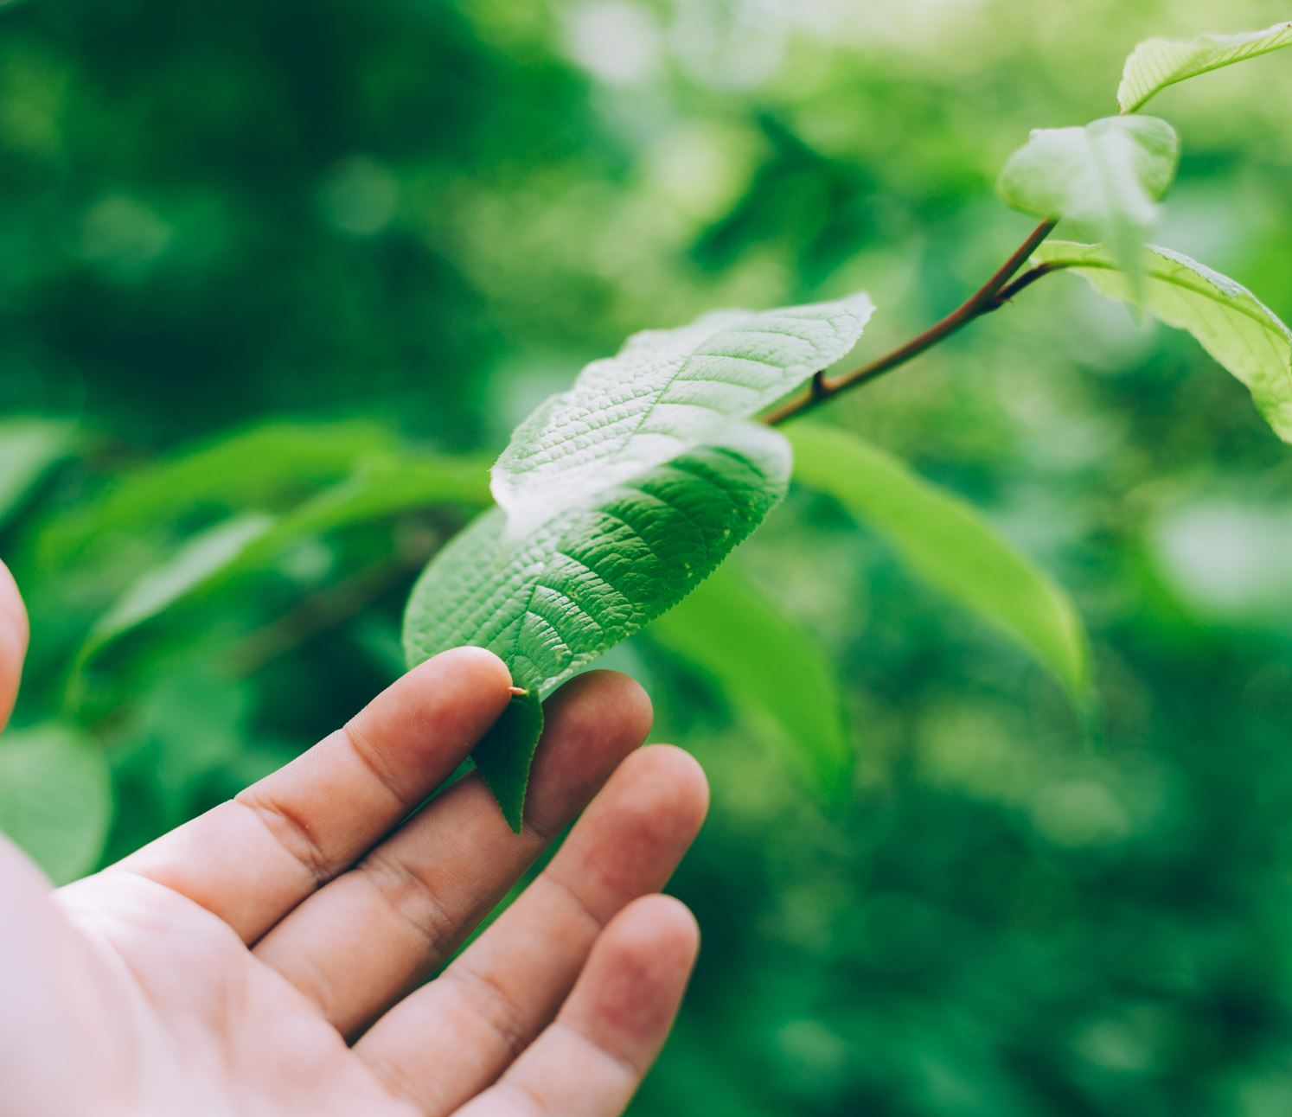
A Man Called Branch
From wild grapes to abiding fruit
Focus: Zechariah 3:1-10
Notes:
Is 11:1, Ml 3:11, 1 Kgs 4:25
Zech starts with explaining the current state of Israel. How awful they have become, how far from God they have drifted. They have abandoned the Lord, and their hearts are far from Him.
Then a set of visions/prophecies are given to Zech. He speaks of a coming King, a promised priest. One who will cleanse Israel of their iniquity.

Slide 2
The Fruitless Vine
God is the vinedresser
He loved the vineyard
He cultivated the vineyard
He protected the vineyard
And He expected good fruit from the vineyard
Israel is the vineyard
Remove its hedge
Break down the wall
Let it be trampled down
Stop the pruning
Thorns will grow
Withold the rain
If the vineyard’s vines produce no fruit,
the vinedresser lets the vineyard die.
ISAIAH 5:1-7

Slide 3
What’s wrong with wild grapes?
Sour, bitter, foul smelling, inedible and they are useless for making wine
Wild grapes – diseased, corrupted, feral
Vineyard is good, the vinedresser is good, the problem is the vine.
Israel fails to produce good grapes.
How does the vineyard of our lives look? What type of fruit do we bare? Are we only pleasing from a distance but rotting underneath?
ISAIAH 11:1
Notes:
Click the button
They are useless. They do not yield any good fruit. The vine is diseased, roots corrupted, return to its wild unmanaged state.

Slide 4
Filthy Garments to a Faithful Branch
Courtroom and accusation
Filth removed and reclothed
The Atoning Branch
A New Vine (Ml 3:11), New Fruit (1 Kgs 4:25)
How does the Branch’s cleansing of iniquity prepare God’s people to bear fruit again?
ZECH 3:1-10

Slide 5
The True Vine Leads to Abiding Fruit
A change in the vine, not the vinedresser
Fruit bearing branches are cultivated
What does it mean to abide?
Apart from Jesus we can do nothing
Fruit is the visible evidence of Christ in us
JOHN 15:1-8
Notes:
Abiding is not trying harder.
Abiding is not doing enough.
Abiding is not religious performance.
Abiding is not occasional connection.
Abiding is not rule keeping.
Abiding is relational attachment to Jesus.
Abiding is Life through Jesus.
Abiding is remaining in His Word.
Abiding is resting is Jesus’ Love.
Abiding is responding with obedience.
Jesus has cultivated the vineyard of our life. What fruit are we producing?

Slide 6
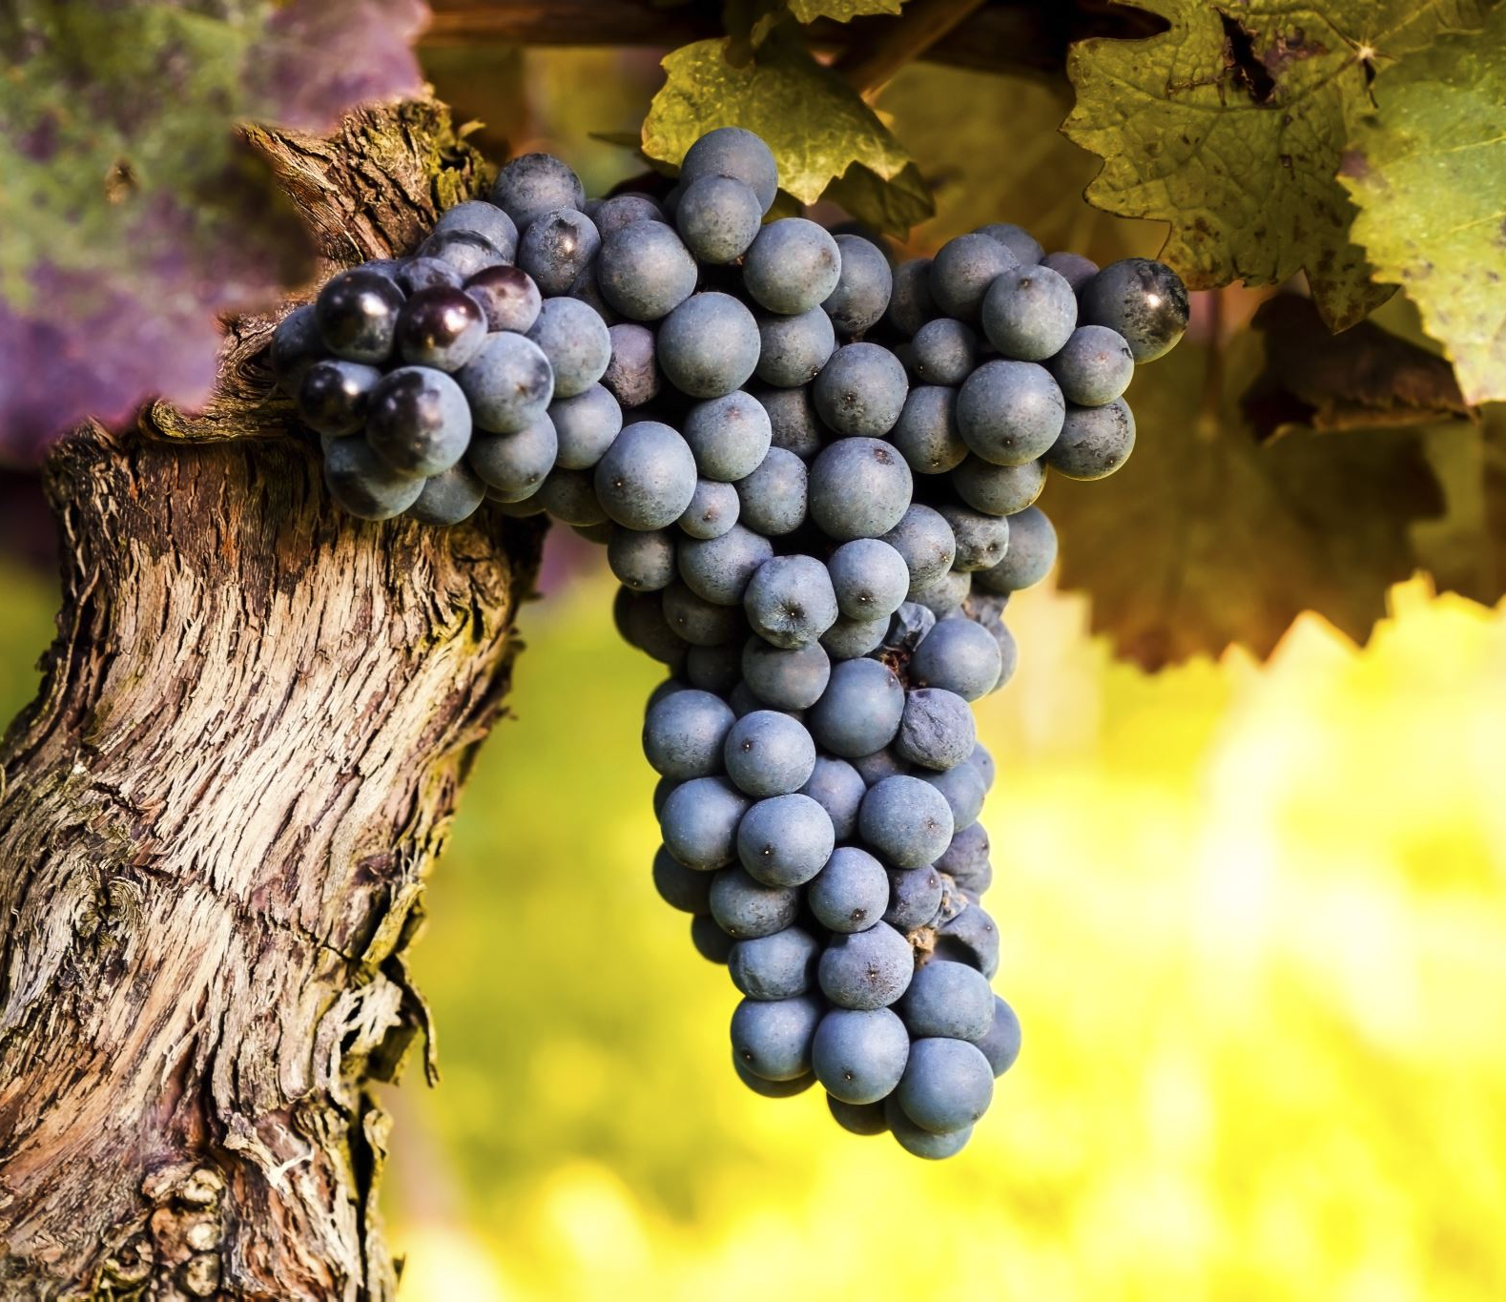
Table Talk
What changes in your life when you see yourself not as someone trying to produce fruit, but as a branch receiving life from the Vine?
Or simply, what does abiding look like for you this week?

