Slide 1

IOT for monitoring water bodies
Team gce
Government college of engineering, Tirunelveli
Notes:
Choose any one of the application from the below link:
https://www.mistralsolutions.com/hackfest/

Slide 2
IOT FOR MONITORING WATER BODIES
Nellai Smart water monitoring system(NSWMS):
“Neerindri amayathu ulagu”
Nellai smart water monitoring system is for monitoring quality of water in river and much more.
This prototype(for challenge 3) will give us useful dashboards with the help of adafruit – io using internet.
For sending data we Wi-Fi module in this prototype ,I am using two modules namly Esp32 and Nodemcu.
Then some required sensors for gathering data for dashboard.
Notes:
Mention the number of challenges being undertaken and a broad description (about 3-4 sentences) for the overall proposed solution for the chosen application.

Slide 3
Components used:
Sensors used:
DHT11- for monitoring temperature and humidity.
Water flow sensor(YF-S201)-for water current.
Water level sensor(SEN18)-for depth of water.
TDS sensor- for Total dissolved solids
pH sensor(with 9 v battery)- for getting pH value
Software used:
Arduino IDE – embedded c
Adafruit-io – dashboards
Modules: Esp32 and Nodemcu
Others : data cable-2 ,jumper wire.
Notes:
Provide the challenge name and a write-up of the proposed solutions along with screenshots, wireframes, block diagram or sketches, if any. Also, explain the type of proto you will be providing during the demo.
Note: This slide needs to be created for each of the challenges being addressed.

Slide 4
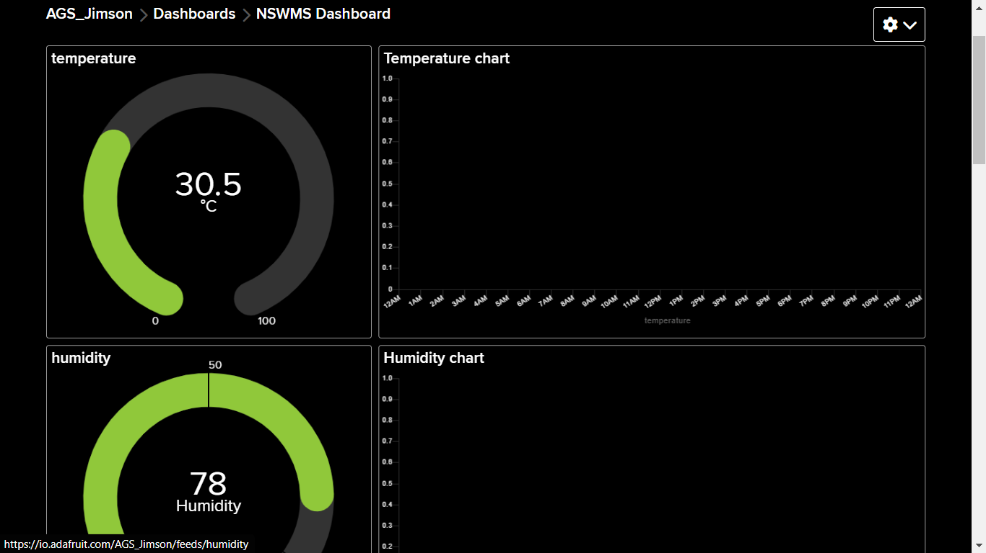
Sample images of dashboard:
Notes:
Provide the challenge name and a write-up of the proposed solutions along with screenshots, wireframes, block diagram or sketches, if any. Also, explain the type of proto you will be providing during the demo.
Note: This slide needs to be created for each of the challenges being addressed.

Slide 5
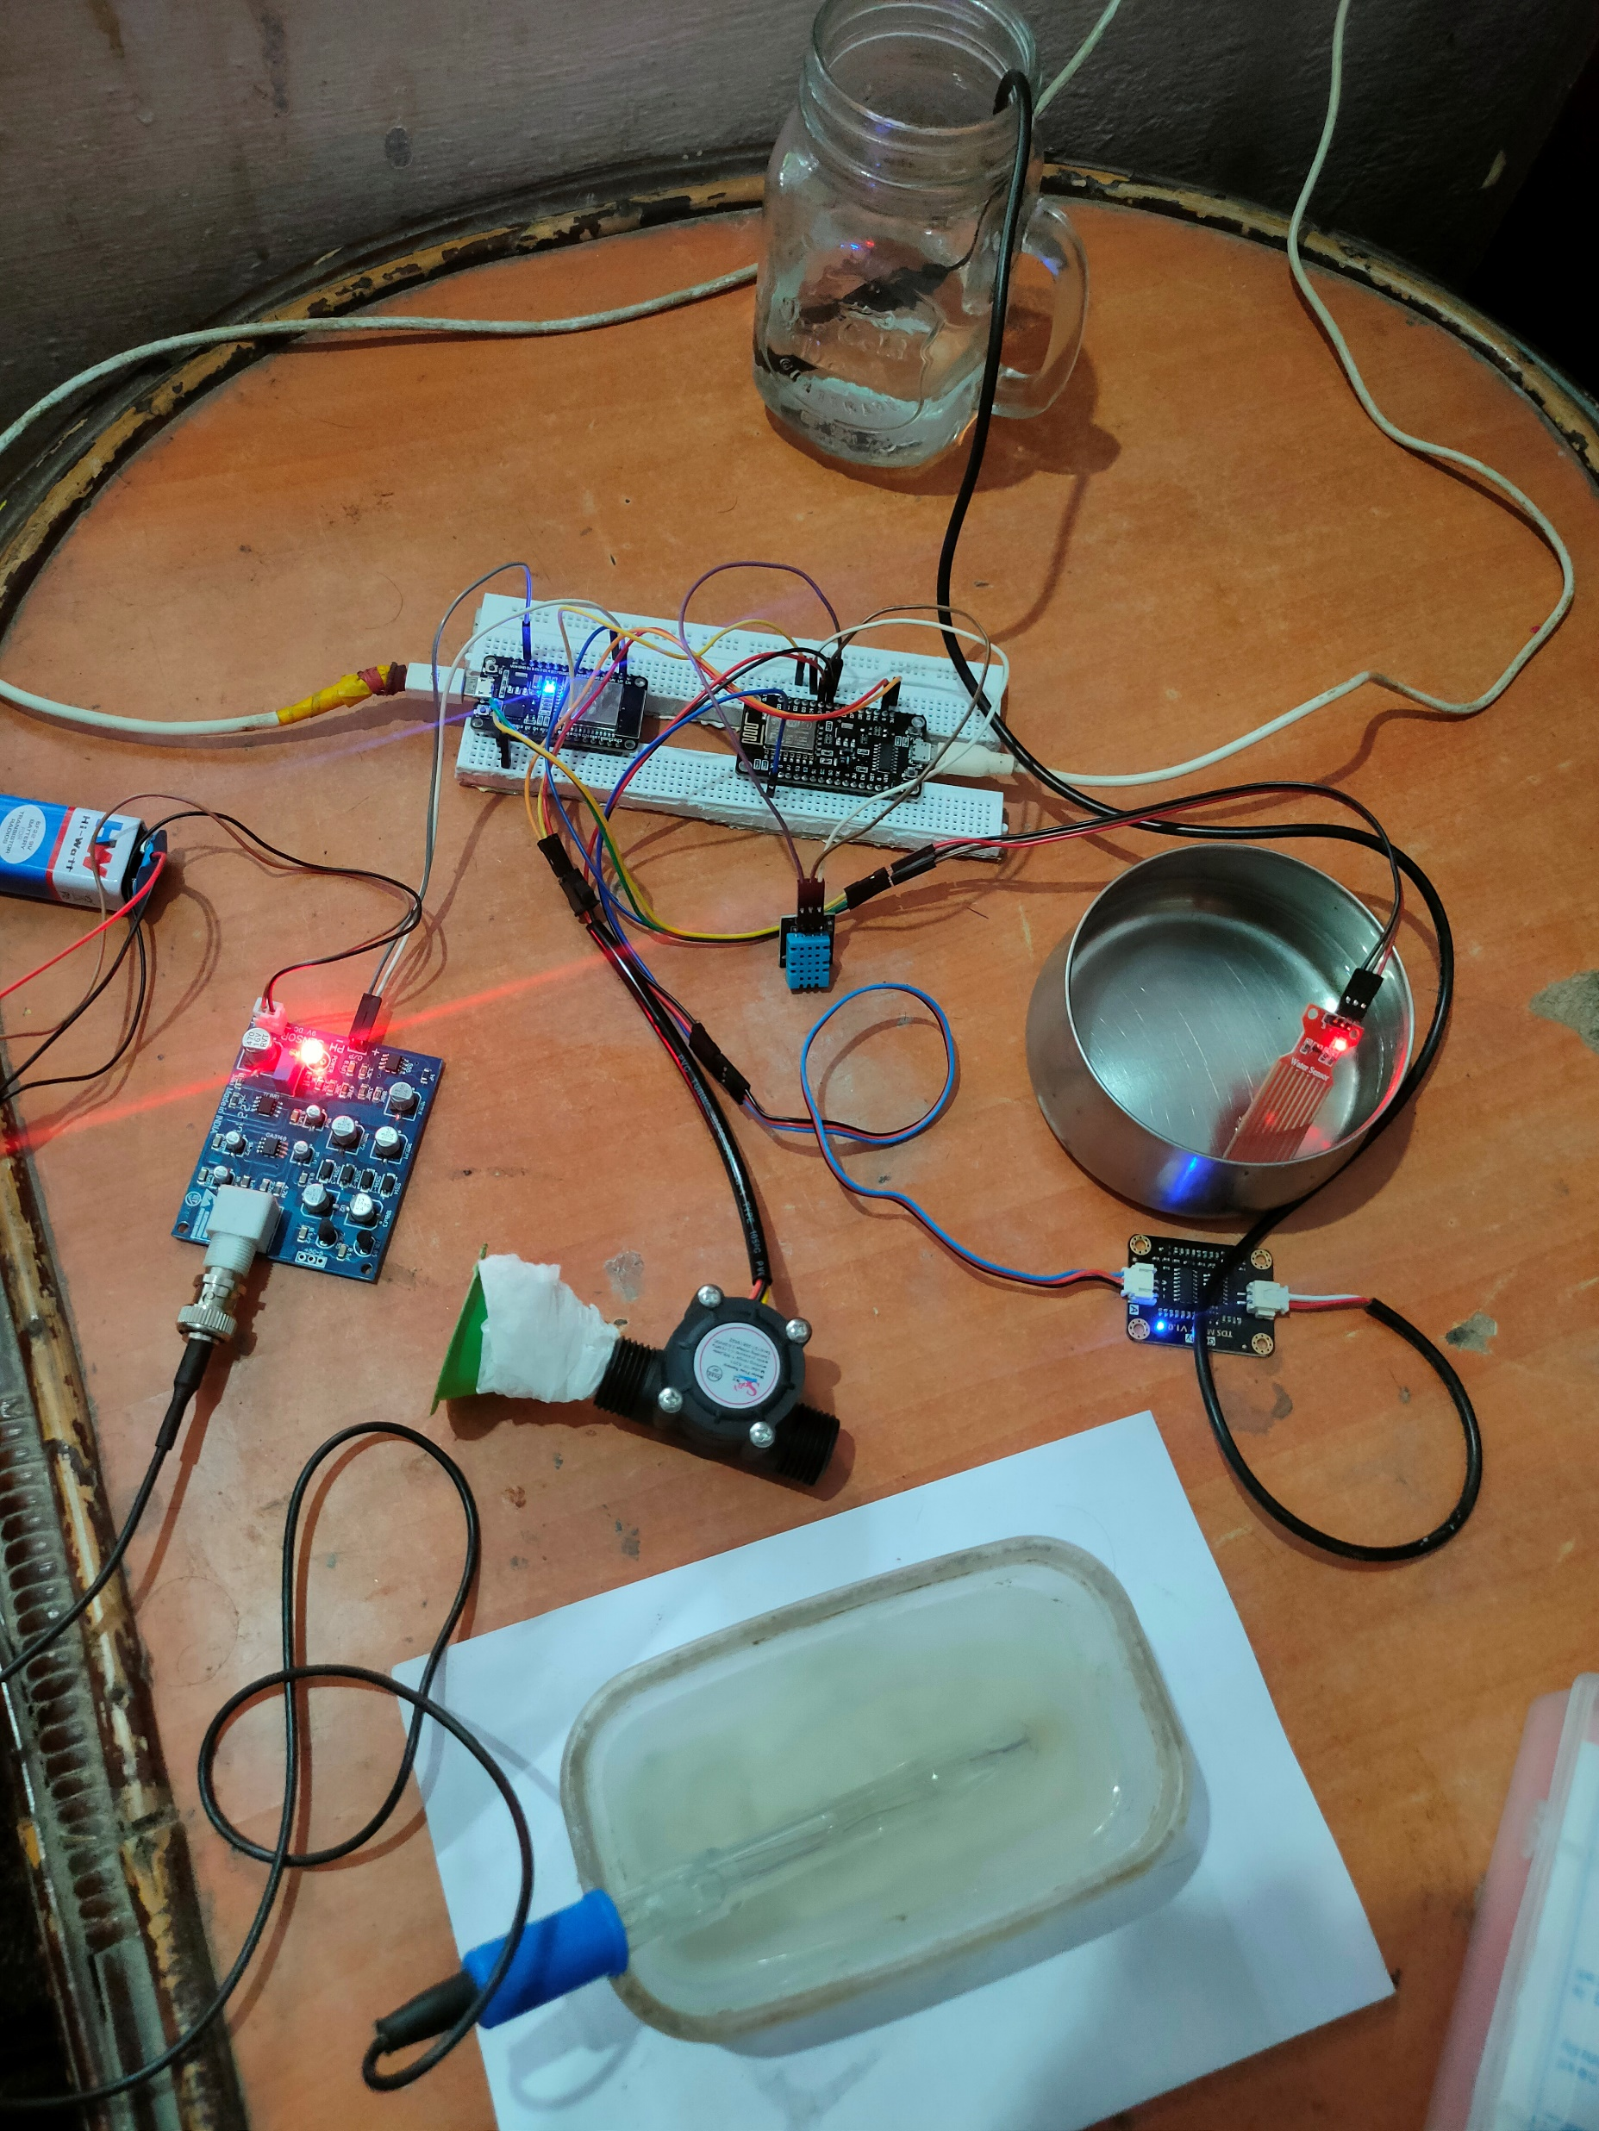
Hardware connections:
Notes:
Provide the challenge name and a write-up of the proposed solutions along with screenshots, wireframes, block diagram or sketches, if any. Also, explain the type of proto you will be providing during the demo.
Note: This slide needs to be created for each of the challenges being addressed.

Slide 6
Link for dash board and code :
Adafruit – io link:
https://io.adafruit.com/AGS_Jimson/dashboards/nswms?kiosk=true
Github Link for code:
https://github.com/JimsonAGS/NSWMS
Notes:
Provide the challenge name and a write-up of the proposed solutions along with screenshots, wireframes, block diagram or sketches, if any. Also, explain the type of proto you will be providing during the demo.
Note: This slide needs to be created for each of the challenges being addressed.

Slide 7
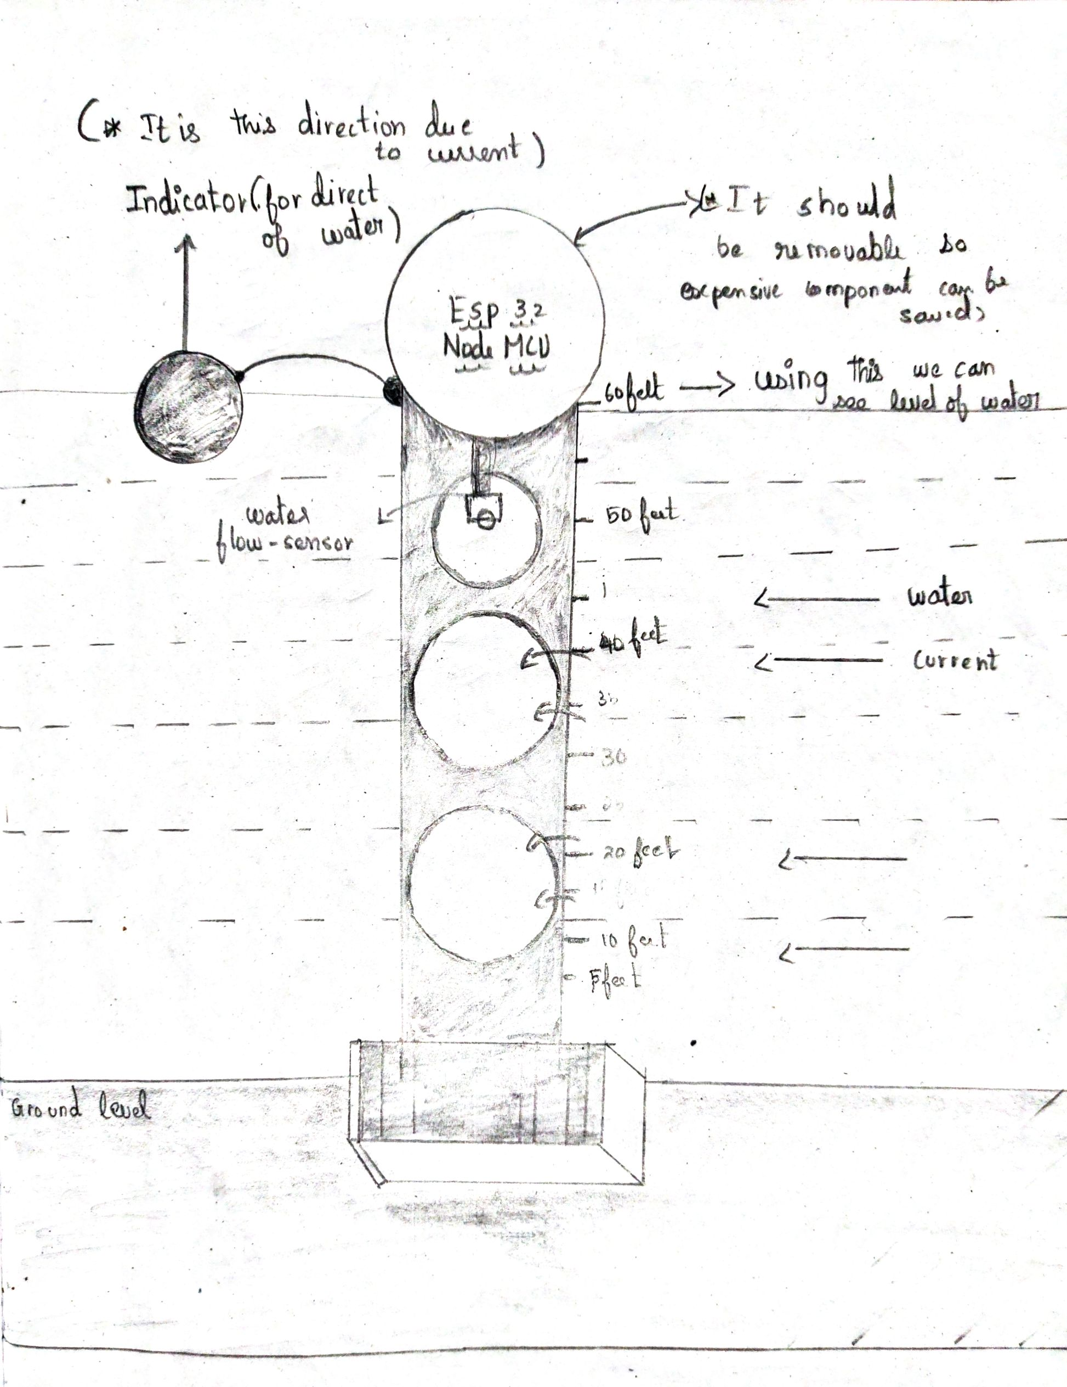
IDEA for challenge 1:
Notes:
Provide the challenge name and a write-up of the proposed solutions along with screenshots, wireframes, block diagram or sketches, if any. Also, explain the type of proto you will be providing during the demo.
Note: This slide needs to be created for each of the challenges being addressed.

Slide 8
Challenge 1 idea:
In this above diagram, a model is placed in the flowing water ,the base was build using concrete .
And the middle part is pipe with holes which reduce the force due to water current.
The top part where the wifi module is placed and it is should be closed well.
It is connected to indicator for knowing the direction of water.
Notes:
Provide the challenge name and a write-up of the proposed solutions along with screenshots, wireframes, block diagram or sketches, if any. Also, explain the type of proto you will be providing during the demo.
Note: This slide needs to be created for each of the challenges being addressed.

Slide 9
Ideas for other challenge
Challenge 2:
For power – solar plane can be used
For connectivity – wifi router like jio router
Alert message for damage / theft alert.
Challenge 4:
We can implement ESP32-CAM for object detection using open CV for counting species and KY-038 can used for recording sound.
Challenge 5:
Alert message through mail using code for out of range values.
Notes:
Provide the challenge name and a write-up of the proposed solutions along with screenshots, wireframes, block diagram or sketches, if any. Also, explain the type of proto you will be providing during the demo.
Note: This slide needs to be created for each of the challenges being addressed.

Slide 10
Faq?
Why you choose Adafruit-io platform ?
*Since uses io-key ,it secure and feature I come to see is my key is reset when I post in public by that adafruit team .there service is good.
What is the main motive of this project?
To monitor water and get useful information that may improve the quality of life
Notes:
Provide the challenge name and a write-up of the proposed solutions along with screenshots, wireframes, block diagram or sketches, if any. Also, explain the type of proto you will be providing during the demo.
Note: This slide needs to be created for each of the challenges being addressed.

