Slide 1
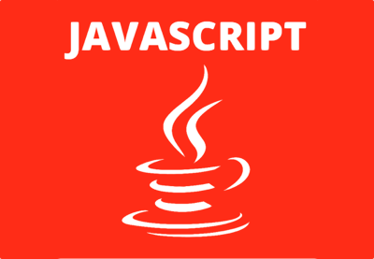
JAVASCRIPT

Slide 2
Why Study JavaScript?
JavaScript is one of the 3 languages all web developers must learn:
1. HTML to define the content of web pages
2. CSS to specify the layout of web pages
3. JavaScript to program the behavior of web pages

Slide 3
WHY JAVASCRIPT?
JavaScript referred to as "a client-side language", which is another way of saying that it's a programming language that runs in a web browser.
Actually, it's the language that runs in the browser—if we want to make an interactive web page, JavaScript is the language to use.
Javascript is:
  High-level
  Dynamic
  Untyped
  Interpreted

Slide 4
JavaScript Can Change HTML Content
One of many JavaScript HTML methods is getElementById().
This example uses the method to "find" an HTML element (with id=“kg") and changes the element content (innerHTML) to “Learning JavaScript”: example 1
JavaScript accepts both double and single quotes: example 2

Slide 5
JavaScript Can Change HTML Styles (CSS)
document.getElementById(“kg").style.fontSize = "35px";
or
document.getElementById(‘kg').style.fontSize = '35px';
Example 3

Slide 6
JavaScript Can Hide HTML Elements
Hiding HTML elements can be done by changing the display style:
document.getElementById(“kg").style.display = "none";
or
document.getElementById(‘kg').style.display
= 'none';
Example

Slide 7
JavaScript Can Show HTML Elements
Showing hidden HTML elements can also be done by changing the display style:
document.getElementById(“kg").style.display = "block";
or
document.getElementById(‘kg').style.display =
'block';
Example

Slide 8
The <script> Tag
In HTML, JavaScript code must be inserted between <script> and </script> tags.
<script>
document.getElementById(“kg").innerHTML =
"My First JavaScript";
</script>
Old JavaScript examples may use a type attribute:
<script type="text/javascript">.
The type attribute is not required. JavaScript is the default scripting language in HTML.
Example:

Slide 9
JavaScript in <head> and <body>
In this example, a JavaScript function is placed in the <head> section of an HTML page.
The function is invoked (called) when a button is clicked: example
In this example, a JavaScript function is placed in the <body> section of an HTML page.
The function is invoked (called) when a button is clicked: example

Slide 10
External JavaScript
Scripts can also be placed in external files:
External file: myScript.js
function myFunction() {
document.getElementById("demo").innerHTML = "Paragraph changed.";
}
External scripts are practical when the same code is used in many different web pages.
JavaScript files have the file extension .js
To use an external script, put the name of the script file in the src (source) attribute of a <script> tag:
Example: <script src="myScript.js"></script>
We can place an external script reference in <head> or <body> as we like.The script will behave as if it was located exactly where the <script> tag is located.
External scripts cannot contain <script> tags.

Slide 11
External JavaScript Advantages
It separates HTML and code
It makes HTML and JavaScript easier to read and maintain
Cached JavaScript files can speed up page loads
To add several script files to one page - use several script tags:
<script src="myScript1.js"></script>
<script src="myScript2.js"></script>

Slide 12
JavaScript Output
JavaScript Display Possibilities
JavaScript can "display" data in different ways:
Writing into an HTML element, using innerHTML.
Writing into the HTML output using document.write().
Writing into an alert box, using window.alert().
Writing into the browser console, using console.log().

Slide 13
Using innerHTML
To access an HTML element, JavaScript can use the document.getElementById(id) method.
The id attribute defines the HTML element. The innerHTML property defines the HTML content
Using innerHTML : Changing the innerHTML property of an HTML element is a common way to display data in HTML.
Using document.write(): For testing purposes, it is convenient to use document.write().
Using window.alert():We can use an alert box to display data.
Using console.log():For debugging purposes, we can use the console.log() method to display data.

Slide 14
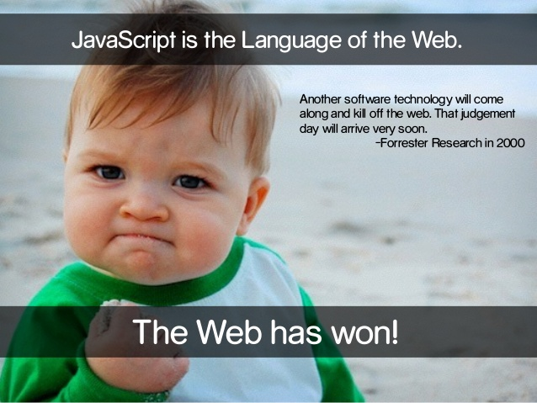
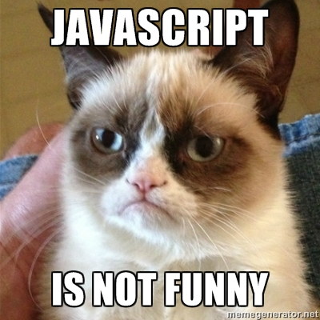
JavaScript Statements

Slide 15
JavaScript statements
JavaScript statements are composed of: Values, Operators, Expressions, Keywords, and Comments.
This statement tells the browser to write “Javascript is NOT java!!." inside an HTML element with id="demo":
Example:
document.getElementById("demo").innerHTML = " Javascript is NOT java!!.”;

Slide 16
Semicolons ;
Semicolons separate JavaScript statements.
Add a semicolon at the end of each executable statement:
var a, b, c; // Declare 3 variables
a = 5; // Assign the value 5 to a
b = 6; // Assign the value 6 to b
c = a + b; // Assign the sum of a and b to c
Example
When separated by semicolons, multiple statements on one line are allowed:
a = 5; b = 6; c = a + b;
Example

Slide 17
JavaScript White Space
JavaScript ignores multiple spaces. You can add white space to your script to make it more readable.
The following lines are equivalent:
var person = ”Holmes";
var person=“Holmes";
A good practice is to put spaces around operators ( = + - * / ):
var x = y + z;

Slide 18
JavaScript Code Blocks
JavaScript statements can be grouped together in code blocks, inside curly brackets {...}.
The purpose of code blocks is to define statements to be executed together.
One place you will find statements grouped together in blocks, is in JavaScript functions:
Example
function myFunction() {
document.getElementById("demo1").innerHTML = ”Mr. Captain:";
document.getElementById("demo2").innerHTML = "How are you?";
}

Slide 19
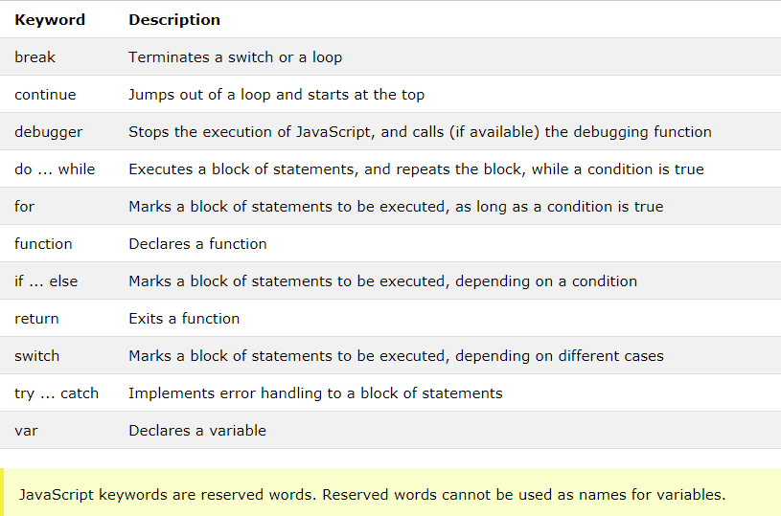
JavaScript Keywords

Slide 20
JavaScript Values
The JavaScript syntax defines two types of values: Fixed values and variable values.
Fixed values are called literals. Variable values are called variables.
The most important rules for writing fixed values are:
Numbers are written with or without decimals
Strings are text, written within double or single quotes
JavaScript Comments
Code after double slashes // or between /* and */ is treated as a comment. Comments are ignored, and will not be executed.

Slide 21
JavaScript Variables
In a programming language, variables are used to store data values.
JavaScript uses the var keyword to declare variables.
An equal sign is used to assign values to variables.
In this example, x is defined as a variable. Then, x is assigned (given) the value 6:
var x;
x = 6;
JavaScript uses arithmetic operators ( + - * / ) to compute values.
JavaScript uses an assignment operator ( = ) to assign values to variables.
Example Example
Expressions can also contain variable values: x * 10 : Example
The values can be of various types, such as numbers and strings.
For example, “Sachin" + " " + “Tendulkar", evaluates to “Sachin Tendulkar":

Slide 22
JavaScript is Case Sensitive
All JavaScript identifiers are case sensitive.
The variables lastName and lastname, are two different variables.
var lastname, lastName;
lastName = ”Johnny";
lastname = ”Johnson"; example

Slide 23
JavaScript and Camel Case
Hyphens:
first-name, last-name, master-card, inter-city.
Hyphens are not allowed in JavaScript. It is reserved for subtractions.
Underscore:
first_name, last_name, master_card, inter_city.
Upper Camel Case (Pascal Case):
FirstName, LastName, MasterCard, InterCity.

Slide 24

JavaScript Comments
Single line comments start with //
Any text between // and the end of the line will be ignored by JavaScript (will not be executed).
Multi-line comments start with /* and end with */

Slide 25
JavaScript Variables
JavaScript variables are containers for storing data values.
Example
var x = 5;
var y = 6;
var z = x + y;
var price1 = 5;
var price2 = 6;
var total = price1 + price2;

Slide 26
JavaScript Identifiers
All JavaScript variables must be identified with unique names.
These unique names are called identifiers.
Identifiers can be short names (like x and y) or more descriptive names (age, sum, totalVolume).
The general rules for constructing names for variables (unique identifiers) are:
Names can contain letters, digits, underscores, and dollar signs.
Names must begin with a letter
Names can also begin with $ and _ (underscore)
Names are case sensitive (y and Y are different variables)
Reserved words (like JavaScript keywords) cannot be used as names
JavaScript identifiers are case-sensitive.

Slide 27
The Assignment Operator
In JavaScript, the equal sign (=) is an "assignment" operator, not an "equal to" operator.
The "equal to" operator is written like == in JavaScript.
JavaScript variables can hold numbers like 100 and text values like "John Doe".
In programming, text values are called text strings.
JavaScript can handle many types of data, but for now, just think of numbers and strings.
Strings are written inside double or single quotes. Numbers are written without quotes.
If you put a number in quotes, it will be treated as a text string.
var pi = 3.14; var person = ”Sachin Tendulkar"; var answer = ’Do it now';
One Statement, Many Variables
Start the statement with var and separate the variables by comma:
var person = ”Viraat Kohli", carName = ”Swift", price = 200;

Slide 28
Value = undefined
& redeclaration of variables
In computer programs, variables are often declared without a value. The value can be something that has to be calculated, or something that will be provided later, like user input.
A variable declared without a value will have the value undefined.
The variable carName will have the value undefined after the execution of this statement:
Example var carName;
// will give the value ‘undefined’ if executed.
If we re-declare a JavaScript variable, it will not lose its value. Example

Slide 29
JavaScript Arithmetic
var x = 5 + 2 + 3;
You can also add strings, but strings will be concatenated:
Ex. var x = ”Big" + " " + ”B";
If you put a number in quotes, the rest of the numbers will be treated as strings, and concatenated.
example

Slide 30
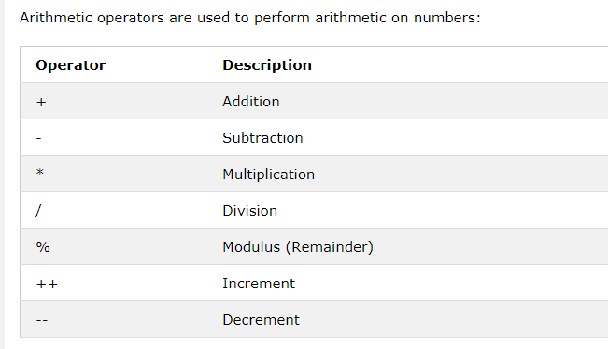
JavaScript Operators
Arithmetic Operators

Slide 31
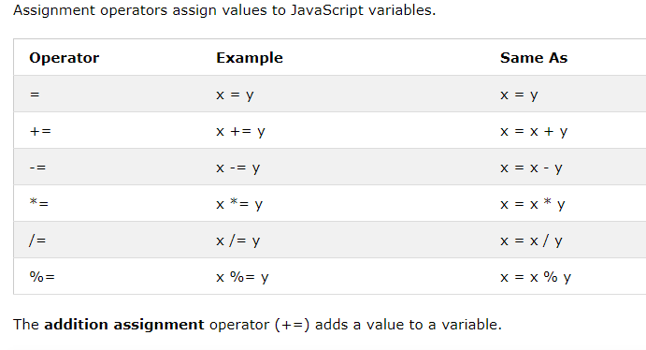
JavaScript Assignment Operators

Slide 32
JavaScript String Operators
The + operator can also be used to add (concatenate) strings.
Example
txt1 = ”Julius";
txt2 = ”Caesar";
txt3 = txt1 + " " + txt2;
The += assignment operator can also be used to add (concatenate) strings:
Example
txt1 = "What a wonderful ";
txt1 += ”worthless day!!";
The result of txt1 will be: What a wonderful worthless day!!
example

Slide 33
Adding Strings and Numbers
Adding two numbers, will return the sum, but adding a number and a string will return a string:
Example
x = 5 + 5;
y = "5" + 5;
z = "Hello" + 5;
The result of x, y, and z will be:
10
55
Hello5

Slide 34
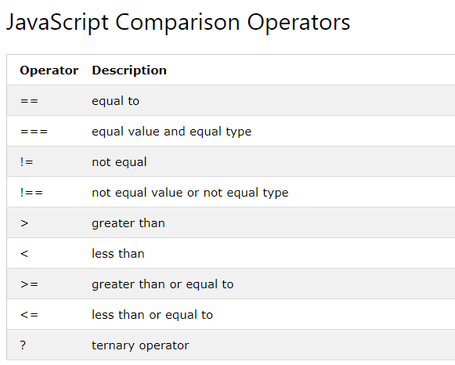
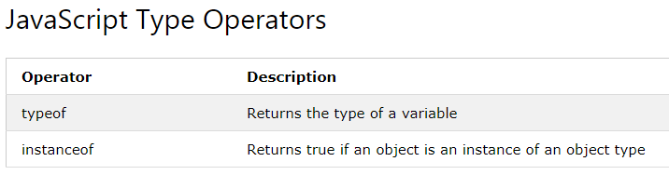
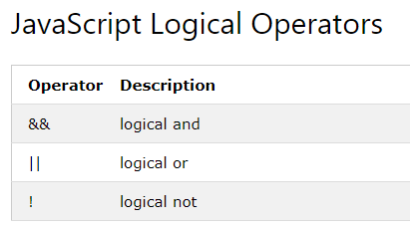

Slide 35
Increment/decrement operator
<html>
<body>
<h2>The -- Operator</h2>
<p id="demo"></p>
<p id ="demo1"></p>
<script>
var x = 5;
x--;
var z = x;
document.getElementById("demo").innerHTML = z;
z++;
var y=z;
document.getElementById("demo1").innerHTML = y;
</script>
</body>
</html>

Slide 36
JavaScript Data Types
JavaScript variables can hold many data types:
numbers, strings, objects and more:
var length = 16; // Number
var lastName = ”Viraat"; // String
var x = {firstName:”Rohit", lastName:”Roy"}; // Object
When adding a number and a string, JavaScript will treat the number as a string.
var x = 7 + 6 + ”maruti";
Result:13maruti
var x = "maruti" + 7 + 6;
Result:maruti76
In the first example, JavaScript treats 7 and 6 as numbers, until it reaches “maruti".
In the second example, since the first operand is a string, all operands are treated as strings.

Slide 37
JavaScript Types are Dynamic.
JavaScript has dynamic types. This means that the same variable can be used to hold different data types:
Example
var x; // Now x is undefined
var x = 5; // Now x is a Number
var x = “Shikhar"; // Now x is a String
A string (or a text string) is a series of characters like “Shikhar“. Strings are written with quotes. We can use single or double quotes.

Slide 38
We can use quotes inside a string, as long as they don't match the quotes surrounding the string
<html>
<body>
<h2>JavaScript Strings</h2>
<p>You can use quotes inside a string, as long as they don't match the quotes surrounding the string:</p>
<p id="demo"></p>
<script>
var answer1 = "It's alright";
var answer2 = "He is called 'John'";
var answer3 = 'He is called "Johnny"';
document.getElementById("demo").innerHTML =
answer1 + "<br>" +
answer2 + "<br>" +
answer3;
</script>
</body>
</html>

Slide 39
JavaScript Numbers & Booleans
JavaScript has only one type of numbers.
Numbers can be written with, or without decimals. example
JavaScript Booleans
Booleans can only have two values: true or false.
Example
var x = 5;
var y = 5;
var z = 6; (x == y) // Returns true
(x == z) // Returns false

