Slide 1
C++
FUNCTION and
OPERATOR OVERLOADING

Slide 2
Function overloading :
A feature in C++ that enables several functions of the same name can be defined with different types of parameters or different number of parameters. This feature is called function overloading. The appropriate function will be identified by the compiler by examining the number or the types of parameters / arguments in the overloaded function. Function overloading reduces the investment of different function names and used to perform similar functionality by more than one function.
Eg.To calculate the area of circle, rectangle and triangle using function overloading.
Operator overloading :
A feature in C++ that enables the redefinition of operators. This feature operates on user defined objects. All overloaded operators provides syntactic sugar for function calls that are equivalent. Without adding to / changing the fundamental language changes, operator overloading provides a pleasant façade.
What is function overloading in C++?
You can have multiple functions with same name using function overloading facility of C++. You can use same name for multiple functions when all these functions are doing same thing.
What is operator overloading in C++?
- With this facility in C++, you can give additional meaning to operators.

Slide 3
Function overloading means two or more functions can have the same name but either the number of arguments or the data type of arguments has to be different. Return type has no role because function will return a value when it is called and at compile time compiler will not be able to determine which function to call.
In the first example in our code we make two functions one for adding two integers and other for adding two floats but they have same name.
In the second program we make two functions with identical names but pass them different number of arguments. Function overloading is also known as compile time polymorphism.

Slide 4
In this example, function test() is called with integer argument at first. Then, function test() is called with floating point argument and finally it is called using two arguments of type int and float.
Although the return type of all these functions is same, that is, void, it's not mandatory to have same return type for all overloaded functions. This can be demonstrated by this example.

Slide 5
Operator overloading is one of the advanced concepts of C++. It is a feature through which most of the standard operators can be used with class objects.
When you use an expression like ‘2 +3’, you know that the answer will be the sum of two integers. This is because the compiler knows how to interpret the + operator when used with integers.
But, what if you want to do something like ‘obj1 = obj2 + obj3’ (where all these are objects of same class) ? How + operator should work in this case?
The answer is through Operator Overloading.
Note that operator overloading is different from function overloading.

Slide 6
Operator Overloading in C++
Consider the following class :
class example
{
public:
int a;
int b;
};
What I want to do is to create three objects of this class and assign the sum of two of these objects to the third one i.e. something like this :
example obj1, obj2, obj3;
obj1.a = 1;
obj1.b = 1;
obj2.a = 2;
obj2.b = 2;
obj3.a = 0;
obj3.b = 0;
obj3 = obj1 + obj2;

Slide 7
When I say that I want to add objects, I want corresponding integer members to added. For example, something like this :
obj3.a = obj1.a + obj2.a;
obj3.b = obj1.b + obj2.b
This is what exactly can be done through operator overloading. Observe the line obj3 = obj1 + obj2;, the operator + and = are being used. So we need to overload these operators in order to achieve exactly what is represented in the above two lines.

Slide 8
Introduction
Overloading an operator
  Write function definition as normal
  Function name is keyword operator followed by the symbol for the operator being overloaded
  operator+ used to overload the addition operator (+)
Using operators
  To use an operator on a class object it must be overloaded unless the assignment operator(=)or the address operator(&)
    Assignment operator by default performs memberwise assignment
    Address operator (&) by default returns the address of an object

Slide 9
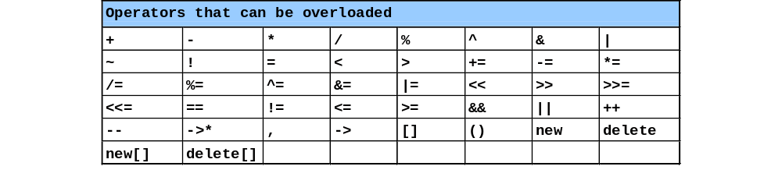
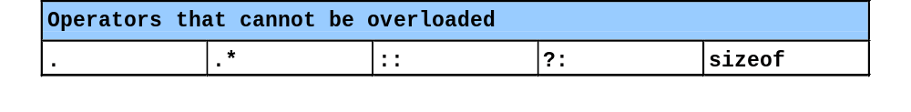
Restrictions on Operator Overloading
C++ operators that can be overloaded
C++ Operators that cannot be overloaded

Slide 10
Restrictions on Operator Overloading
Overloading restrictions
  Precedence of an operator cannot be changed
  Associativity of an operator cannot be changed
  Arity (number of operands) cannot be changed
    Unary operators remain unary, and binary operators remain binary
    Operators &, *, + and - each have unary and binary versions
    Unary and binary versions can be overloaded separately
No new operators can be created
  Use only existing operators
No overloading operators for built-in types
  Cannot change how two integers are added
  Produces a syntax error
  Example

Slide 11
Unary operator Overloading: Example
Binary + Operator Overloading: Example

