Slide 2
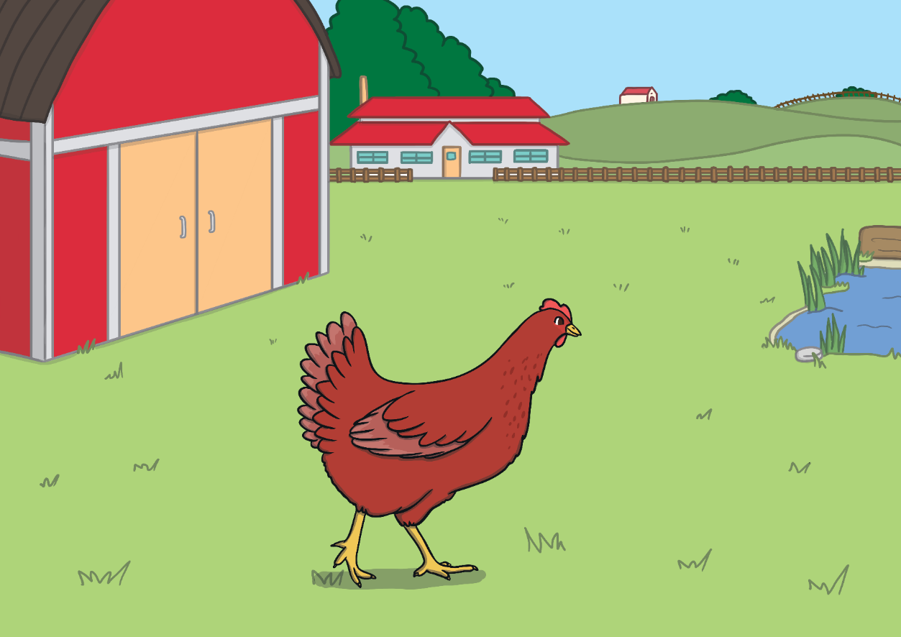
Once upon a time, there was a Little Red Hen.
The Little Red Hen lived on a farm and was friends with...

Slide 3
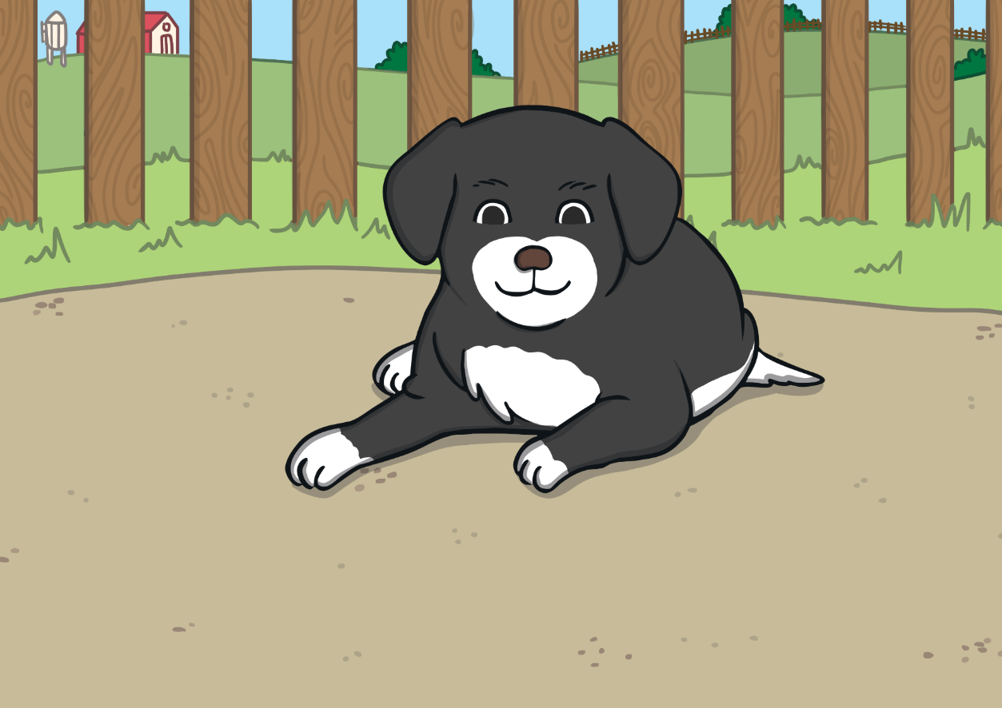
... a lazy dog,

Slide 4
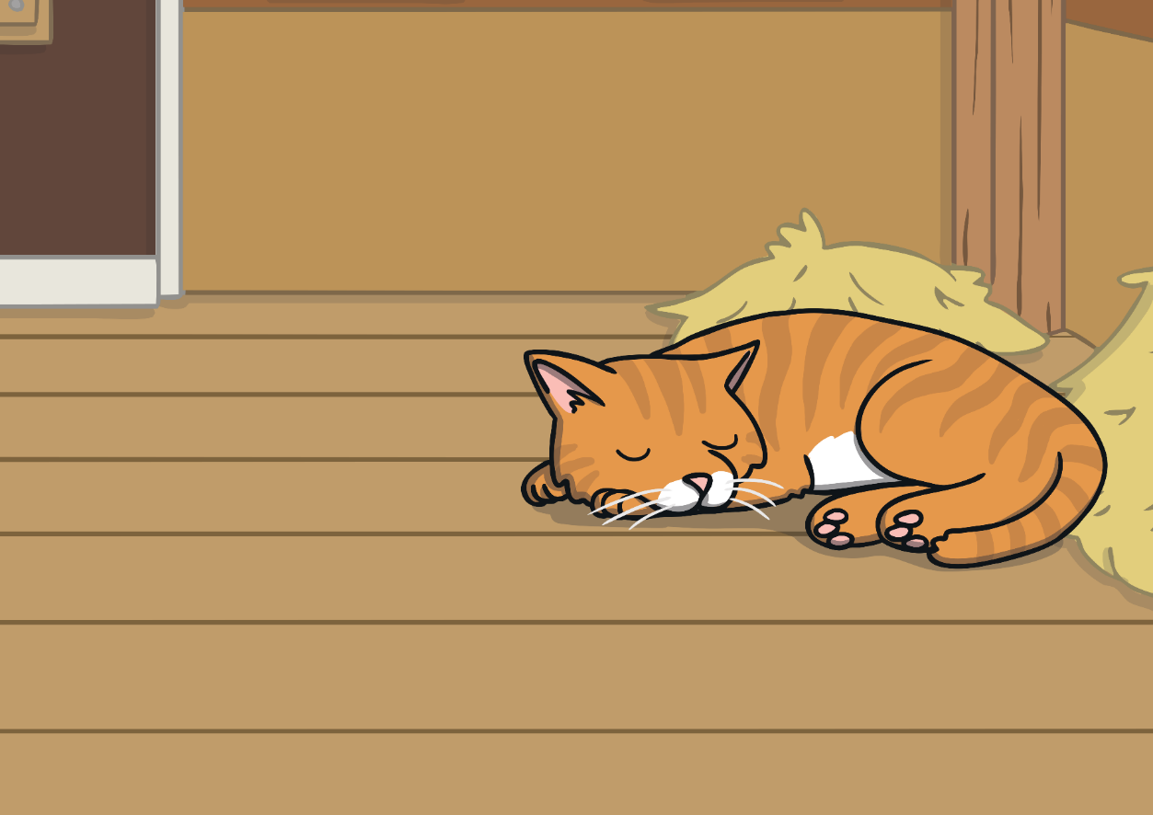
... a sleepy cat,

Slide 5
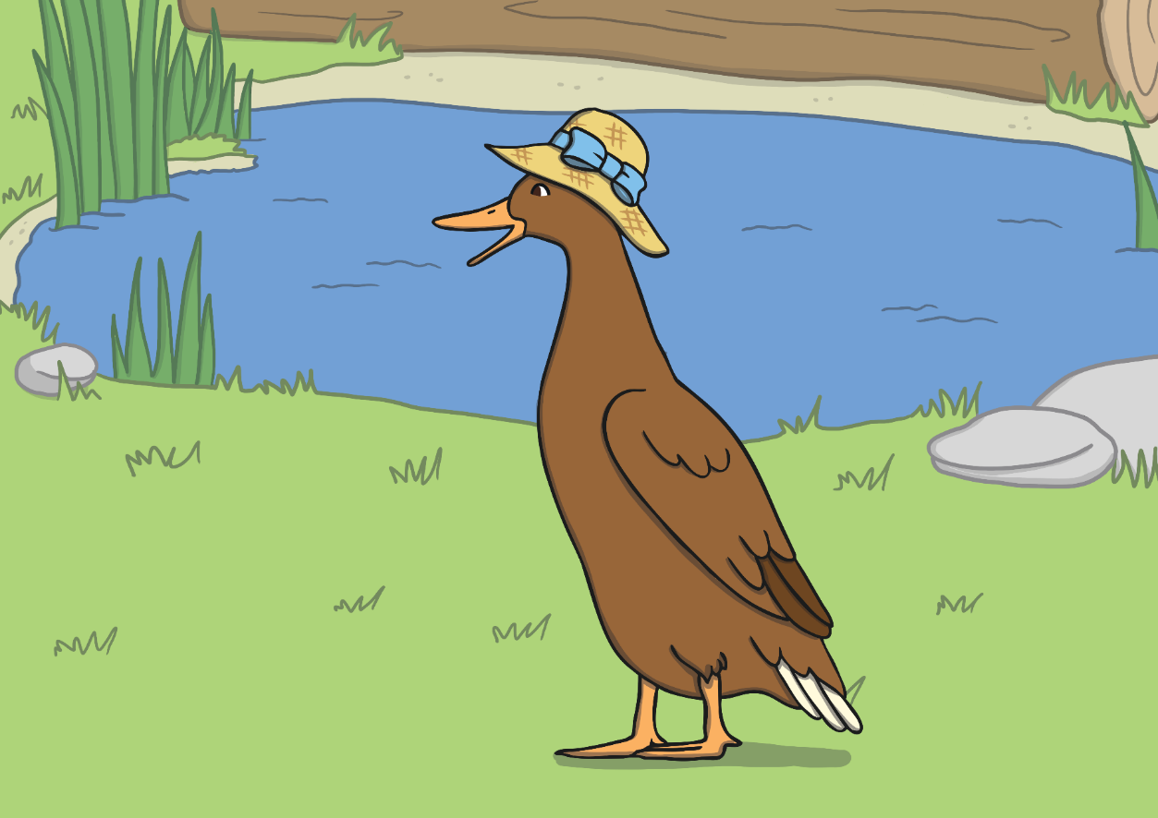
and a noisy duck.

Slide 6
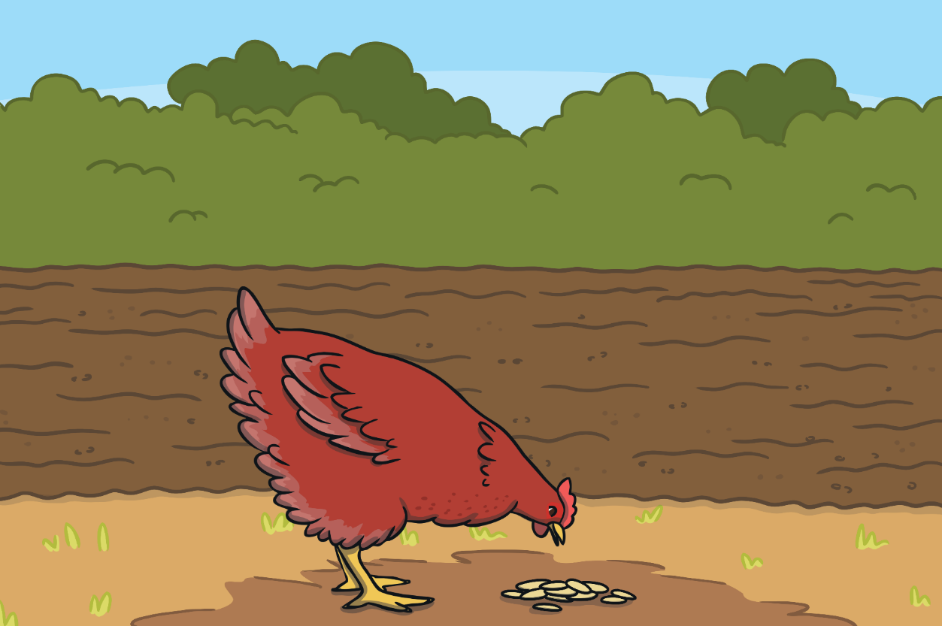
One day, the Little Red Hen found some grains of wheat on the ground.
“Who will help me plant these grains of wheat?” the Little Red Hen asked.

Slide 7
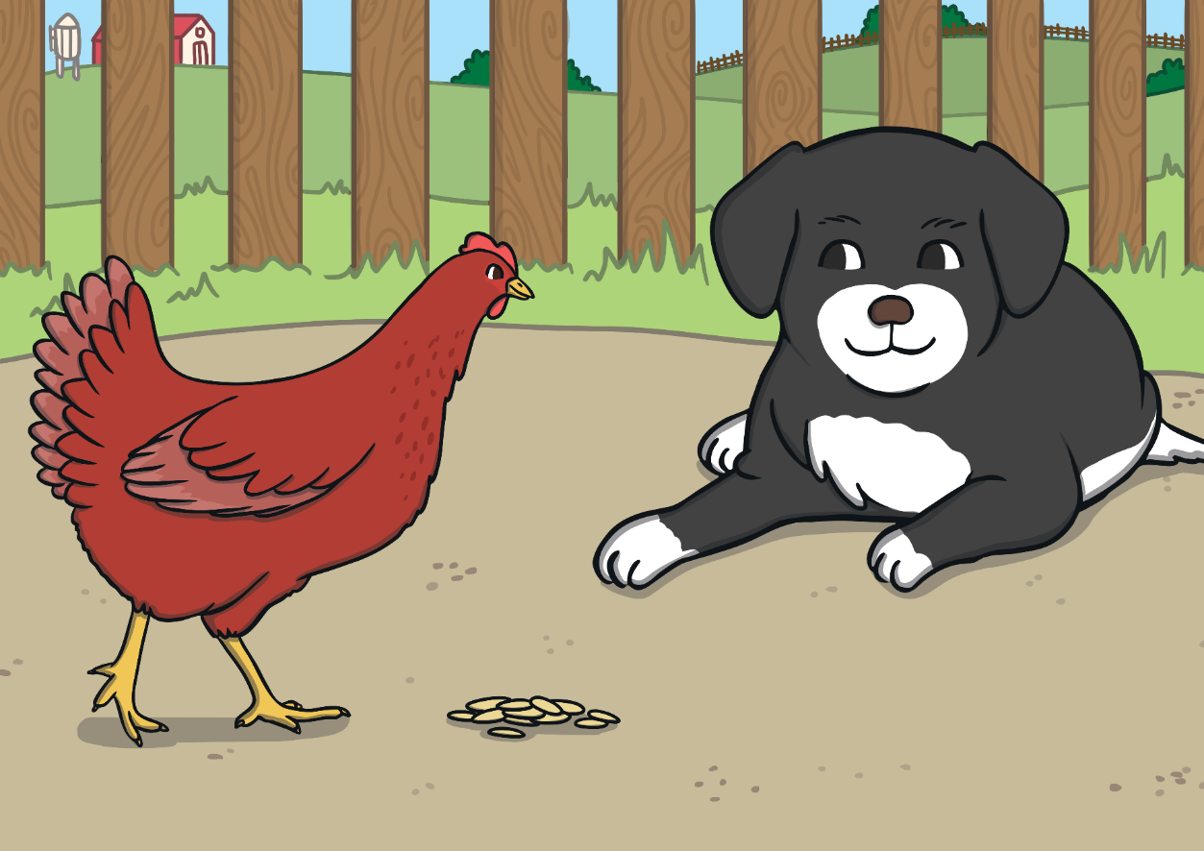
“Not I,” barked the lazy dog.

Slide 8
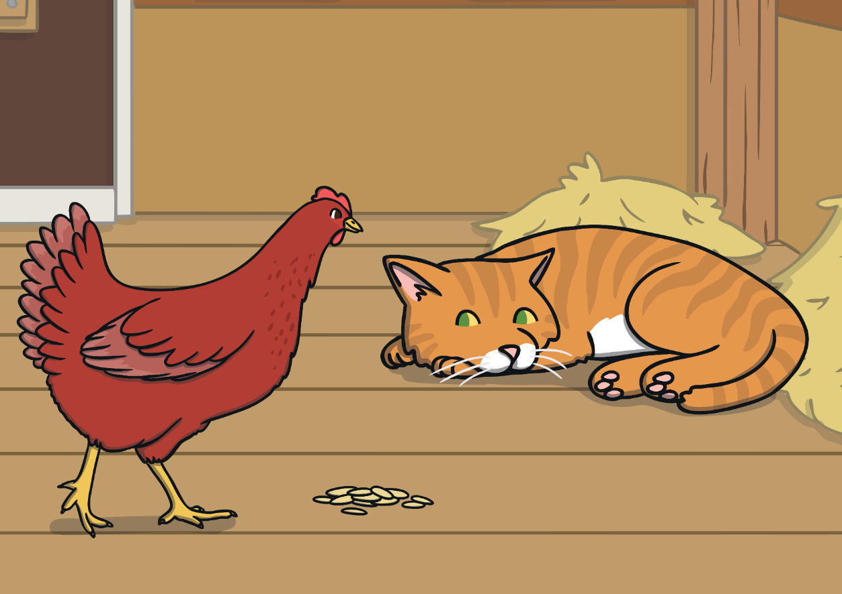
“Not I,” purred the sleepy cat.

Slide 9
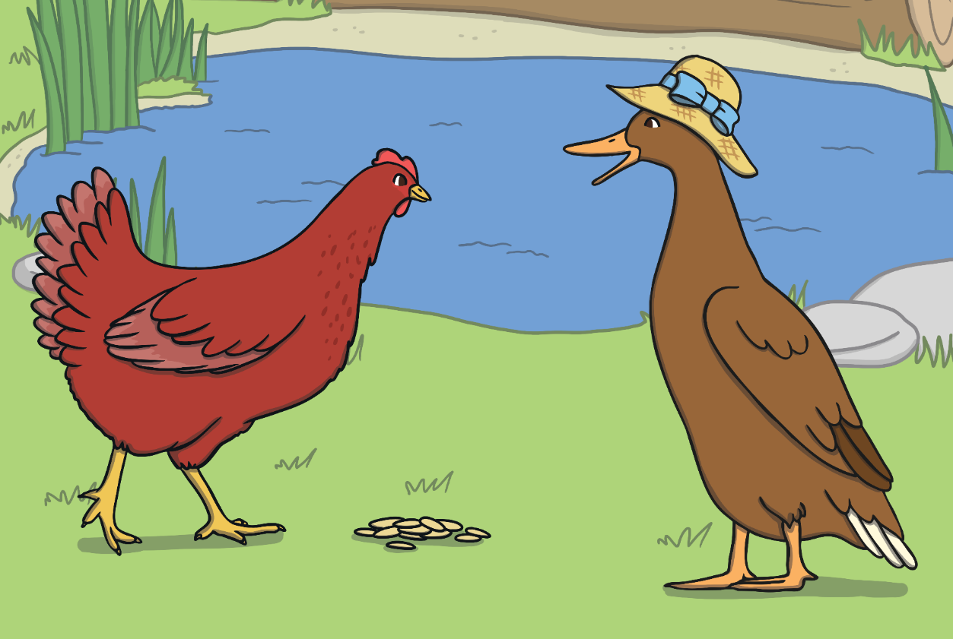
“Not I,” quacked the noisy duck.

Slide 10
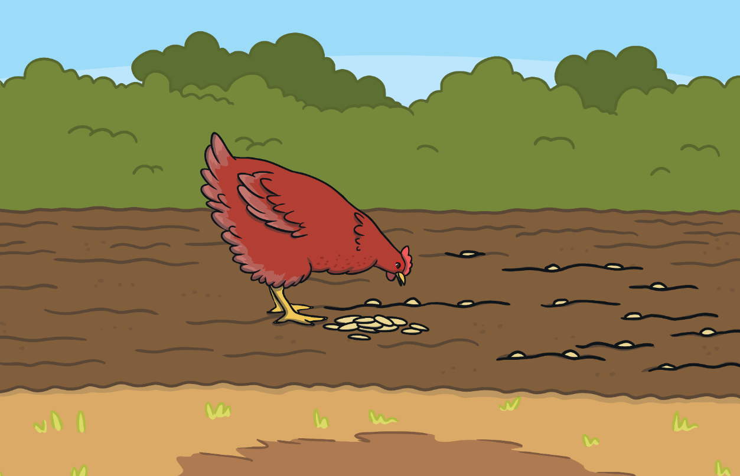
“Then I will,” said the Little Red Hen. So the Little Red Hen planted the grains all by herself.

Slide 11
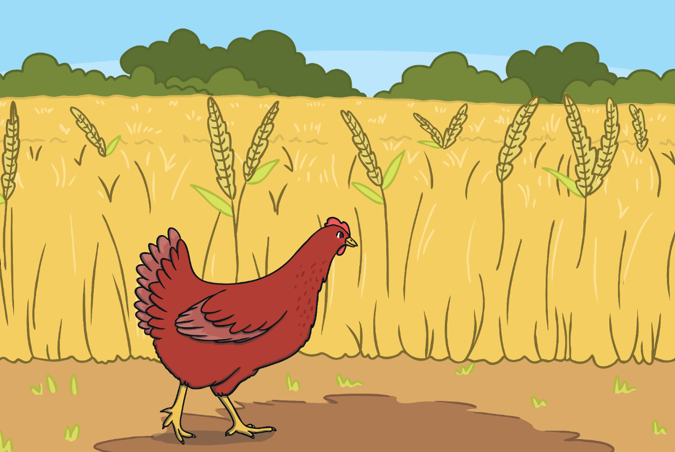
When the wheat had grown, the Little Red Hen asked her friends, “Who will help me cut the wheat?”

Slide 12
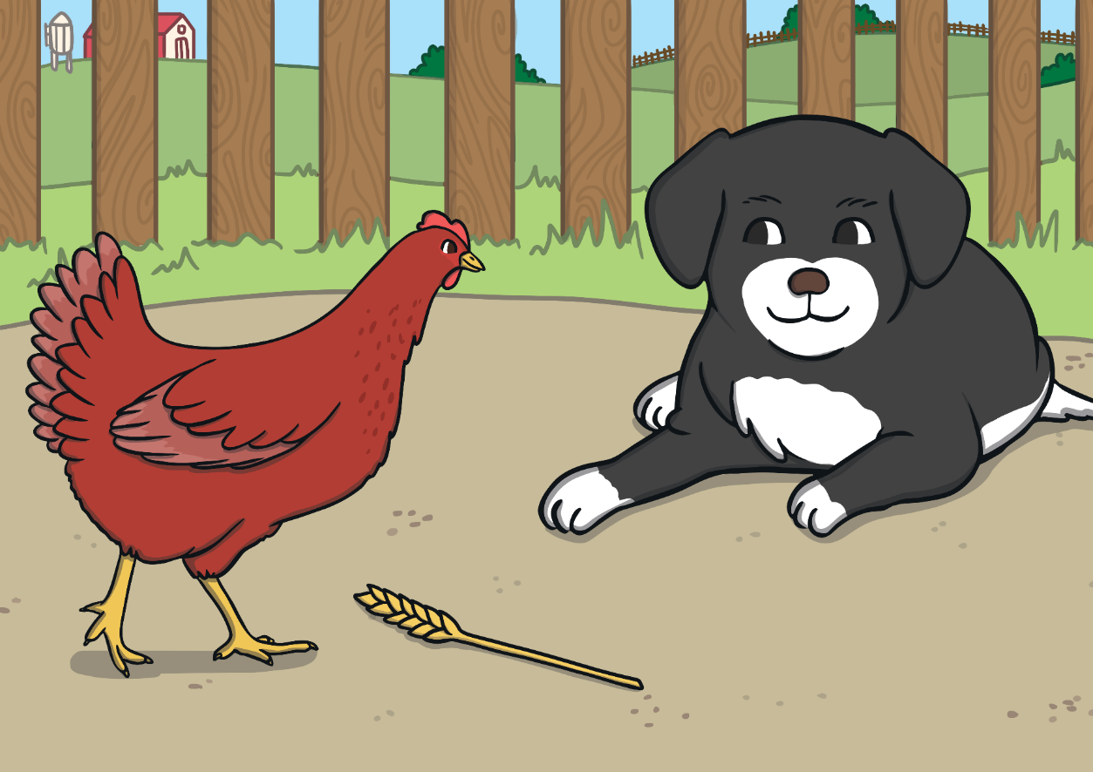
“Not I,” barked the lazy dog.

Slide 13

“Not I,” purred the sleepy cat.

Slide 14
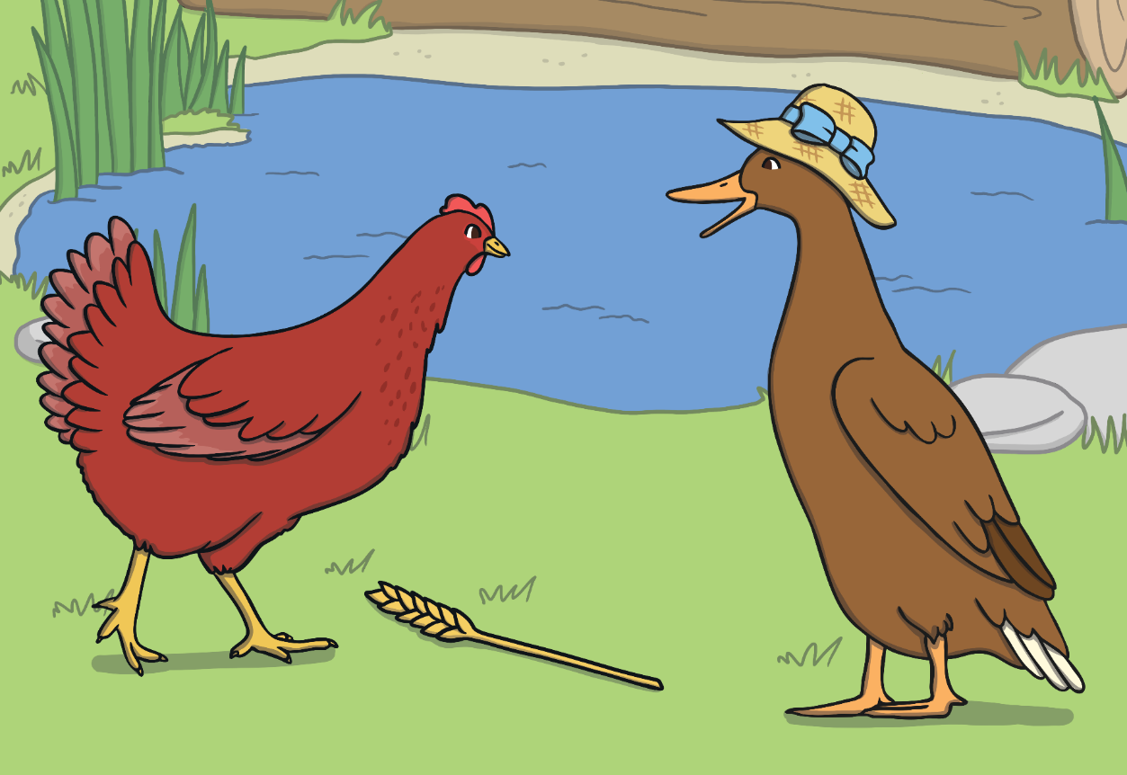
“Not I,” quacked the noisy duck.

Slide 15
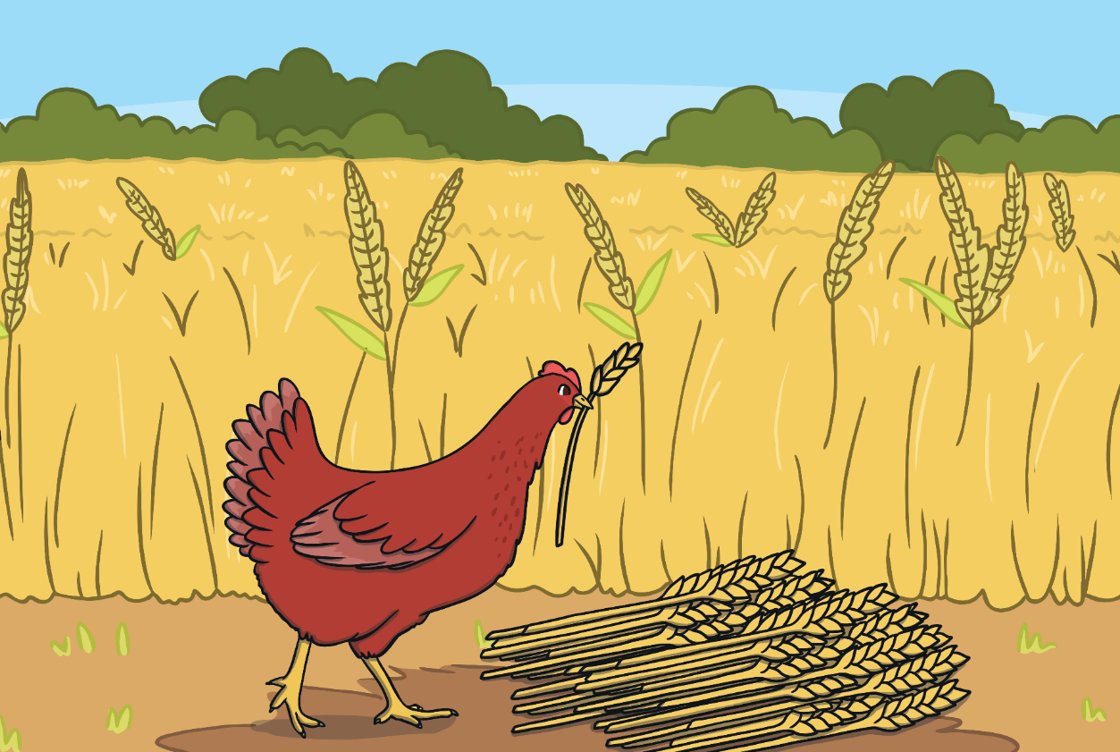
“Then I will,” said the Little Red Hen.
So the Little Red Hen cut the wheat all by herself.

Slide 16
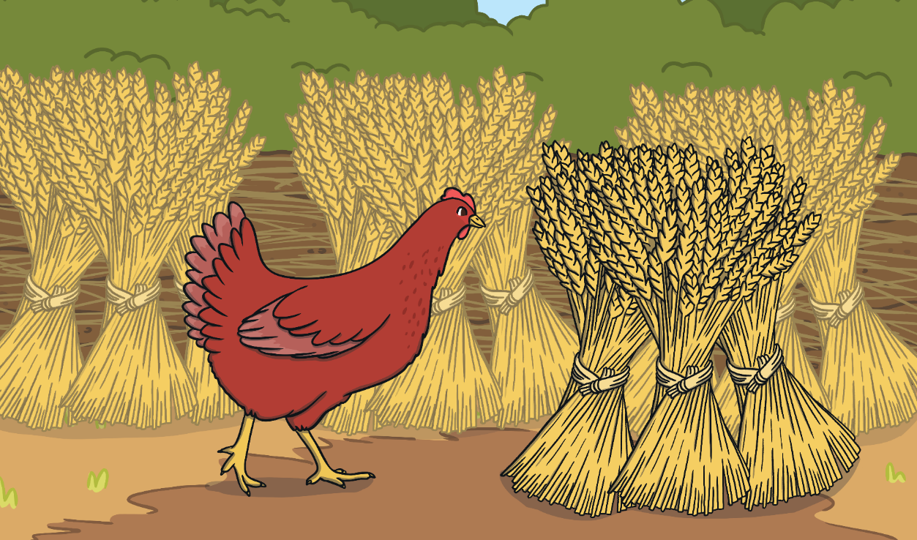
When all the wheat was cut, the Little Red Hen asked, “Who will help me take the wheat to the mill, to be made into flour?”

Slide 17
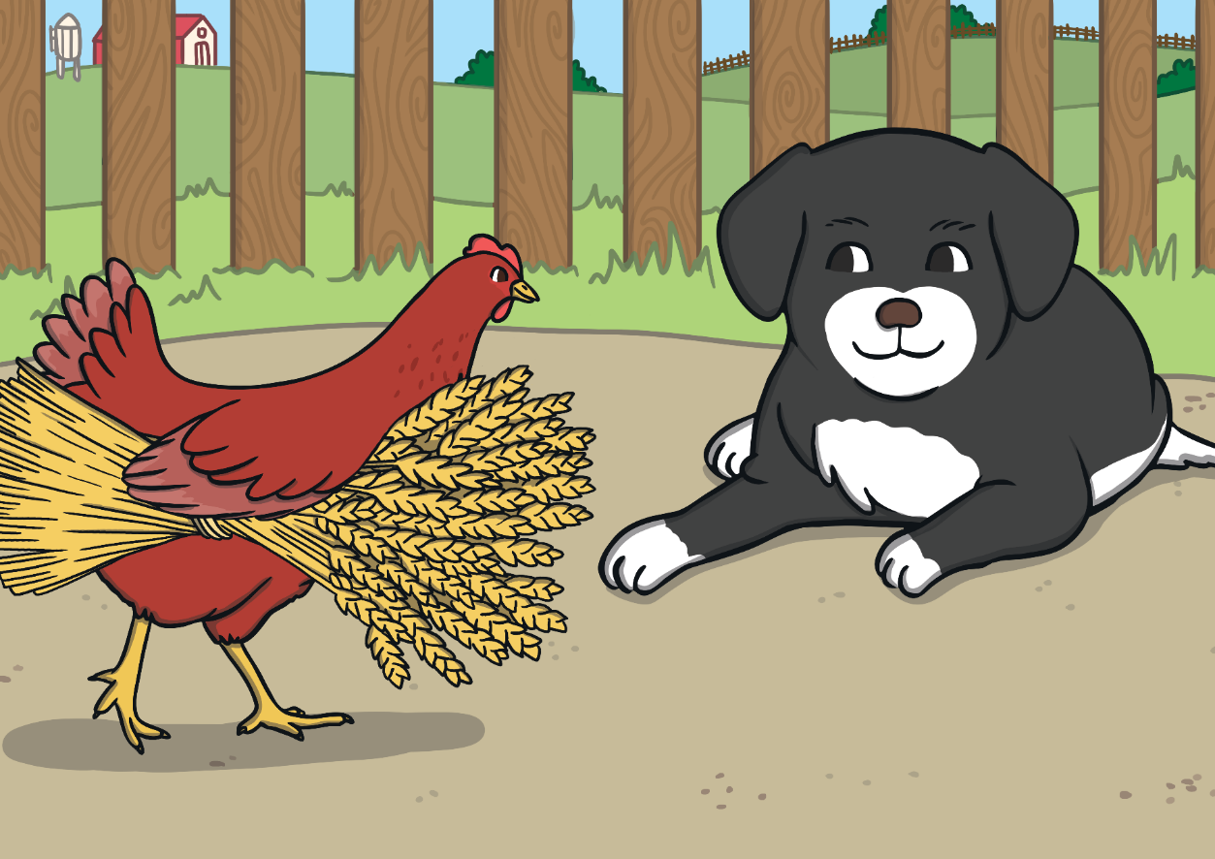
“Not I,” barked the lazy dog.

Slide 18
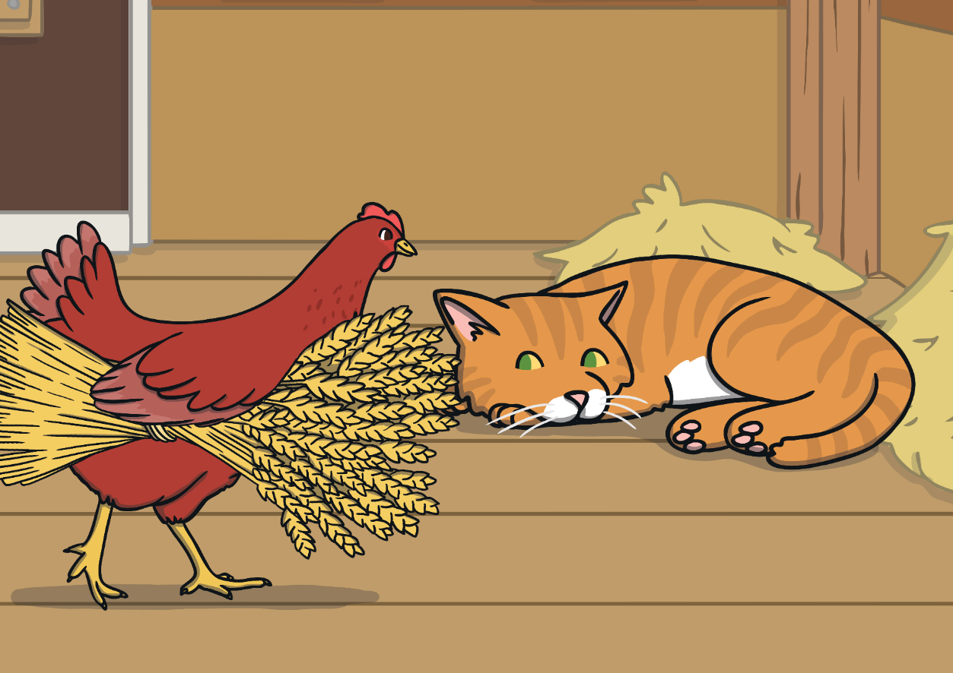
“Not I,” purred the sleepy cat.

Slide 19
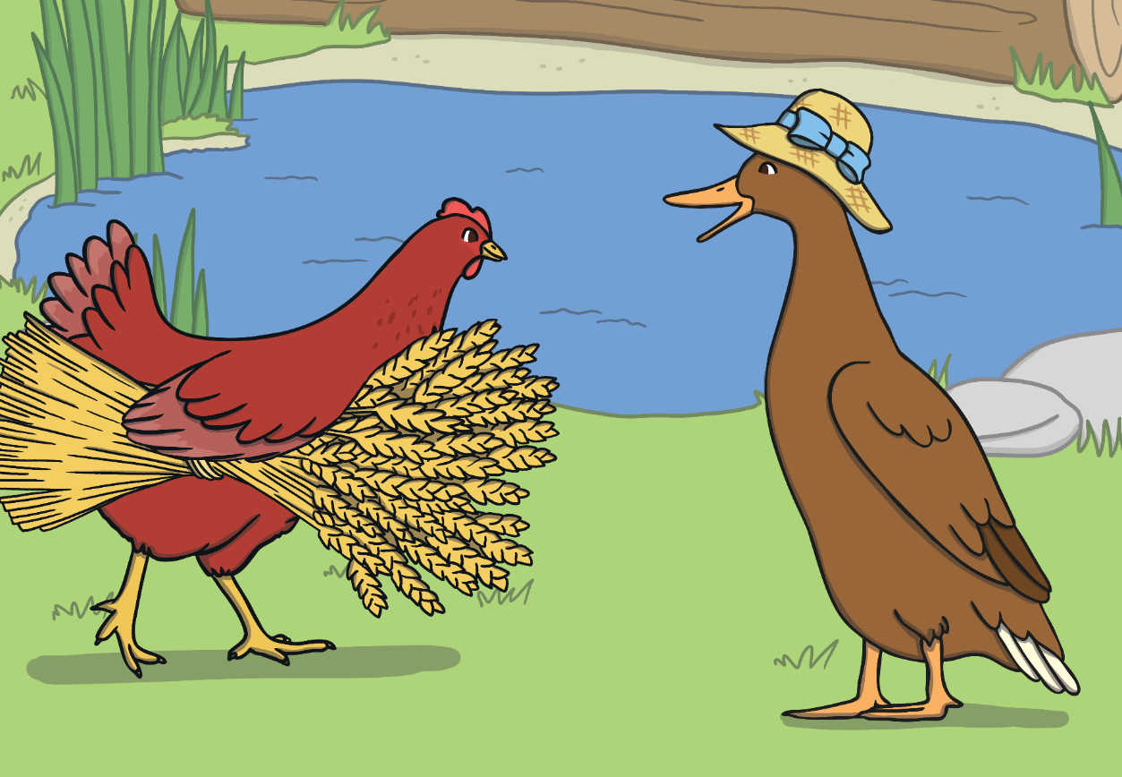
“Not I,” quacked the noisy duck.

Slide 20
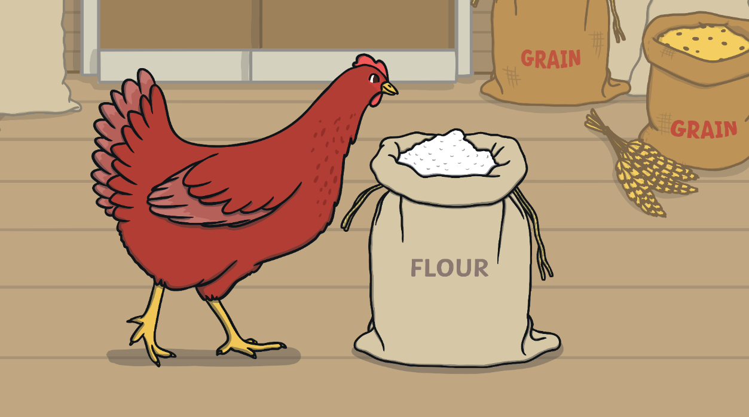
“Then I will,” said the Little Red Hen. So the Little Red Hen took the wheat to the mill, ground the wheat into flour, and carried it back to the farm all by herself.
By now, the Little Red Hen was tired. “Who will help me bake the bread?” asked Little Red Hen.

Slide 21
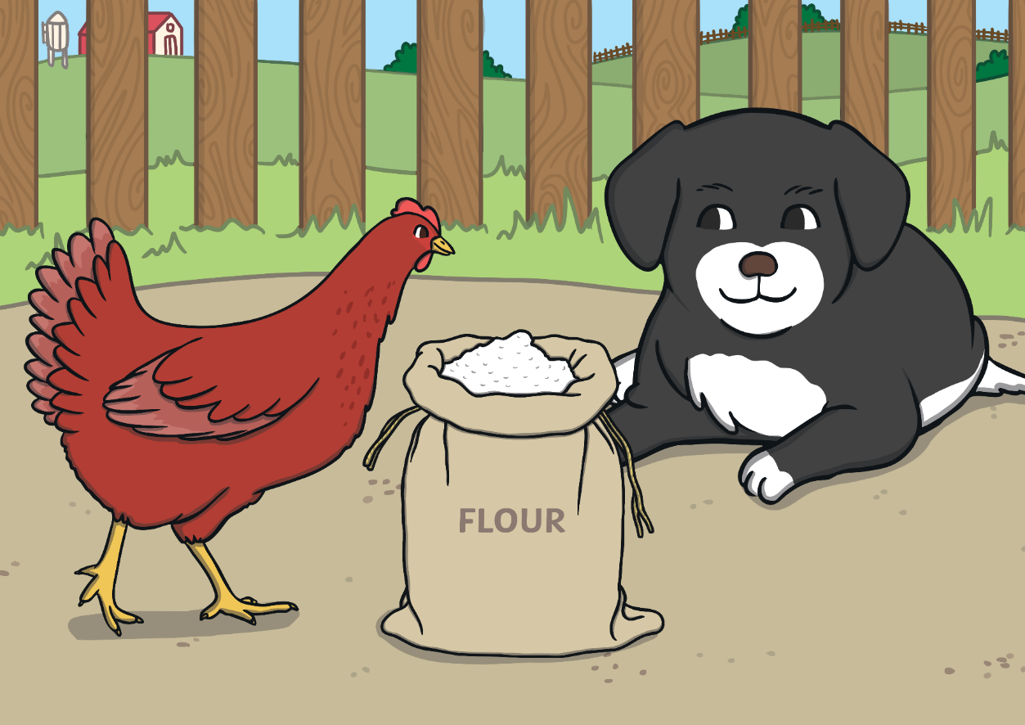
“Not I,” barked the lazy dog.

Slide 22
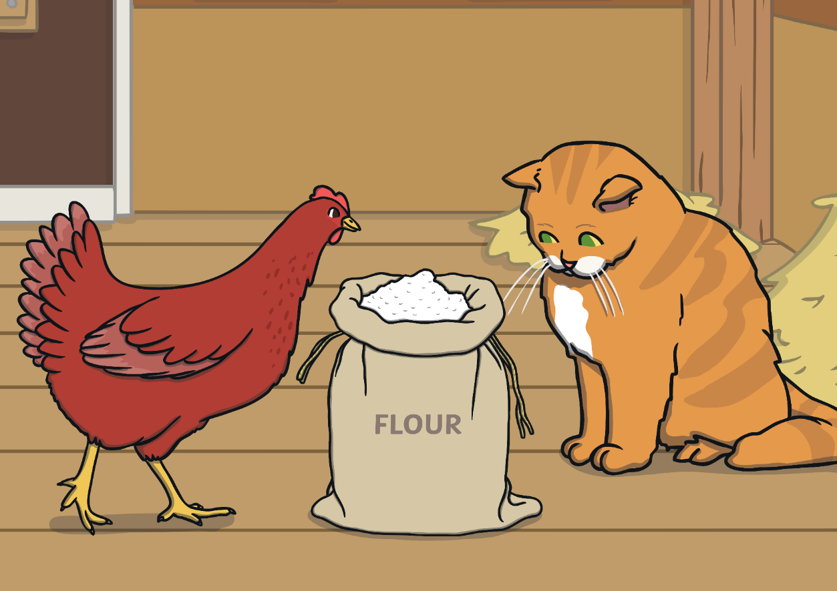
“Not I,” purred the sleepy cat.

Slide 23
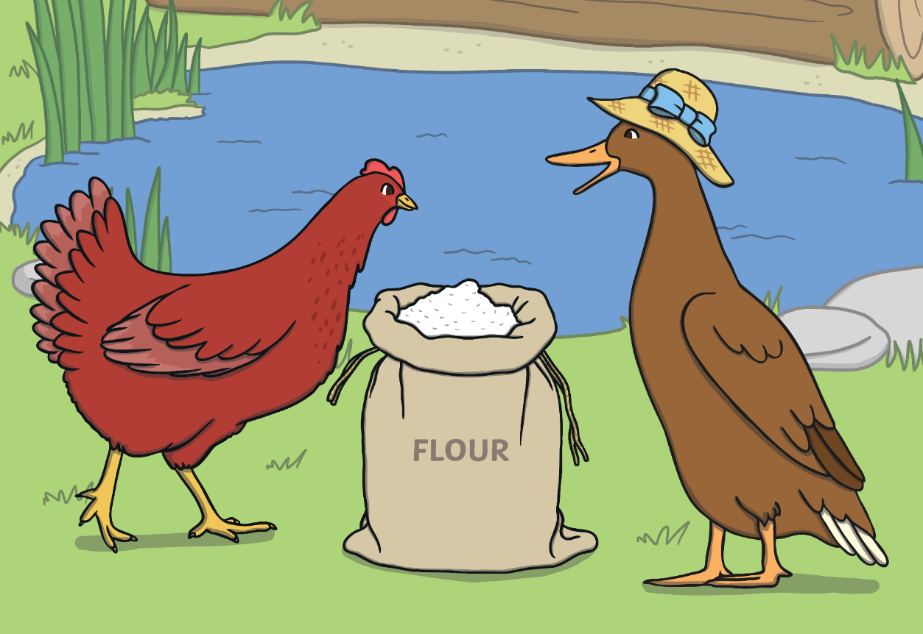
“Not I,” quacked the noisy duck.

Slide 24
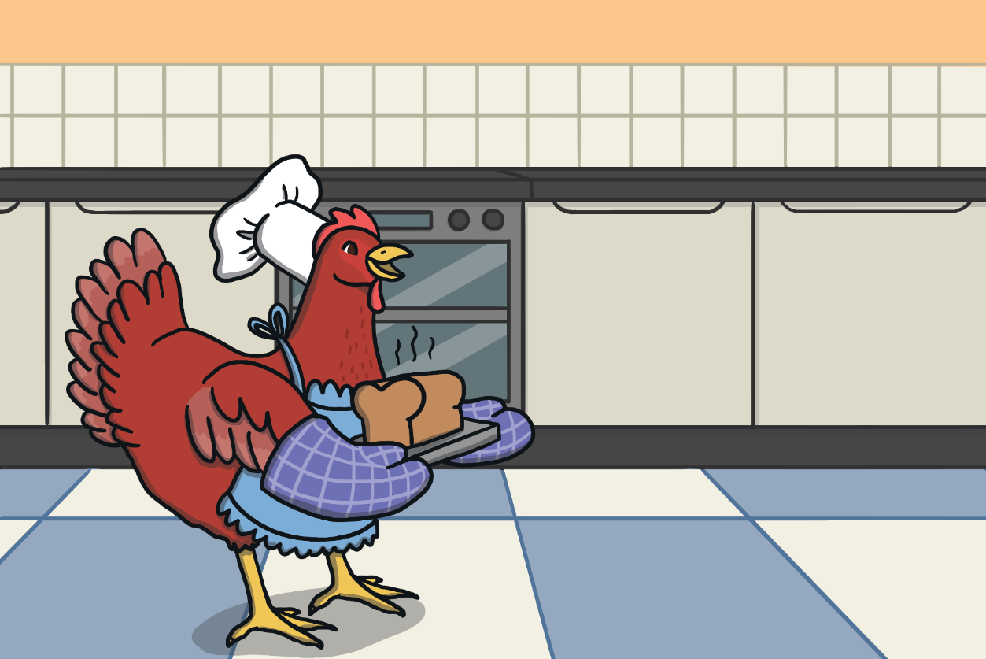
“Then I will,” said the Little Red Hen.
So the Little Red Hen baked the bread all by herself.
When the bread was finished, the Little Red Hen asked, “Who will help me eat the bread?”

Slide 25
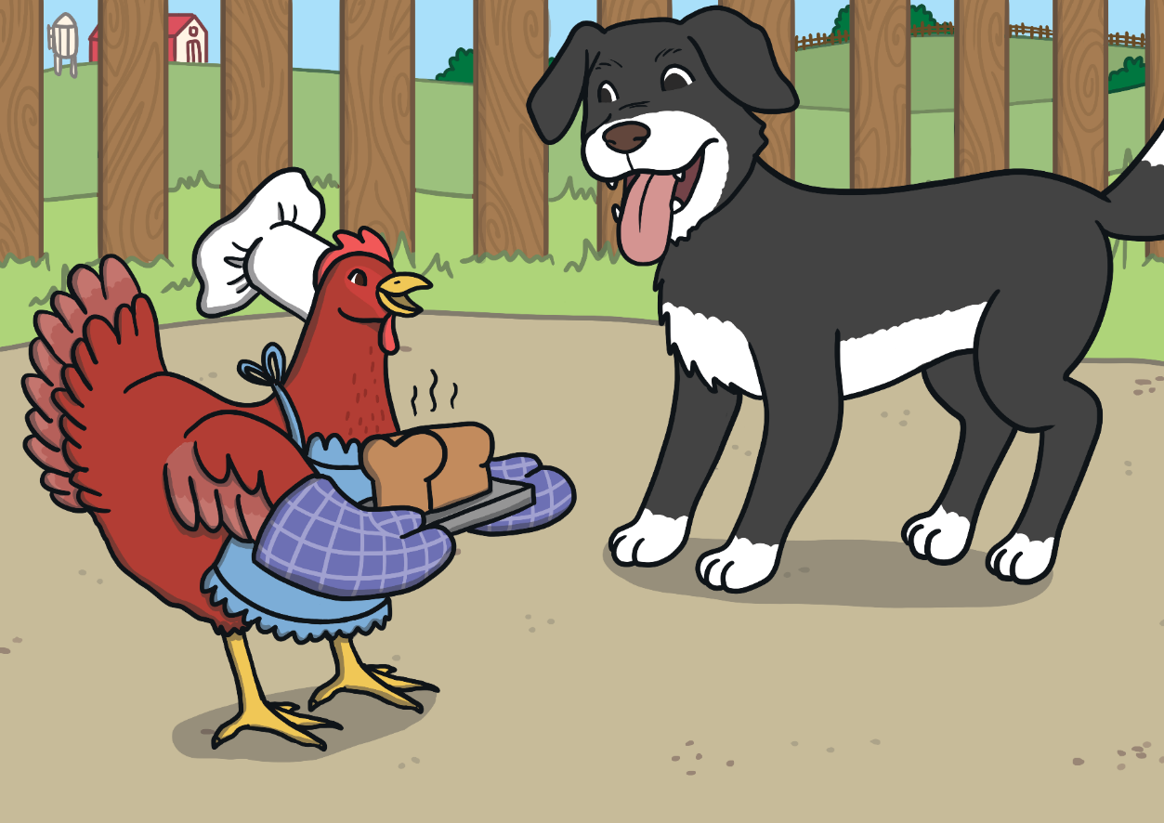
“I will,” barked the lazy dog.

Slide 26
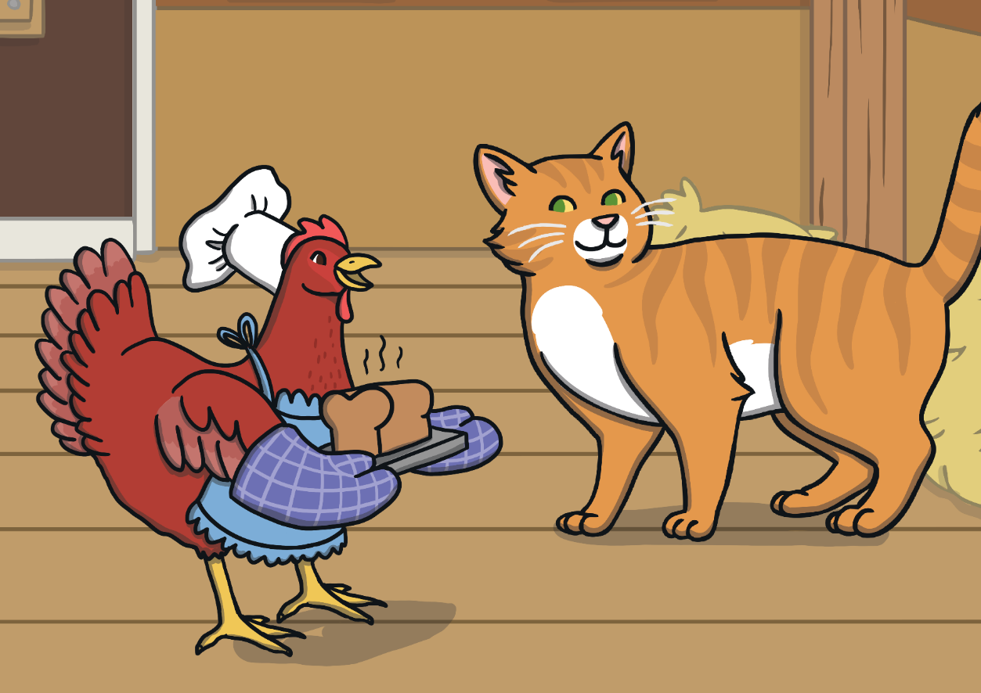
“I will,” purred the sleepy cat.

Slide 27
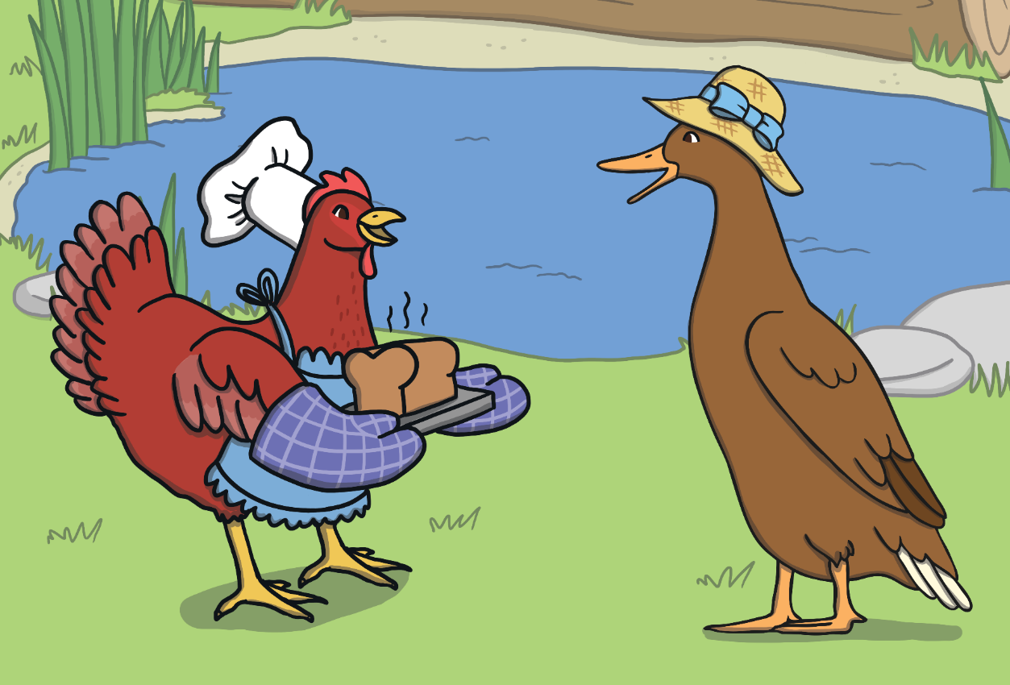
“I will,” quacked the noisy duck.

Slide 28
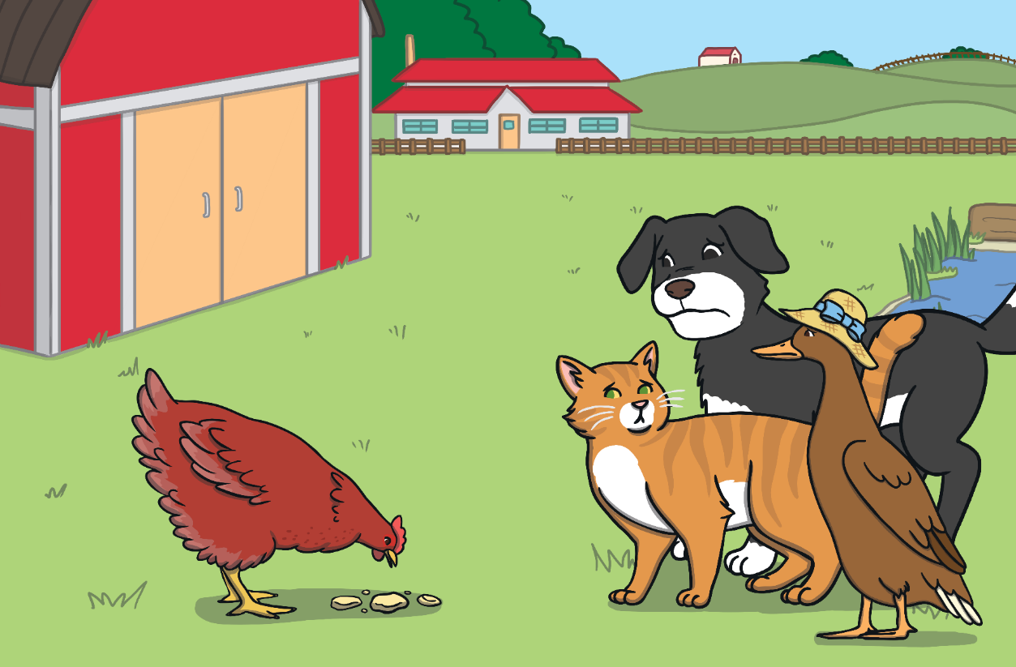
“No, I will!” said the Little Red Hen.
So the Little Red Hen ate the bread all by herself.

