Slide 1
深入理解数据库事务隔离级别 --使用MySQL做实验
竹翁 <zhuweng.yzf@alipay.com>
OceanBase项目组

Slide 2
MySQL实验环境说明
建表语句
create table yzf (c1 int primary key, c1 int, c3 int) engine=innodb;
可以用下面语句修改隔离级别
set session transaction isolation level repeatable read;
可以用下面的语句插入初始化数据
insert into yzf values (1, 2, 3);
后续所有例子，都假设session处于autocommit=0的状态；在这种状态下，commit/rollback后的一条语句会自动开启一个新事务。
set autocommit=0;

Slide 3
READ UNCOMMITTED
Read uncommitted允许Dirty read
简单的说，Dirty read是说一个事务可以读到另一个事务尚未提交的数据

Slide 4
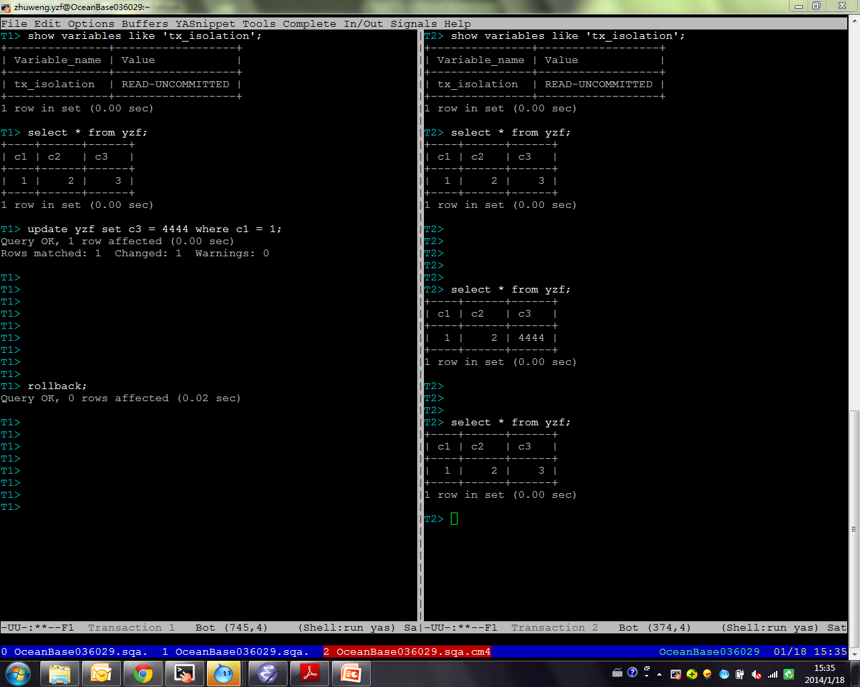

Slide 5
READ COMMITTED
Read committed不允许Dirty read

Slide 6
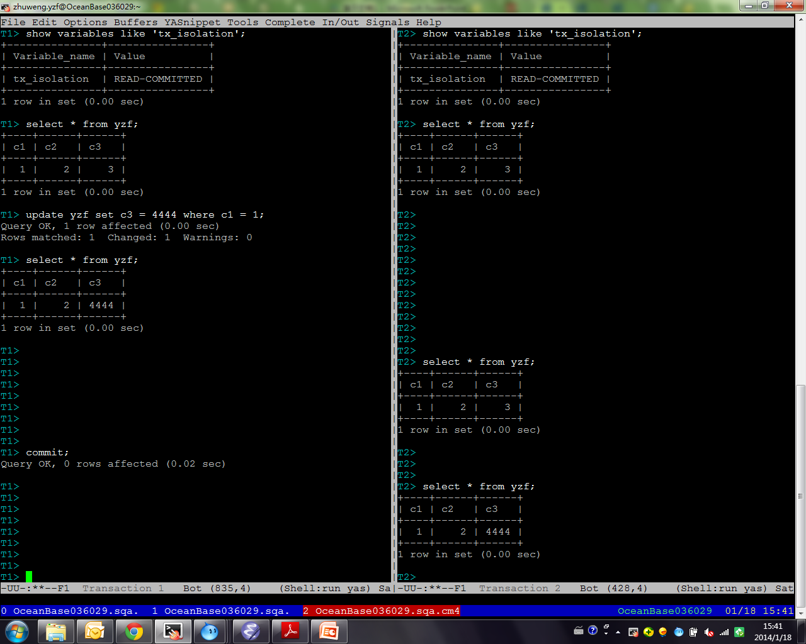

Slide 7
Read Committed允许Fuzzy Read
Fuzzy read也叫non-repeatable read，简单的讲，指一个事务内的两次读同一行看到的数据不一样，“不可重复”
Notes:
With READ COMMITTED isolation level, each consistent read within a transaction sets and reads its own fresh snapshot.

Slide 8
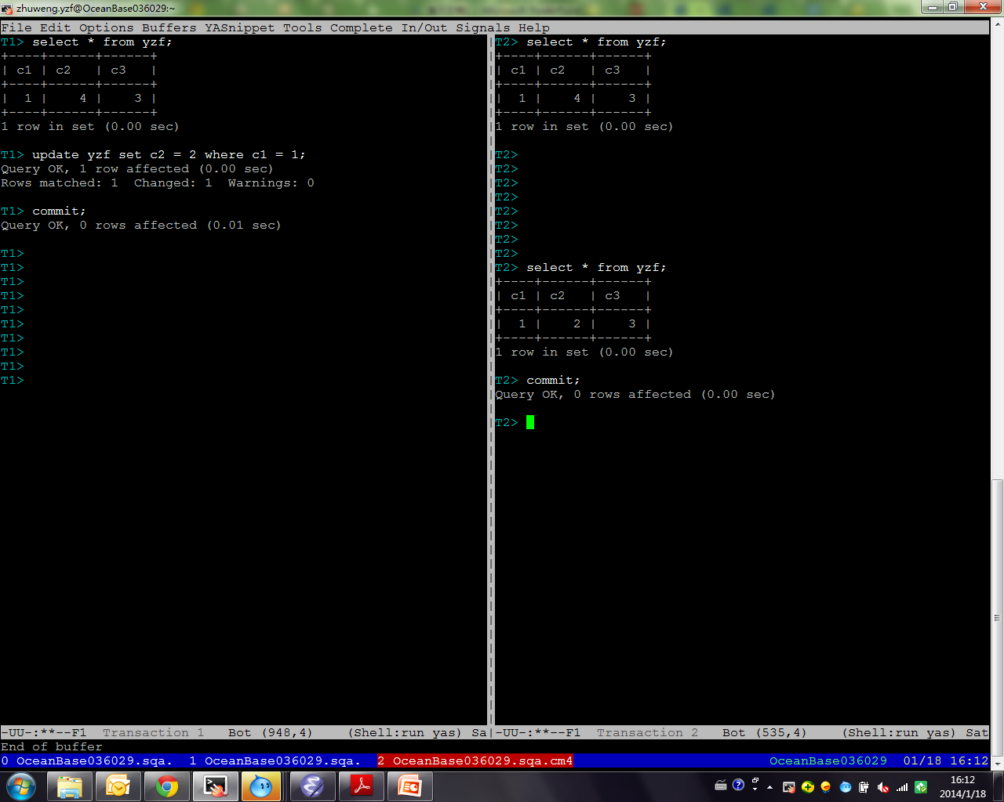
Notes:
单行读

Slide 9
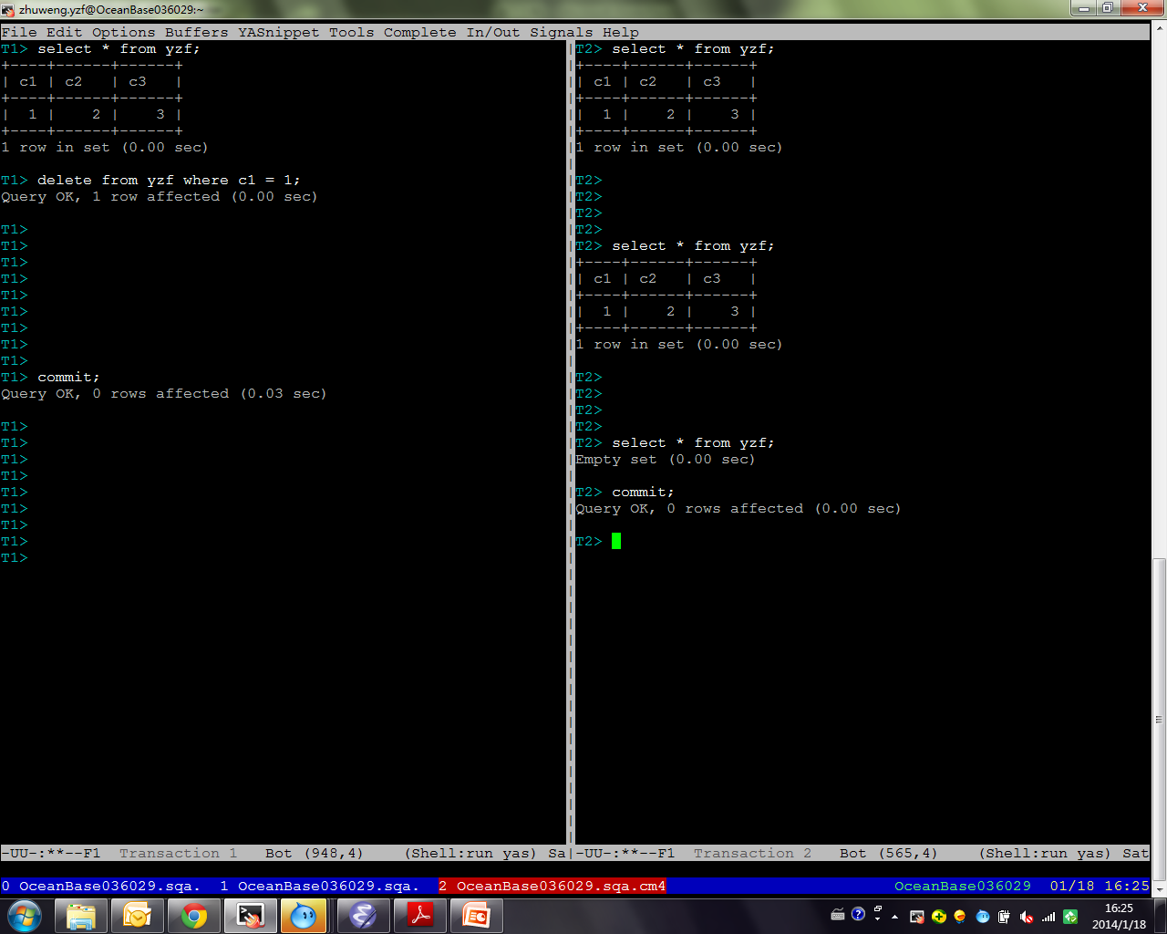
Notes:
delete

Slide 10
REPEATABLE READ
Repeatable read不允许Fuzzy read

Slide 11
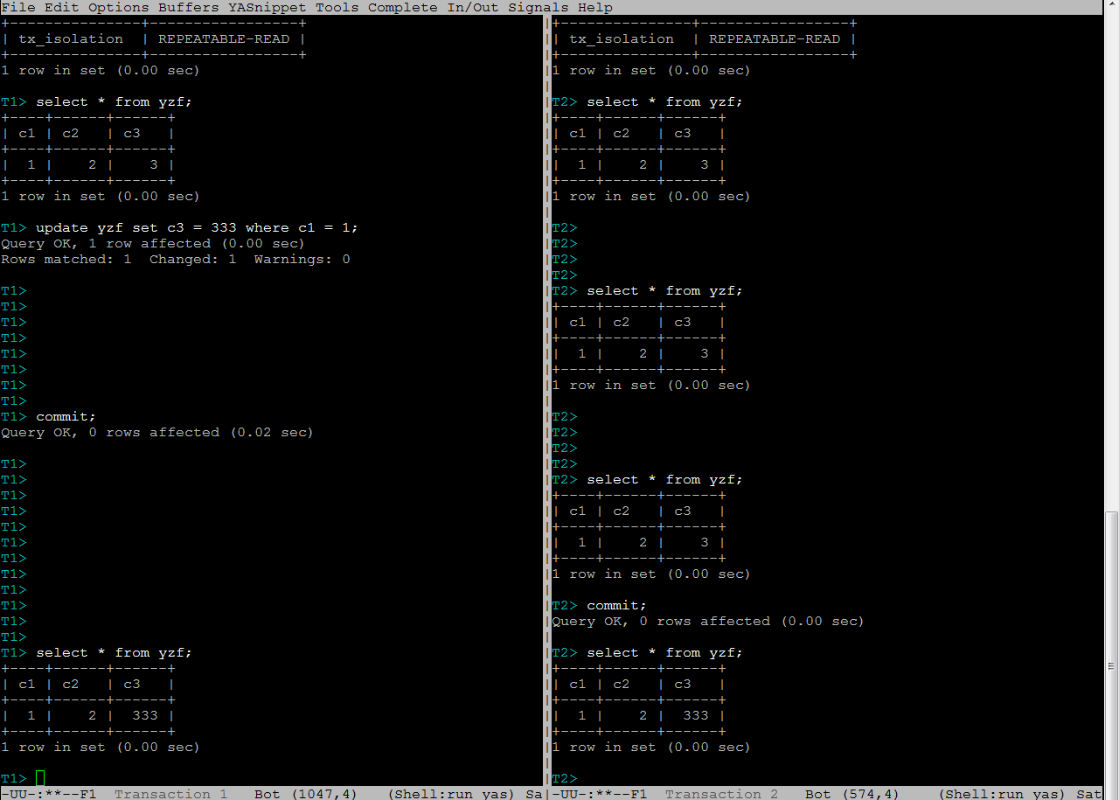

Slide 12
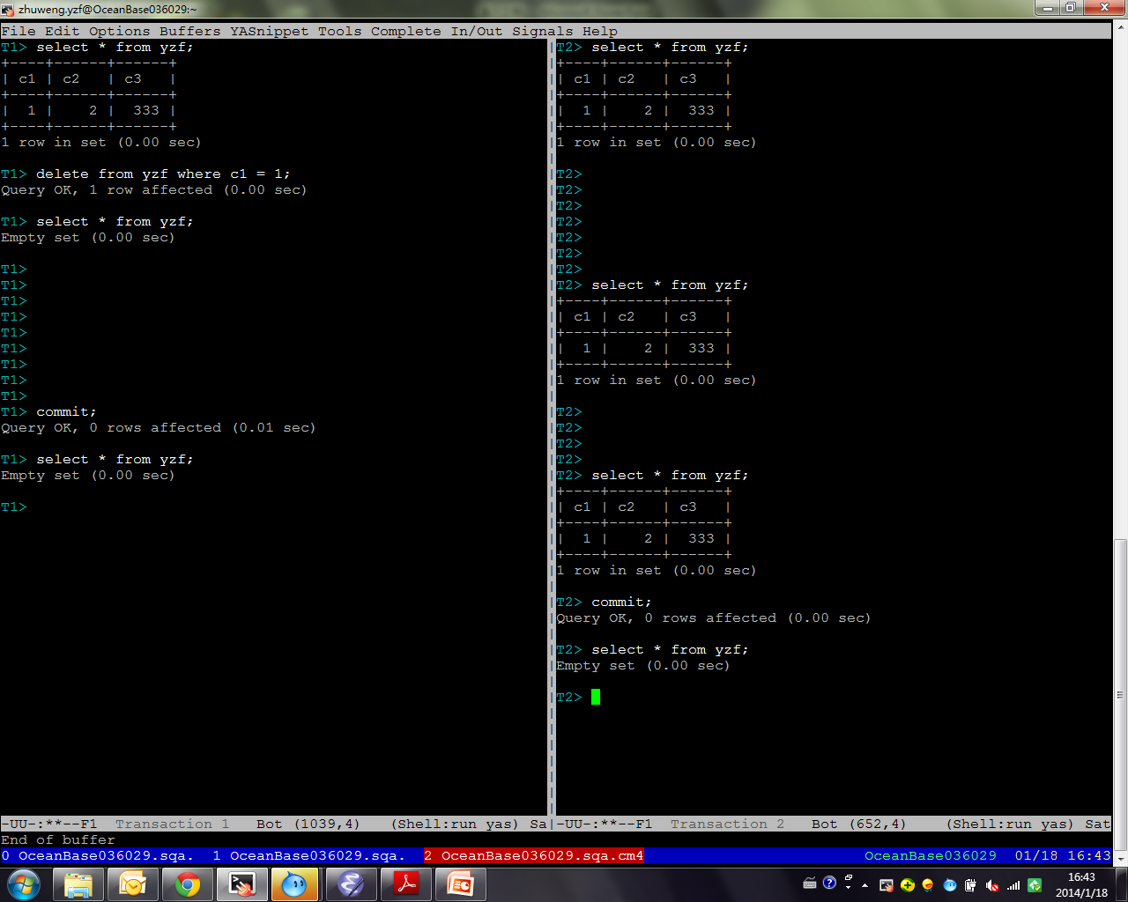

Slide 13
Repeatable read（使用Snapshot read实现时）允许某些Phantom现象
简单的讲，Phantom现象包括第二次读读到了第一次没有的行数据。
Notes:
If the transaction isolation level is REPEATABLE READ (the default level), all consistent reads within the same transaction read the snapshot established by the first such read in that transaction. You can get a fresher snapshot for your queries by committing the current transaction and after that issuing new queries.
With READ COMMITTED isolation level, each consistent read within a transaction sets and reads its own fresh snapshot.

Slide 14
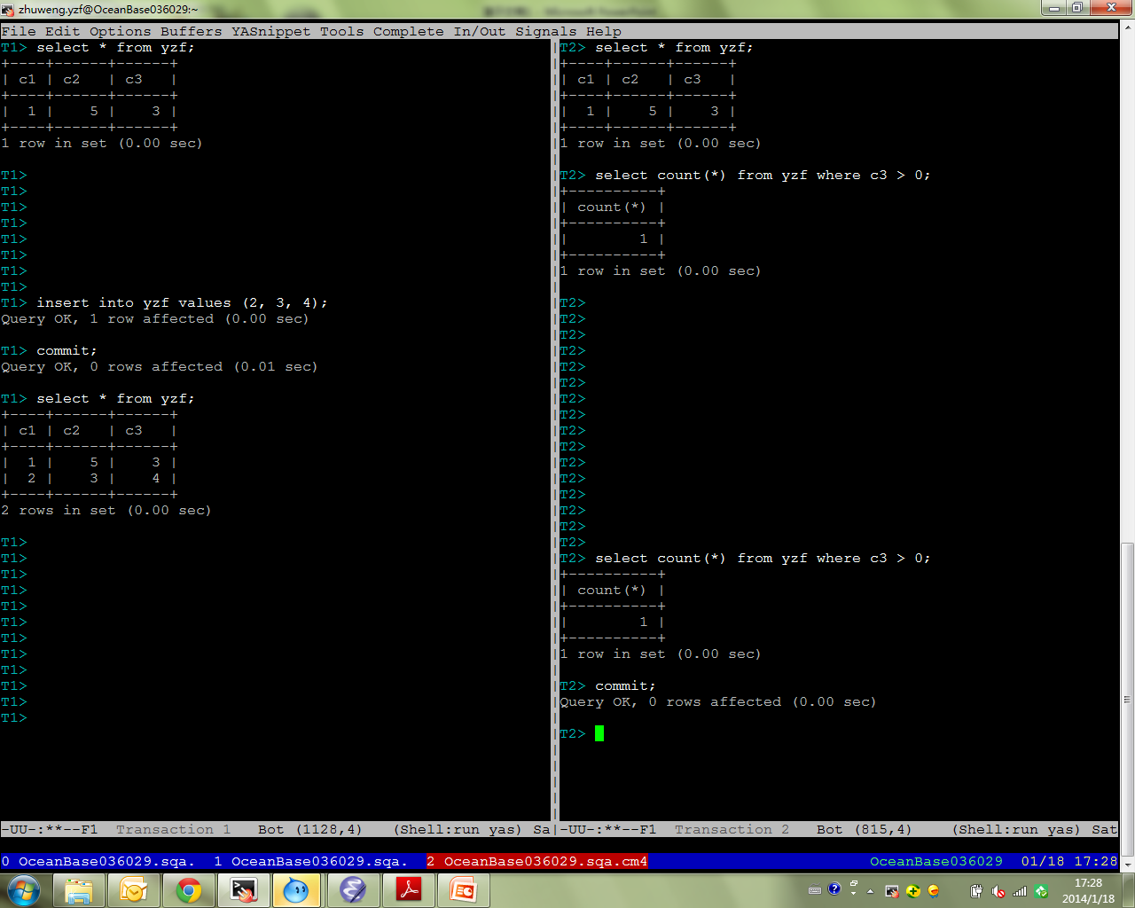
因基于快照读，本例无异常

Slide 15
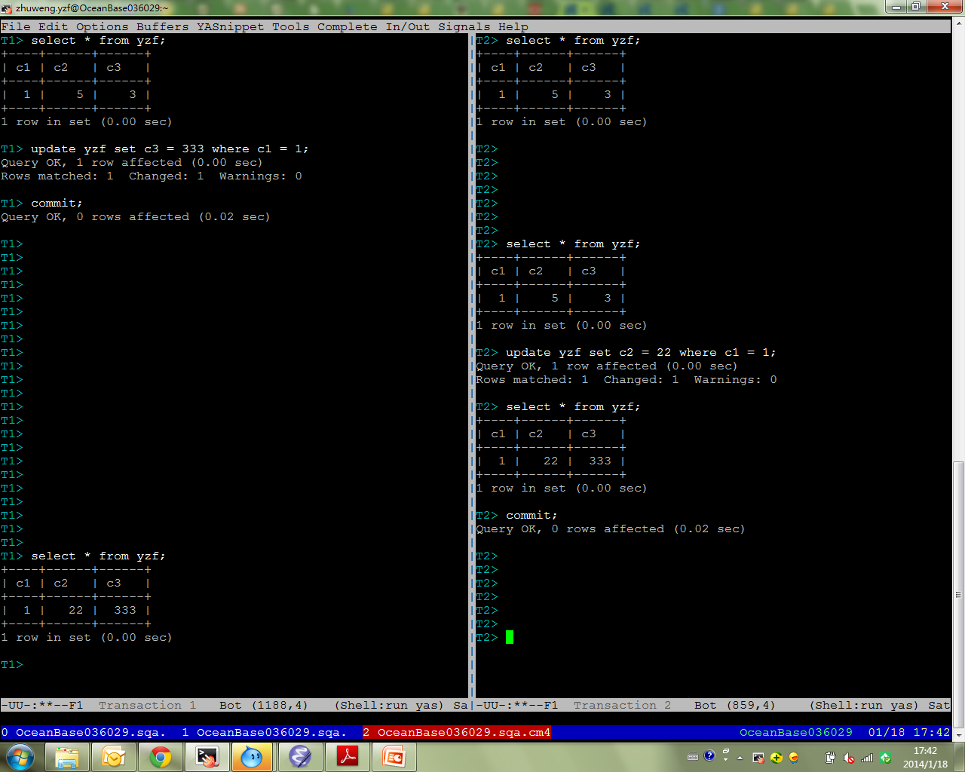
事务有了修改后，原来
不可见的333变的可见了

Slide 16
Repeatable read允许Write Skew
Write Skew异常针对多行事务。如果事务1读取了行x，修改了y，提交；同时事务2读取了行y，修改了x；最终结果可能违反x和y相关的某些约束。

Slide 17
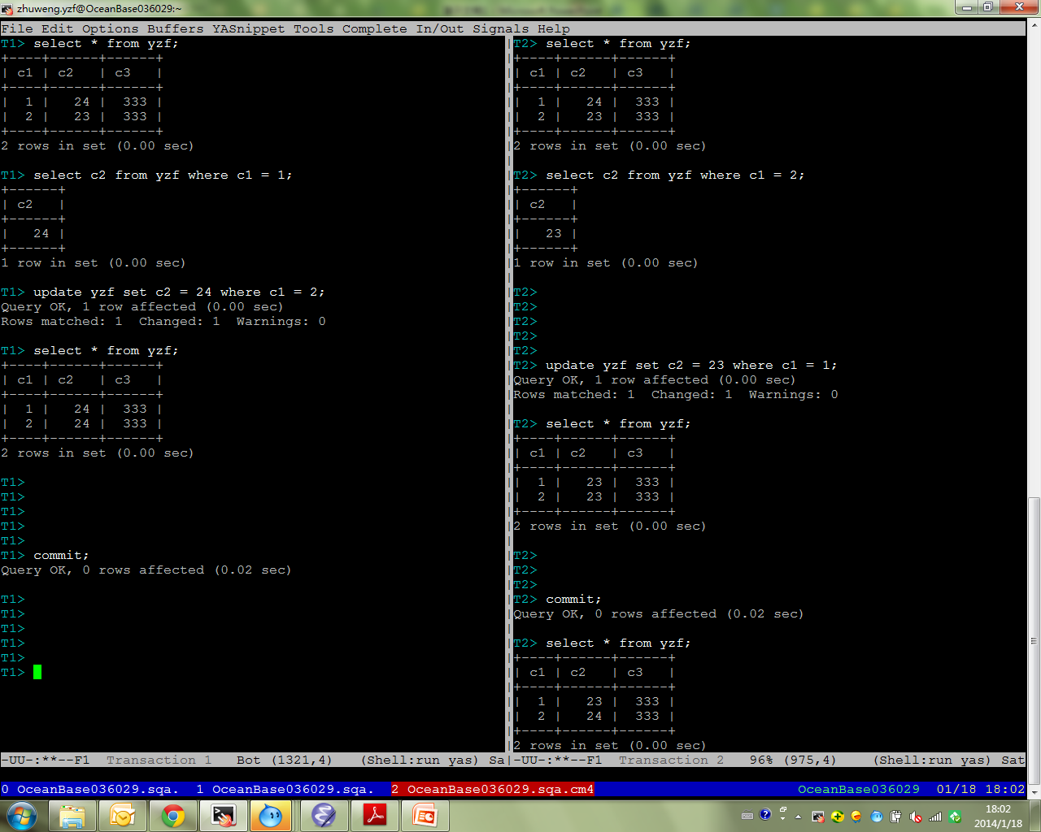
两个事务单独运行的结果本应该是这两行c2列最终结果“相等”，但并发执行的结果违反了这个约束

Slide 18
SERIALIZABLE
Serializable不允许Phantom和Write Skew以及任何不可串行化的反常情况

Slide 19
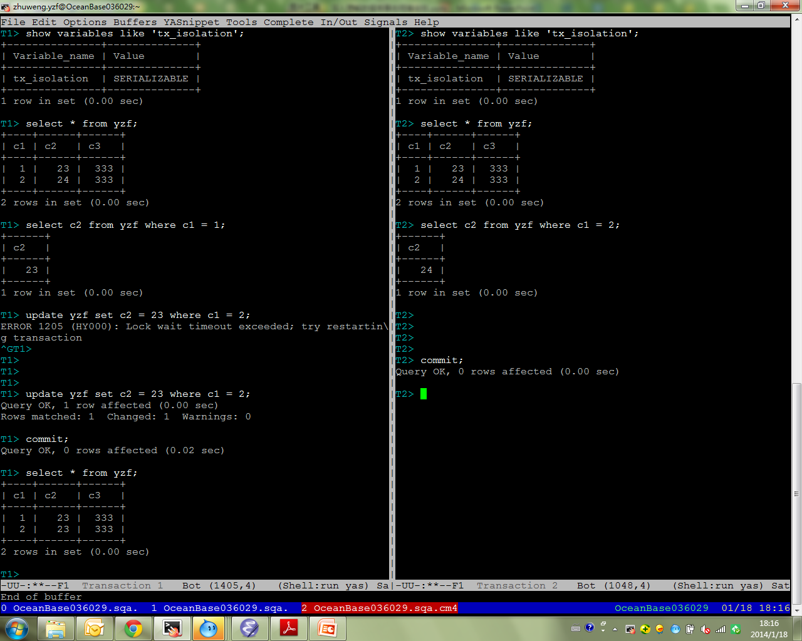

Slide 20
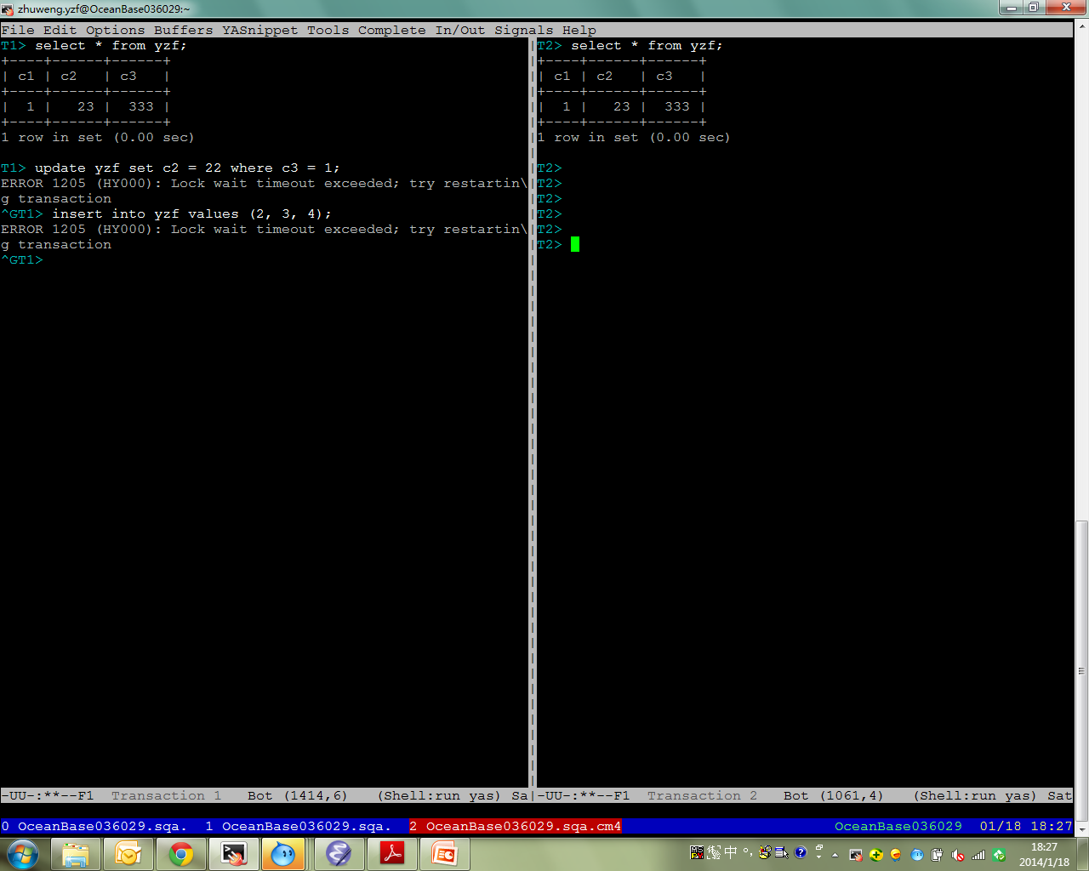

Slide 21
SNAPSHOT READ
除了serializable级别，其他三个级别的select语句都是snapshot读，不上锁
当处于这些隔离级别时，为了避免反常现象，用户可以使用select … lock in share mode显式上读锁

Slide 22
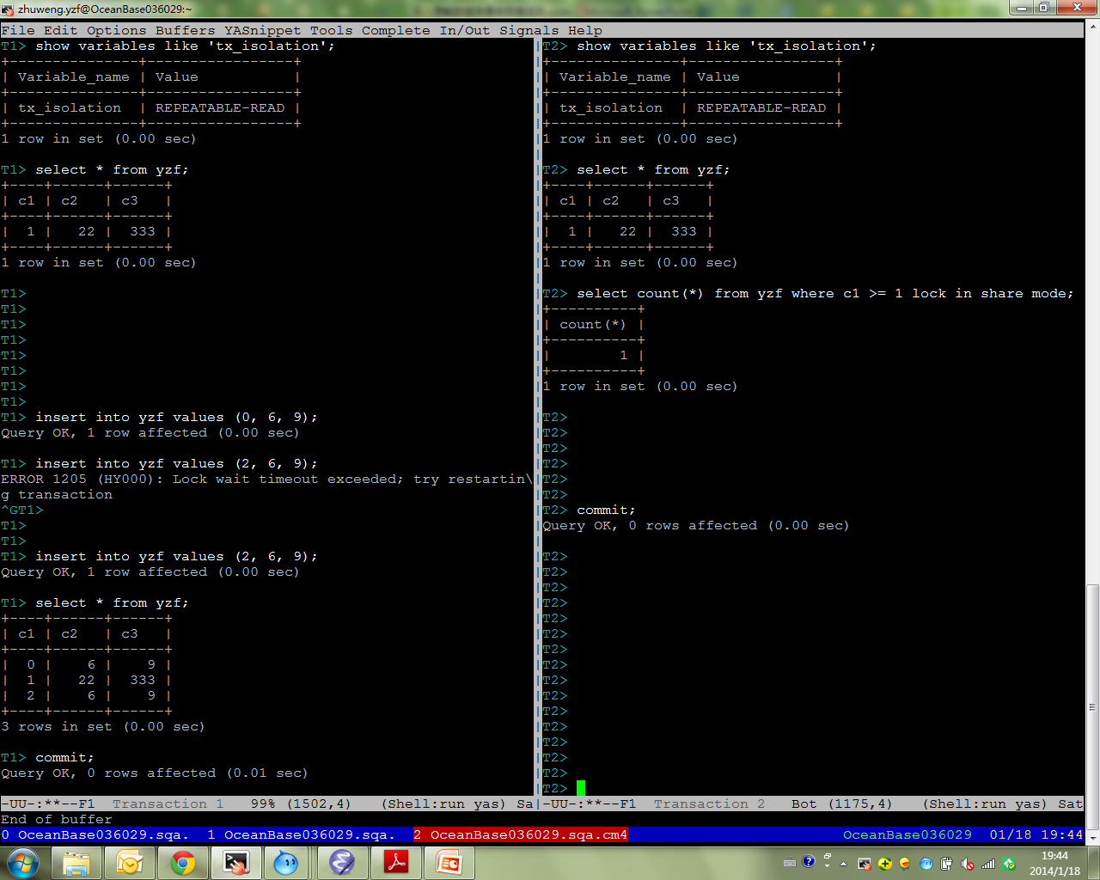

Slide 23
Oracle提供read committed和serializable两个隔离级别
OceanBase目前只提供read committed隔离级别

