Slide 1
Assignment #01
Sep, 11, 2017
JinYeong Wang
Damin Lee
Parallel Computing Lab.
Mechanical Engineering
Hanyang University

Slide 2
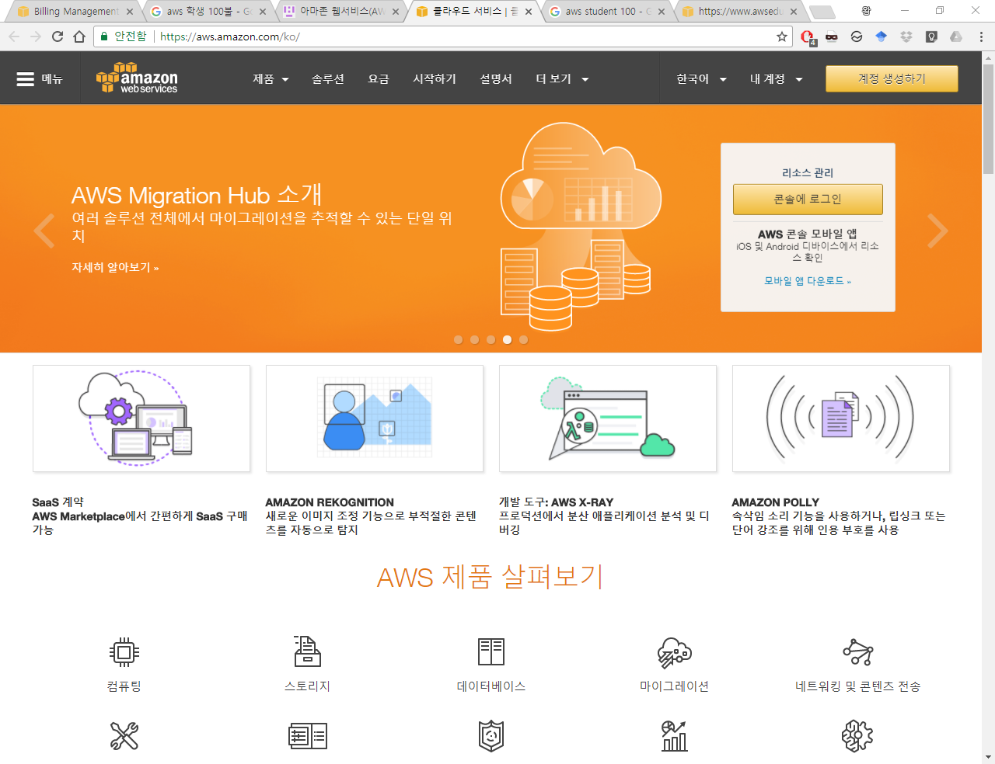
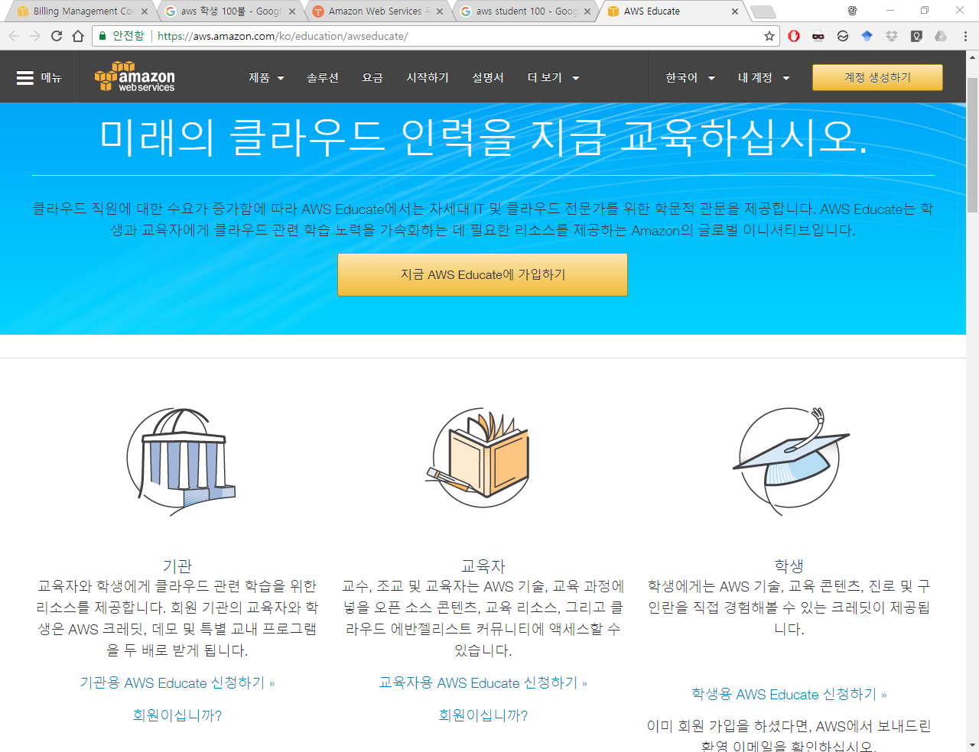
AWS - Amazon Web Services
https://imyeonn.github.io/blog/web/42/ (In Korean)
https://aws.amazon.com/ko/
https://aws.amazon.com/ko/education/awseducate/
1. Join AWS
2. Join AWS Educate

Slide 3
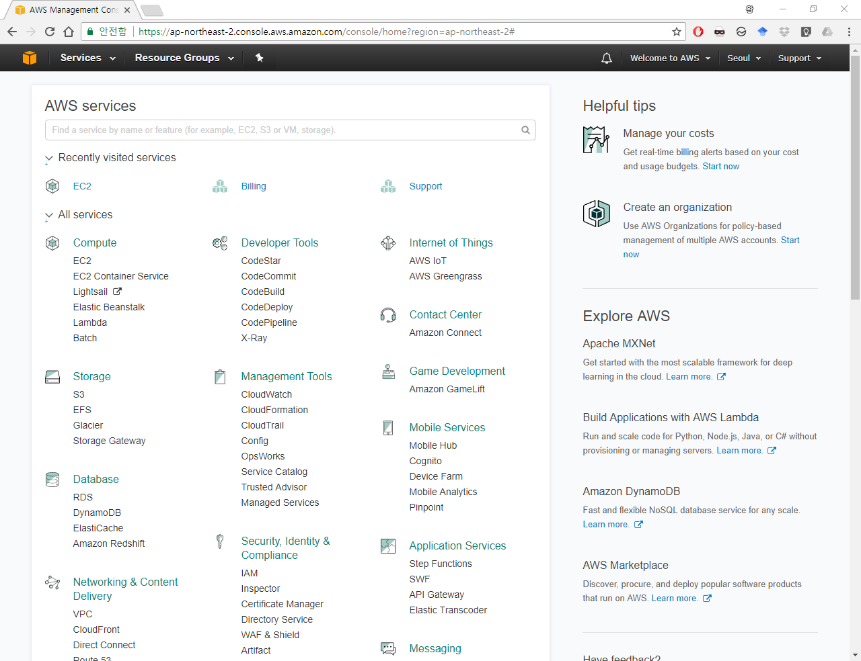
Login to AWS

Slide 4
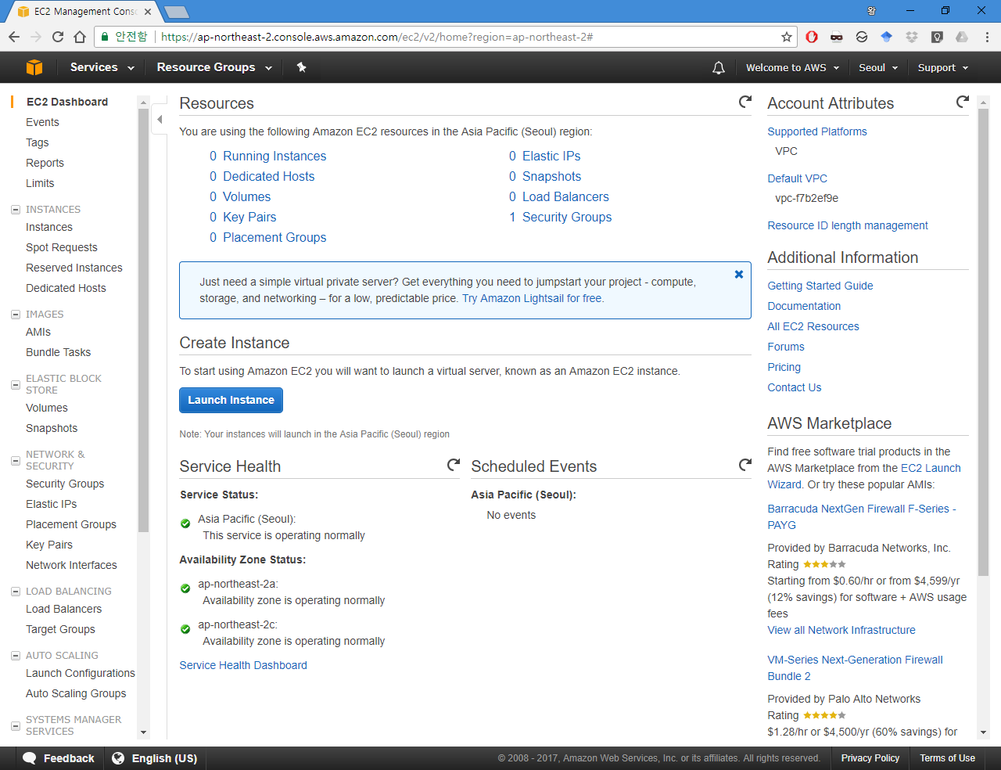
EC2 dashboard

Slide 5
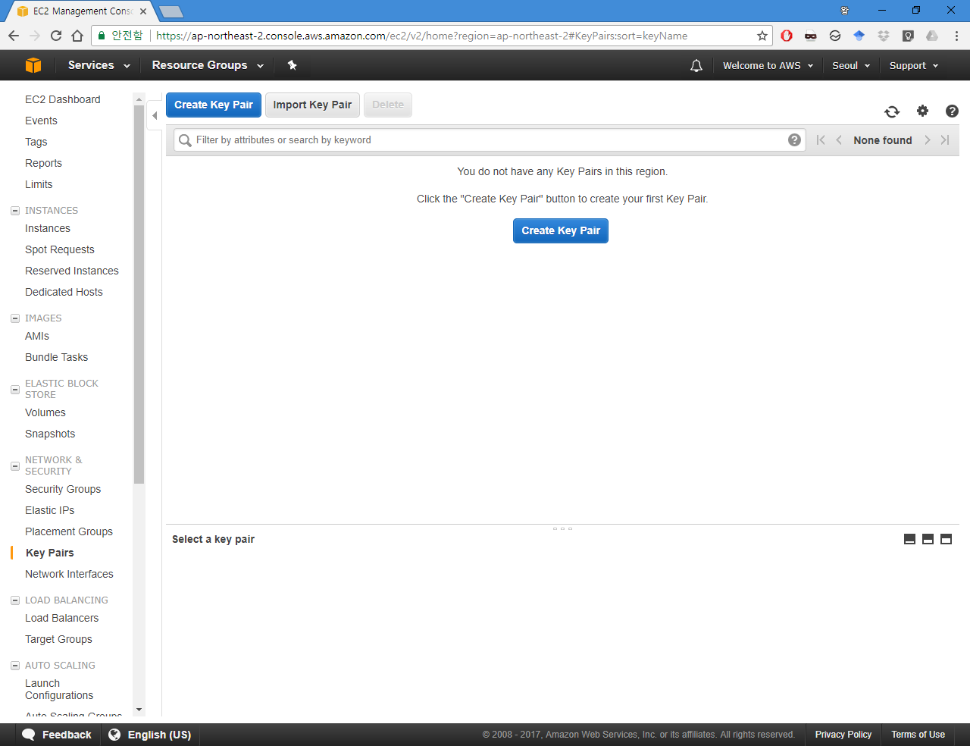
Create Key Pair

Slide 6
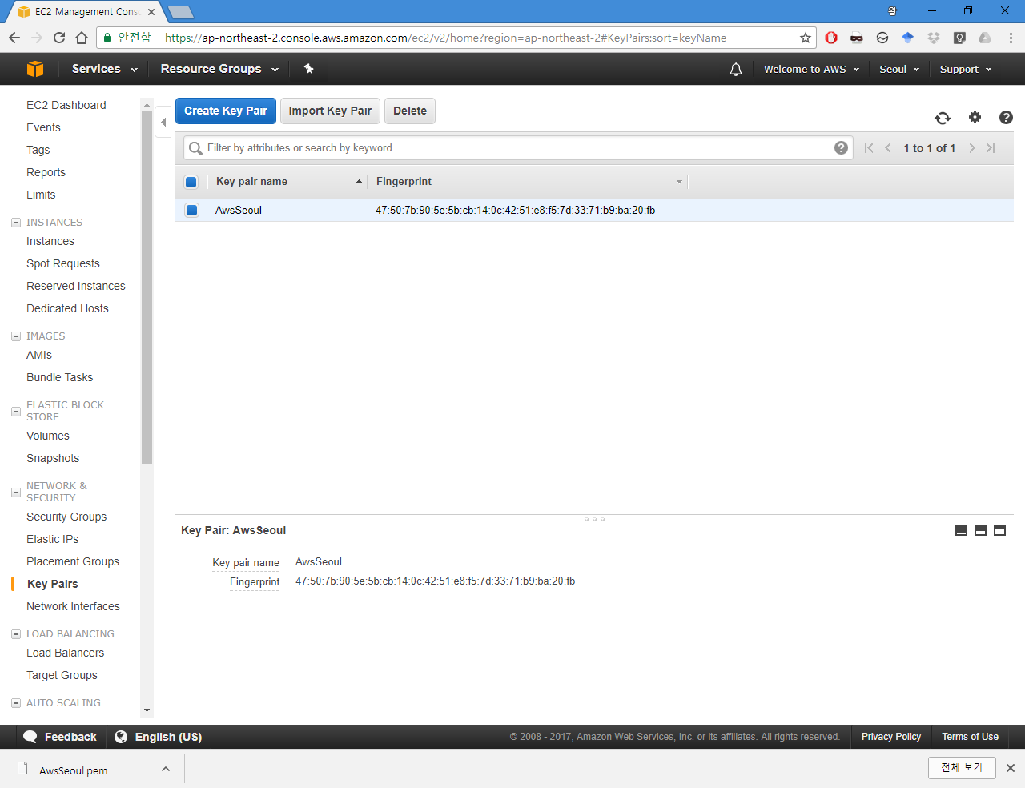

Slide 7
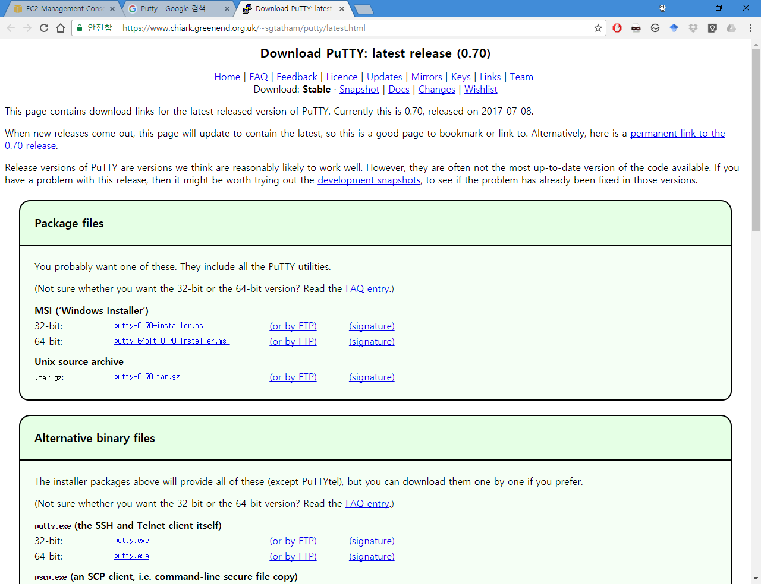
Install Putty when using Windows OS

Slide 8
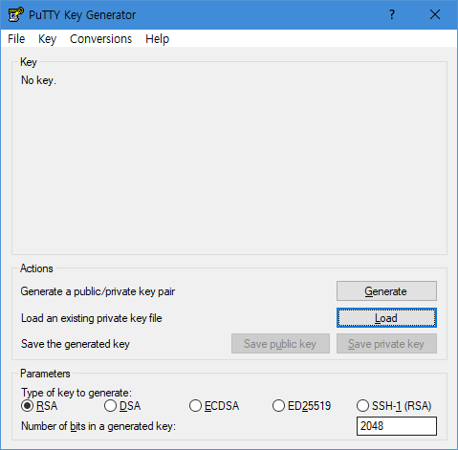
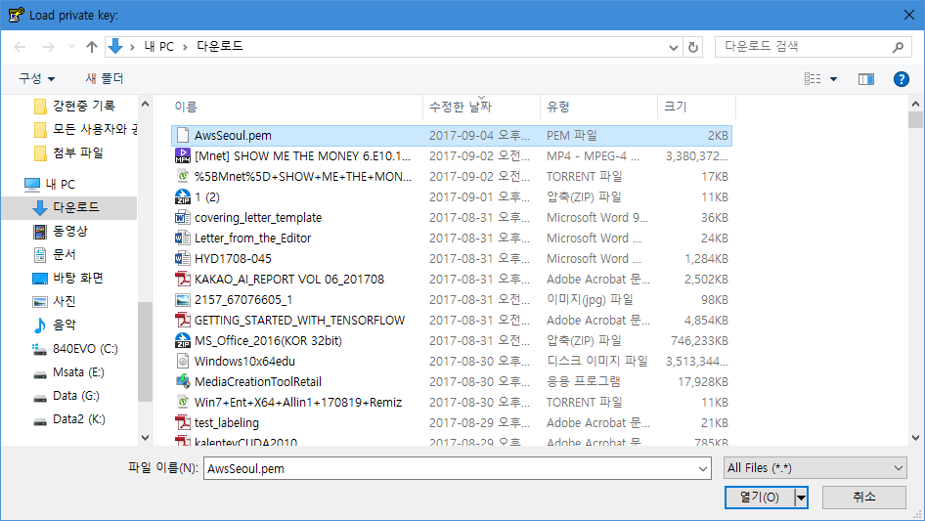
Using Puttygen to convert *.pem to *.ppk
Load Key
Load Key

Slide 9
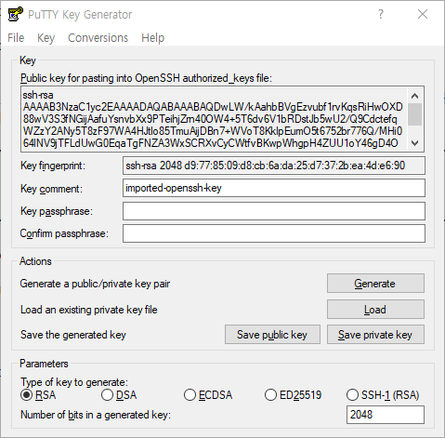
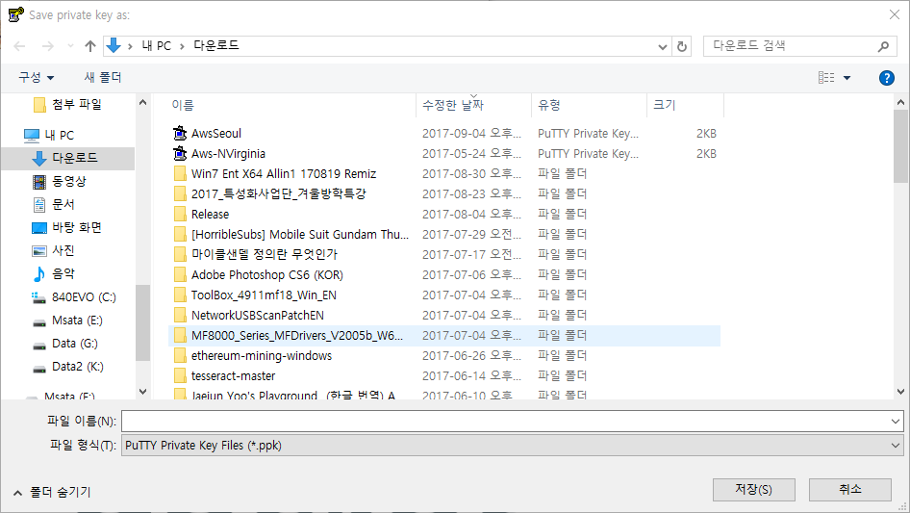
Using Puttygen to convert *.pem to *.ppk
Save Private Key
Save Private Key

Slide 10
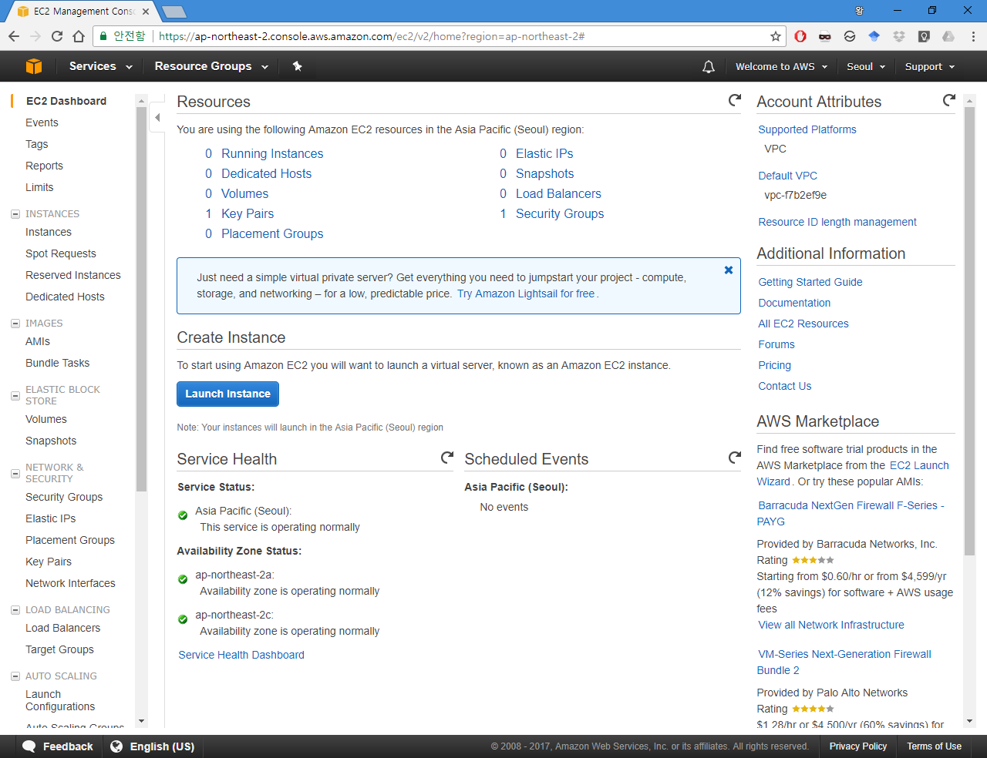
Make EC2 instance

Slide 11
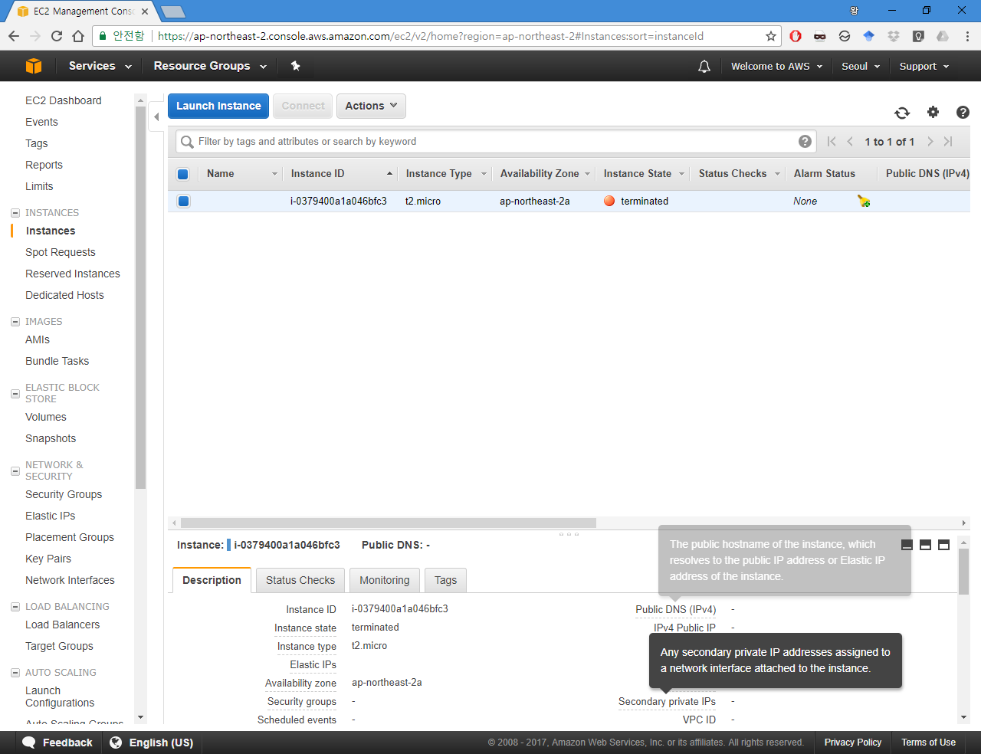
Launch Instance

Slide 12
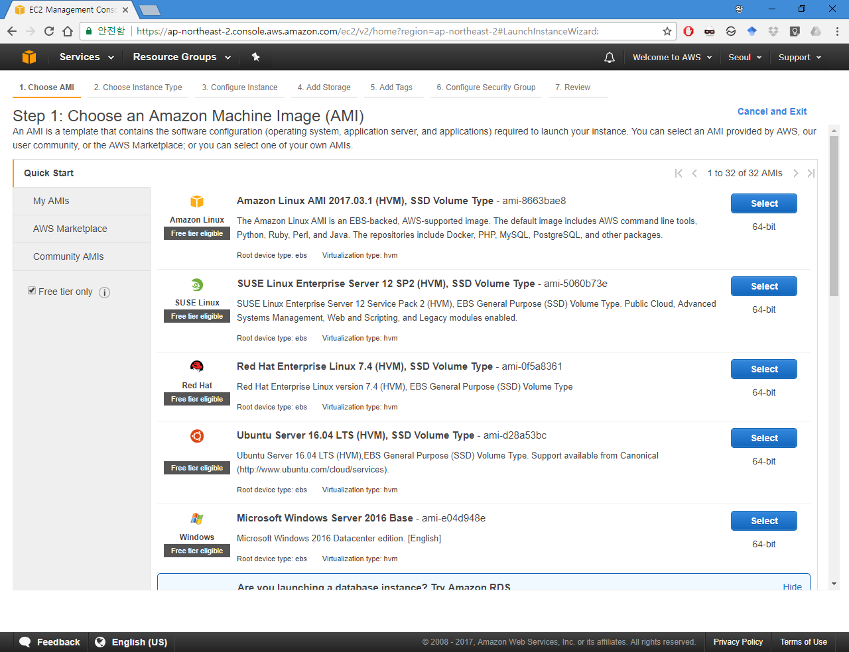
Select Ubuntu 16.04 LTS

Slide 13
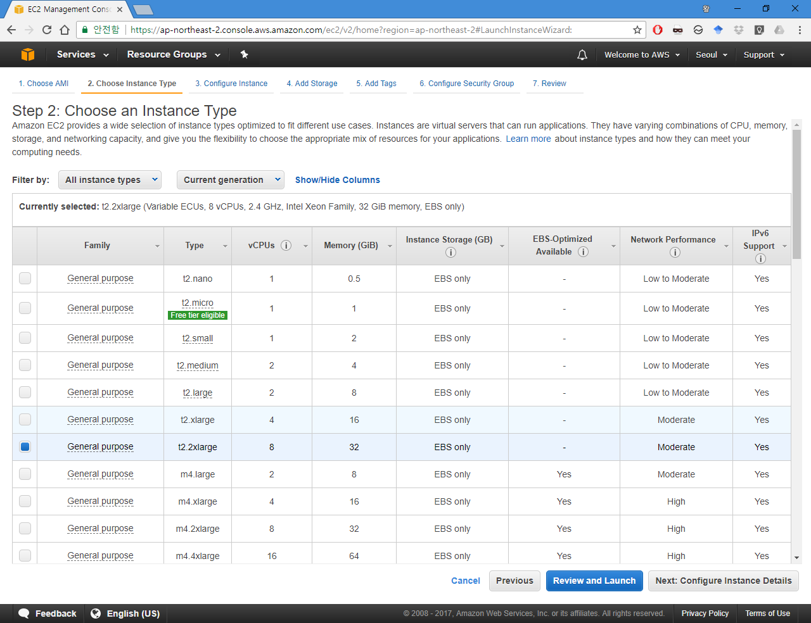
Select H/W Type
For Free tier use, 1 Core
For MPI Study, 8 Core

Slide 14
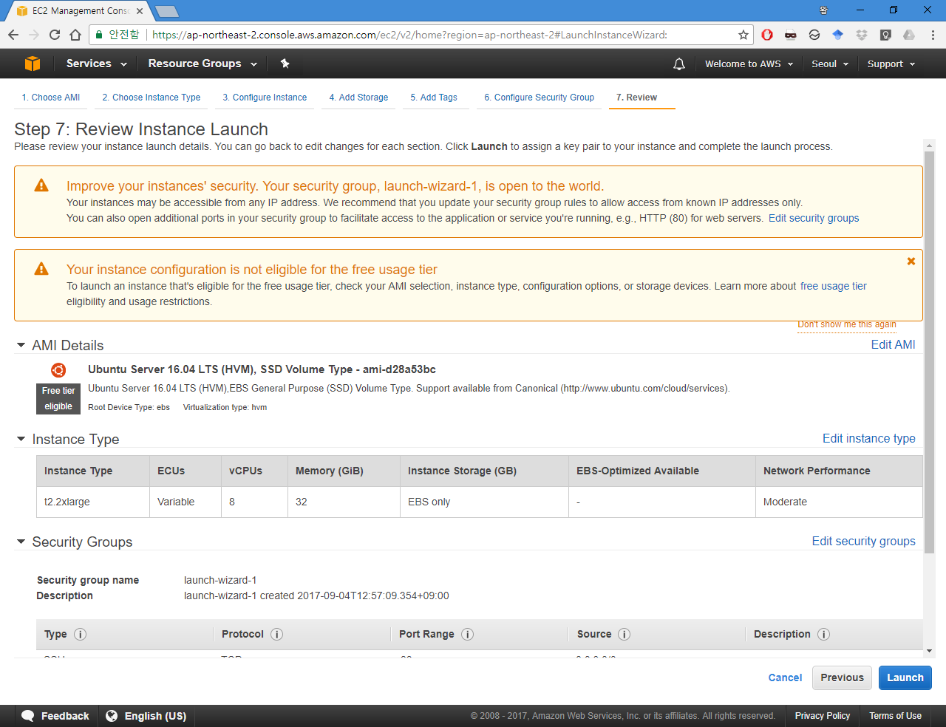
Launch EC2

Slide 15
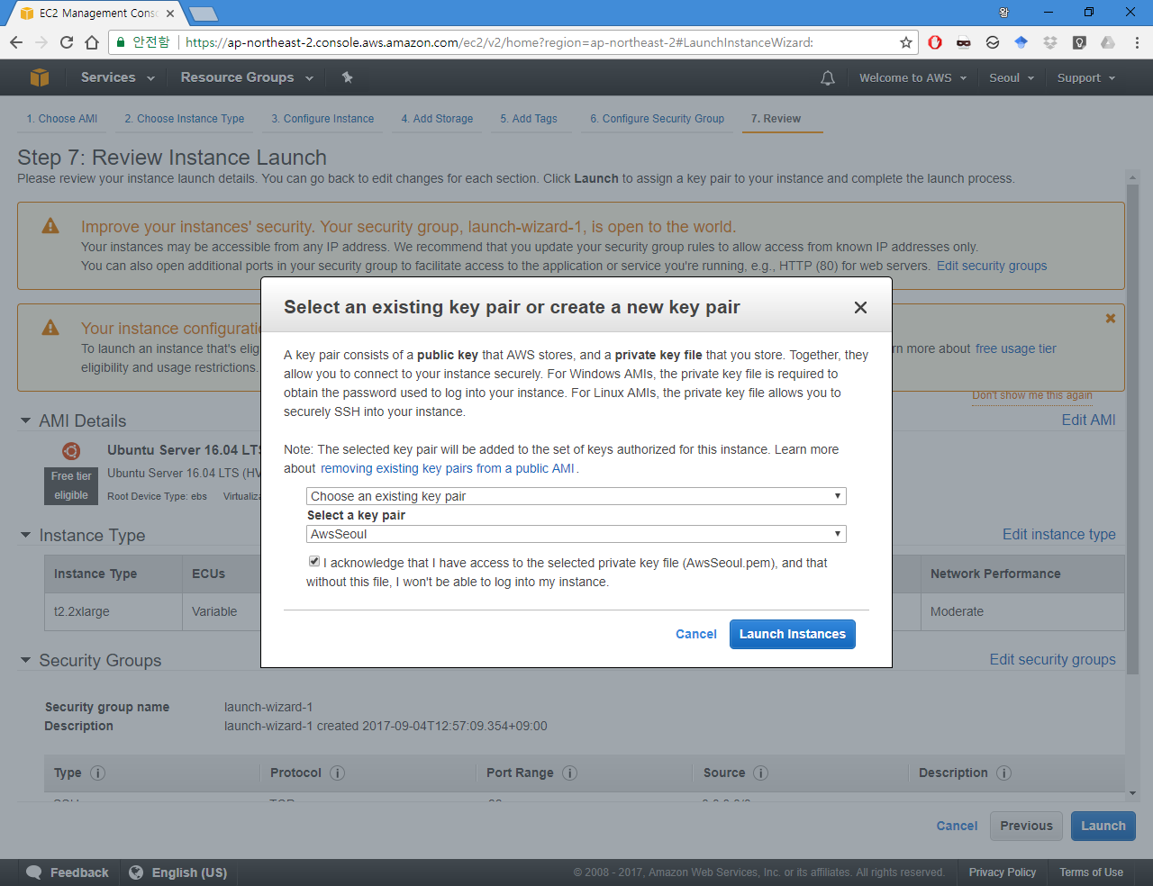
Select Key Pair

Slide 16
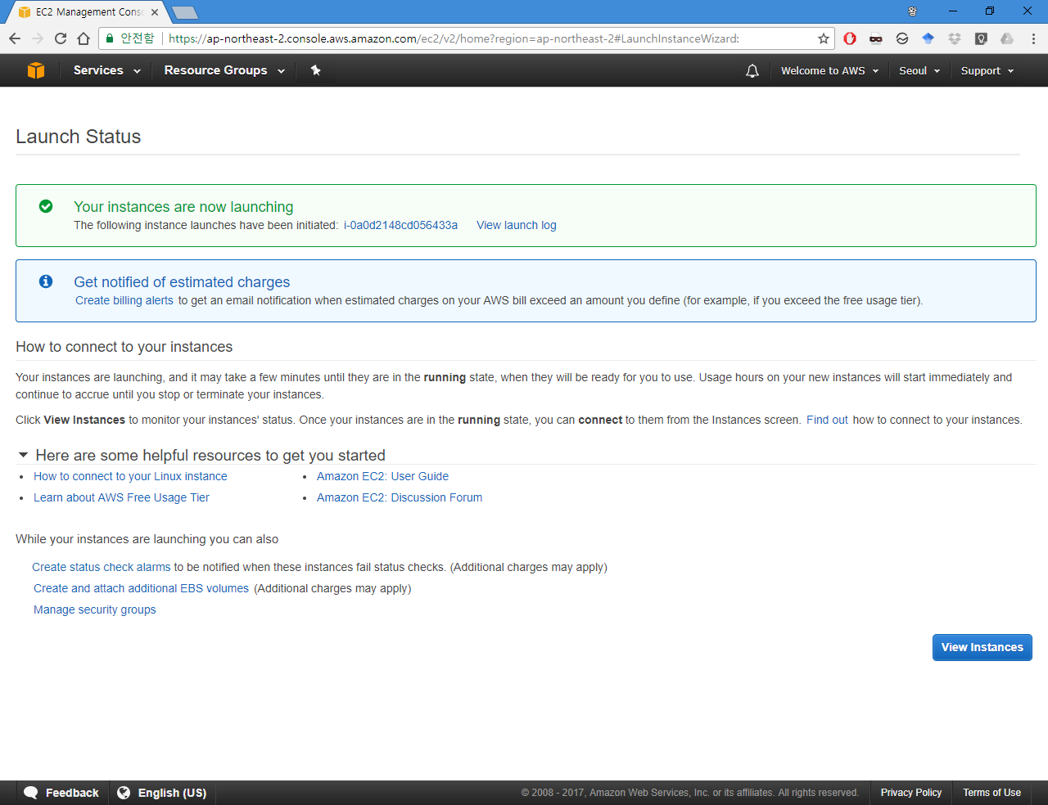
After Launch

Slide 17
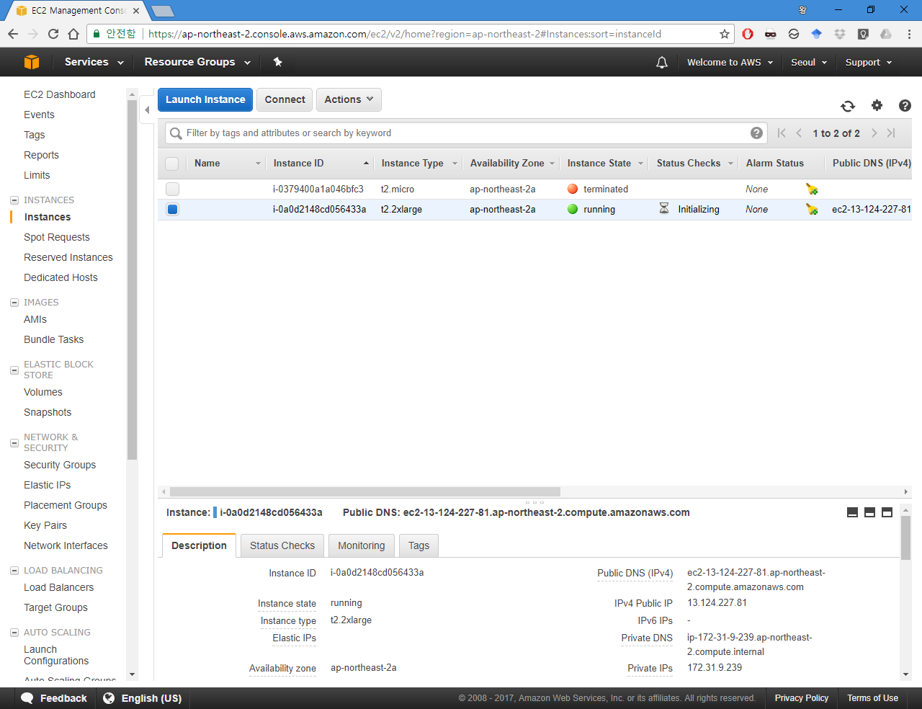
Check IP

Slide 18
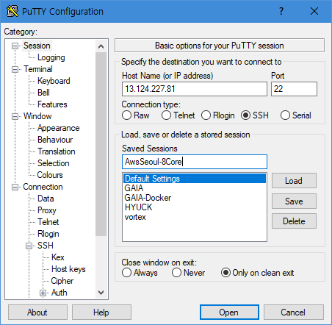
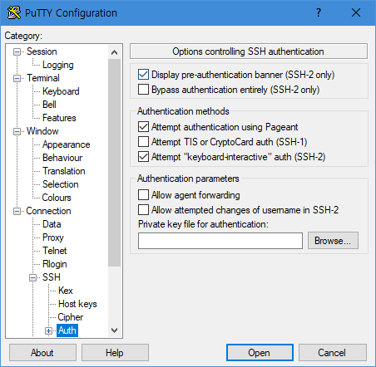
Putty Configuration
Input IP and Port
Input Private Key

Slide 19
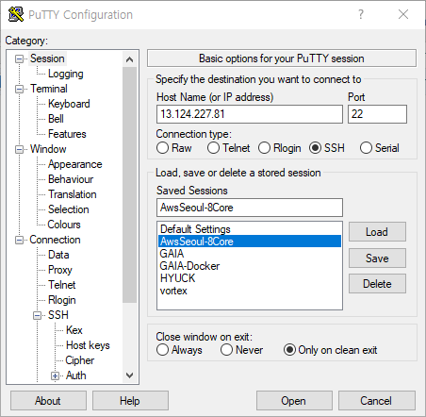
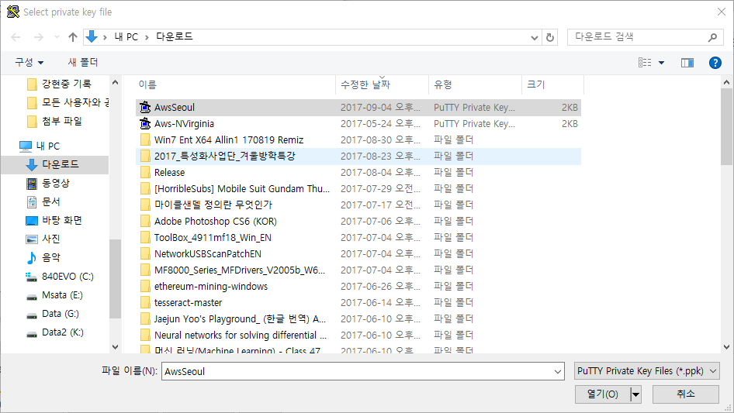
Putty Configuration
Input Private Key
Save and Open

Slide 20
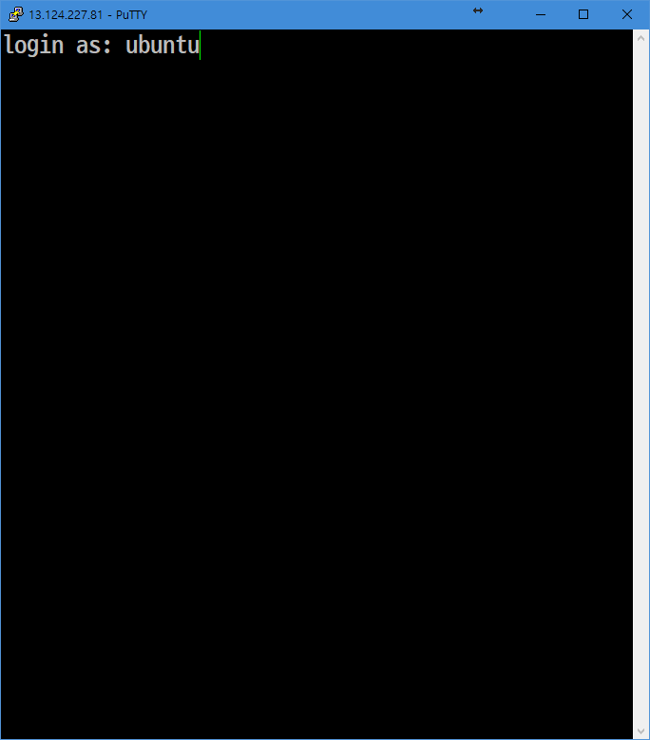
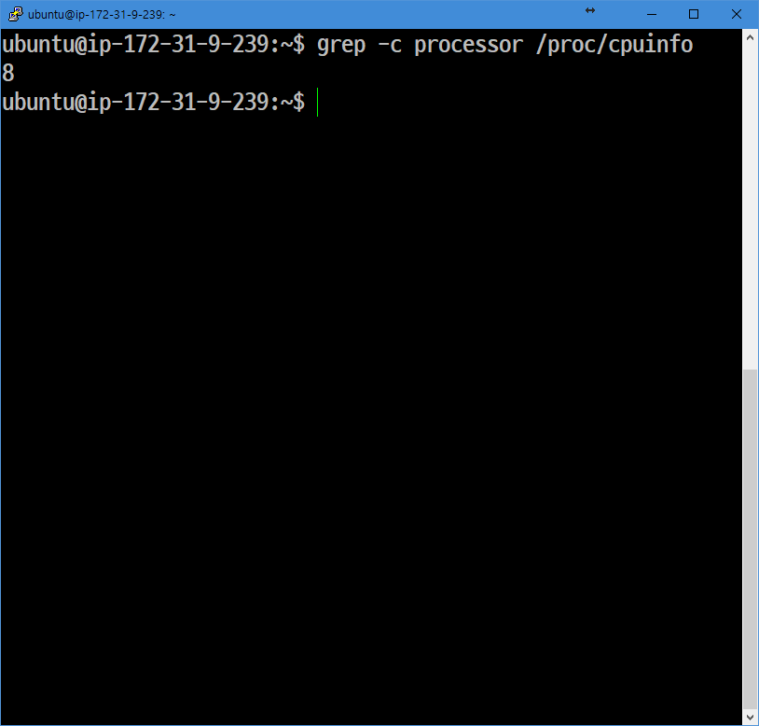
SSH Login
Login as ubuntu
8 Core CPU

Slide 21
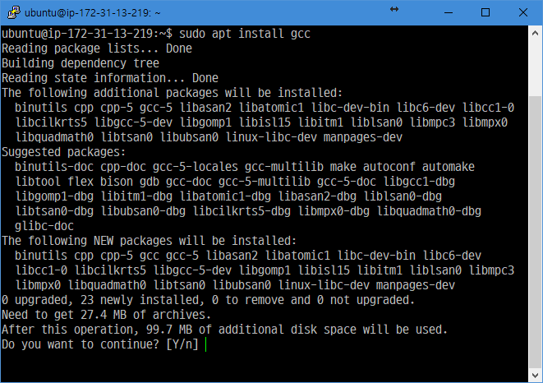
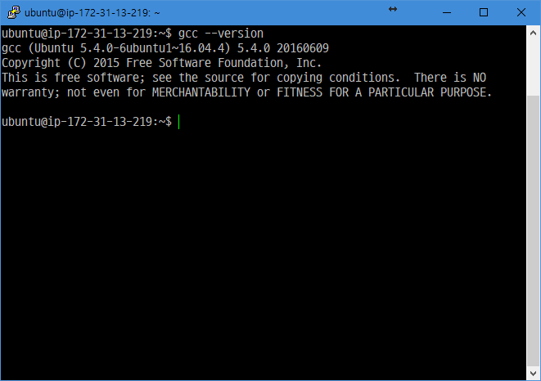
Install gcc
sudo apt update
sudo apt install gcc -y
gcc --version

Slide 22
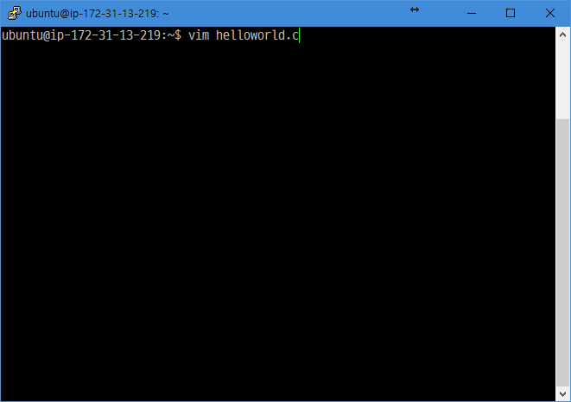
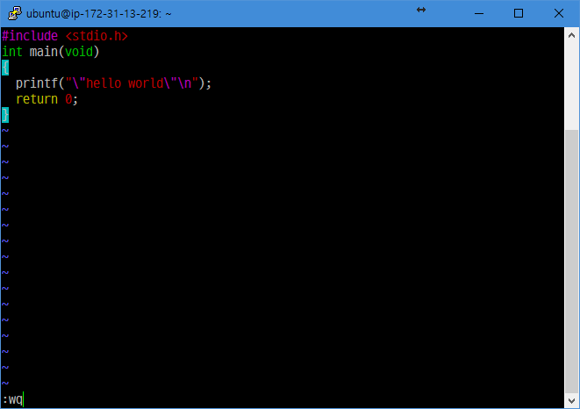
Make helloworld.c file
Vim helloworld.c
Write code and save

Slide 23
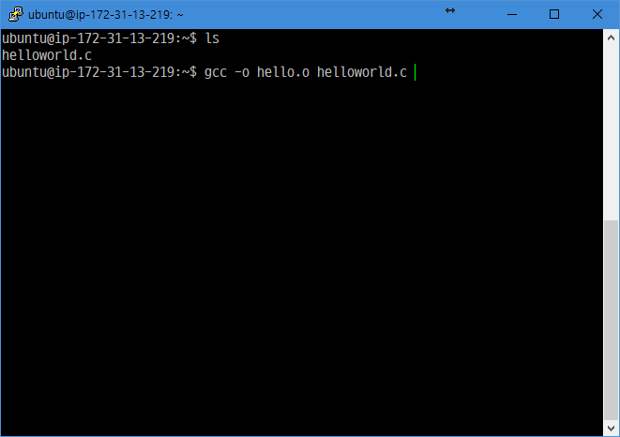
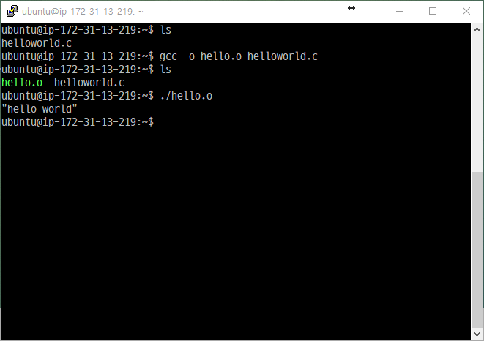
Compile code
gcc –o hello.o helloworld.c
./hello.o

Slide 24
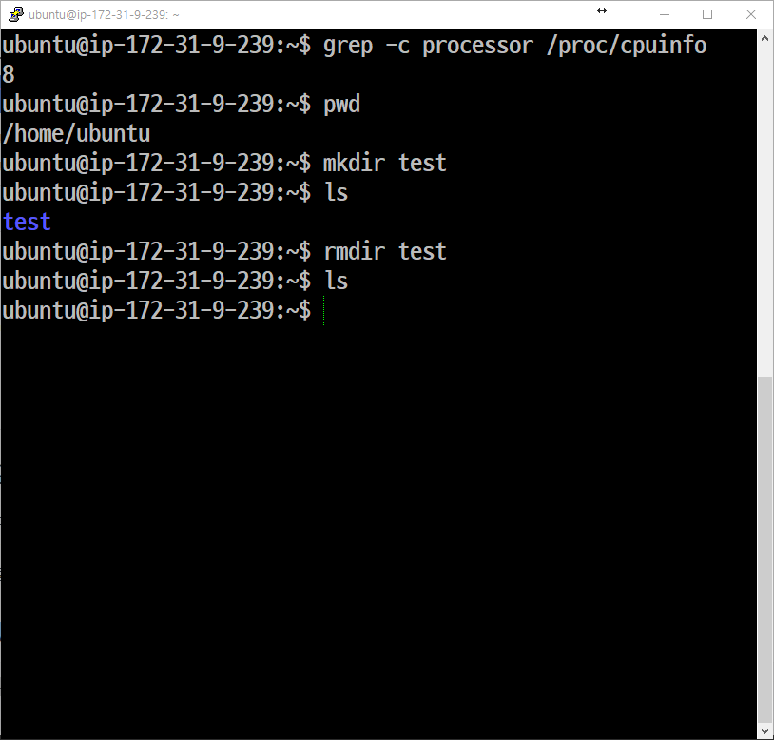
Basic commands
Commands
behavior
pwd
Show path of working directory
mkdir test
Make directory named test
ls
Show what is in this directory
rmdir test
Remove directory named test

Slide 25
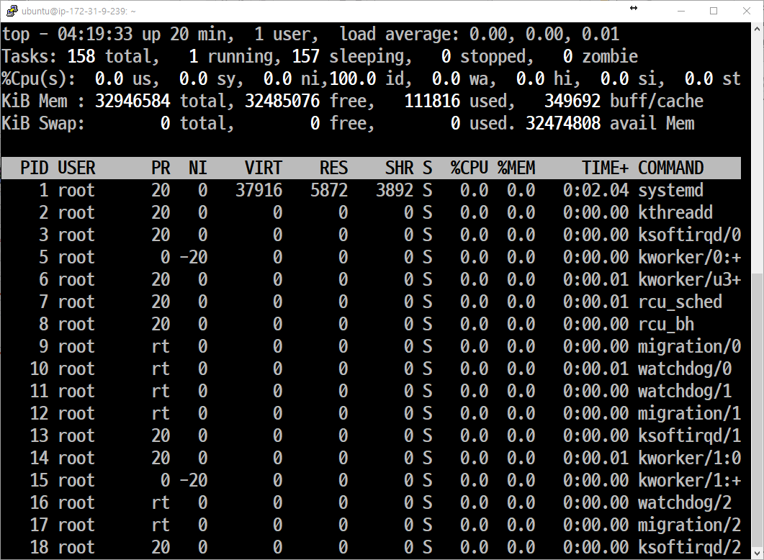
Basic commands
Commands
Behavior when input top
clear
Clear the screen
top
Show cpu workload
cp a b
Copy a to b
mv a b
Move a to b
Ctrl + C
Cancel job running on the terminal
Ctrl + D
Cancel connection

Slide 26
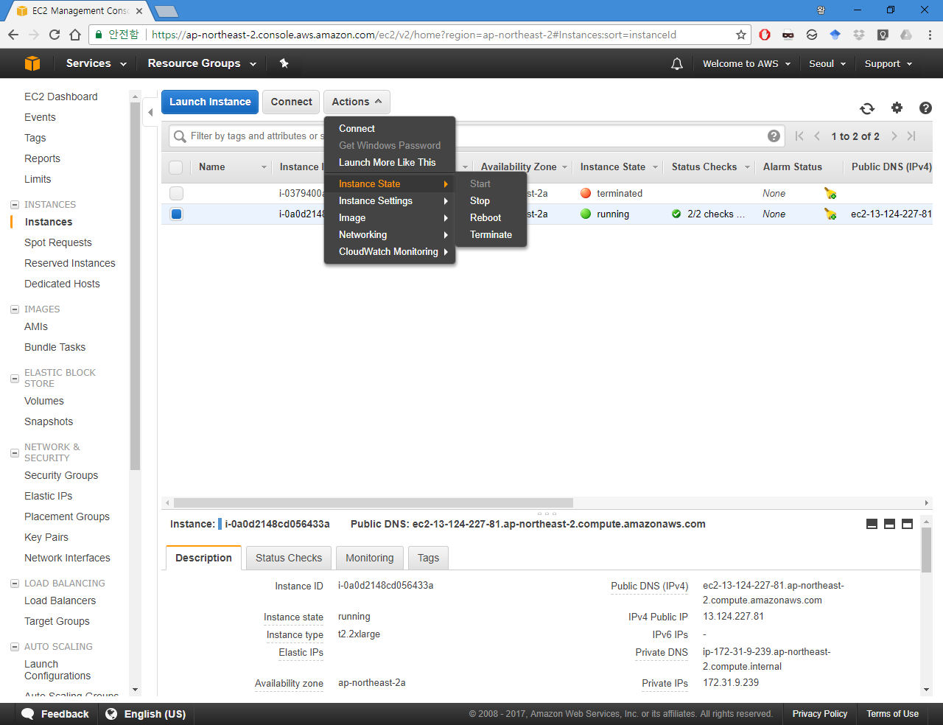
After use, You must stop instance to save the money

Slide 27
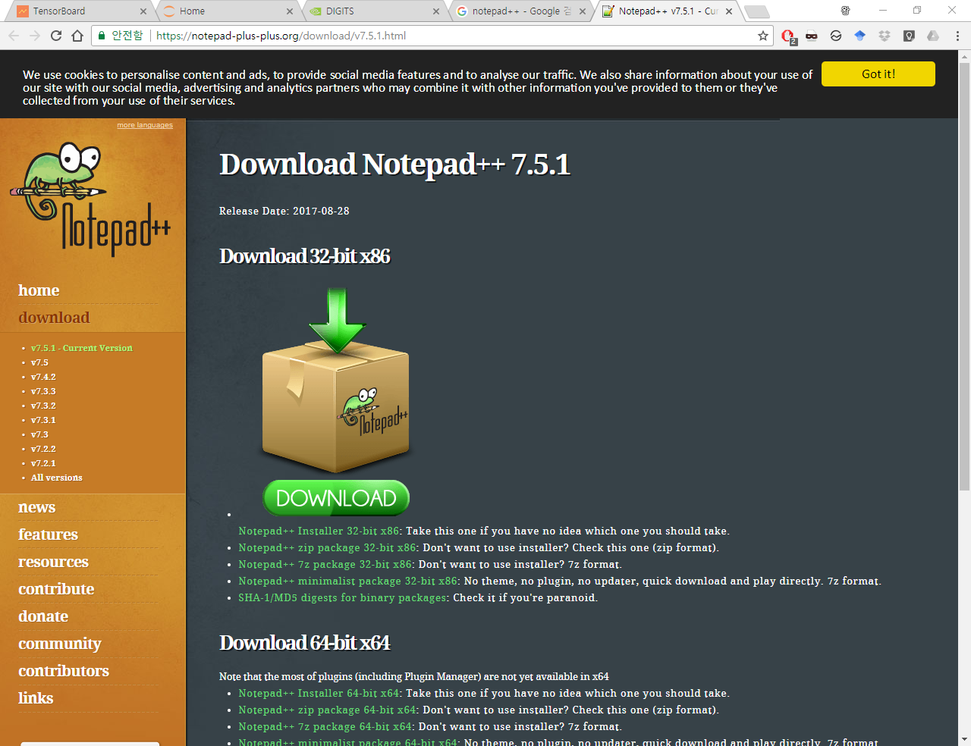
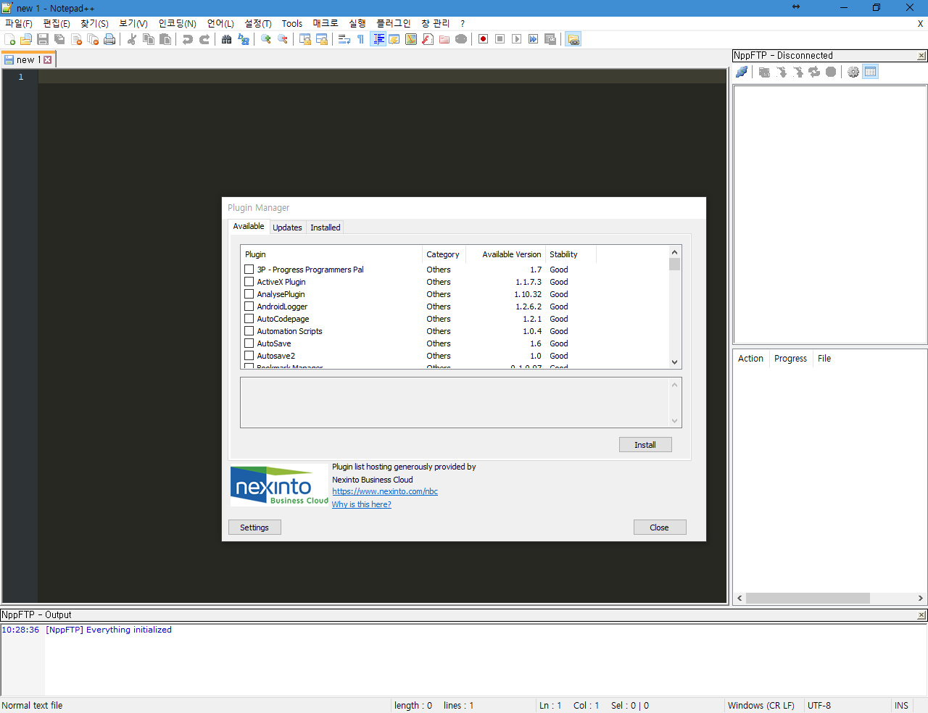
If you are not familiar with VIM
Install Notepad++
Install Plugin named NppFTP
https://notepad-plus-plus.org/download/v7.5.1.html
Plugin – Plugin Manager – Show Plugin Manager
Install NppFTP

Slide 28
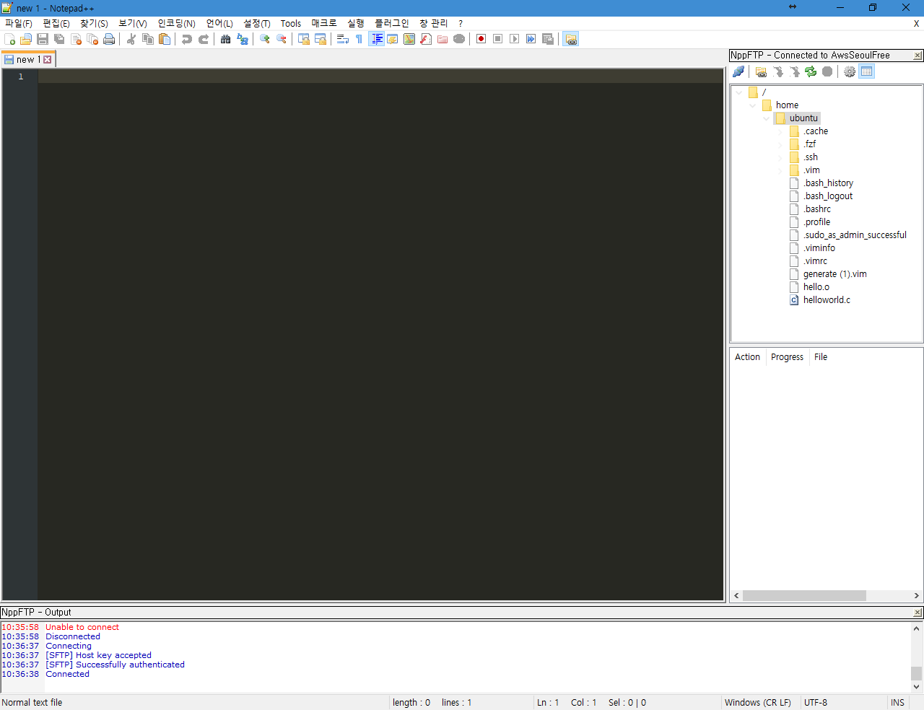
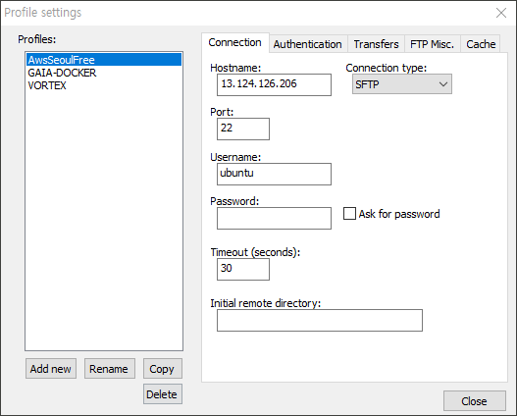
If you are not familiar with VIM
Profile settinge
Input Options
IP, Port, Username

Slide 29
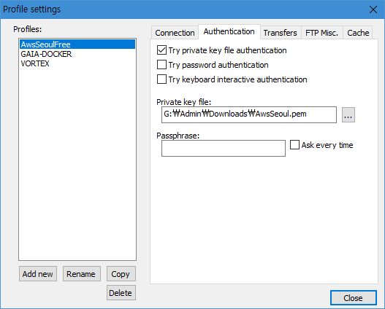
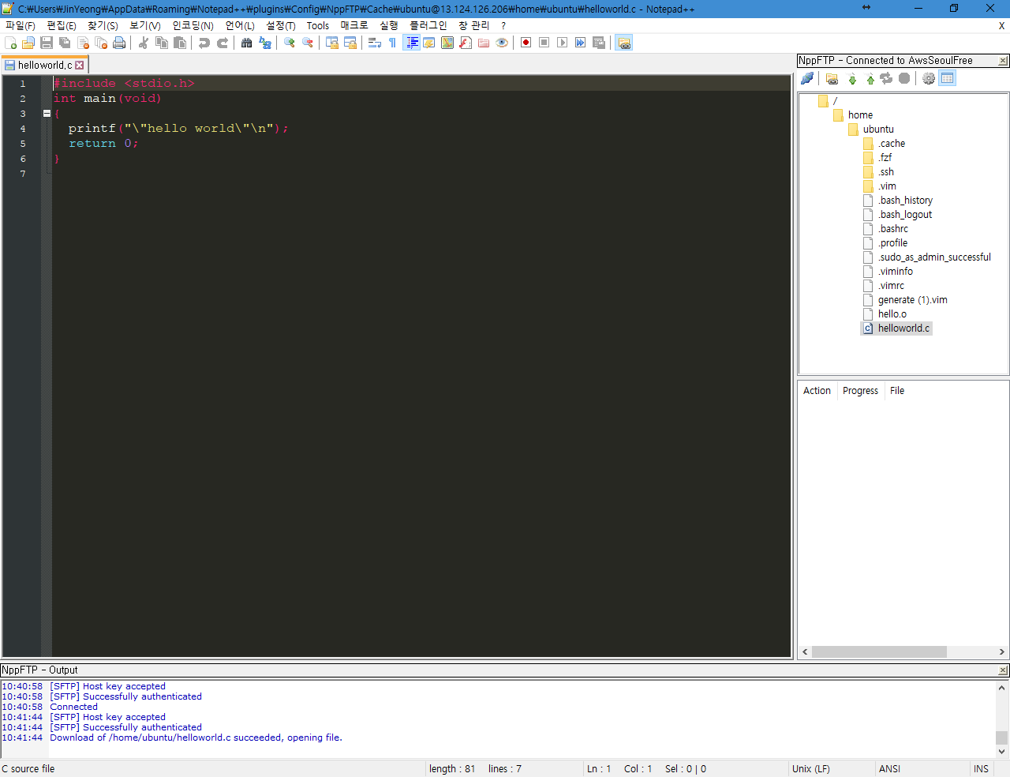
If you are not familiar with VIM
Input Optins
Connect and Write Code
Select Keyfile *.pem
Compile and execution by Putty

