Slide 1
Assignment #02
Sep, 25, 2017
JinYeong Wang
Parallel Computing Lab.
Mechanical Engineering
Hanyang University

Slide 2
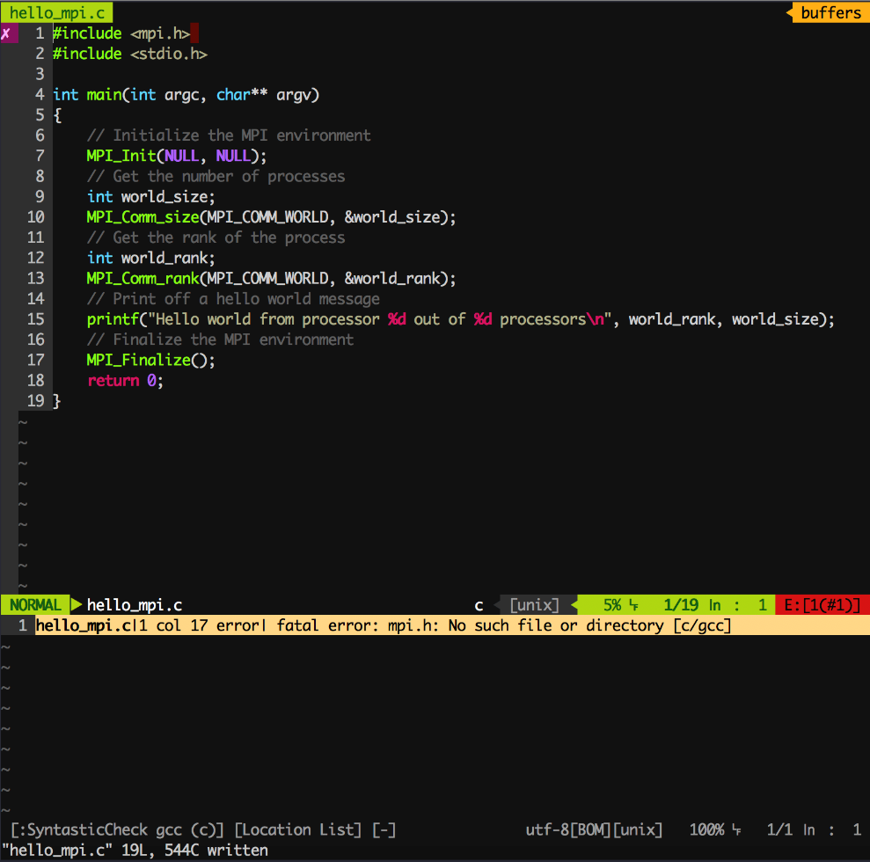
How to install OpenMPI in UBUNTU 16.04
Install OpenMPI
vim hello_mpi.c
sudo apt install openmpi-common openmpi-bin libopenmpi-dev -y

Slide 3
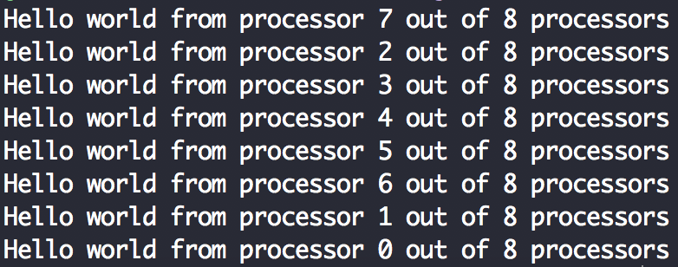
Hello world using MPI
Compile and Run
Result
mpicc hello_mpi.c –o hello_mpi.o
mpirun -np 8 ./hello_mpi.o

Slide 4
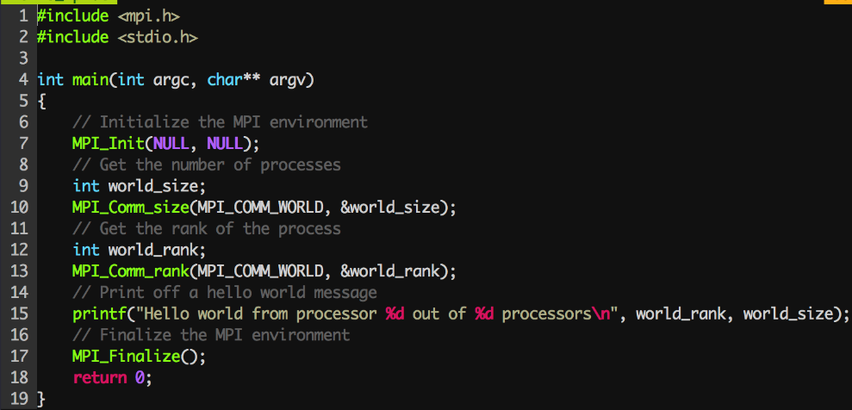
Investigate MPI functions used in hello.c
Whole Code
MPI functions
MPI_Init(NULL, NULL);
Initialize the MPI environment
MPI_Comm_size(MPI_COMM_WORLD, &world_size);
Get the number of processes
MPI_Comm_rank(MPI_COMM_WORLD, &world_rank);
Get the rank of the process
MPI_Finalize();
Finalize the MPI environment

