Slide 1
Assignment #03
Oct, 23, 2017
JinYeong Wang
Parallel Computing Lab.
Mechanical Engineering
Hanyang University

Slide 2
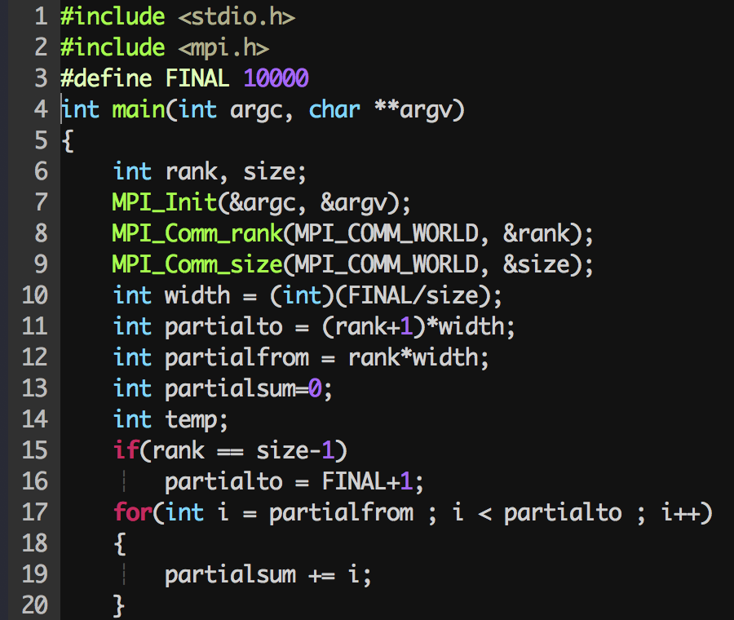
Compute partial sum
Implementation
Code
Width = 10000 / ( # of processors )
1 | · · · |  |  | 10000
Partial from | Partial to - 1 | · · · | Partial from | Partial to - 1
<- Width -> |  | · · · | <- Width + a ->

Slide 3
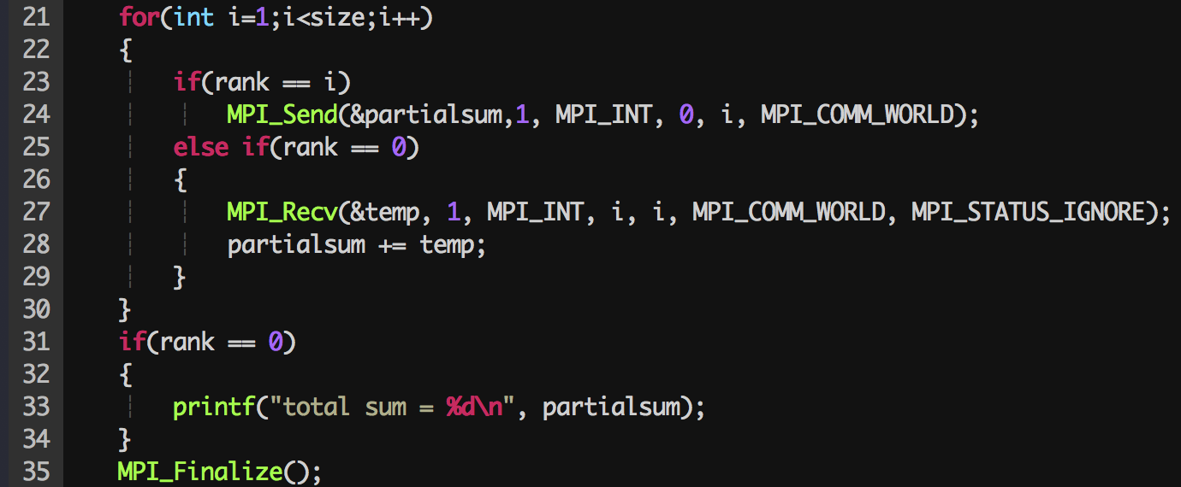
Gathering computed partial sums
Case 1. Send to rank 0

Slide 4
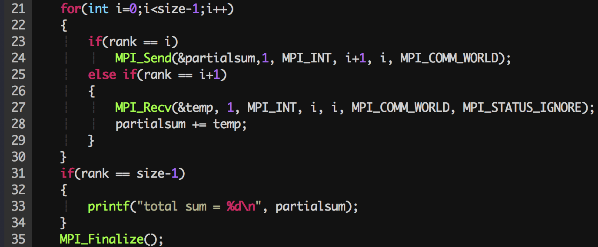
Gathering computed partial sums
Case 2. Send to next rank

Slide 5
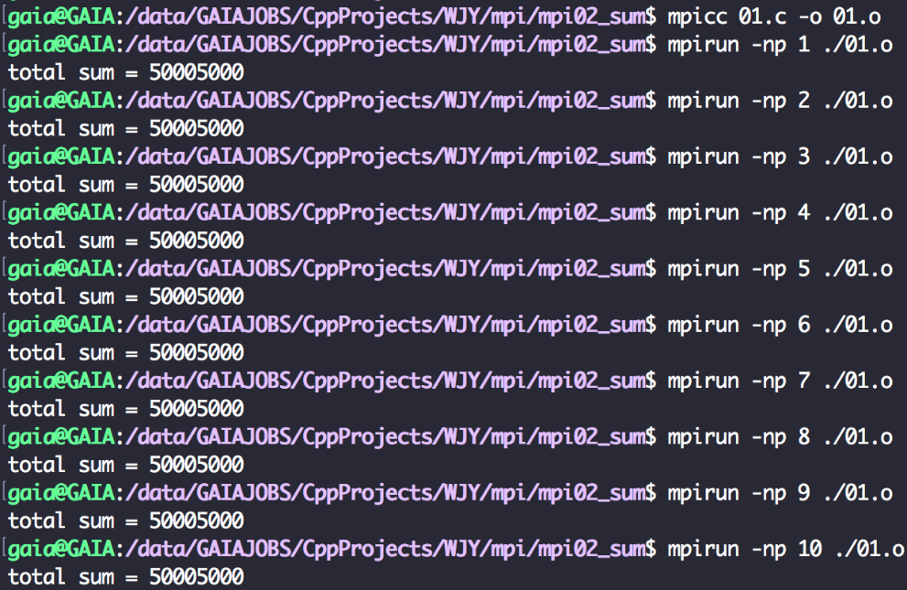
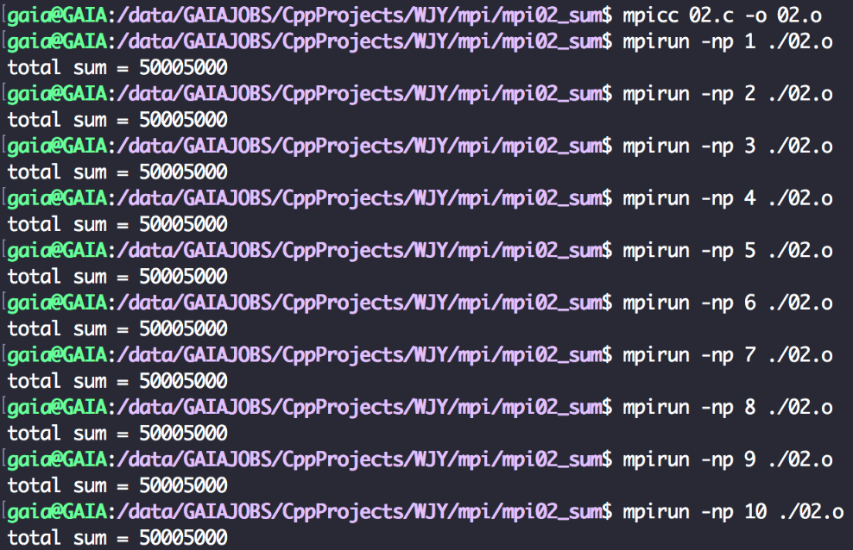
Run the code
Case 1. Send to rank 0
Case 2. Send to next rank

