Slide 1
Assignment #04
Oct, 30, 2017
JinYeong Wang
Parallel Computing Lab.
Mechanical Engineering
Hanyang University

Slide 2
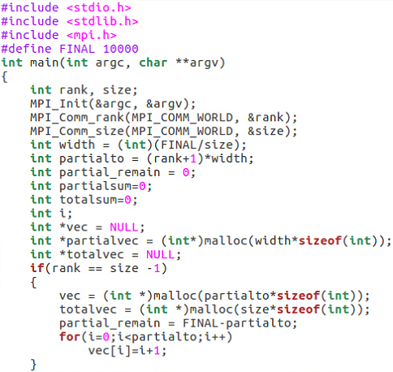
Case 1. Use MPI_Scatter and MPI_Gather
Implementation
Code
Width = 10000 / ( # of processors )
For use MPI_Scatter, define vector named vec and partialvec
For use MPI_Gather, define vector named totalvec
If ( Size * Width ) != 10000
Store that information
Compute After gathering all partial sums
1 | Width | · · · | (Size-1) * Width +1 | Size * Width
partialvec |  | · · · | partialvec

Slide 3
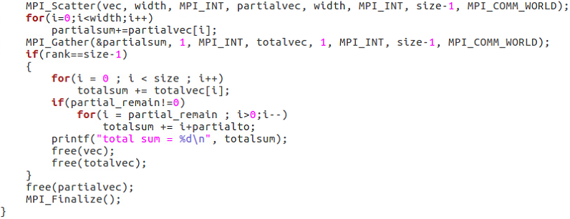
Case 1. Use MPI_Scatter and MPI_Gather
Scatter the vec to partialvec
Partial Summation
Gathering result to totalvec
If ( Size * Width ) != 10000
partial_remain != 0

Slide 4
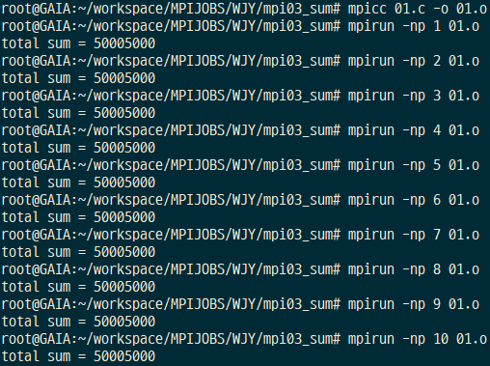
Case 1. Use MPI_Scatter and MPI_Gather

Slide 5
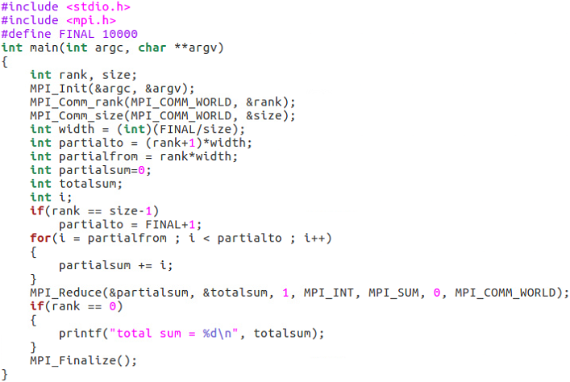
Case 2. Use MPI_Reduce
Same as Assignment #03

Slide 6
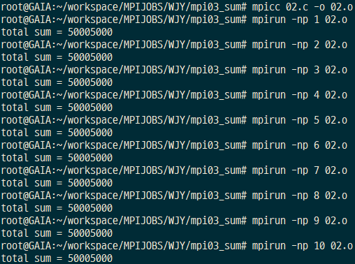
Case 1. Use MPI_Scatter and MPI_Gather

