Slide 1
Assignment #05
Nov, 13, 2017
JinYeong Wang
Parallel Computing Lab.
Mechanical Engineering
Hanyang University

Slide 2

Problem Definition
Compute
$$\sum_{i=1}^{N}{\frac{\sqrt{i}}{N}}=\frac{\sqrt{1}}{N}+\frac{\sqrt{2}}{N}+⋯+\frac{\sqrt{N}}{N}$$
While
$$N={10}^{n}$$
Using
Case 1: MPI_Reduce
Case 2: MPI_Scatter & MPI_Gather

Slide 3
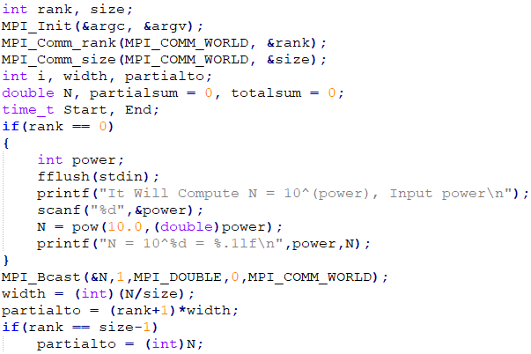

Algorithm for Case 1. MPI_Reduce
If rank == 0
Input $n$
Compute $N={10}^{n}$
MPI_Bcast( N )
Parallel Sum
MPI_Reduce

Slide 4
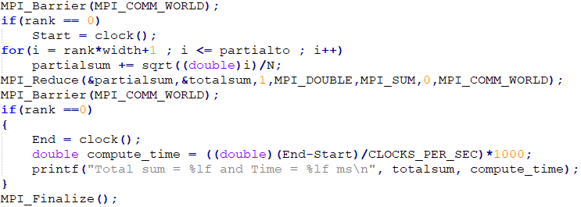
Algorithm for Case 1. MPI_Reduce
MPI_Barrier and Time check
Parallal sum and MPI_Reduce
MPI_Barrier and Time check
Time scale is ms

Slide 5
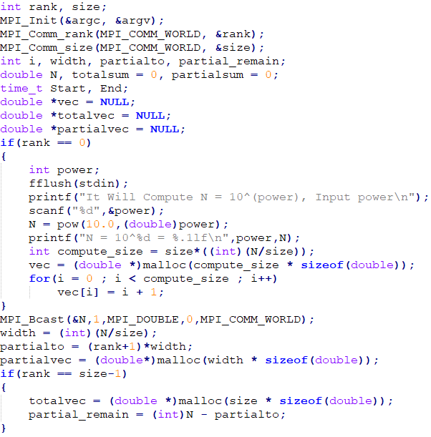
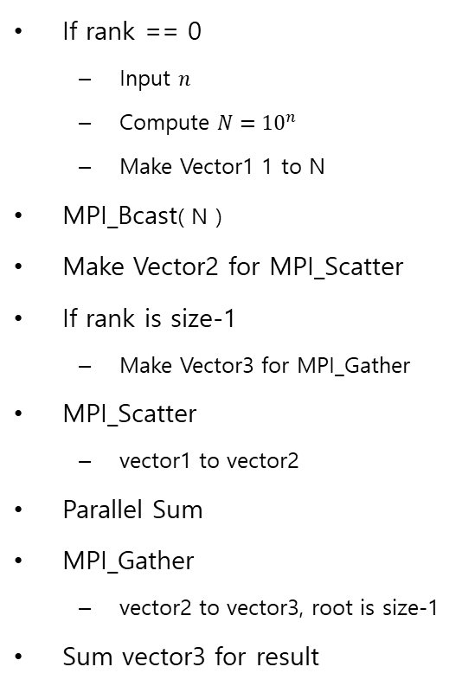
Algorithm for Case 2. MPI_Scatter & MPI_Gather
If rank == 0
Input $n$
Compute $N={10}^{n}$
Make Vector1 1 to N
MPI_Bcast( N )
Make Vector2 for MPI_Scatter
If rank is size-1
Make Vector3 for MPI_Gather
MPI_Scatter
vector1 to vector2
Parallel Sum
MPI_Gather
vector2 to vector3, root is size-1
Sum vector3 for result

Slide 6
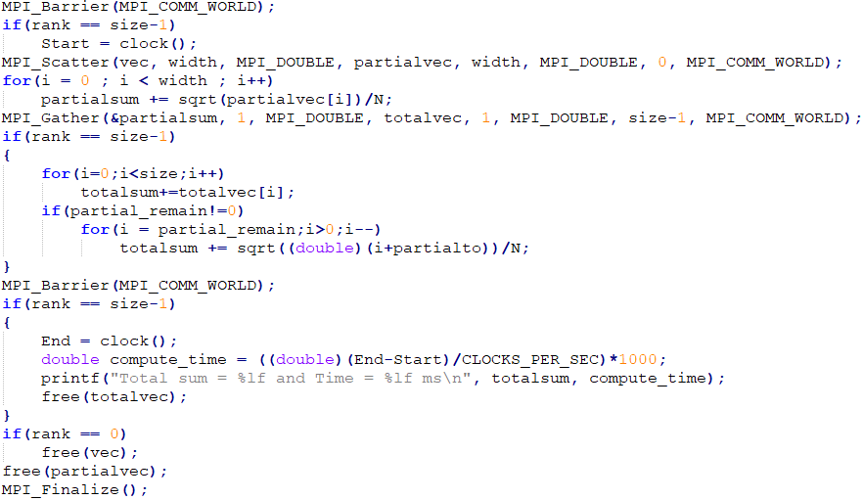
Algorithm for Case 2. MPI_Scatter & MPI_Gather

Slide 7
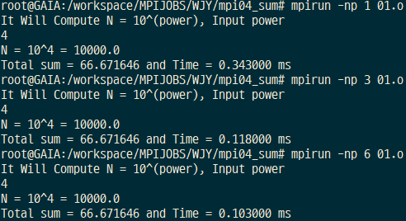
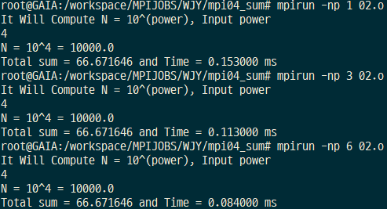
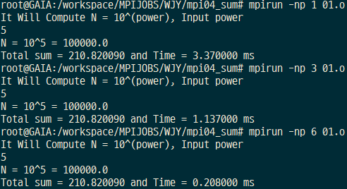
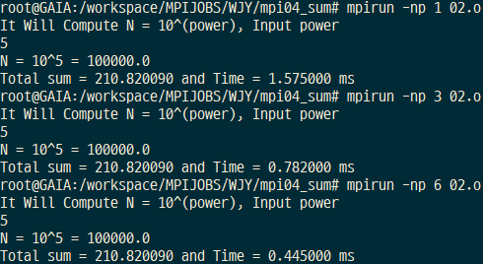
Validation Result
Case 1. MPI_Reduce
Case 2. MPI_Scatter & MPI_Gather

Slide 8
Compare the result
Case 1. MPI_Reduce
Case 2. MPI_Scatter & MPI_Gather

Slide 9
Compare the result
N = ${10}^{4}$
N = ${10}^{8}$
Notes:
Scatter & Gather Solution has some scalable issue
Reduce is slightly slower, but it is scalable

