Slide 1
Assignment #06
Nov, 20, 2017
JinYeong Wang
Parallel Computing Lab.
Mechanical Engineering
Hanyang University

Slide 2

Problem Definition
Compute
$$Ax=y$$
While
$$A=N by N Matrix$$
$$x and y=N by 1 Vector$$
Using
MPI_Gatherv

Slide 3
Methodology
Matrix Divide
Gatherv
N
If N % size != 0
Make N_fix
Increase N_fix till N_fix%size ==0
Each Processor has N by 1 vector for using MPI_Gatherv for gathering X vector
N_fix/size
X
N_fix/size
Remainder

Slide 4

Example when $N$=3 When 2 Processors
$$\left[\begin{matrix}4 & 5 & 5 \\ 2 & 7 & 9 \\ 7 & 2 & 7\end{matrix}\right]\left[\begin{matrix}7 \\ 4 \\ 3\end{matrix}\right]=\left[Unknown\right]$$
In rank 0
A = $\left[\begin{matrix}4 & 5 & 5 \\ 2 & 7 & 9\end{matrix}\right]$
X = $\left[\begin{matrix}7 \\ 4\end{matrix}\right]$
In rank 1
A = $\left[\begin{matrix}7 & 2 & 7\end{matrix}\right]$
X = $\left[3\right]$
Gather X to Temp
Each Processors will has Entire X
Temp = $\left[\begin{matrix}7 \\ 4 \\ 3\end{matrix}\right]$

Slide 5
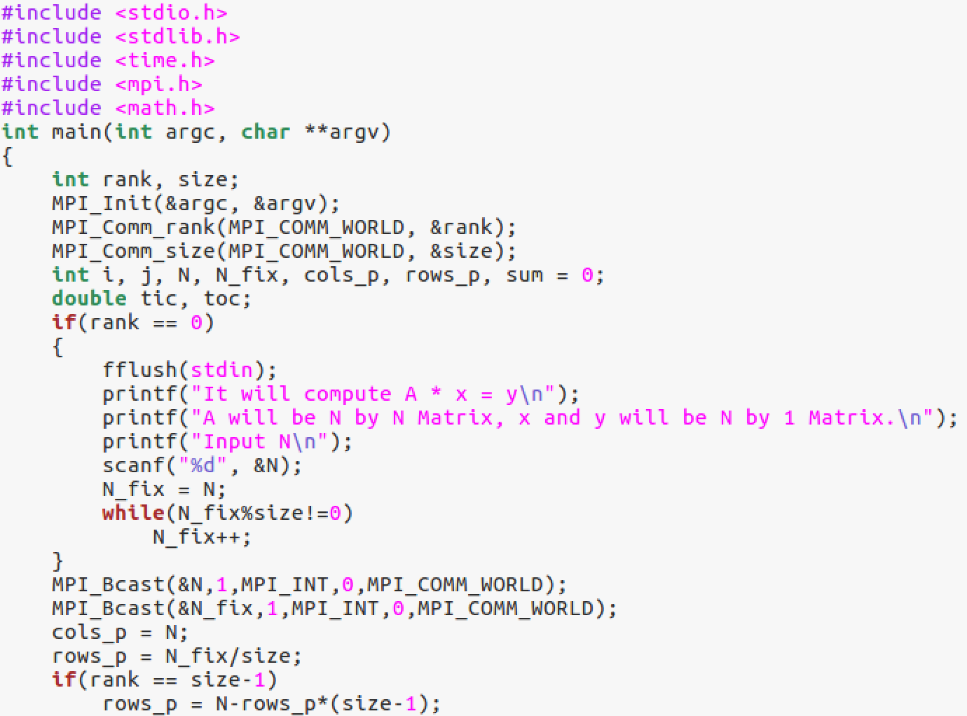
Code
Compute cols_p ans rows_p for
Memory allocation

Slide 6
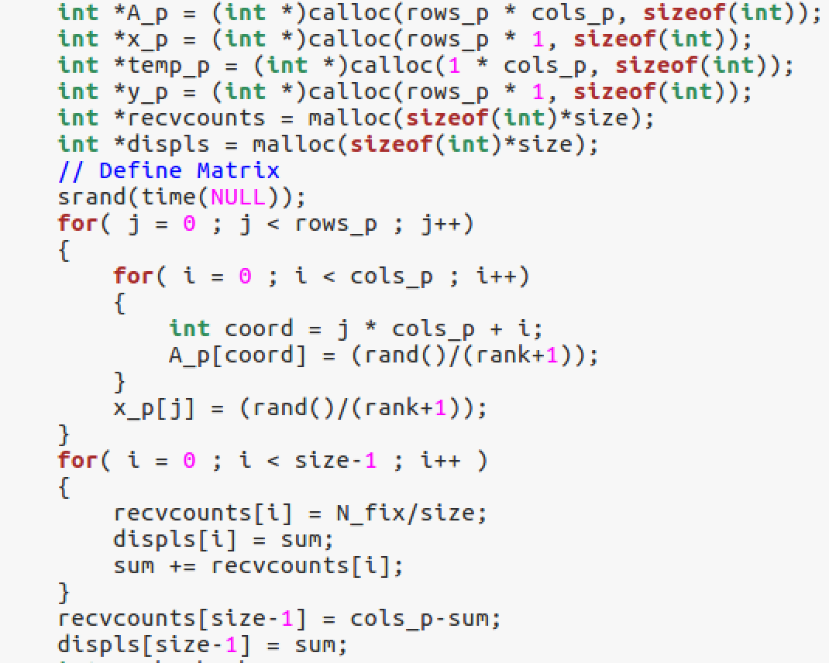
Code
Memory allocation for A, x, y and temp for gather x
Memory allocation for Using MPI_Gatherv
Input Random Number to A and x
Input Parameter for MPI_Gatherv

Slide 7
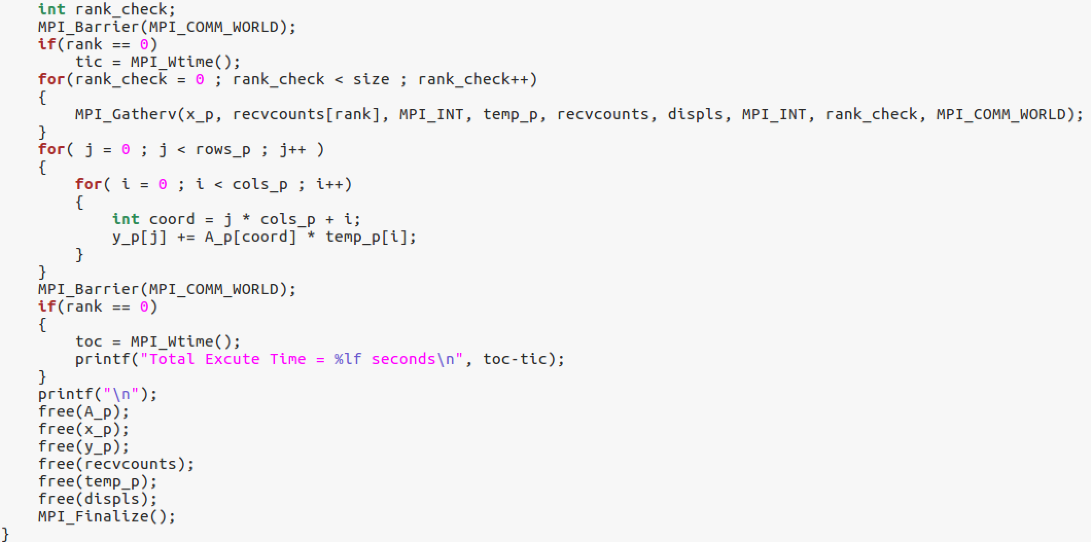
Code
Main Computation
MPI_Gatherv and Compute y

Slide 8
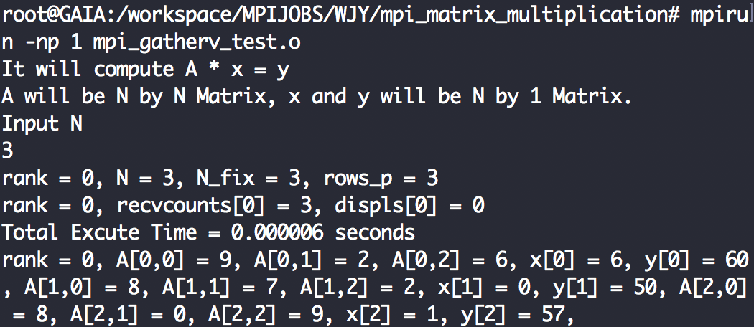
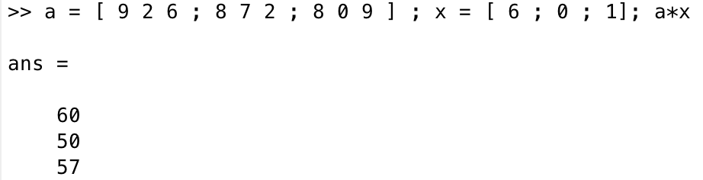
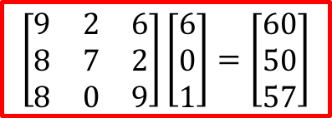
Validate Result
Code, np=1, N=3
Matlab
$$\left[\begin{matrix}9 & 2 & 6 \\ 8 & 7 & 2 \\ 8 & 0 & 9\end{matrix}\right]\left[\begin{matrix}6 \\ 0 \\ 1\end{matrix}\right]=\left[\begin{matrix}60 \\ 50 \\ 57\end{matrix}\right]$$

Slide 9
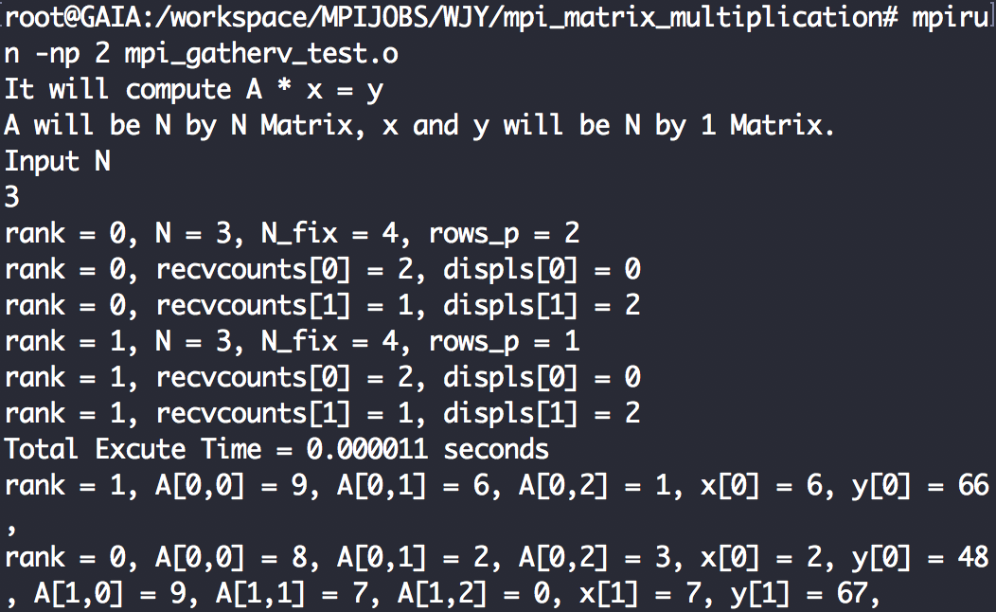
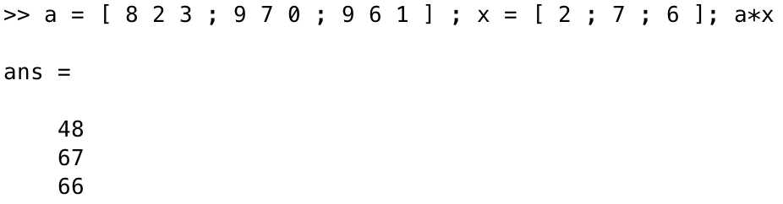

Validate Result
Code, np=2, N=3
Matlab
$$\left[\begin{matrix}8 & 2 & 3 \\ 9 & 7 & 0 \\ 9 & 6 & 1\end{matrix}\right]\left[\begin{matrix}2 \\ 7 \\ 6\end{matrix}\right]=\left[\begin{matrix}48 \\ 67 \\ 66\end{matrix}\right]$$

Slide 10
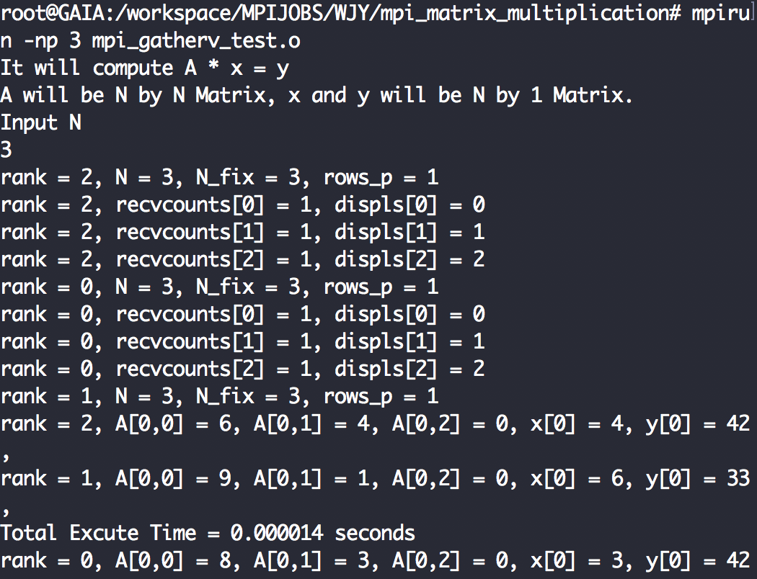
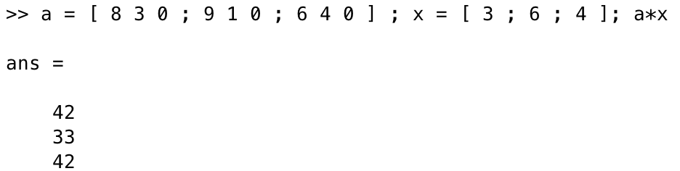
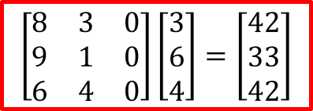
Validate Result
Code, np=3, N=3
Matlab
$$\left[\begin{matrix}8 & 3 & 0 \\ 9 & 1 & 0 \\ 6 & 4 & 0\end{matrix}\right]\left[\begin{matrix}3 \\ 6 \\ 4\end{matrix}\right]=\left[\begin{matrix}42 \\ 33 \\ 42\end{matrix}\right]$$

Slide 11
Result
Log( Time ) vs NP
Speedup

