Slide 1
Assignment #07
Nov, 27, 2017
JinYeong Wang
Parallel Computing Lab.
Mechanical Engineering
Hanyang University

Slide 2

Problem Definition
Compute
$$\frac{∂^{2}u}{∂x^{2}}+\frac{∂^{2}u}{∂y^{2}}=\cos\left[πx\right]\sin\left[y\right]+π^{2}\cos\left[πx\right]sin⁡[y]$$
While
$$0≤x≤2 and 0≤y≤2$$
Exact solution
$$u_{exact}\left(x,y\right)=\cos\left[πx\right]sin⁡[π+y]$$
Using Jacobi method, compute till
$$Error=max\left|u_{m}^{k+1}−u_{m}^{k}\right|<{10}^{−4}$$
Number of grid nodes are
50
100
200
Plot L2 error vs. Grid node

Slide 3






Dirichlet Boundary Condition
$$\left\{\begin{matrix}\begin{matrix}u\left(0,y\right)=sin⁡[π+y] \\ u\left(2,y\right)=sin⁡[π+y] \end{matrix} \\ \begin{matrix}u\left(x,0\right)=0 \\ u\left(x,2\right)=cos⁡[πx]sin⁡[π+2] \end{matrix}\end{matrix}\right.$$
$$u\left(x,2\right)=cos⁡[πx]sin⁡[π+2]$$
$$\frac{∂^{2}u}{∂x^{2}}+\frac{∂^{2}u}{∂y^{2}}=\cos\left[πx\right]\sin\left[y\right]+π^{2}\cos\left[πx\right]sin⁡[y]$$
$$u\left(0,y\right)=sin⁡[π+y]$$
$$u\left(2,y\right)=sin⁡[π+y]$$
$$u\left(x,0\right)=0$$

Slide 4

Discretized Equation
$$u_{i,j}^{k+1}=\frac{∆y^{2}\left(u_{i+1,j}^{k}+u_{i−1,j}^{k}\right)+∆x^{2}\left(u_{i,j+1}^{k}+u_{i,j−1}^{k}\right)−∆x^{2}∆y^{2}f_{i,j}}{2(∆x^{2}+∆y^{2})}$$
While
$$∆x=∆y=\frac{2}{\# of Grid Node−1}$$
$$f_{i,j}=\cos\left[πx\right]\sin\left[y\right]+π^{2}\cos\left[πx\right]sin⁡[y]$$
$$x=∆x×i$$
$$y=∆y×j$$
Discretized Equation can be compressed to
$$u_{i,j}^{k+1}=\left(u_{i+1,j}^{k}+u_{i−1,j}^{k}+u_{i,j+1}^{k}+u_{i,j−1}^{k}−∆^{2}f_{i,j}\right)∗0.25$$

Slide 5
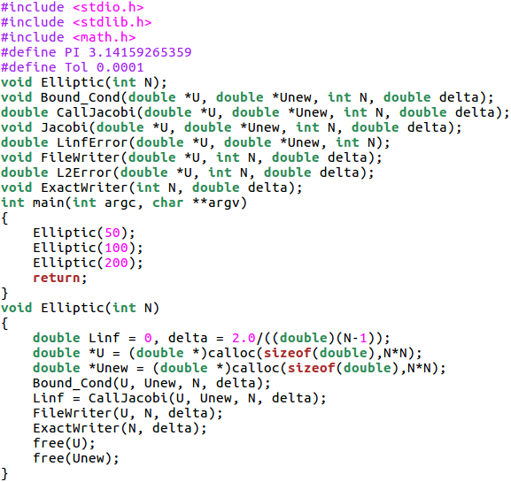
Code
# of Grid Node
Memory Allocation
Define B.C. and Compute Jacobi
Write Result

Slide 6
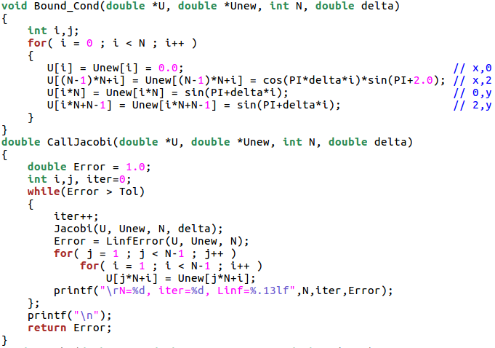
Code

Slide 7
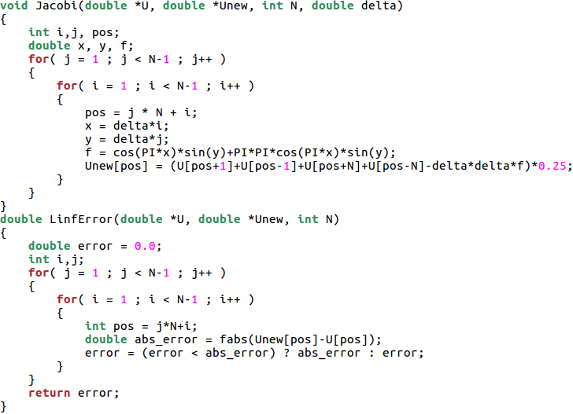
Code
Dirichlet B.C – Boundary Values are Fixed value
For Double, Use fabs

Slide 8
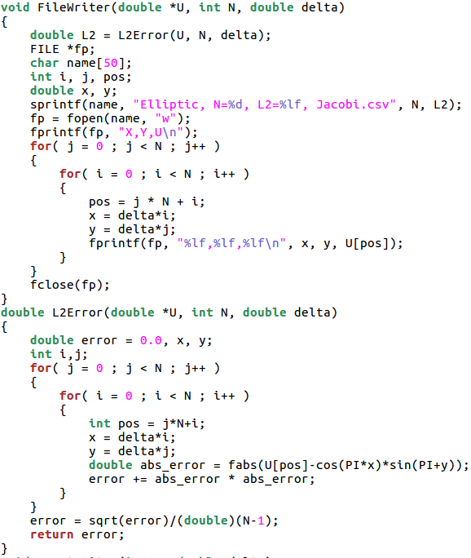
Code
Print L2 error to filename
Exact solution

Slide 9
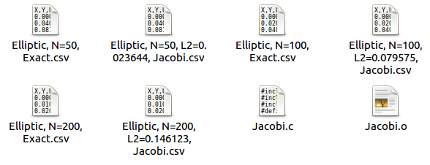
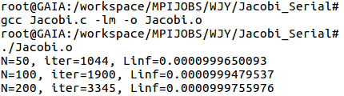
Compile and Run

Slide 10
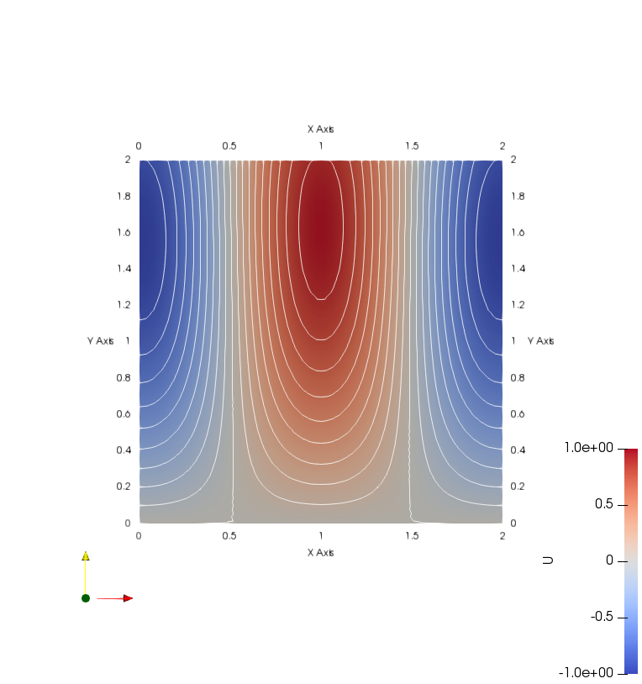
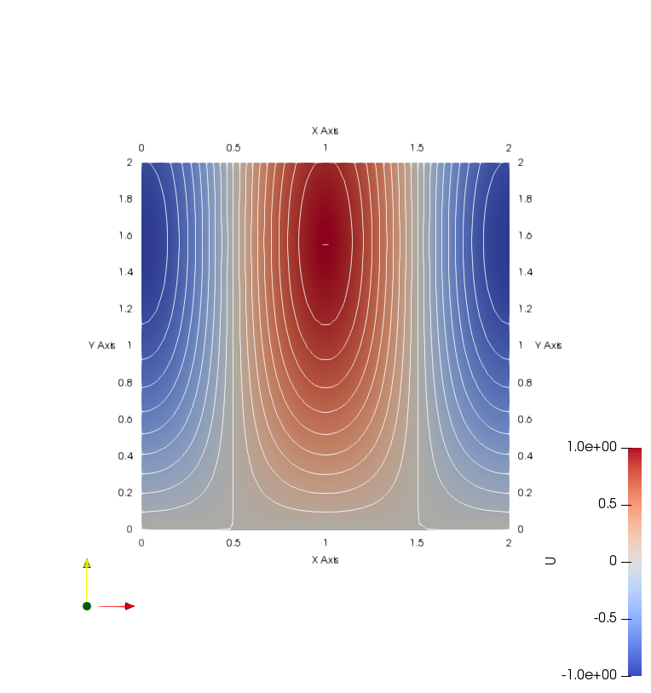
N=50, L_inf < 10^-4
Solve by Jacobi method
Exact solution

Slide 11


N=100, L_inf < 10^-4
Solve by Jacobi method
Exact solution

Slide 12
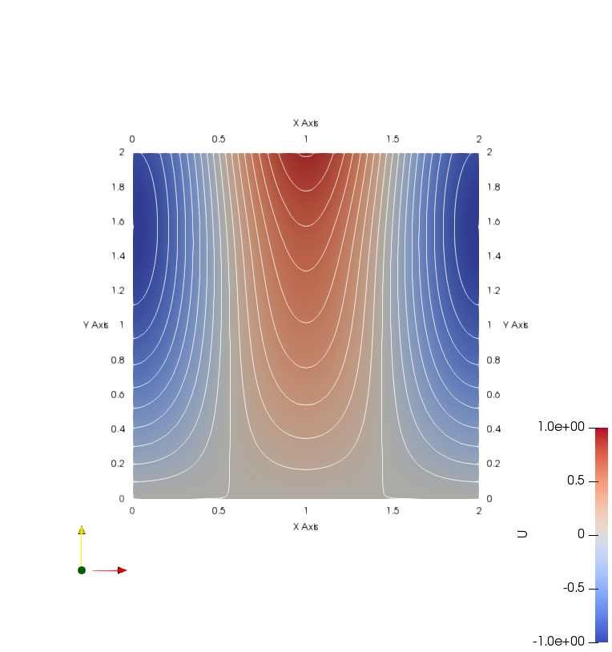

N=200, L_inf < 10^-4
Solve by Jacobi method
Exact solution

Slide 13
L2 error vs N

Slide 14

N=200, L_inf < 10^-6
Solve by Jacobi method
Exact solution

