Slide 1
Assignment #08
Dec, 11, 2017
JinYeong Wang
Parallel Computing Lab.
Mechanical Engineering
Hanyang University

Slide 2

Problem Definition
Compute
$$\frac{∂^{2}u}{∂x^{2}}+\frac{∂^{2}u}{∂y^{2}}=\cos\left[πx\right]\sin\left[y\right]+π^{2}\cos\left[πx\right]sin⁡[y]$$
While
$$0≤x≤2 and 0≤y≤2$$
Exact solution
$$u_{exact}\left(x,y\right)=\cos\left[πx\right]sin⁡[π+y]$$
Using Jacobi method, compute till
$$L_{1} Error=∑\left|u_{m}^{k+1}−u_{m}^{k}\right|<{10}^{−4}$$
Number of grid nodes are at least 500, more than 5 cases
500, 525, 550, 575, 600
Plot L2 error vs. Grid node

Slide 3
Pseudo Code
If size == 2
Parallelize Memory Indexing
rank | U | displs | counts | U_p
0 | 0 | displs [rank] = 0 | counts [rank] = 3 | 0
 | 1 |  |  | 1
 | 2 |  |  | 2
1 | 3 | displs [rank] = 3 | counts [rank] = 3 | 0
 | 4 |  |  | 1
 | 5 |  |  | 2
N_fix = N * N
While( N_fix % size )
N_fix++
rows_p = N_fix / size
If( rank == size-1 )
rows_p = N * N - N_fix / size * (size - 1)
U = memory allocation( N * N )
U_p = memory allocation( rows_p )
counts = memory allocation( size )
displs = memory allocation( size )
Sum = 0
for( i, 0 to size - 1 )
counts[ i ] = N_fix / size
displs[ i ] = sum
sum += counts[ i ]
counts[ size – 1 ] = N * N – sum
displs[ size – 1 ] = sum

Slide 4
Pseudo Code
Boundary Condition
Jacobi Iteration Method
for ( index, 0 to counts[rank] )
pos = index + displs[rank]
i = pos % N
j = pos / N
if( pos is not boundary )
U_p[pos] = 0.0
else if ( 0,y )
U_p[pos] = sin(pi*delta*j)
else if ( 2,y )
U_p[pos] = sin(pi*delta*j)
else if ( x,0 )
U_p[pos] = 0.0
else if ( x,2 )
U_p[pos] = cos(pi*delta*i)*sin(pi+2.0)
Tol = 0.00001
error = 1.0
repeat
MPI_Allgatherv( U_p to U )
for ( index, 0 to counts[rank] )
pos = index + displs[rank]
i = pos % N
j = pos / N
x = delta * i
y = delta * j
f = cos(pi*x)sin(y)+pi*pi*cos(pi*x)sin(y)
if( pos is not boundary )
U_p[pos] = (U[pos+1]+U[pos-1]+U[pos+N]+U[pos-N]-delta*delta*f)*0.25
error_p = 0.0
for ( index, 0 to counts[rank] )
pos = index + displs[rank]
error_p = fabs(U_p[index] – U[pos])
MPI_Allreduce(error_p to error, sum)
until error < Tol

Slide 5
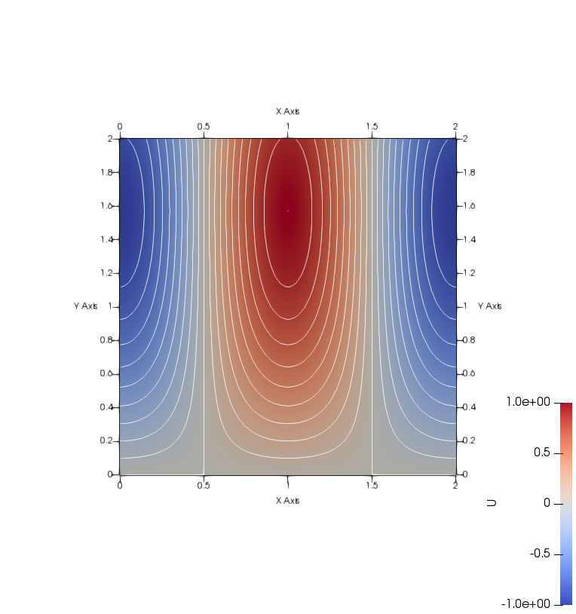
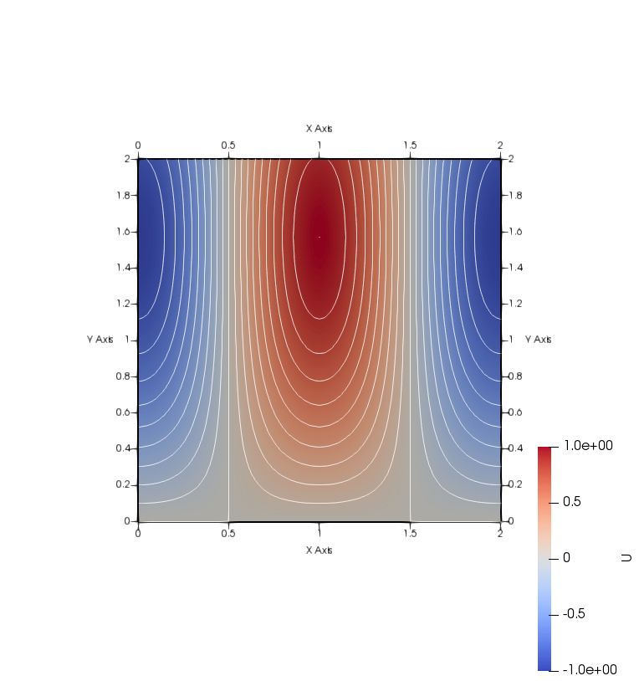
N=500
Solve by Jacobi method
Exact solution

Slide 6


N=525
Solve by Jacobi method
Exact solution

Slide 7
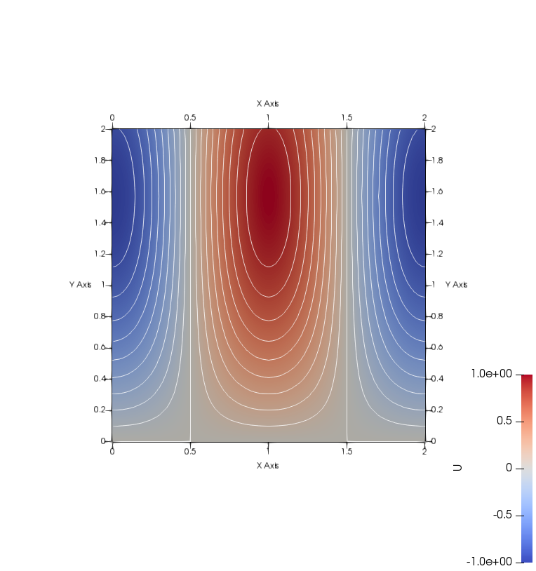

N=550
Solve by Jacobi method
Exact solution

Slide 8


N=575
Solve by Jacobi method
Exact solution

Slide 9


N=600
Solve by Jacobi method
Exact solution

Slide 10
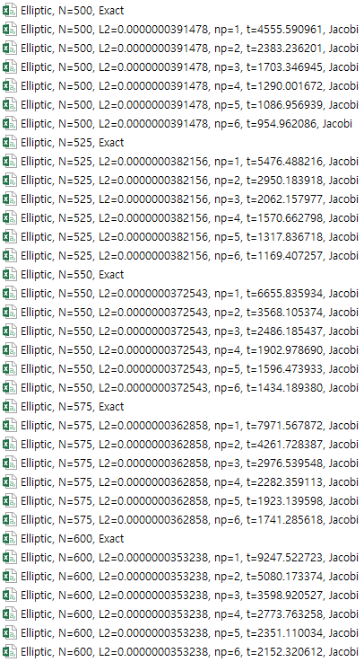
Result

Slide 11
Result
L2 error vs # of grid nodes
Log( L2 error ) vs # of grid nodes
Error caused by grid size
Error caused by truncation error

Slide 12
Result
Log( Time ) vs NP
Speedup

