Slide 1
Computational Fluid Dynamics
Parallel Computing Lab.
Mechanical Engineering
Hanyang University

Slide 2
주차 | 주제
1주차 | Introduction
2주차 | 편미분방정식의 분류
3주차 | 편미분방정식 차분화
4주차 | Parabolic 형식의 편미분 방정식 – 확산 방정식
5주차 | Elliptic 형식의 편미분 방정식 – 라플라스 방정식
6주차 | Hyperbolic 형식의 편미분 방정식 – 파동 방정식
7주차 | CFD프로그램의 소개

Slide 3
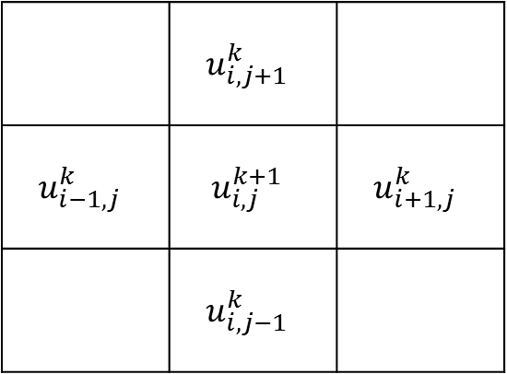
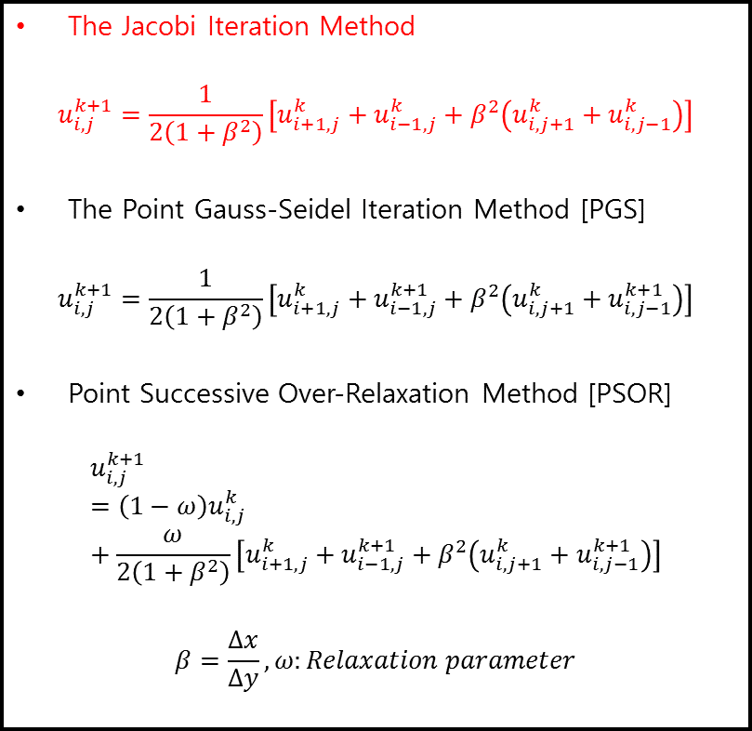

Elliptic PDE – Explicit Methods
The Jacobi Iteration Method
$$u_{i,j}^{k+1}=\frac{1}{2\left(1+β^{2}\right)}\left[u_{i+1,j}^{k}+u_{i−1,j}^{k}+β^{2}\left(u_{i,j+1}^{k}+u_{i,j−1}^{k}\right)\right]$$
The Point Gauss-Seidel Iteration Method [PGS]
$$u_{i,j}^{k+1}=\frac{1}{2\left(1+β^{2}\right)}\left[u_{i+1,j}^{k}+u_{i−1,j}^{k+1}+β^{2}\left(u_{i,j+1}^{k}+u_{i,j−1}^{k+1}\right)\right]$$
Point Successive Over-Relaxation Method [PSOR]
$$u_{i,j}^{k+1}={\left(1−ω\right)u}_{i,j}^{k}+\frac{ω}{2\left(1+β^{2}\right)}\left[u_{i+1,j}^{k}+u_{i−1,j}^{k+1}+β^{2}\left(u_{i,j+1}^{k}+u_{i,j−1}^{k+1}\right)\right]$$
$$β=\frac{Δx}{Δy},ω:Relaxation parameter$$
$$\frac{∂^{2}T}{∂x^{2}}+\frac{∂^{2}T}{∂y^{2}}=0$$
 | $$u_{i,j+1}^{k}$$
$$u_{i−1,j}^{k}$$ | $$u_{i,j}^{k+1}$$ | $$u_{i+1,j}^{k}$$
 | $$u_{i,j−1}^{k}$$

Slide 4
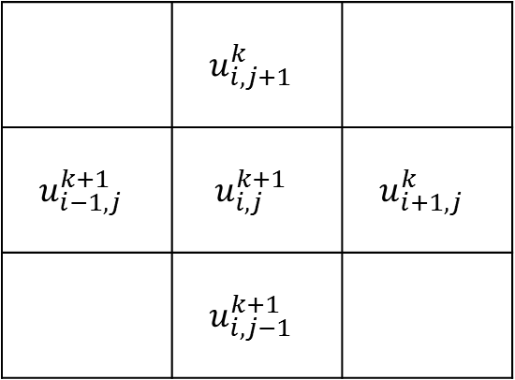
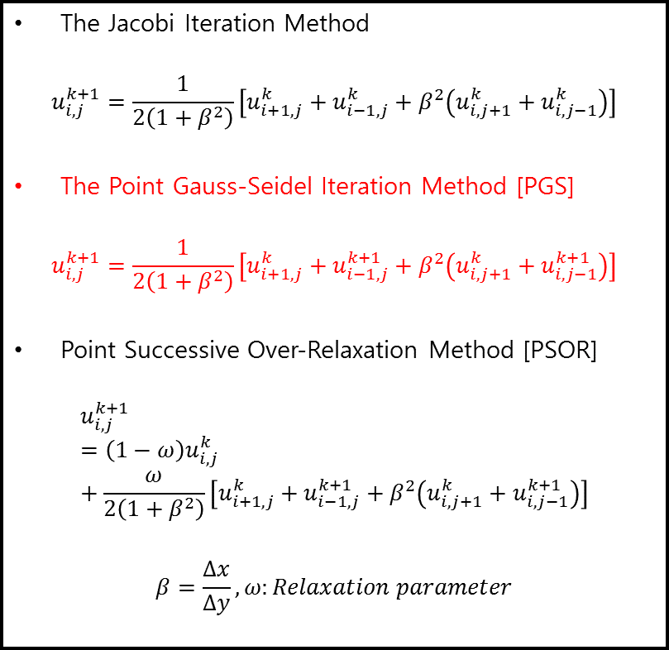
Elliptic PDE – Explicit Methods
The Jacobi Iteration Method
$$u_{i,j}^{k+1}=\frac{1}{2\left(1+β^{2}\right)}\left[u_{i+1,j}^{k}+u_{i−1,j}^{k}+β^{2}\left(u_{i,j+1}^{k}+u_{i,j−1}^{k}\right)\right]$$
The Point Gauss-Seidel Iteration Method [PGS]
$$u_{i,j}^{k+1}=\frac{1}{2\left(1+β^{2}\right)}\left[u_{i+1,j}^{k}+u_{i−1,j}^{k+1}+β^{2}\left(u_{i,j+1}^{k}+u_{i,j−1}^{k+1}\right)\right]$$
Point Successive Over-Relaxation Method [PSOR]
$$u_{i,j}^{k+1}={\left(1−ω\right)u}_{i,j}^{k}+\frac{ω}{2\left(1+β^{2}\right)}\left[u_{i+1,j}^{k}+u_{i−1,j}^{k+1}+β^{2}\left(u_{i,j+1}^{k}+u_{i,j−1}^{k+1}\right)\right]$$
$$β=\frac{Δx}{Δy},ω:Relaxation parameter$$
$$\frac{∂^{2}T}{∂x^{2}}+\frac{∂^{2}T}{∂y^{2}}=0$$
 | $$u_{i,j+1}^{k}$$
$$u_{i−1,j}^{k+1}$$ | $$u_{i,j}^{k+1}$$ | $$u_{i+1,j}^{k}$$
 | $$u_{i,j−1}^{k+1}$$

Slide 5
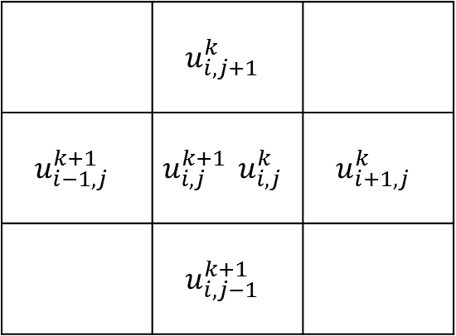
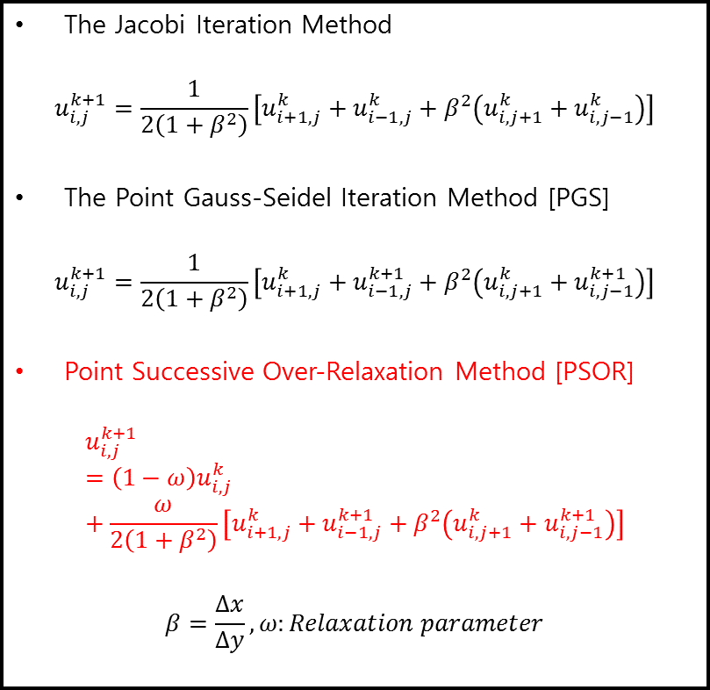
Elliptic PDE – Explicit Methods
The Jacobi Iteration Method
$$u_{i,j}^{k+1}=\frac{1}{2\left(1+β^{2}\right)}\left[u_{i+1,j}^{k}+u_{i−1,j}^{k}+β^{2}\left(u_{i,j+1}^{k}+u_{i,j−1}^{k}\right)\right]$$
The Point Gauss-Seidel Iteration Method [PGS]
$$u_{i,j}^{k+1}=\frac{1}{2\left(1+β^{2}\right)}\left[u_{i+1,j}^{k}+u_{i−1,j}^{k+1}+β^{2}\left(u_{i,j+1}^{k}+u_{i,j−1}^{k+1}\right)\right]$$
Point Successive Over-Relaxation Method [PSOR]
$$u_{i,j}^{k+1}={\left(1−ω\right)u}_{i,j}^{k}+\frac{ω}{2\left(1+β^{2}\right)}\left[u_{i+1,j}^{k}+u_{i−1,j}^{k+1}+β^{2}\left(u_{i,j+1}^{k}+u_{i,j−1}^{k+1}\right)\right]$$
$$β=\frac{Δx}{Δy},ω:Relaxation parameter$$
$$\frac{∂^{2}T}{∂x^{2}}+\frac{∂^{2}T}{∂y^{2}}=0$$
 | $$u_{i,j+1}^{k}$$
$$u_{i−1,j}^{k+1}$$ | $$u_{i,j}^{k+1} u_{i,j}^{k}$$ | $$u_{i+1,j}^{k}$$
 | $$u_{i,j−1}^{k+1}$$

Slide 6

Elliptic PDE
$\frac{∂^{2}T}{∂x^{2}}+\frac{∂^{2}T}{∂y^{2}}=0$
Boundary Condition
$T_{1}=100$
$T_{2}=0$
$T_{3}=0$
$T_{4}=0$
$IM=21$
$Δx=\frac{1}{21−1}=0.05$
$JM=41$
$Δy=\frac{2}{41−1}=0.05$
$β=\frac{Δx}{Δy}=\frac{0.5}{0.5}=1$

Slide 7
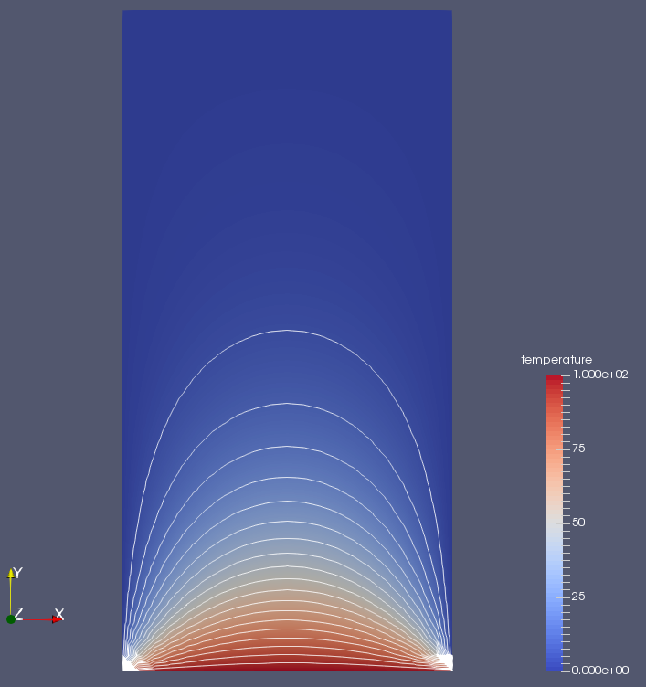
Elliptic
The Jacobi Iteration Method
The Point Gauss-Seidel Iteration Method (PGS)
Point Successive Over-Relaxation Method (PSOR)

Slide 8

H/W #4
$$\frac{∂^{2}T}{∂x^{2}}+\frac{∂^{2}T}{∂y^{2}}=0$$
위 식을 Implicit으로 차분할 수 있는 방법들을 조사할 것
LGS, ADI, LSOR
각 Scheme별 Iteration 횟수 및 결과 고찰할 것
PSOR iteration에서 가장 빠른 연산이 가능한 w값 찾아볼 것
[Hint] w를 변화시키면서 w에 따른 iteration의 변화를 그래프로 그려보면 알 수 있음

