Slide 1
Computational Fluid Dynamics
Parallel Computing Lab.
Mechanical Engineering
Hanyang University

Slide 2

Paraview
오픈소스 Post-Processing 프로그램
다운로드 링크: http://www.paraview.org/download/

Slide 3
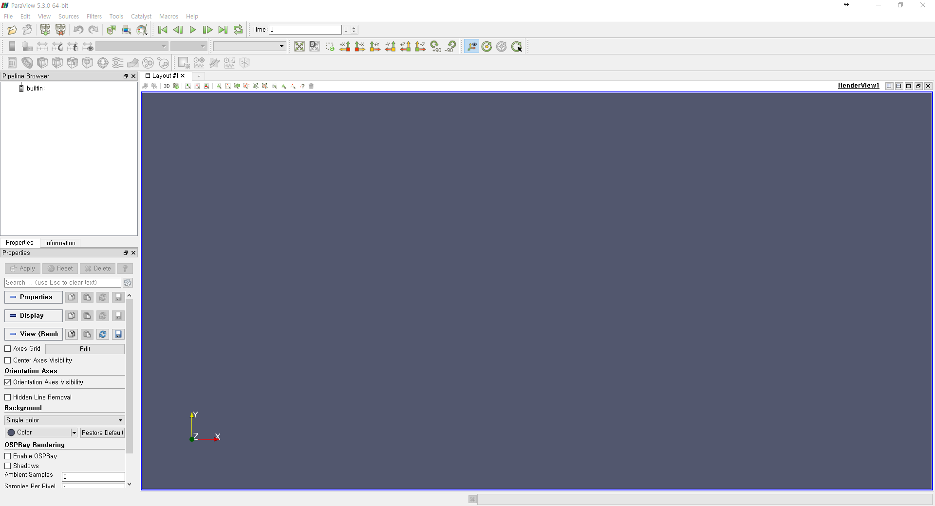
첫 실행

Slide 4
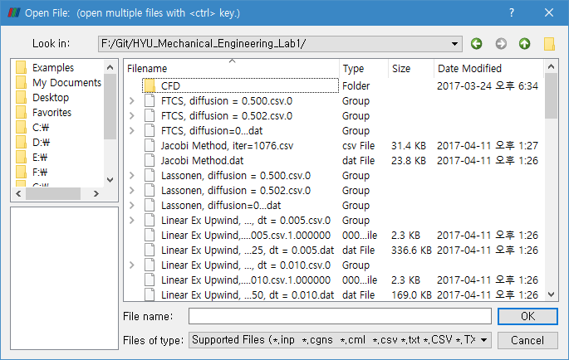
File – Open [Ctrl + O]

Slide 5
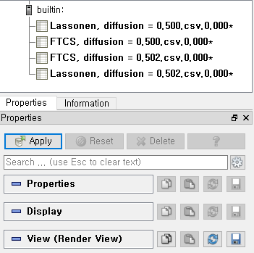
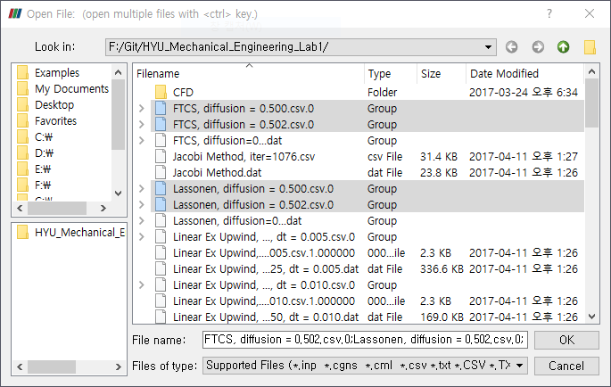
For Parabolic
Open File
Apply Data

Slide 6
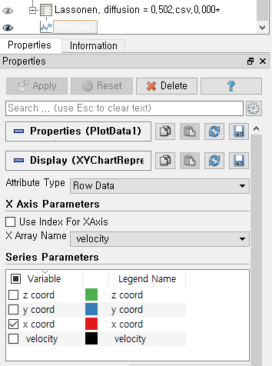
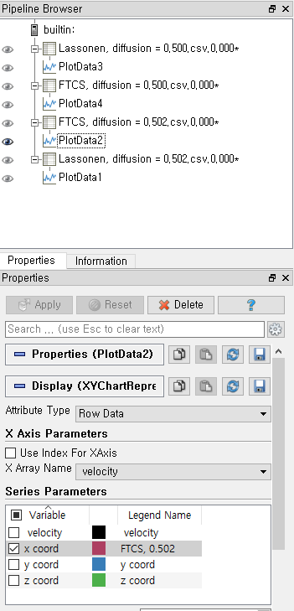
For Parabolic
Filter – Alphabetical – Plot Data
Filter – Alphabetical – Plot Data

Slide 7
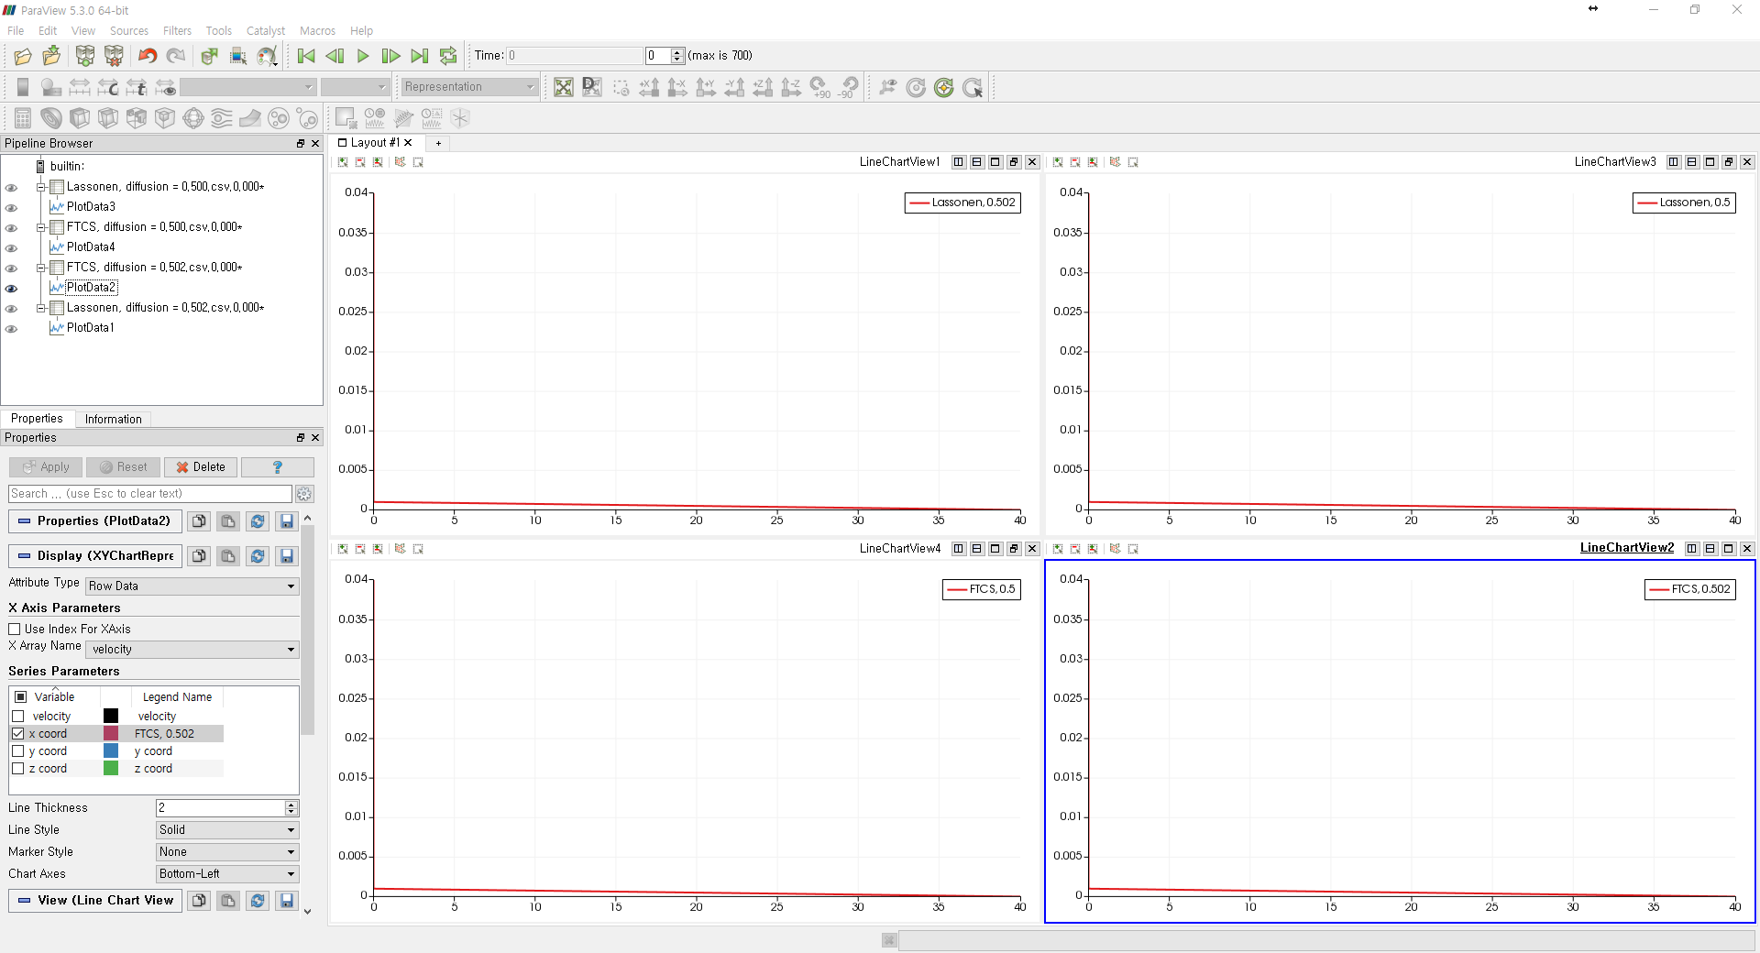
For Parabolic

Slide 8
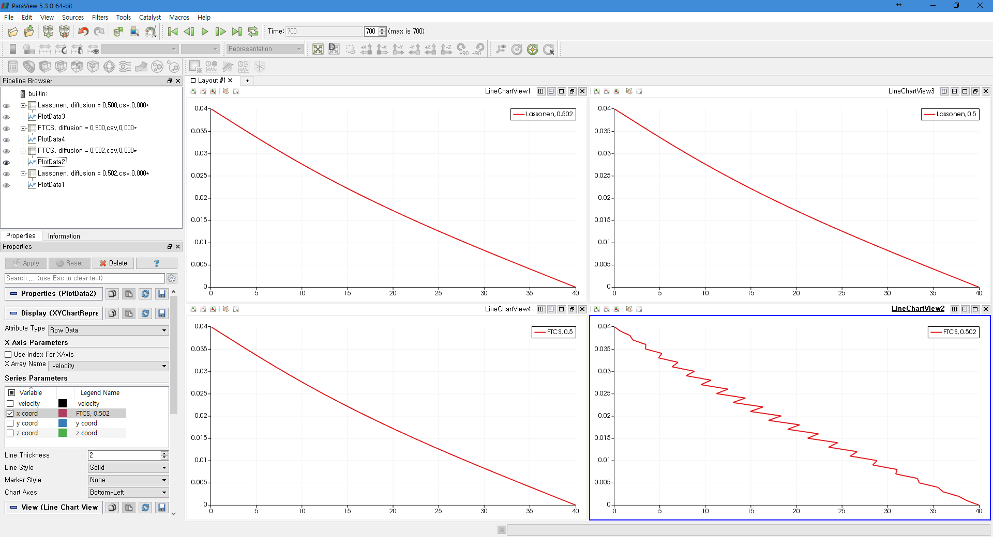
For Parabolic

Slide 9
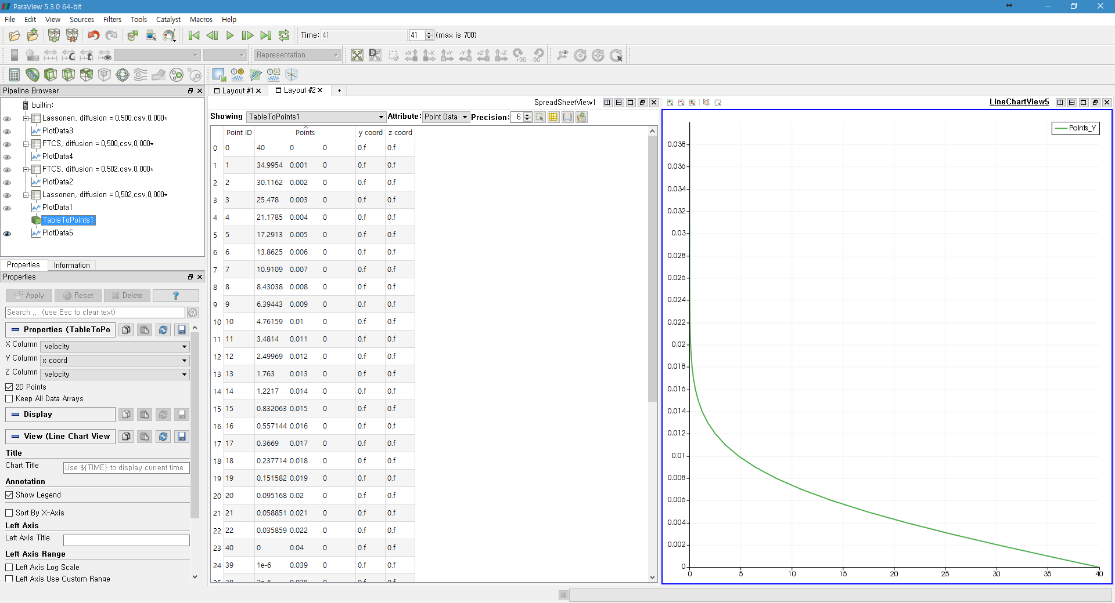
For Parabolic – Other Layout

Slide 10
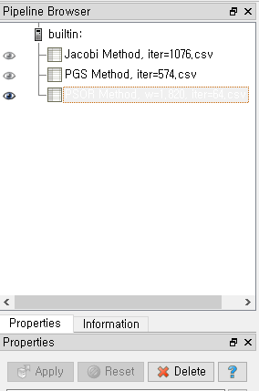
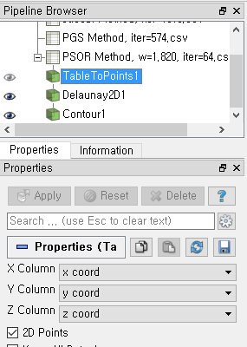
For Elliptic
Open File & Apply Data
Filter – Alphabetical – Table to Points

Slide 11
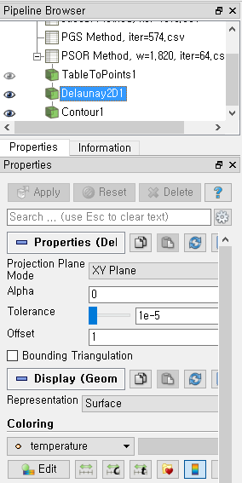
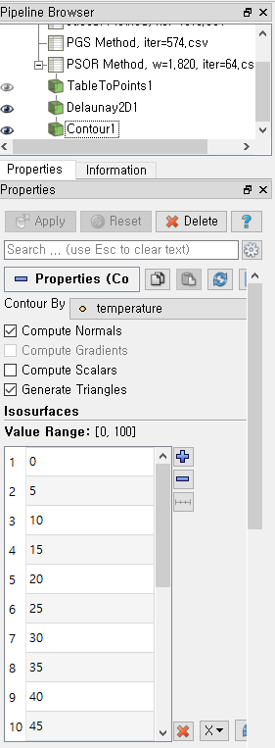
For Elliptic
Filter – Alphabetical – Delaunay2D
Filter – Alphabetical – Contour

Slide 12
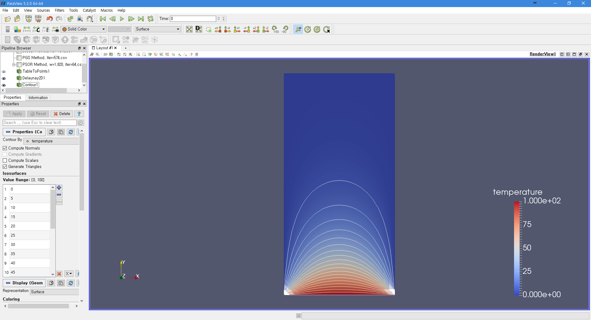
For Elliptic

Slide 13
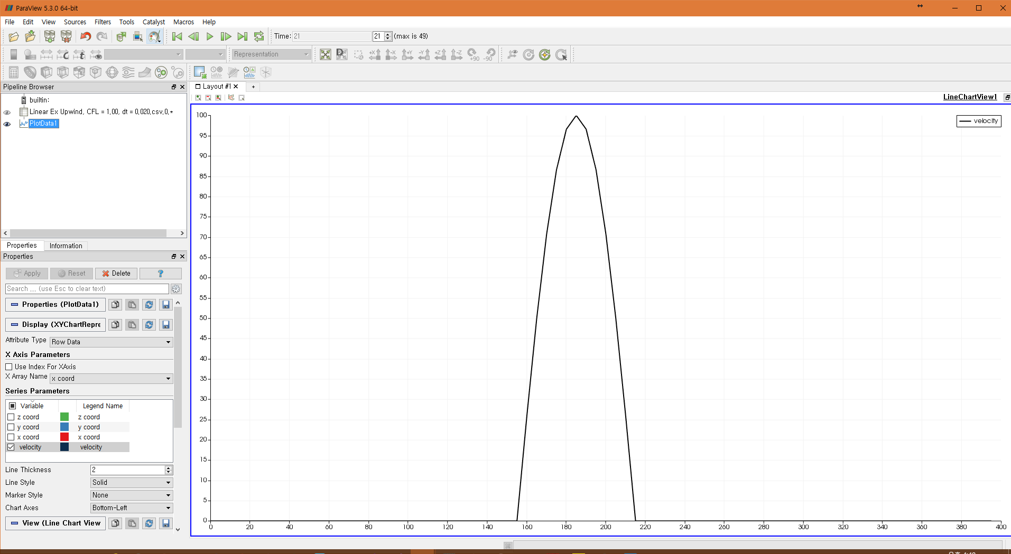
For Hyperbolic – Same as Parabolic

