Slide 1
순서
Split datasets
Select features and engineering
Token (text → num)
Set sample weights
Text embedding
Train model
Average predictions
submit

Slide 2
Word embedding algorithms
Word2vec, 구글 2013
Glove, Stanford 2014
FastText, Facebook, 2015-2018
BERT, 구글 2018
word2vec
glove
FastText
BERT

Slide 3
GloVe: Global Vectors for Word Representation
pre-trained word vectors by Stanford Uni
glove.840B.300d.txt
https://nlp.stanford.edu/projects/glove/
https://ratsgo.github.io/from%20frequency%20to%20semantics/2017/04/09/glove/

Slide 4
BERT
https://www.kaggle.com/christofhenkel/bert-embeddings-lstm

Slide 5
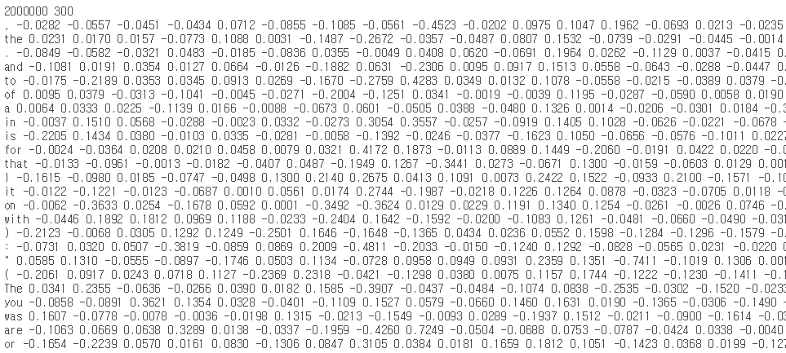
FastText crawl 300d 2M
300-dimensional pretrained FastText English word vectors released by Facebook.

Slide 6
Sample weights

Slide 7
BERT

Slide 8
token

