Slide 1
News Article Sentiment Analysis

Slide 2
CONTENTS
Sentiment Analysis
Tools
Data Model
Code
The Info of Data
The result of Sentiment Analysis

Slide 3
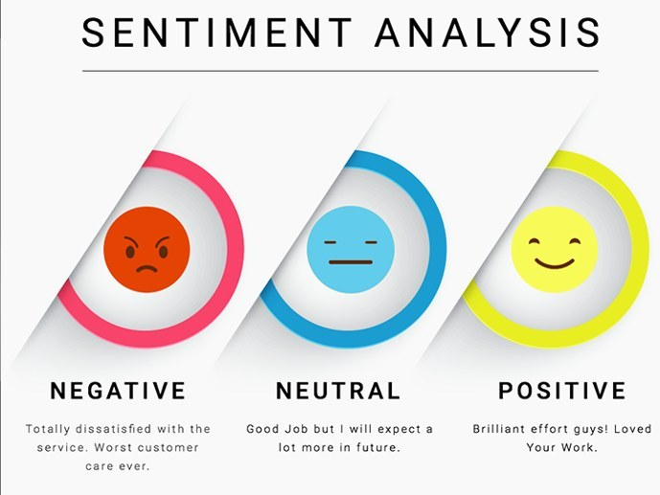
Sentiment Analysis
What is the Sentiment Analysis?
The process of determining the emotional tone behind a series of words,
Used to gain an understanding of the attitudes, opinions and emotions expressed within an online mention
Extremely useful in social media monitoring

Slide 4


Sentiment Analysis
The purpose of Sentiment Analysis
To find out the reaction from users related to specific person or subject
How we can get data?
- Scrape the data from Two major news

Slide 5





Tools

Slide 6
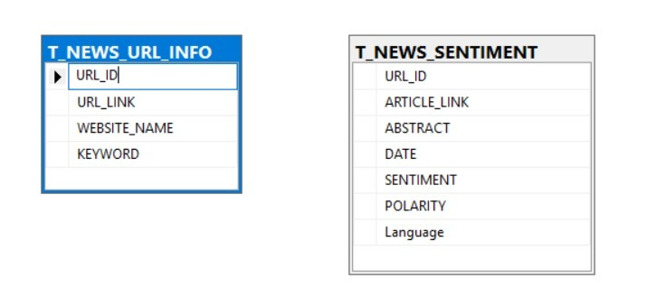
Data Model

Slide 7
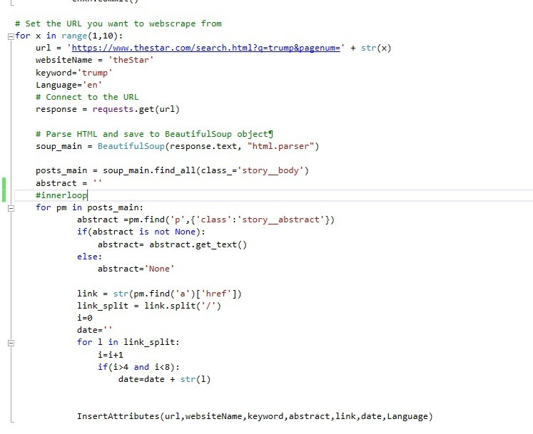
Code
Getting data from ‘The Star’

Slide 8
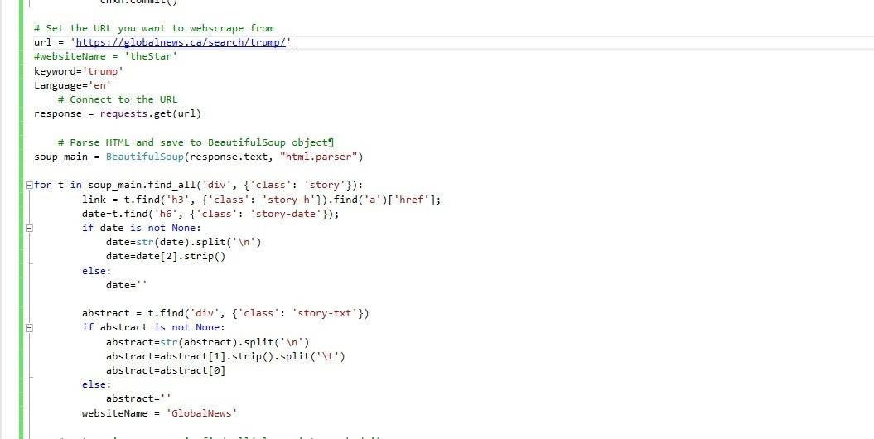
Code
Getting data from ‘Global News’

Slide 9
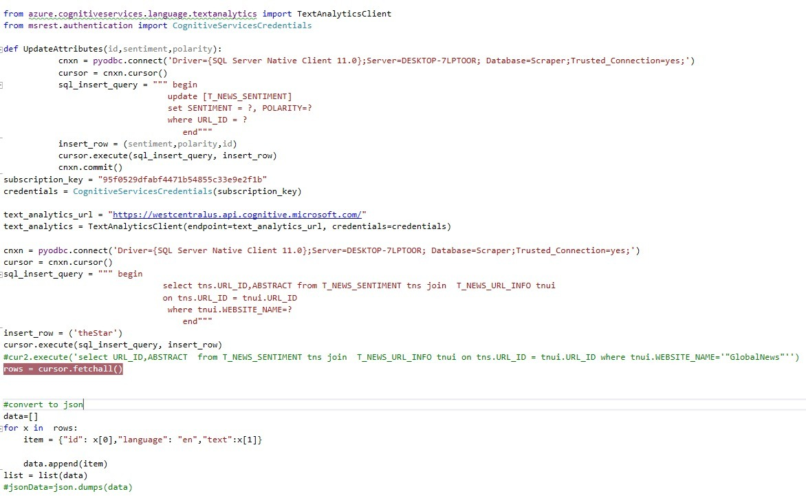



Code
Calling cognitive services
for Text Analysis

Slide 10
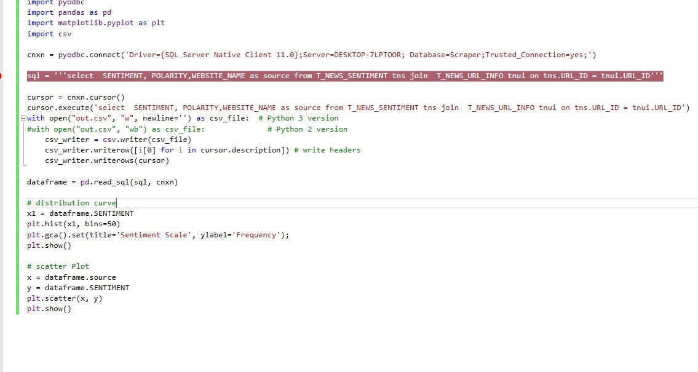
Code
To Generate Graphs

Slide 11
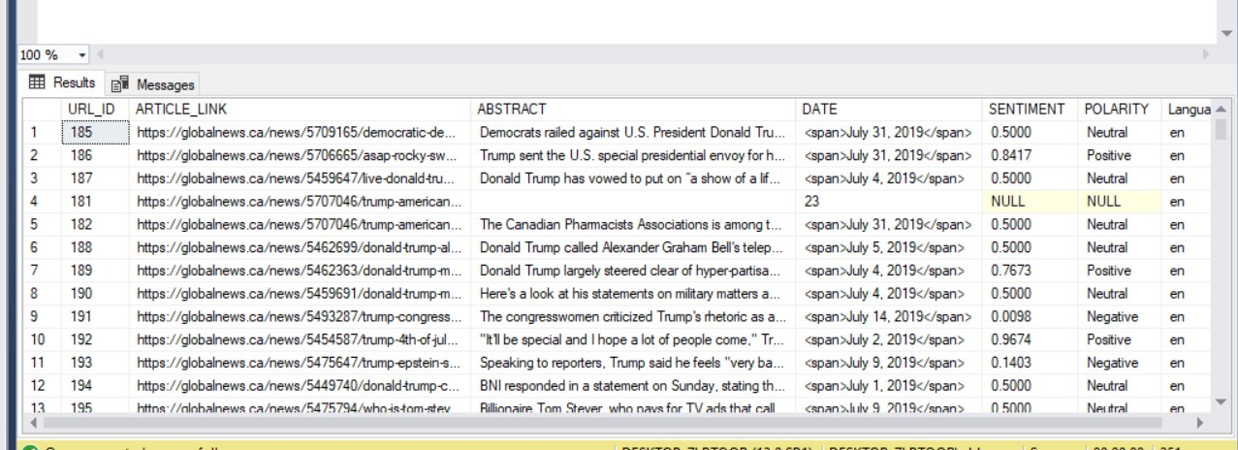
The info of Data
The Sentiment data source
Search the keyword ‘Trump’
Compare the result from ‘Global News’ and ‘The Star News

Slide 12
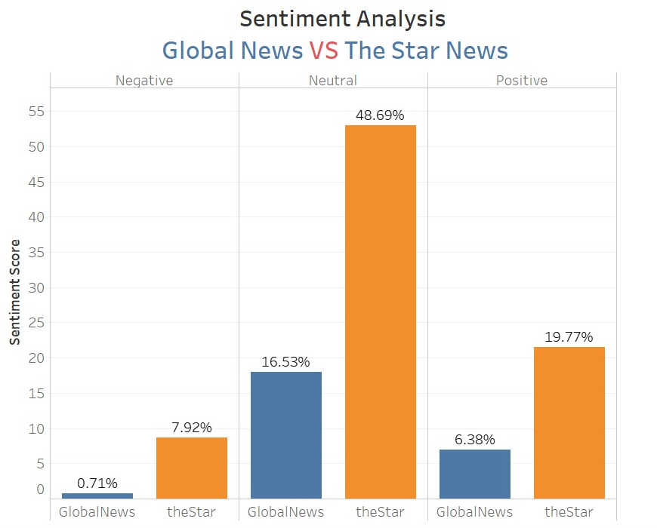

The result of Sentiment Analysis
Analysis of article related to Trump
Search the keyword ‘Trump’
Compare the result from
‘Global News’ and ‘The Star News’

Slide 13
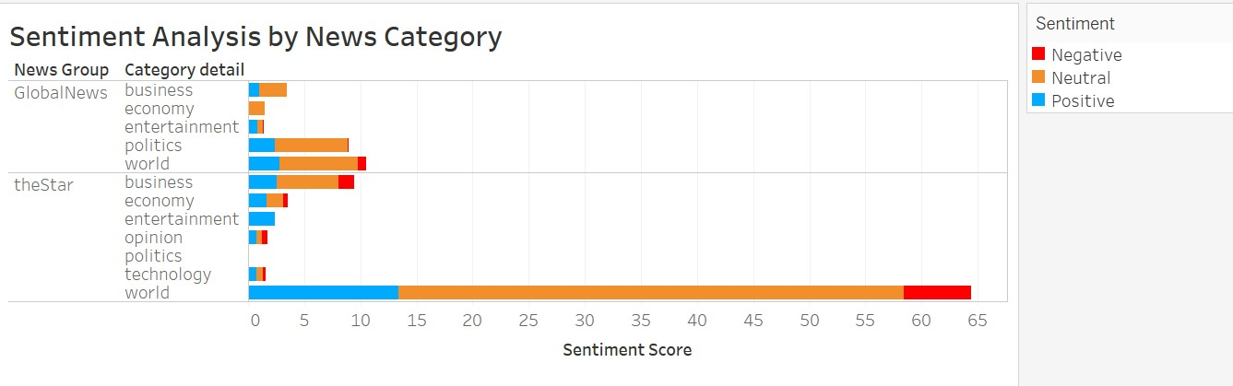
The result of Sentiment Analysis

Slide 14
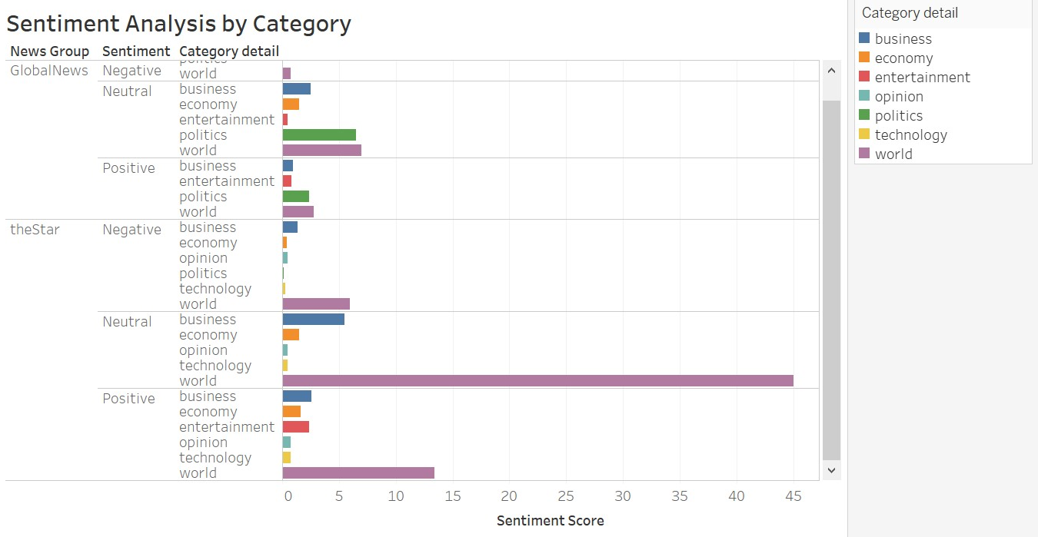
The result of Sentiment Analysis

Slide 15
Conclusion
Two news shows similar result
We analysis the Category to see the positive and negative reaction from users
The result by category
Compare each subjects of articles, we can figure out different reactions based on special subject

Slide 16
Q&A

Slide 17
Thank you
End of Document
BIZFORMS

