Slide 1
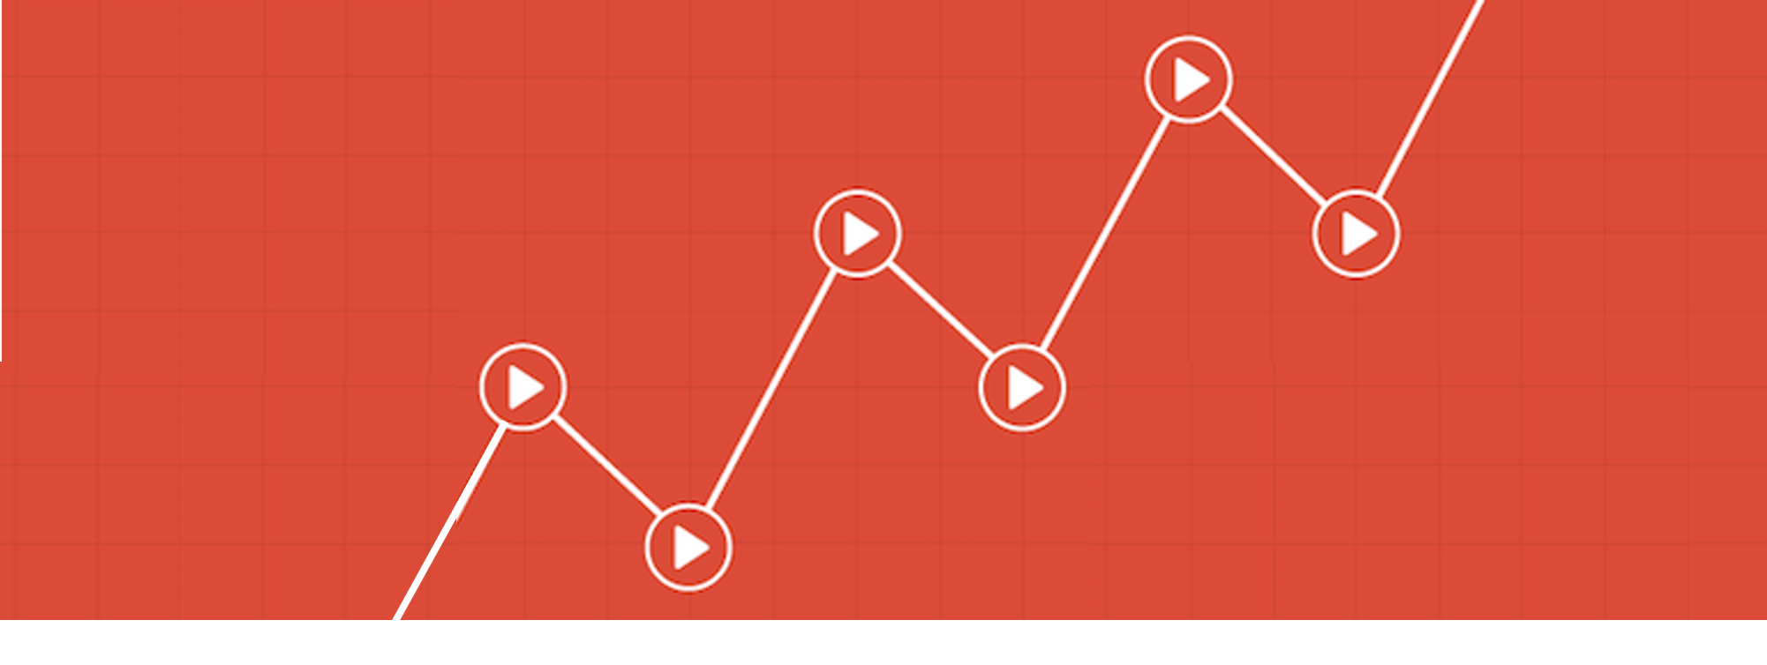
YouTube Trending Videos Analysis
Find out how to maximize the effectiveness of online advertising
Notes:
Do you happen to know how many people have had watched YouTube last year?
1.8 billion!!!
Almost quarter of people across the world are using YouTube ( 7.7 billion)
YouTube is obviously one of the most powerful online marketing tools. Also there has been a noticeable shift in people spending more time to watch stuff online rather than on TV. Many people want to make money through YouTube.
So we decided to find out how to maximize the effectiveness of advertisement via youtube trening video.
Simplely, how to make more money using youtube trening video.

Slide 2
CONTENTS
Planning Background
How to Make Trending Videos
How to Increase The Views
How about other countries
Further Extension
Notes:
This is the steps of our journey.

Slide 3
Planning
Background
01

Slide 4



Planning Background
1
Billion Unique monthly visitors
2
nd largest search engine
3
Billion searches each month
Notes:
Let me briefly explain what the YouTube trending video is.
Youtube describe it as a scientificall-enhenced way to understand youtube.
YouTube detect viral video vibration in it’s plaform so people find out what’s hot at home
Trending considers many signals, including:
View count
The rate of growth in views
The age of the video (when does this video published.)
Where views are coming from (it could be physical location, other online platform, or it could be categories)
It said youtube combine these signals to produce a list of videos that showcases what’s happening on YouTube and in the world.
However they didn’t reveal how much important that each signals are.
So we are going to figure out step by step.

Slide 5
How to Make
Trending Videos
01

Slide 6
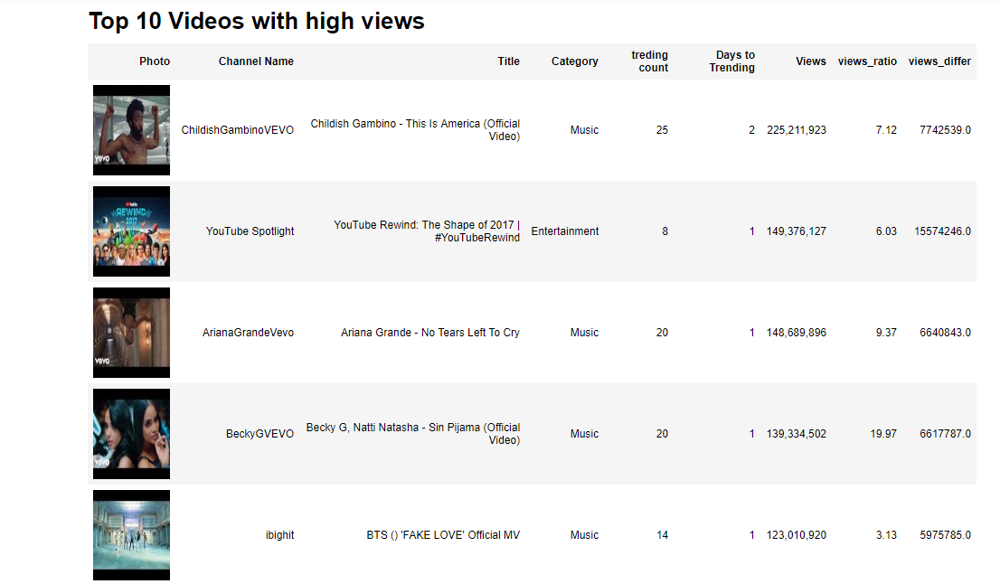
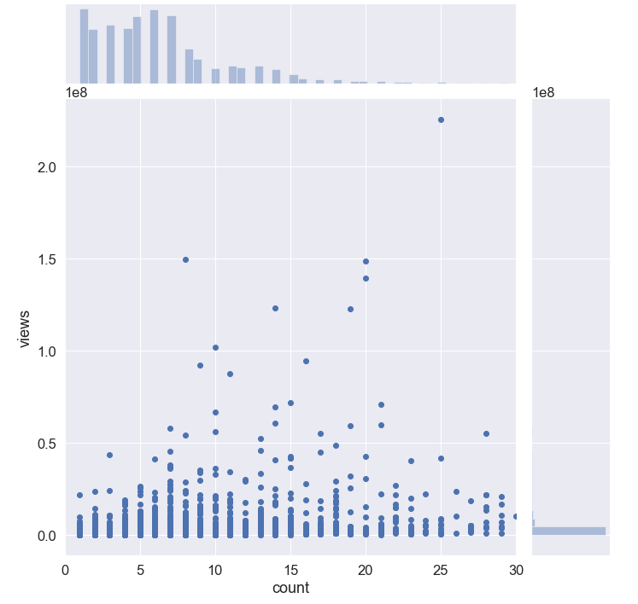
Are the most viewed videos the most often selected ?
Views and Selected times
25
8
20
29
14
Notes:
Let’s start from the view.
We start our journey with simple easy question.
Are the most viewed videos the most often selected for trending videos?
If the number of view is the most strongest factor to being trending video, the highest number of viewed video would have the highest frequency of selecting times.
In order to confirm this, we sorted the data set by the number of views and observed how the selected times are changed.
As you can see the right scatter plot, there is no strong connection between number of view and being trending video.
We can infer that the number of view itself is not strongly affect to trending videos.

Slide 7
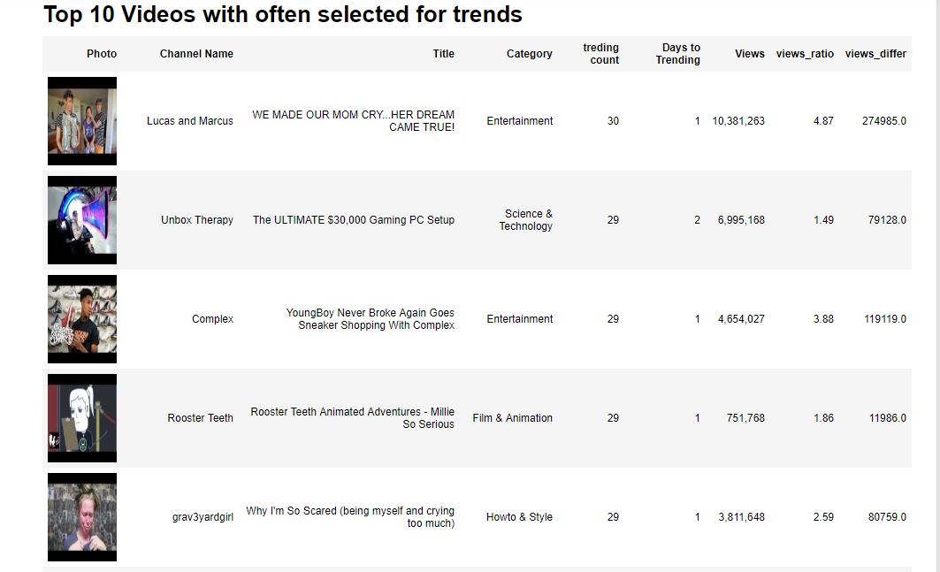
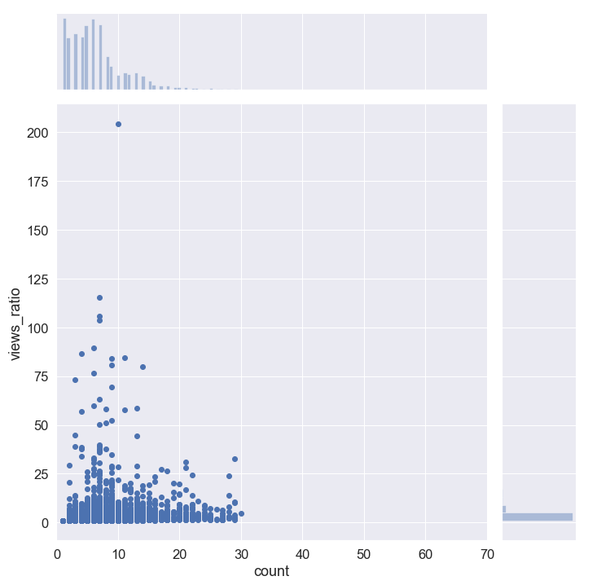
Are the most selected videos the most fastest growing
Growth rate and selected times
Ent
30
Tech
29
Music
29
Film
29
Style
29
Notes:
Next, the growth rate.
If the video rapidly increase it’s number of views, can it be selected for trending video?
So we looked through the most selected trending videos ‘s growth rate.
The right side of the scatter plot shows, there is no relation between trending videos and growth rate.
But, we found out very interesting fact from the result.
I couldn’t contained all the results , but when we see the top 10 of the result, each videos are belongs to different category.
So we started to think, Maybe there is something behind the categories.

Slide 8
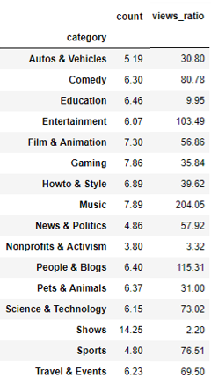
Let’s separate the categories
The rate of growth in views by Category
Music
204 times
Average selected times for Trending video: 7.89
Show
2 times
Average selected times for Trending video: 14.25
It has different criteria
depending on Categories
Notes:
So we re-analyzed growth rate by categories. and the result appeared like this.
Music trending videos grows 204 times view in average. Entertainment shows 115 times increased.
It means these two categories are the most competitive categories, so, in order to be selected trending videos, the video should show massive increase of view rate compare to other categories video.
On the other hand, in terms of the show and non profit categories, once the video show 2 or 3 times of growth rate, It can be selected as trending video.
It’s like when we through a pebble at the calm lake, we can easily notice, but hard to catch at the wild sea.
we can say Music category is the wild sea and the show, non-profit categories are calm lake.
We’d better through out pebbles at the calm lake so it can be easily noticed by users.
But why it has such a big gap between by categories?
From this result, we can assume that each category applies different rules/criteria to select trending videos.
They might use same variables but the importance or impact of each variables could be different by categories.
Also we can infer the intention of Youtube treding video system.
Youtube wants to track diverse topics.
if Youtube merely wanted to see the most popular videos, this trending video section would be plastered with Music and Entertainmnet videos.
But it is not.

Slide 9
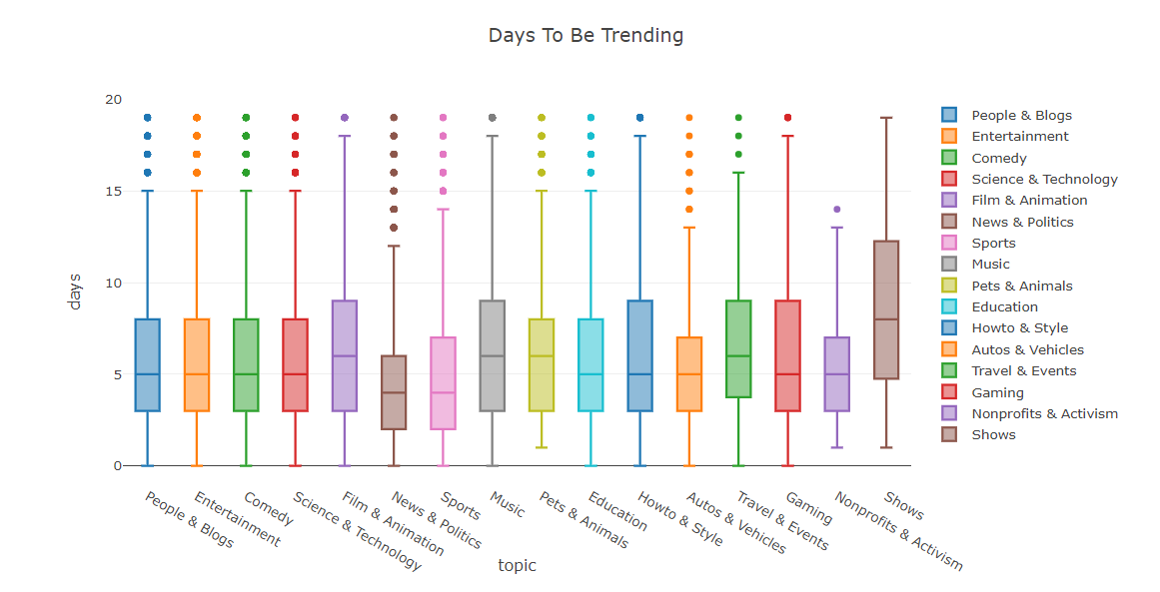
How old are the trending videos?
How long does it take to become a trending video
1week
90%가 지속되지않아.
(Within 4-8 days)
Notes:
How old are the trending videos?
How long does it take to become a trending video after it is published?
Most categories have similar distribution of date. Generally, it takes 4-8 days, to be selected.
It means, if your video couldn’t get into trending video within 1 week, your video hardly to be a trending video.
So if you are a Youtuber who wants to make your video to select as a trending video, you’d better update at least once a week.

Slide 10
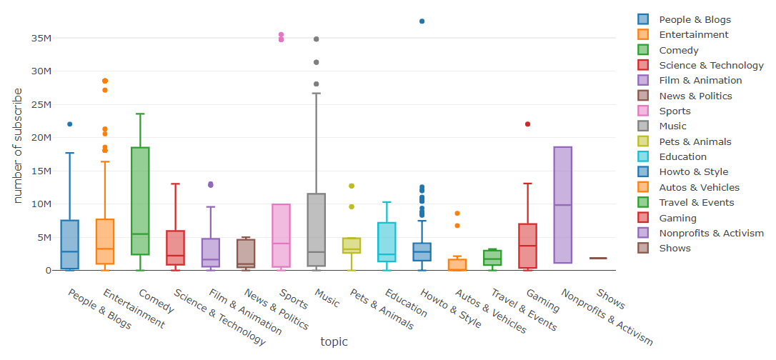
What makes first-day trending videos?
It has different criteria depending on categories
Notes:
We had another question after that.
If becoming a trending video in early phase is important, how can we make it possible?
If I have huge number of subscribers, does it helpful to make my video as a trending video?
to confirm our hypotheses, we analyze the trending video that are selected in a day.
When we see this a broad range of the values
it turns out with. number of subscribers are not an absolute factor to become a trending video.
The median value of subscriber numbers are distributed in lower area,
It means most of the first day trending video’s don’t have many subscribers.

Slide 11
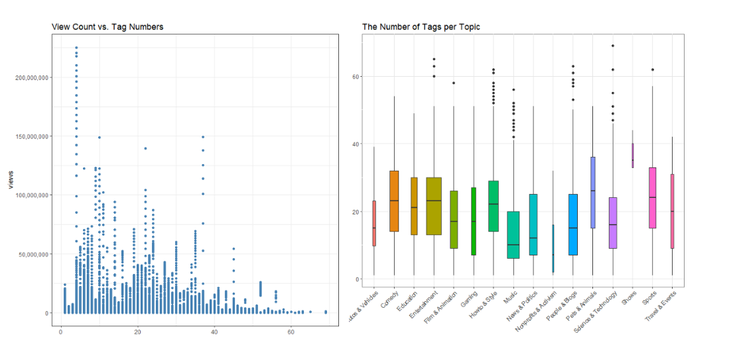
Is there a relationship between trending videos and words?
Title & Tag
A
7 words
Title phrasing is important
4 tags
#
Including keywords is more important
Notes:
Is there a relationship between trending videos and tag or title
Generally, treding videos have 7 to 8 words in it’s title and 4 tags are saved with video.
However, there is no apparent tendency through the number of titles or tags. Additionally, with the right plot, we can see that they have different distributions for each topic. It indicates that it’s more about what keywords you, not about how many you have.

Slide 12
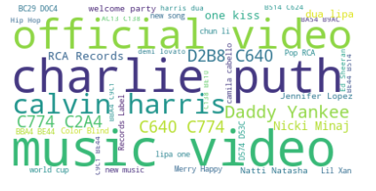
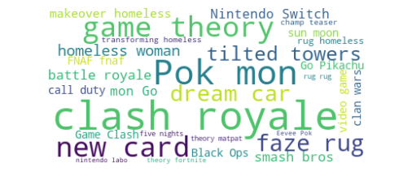
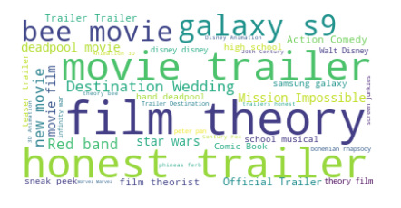
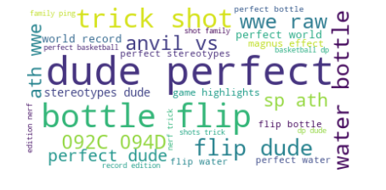
What was the hottest keyword in each category?
Music
Game
Film
News
Notes:
Let’s have a look what was the hottest keyword in each category in last years ago.
Music : official music video, Charlie Puth, American sing a song writer,
Game : Clash royale, Pok mon
Film : Honest trailer, web series that picks out everything that is wrong with a movie .
News : American sports entertainment youtube channel. those trick shot, bottle flip and flip dude, watter bottle are all related dude perfect.

Slide 13
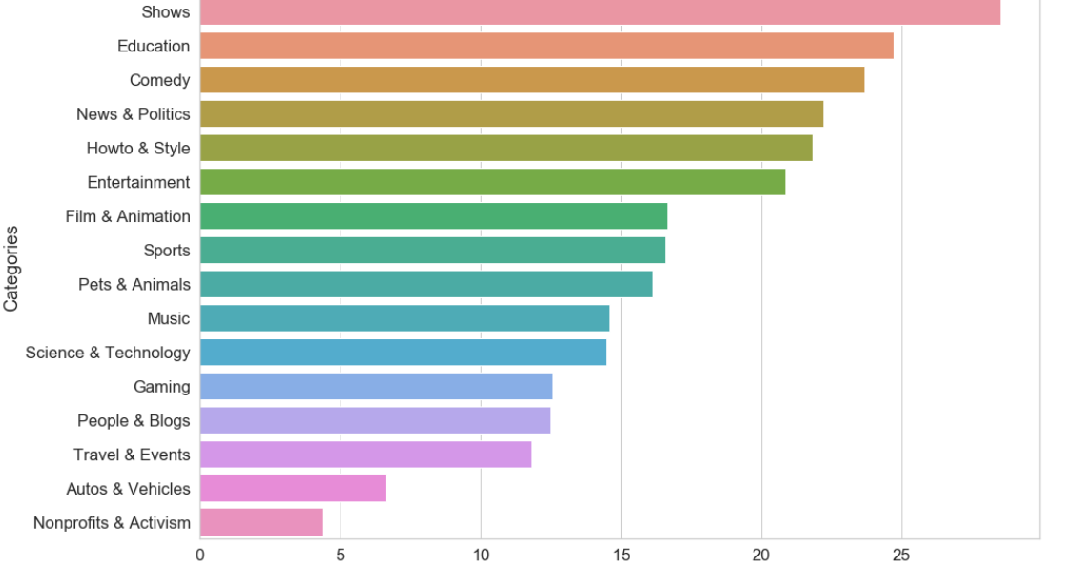
Which category is the most competitive?
The number of trending video / The number of Channels
Notes:
Let’s have a look what other factors could have impact.
How about competitiveness.
According to the results, among the 16 categories in YouTube, Music and Entertainment are the most competitive channels and Automotive and non-profit categories are the least competitive categories. If there is anyone who want to start their own YouTube channel, you’d better consider these categories at bottom there.

Slide 14
What categories’ users are most actively interacting
The categories that has the most subscribers, views, likes and comments.
COMEDY
GAME
MUSIC
MUSIC
GAME
MUSIC
MUSIC
GAME
SPORT
FILM
GAME
FILM
FILM
GAME
FILM
Subscribers
Likes
Dislikes
Views
Comments
Notes:
We Selected the categories that have most active users among 16 categories.
As you can see these graphs,
Game channels have the most subscribers, and likes, Dislikes ,number of views and comments.
Even though the
Game category has the highest number of subscriber and views, it doesn’t fulfill the “where” requirement.
Game category is loved by mania/specific fans. so it is little far from diversity.

Slide 15







How can we create a strategy
Competitive-
ness
Interaction
Notes:
So far, we’ve been look through the important factors that YouTube emphasize.
Now we can make a strategy based on the facts that we found out from the analysis.
If you want your video to be selected as a trending video
First, you need to analyze data by category because it seems each category has different criteria for their trending vidoes .
Growth rate of view is one of the important factors that we need to consider when you choose category.
If you make a music related video, you have to increase 204 times number of views while the game categories videos doubled it’s view.
Number of view itself is not directly related to trending video, but it is important to maximize your advertisement effect.
You’d better upload new video at lease once a week, because freshness is crucial for trending video.
If you want to start less competitive area, I recommend the non-profit category.
If you want to get high loyal customers who actively interact with your video and channel, YouTube game would be the perfect choice for you.

Slide 16
How To Increase The Views
03
Notes:
Now, we build a strategy to be selected as a trending video.
Now let’s move on money. In YouTube world, money is view.
Since the Advertisers only pay when someone clicks an ad or watches for certain minutes. So it is crucial to expose their video to as many people as possible.
Let’s find out what factors are affects to increase the number of view.

Slide 17
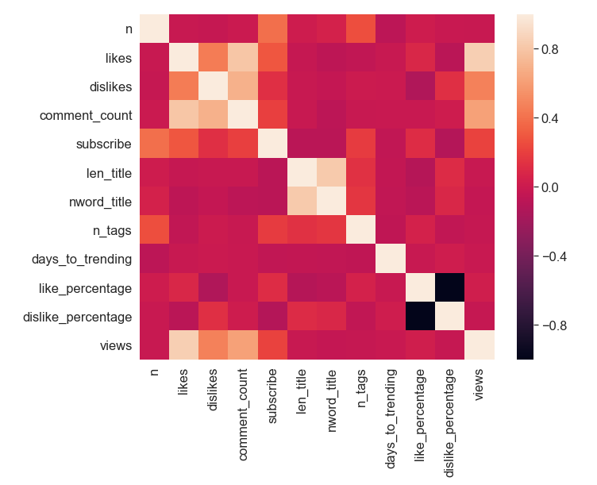
Correlation analysis
Subscribe
Category
Number of videos
Numebr of Tags
Notes:
In terms of variance, the less variances are the better to derive more intuitive results.
For feature selection, we analyze correlationship of variances by using heatmap.
And we picked out some important features that includes, number of subscribers, category, number of video, number of tags
as I mentioned already, trending video shows different features by categories, so we measured the importance of variables by category.

Slide 18
Important factors by category
Entertainment
Music
Notes:
As you can see, the importance of variables in Entertaimnets and Music categories are very similar.
The number of Subscriber is the highest influential factor in these categories.

Slide 19
Important factors by category
Show
News
19
Notes:
Now Show and News.
The most remarkable fact on this graphs is,
Unlike Ent or Music category , the number of Tag is relatively high in Show and news categories.
If you have a YouTube channel in show or news category, adding as many tags as possible might works to increase your number of views.

Slide 20
How about other countries
05

Slide 21
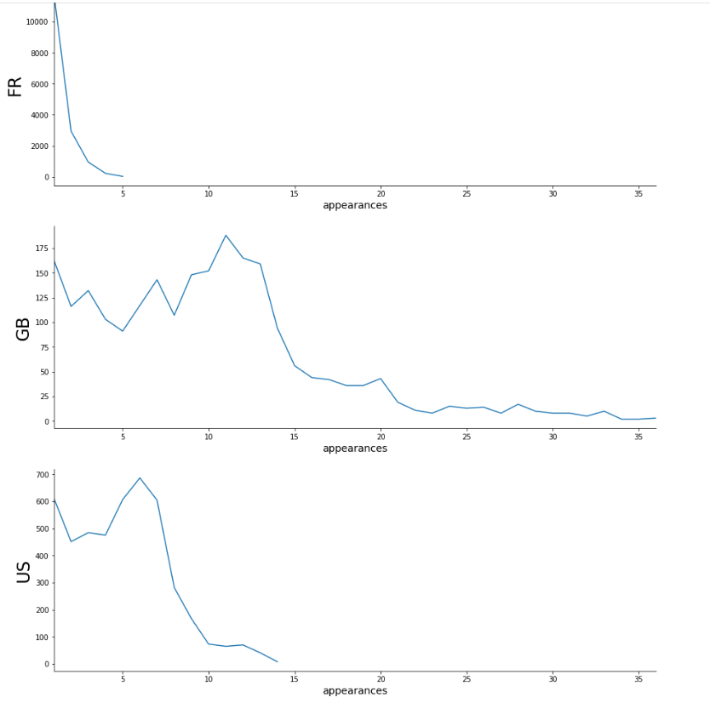
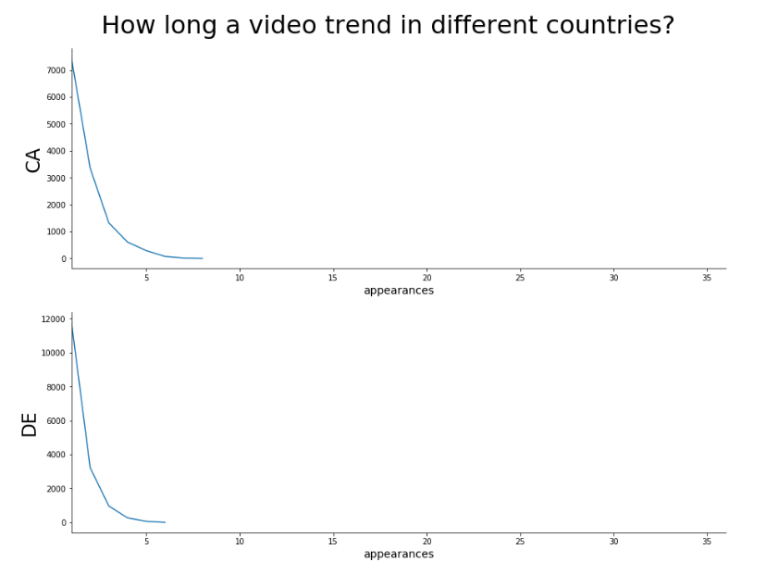





How long video trend in different countries?
5
9
25
6
10
Notes:
Let’s say, we are going to analyze tags every single day. Through that activity, We could find some pattern of high ranked word.
Once we found the pattern, we can apply this formula to current dataset and
We can predict,
Which word will become a high ranked word.
How long will the word be continued depending on how much fast increased.
Not only this, but also can find out how viewers react to each word and we can select the appropriate tags that the most attractive words for the target viewers
We can Induce viewers to spread positive image of the video. It will have massive effect to build up positive reputation of the channel as well.
It means we can predict trend! And control user’s reaction.

Slide 22
Which categories are the most popular
The categories that has the most subscribers, views, likes and comments.
Music
People
Style
Music
News
People
People
News
People
Sport
Ent
Ent
Ent
Ent
Ent
Notes:
Select top 3 categories that has most active users among 16 categories.
Game channels have the most subscribers, and likes, Dislikes views and the number of comments, the game category users are actively involve with the contents.
Again, We can see the influence of subscriber and view for trending video.
Even though the game category has the highest number of subscriber and views, the reason why game videos are hard to be find

Slide 23
Further Extension
05

Slide 24
Hashtags
On
YouTube
Notes:
Why we need to focus on this tag?
Like I said in Title and Tag slide, quality of words a lot more important rather than quantity of words.
Let’s say, we analyze tags everyday. We can find some pattern of high ranked word.
Which word will be high ranked word.
how much fast increased.
How long will the word be continued.
Furthermore, we also can predict how viewers are react to each word and
we can select the most attractive words for tags so that viewer can spread positive image of the video.
It will have massive effect to build up positive reputation of the channel as well.
we might control public opinion.

Slide 25
The process of Analysis
Analyze
old data
Formulate a hypothesis
Analyze current data
verify a hypothesis
Time Series Analysis
Sentimental Analysis
Predict what words will trend
How do users react to word/tag
Notes:
This flow chart shows our next steps.
We just finished Analyzing old data and set hypothesis
Then, we need to formulate a hypothesis Finding the pattern.
After we find this pattern/ formula we will apply this model to old data set and compare with current data set so that we can verify that our hypothesis were correct or not.
And finally we can apply this model to current dataset. Then we can find out which video will be selected as a trending video in the future.
Two main key Analysis methodology that we are going to use are the Time series analysis for the word prediction and sentimental analysis to see how do users are react to the certain words.

Slide 26
Thank you
Notes:
This is the end of my presentation. Hopefully, we can have another chance to introduce our next journey.
Thank you.

